Slide 1
ERASMUS+
Mobil İmam Hatip Secondary School
22nd of October, 2021

Slide 2
As you know , we are Turkish team in Mobil İHO Secondary school. As a school, in addition to this effective EU project; we have also completed at least 15 EU projects in last 10 years. Like in our previous EU project; we learnt a lot. We shared and shared.

Slide 3
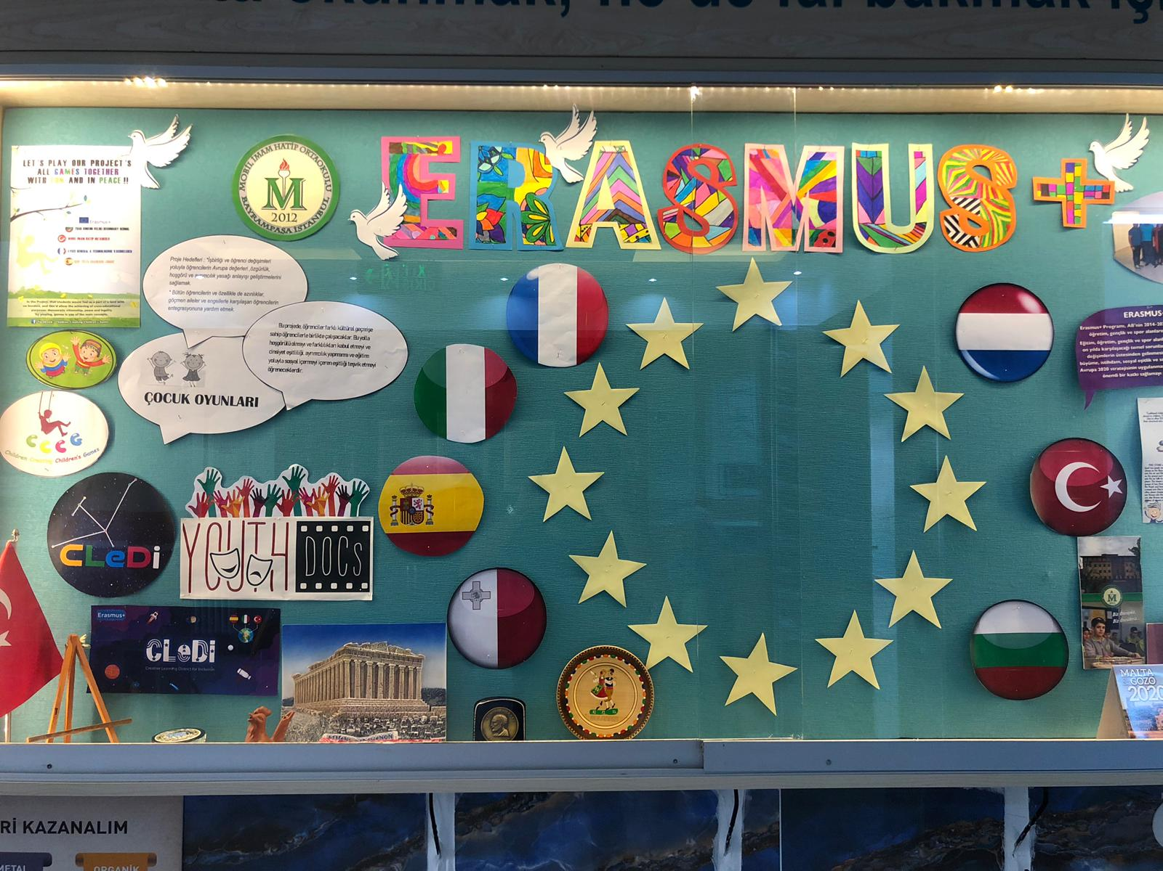
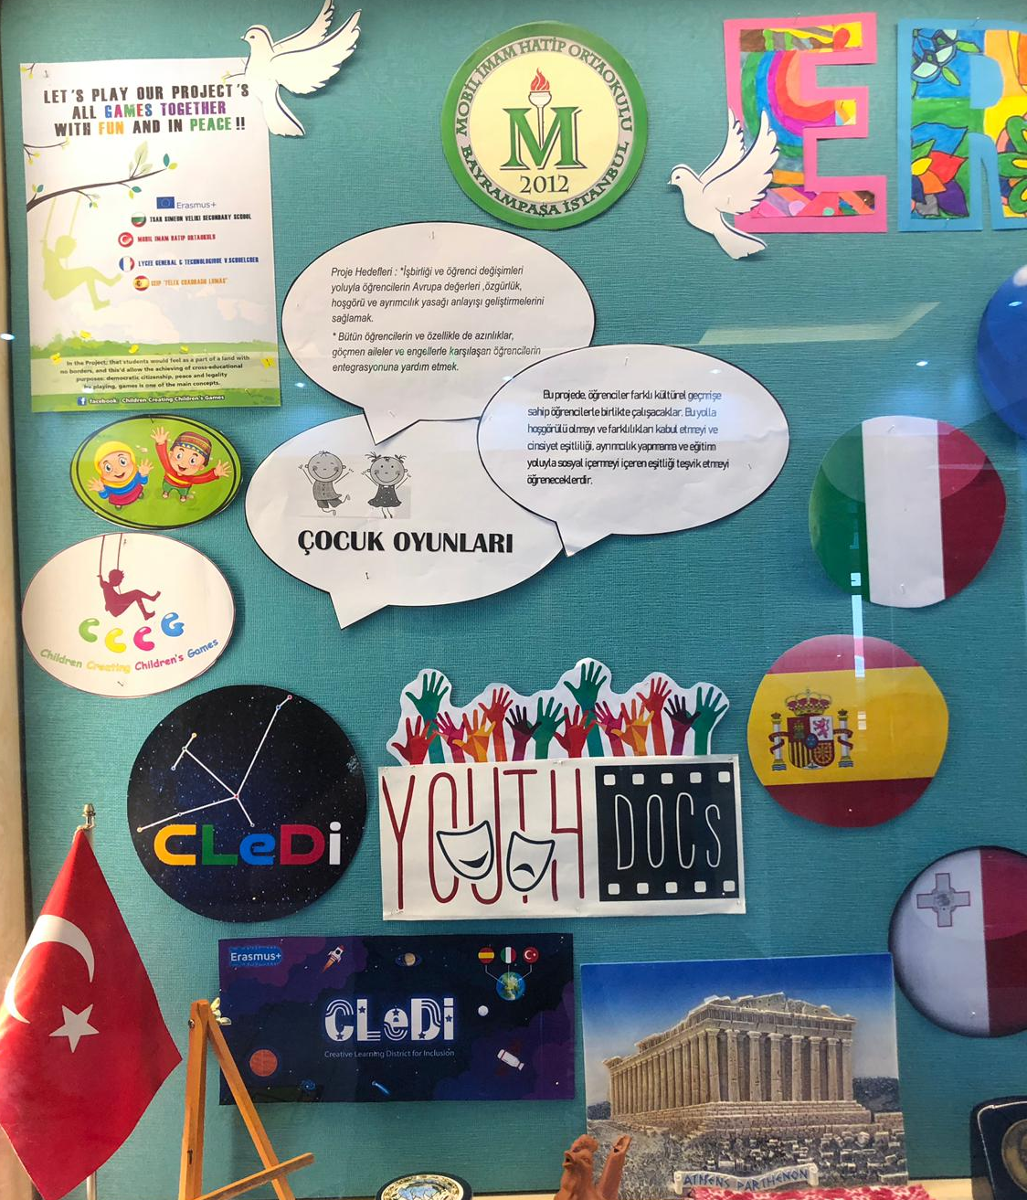
In this project, a notice board was prepared and every 2-3 months ; the data was updated regularly and in this way; the attention of guests of our schools increased too much. Latest visuals, news and basic information were displayed and explained by these project corners.

Slide 4
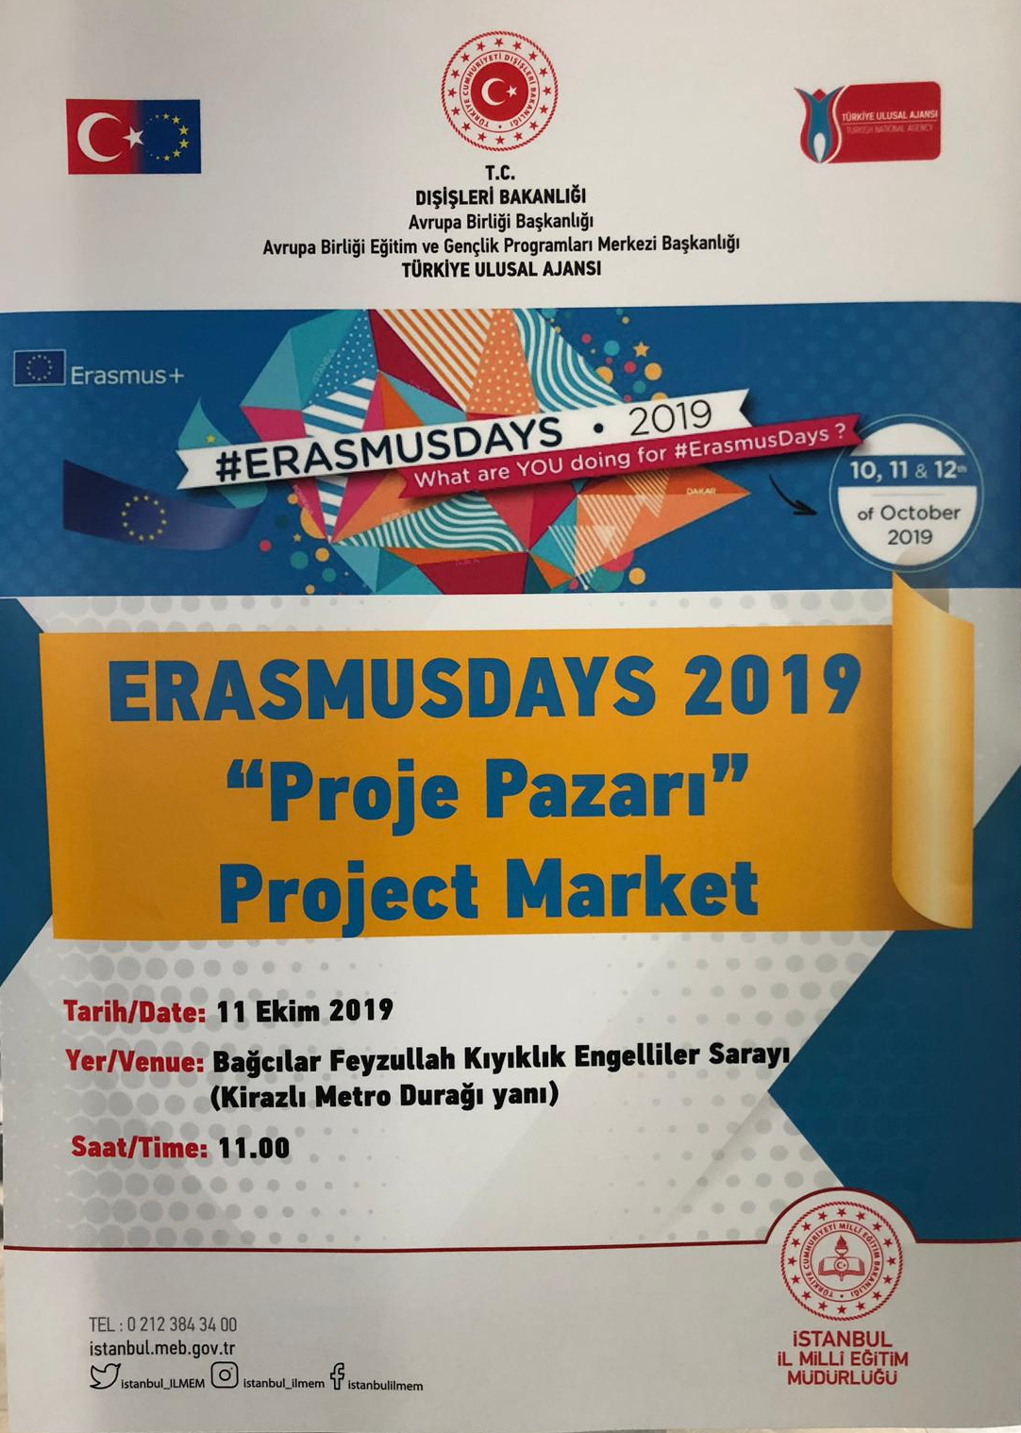
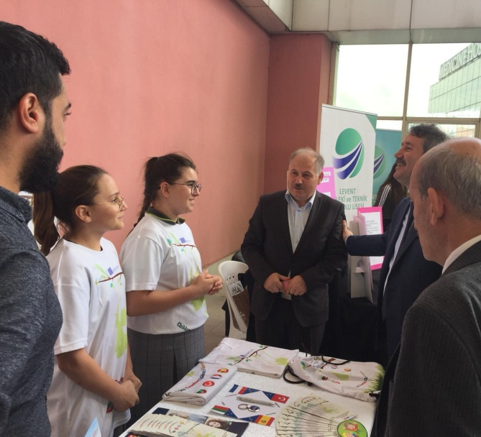
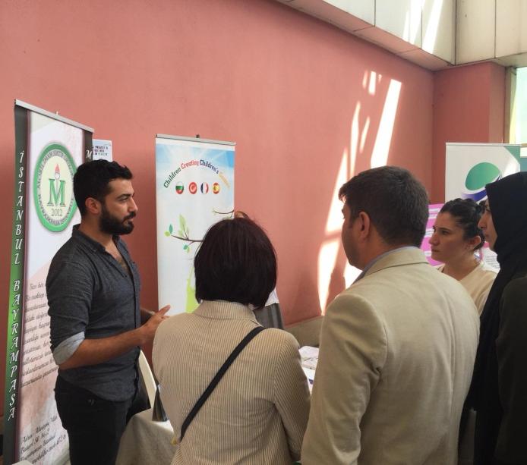
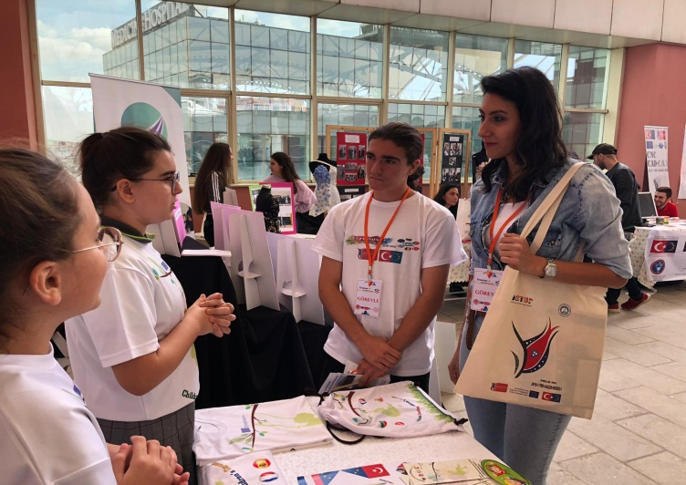
In İstanbul, A Project Market was organized. In that organization, our EU project was explained in detail to stakeholders and ALL participants of that fair-market. Educational authorities, policy makers of other regional departments were given information about the aims, steps and process of the projects.

Slide 5
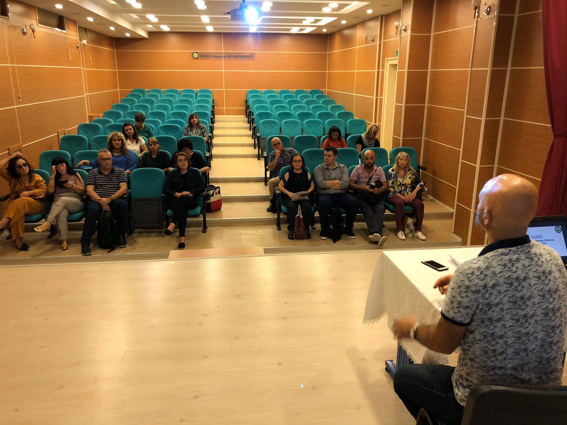
Also in our school, we had met with our international project partners and all of those meetings – brain stormings added to our academic knowledge very much. We developed ourselves ideally.

Slide 6
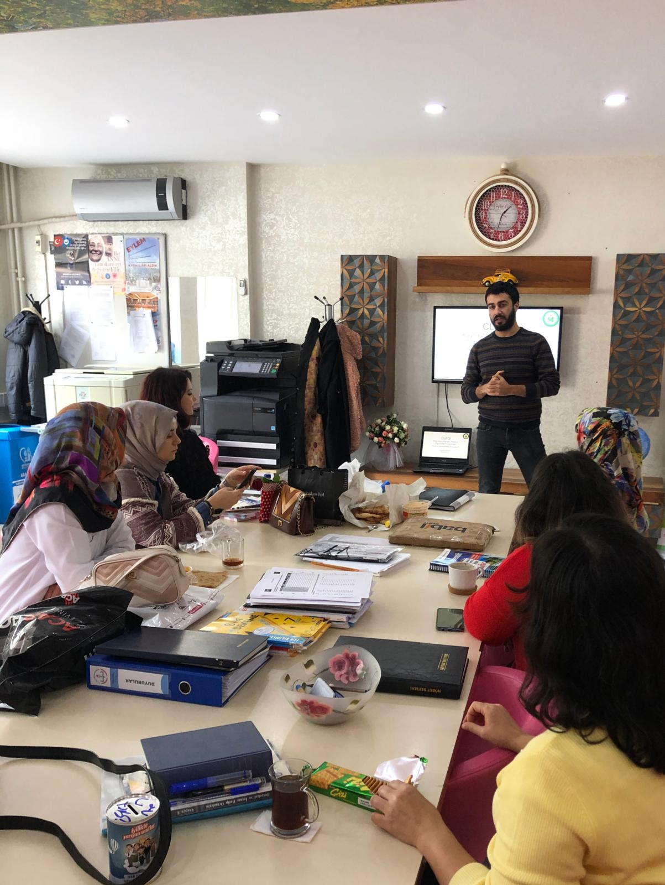
At the beginning period of our project; teachers at Mobil İmam Hatip Secondary School were informed about the significance of the project. Details were presented related to project time schedule, project partners, information gathering ways and tools, policy makers and ongoing process.

Slide 7
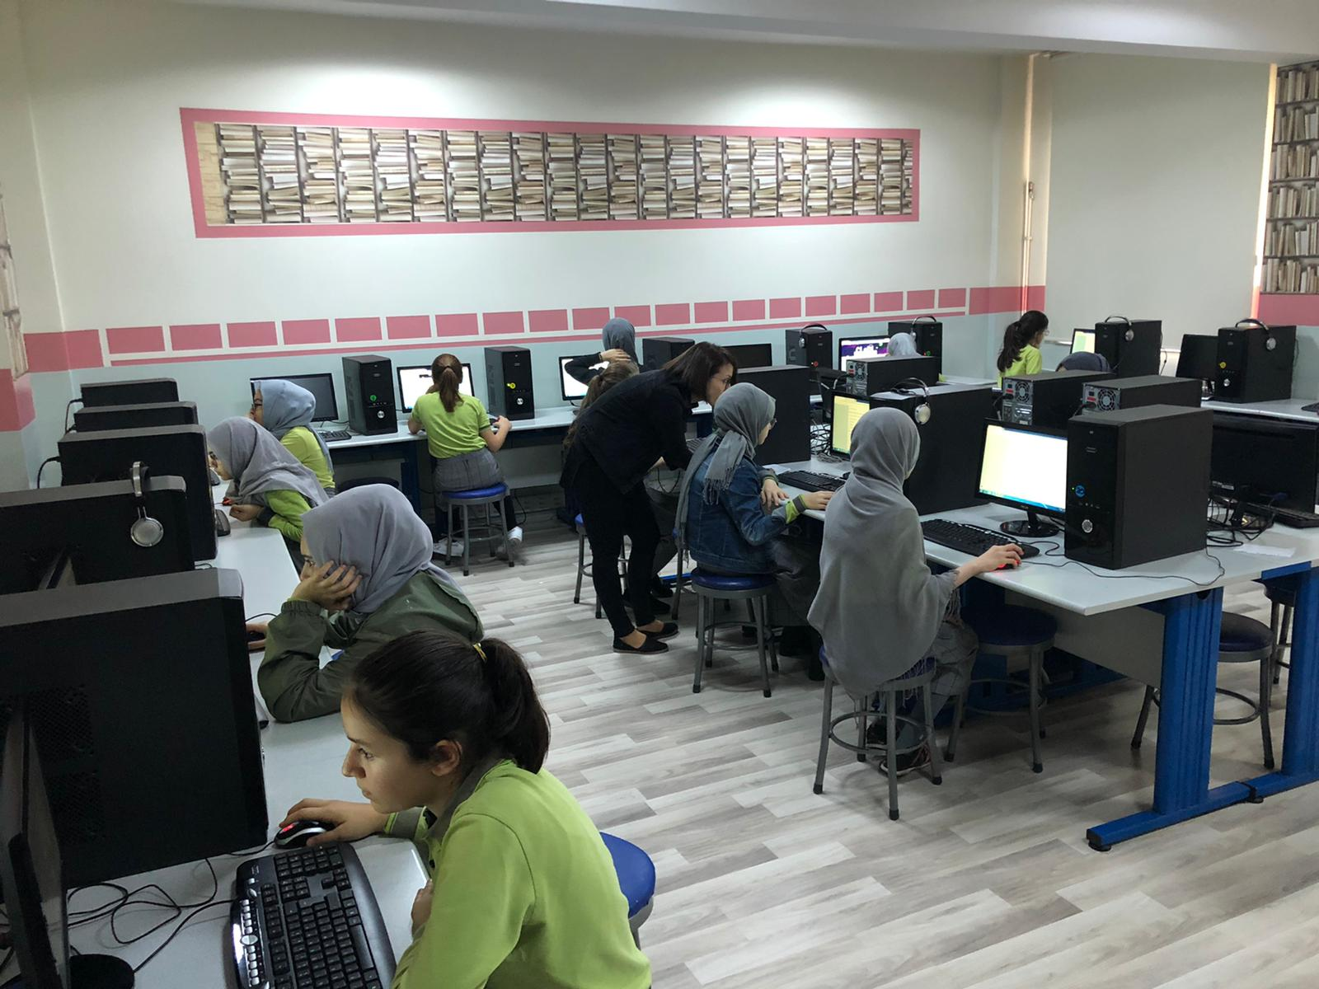
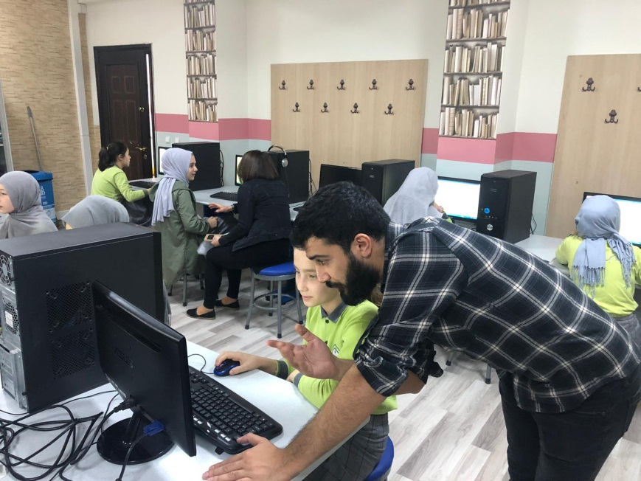
In this project facilities, most of our girls take part in the whole project process, actively. This is a big chance for them. They usually work and train with the project instructors. Lesson plans, ICT usage while training made them very active and energetic.

Slide 8
As Turkish partners, altogether we developed innovative, ICT based, methodology for enhancing the intercultural competences and skills of both teachers and students in our schools, namely in Mobil school. Many teachers learnt a lot.
Since 2018 we have stimulated collaboration between the participating countries through exchange of good practices; for instance we learnt some detailed Maltese and Bulgarian lesson plans which are full of nonformal techniques and etc. We improved ourselves by the time. This educational journey was amazing.

Slide 9
We have upgraded the level of English language proficiency of the teachers and students. Their language skills are developed anyway. In addition to these; we have strengthened the profile of the lecturer's and academicians’ profession and, in this way their motivation for lifelong learning have increased.
In many perspectives; we have encouraged school-local authorities partnership. Especially with Sultangazi, Bayrampaşa and EyüpSultan local Authorities and policy makers; we have shared our academic ideas in detail.

Slide 10
With the help and intention of coordinator and all partners, developing an innovative methodology of teaching and learning English was very viatl for us but we succeeded this. Thanks to ALL of you in this matter. Designing new teaching materials like this toolkit is very important for future. All the schools, lecturers from ALL countries will be able to use this and this toolkit or outcome makes us pleased.
Establishing partnerships with schools, regional educational authorities and NGOs is a very positive aspect of our project.
Exchanging good practices among partners.

Slide 11
In these nearly three years period; we also shared a lot of educational issues with Sultangazi Local Authority of Education. We have met with Ms.Sezen Çetin, Mr. Savaş Özkaya , Mr.Ahmet Türk, Mr. İbrahim Demir, Ms. İclal İlbi and Mr. Necati Tekbaş.
They also supported and helped us in detail. We evaulate and disseminate all the results together. It was a fruitful and positive partnership with them. We are very pleased to cooperate with this educational Authorithy.

Slide 12
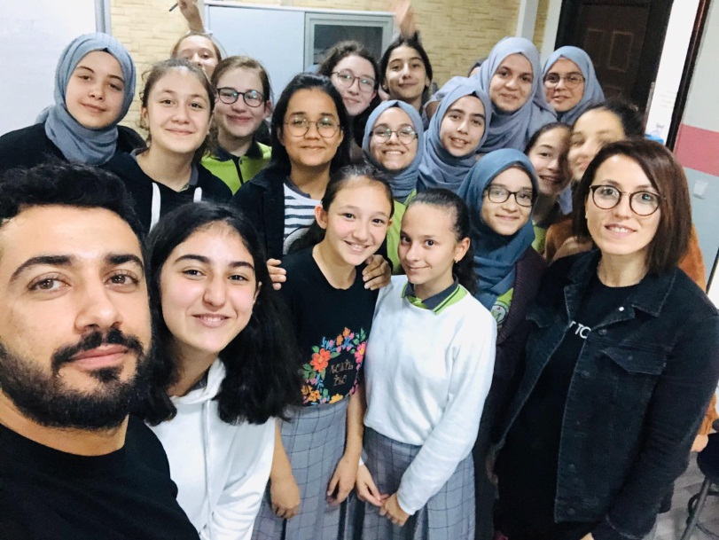
Thanks from our girls and our project team ☺

