Slide 1
DISSEMINATION
DE LA SALLE COLLEGE

Slide 2
1. Leaflets about Project to be distributed to staff and students

Slide 3
INFORMATION BOARDS IN CORRIDORS – CANVAS POSTERS
Kindly see the following.

Slide 4
Taster ABOUT PROJECT GIVEN IN SEPTEMBER

Slide 5
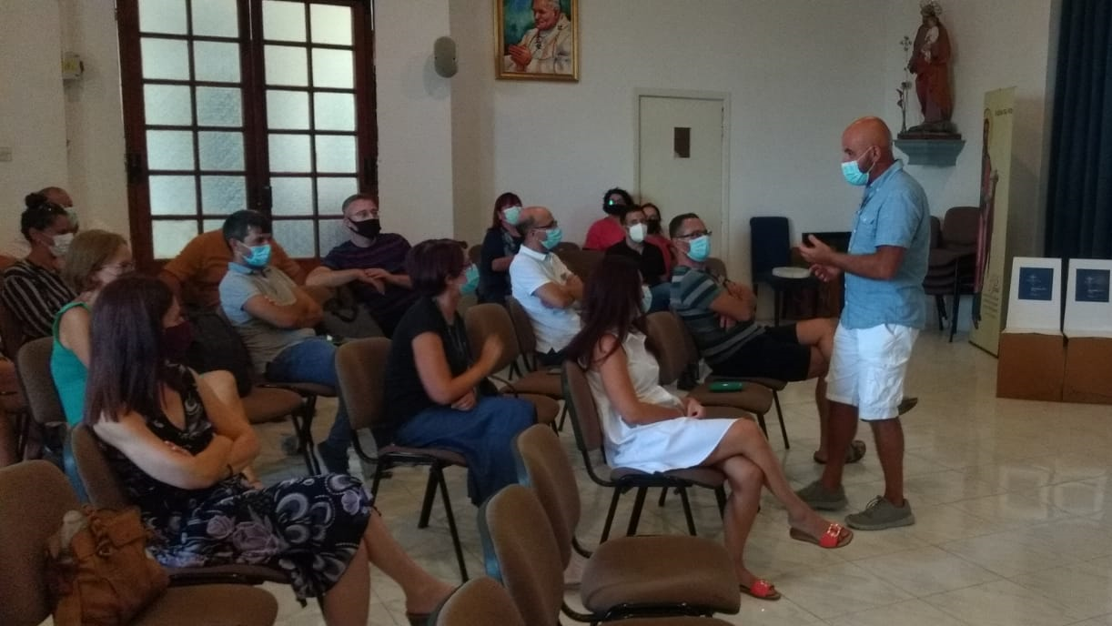
TASTER I=ABOUT PROJECT IN STAFF SEMINAR

Slide 6
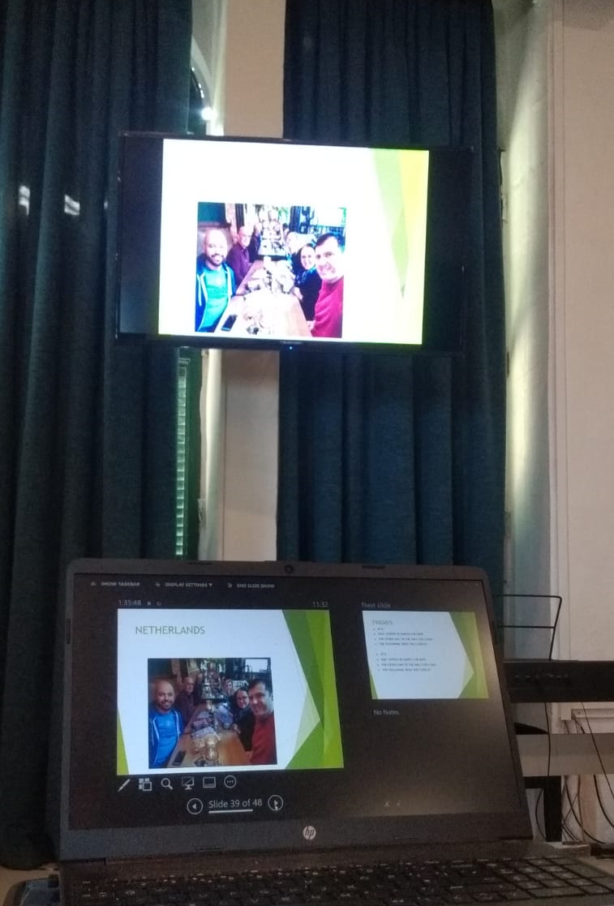
TASTER ABOUT PROJECT IN STAFF SEMINAR

Slide 7
. FLASHDRIVES WITH PROJECT MATERIAL TO BE DISTRIBUTED TO TEACHERS IN OUR SCHOOL AND ANOTHER MaJOR SCHOOL IN MALTA
This Photo by Unknown Author is licensed under CC BY-SA-NC

Slide 8
Staff conference to be held on 29th October -
Non formal methods in education will be tested on teachers
Lesson plan to be discussed

Slide 9
school magazine to be published with information regarding the project-

