Slide 1
Project № 2018-1-BG01-KA201-047998
CREATING AN INNOVATIVE PLATFORM
OF COMMUNICATION AND TEACHING
IN A DIGITAL SOCIETY
THE HUMAN AND THE POST-HUMAN
Project coordinator: Association Education without Barriers: http:// www.ewb.bg
Presentation prepared by: Associate Professor Dr. Julia Stefanova: jstefanova@fulbright.bg

Slide 2
Imponderables
If people from Poland are called Poles, why aren’t people from Holland called holes?
Do infants enjoy infancy as much as adults enjoy adultery?
If love is blind, why is lingerie popular?
Why is the man who invests all your money, called a broker?
Why are a wise man and a wise guy opposites?
If lawyers are disbarred and clergymen defrocked, doesn’t it follow that electricians can be delighted, musicians denoted, cowboys deranged, models deposed, tree surgeons debarked, and dry cleaners depressed?

Slide 3
Paraprosdokians
A clear conscience is usually...
Money can’t buy happiness, but it sure makes...
Change is inevitable , except ...
To steal ideas from one person is plagiarism. To steal from many...

Slide 4
A clear conscience is usually a sign of bad memory.
Money can’t buy happiness, but it sure makes misery easier to live with.
Change is inevitable , except from a vending machine.
To steal ideas from one person is plagiarism.
To steal from many is research.

Slide 5
Vocabulary
Human, humane, humanity, humanness; to humanize
inhuman, non-human; to dehumanize
super/suprahuman, subhuman;
post-human/ism; transhuman/ism;

Slide 6
What does it mean to be human?

Slide 7
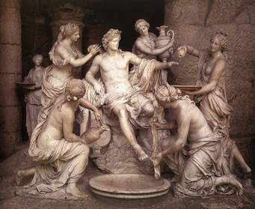
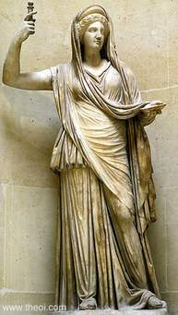
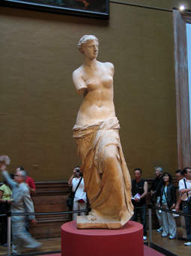
The Human in Greek Mythology

Slide 8
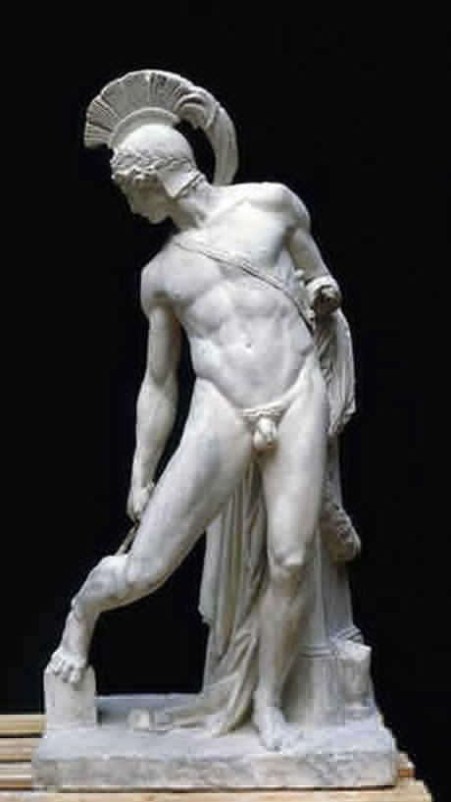
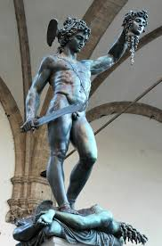

Slide 9
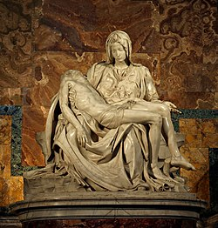
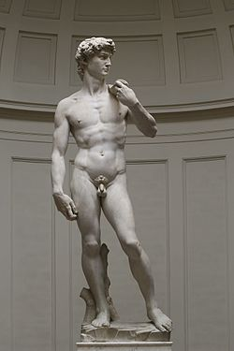
The Human in the Renaissance

Slide 10
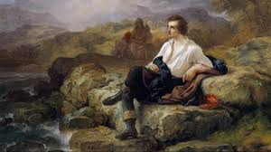
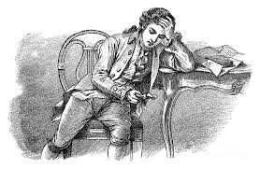
The Romantic Hero

Slide 11
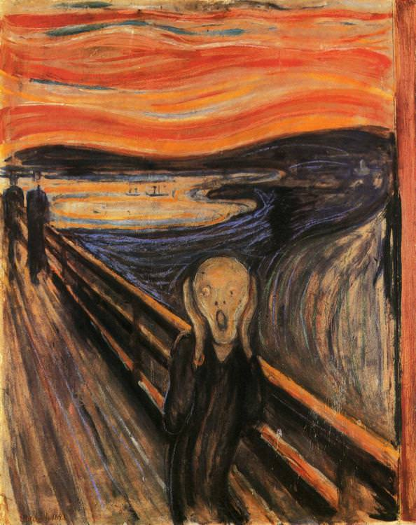
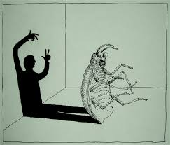
The Modernist Self

Slide 12
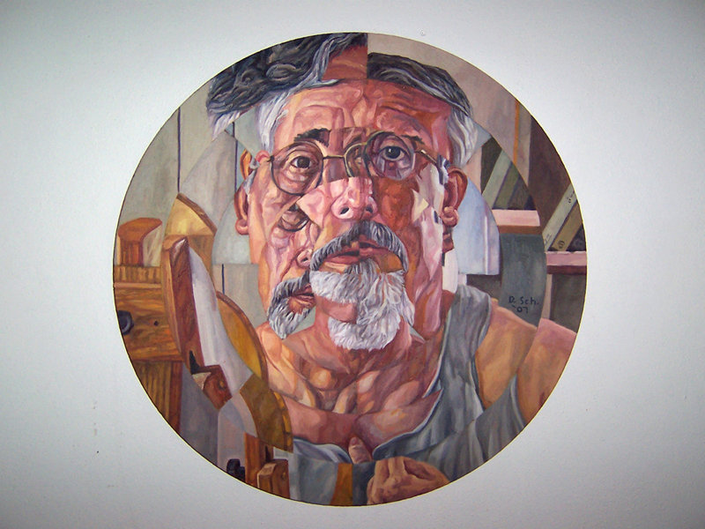
The Postmodern Self
Fluid, multiple, inter-subjective, context-dependent, decentered, social construct, shifting, inconsistent.

Slide 13
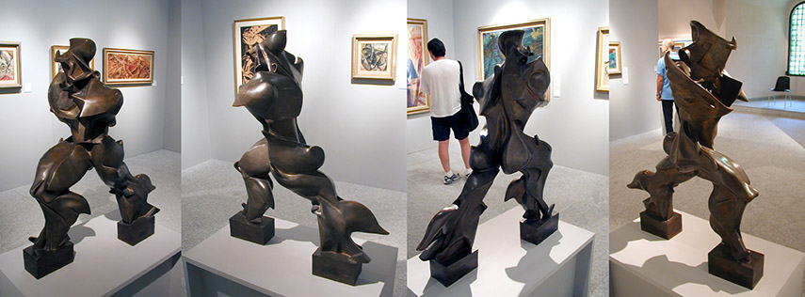
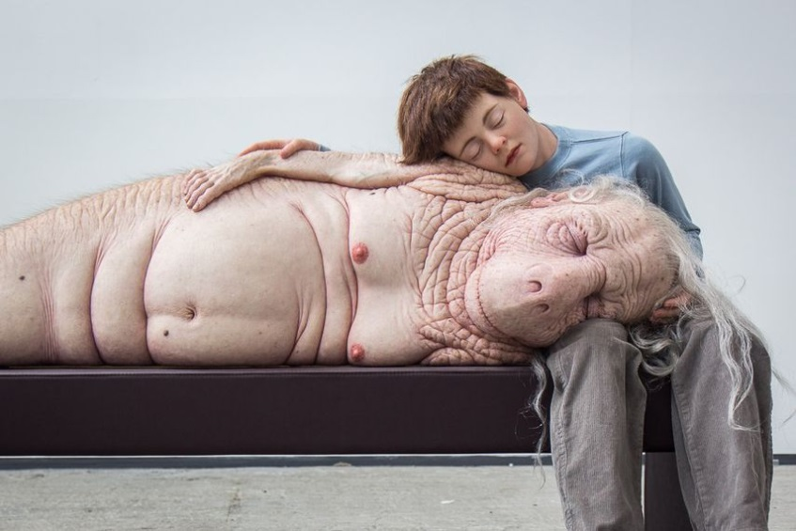
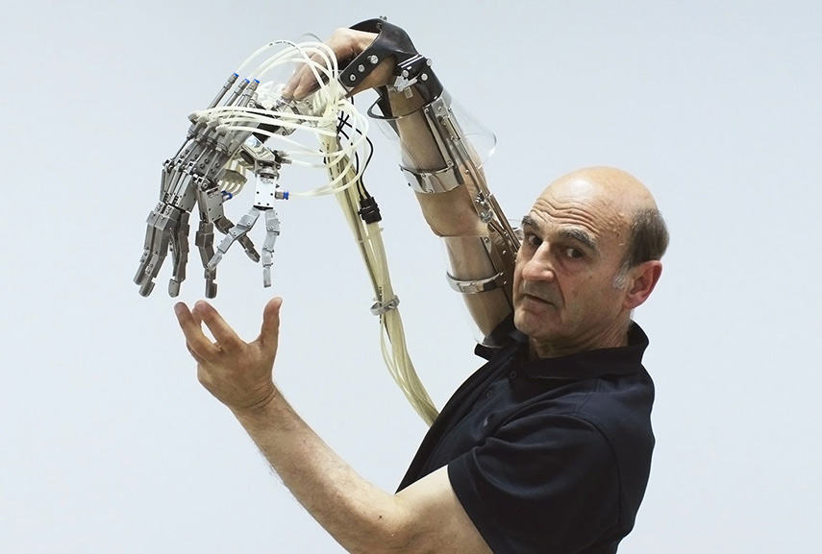
The Post(Trans)human self

Slide 14
I am transhuman
https://www.youtube.com/watch?v=qOcktbXSfxU

Slide 15
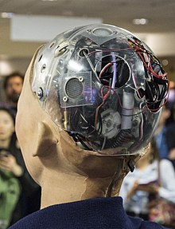
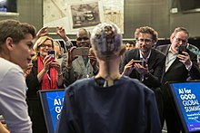
Robot Sophia

Slide 16
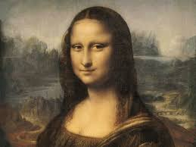
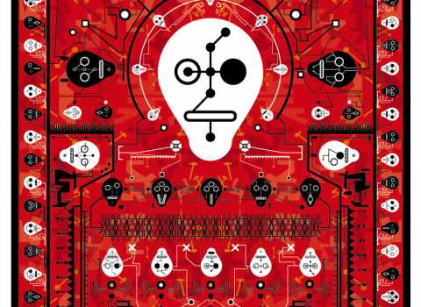

Slide 17
To stay human, or to become transhuman – that is the question...

Slide 18
Topic-related vocabulary
Human, humane, humanity, humanness; inhuman, non-human, super/suprahuman, subhuman; post-human/ism; transhuman/ism; cyborg/isation;android
Diminishment,belittlement; nanobiotechnological enhancement;
epiphenomenon, prosthesis;

Slide 19
I am only human, Song by Rag’n’ Bone Man
https://www.youtube.com/watch?v=L3wKzyIN1yk

