Slide 1
Erasmus+ project -reg. No 2018-1-BG01-KA201-047998
Creating an Innovative Platform of Communication and Teaching in a Digital Society
STICHTING INTERNATIONAL YOUTH BRIDGES

Slide 2
The toolkit was published in February 2020

Slide 3
Project No 2018-1-BG01-KA201-047998 Creating an Innovative Platform of Communication and Teaching in a Digital Society
SIYB passed the information about the project inside and outside of the organization.

Slide 4
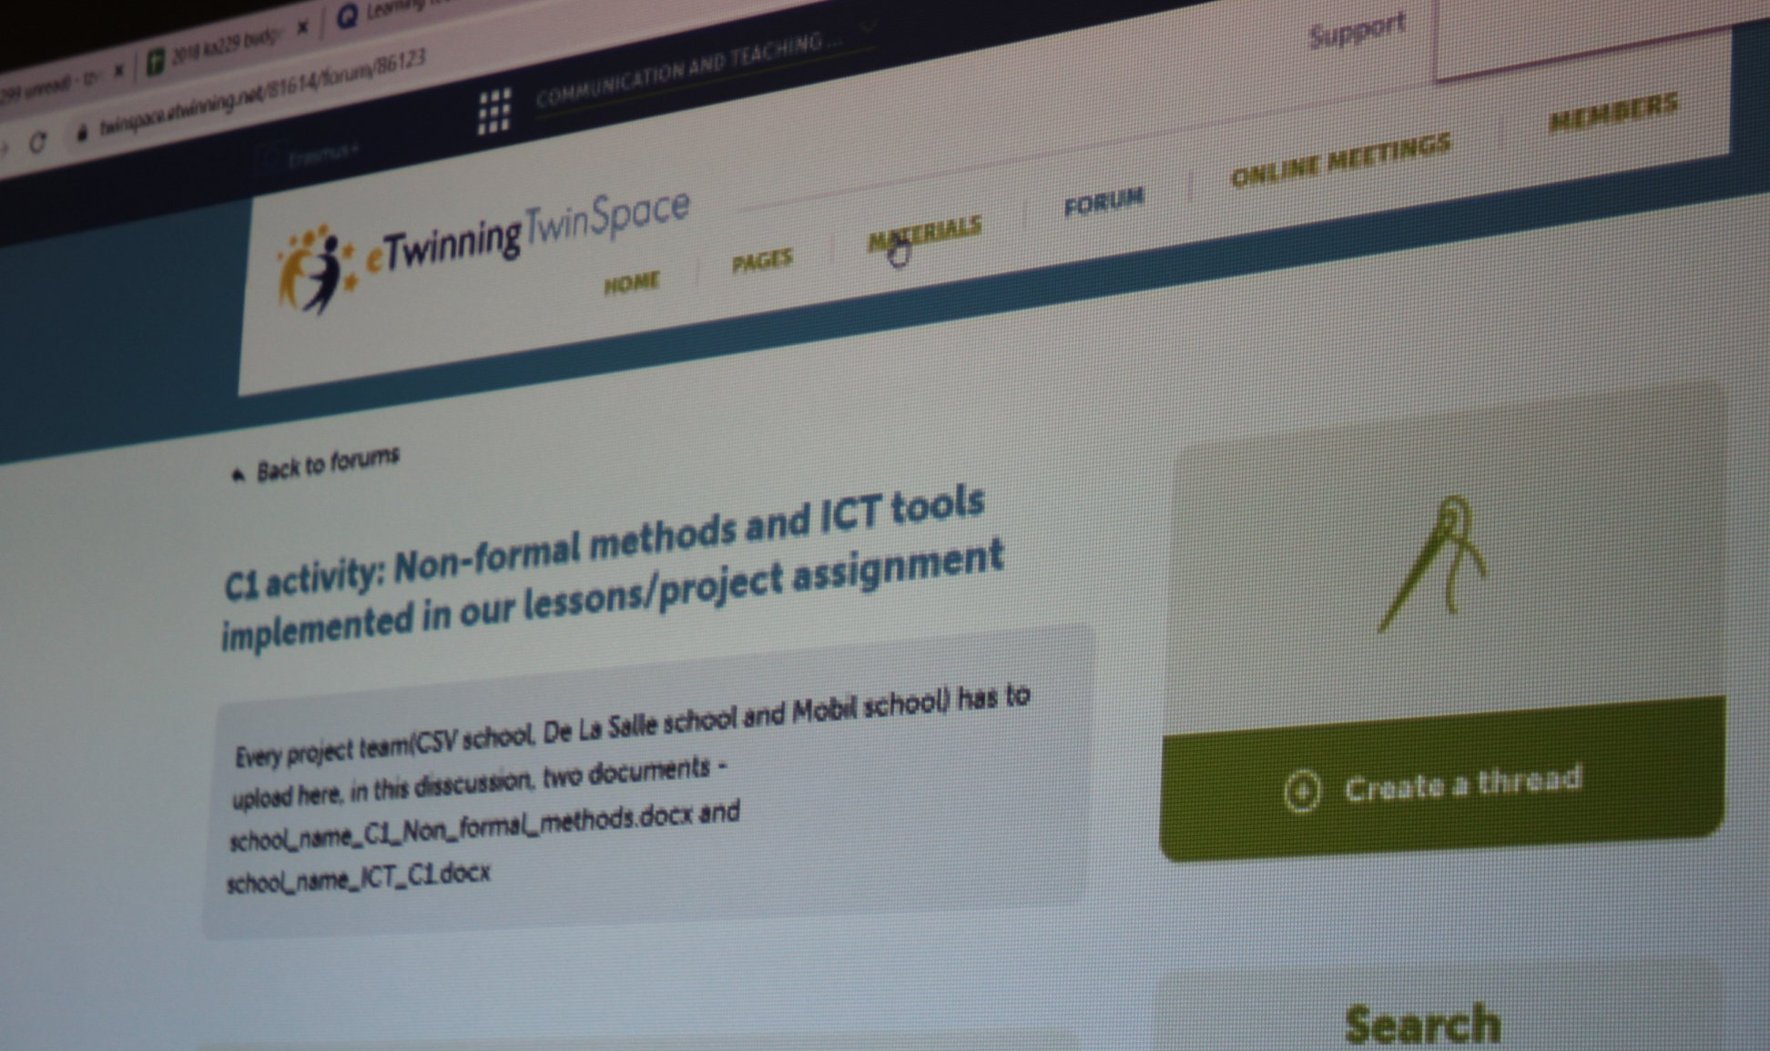
10 March 2020 Valkenburg SIYB organized workshops and were tried some exercises from the Toolkit- “Learn, (Re)think, Express”

Slide 5
7th of May
Some workshops were tried during an online meeting with youth workers, educators, and trainers

Slide 6
SIYB presented Toolkit in International Maastricht school in June,2020

Slide 7
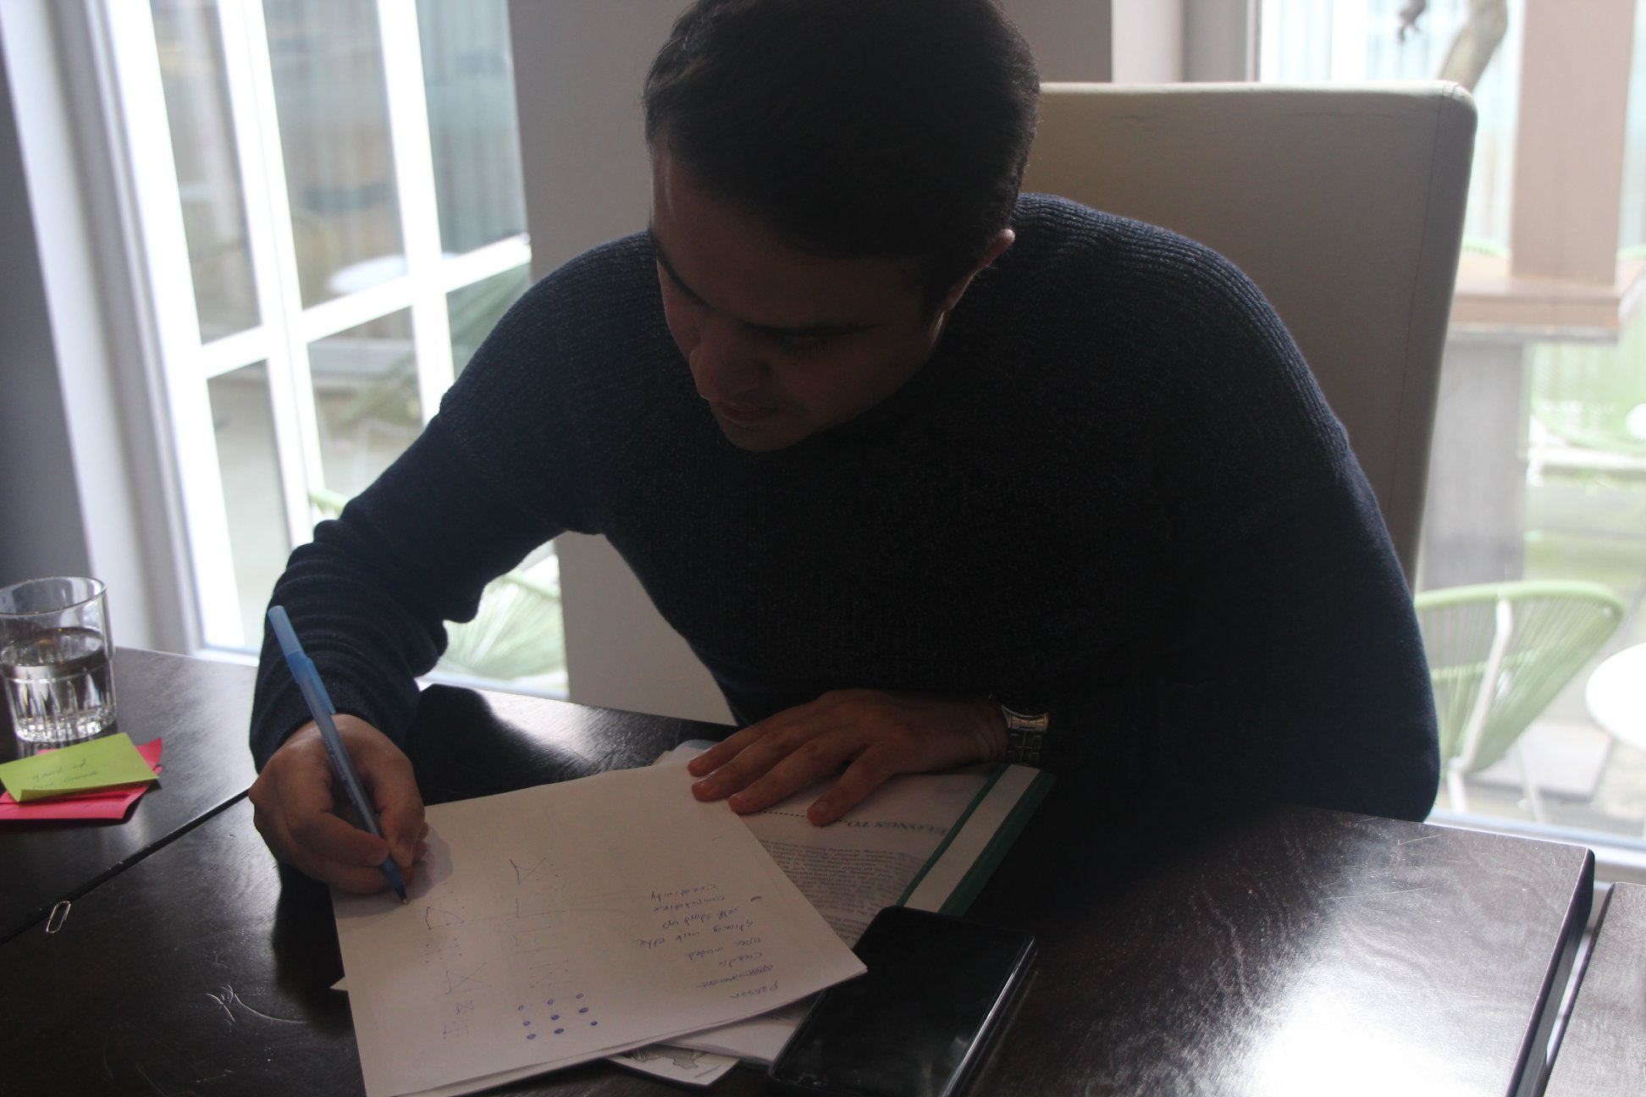
It was experiencing some workshops from the toolkit on 16th of September 2020 TARGET GROUP: YOUTH WORKERS, EDUCATORS, TRAINERS, TEACHERS

Slide 8
It was experiencing some online activities from the toolkit on 28th of October 2020 TARGET GROUP: YOUTH WORKERS, EDUCATORS, TRAINERS, TEACHERS

Slide 9
2 March,2021 It was an online meeting with Dutch NA and SIYB team shared the project result as a good practice.

Slide 10
22nd March ,2021 SIYB team had a meeting with a partners of the project (KA2) Read the City which was connected about outdoor tools and SIYB team made a presentation and shared technics and tools from the Toolkit: “Learn, (Re)think, Express” as an example can be used in this project.

Slide 11
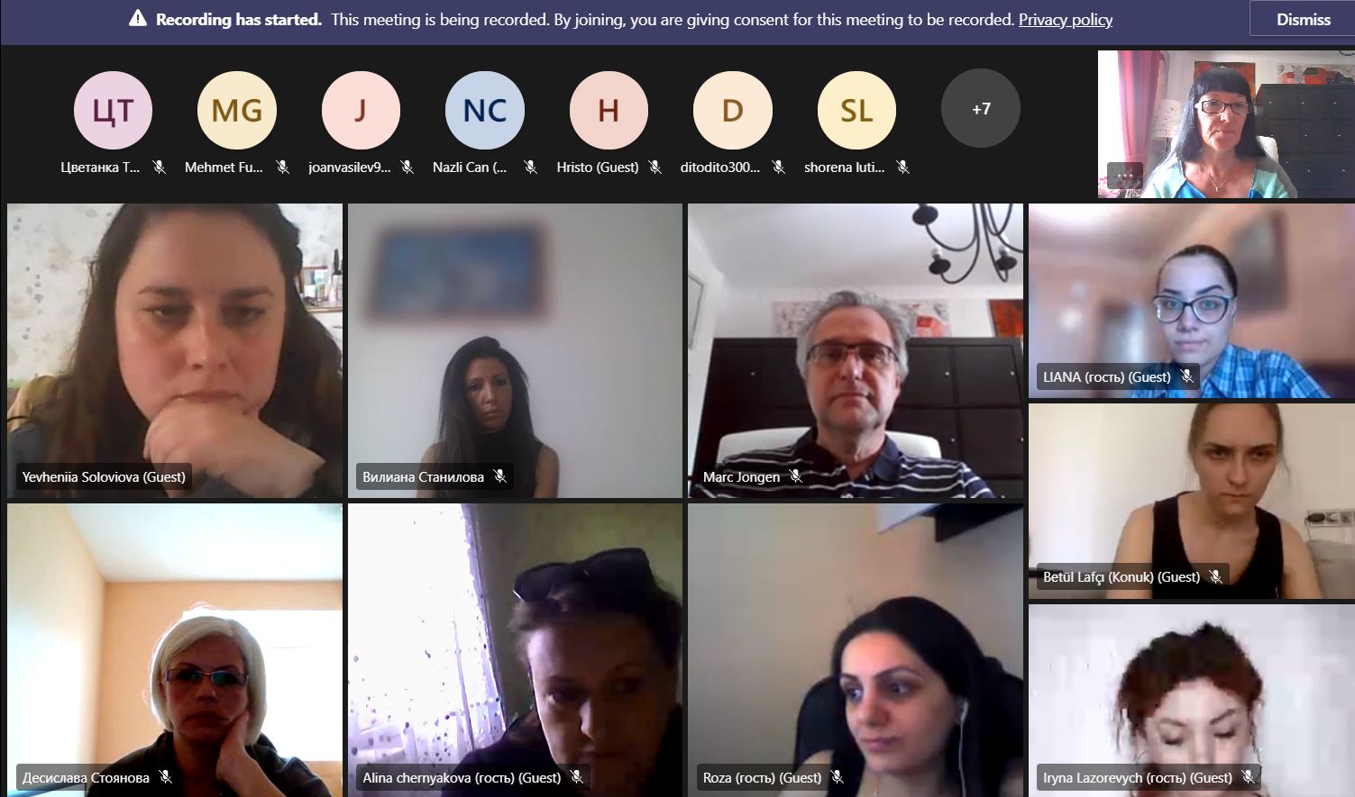
The participants experienced online exercises from the toolkit 21-23 May,2021

Slide 12
3rd July, We had a meeting with Educators where we have shared information about the project and talked the importance of the new online tools for the toolkit

Slide 13
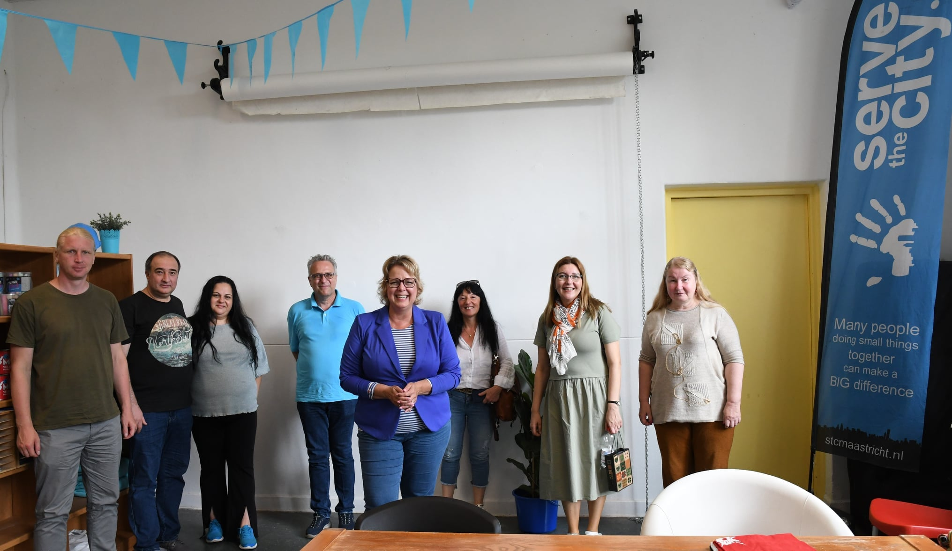
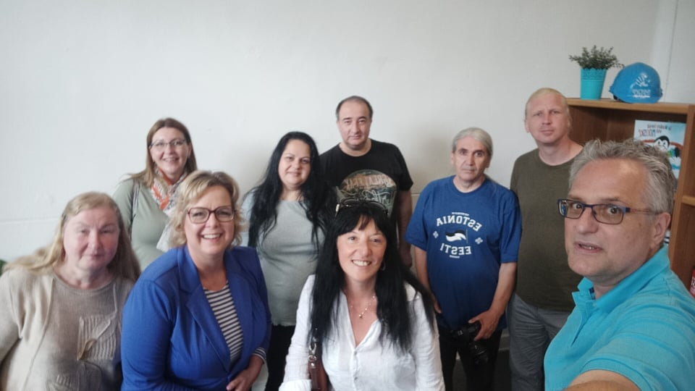
SIYB sheared information and talked about the ongoing project on in July in Maastricht in Traject Centre, serve the city and on in the library of Maastricht

Slide 14
16 May 2021 Online Training SIYB team shared experiences and good practices to the partners working on KA201 "Non Formal in Formal Education-Teaching Subjects Through Culture and ICT".

Slide 15
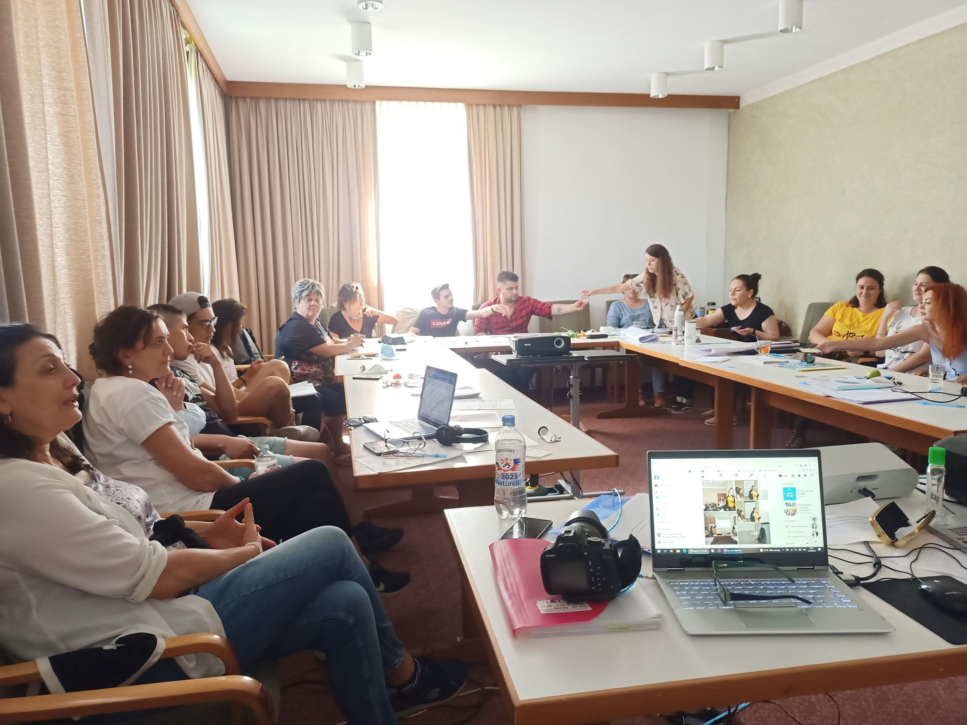
11 August 2021 Bad Laer
SIYB organized workshops and were tried some exercises from the Toolkit- “Learn, (Re)think, Express”
TARGET GROUP: YOUTH WORKERS, EDUCATORS, TRAINERS, TEACHERS

Slide 16
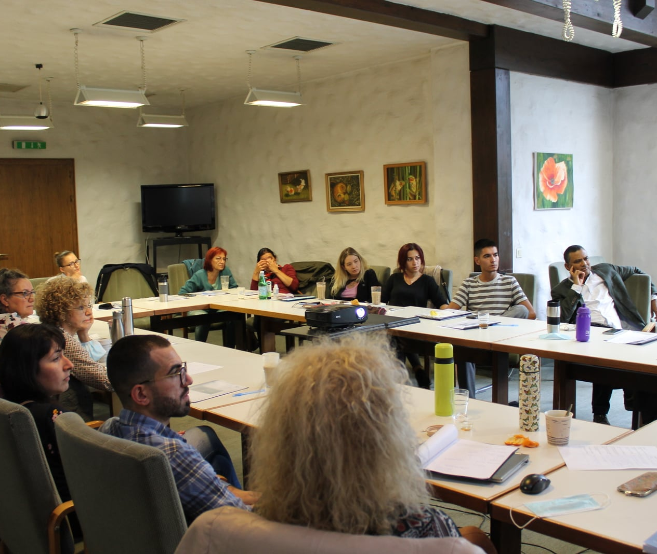
2 October 2021
SIYB team shared information about the project , also presented Toolkit- Learn, (Re)think, Express
TARGET GROUP: YOUTH WORKERS, EDUCATORS, TRAINERS, TEACHERS

