Slide 1
Creating an Innovative Platform of Communication and Teaching in a Digital Society
The Bulgarian Educational System in the European Area of Education. English language teaching
Malta short-term joint staff training June 2019
Kristina Petkova & the Bulgarian team
“Education Without Barriers” Association

Slide 2
Creating an Innovative Platform of Communication and Teaching in a Digital Society
OUTLINE
Educational attainment of Bulgarian population
Bulgarian education system – an overview
Main recent reforms
Expenditure on education
Effectiveness of education
Value of education
Main problems
Challenges
Strategies

Slide 3
Creating an Innovative Platform of Communication and Teaching in a Digital Society
Educational attainment of Bulgarian population aged 15-29 (1975-2011), %
Source: NSI, Population and Housing Census 2011, Vol.1 Population, Book 2 Demographic and social characteristics, p. 91
3
Notes:
Following the overall trend of educational expansion, the percentage of tertiary degree holders among the young people has increased over time among Bulgarian youth. Thus, for the period 1992 and 2011 it was threefold. Despite that in 2011 approximately 40% of the population aged 15-29 is with lower secondary and less education.

Slide 4
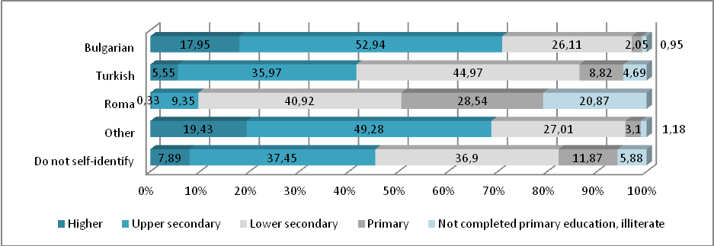
Educational attainment of Bulgarian population 15-29 by ethnic group (2011), % Source: Population and Housing Census 2011
Creating an Innovative Platform of Communication and Teaching in a Digital Society

Slide 5
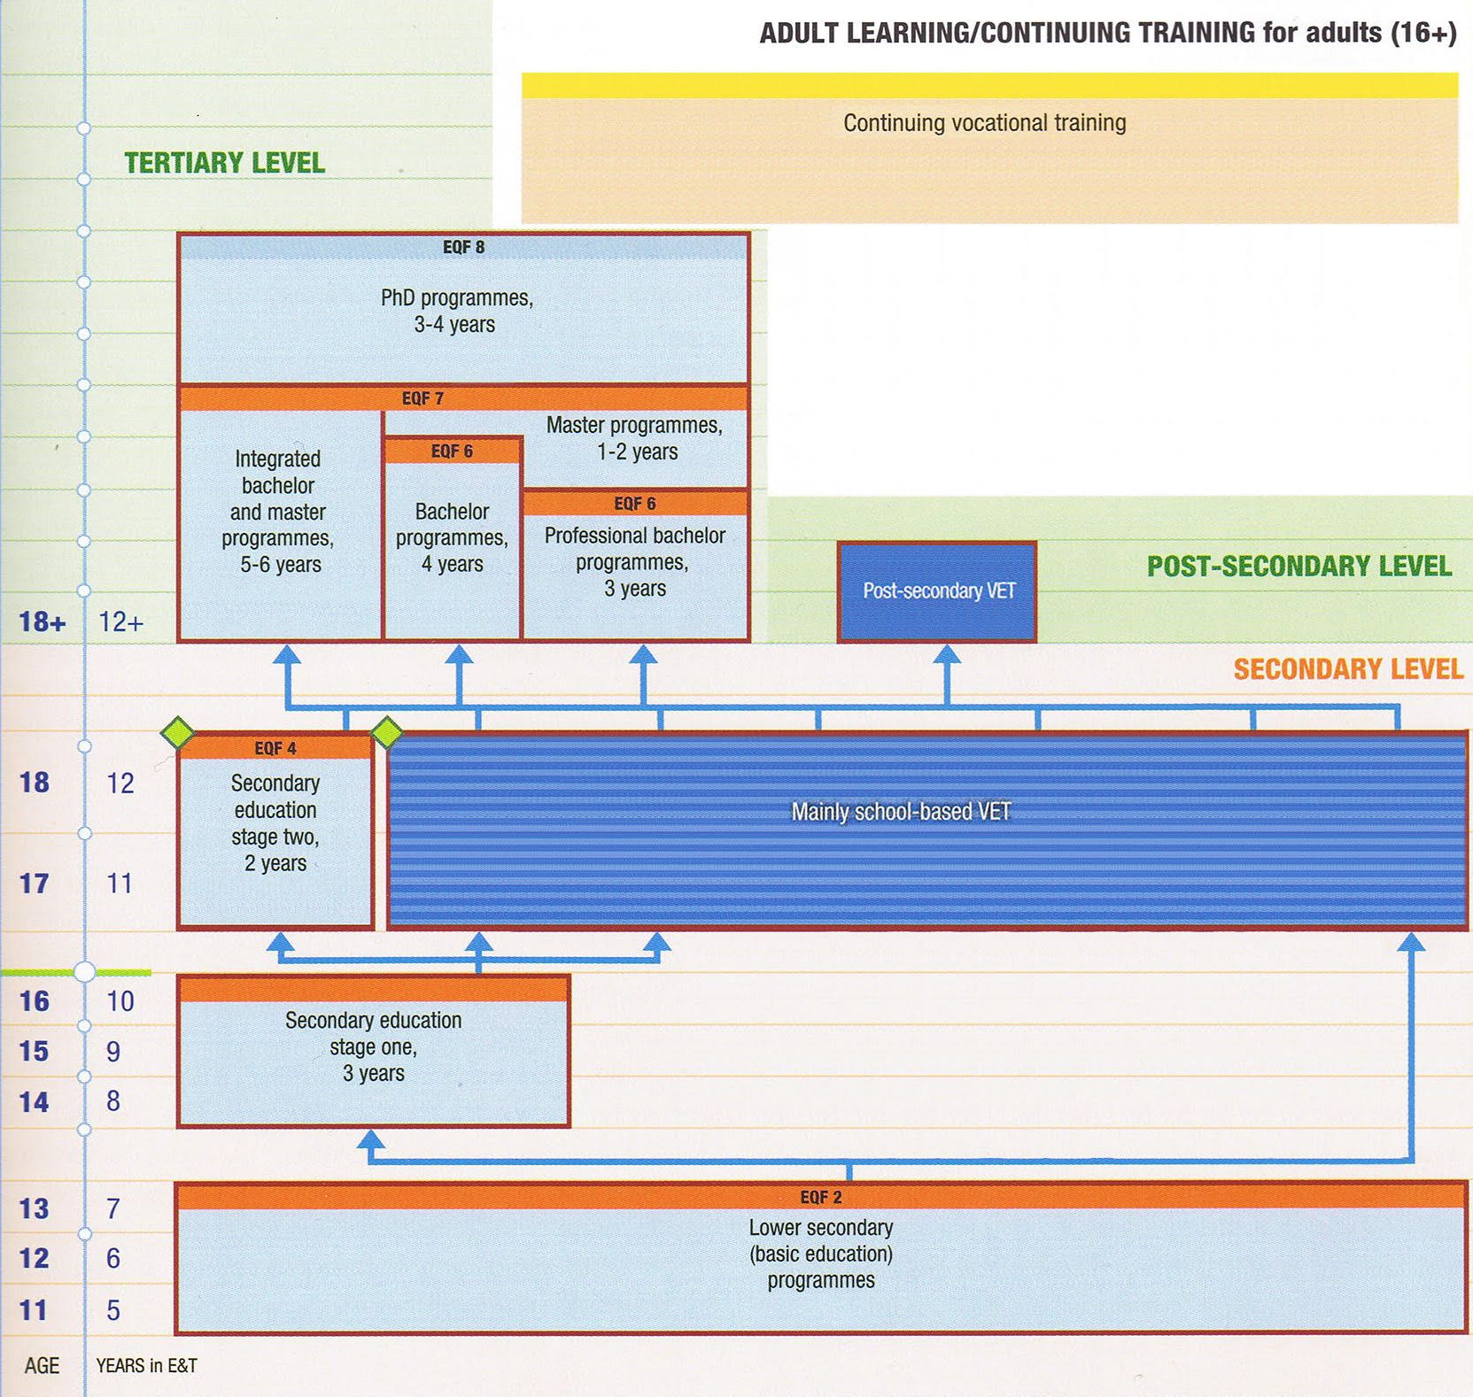
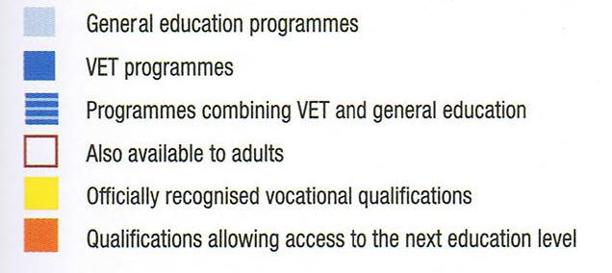
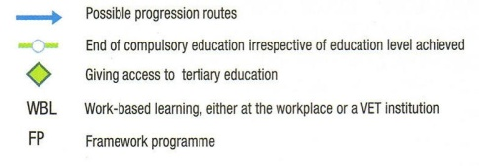
Creating an Innovative Platform of Communication and Teaching in a Digital Society
Bulgarian Educational System. An Overview

Slide 6
Creating an Innovative Platform of Communication and Teaching in a Digital Society
Dynamics of schools structure (2000-14), (number)
Source: NSI, http://www.nsi.bg/en/content/4788/educational-institutions-type-and-kind-ownership
Notes:
In the beginning of the school (academic) year 2013/14 in Bulgaria are functioning 2097 general, 488 vocational, and 53 higher schools (51 of which are accredited).
Due to closure or modification the number of general schools has been decreasing gradually throughout the period between 2000 and 2014. The number of vocational and special schools also has been shrinking for the same period although this happened in a much lesser extent in the case of vocational schools. In contrast the number of Higher schools and University equivalents is stable in the last 10 years.
The effect of these changes is that many small settlements are left without schools and children have to travel everyday a considerable distance to the closest school.

Slide 7
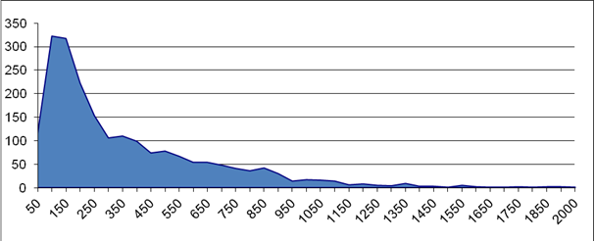
Schools by size (number of schools according to number of students in them) Source: Zachariev, 2014
Creating an Innovative Platform of Communication and Teaching in a Digital Society

Slide 8
Public expenditure on education
Creating an Innovative Platform of Communication and Teaching in a Digital Society
The proportion of GDP allocated to education in Bulgaria increased by over 20% between 2001 and 2008 and reached 4.6% in 2008.
In recent years, the situation has become worse – the share of GDP allocated to education fell to 3.2% in 2011 and 3.4% in 2012.
During the last years, the proportion of GDP allocated to education slightly increased: to 3.5% in 2013 and about 3.8 in 2014 and 2016.

Slide 9
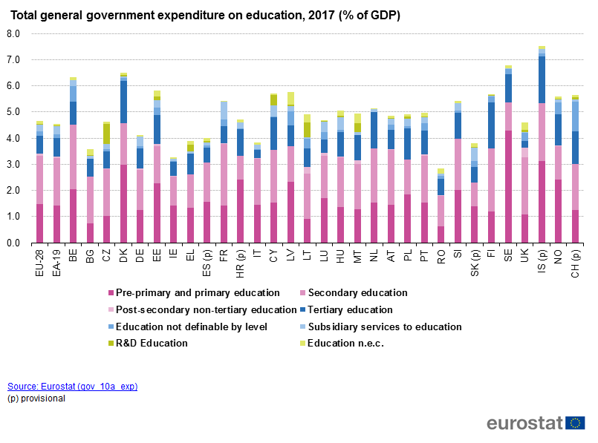
Public expenditure on education in 2017 in EU-28
Creating an Innovative Platform of Communication and Teaching in a Digital Society

Slide 10
Creating an Innovative Platform of Communication and Teaching in a Digital Society
Effectiveness of the educational system
For assessing the effectiveness of the system we apply the criteria of quality which we define as important and look at:
the nation-wide external evaluation and
results from PISA and international rankings to determine its level.
10

Slide 11
Creating an Innovative Platform of Communication and Teaching in a Digital Society
Nation-wide external evaluation
Nation-wide external evaluations of the learning outcomes of students have been performed since 2006.
Starting from 20010/2011 school-year, the external evaluation has been carried out for all students at the end of 4th and 7th grades on all basic subjects, and at the end of the 8th grade on foreign languages for students in schools with intensive foreign language programmes.
Notes:
http://www.ckoko.bg/page.php?c=10&d=98; National report, 2014, p. 14-15.
http://www.ckoko.bg/
The Centre for Monitoring and Evaluation of Quality of School Education annually prepares analyses of the results obtained; the analyses are then used by the Ministry of Education and Science as a basis for upgrading the educational standards and curricula.

Slide 12
Creating an Innovative Platform of Communication and Teaching in a Digital Society
The effects of education in international rankings
In all rounds of the evaluation the pupils’ mean scores are much lower than the OECD average.
There are huge differences between the shares of low achievers and top performers. For instance in 2012 the proportion of low achievers in mathematics is 43.8, whereas the share of high achievers is only 4.1.
The diference between the low and top performers seems to be stable over time. In the case of evaluations in reading the share of low achievers in PISA 2000 is 40%; PISA 2006 – 51%, and PISA 2009 – 41%, PISA 2012 – 41.5%.
There is a difference in the average performance of pupils from different type of schools. The impact on the socio-economic and family environment also has a huge impact on the pupils performance.
Notes:
The results of the evaluations at all rounds of the survey conducted in Bulgaria PISA 2000, 2006, 2009 and 2012 reveal worrying in all areas of interest, some of which are stable over time.

Slide 13
Creating an Innovative Platform of Communication and Teaching in a Digital Society
Student performance in Mathematics, Reading and Science 2012 in Bulgaria and OECD countries
Source: OECD (2014 ). PISA 2012 Results in Focus What 15-year-olds know and what they can do with what they know, p. 5
Notes:
http://www.oecd.org/pisa/keyfindings/pisa-2012-results-overview.pdf
In fact, the PISA results in all three area in which pupils’ knowledge has been assessed in Bulgaria they are very poor, compared to the OECD average.
Despite that there are huge disparities between the low and high achievers, by the type of school and most severely by socioeconomic and cultural status of pupils.

Slide 14
Creating an Innovative Platform of Communication and Teaching in a Digital Society
The value of education
Focus on the instrumental value of education
Following the overview of sociological surveys among youth carried out in Bulgaria in the period between 1973 and 2005, the changes in attitudes to education may be summarized in 6 directions (Mitev & Matev 2005: 19-30):
Education increases its value among young people and their parents.
Aspiration for high education is motivated by the wish for improvement of the chances for better paid job and prestigious occupation.
The value of education is increasingly measured not only with formal diploma, but with mastering of a foreign language, computer technology, informal education for acquiring additional skills and knowledge.
A considerably demotivating influence is rendered to the youth unemployment and the prosperity of people who lack the necessary education.
The market economy interferes in the educational process in different ways – via providing private lessons to buying exams and credentials.
Teachers lose their prestige among pupils and adults.
Notes:
The educational expansion, the introduction of market mechanisms in education and the transformation of the opportunities for employment changed the thinking about education among the youth but also among the whole population. It is perceived mainly in instrumental terms and as a way to make them more competitive on the labour market Focus on the instrumental value of education

Slide 15
Creating an Innovative Platform of Communication and Teaching in a Digital Society
National specificity
High prestige of language high schools among Bulgarians;
Strong intention to acquire credentials (it is associated with some negative practices in Bulgaria such as buying degrees or paying for passing of an exam).
Strong role of private lessons in both preparing pupils for applying to high schools and Universities

Slide 16
Main problems
Creating an Innovative Platform of Communication and Teaching in a Digital Society
The low or inadequate quality of education at all levels;
Under-funding for all educational levels;
The low effectiveness of the developed strategies and proposed measures;
The significant disparities in access to education, quality of education, educational results and dropout, caused by socio-economic factors;
The significant differences in quality of education in different types of (secondary) schools;
The increasing average age of teachers.

Slide 17
Creating an Innovative Platform of Communication and Teaching in a Digital Society
Challenges
How to improve the student performance in PISA and generally to improve the quality of education?
How to improve education and skills of Roma population?
How to ensure that education won’t lead to broken promises from education but for more and better opportunities for their development in future?

Slide 18
Creating an Innovative Platform of Communication and Teaching in a Digital Society The touch of Europe
National Strategy for Development of the Pedagogical Staff 2014-2020;
National Strategy for Lifelong Learning for the period 2014-2020;
National Strategy of Republic of Bulgaria for Integration of Roma (2012-2020);
Strategy for Reducing the Share of Early School Leavers (2013–2020);
National Strategy for Promoting and Raising Literacy (2014-2020);
National Youth Strategy (2012-2020);
Strategy for Effective Implementation of Information and Communication
technologies in Education and Science of the Republic of Bulgaria (2014-2020);
National Qualifications Framework of the Republic of Bulgaria;
Strategy for Development of Higher Education (2014-2020).

Slide 19
Creating an Innovative Platform of Communication and Teaching in a Digital Society
THANK YOU FOR YOUR ATTENTION!

