Slide 1
Police
Describe a person to the police.

Slide 2
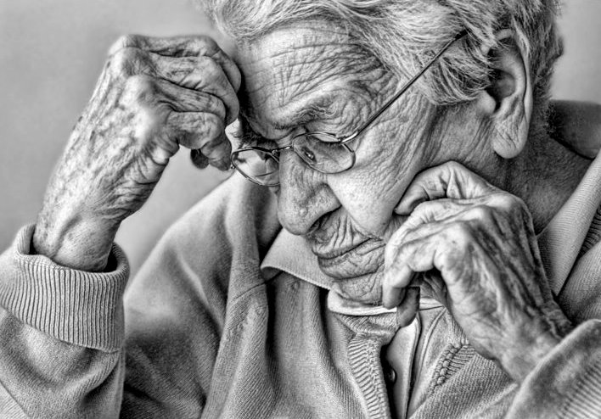

Slide 3
Material: Copies of the photograph of the elderly person
Other Material: A Police Form to complete
Group: Four +
Level: All

Slide 4
Task 1: descriptions of people
Elicit physical descriptions of people in the group. With higher levels, make sure the descriptions are in-depth.
Notes:
Make an extended list of physical descrptions in general

Slide 5
Task 2: describe a missing person
Give participants the photo.
Tell participants that this person has gone missing and they are going to have to give a detailed description of him/her to the police. They could invent mannerisms e.g. the way he/she walks.
Participants work in pairs and make notes around the photo about what they will say to the police.

Slide 6
Task 3: Interviews in pairs
Participants work in different pairs.
The Police man/woman interviews the person giving the description and fills in his/her form.
One person has the photo, the other has the police form.
Participants swap roles and partners, and repeat the interviews.

Slide 7
Task 4: Display of the Police forms
Police forms can be displayed and compared; Any extra language can be added where necessary.

Slide 8
Variation:
This can be extended to a more literary description of someone they know, where the physical description leads on to a detailed ‘story’ of this person’s life in narrative form. This can be very interesting when participants share information about people who are very special to them.

Slide 9
Police Form Description of the missing person:
Name of the missing person: ………………………………………………………….
Physical description of the person: …………………………………………………. ……………………………………………………………………………………………………….. ………………………………………………………………………………………………………..
Any distinguishing features: ……………………………………………………………. ……………………………………………………………………………………………………….. ………………………………………………………………………………………………………..
Comments: …………………………………………………………………………………….. ………………………………………………………………………………………………………..
Name and contact details of the person giving the information: …….. ………………………………………………………………………………………………………..
Notes:
Or create your own Police Form of course

