Slide 1
Interview
Holding an interview and presenting the summary of those.
Because all these workshop are about elderly, the interview should be with an elderly person.

Slide 2
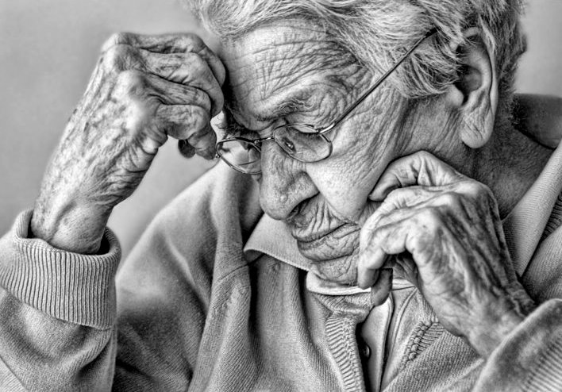

Slide 3
Material: Copies of the photograph of the elderly person
Other Material: (elderly people to interview!); stationery
Group: Six +
Level: Intermediate - Higher

Slide 4
Task 1: who is he?
Show the participants the photo, and ask them to describe the person:
What kind of character do they think he/she might have?
What kind of life do they think he/she might lead ?
…….

Slide 5
Task 2: prepare questions
Ask the participants : if you were going to interview this person, what would you like to ask him/her?
Prepare this list of questions.

Slide 6
Task 3: Interview
The participants individually interview some elderly people. If the course is not taking place in the target language country, the interviews can be done in the local language, and the presentations in the target language.
Notes:
If you can not have elderly, then use the other participants in the role of elderly.

Slide 7
Task 4: Presentations
Participants present a summary of their interviews to the rest of the group.

Slide 8
Task 5: learnt and reactions?
Ask the participants what they learnt from this : what were their reactions to the elderly people’s answers ?

Slide 9
Variations:
Lower level participants can be involved by interviewing people together with someone of a slightly higher level: the questions could be decided upon together.
If there are no elderly people available to be interviewed, some participants can play the part of an elderly person: invent things the person has done; the kind of life he/she has led etc.
This can be a fun activity regardless of whether the interviews are carried out with real elderly people, especially if the group is creative: they can think up adventures the person has had etc.
The task would then be the conducting of interviews, which could be video taped.

