Slide 1

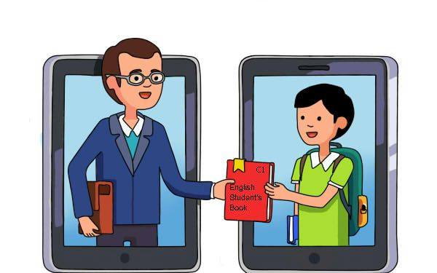
Creating an Innovative Platform of Communication and Teaching in a Digital Society, December 2018 – November 2021
All’s well that ends well.
Whatever the course, the end is the renown.

Slide 2
Project summary
Start date: December 3, 2018
End date: November 2, 2021
Coordinator: Association “Education without Barriers”, Sofia, Bulgaria
Partners:
Tsar Simeon Veliki Secondary School, Vidin; Regional Department of Education,Vidin; Stichting International Youth Bridges (NGO), Maastricht; De La Salle College, Malta; Mobil iHO School, Istanbul; National Authority of Education, Sultangazi District, Istanbul.

Slide 3
Principal objectives
To develop an innovative methodology of foreign language (mainly English) teaching and learning based on thematic contextualization, use of ICT, and elements of non-formal and informal education;
To develop and upgrade ICT competences and foreign language skills of both teachers and students;
To enhance the intercultural literacy and competences of teachers and students and promote mutual understanding, cultural sensitivity, and tolerance;
To stimulate collaboration between the participating countries through exchange of good practices;
To raise the profile of the teacher’s profession and increase motivation for lifelong learning;
To encourage partnerships between schools and local educational authorities.

Slide 4
Chronology of events and activities
2018
Project presentation in Vidin, December;
1st Transnational Meeting (TM1), December, Sofia;
2019
Workshop in Vidin, February;
Online trainings, February-May;
Short-Term Staff Training (C1), June;
2nd Transnational Meeting (TM2), October, Istanbul;
Workshop organized by RDE-Vidin, November;

Slide 5
Chronology of events and activities (cd)
2020
3rd Transnational Meeting (TM3), February, Valkenberg;
Virtual meetings with partners, December;
2021
Virtual meetings with partners, March, May, June;
Virtual Short-Term Exchange of Students(C2), June;
4th Transnational Meeting (TM4), October, online.

Slide 6
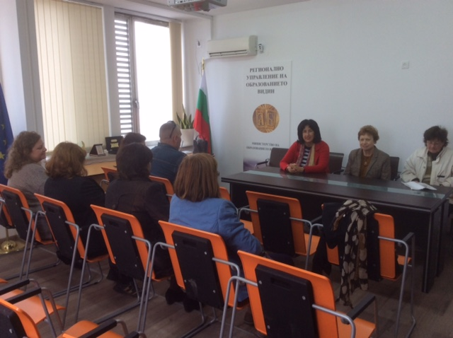
Project presentation at the Regional Department of Education-Vidin, December 2018

Slide 7
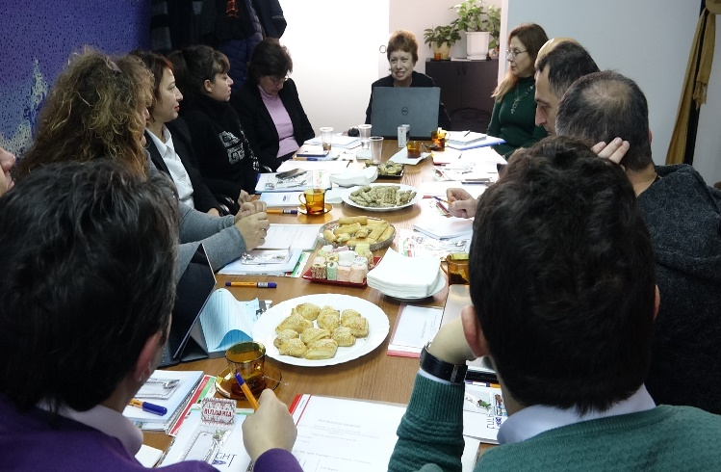
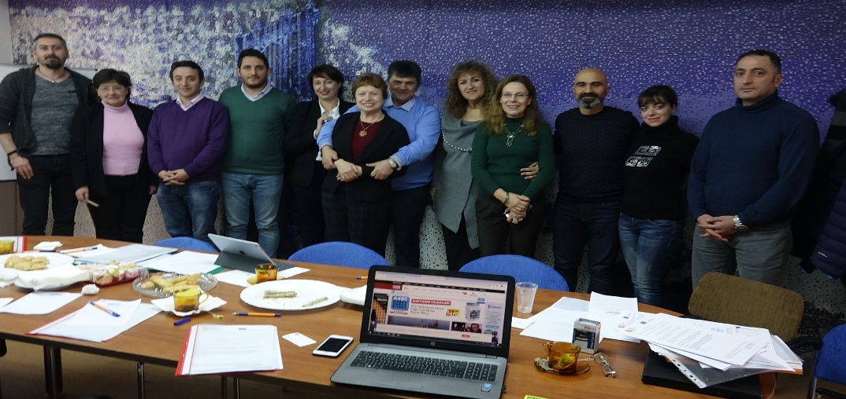
TRANSNATIONAL MEETING 1
Sofia 7-9 Dec. 2018

Slide 8
Workshop in Vidin, 16-17 February 2019
Tsvetanka Todorova instructing Anastassia Miteva on how to use the eTwinning and Mobility+ platforms (front).
Julia Stefanova demonstrating the innovative English teaching method to teachers from Tsar Simeon Veliki School Natasha Krumova, Evelina Andreeva, and Iliana Todorova (back).

Slide 9
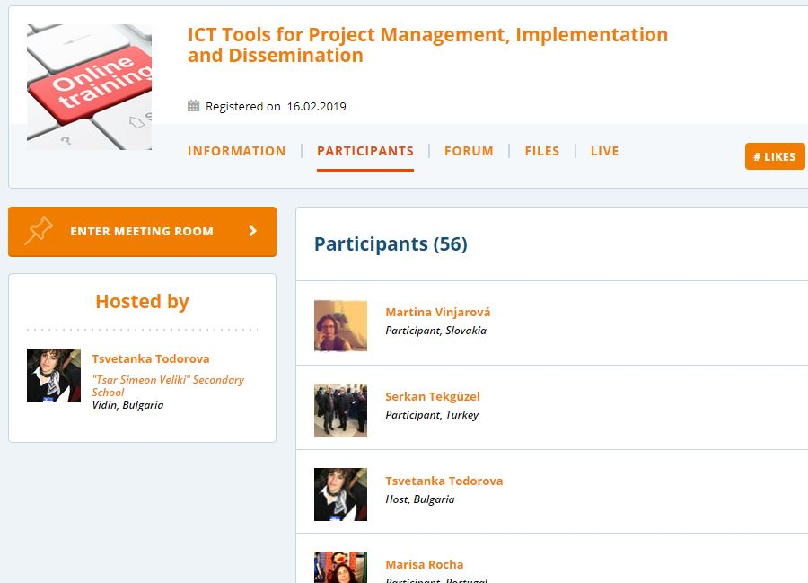
On February 21, 2019, Tzvetanka Todorova conducted an eTwinning online session on "ICT Tools for Project Management, Implementation and Dissemination".

Slide 10
On April 10, 2019, Dr. Julia Stefanova conducted an online training session on the innovative teaching methodology presenting the topic "Cultural Differences and Cultural Divides".

Slide 11
On May 22, 2019, Tsvetanka Todorova conducted an eTwinning online event on "ICT Tools for Outdoor and Classroom Activities ".

Slide 12
On May 15, 2019, Dr. Julia Stefanova conducted a second online eTwinning event on “The Pros and Cons of Globalization”.

Slide 13
Short-term staff training (C1), Malta, June 20-28, 2019 attended by 25 participants from the 7 partner institutions

Slide 14
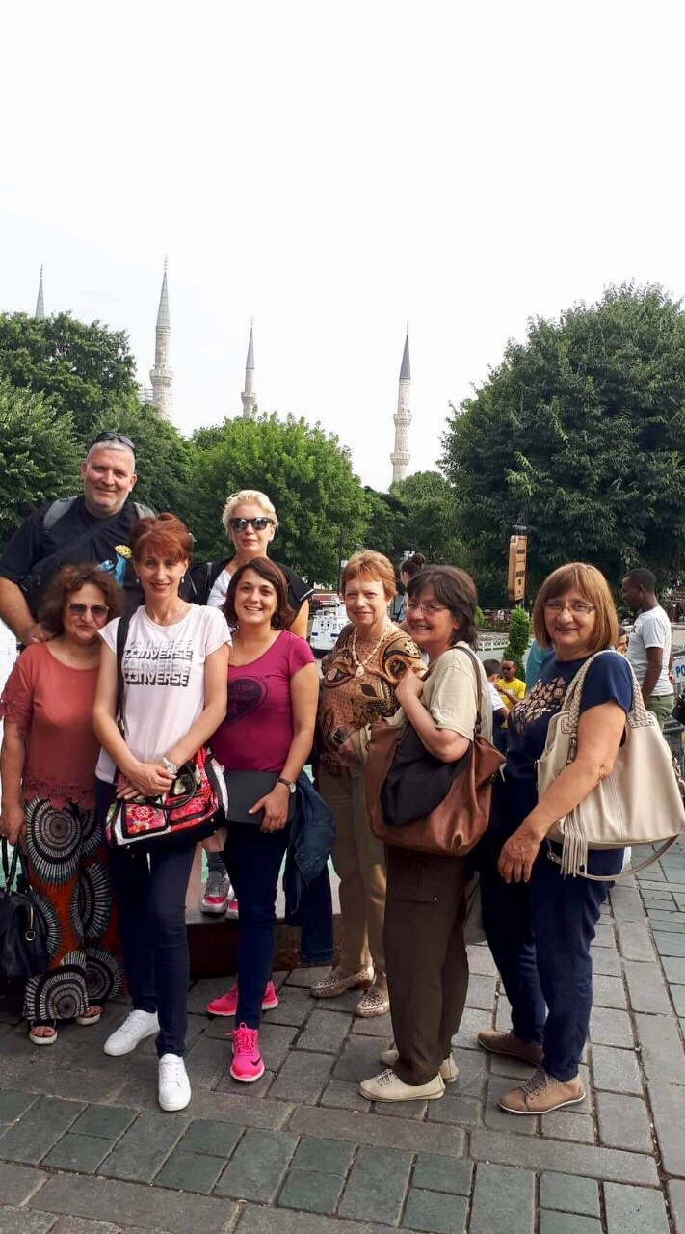
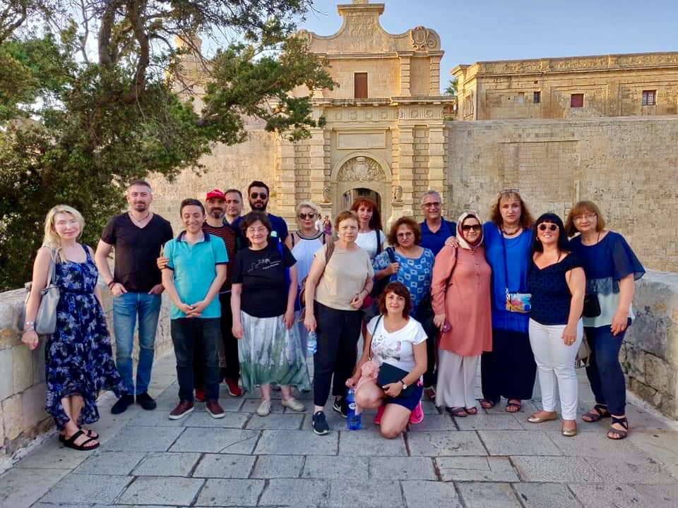
Cultural enrichment is a lot of fun

Slide 15
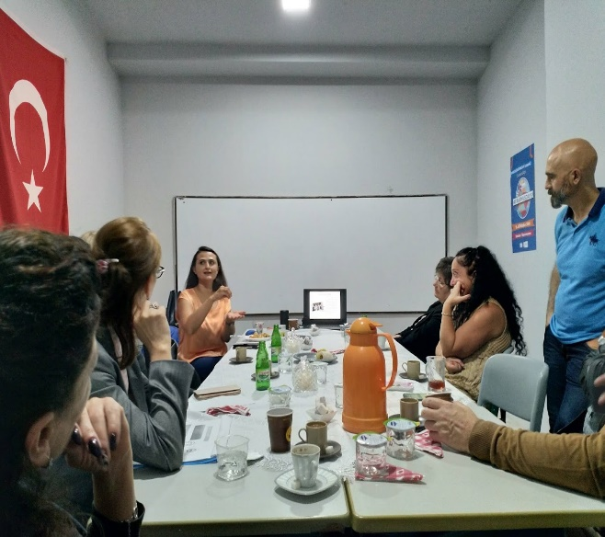
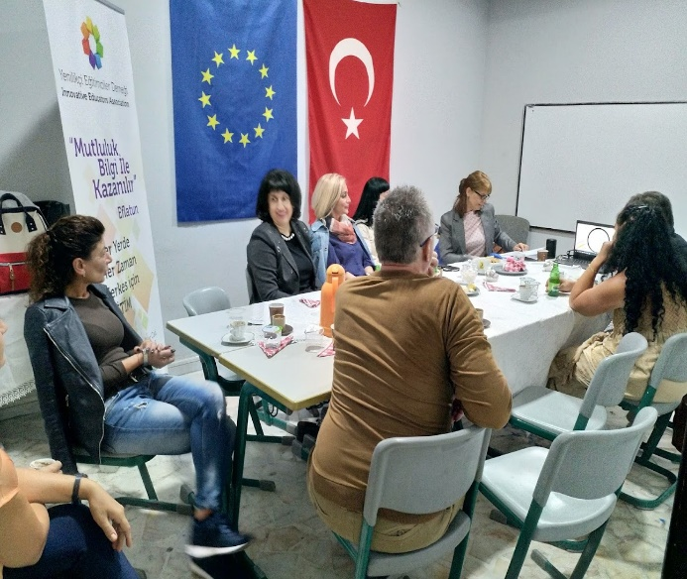
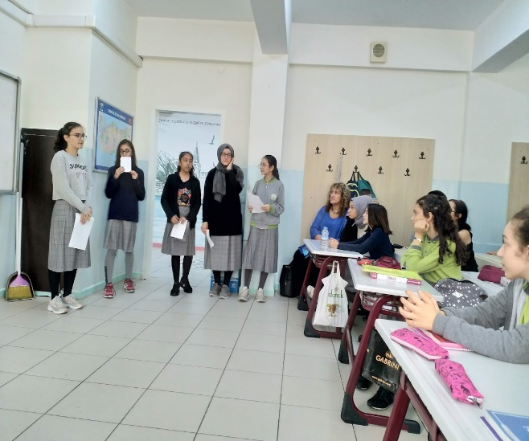
TRANSNATIONAL MEETING 2
Istanbul, 17-20 Oct.2019, 24 participants

Slide 16
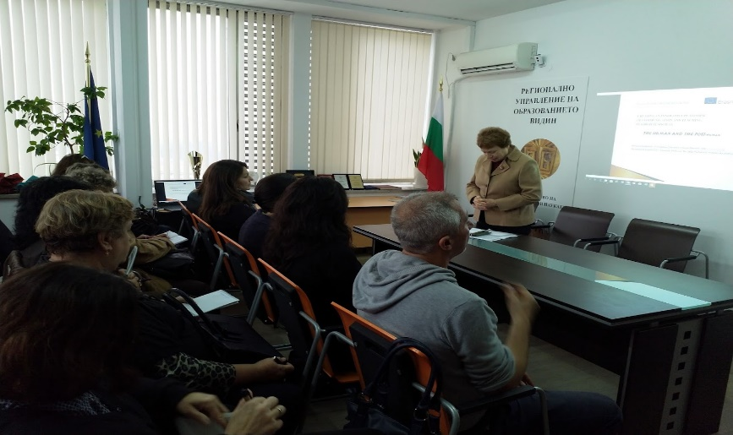
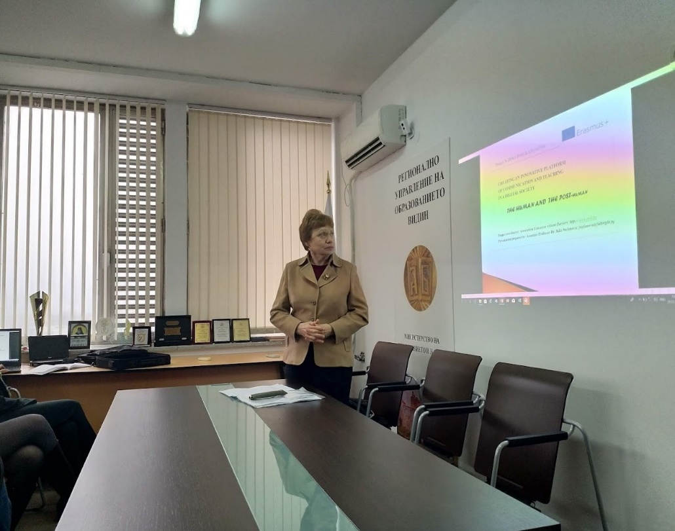
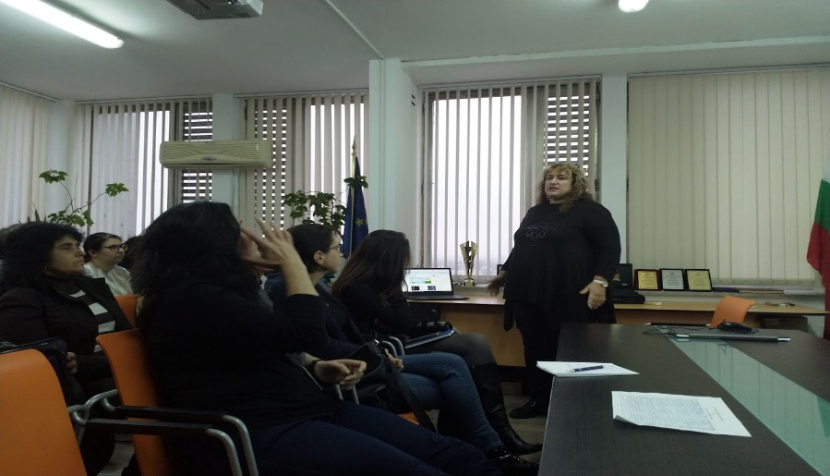
Workshop organized by the Regional Department of Education – Vidin,
21 Nov. 2019, attended by 29 foreign language teachers from 20 schools in Vidin region

Slide 17
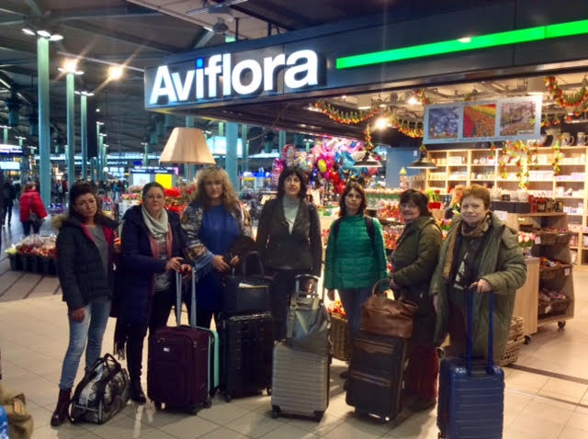
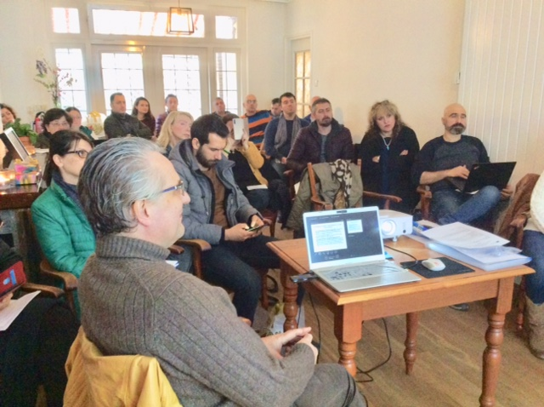
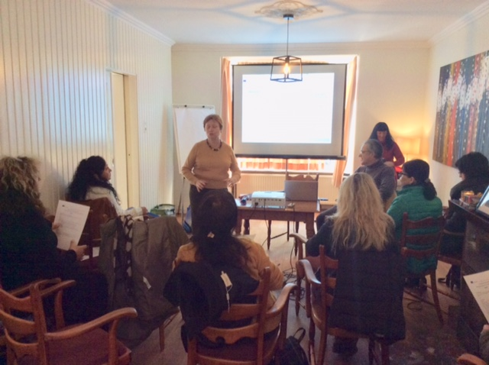
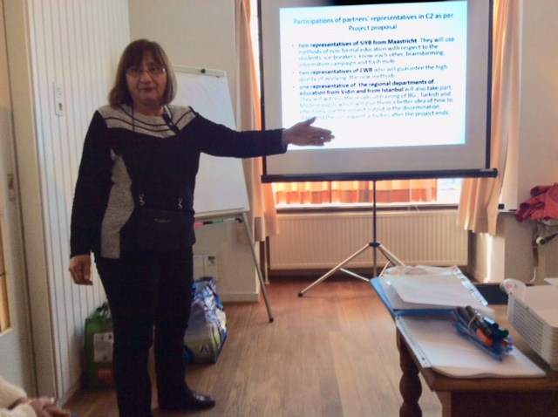
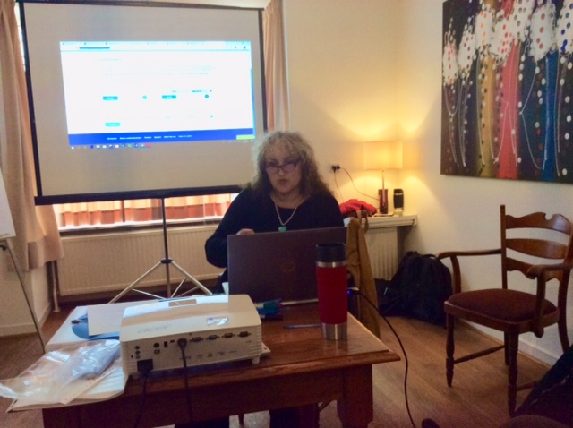
TRANSNATIONAL MEETING 3
20-23 February 2020, Valkenburg aan de Geul, Netherlands
24 participants

Slide 18
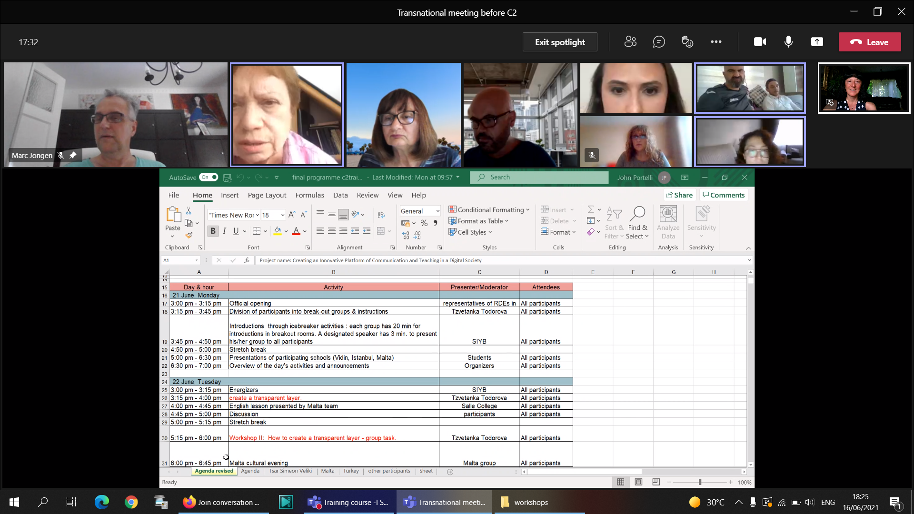
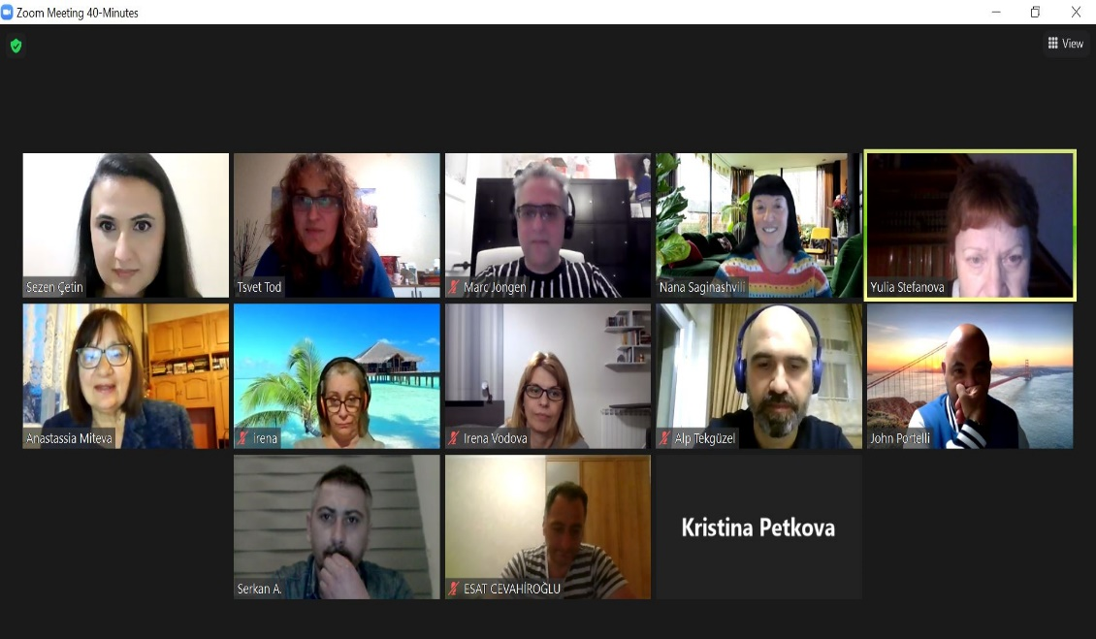
Virtual meetings with partners - 17 Dec. 2020, 20 Dec. 2020,
25 March, 10 May, 16 June 2021

Slide 19
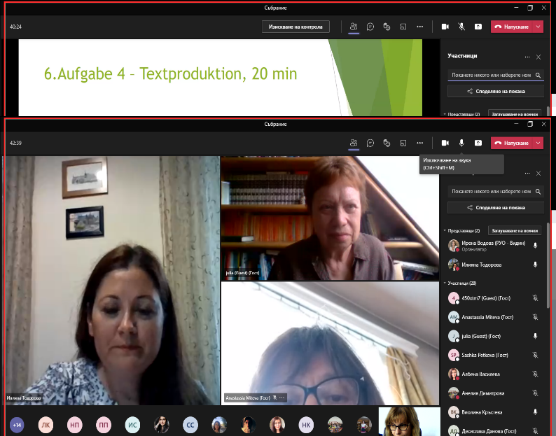
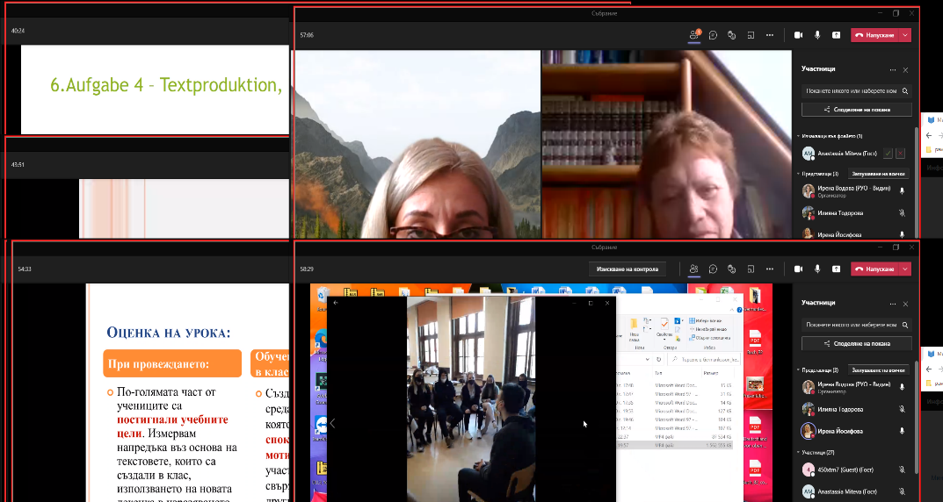
Virtual workshop organized by RDE-Vidin on 17 May 2021 for 30 foreign language teachers from Vidin region

Slide 20
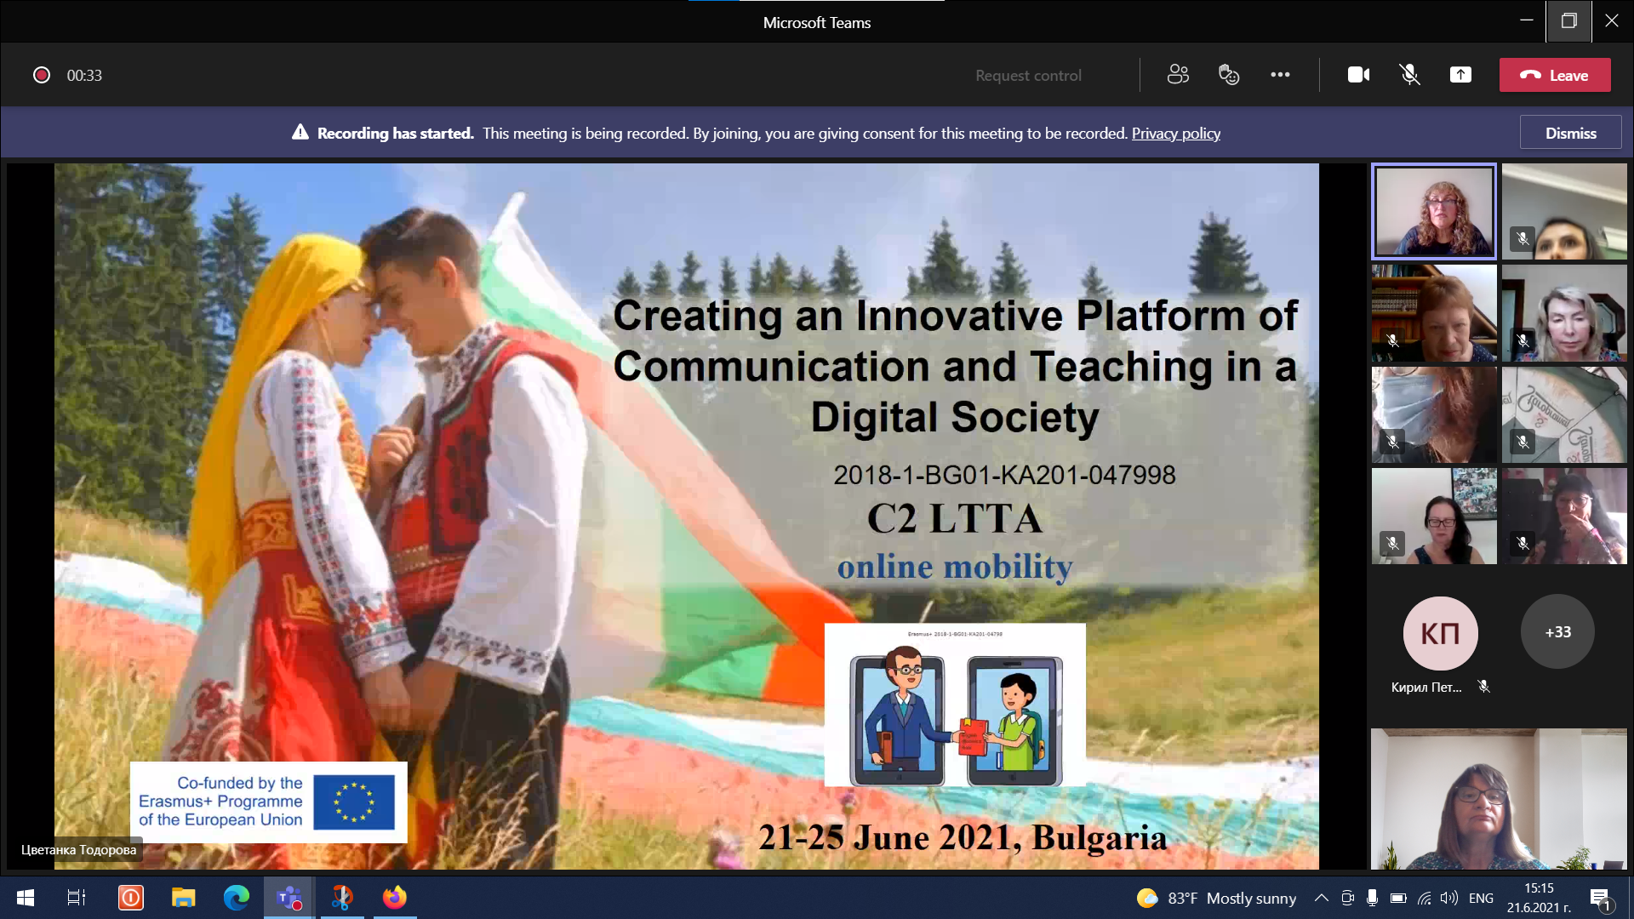
Virtual short-term exchange of groups of pupils (C2),21-25 June 2021
Participants: 37 students, 12 teachers, trainers, organizers, partners

Slide 21
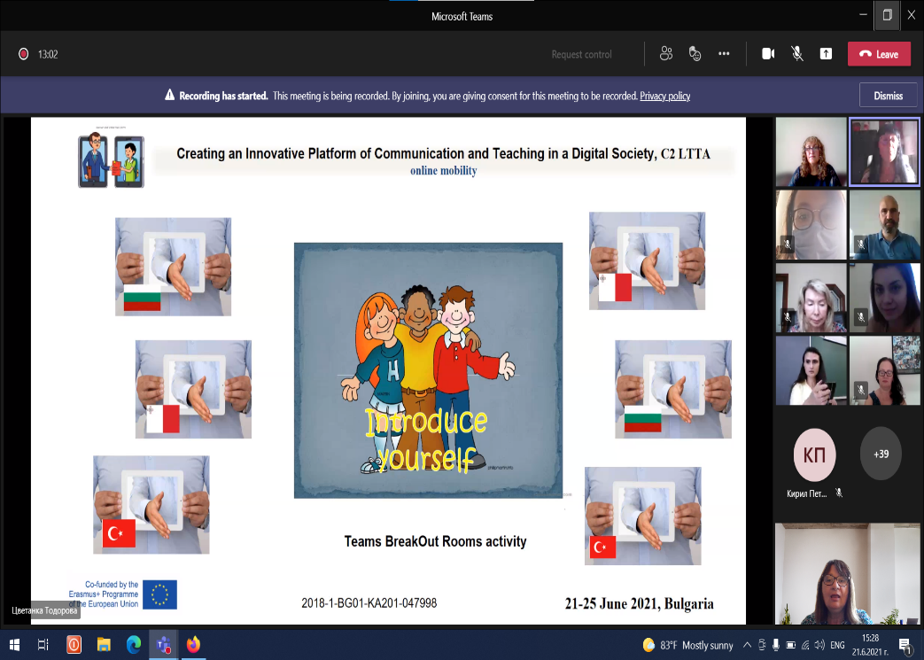
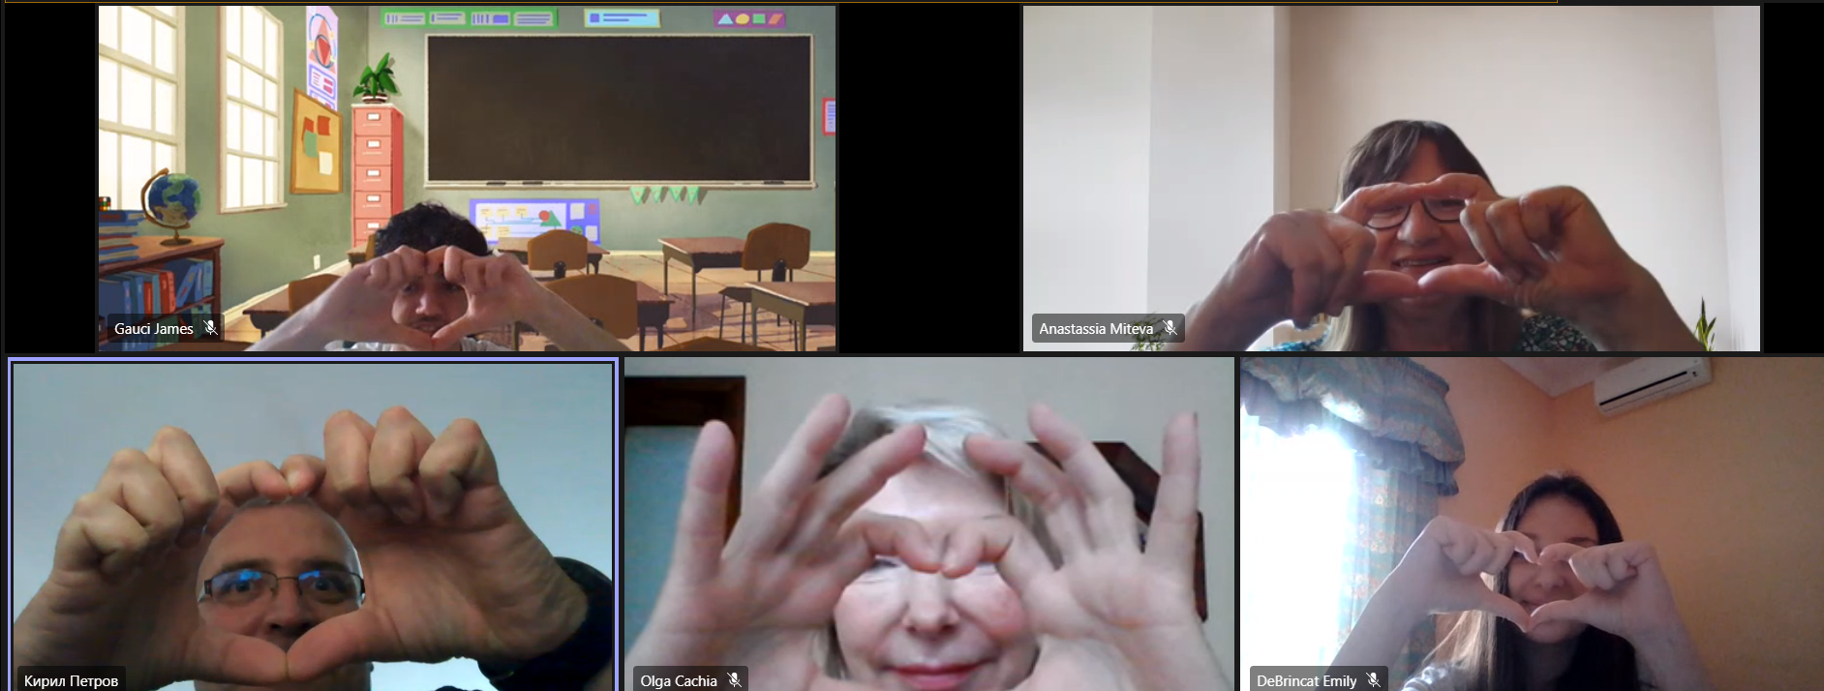
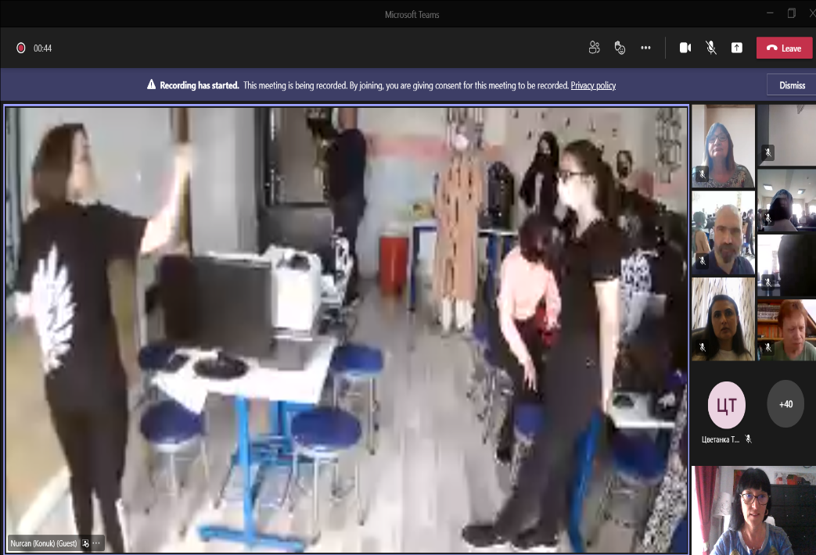
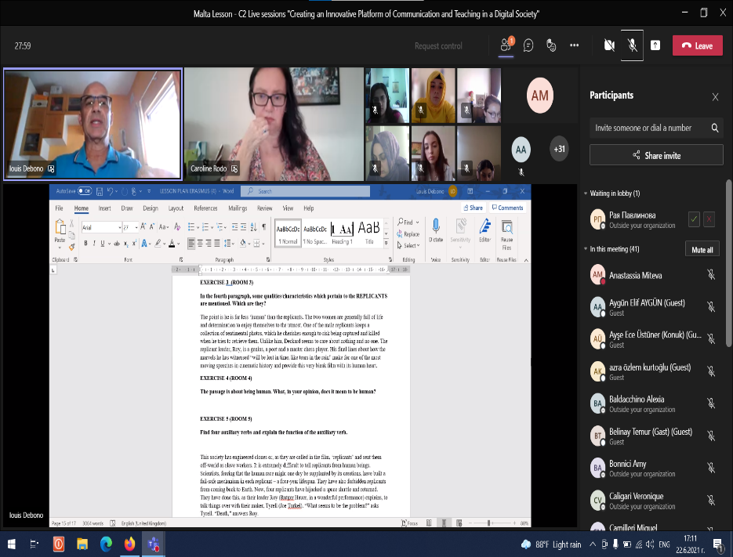

Slide 22
VIRTUAL TRANSNATIONAL MEETING 4
22 October 2021
AGENDA
11:30-11:45 TM4 Opening
11::45 – 12:30 Report on project activities (2018-2021), PPT presentation by coordinators- Julia Stefanova and Anastassia Miteva, Q&A
12:30-13:00 Report on project activities by De La Salle College team
13:00-13:30 Report on project activities by Mobil Imam Hatip School team
13:30-14:00 Lunch break
14:00-14:30 Report on dissemination of project activities by RDE-Sultangazi
14:30-15:00 Report on project activities by Tsar Simeon Veliki School team
15:00-15:30 Report on project activities by RDE-Vidin
15:30-16:00 Report on project activities by SIYB
16:00-16:15 Break
16:15-17:00 Unfinished business, remaining tasks, financial issues, etc.

Slide 23
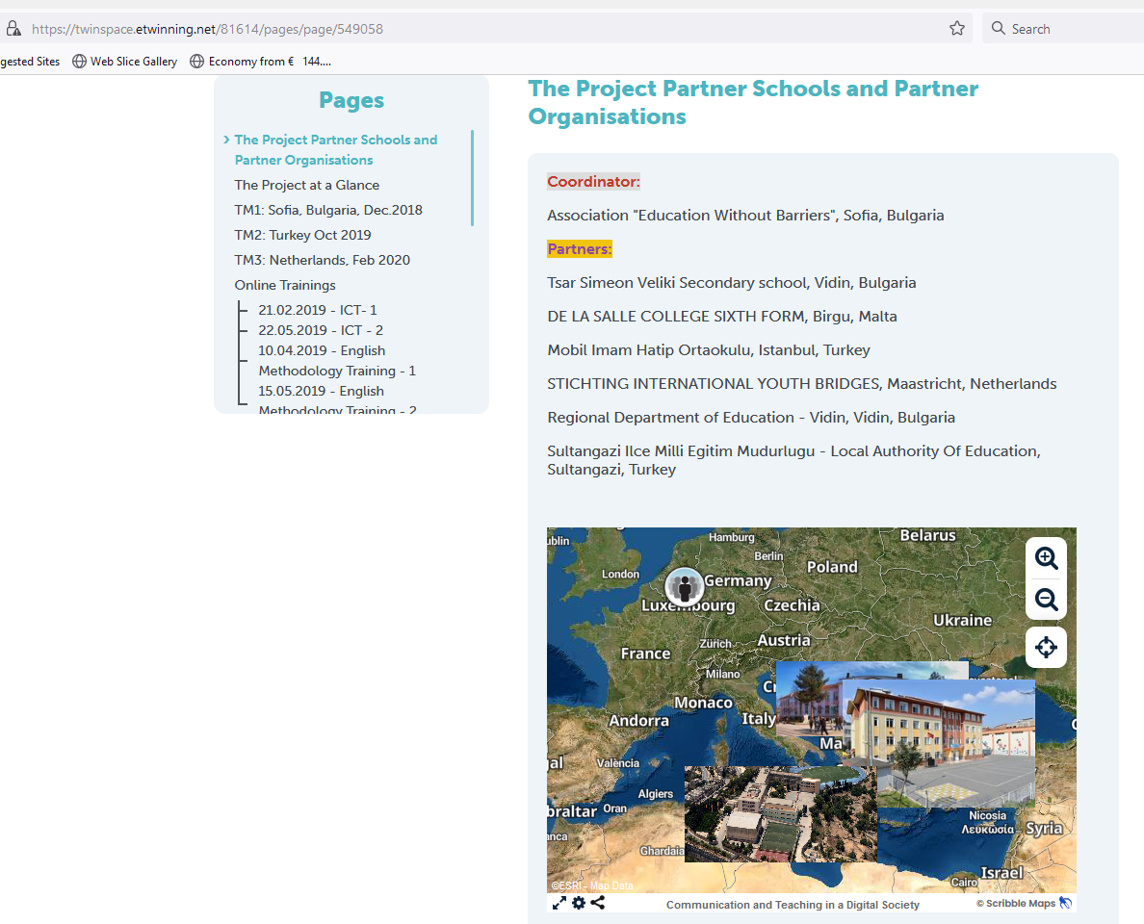
PROJECT TWINSPACE https:twinspace.etwinning.net/81614

Slide 24
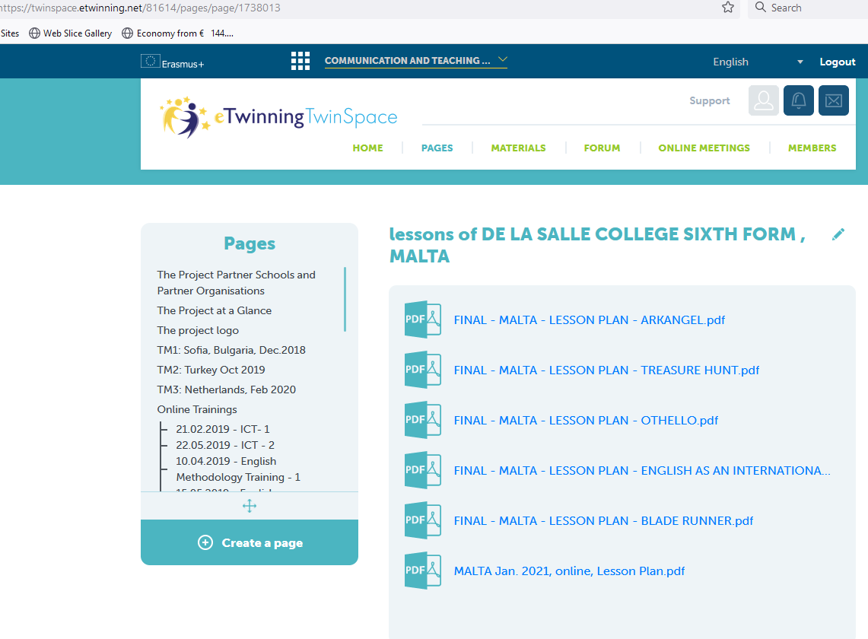
PROJECT OUTPUT

Slide 25
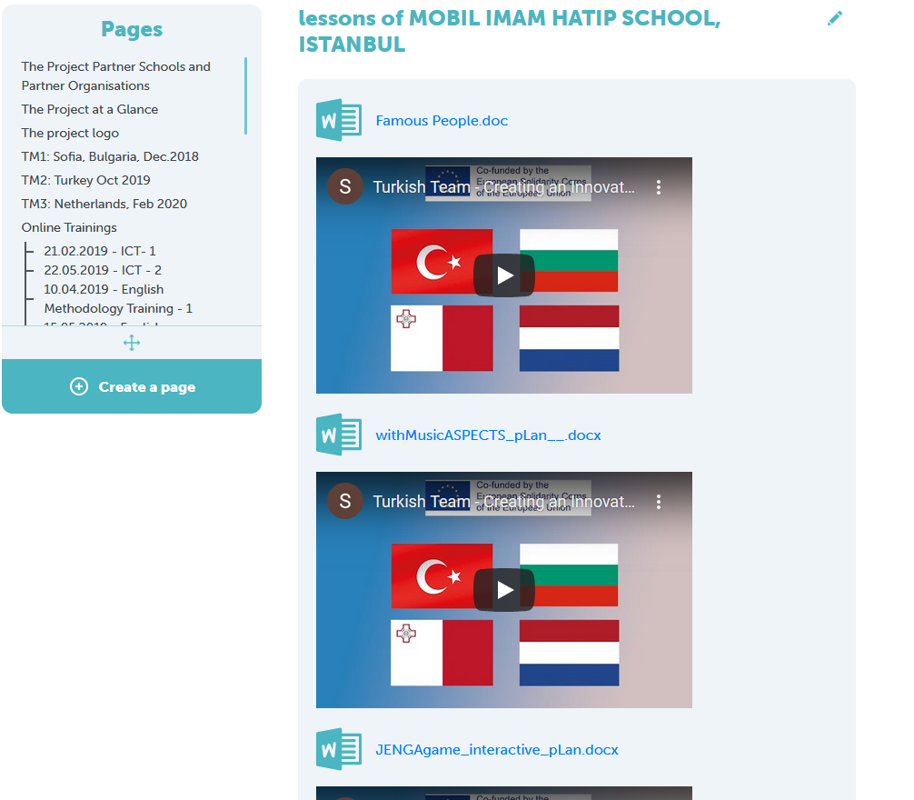
PROJECT OUTPUT

Slide 26
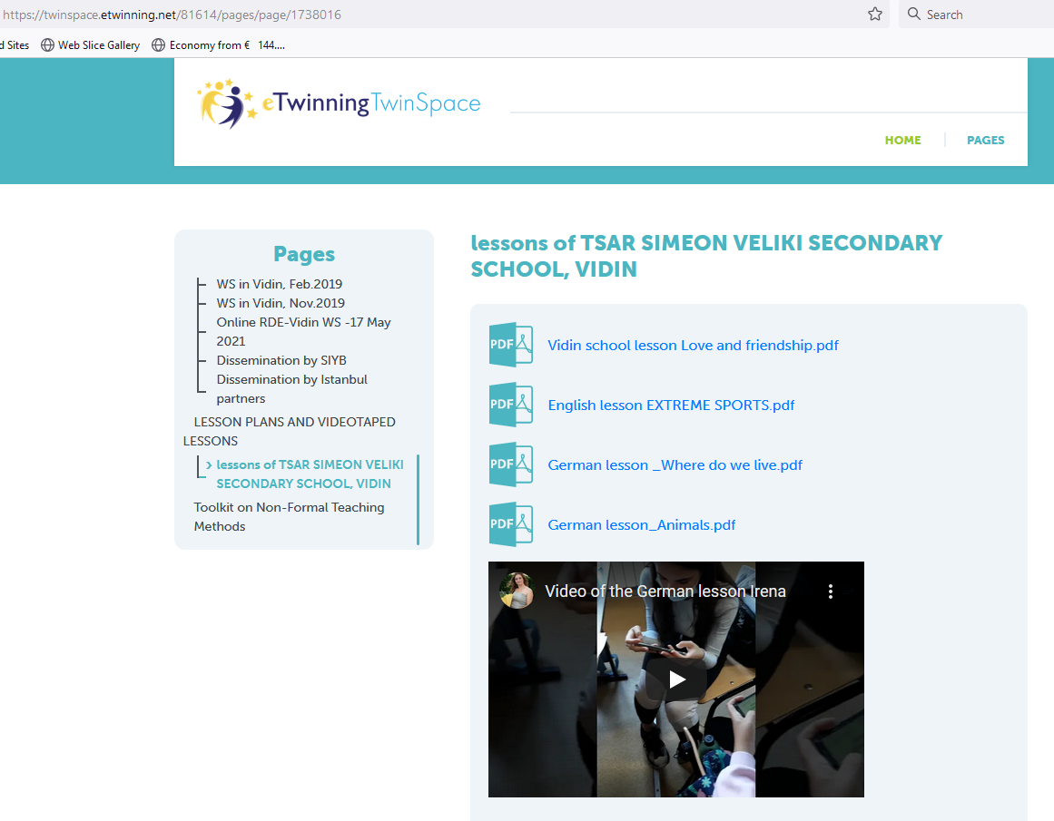
PROJECT OUTPUT

Slide 27


Slide 28

TOOLKIT

Slide 29
Project outcomes
Developing an innovative methodology of foreign language (English) teaching based on thematic contextualization, use of ICT, and elements of non-formal and informal education;
Upgrading ICT competences of teachers and students;
Exposing teachers and students to a variety of non-formal education techniques;
Familiarizing project participants with the educational systems of the partner countries;

Slide 30
Project outcomes (cd)
Cultural enrichment of project participants through mobilities;
Enhancing intercultural literacy and cultural sensitivity, and promoting mutual understanding and tolerance;
Collaboration between the participating countries through exchange of good practices;
Expanding partnerships between schools and local educational authorities.

