Slide 1


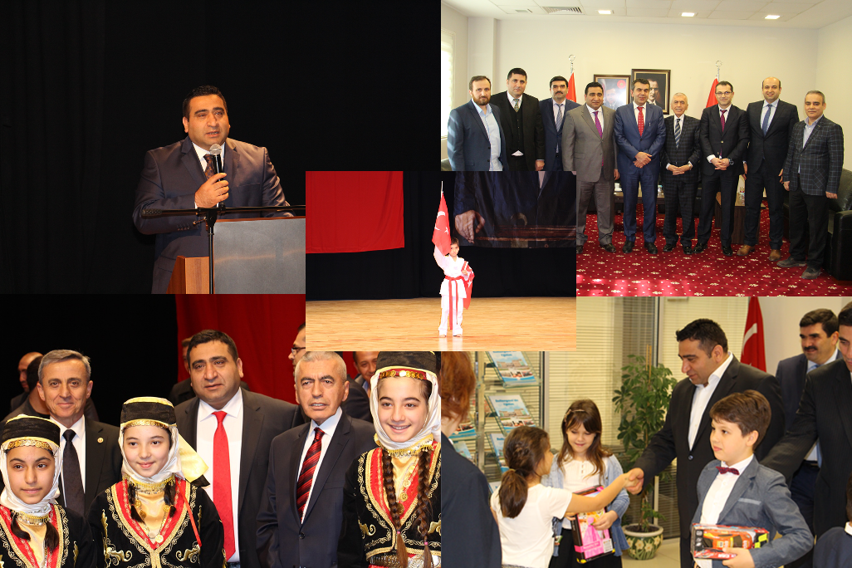
TURKISH REPUBLIC
SULTANGAZI LOCAL EDUCATION AUTHORITY

Slide 2
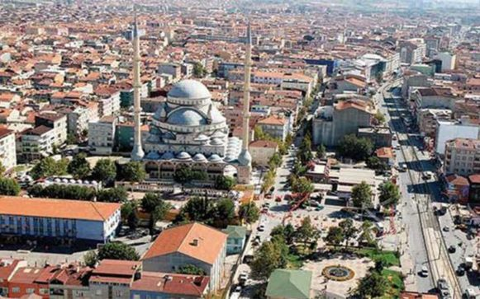
SULTANGAZI

Slide 3
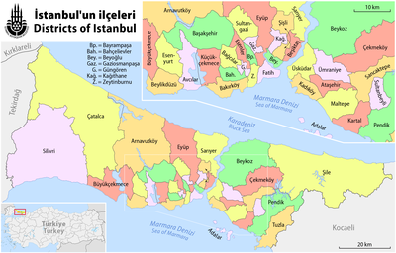
YEARS | POPULATION
2019 | 600.125
2018 | 575.074
2017 | 543.789
2016 | 525.090
2015 | 521.524
2014 | 513.022
2013 | 505.190
2012 | 492.212
2011 | 483.225
2010 | 468.274
The area of Sultangazi district is 36 km2. Our district has 19th place among Istanbul districts in terms of surface area but 7th place in terms of population.

Slide 4
STATISTICS ABOUT SCHOOLS IN SULTANGAZI
Number of Students: 112.637
Number of Teachers: 4.727
Number of Classrooms: 2.461

Slide 5
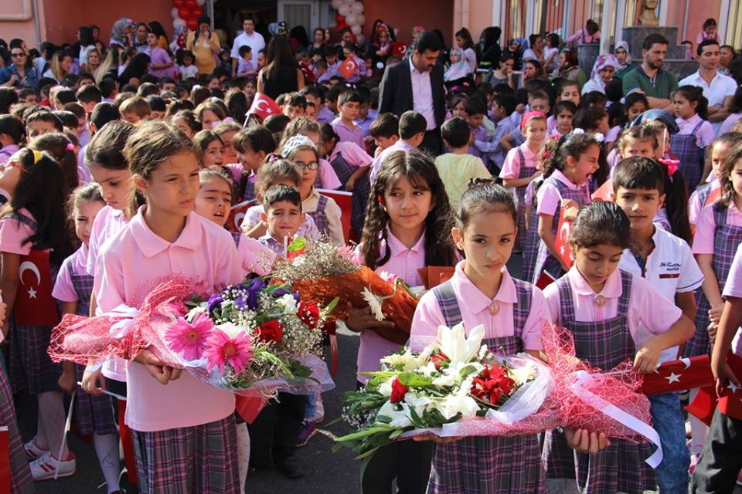
EDUCATION IN SULTANGAZI
Educational instutions are open to everyone regardless of language, race, sex or religion. Students are obliged to take twelve years of education between the ages of six and eighteen.

Slide 6
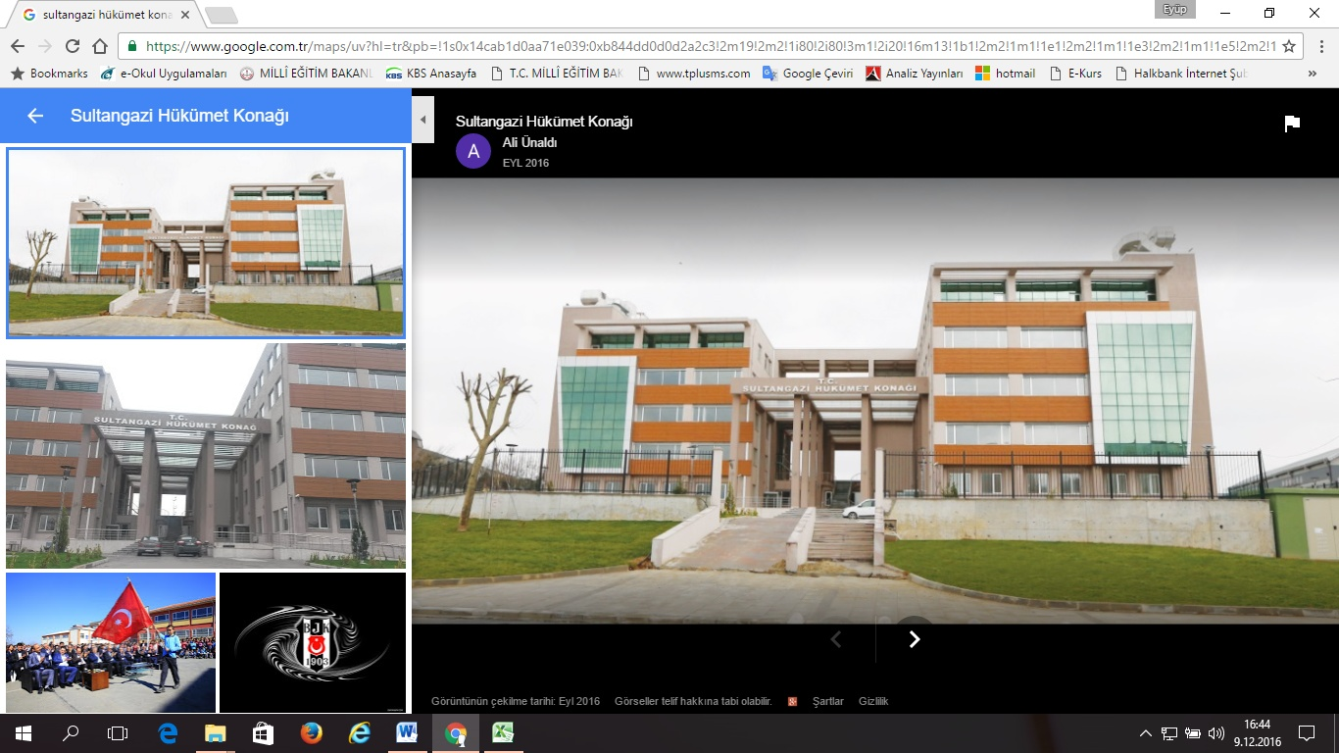
NAME OF INSTITION | : | SULTANGAZI LOCAL EDUCATION AUTHORITY
CITY | : | ISTANBUL
DISTRICT | : | SULTANGAZI
ADDRESS | : | Uğur Mumcu Street Atatürk Boulevard No:58 4. Floor Sultangazi / Istanbul
WEB ADDRESS | : | http://sultangazi.meb.gov.tr/
SOCIAL NETWORK ADDRESSES |  | https://www.facebook.com/sgmem https://twitter.com/sultangaziilce
E-MAIL | : | sultangazi34@meb.gov.tr
PHONE NUMBERS | : | 0212 - 606 00 76 / 606 04 52 / 606 08 94/ 606 08 95 / 606 04 52 / 606 01 25
FAX | : | 0 212 606 04 60

Slide 7
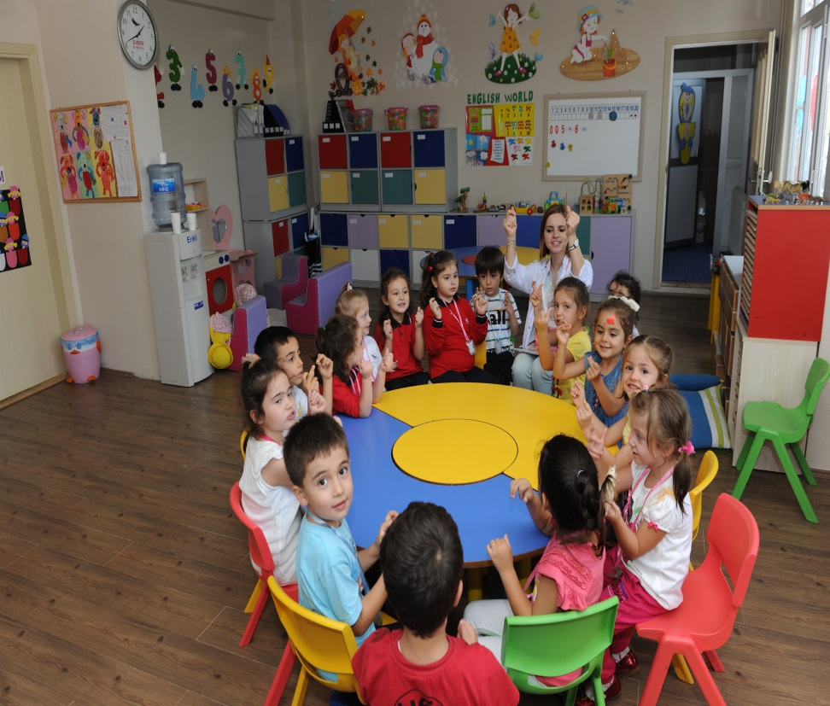
PRE-PRIMARY EDUCATION
Pre-primary education is optional and covers children who are under the age of six. Although it is not compulsory, pre-school education is encouraged by state.

Slide 8
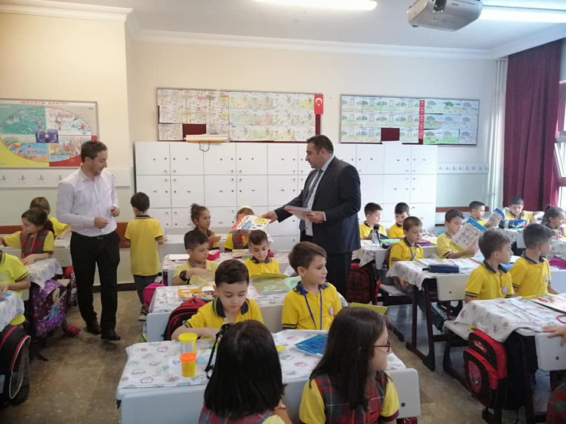
PRIMARY EDUCATION
.
Primary education is free of charge at all state schools and it is compulsary for the children aged 5 to 10. The primary education program includes social studies, human rights, history, music, religion, foreign language, maths, etc.

Slide 9
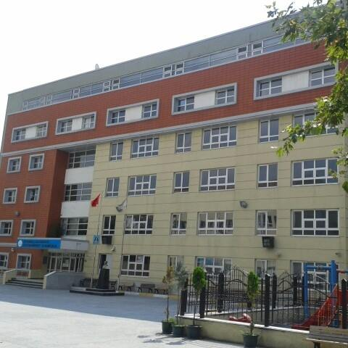
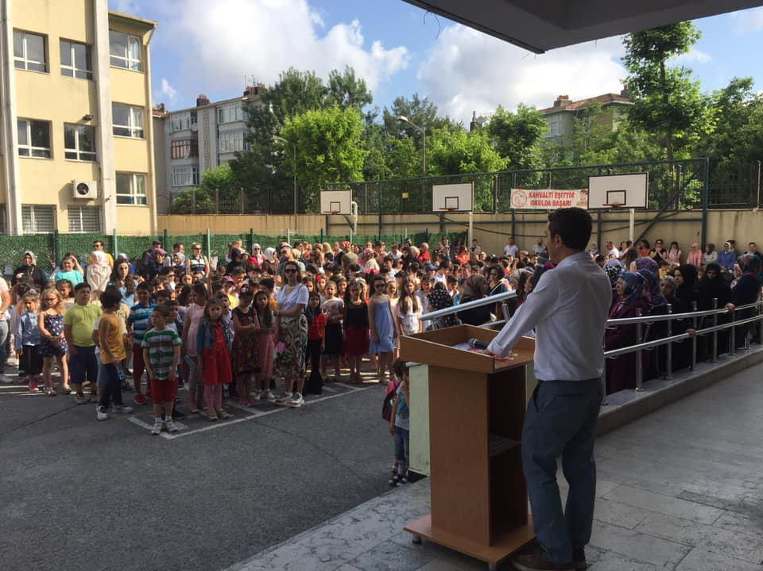
CUMHURIYET PRIMARY SCHOOL

Slide 10
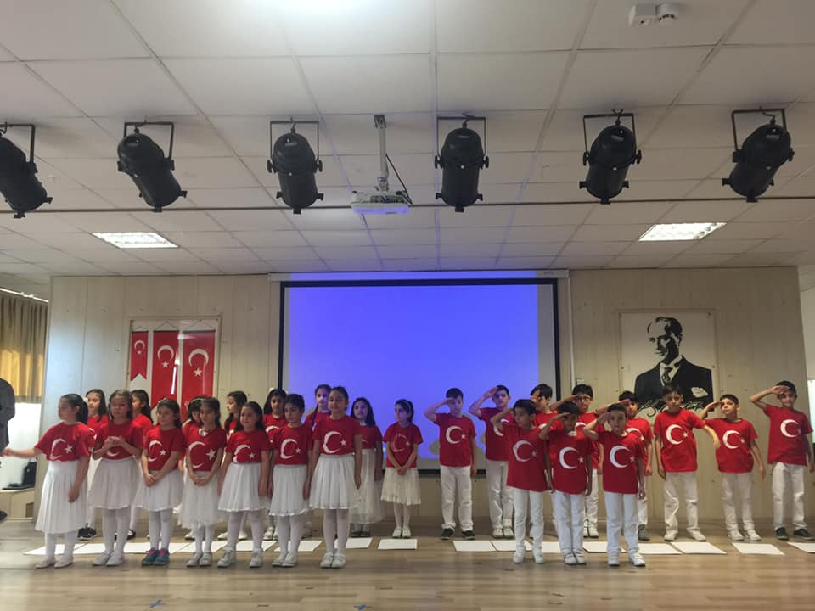
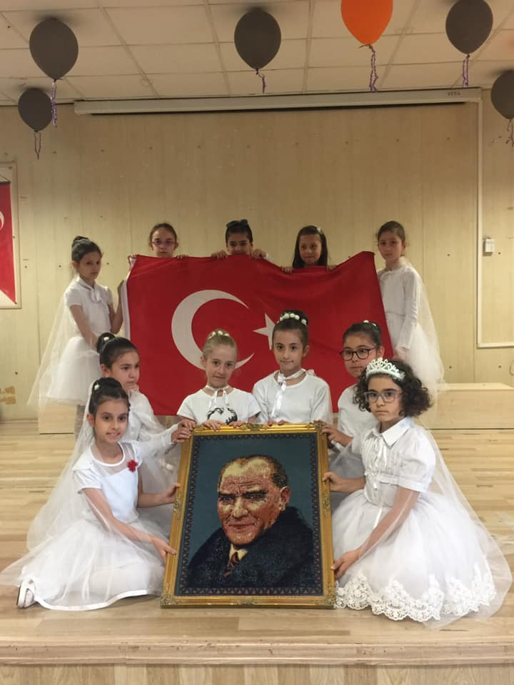

Slide 11
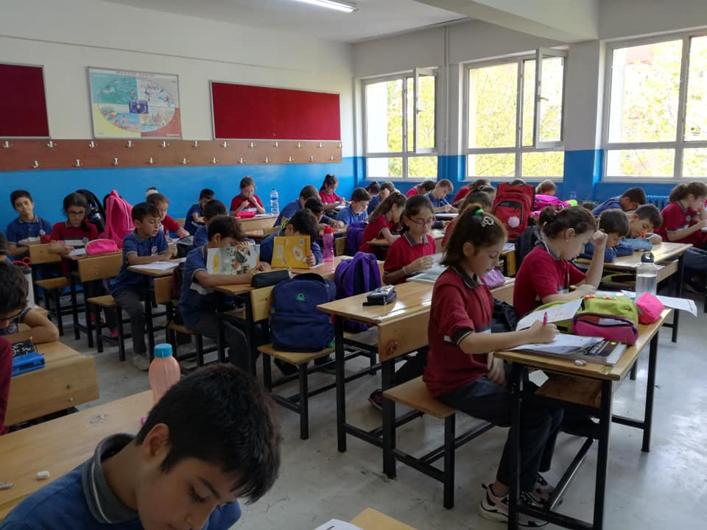
SECONDARY SCHOOL EDUCATION
Four years of secondary school is also compulsory in Turkey. After finishing the primary school, students between the ages of ten to fourteen continue secondary school. Public schools, private schools or religous vocational secondary schools may be preffered. Students study Turkish, social science, science, technology, maths, foreign language, visual arts and optional subjects.

Slide 12
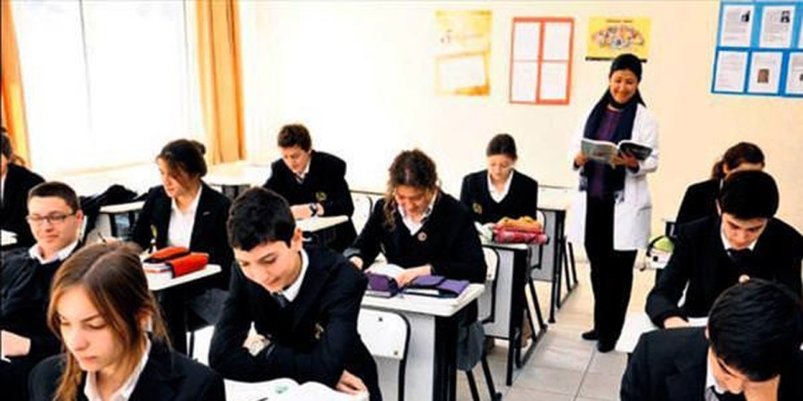
HIGH SCHOOL EDUCATION
High school education is compulsory in Turkey since 2012. Students aged fourteen to eighteen go to high school. In Sultangazi we have general and vocational-technical high schools that provide four years education.

Slide 13
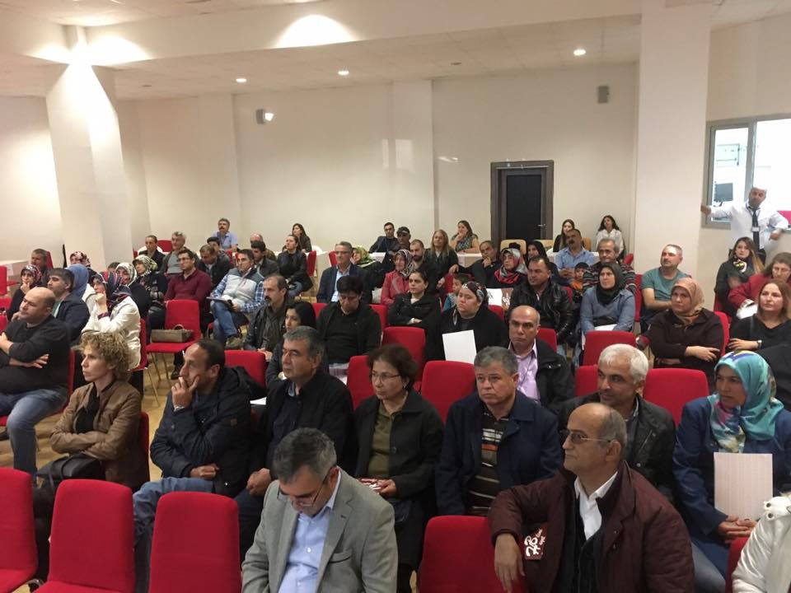
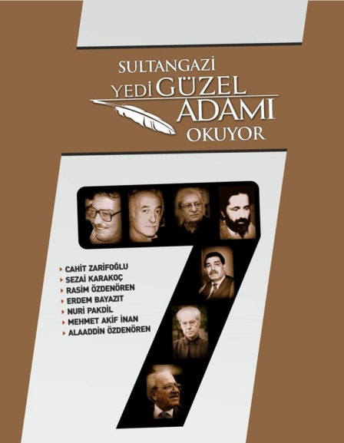
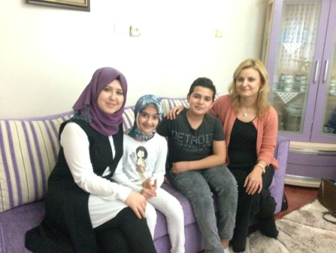
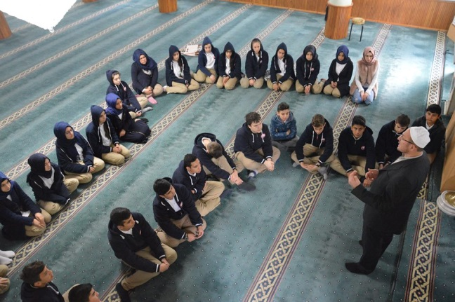
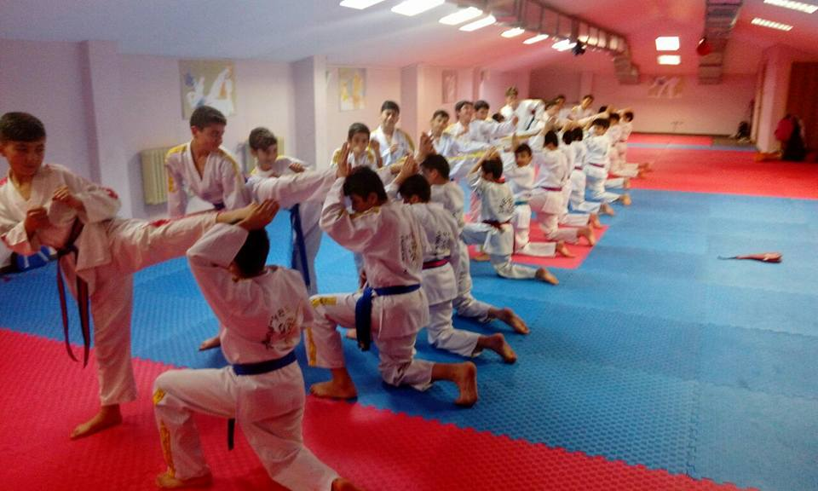
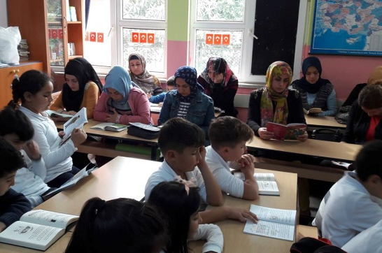
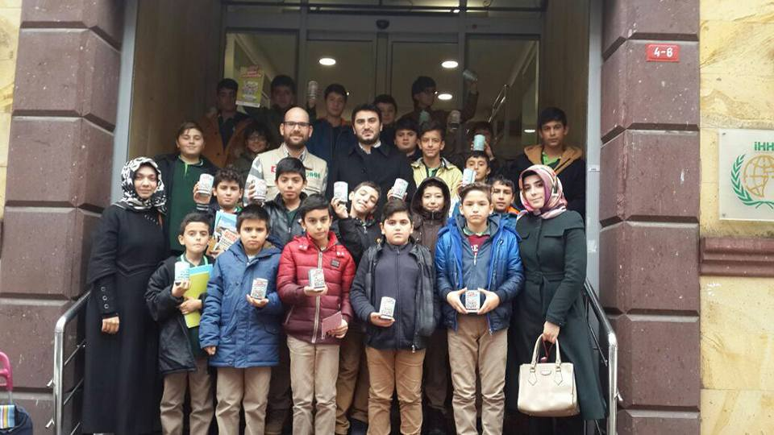
OUR PROJECTS

Slide 14
ORPHAN BROTHER
With this project, which has been implemented in our district since 2014, the importance of helping one another and solidarity has been taught to our children. Students help orphan children from different countries. It continues in 2019-2020 academic year.

Slide 15
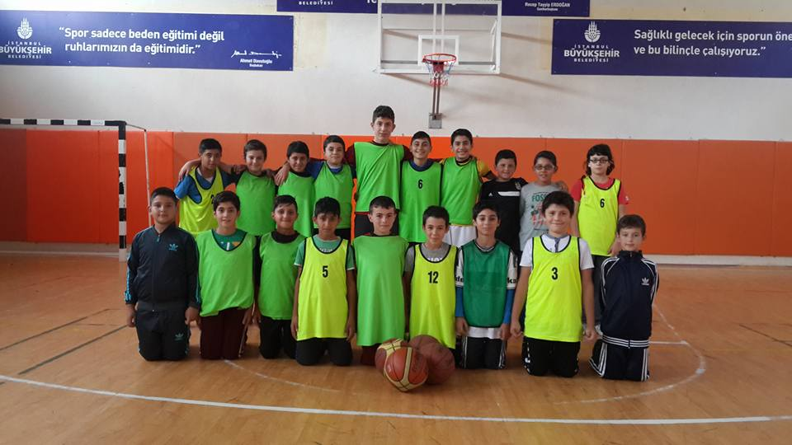
LET OUR FUTURE GROW UP WITH SPORT
In order to protect our students from harmful habits by directing them to sports and to ensure their physical and mental development, a protocol was signed between Istanbul Metropolitan Municipality Sports Club, National Education Directorate, Police Department and Sultangazi Municipality with a target population of 100.000 students.

Slide 16

MY TEACHER GUEST
The main aim of the project is to strengthen the cooperation with the families of the students at the primary and secondary level through family visits, to provide educational cooperation between the school and the family, to increase the academic achievement of the students as well as to educate them as individuals who are respectful to the values of society and who have a sense of responsibility and morality.

Slide 17

SCHOOL MOSQUE ENCOUNTERS
Thanks to our project mosques met with children, classrooms met with imams and lecterns met with teachers. Summer Quran courses were opened in schools and summer activities were organized for our students in our schools. Our mosque imams visited the schools in their neighborhood, introduced themselves to students and invited them to the mosque. Book reading rings were created in our mosques and our students started to read regularly in mosques.

Slide 18
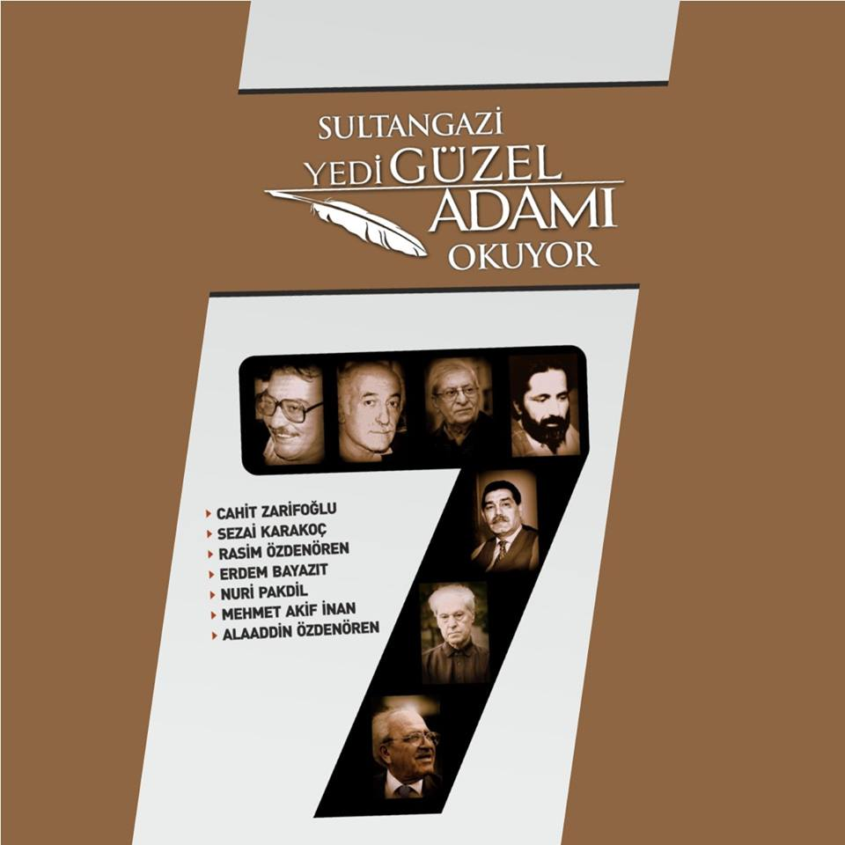
SULTANGAZI READS 7 BEAUTIFUL MEN
Our project has been implemented since 2015 with the aim of introducing important civilization engineer writers to new generations and educating new generations willing to walk on their path. With this project, 4 author meetings were held.

Slide 19
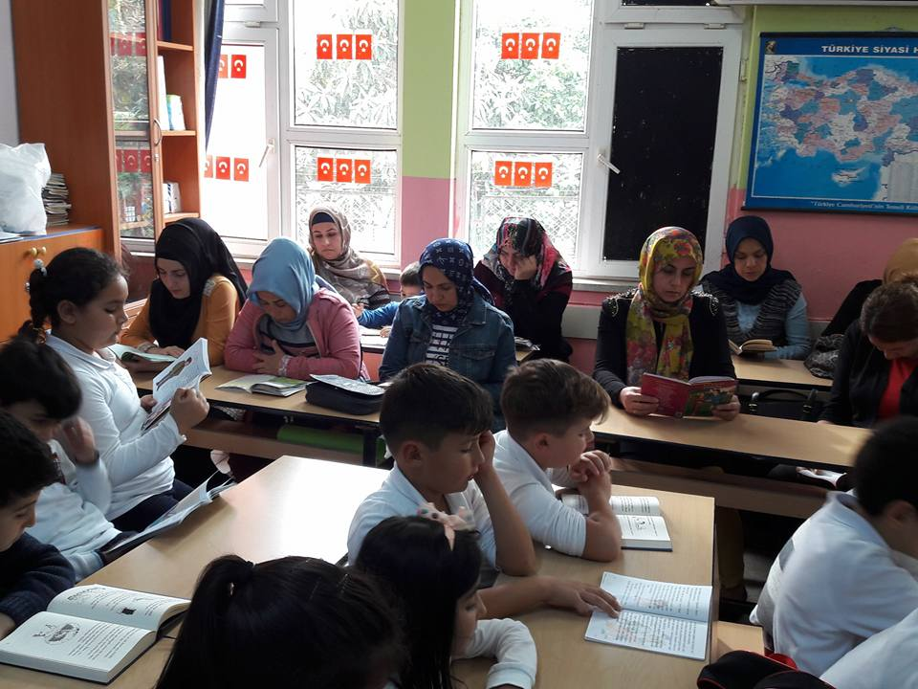
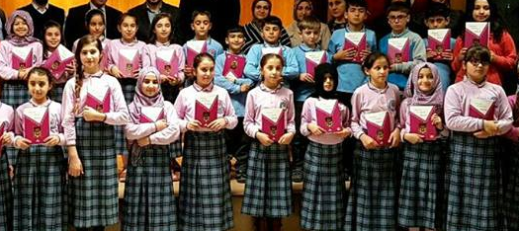
I’M READING BOOK WITH MY FAMILY
Within the scope of the project, families gather once a week at previously determined hour and read a chapter from the book titled ‘Ethics in 52 Lessons with My Family’ and talk about that chapter. The teachers in charge follow the project.

Slide 20
PARENT TRAINING PROGRAMS
With the principle ‘training starts in the family first’, we set out parent training programs with expert trainers and psychologists. With this project, parents read books and play an active role in the learning process of the students.

Slide 21
(ERASMUS +) PROJECTS CONDUCTED BY SCHOOLS IN SULTANGAZI
 | NAME OF SCHOOL | NAME OF THE PROJECT
1 | CEBECI SULTANCIFTLIGI PRIMARY SCHOOL | DEVELOPING LITERACY AND LANGUAGE SKILLS OF STUDENTS | 1
2 | HUSEYIN ERSU PRIMARY SCHOOL | INCLUSIVE STRATEGIES | 1
3 | SULTANGAZI ATATURK VOCATIONAL AND TECHNICAL HIGH SCHOOL | MOBILE APPS INTO EDUCATION INTEGRATING TECHNOLOGY IN THE TEACHING PROCESS PATH TOWARDS BUILDING 21st CENTURY SKILLS EUROPE ON SEVEN HILLS HOW TO USE GOOGLE TOOLS AND MOBILE APPS IN THE EDUCATION EFFECTIVELY | 4
4 | GAZI VOCATIONAL AND TECHNICAL HIGH SCHOOL | CONTRIBUTION TO THE SOLUTION OF UNEMPLOYMENT PROBLEM BY IMPROVING THE QUALIFICATIONS OF VOCATIONAL EDUCATION STUDENTS | 1
5 | HACI AYŞE ATES HIGH SCHOOL | INNOVATIVE MATHS TEACHING | 1
6 | SAIR ABAY KONANBAY HIGH SCHOOL | WATCH, LEARN, ACT | 1
SIX SCHOOLS / NINE PROJECTS

Slide 22

THANK YOU

