Slide 1
Old age & Youth
Prepare and hold an exhibition about Old age & Youth

Slide 2
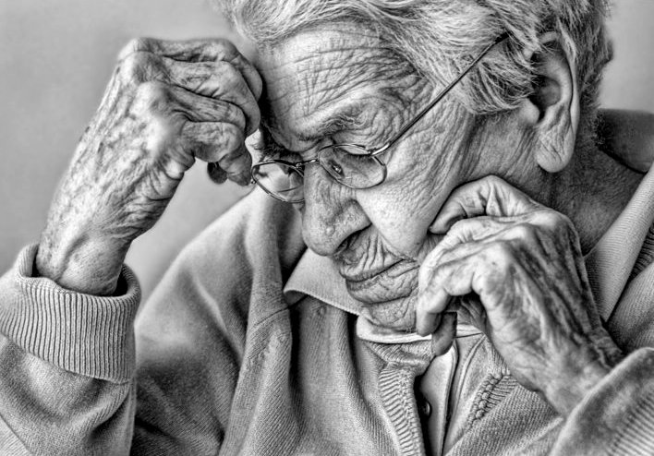

Slide 3
Create an exhibition about “Old age & Youth”
Material: Copies of the photograph of the elderly person
Other Material: Old magazines and newspapers; stationery
Group: Four +
Level: Intermediate and Higher
Notes:
Group is just an iindication

Slide 4
Task 1: make a list, with antonyms
Show participants the photo and ask them to brainstorm all the words that come into their heads when they look at the photo – someone writes all the words up in one column.
The group then thinks of all the opposites they can to the words they have written – someone writes this up in a second column.
Make sure the words ‘young’ and ‘old’ are clearly visible.

Slide 5
Task 2: select the pictures
Divide the group into two subgroups (not according to ages !) and label them either ‘old’ or ‘young’.
Give the groups a selection of magazines and newspapers.
Ask the participants to pick out a picture which they think relates to their topic, i.e. old or young.
Encourage them to discuss with each other why they have chosen those pictures.

Slide 6
Task 3: Posters and exhibition
Participants put their pictures onto a poster and display the posters.
Half the participants walk around the exhibition while the other half stay by their posters and explain why they chose the pictures.
After a while, swap the groups over so the other half has a chance to walk around the exhibition.

Slide 7
Task 4: Prejudices
The group can reflect upon the words they chose at the beginning and discuss what they feel are prejudices surrounding the young and old: do people have any first-hand experiences of these prejudices ?

Slide 8
Variation:
This can be adapted to lower levels where the language input would be more in the nature of single items of vocabulary and simple constructions.

