Slide 1
Social Services
Present a case history of a person to Social Services

Slide 2
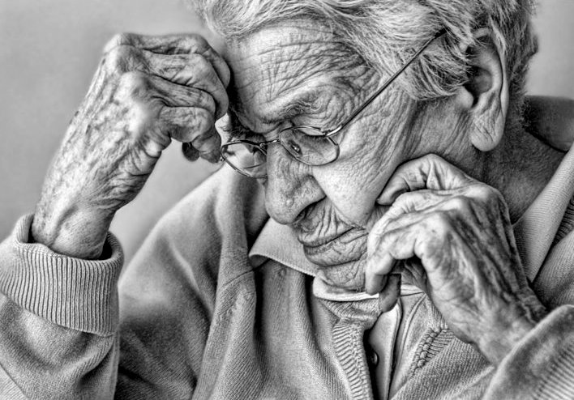

Slide 3
Material: Copies of the photograph of the elderly person
Other Material: Stationery
Group: Eight +
Level: All levels including mixed

Slide 4
Task 1: Describe the person
Either as a whole group, or in smaller sub-groups : Describe the person in the photo ; give him/her a name, social situation, a profession, typical daily activities, preferred diet etc.
Write up the suggestions in note form for everyone to see, or, after about 5 – 10 minutes, ask someone in the group to make notes on the description.

Slide 5
Task 2: Prepare the presentations
Tell the groups that this person has just been referred to Social Services. He/she needs to be rehoused in an old people’s home. The community he/she is going into is different from the one he/she is leaving.
In their presentation, they should make Social Services aware of what will be different for the person entering the new situation and give any advice on helping him/her to adapt.
Each group is going to make a presentation to Social Services describing this person’s situation (way of life, including any religious convictions, diet etc.).
In the sub-groups, participants plan their presentation, making notes only.

Slide 6
Task 3: give the presentation
Groups give their presentations to the rest.
This could be arranged as if the rest of the participants were a committee from Social Services.

Slide 7
Variations:
This could be done with a lower group if more language was provided during the preparation stage: e.g.: he likes/he doesn’t like etc. She is Jewish/Christian/Muslim etc.
Take a different photo for each group, see also next pages for some examples.

Slide 8
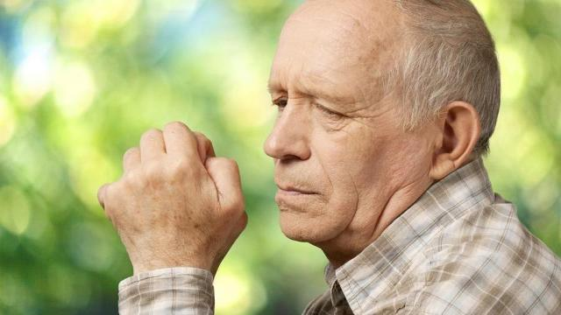
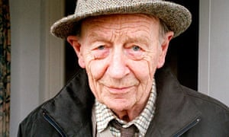
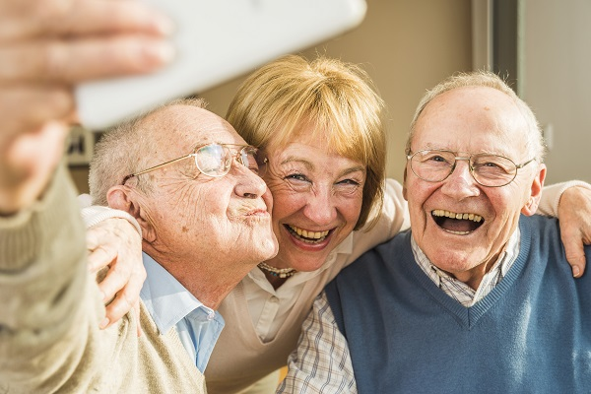
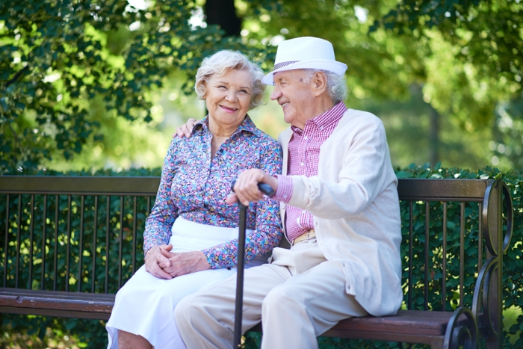

Slide 9
