Slide 1
MOBİL İHO – SECONDARY SCHOOL , bayrampasa İstanbul turkey

Slide 2
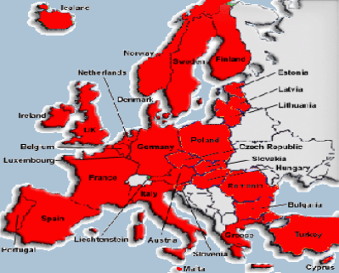
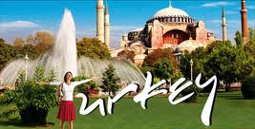

Slide 3
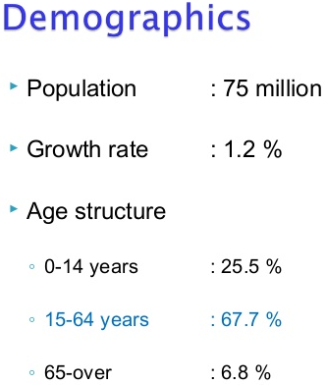
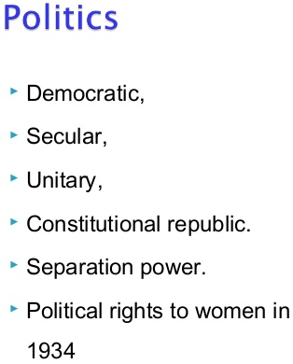
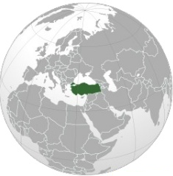

Slide 4
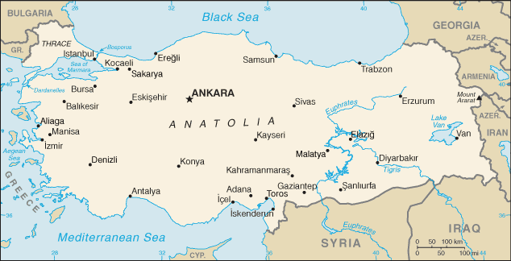
Turkey’s area is 814.578 kilometers squares.

Slide 5
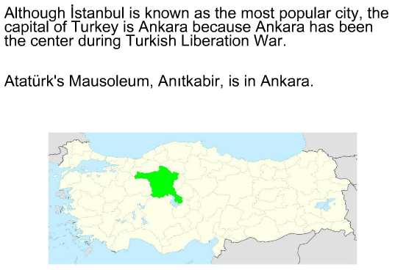

Slide 6
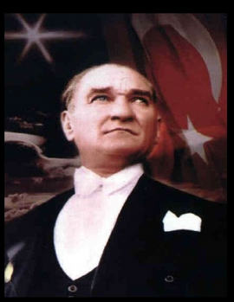

Slide 8
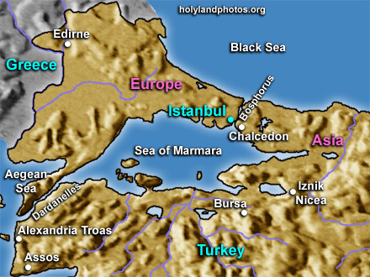

Slide 9
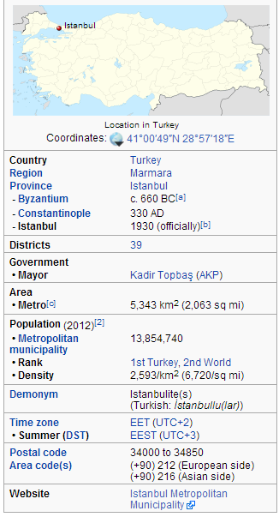
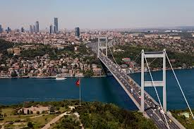
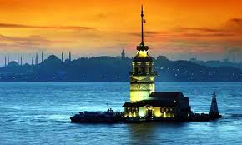
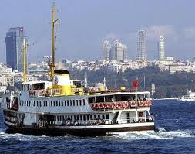
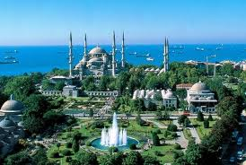
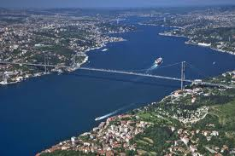
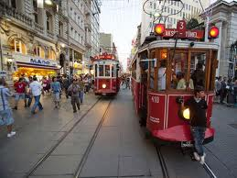
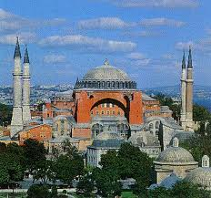
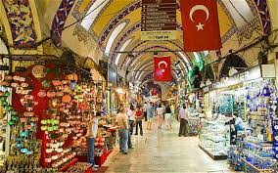

Slide 10
Turkish Education System
General Information

Slide 11
Turkish Education System
General Information
FORMAL EDUCATION
PRESCHOOL
PRIMARY
SECONDARY
HIGHER EDUCATION
SPECIAL EDUCATION

Slide 12
Turkish Education System
General Information
SECONDARY EDUCATION
GENERAL SECONDARY
EDUCATION
VOCATIONAL and TECHNICAL
SECONDARY EDUCATION

Slide 13
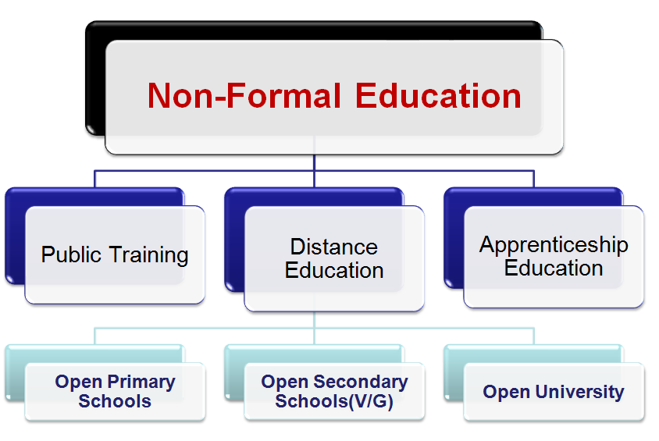
Turkish Education System
General Information

Slide 14
Turkish Education System
General Information

Slide 15
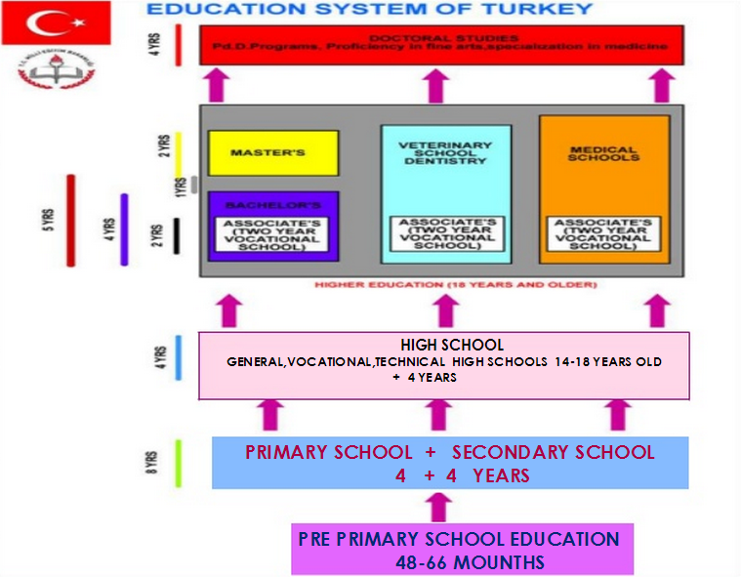

Slide 16
Now, lets take a look at to our topics:

Slide 17
Educational system in Turkey
www.meb.gov.tr

Slide 18
We want to improve ourselves by
participating in this EU project.
We want to learn about good examples and best practices.
Our main goal is to evaluate our educational practices through comparing them with the experience of the partner countries.
We would like to improve the teaching process by using best practices, such as new lesson plans and materials from the Toolkit.

Slide 19
THANK YOU VERY MUCH
for your attention and interest in us!
Serkan ARSLANTAŞ
0090 505 875 95 08
serkanarslantash@hotmail.com
Serkan TEKGÜZEL
0090 532 343 88 43
stekguzel@gmail.com

