Slide 1
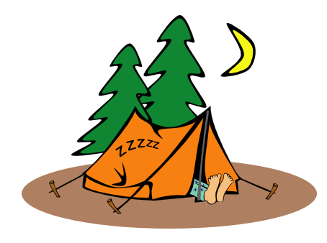
My teacher gave us a task to have more outdoor activities.

Slide 2
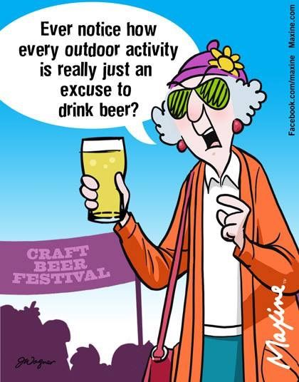
We
can find
how to motivate teachers

Slide 3
Sofia, Bulgaria, 16-18 May 2019

Slide 4
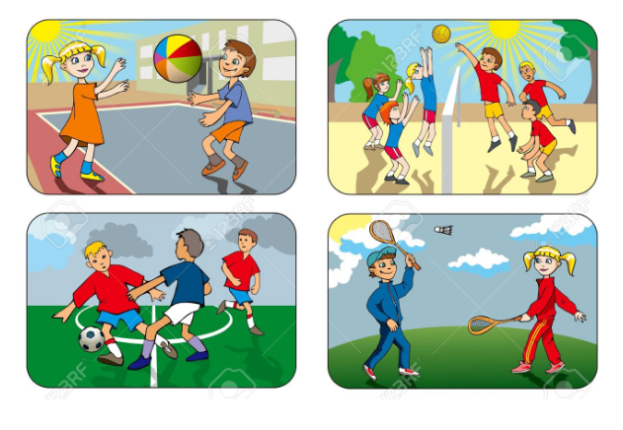
Play not only teaches critical life skills such as resilience, team work and creativity,
Outdoor learning improves children’s health, engages them with learning and leads to a greater connection with nature.
Paradise Bay Hotel, Malta, 20-27 June 2019
Erasmus+ 2018-1-BG01-KA201-047998
Notes:
Play not only teaches critical life skills such as resilience, teamwork and creativity, Outdoor learning improves children’s health, engages them with learning and leads to a greater connection with nature.but is central to children’s enjoyment of childhood.
It’s easy to get involved and there is something everyone can do!

Slide 5
It’s easy to get involved and there is something everyone can do!
Paradise Bay Hotel, Malta, 20-27 June 2019
Erasmus+ 2018-1-BG01-KA201-047998

Slide 6
Paradise Bay Hotel, Malta, 20-27 June 2019
Erasmus+ 2018-1-BG01-KA201-047998

Slide 7
The ICT tools and the outdoor activities
How to create your own Scavenger/Treasure hunt game
C1: Short-term join staff training event
Paradise Bay Hotel, Malta, 20-27 June 2019
Erasmus+ 2018-1-BG01-KA201-047998

Slide 8
A treasure hunt is one of many different types of games for players who try to find hidden objects or places by following a series of clues.
A scavenger hunt is a party game in which the organizers prepare a list defining specific items, which the participants seek to gather or complete all items on the list, usually without purchasing them. Usually participants work in small teams, although the rules may allow individuals to participate.
C1: Short-term join staff training event
Paradise Bay Hotel, Malta, 20-27 June 2019
Erasmus+ 2018-1-BG01-KA201-047998

Slide 9
Other …
H5P Interactive movie
Scribble Map
H5P Virtual Tour (360)
Paradise Bay Hotel, Malta, 20-27 June 2019
Erasmus+ 2018-1-BG01-KA201-047998

Slide 10
After attending the Workshop B you know how to create your own Google maps.
In this workshop the participants will learn about another tool - Scribble Map.
Why Scribble Map?
Scribble Maps is the quick and easy way to create and share custom maps, even without an account!
That is why this App is easy to use with younger students who don't have Google account and can't use MyGoogleMap application.
Scribble Map
Paradise Bay Hotel, Malta, 20-27 June 2019
Erasmus+ 2018-1-BG01-KA201-047998

Slide 11
Examples:
Create in collaboration with your project partners a map - My way to School. Take photos, record videos and make researches about the landmarks on the road. Then upload all materials on the map.
2. Create an interactive map to present the partners/town/organization
3. Create a map to play an outdoor game (like tresure hunt)
Paradise Bay Hotel, Malta, 20-27 June 2019
Erasmus+ 2018-1-BG01-KA201-047998

Slide 12
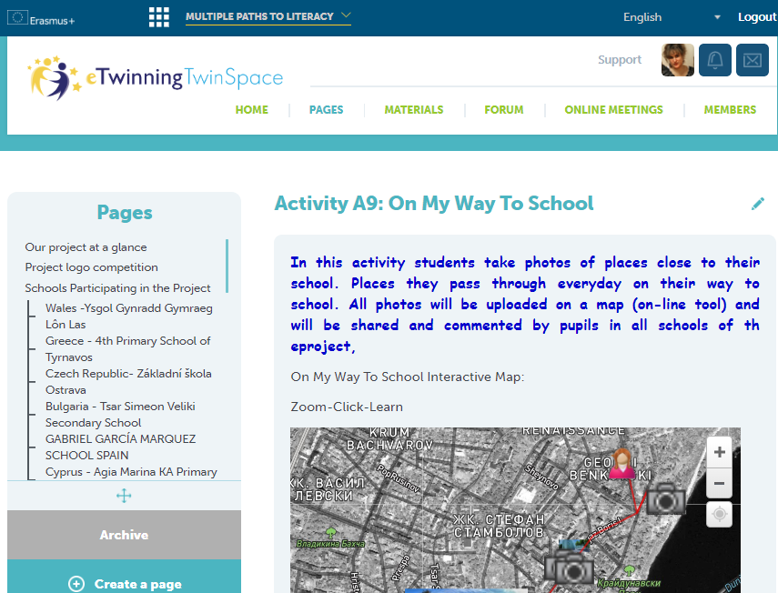
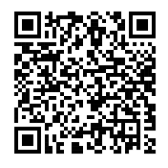
Example 1:
My Way to School
Paradise Bay Hotel, Malta, 20-27 June 2019
Erasmus+ 2018-1-BG01-KA201-047998

Slide 13
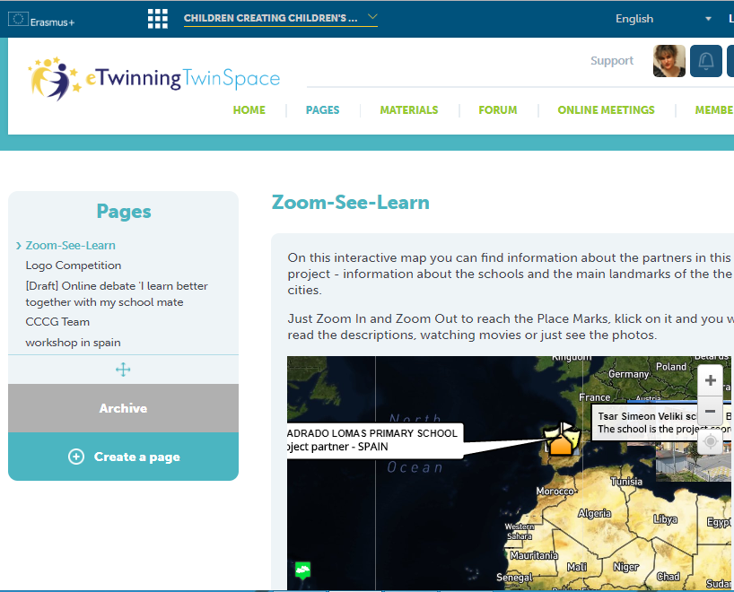
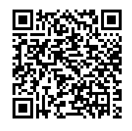
Example 2:
Present your school/city
Paradise Bay Hotel, Malta, 20-27 June 2019
Erasmus+ 2018-1-BG01-KA201-047998

Slide 14
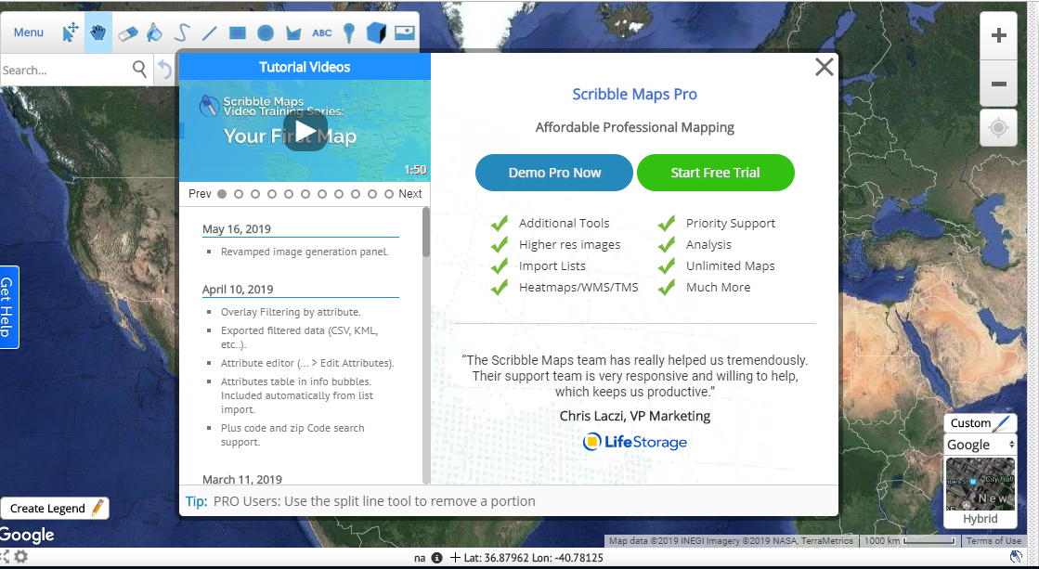
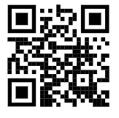
www.scribblemaps.com
Paradise Bay Hotel, Malta, 20-27 June 2019
Erasmus+ 2018-1-BG01-KA201-047998

Slide 15
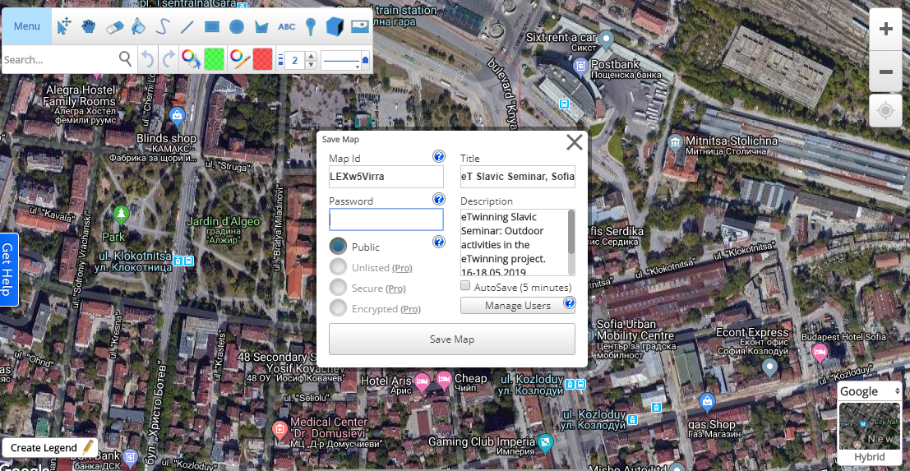
Don’t forget to save your map!
123456

Slide 16
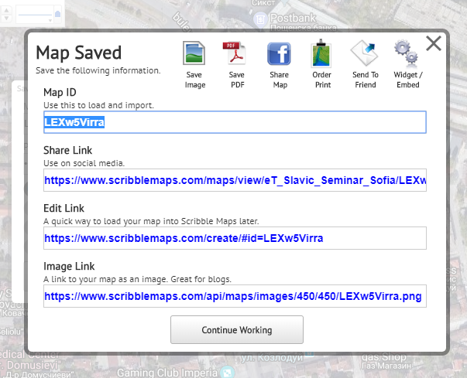

Slide 17
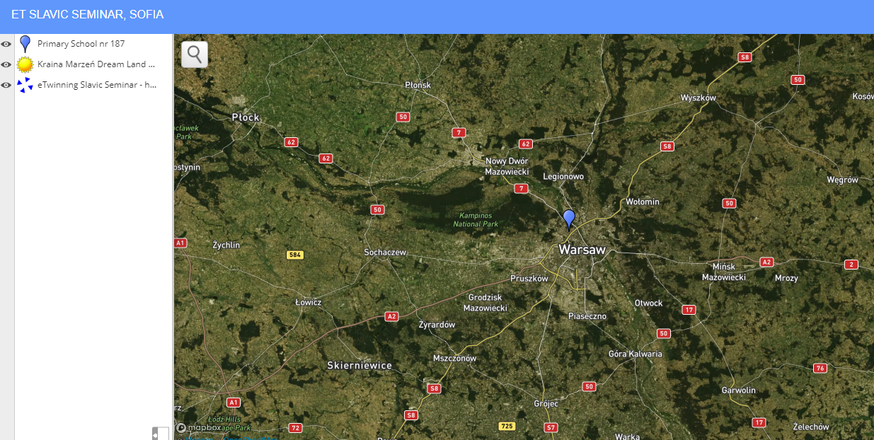
Link to view the Map

Slide 18
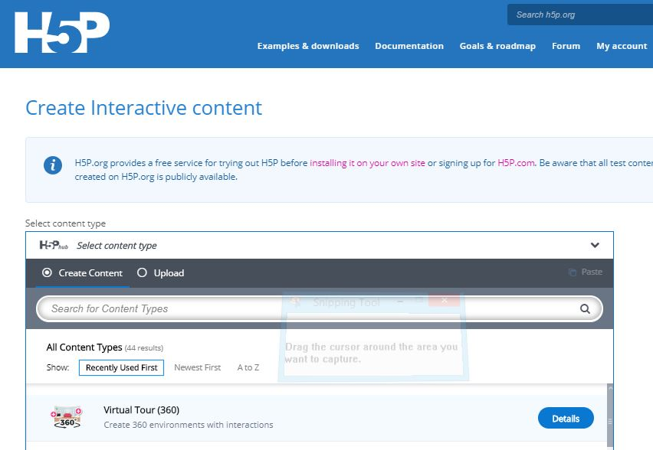
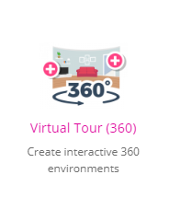
H5P Virtual Tour (360)
Paradise Bay Hotel, Malta, 20-27 June 2019
Erasmus+ 2018-1-BG01-KA201-047998

Slide 19
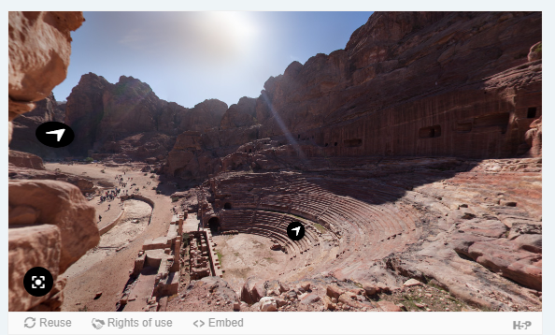
Click on the photo to see the example
Paradise Bay Hotel, Malta, 20-27 June 2019
Erasmus+ 2018-1-BG01-KA201-047998

Slide 20
H5P Interactive movie
Paradise Bay Hotel, Malta, 20-27 June 2019
Erasmus+ 2018-1-BG01-KA201-047998

Slide 21
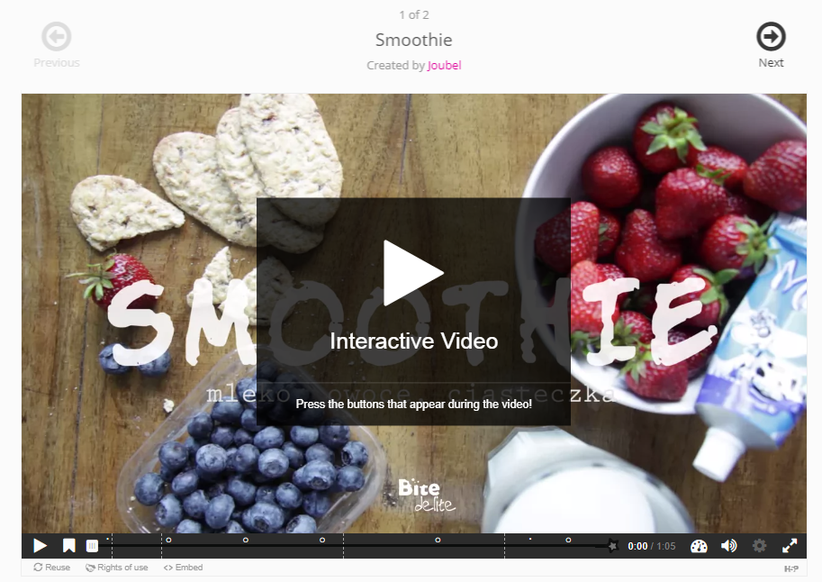
Click on the photo to see the example
Paradise Bay Hotel, Malta, 20-27 June 2019
Erasmus+ 2018-1-BG01-KA201-047998

Slide 22
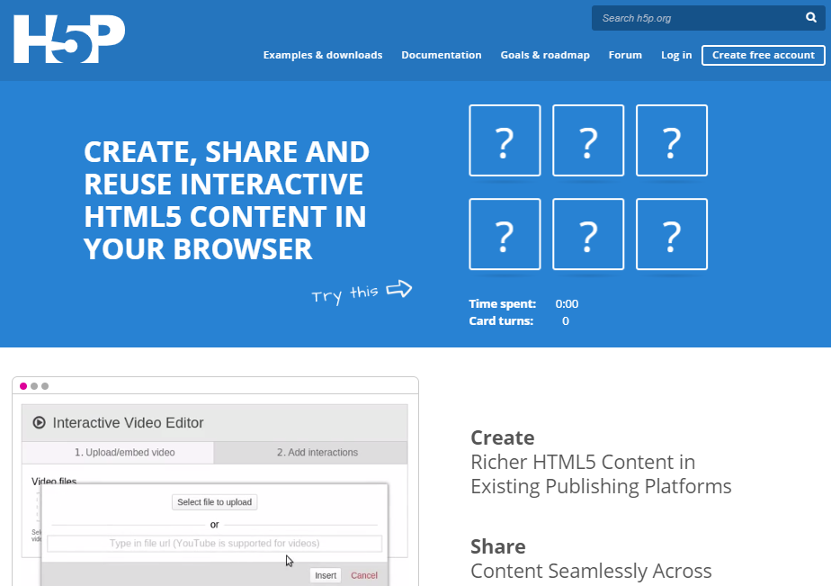
1. Log In (Create an account if you don’t have one)
Paradise Bay Hotel, Malta, 20-27 June 2019
Erasmus+ 2018-1-BG01-KA201-047998

Slide 23
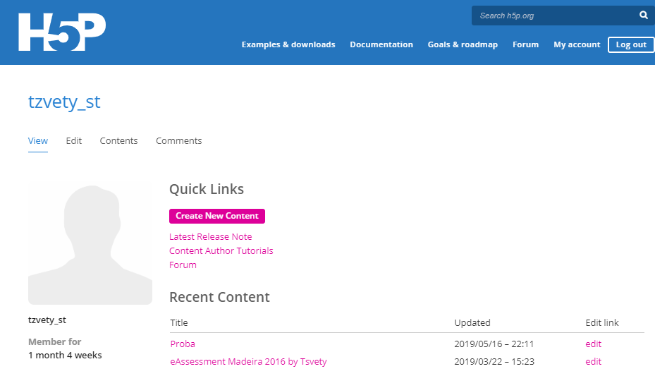
Click on My account
To Create content click on Create New Content
Paradise Bay Hotel, Malta, 20-27 June 2019
Erasmus+ 2018-1-BG01-KA201-047998

Slide 24
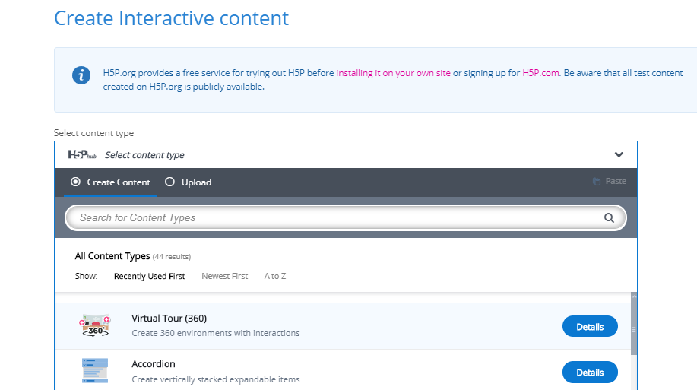
4. Select the content type by clicking on the icon.
Paradise Bay Hotel, Malta, 20-27 June 2019
Erasmus+ 2018-1-BG01-KA201-047998

Slide 25
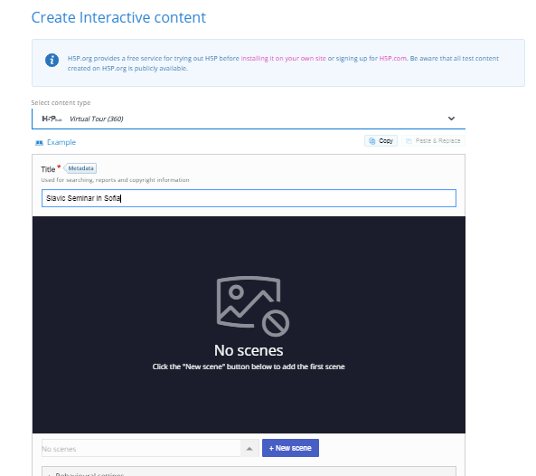
Type the Title
Click on Add New scene
Paradise Bay Hotel, Malta, 20-27 June 2019
Erasmus+ 2018-1-BG01-KA201-047998
16-18 May 2019

Slide 26
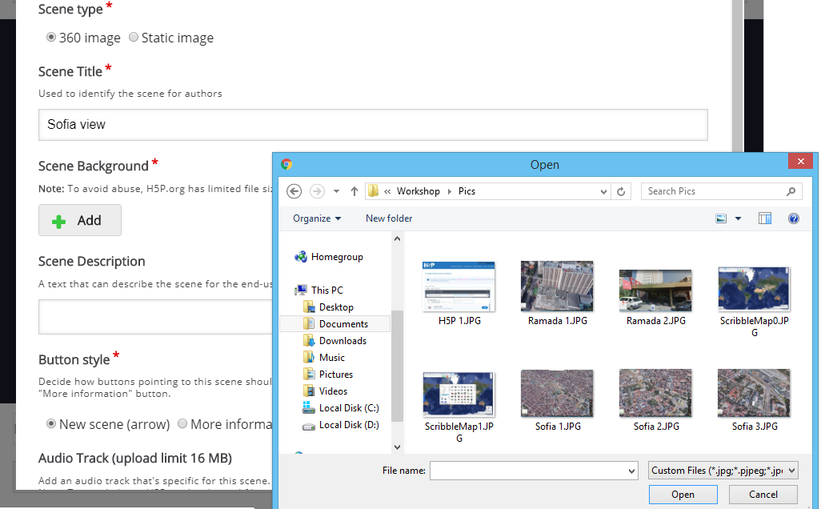
16-18 May 2019

Slide 27
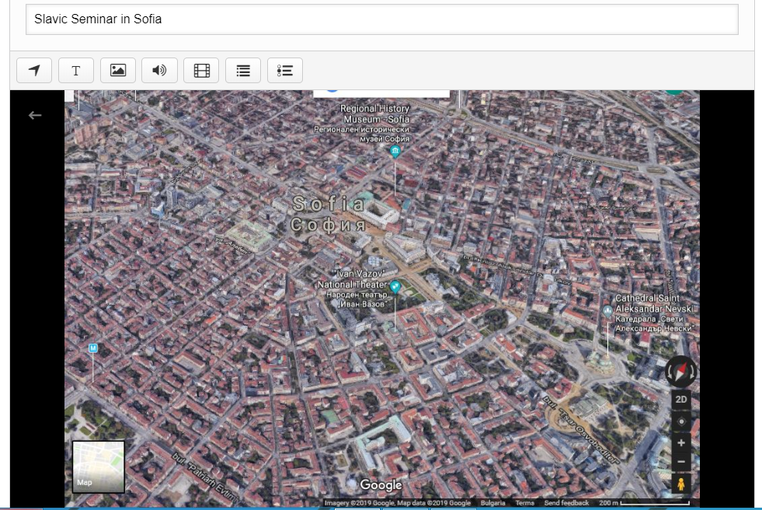
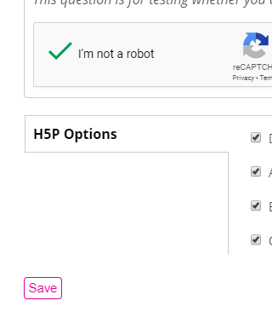

Slide 28
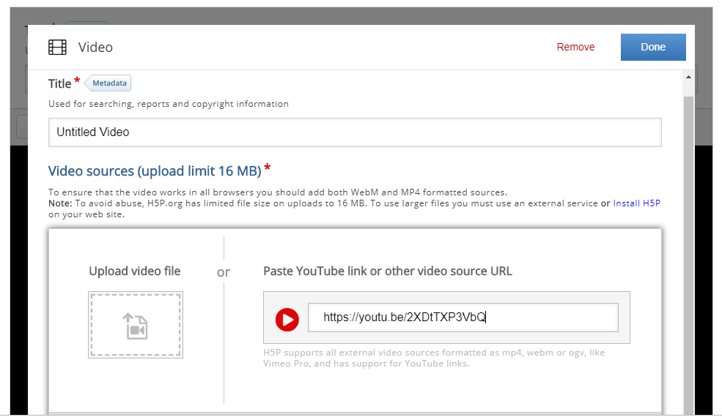

Slide 29
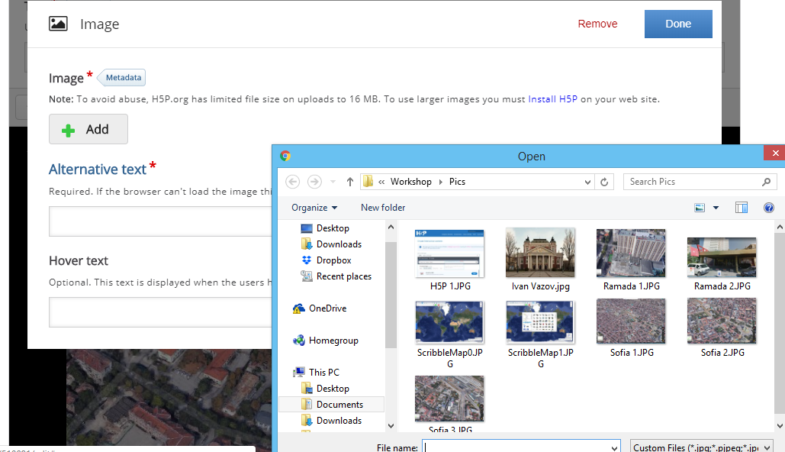

Slide 30
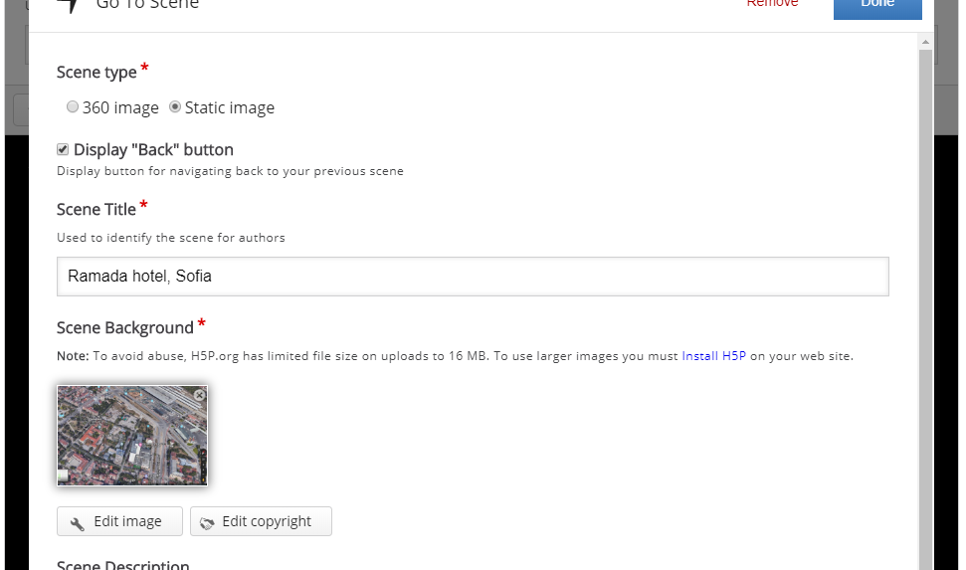

Slide 31
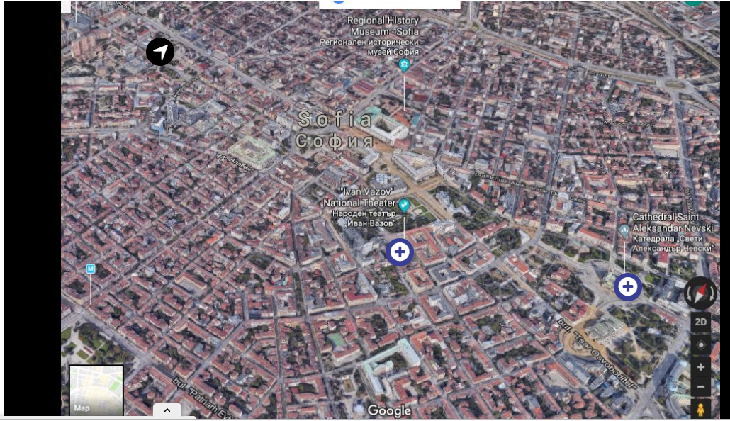

Slide 32
Other …
Paradise Bay Hotel, Malta, 20-27 June 2019
Erasmus+ 2018-1-BG01-KA201-047998

Slide 33
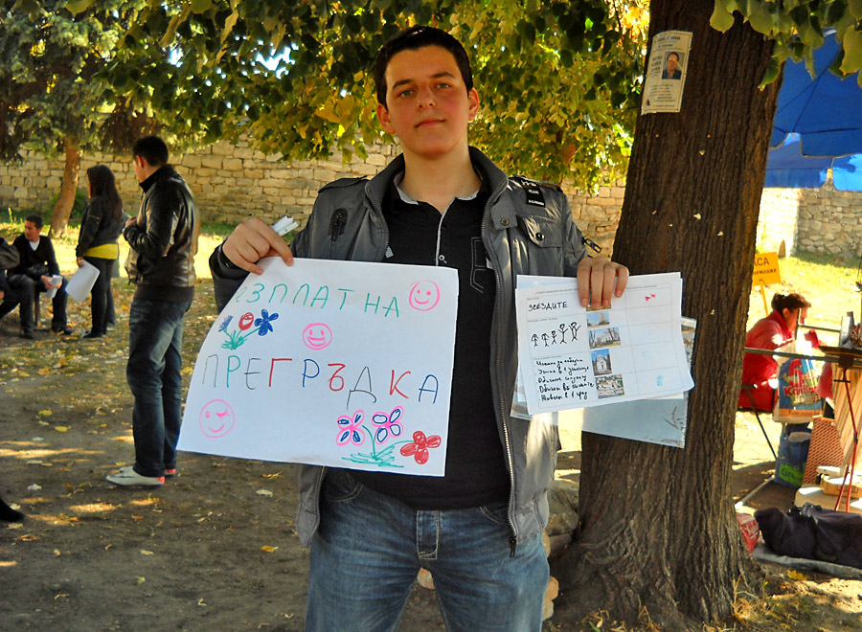
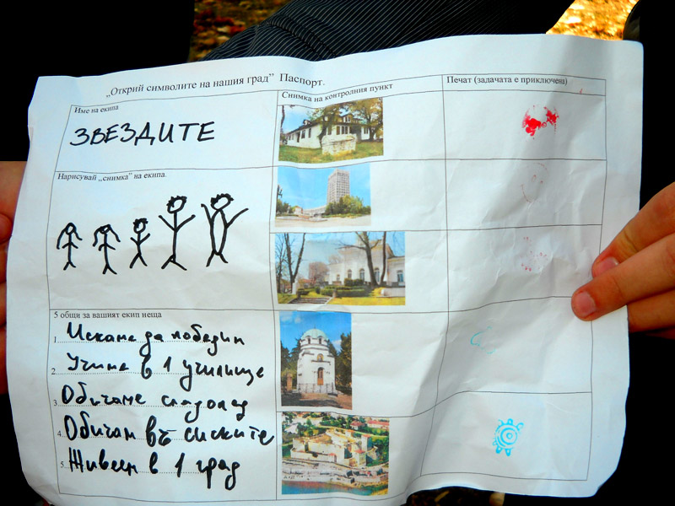
Paradise Bay Hotel, Malta, 20-27 June 2019
Erasmus+ 2018-1-BG01-KA201-047998

Slide 34
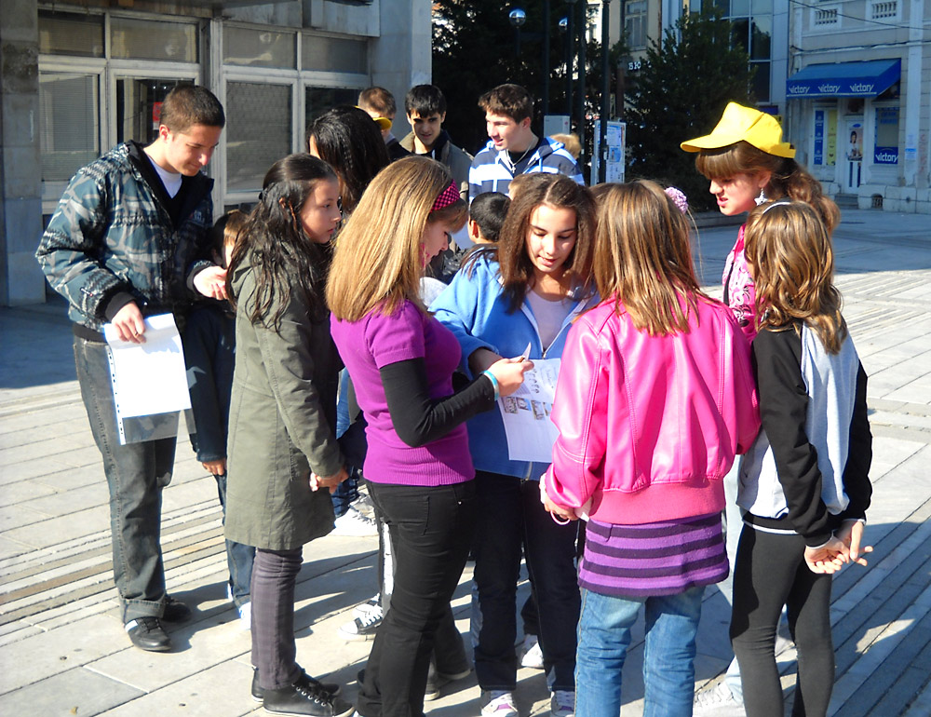
Paradise Bay Hotel, Malta, 20-27 June 2019
Erasmus+ 2018-1-BG01-KA201-047998

Slide 35
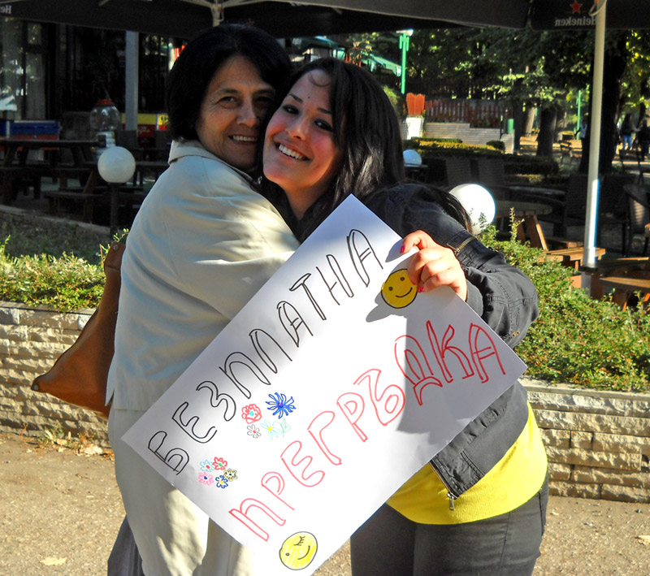
Paradise Bay Hotel, Malta, 20-27 June 2019
Erasmus+ 2018-1-BG01-KA201-047998

Slide 36
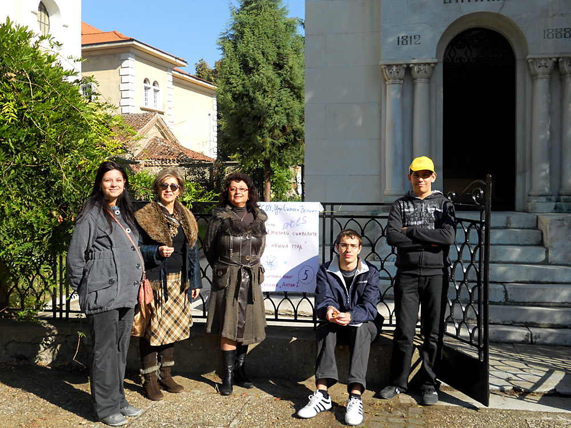
Paradise Bay Hotel, Malta, 20-27 June 2019
Erasmus+ 2018-1-BG01-KA201-047998

Slide 37
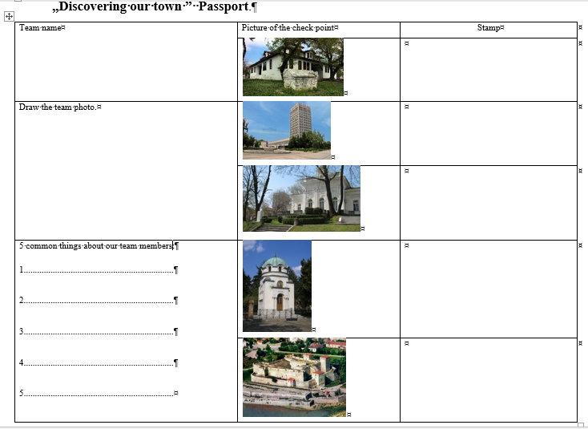
Game Passport
Paradise Bay Hotel, Malta, 20-27 June 2019
Erasmus+ 2018-1-BG01-KA201-047998

Slide 38
The Sunday Task:
Create a scavenger hunt game.
Create an Interactive map/Virtual tour/Interactive video that the students can use to explore Valetta/Comino/Popay Village/Gozo
Use your own photos/videos.
Paradise Bay Hotel, Malta, 20-27 June 2019
Erasmus+ 2018-1-BG01-KA201-047998

Slide 39
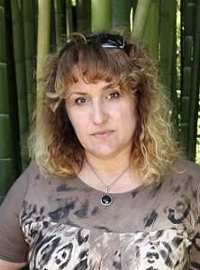
Paradise Bay Hotel, Malta, 20-27 June 2019
Erasmus+ 2018-1-BG01-KA201-047998
tzvety_st@yahoo.com
Tsvetanka Todorova
IT teacher, eTwinning Ambassador for Bulgaria
Tsar Simeon Veliki Seconaday School,
Vidin, Bulgaria

