Slide 1
Role play: suggesting housing options for the elderly person

Slide 2
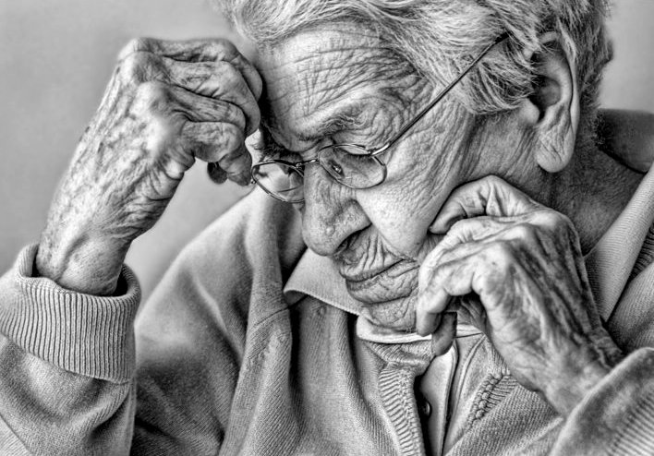

Slide 3
Material: Copies of the photograph of the elderly person
Other Material: Role-cards
Group: Any
Level: Intermediate - Higher

Slide 4
Role Cards (1/3)
Chairman:
You are the chairman at a meeting of people deciding the best housing option for the elderly person.
Relative 1:
You are a relative of the elderly person who thinks that he/she should come and live with you.
Notes:
Chairman decides
Relative 1 want to take him/her

Slide 5
Role Cards (2/3)
Relative 2:
You are a relative of the elderly person who thinks that he/she should remain in his/her own house but should be provided with a full-time carer by Social Services.
Doctor:
You are the elderly person’s doctor. You think that he/she should be put in an old people’s home, paid for partly by Social Services and partly by the family.
Notes:
Relative 2: he/she stays at home with full care
Doctor: in old-people home party paid by family

Slide 6
Role Cards (3/3)
Social Worker:
You are the elderly person’s social worker. You think he/she would prefer to live alone, with a part-time carer visiting daily.
:
Notes:
Social worker: stay alone with part-time carer
The last role card YOU can fill as you like or need.

Slide 7
Task 1: Brainstorm
Brainstorm possible housing options for this person, assuming he/she could no longer live independently.
Make comparisons between different countries : what are the possibilities/common practices for elderly people in this situation ?
Display the list of alternatives.
Notes:
2. This can be done easily in international groups, but perhaps with good preparations also in national class/group.

Slide 8
Task 2: prepare the meeting
Divide participants into subgroups – one group for each role-card.
Distribute the role-cards so that the members of each group have the same roles, e.g. doctors, social workers etc.
Tell the participants that they are going to take part in a meeting with other people to decide the best housing option for the elderly person.
The groups who have to give an opinion brainstorm the arguments for their case. Each group may want to make notes.
Groups of chairpersons can decide how they will chair the meeting, and how they will make a decision. Do they have any criteria which might affect their decision ? E.g. how will the idea be financed ?
The facilitator provides language for persuasive arguing.
Give them 10 to 15 minutes to prepare.
Notes:
Make groups of the roles like doctors, chairmen. And in 10 15 minutes to prepare.

Slide 9
Task 3: the meetings
Divide them into new groups of mixed characters. E.g. a group of 25, and you have 5 roles are divided into 5 meetings of each 5 persons with different role-cards.
Each of the groups has their meeting/discussion.
The facilitator monitors, but does not interact at this stage.
Notes:
Make groups where all roles are inside. And have the meeting

Slide 10
Task 4:
Everybody comes together into one full group.
The chairpersons come to the front of the full group and discuss their decisions. The others may wish to comment, but the chairpersons will be able to compare their discussions and the group can discuss the main arguments.
The facilitator gives some feedback on language used and its effectiveness.

