Slide 1
PARAPROSDOKIANS
To steal ideas from one person is plagiarism. To steal from many is…
Some cause happiness wherever they go. Others, …..
Before you criticize a man, walk a mile in his shoes. That way,….
Marriage is a great institution, but I…

Slide 2
PARAPROSDOKIANS
To steal ideas from one person is plagiarism. To steal from many is research.
Some cause happiness wherever they go. Others, whenever they go.
Before you criticize a man, walk a mile in his shoes. That way, you will be a mile away and he won’t have any shoes.
Marriage is a great institution, but I am not ready for an institution.

Slide 3
Truth and Fact in the Era
of Post-Truth and Alternative Fact

Slide 4
1. What is truth?

Slide 5
Contexts of Truth
Truth in religion and theology – truth and belief;
Truth in philosophy – objective, subjective, empirical, absolute, relative;
Truth in science – mathematics, natural sciences, ethics.

Slide 6
Contexts of Truth (cd)
Truth in history – facts and myths;
Truth in law;
Truth in politics – ideology;
Truth in art and literature;

Slide 7
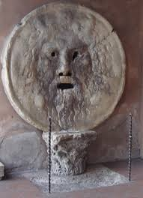
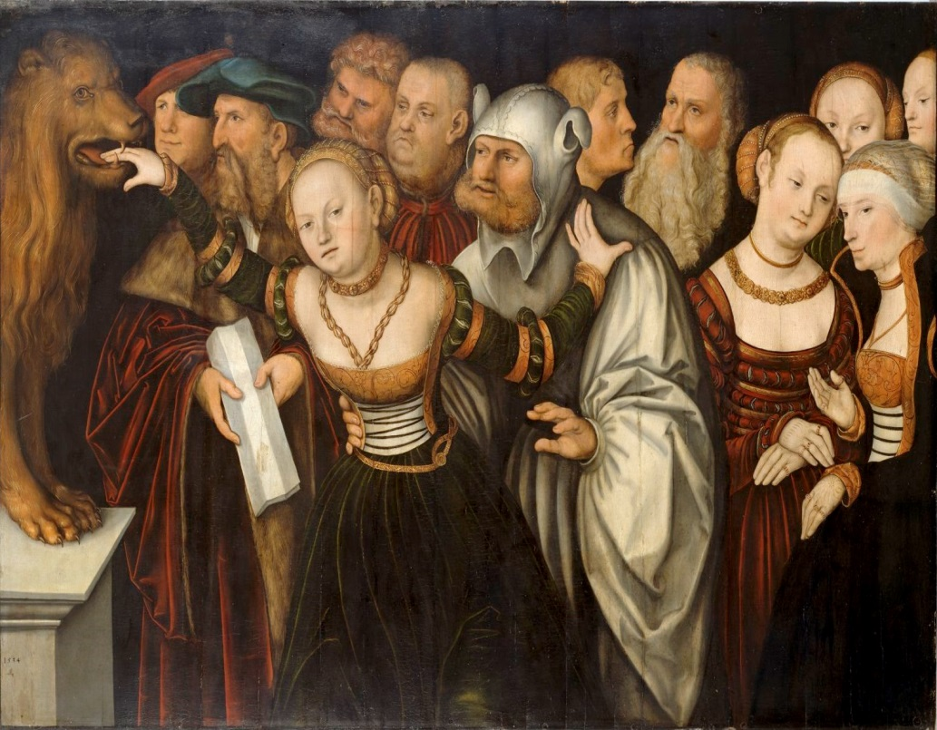
Truth in interpersonal relations
The Mouth of Truth - Rome
The Mouth of Truth - Rome Lucas Cranach - The Mouth of Truth( 1525-27)

Slide 8
Truth and fact
What is a fact? A statement that is true and can be proved by evidence;
How is fact related to truth?
Fact and opinion/speculation;
Fact and value.

Slide 9
Post-Truth

Slide 10
Post-Truth
Definition in Oxford Dictionary in 2016:
Circumstances in which objective facts are less influential in shaping public opinion than appeals to emotion and personal belief.
Social basis – disillusionment, distrust;
Post-truth and the rise of the misinformation industry;
Post-truth and entertainment

Slide 11
Post-truth and information technology - the digital bazaar
Post-truth and conspiracy theories;
Post-truth and Postmodernism

Slide 12
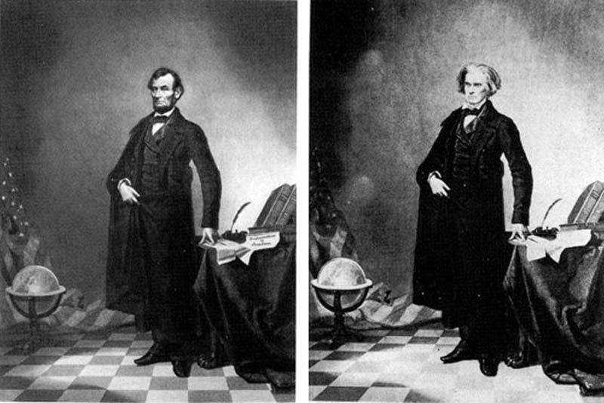
Fake News

Slide 13
Fake News
Government media and independent press;
Citizen journalism;
Propaganda and persuasion;

Slide 14
How to Combat Fake News and Post-Truth
As a biological model suggests, the epidemic of fake news can combatted by a variety of methods, including:
Not deliberately spreading illness(governments and scientific agencies should tell the truth);
Washing of hands or removal of pathogens before they enter the body (curating posts and validating accounts);
Antibiotics (aggressive introduction of truth to combat lies);
Strengthening the immune system (education about how to recognize fake news).
Paul Levinson, Fake News in Real Context, 2017

Slide 15
Vocabulary
Truth, truthful, true, real, honest; genuine, authentic, loyal, faithful, veracious, verifiable;
truth, verity,veracity, reality, authenticity; genuineness,honesty, integrity, loyalty, faithfulness;
Falsity, falsehood, lie, fraud, hoax, deception, sham;
Fake, false, deceptive, mendacious, phony, sham,
Bogus, counterfeit; feigned etc.
Gestalt image

