Slide 4
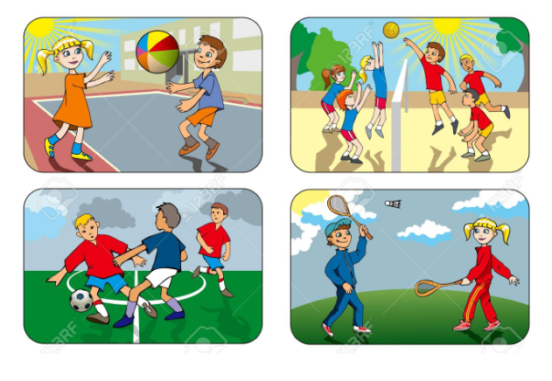
Play not only teaches critical life skills such as resilience, team work and creativity,
Outdoor learning improves children’s health, engages them with learning and leads to a greater connection with nature.
Notes:
Play not only teaches critical life skills such as resilience, teamwork and creativity, Outdoor learning improves children’s health, engages them with learning and leads to a greater connection with nature.but is central to children’s enjoyment of childhood.
It’s easy to get involved and there is something everyone can do!

Slide 5
It’s easy to get involved and there is something everyone can do!

Slide 6
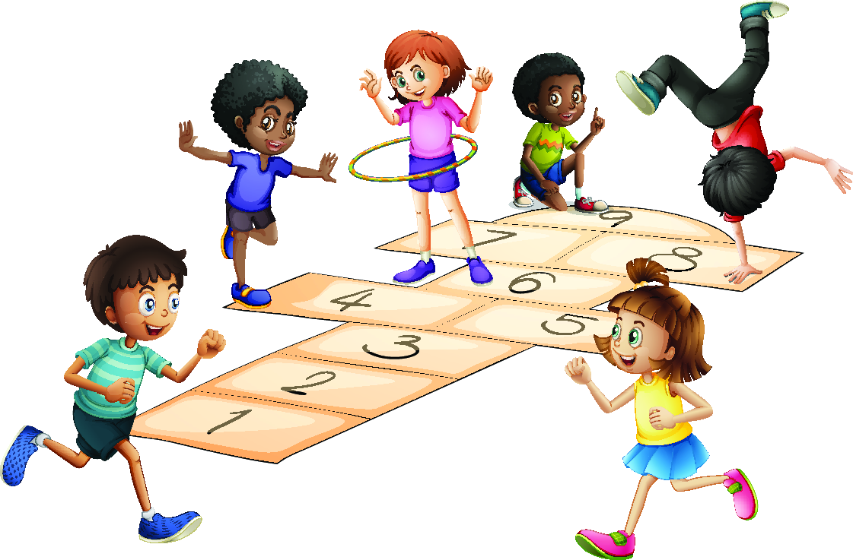
ICT tools for outdoor and classroom activities
22 May 2019

Slide 7
H5P Interactive movie
Scribble Map
H5P Virtual Tour (360)

Slide 8
There is one very good tool to create an interactive map - My Google Maps.
In this workshop the participants will learn about another tool - Scribble Map.
Why Scribble Map?
Scribble Maps is the quick and easy way to create and share custom maps, even without an account!
That is why this App is easy to use with younger students who don't have Google account and can't use MyGoogleMap application.
Scribble Map

Slide 9
Examples:
Create in collaboration with your project partners a map - My way to School. Take photos, record videos and make researches about the landmarks on the road. Then upload all materials on the map.
2. Create an interactive map to present the partners/town/organization
3. Create a map to play an outdoor game (like tresure hunt)

Slide 10
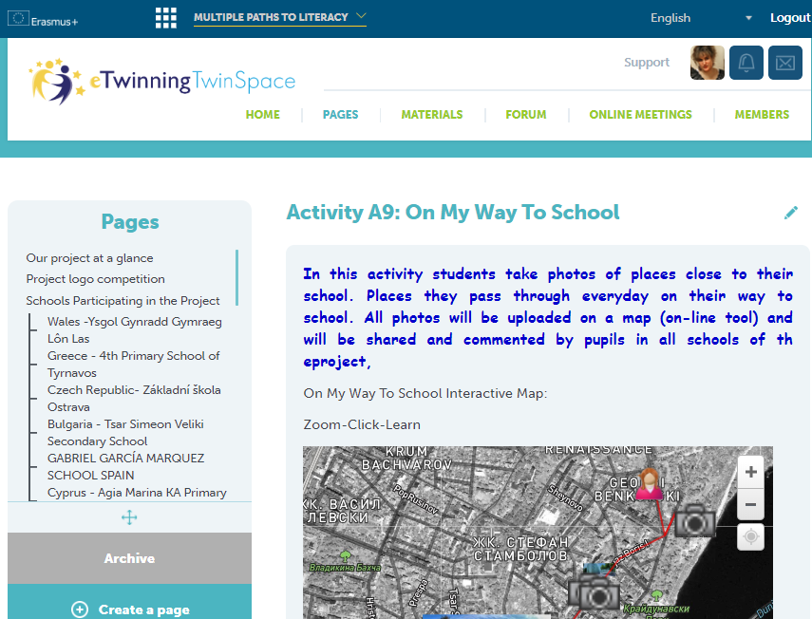
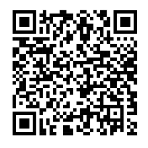
Example 1:
My Way to School

Slide 11
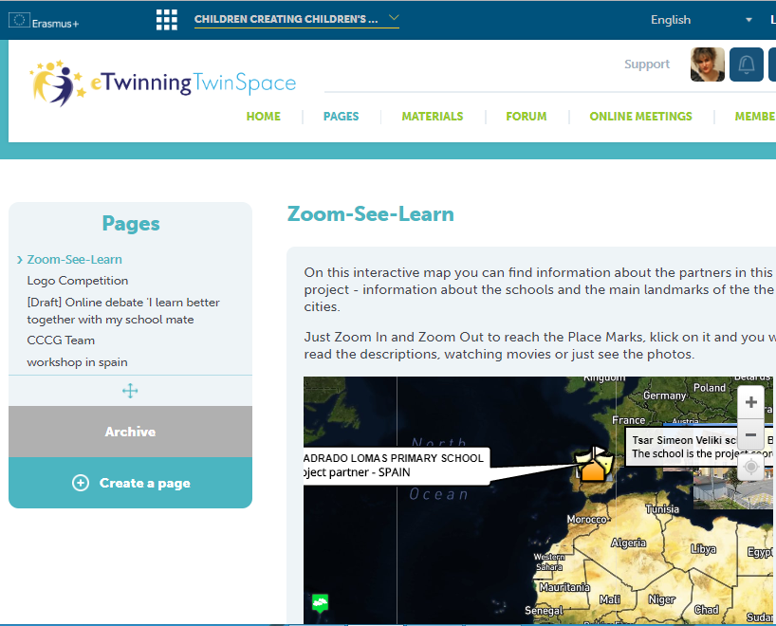
Example 2:
Present your school/city

Slide 12
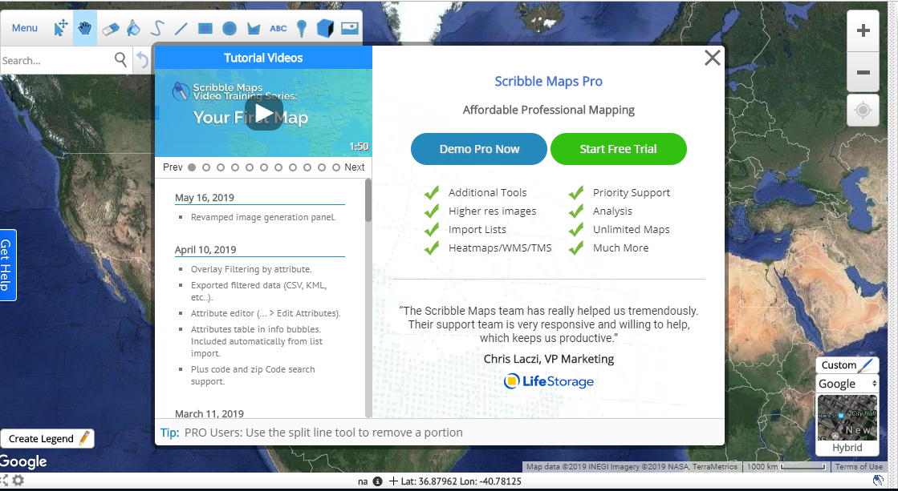
www.scribblemaps.com

Slide 13
Edit Link:
You can find the link in the seminar TwinSpace
Homework:
Upload information about your school/organisation/city/country
During the Guided walk in Sofia take photos/video and add them to the map.

Slide 14
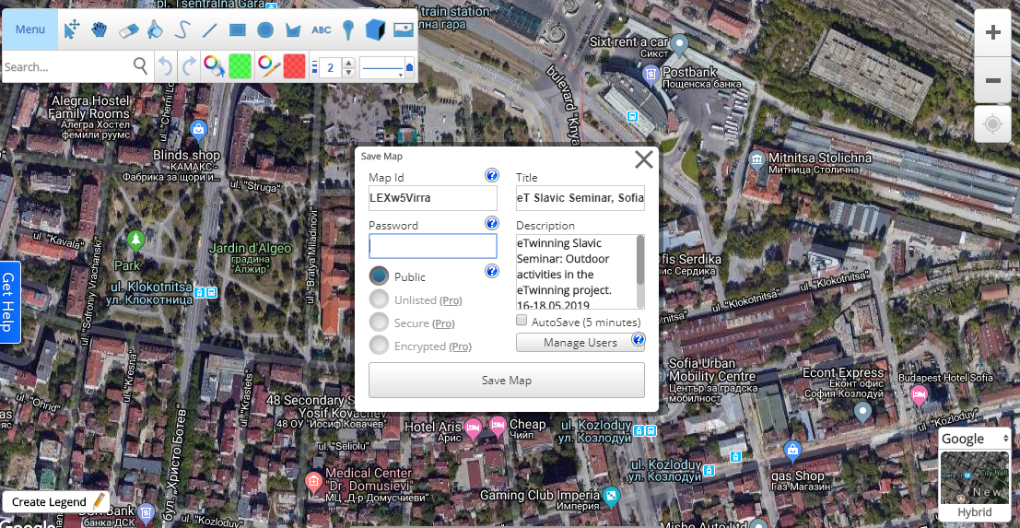
Link to view the Map
Don’t forget to save your map!
123456

Slide 15
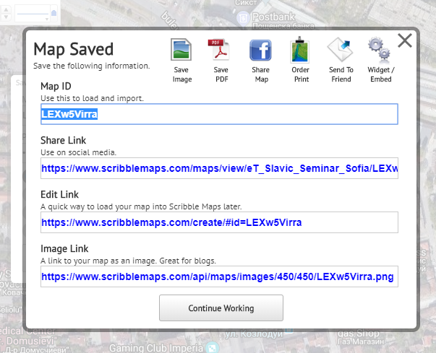

Slide 16
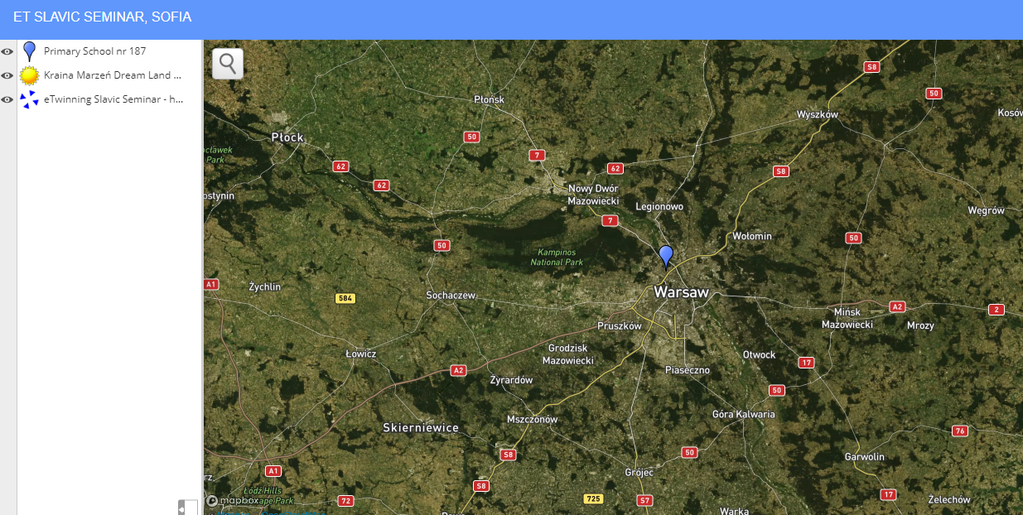
Link to view the Map

Slide 17
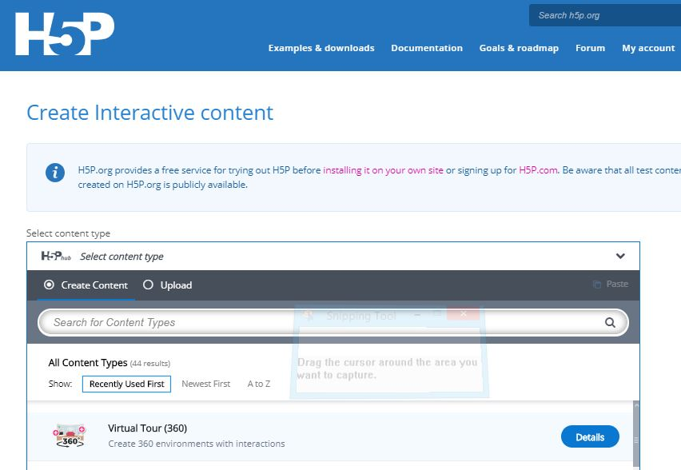
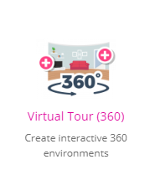
H5P Virtual Tour (360)

Slide 18
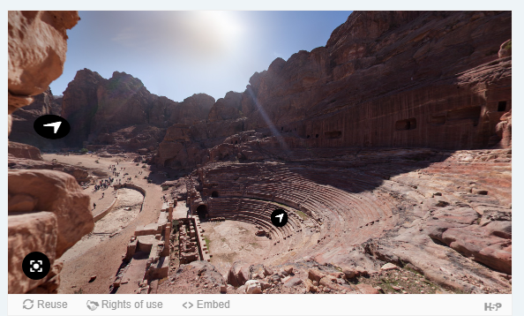
Click on the photo to see the example

Slide 19
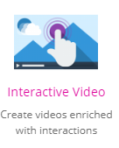
H5P Interactive movie

Slide 20
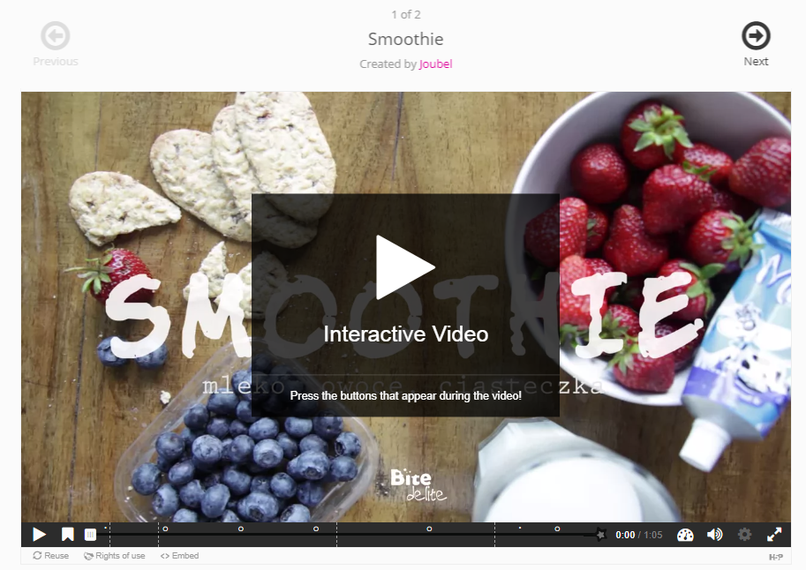
Click on the photo to see the example

Slide 21
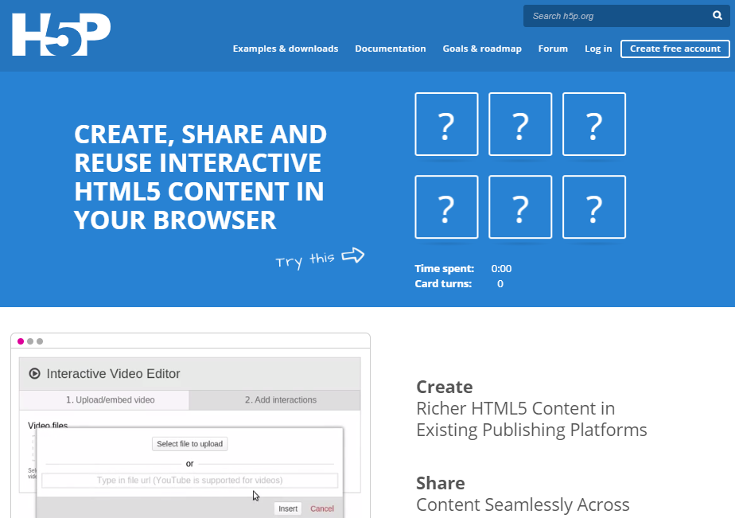
1. Log In (Create an account if you don’t have)

Slide 22
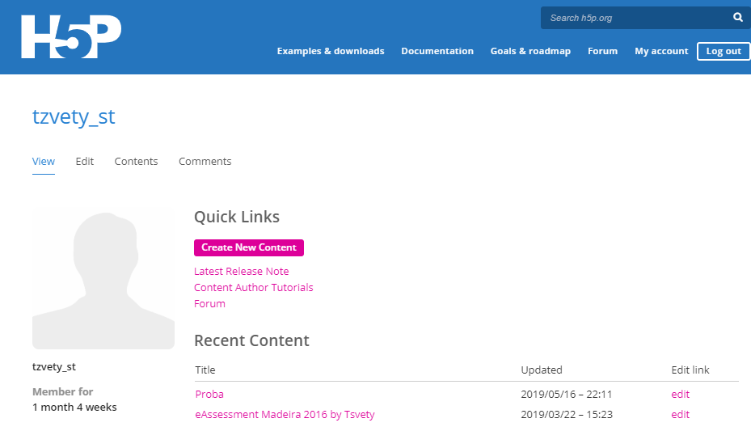
Click on My account
To Create content click on Create New Content

Slide 23
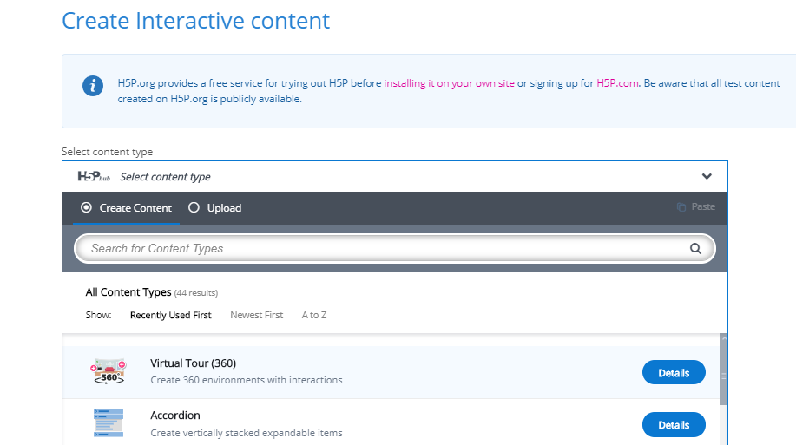
4. Select the content type by clicking on the icon.

Slide 24
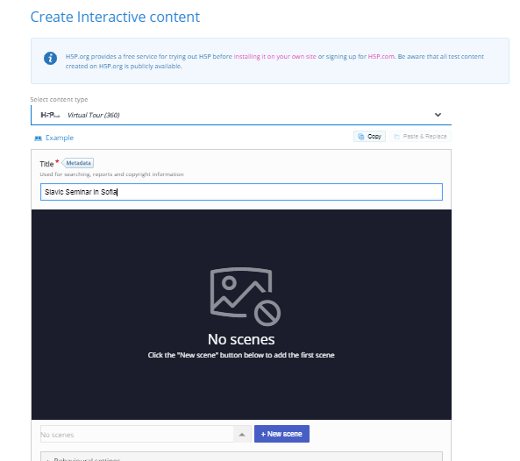
Type the Title
Click on Add New scene
16-18 May 2019

Slide 25
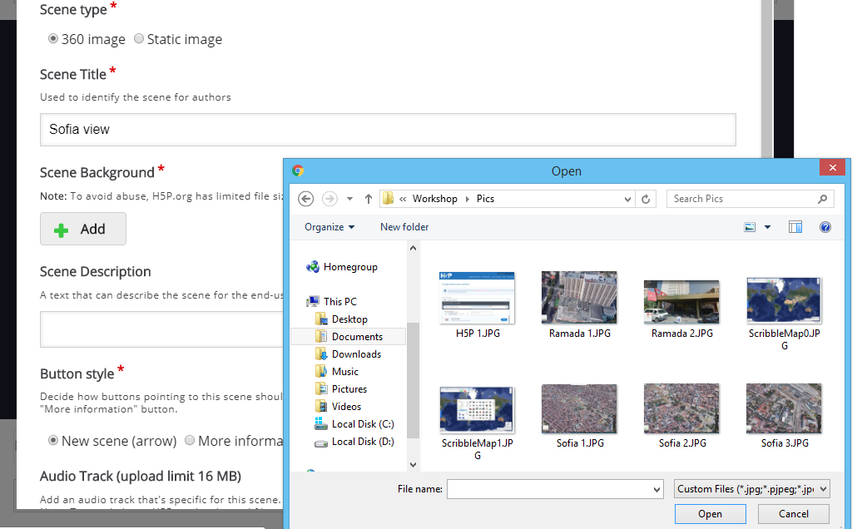
16-18 May 2019

Slide 26
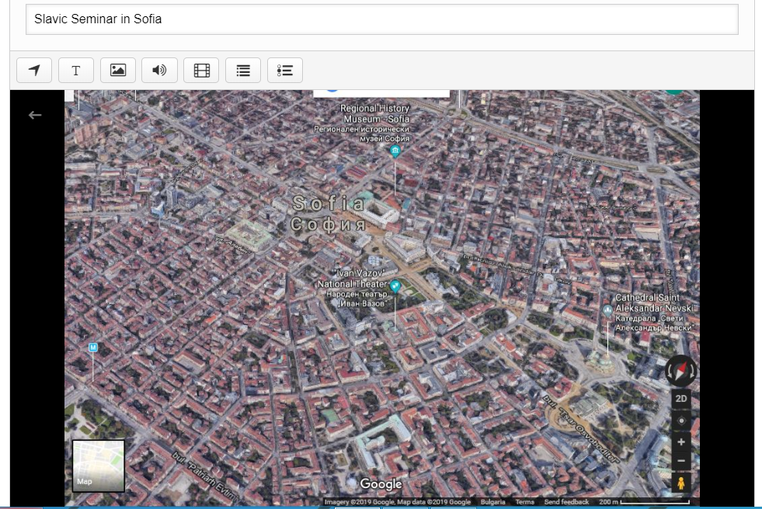
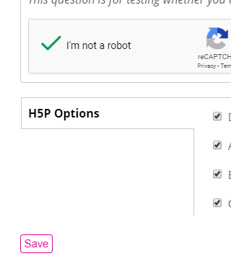

Slide 27
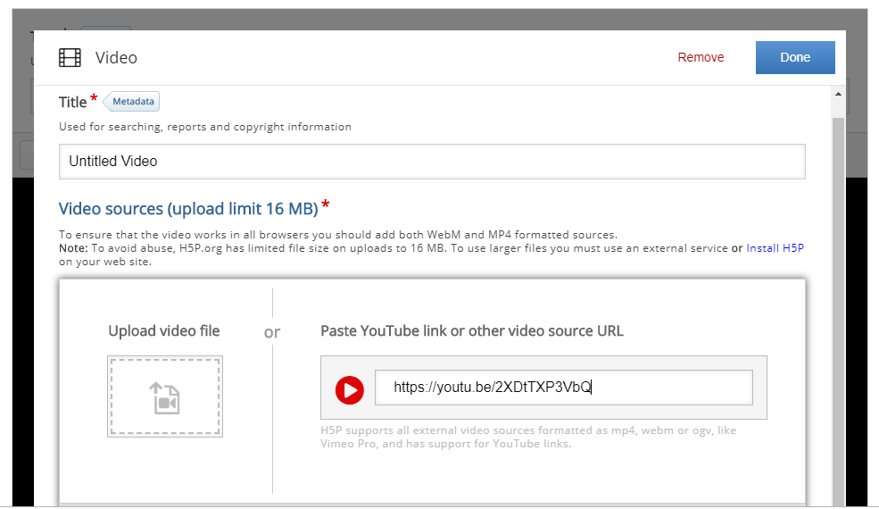

Slide 28
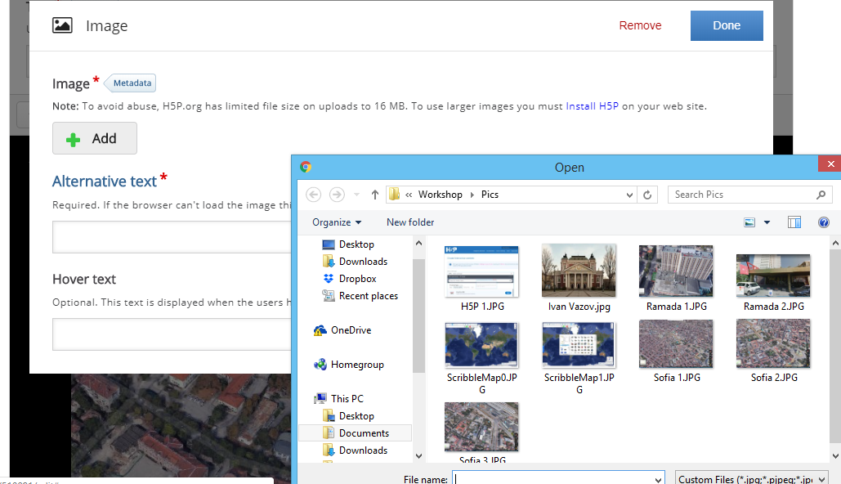

Slide 29
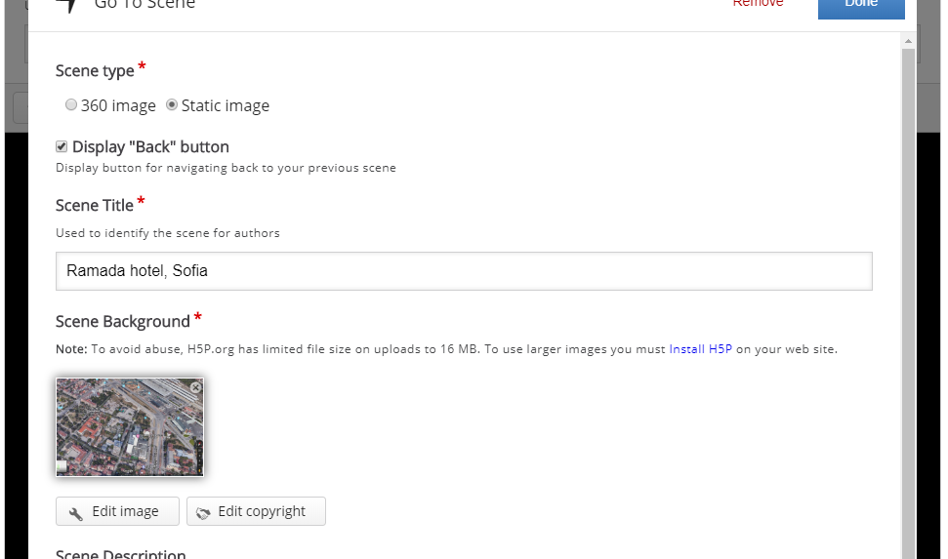

Slide 30
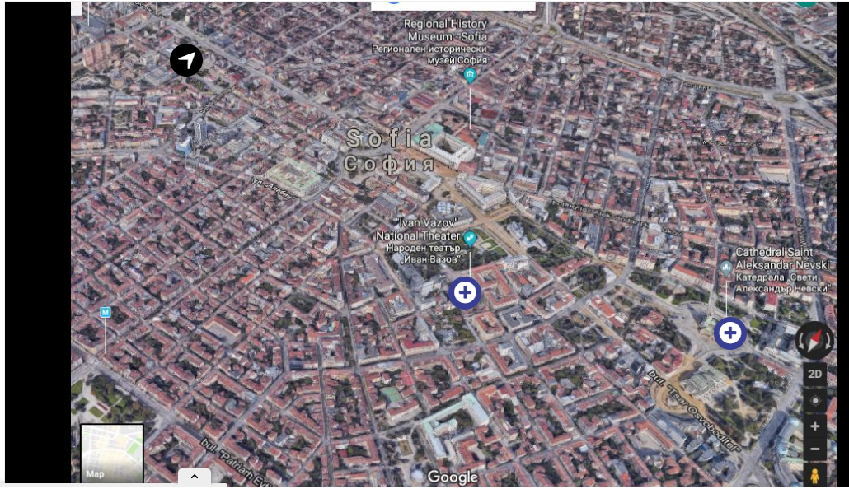

Slide 31
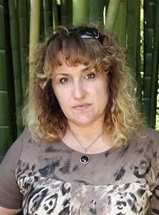
tzvety_st@yahoo.com
Tsvetanka Todorova
IT teacher, eTwinning Ambassador for Bulgaria
Tsar Simeon Veliki School,
Vidin, Bulgaria

