Slide 1
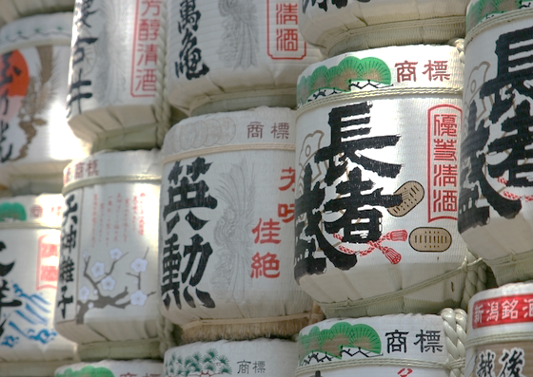
It is us
3rd Class
from Poland

Slide 2
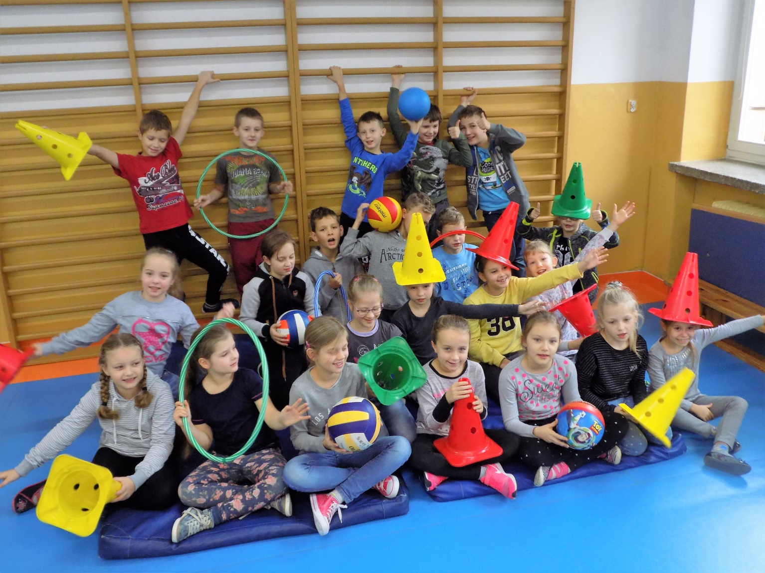
We love playing

Slide 3
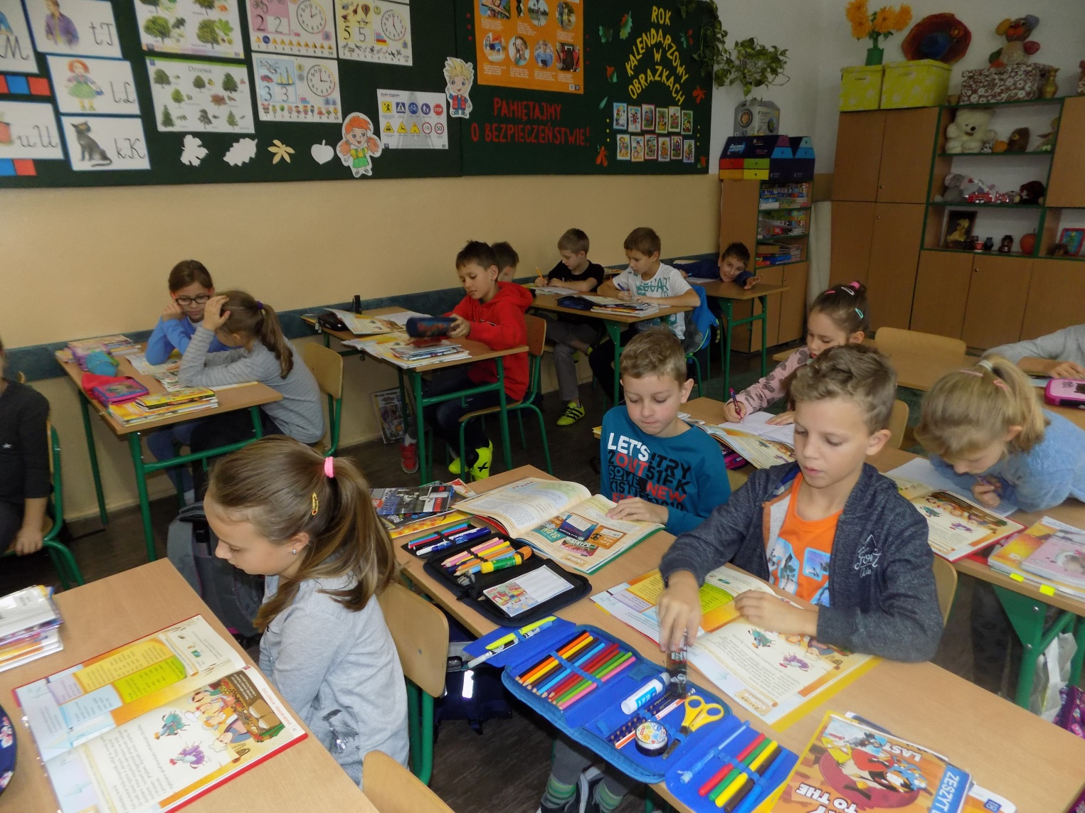
During the lessons

Slide 4
We love PE

Slide 5
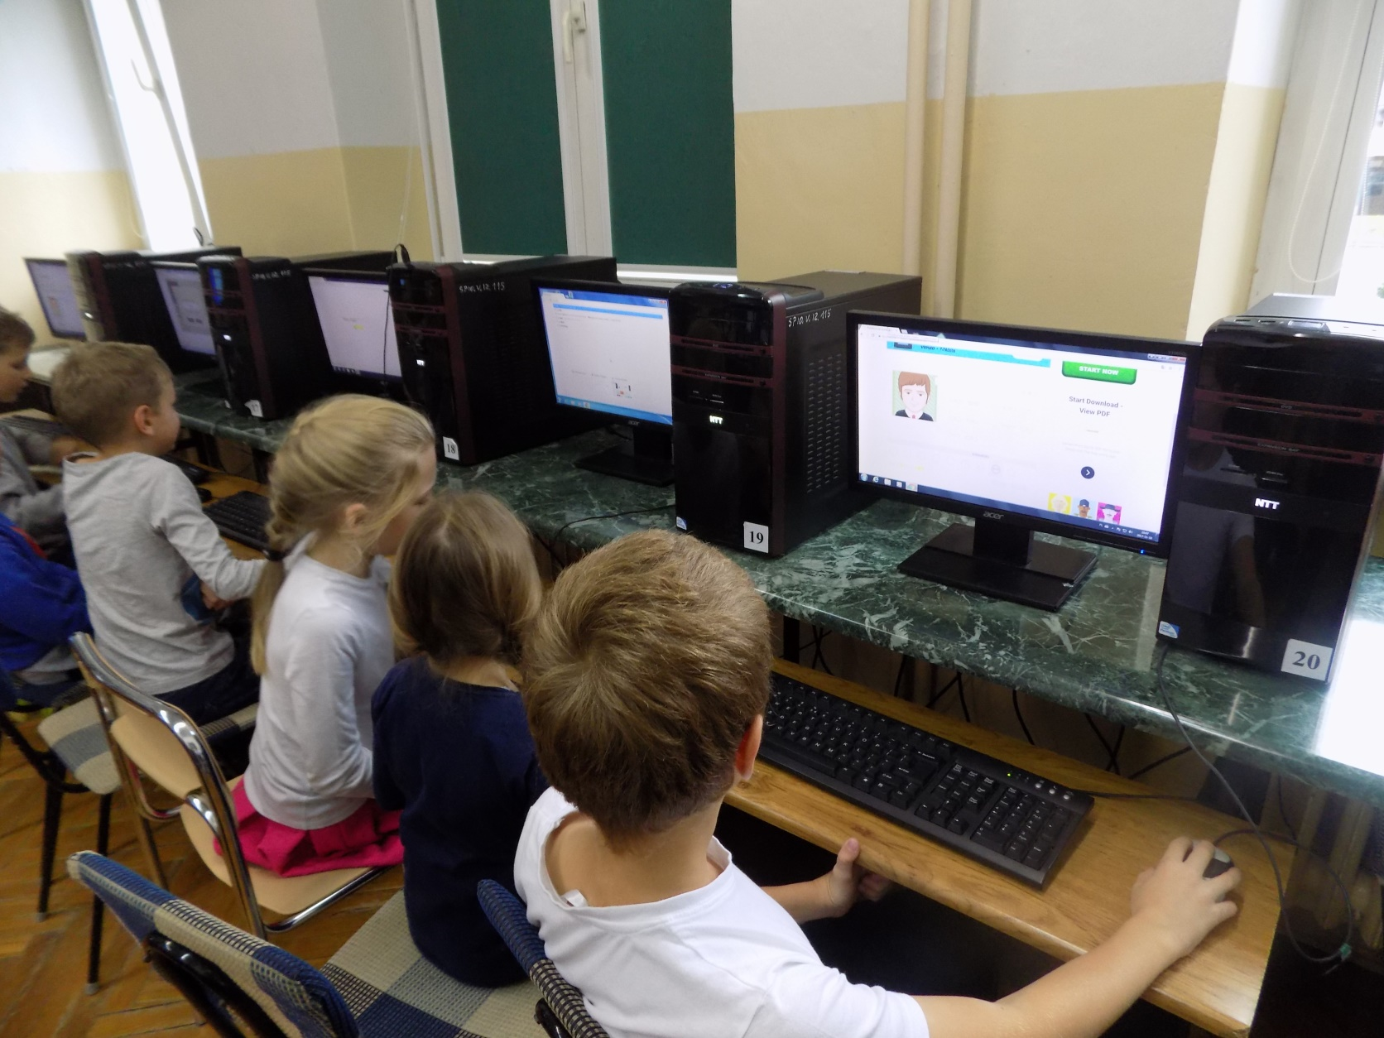
Computer Studies

Slide 6
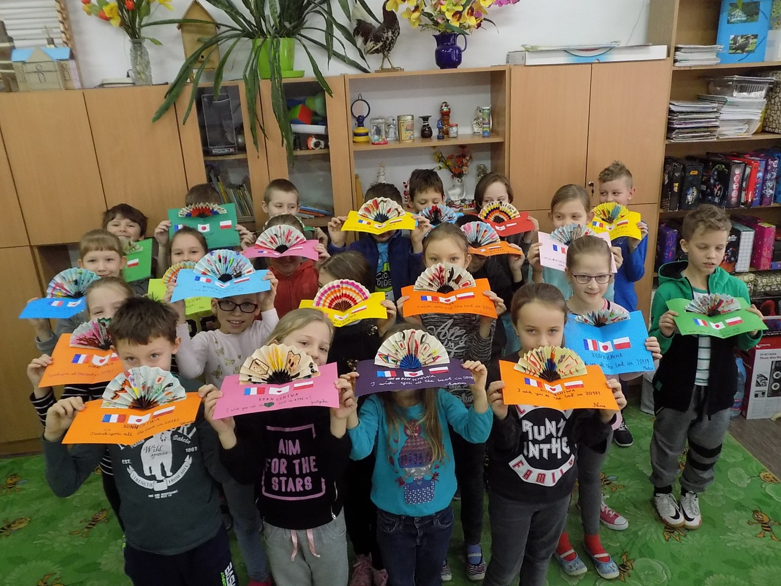
Cards for our friends from France

Slide 7
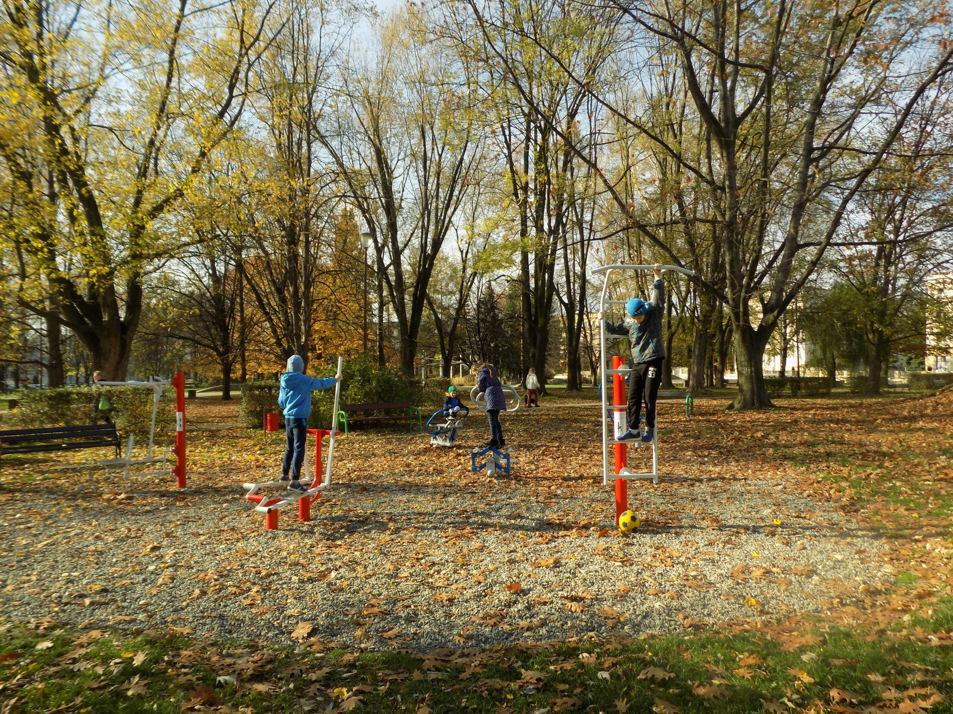
Outdoor playing

Slide 8
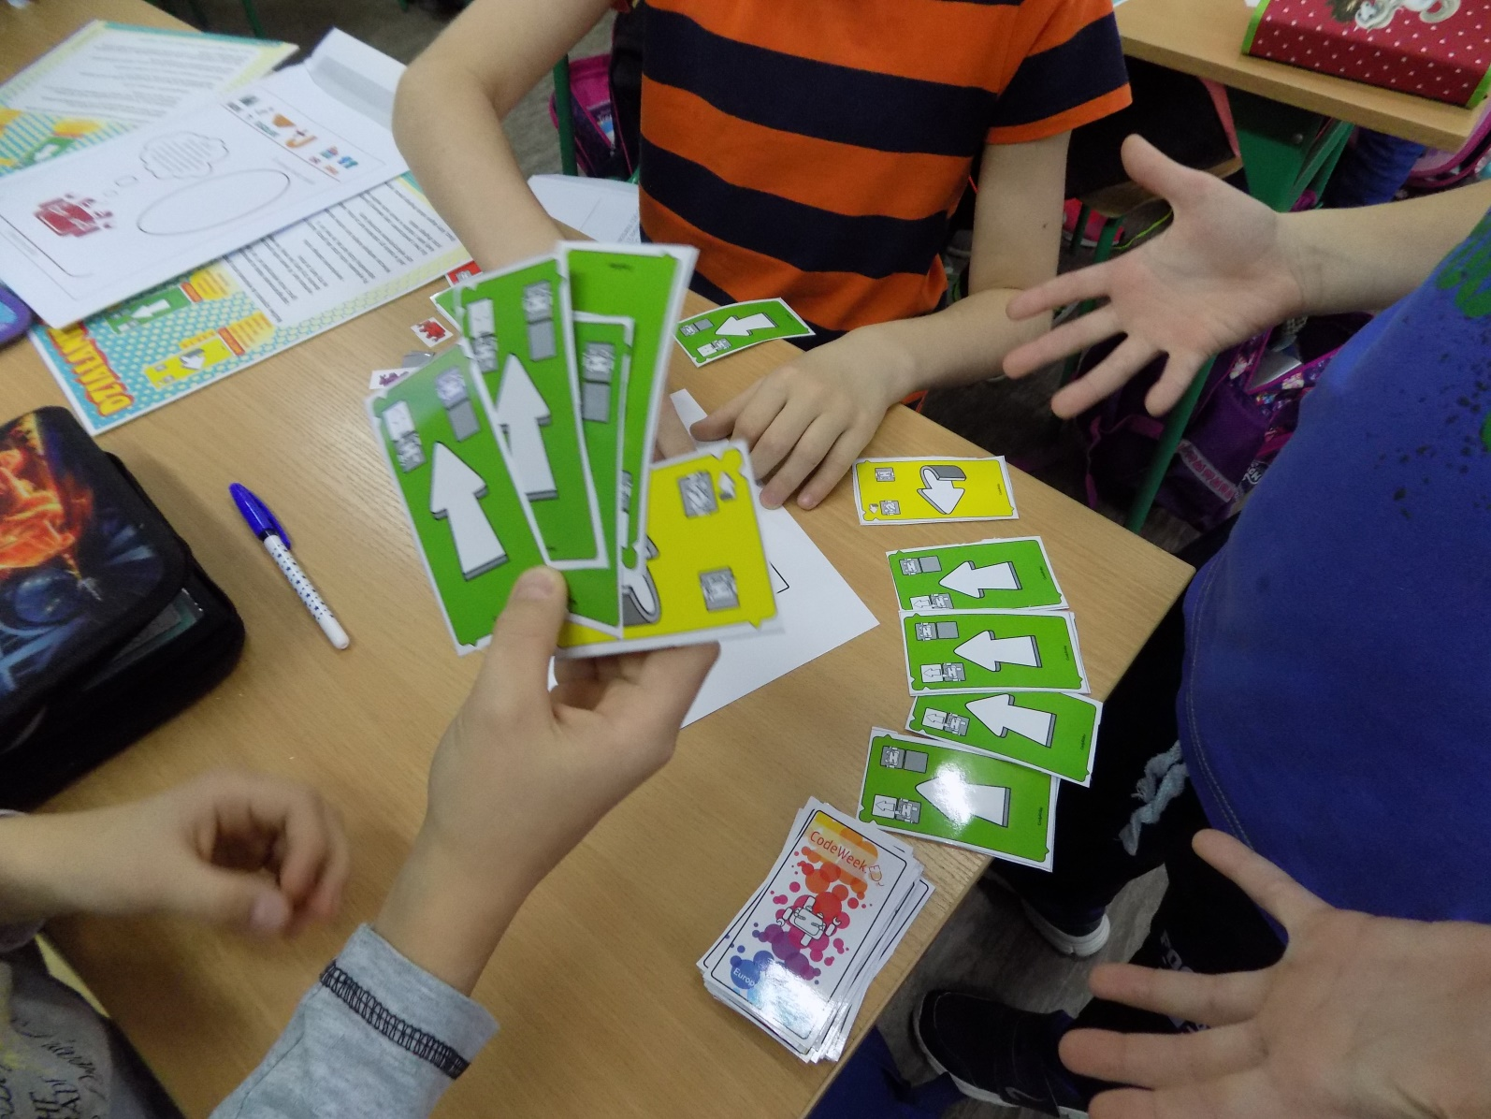
Coding

Slide 9
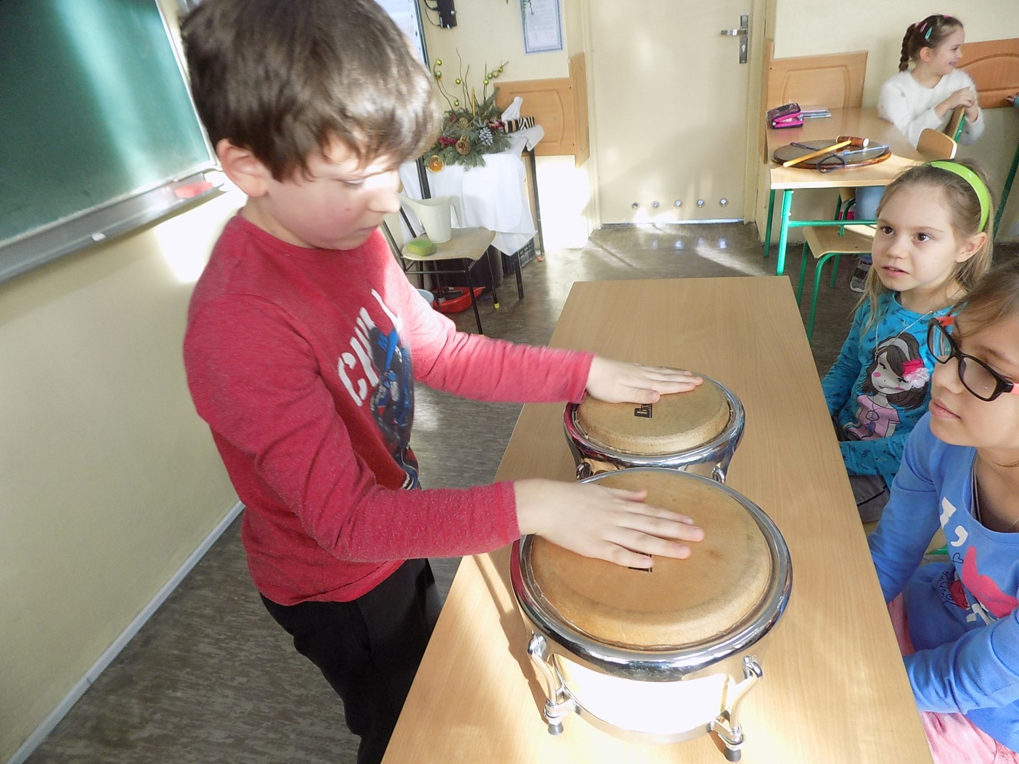
Playing musical instruments

Slide 10
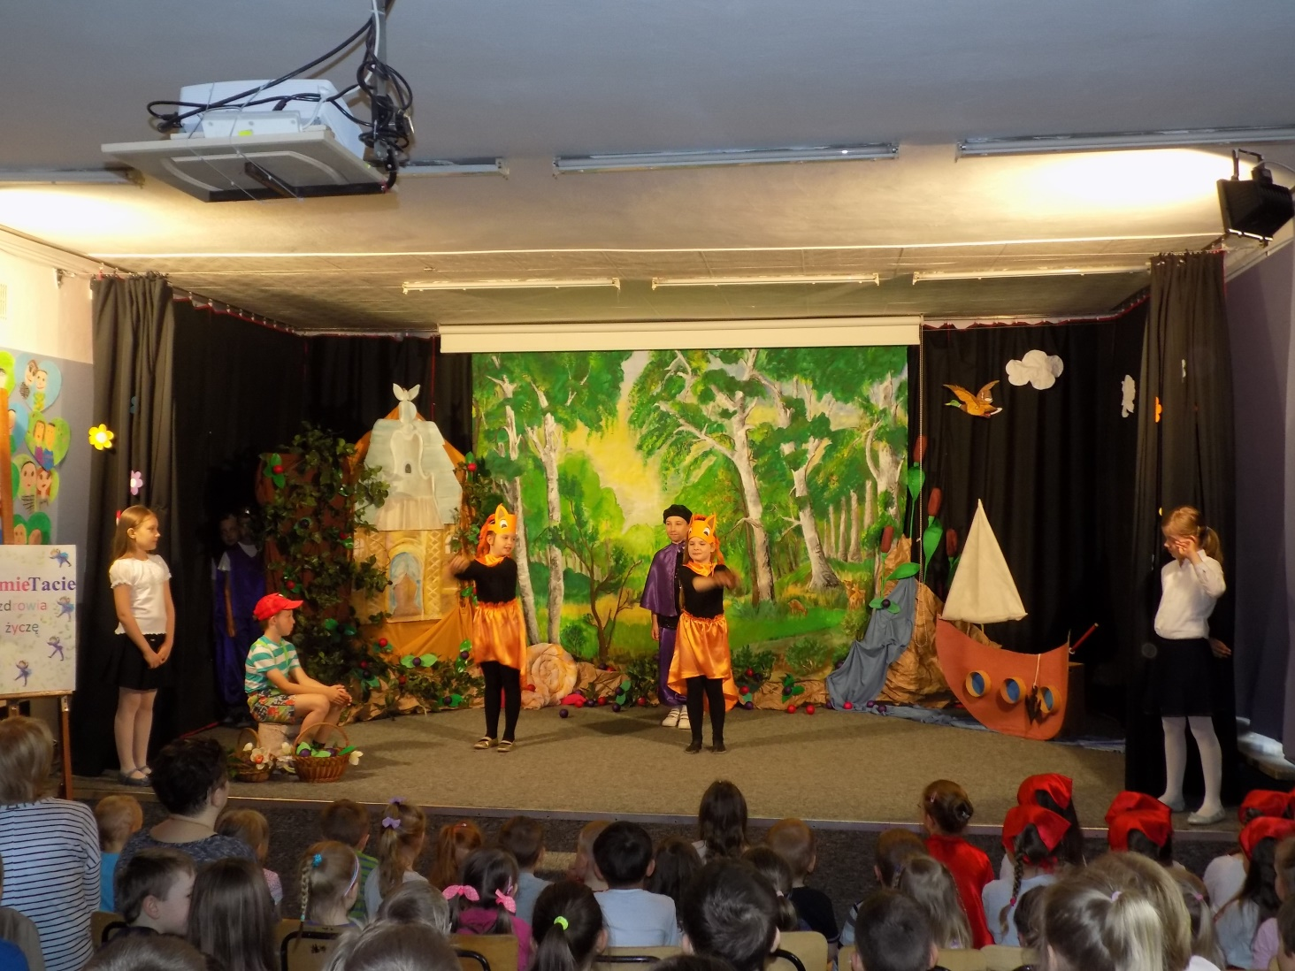
We love performing

Slide 11
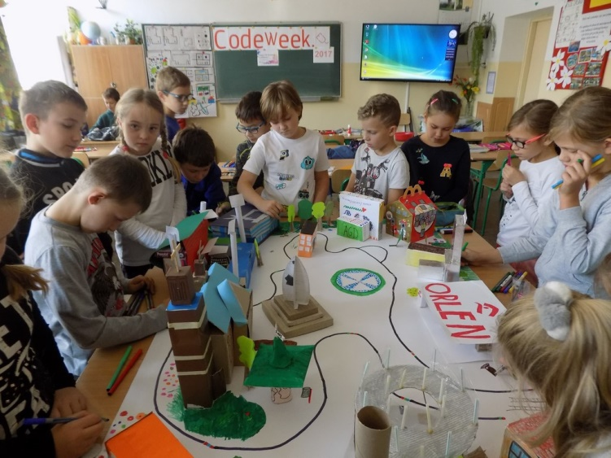
Code Week 2017

Slide 12
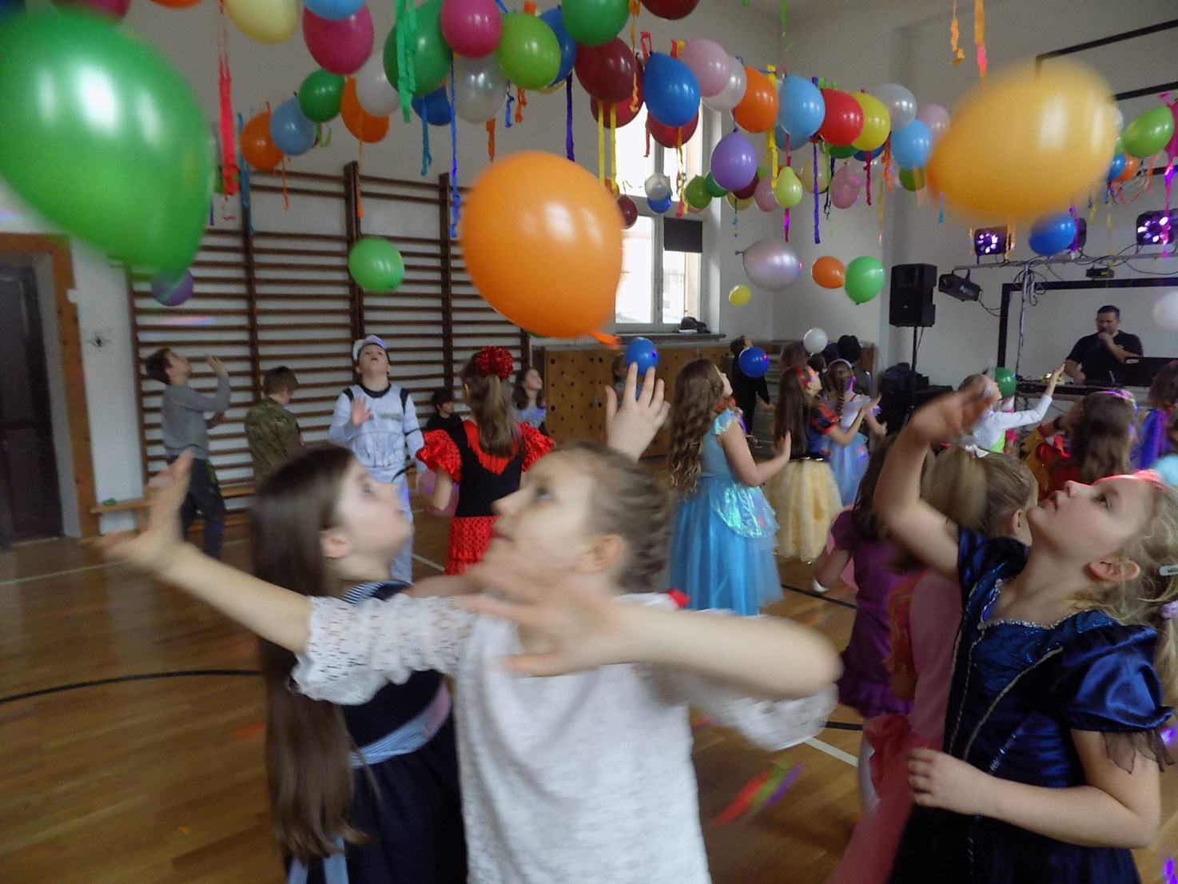
Our last carnival

Slide 13
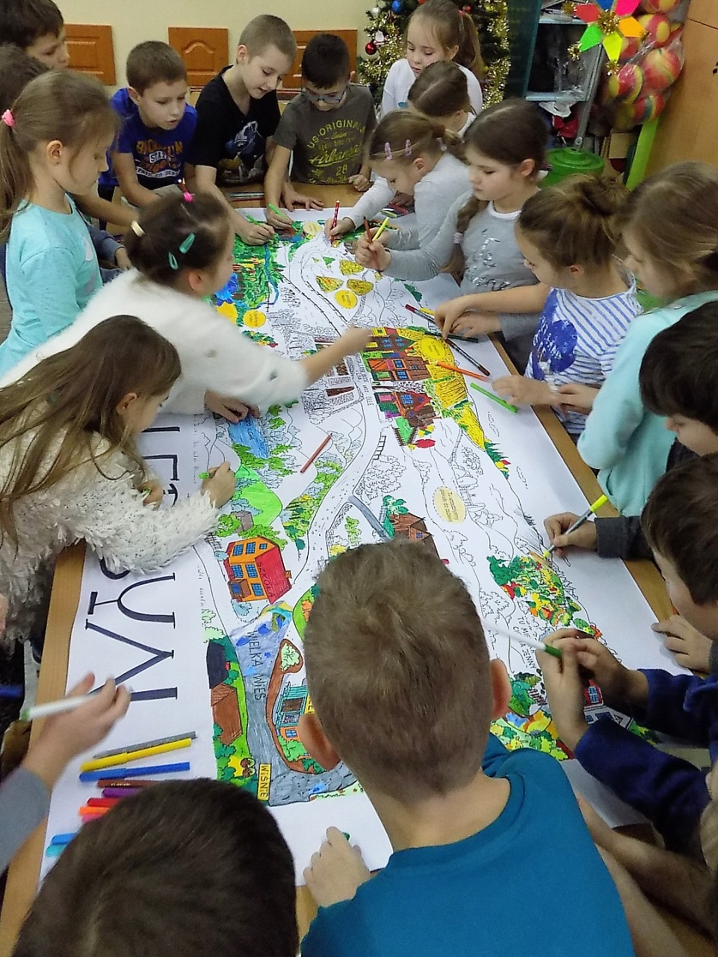
We work together

Slide 14
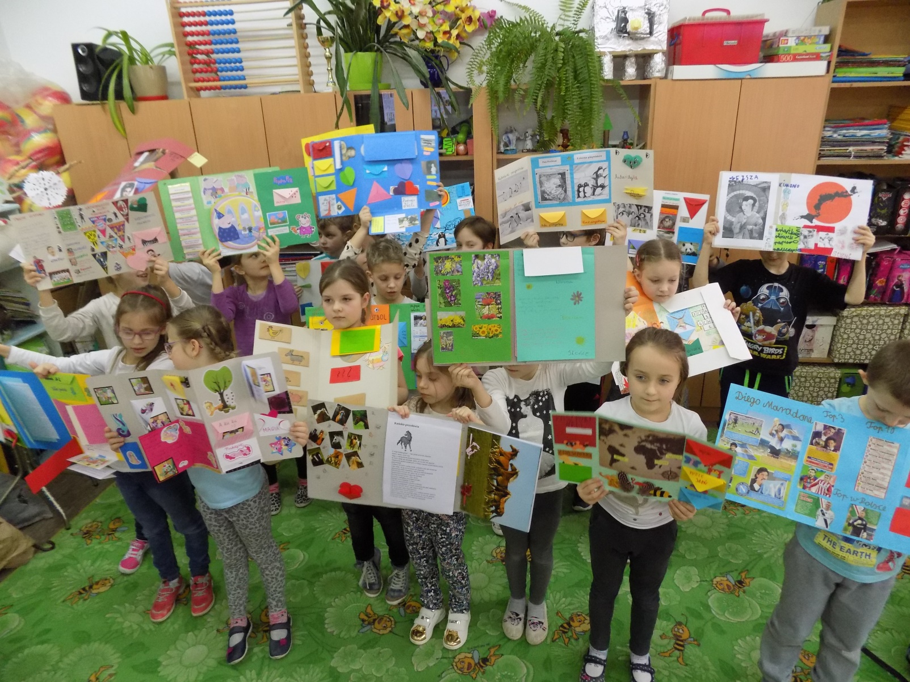
Our lapbooks

Slide 15
We are interested in Japan

Slide 16
Thank you for your attention

