Slide 1
KAMISHIBAI
In the Japanese Theatre
Primary School No 10 Rzeszów, Poland

Slide 2
Recently, we got to know the history of the Japanese KAMISHIBAI theatre. In the middle of the week we read a beautiful story called My Friend Kemushi It is a story about the life of a butterfly, which from the pupa turned into a beautiful, colourful insect. Then we watched the movie about butterfly’s life phases and we designed our butterflies. We encourage our French friends to learn about this story

Slide 3
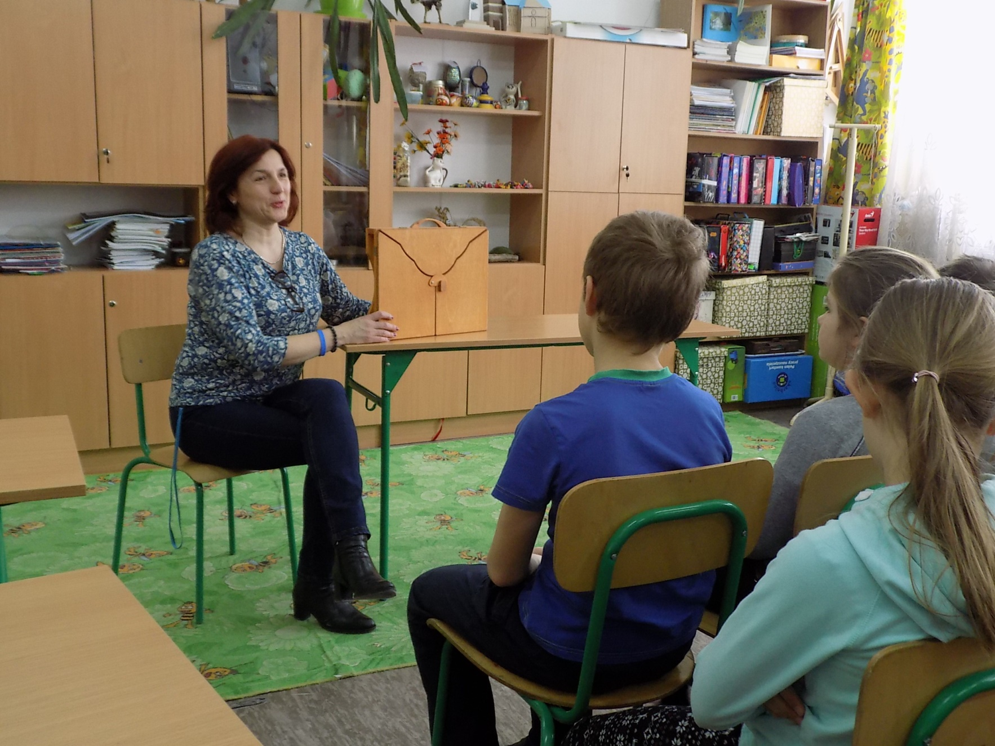

Slide 4
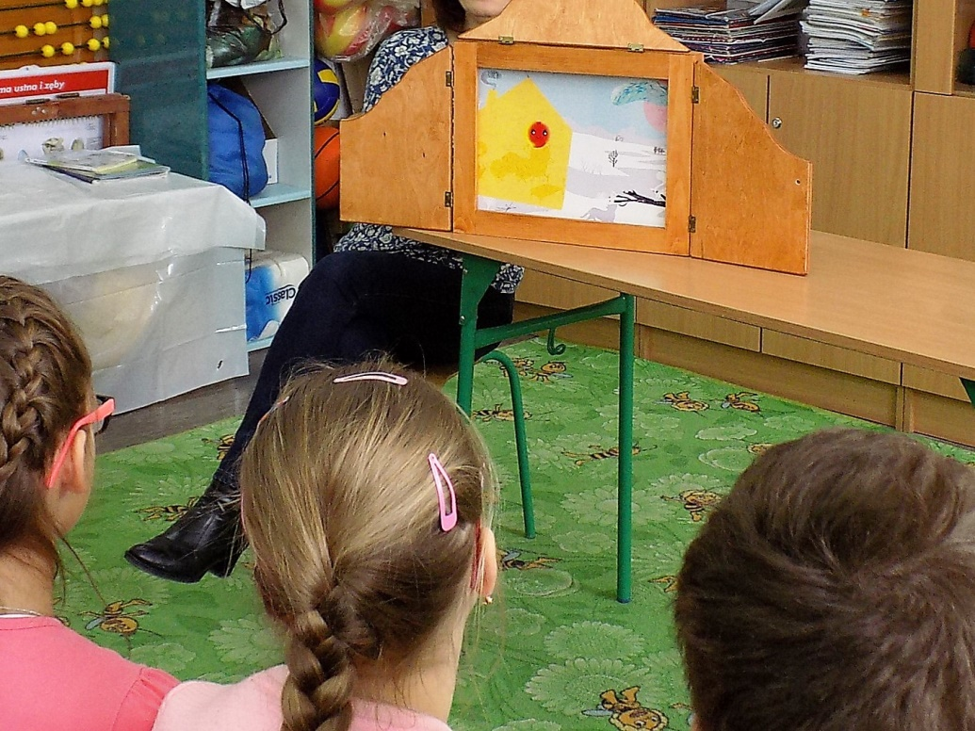

Slide 5
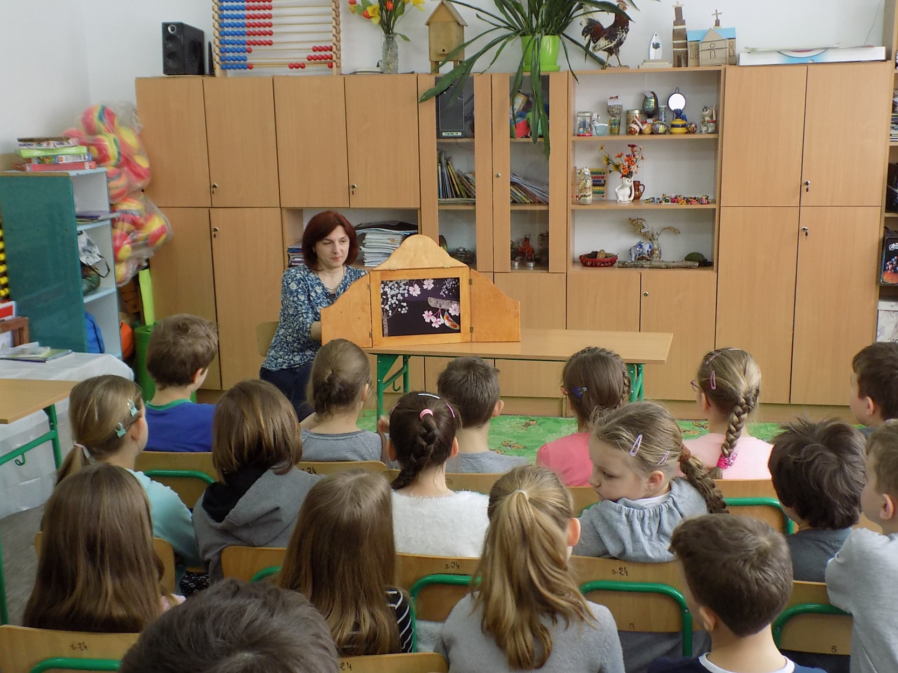

Slide 6
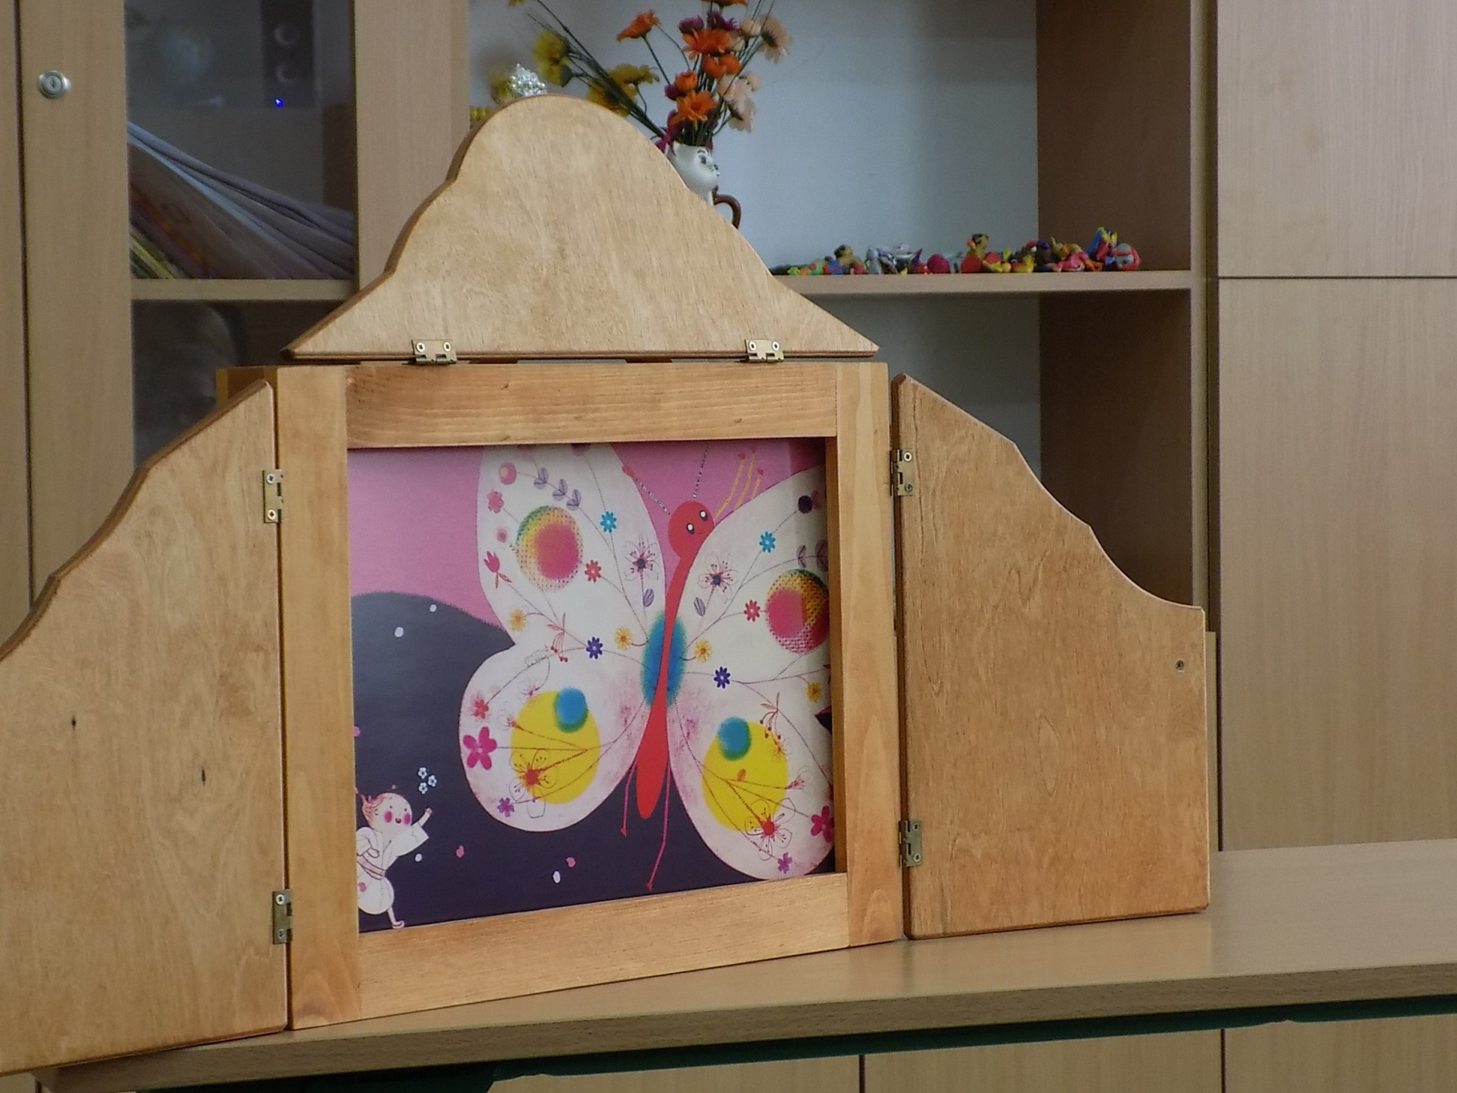

Slide 7
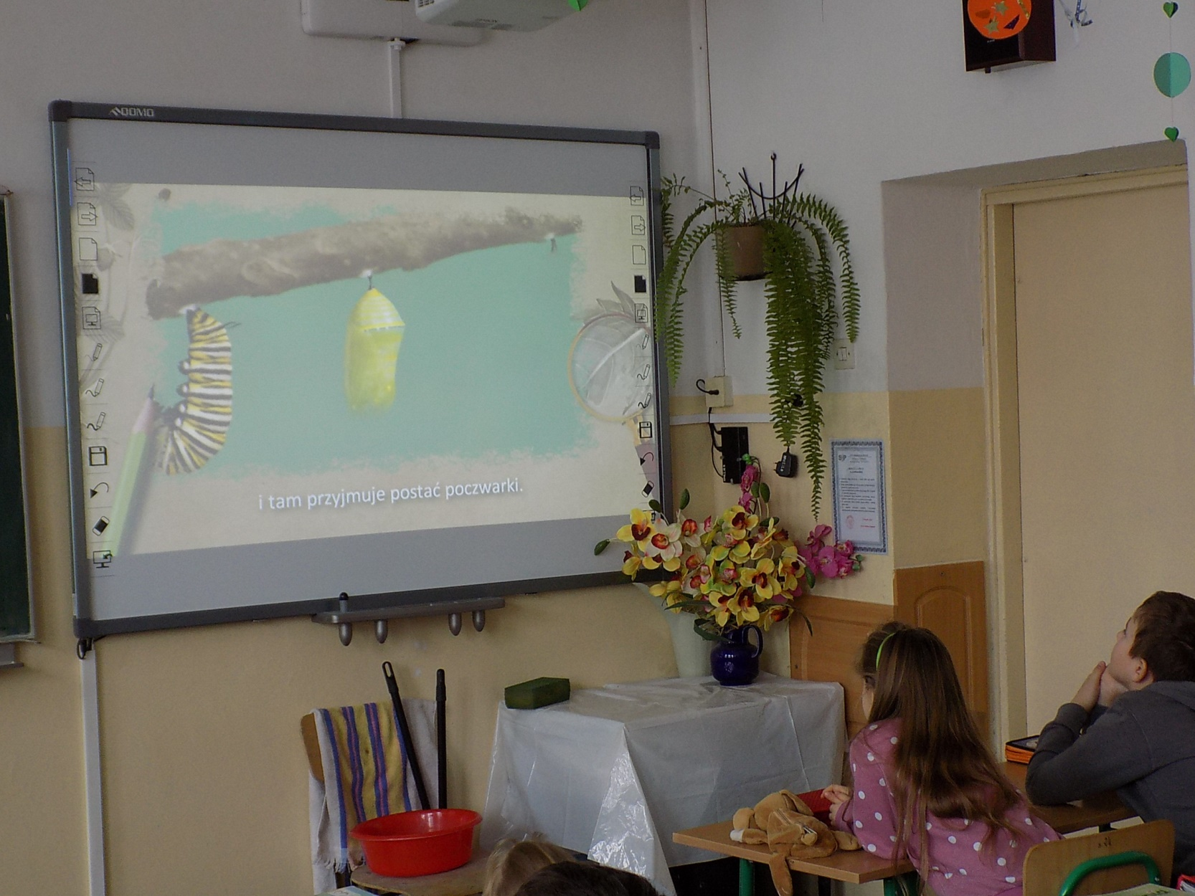

Slide 8
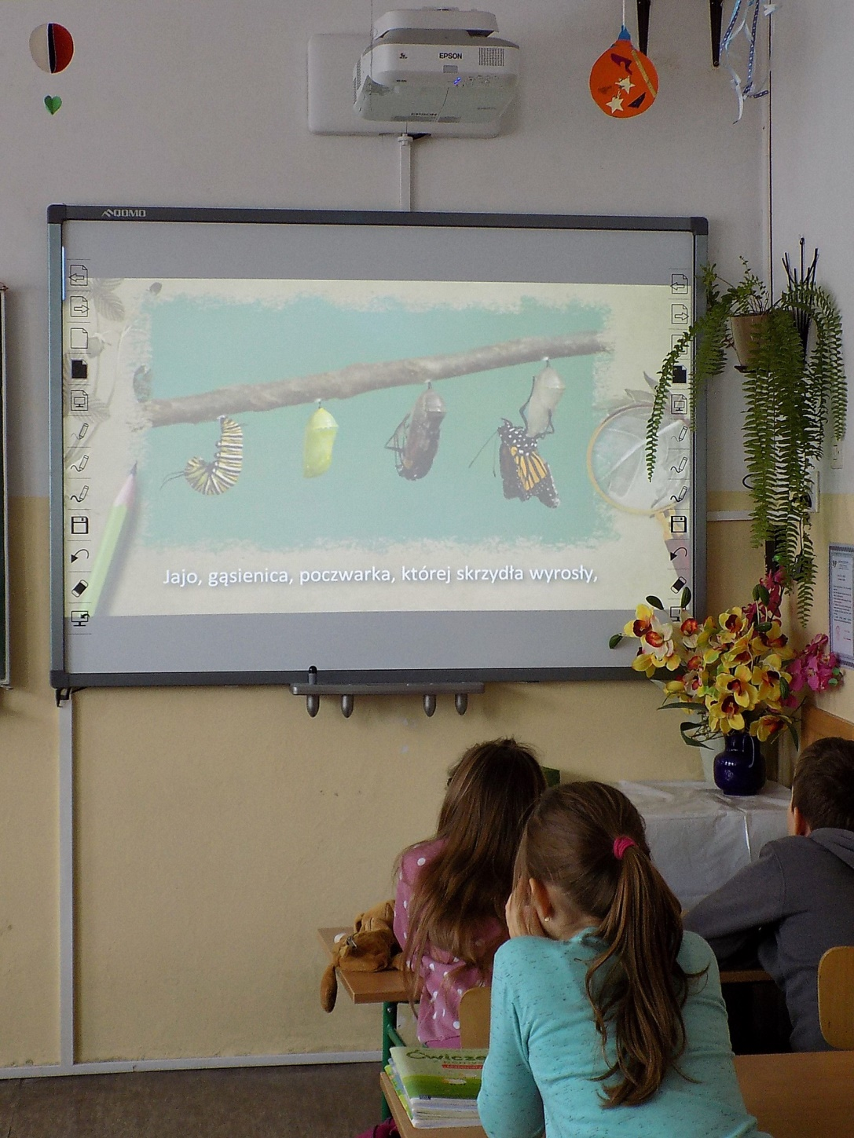

Slide 10
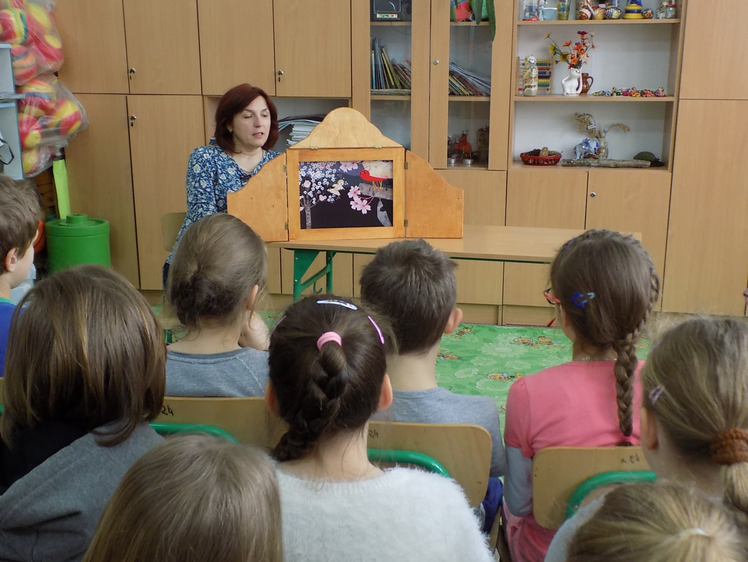

Slide 11
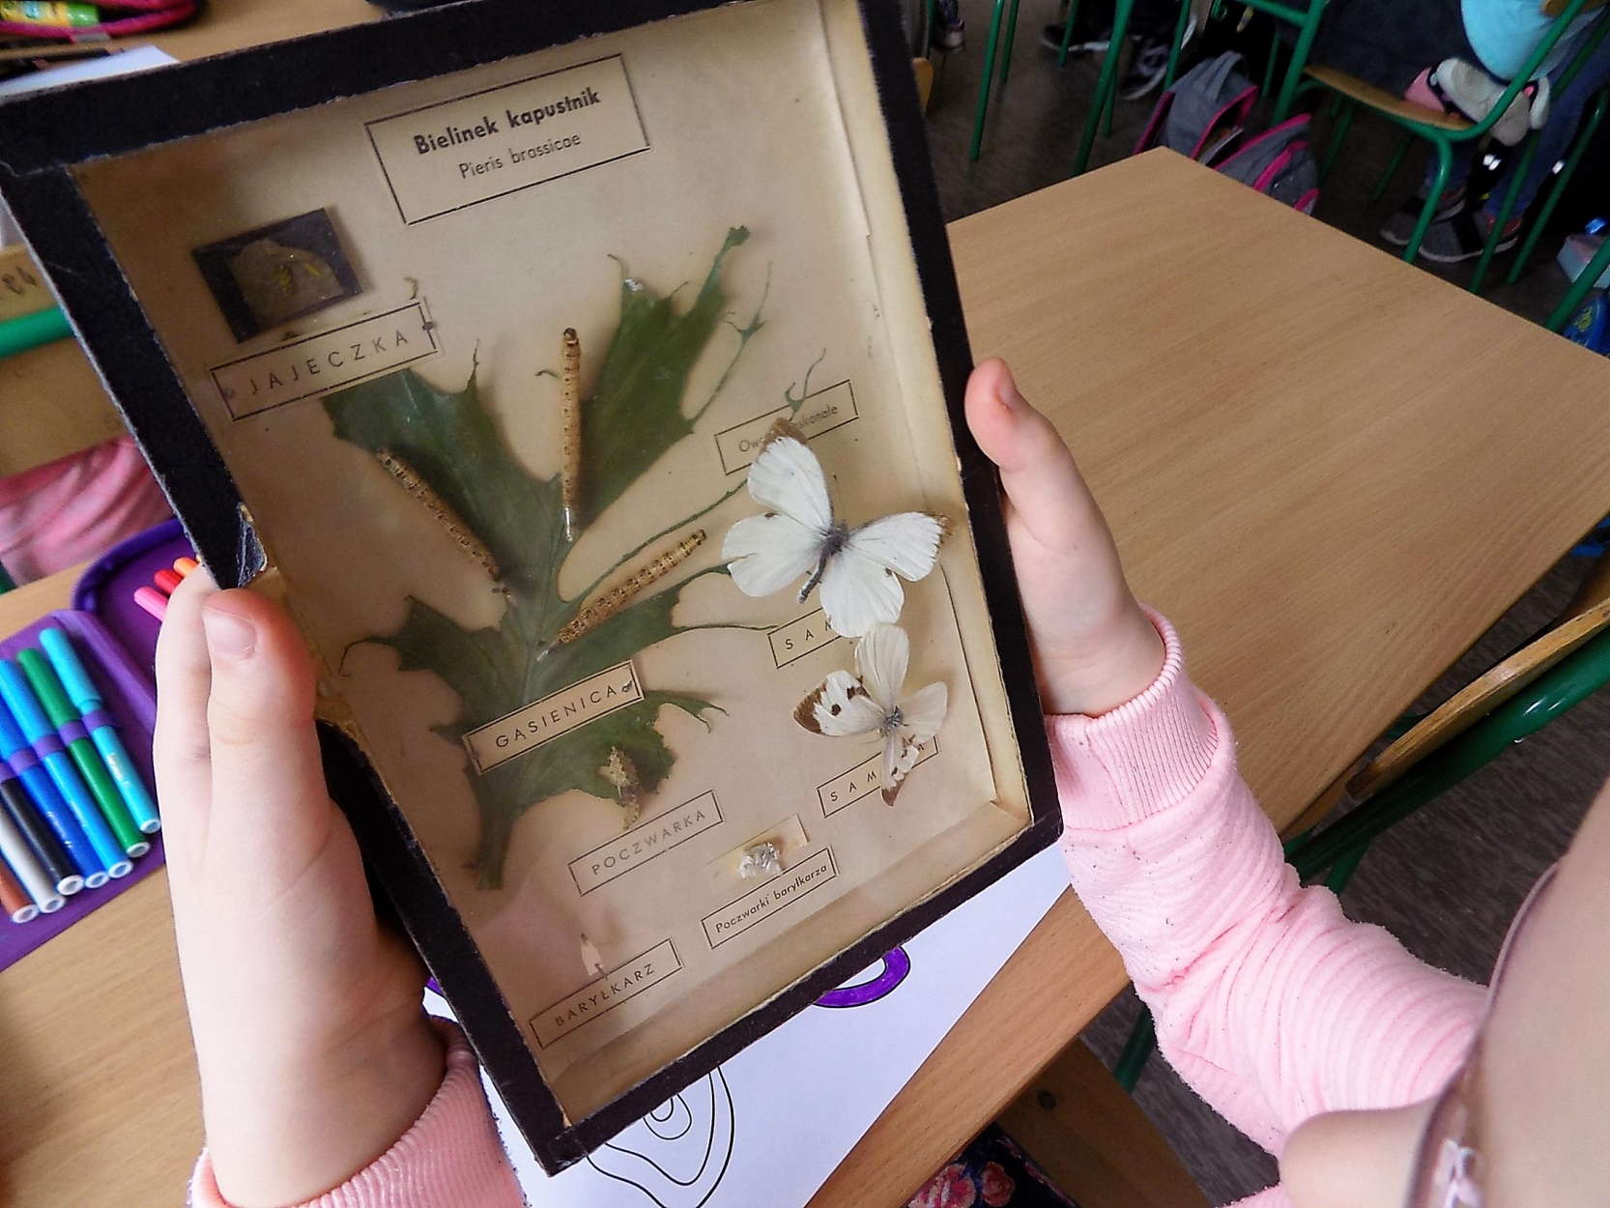

Slide 12
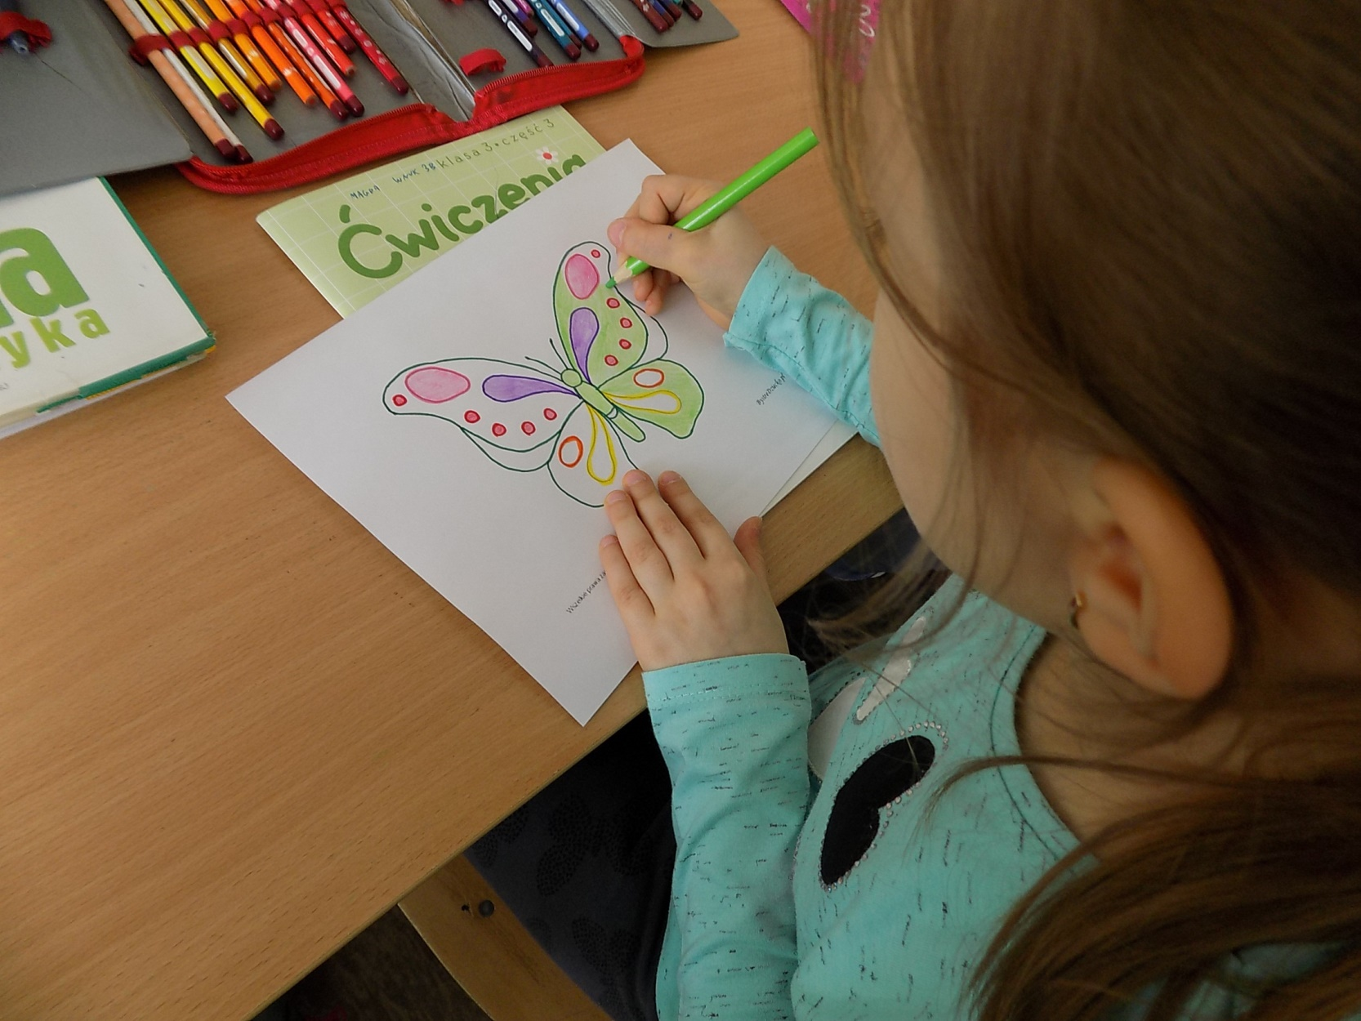

Slide 13
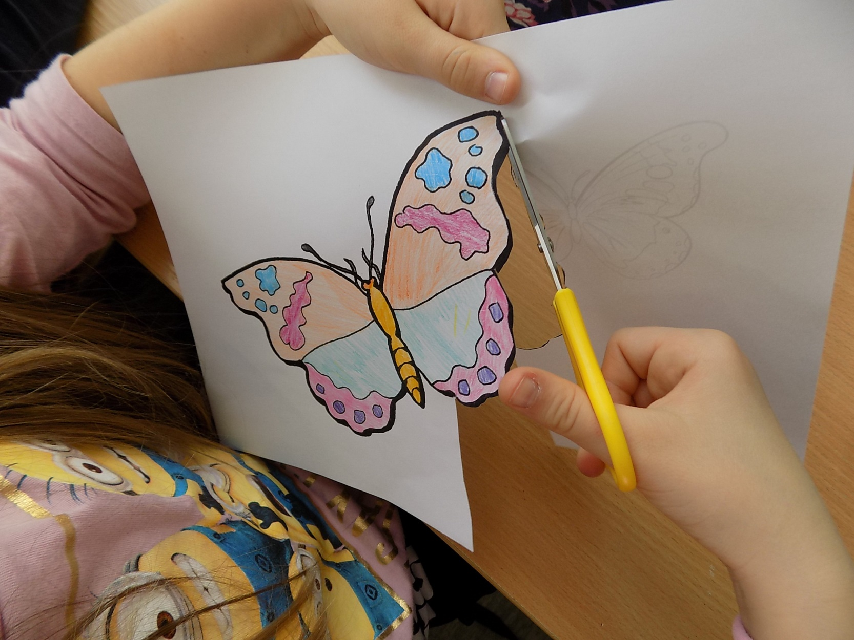

Slide 14
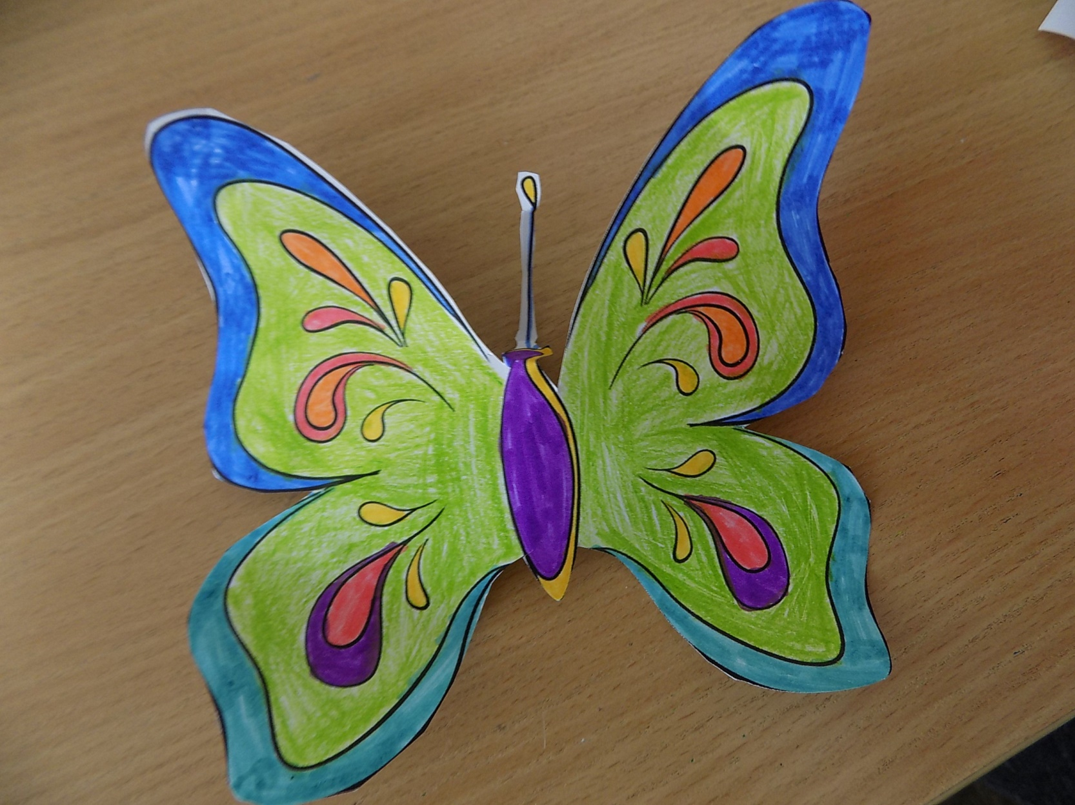

Slide 15
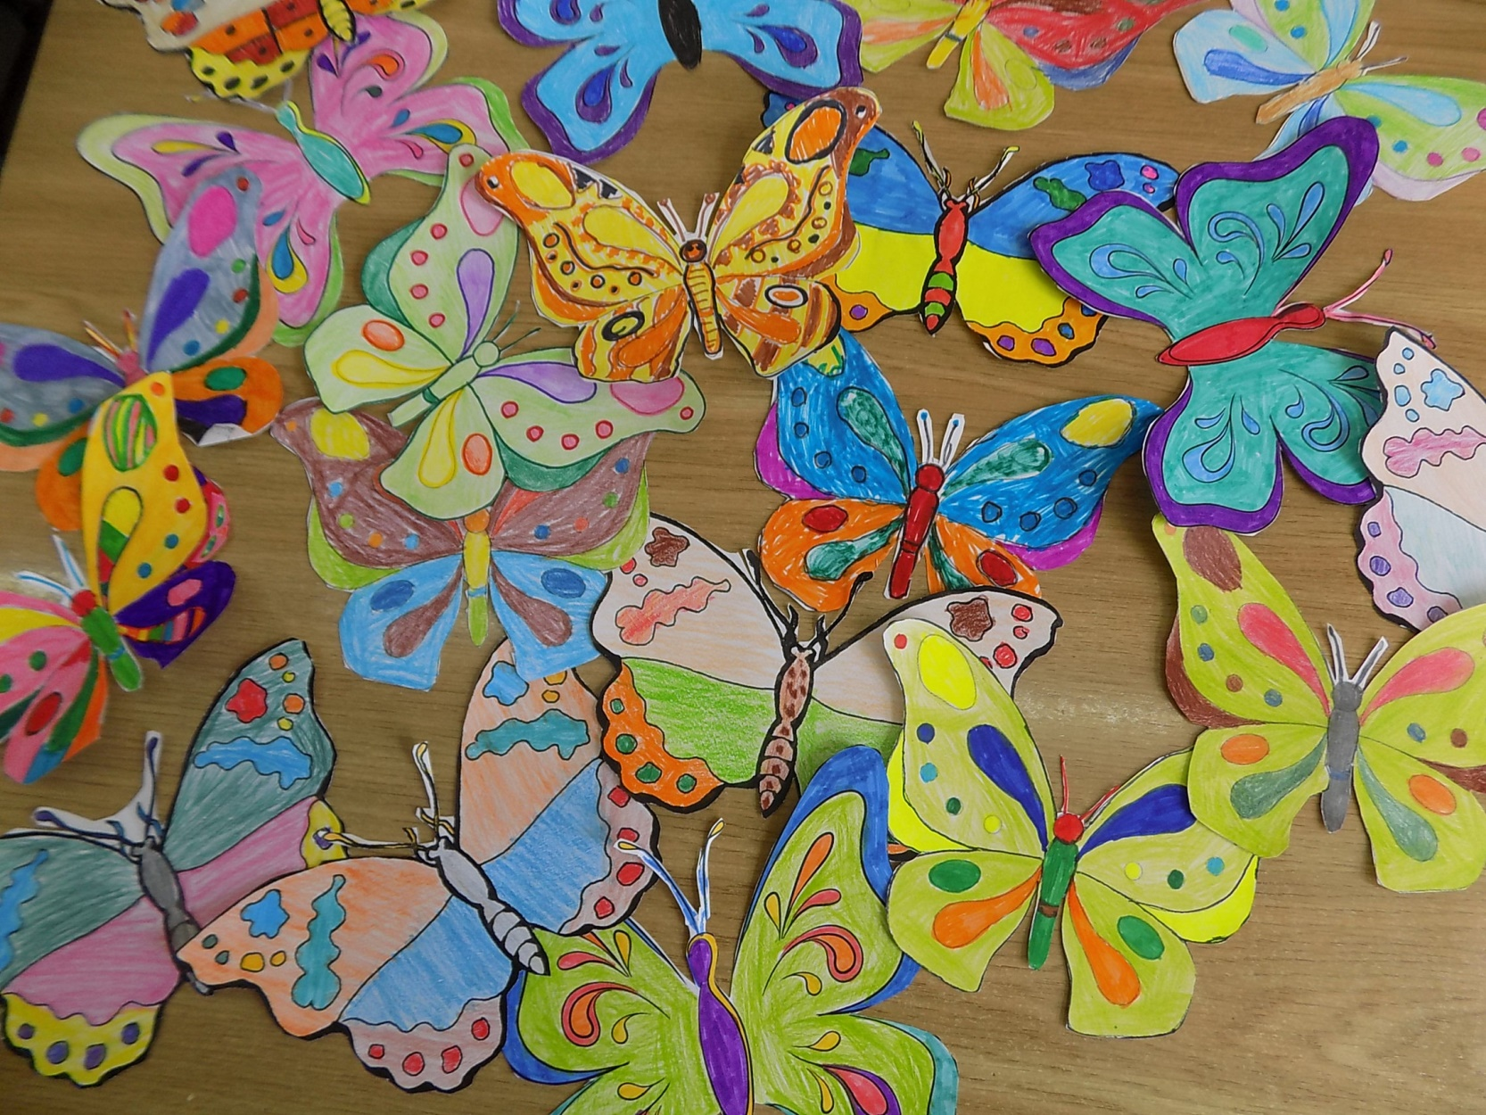

Slide 16
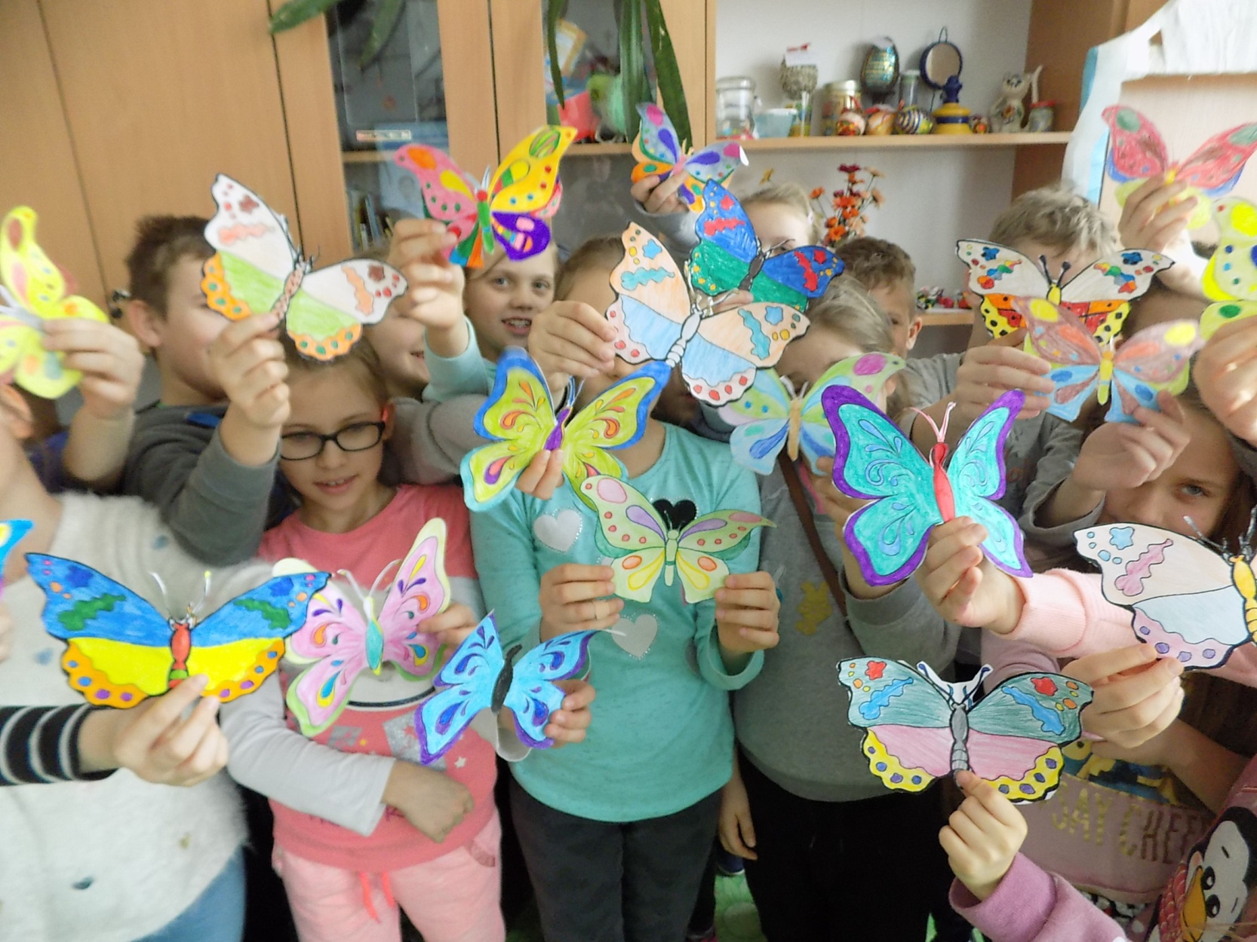

Slide 17
Merci pour votre attention Thank you for your attention
Dziękujemy za uwagę

