Slide 1
A Japanese Day
Konnichiwa, a French-Polish eTwinning Project
by Primary School Rzeszow, Poland

Slide 2
On a beautiful spring day, we organized a Japanese Day in our class. We started by watching multimedia presentations using the Internet on the geography, culture and life of people in Japan.

Slide 4
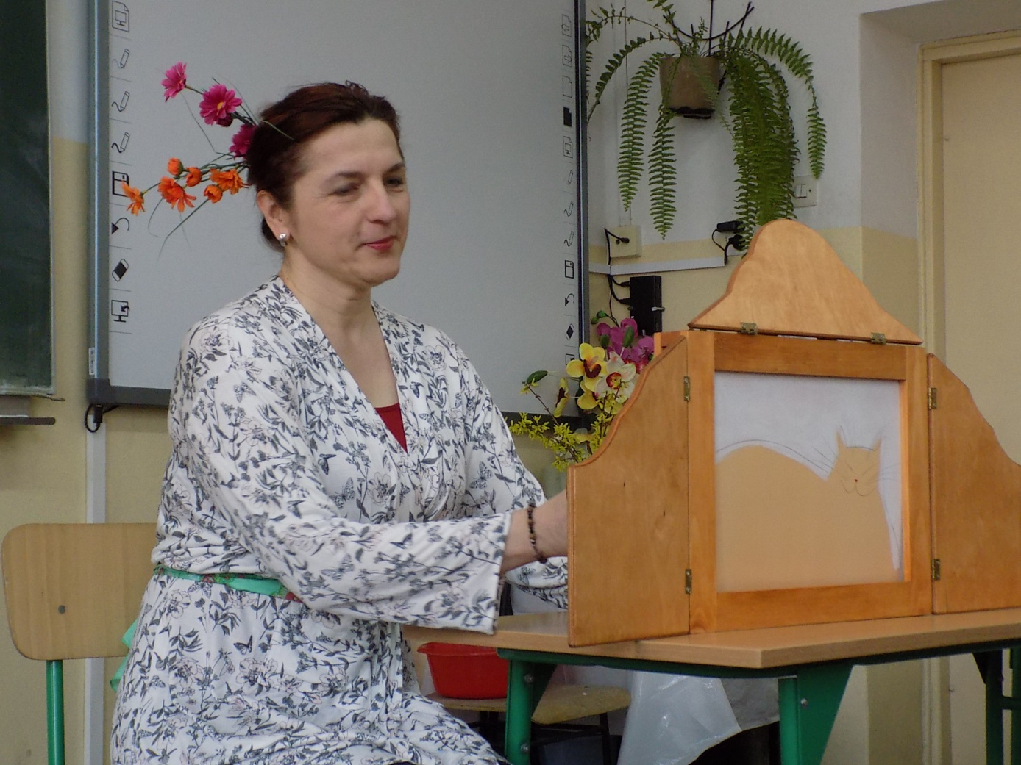
Then we listened to the story titled "Kotka Milusia" ( The Nicey Cat ) with the use of a kamishibai theater. We learned from this story that one should learn to live by himself and that a more difficult life in the wild is more interesting than a comfortable life, but dependent on others.

Slide 5
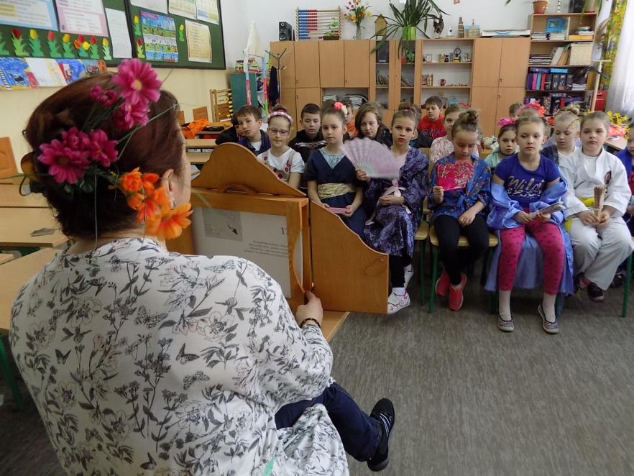

Slide 6
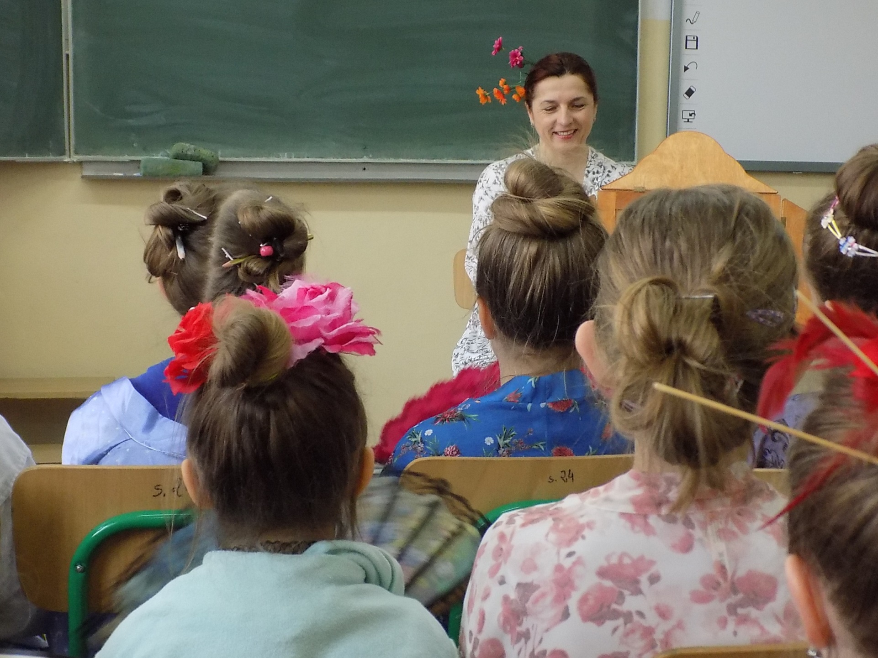

Slide 7
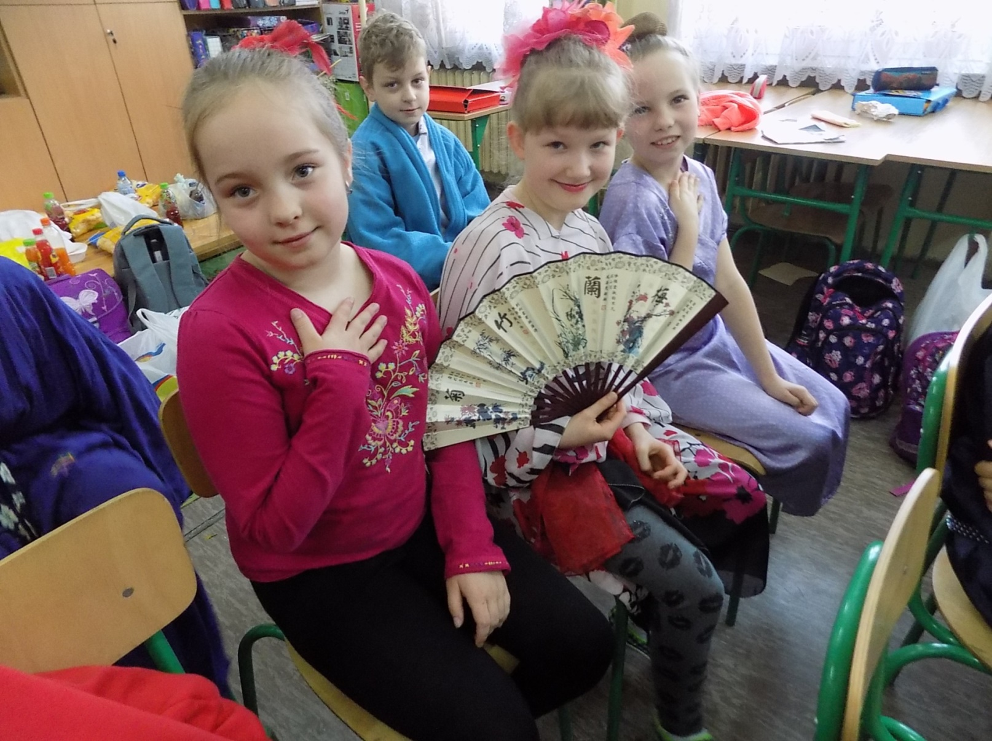
We also were listening to Japanese music all the time

Slide 8
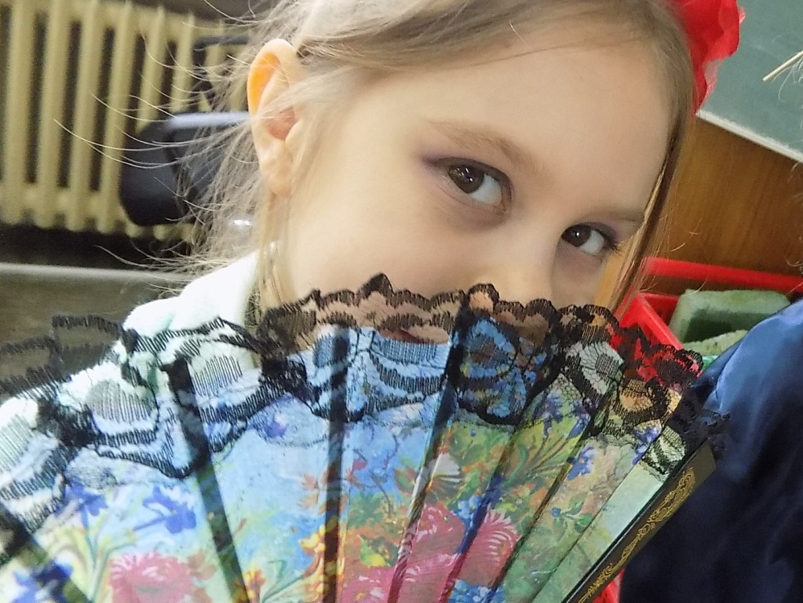
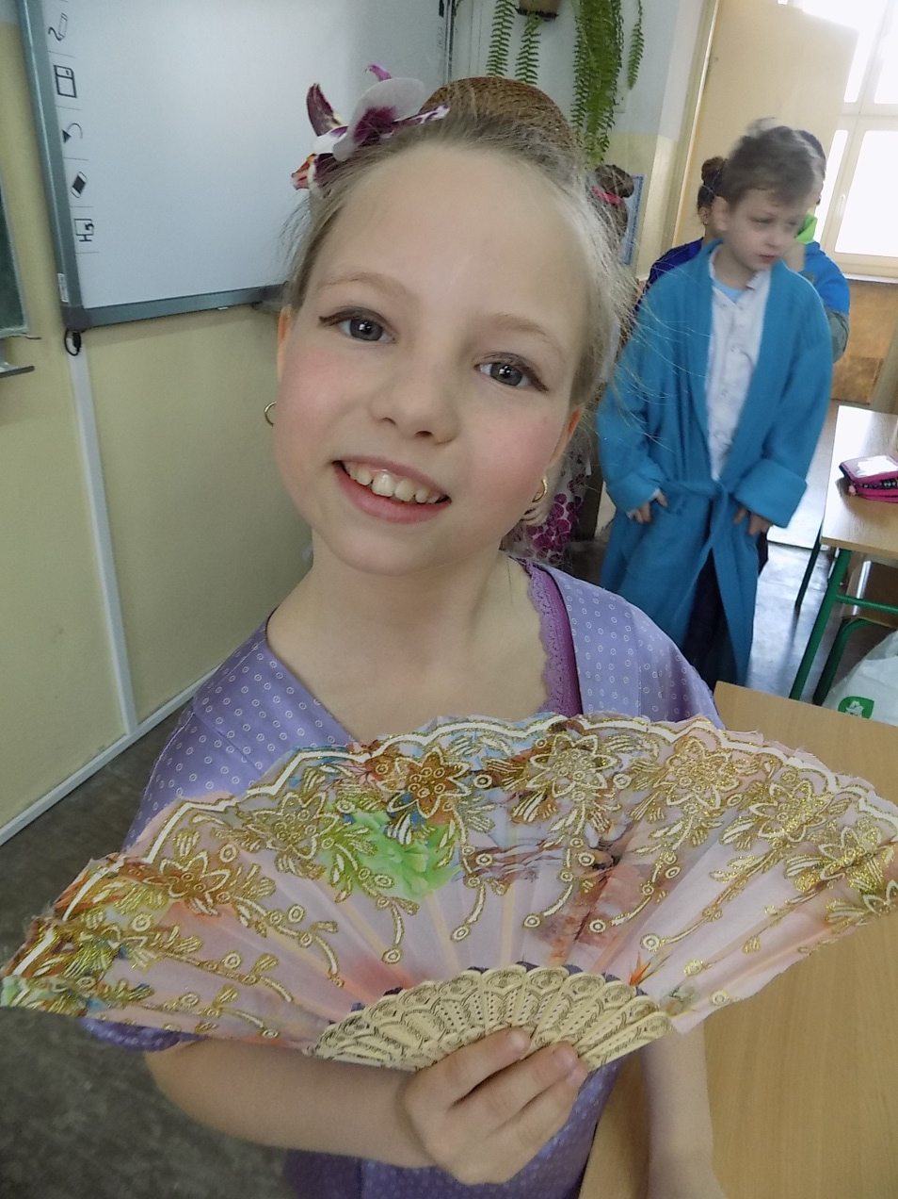
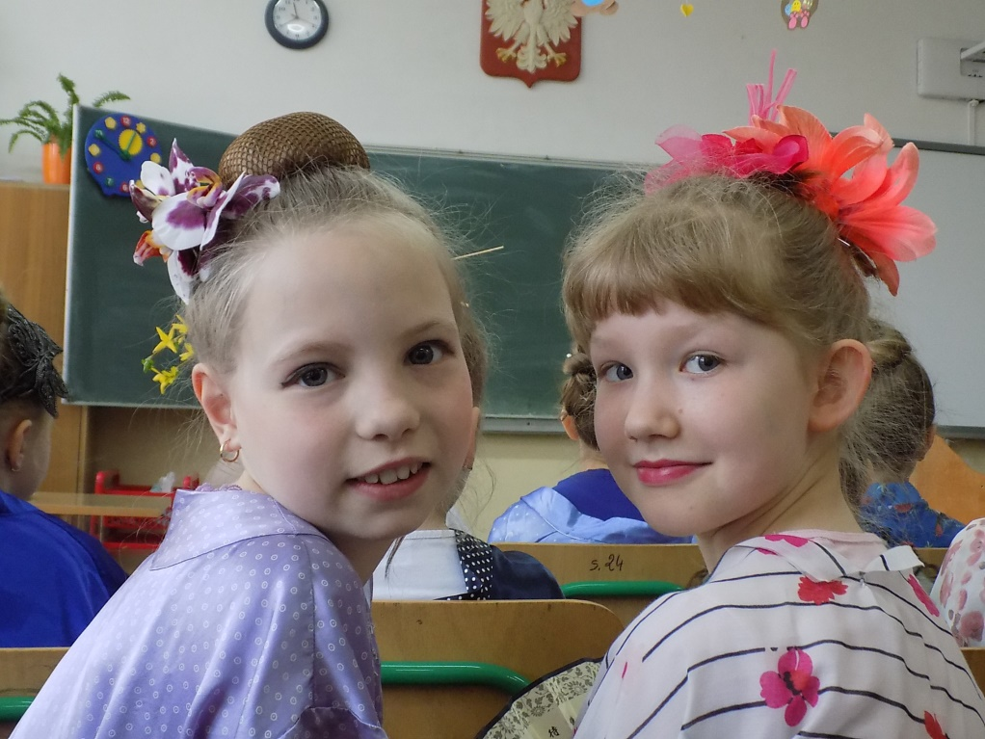

Slide 9
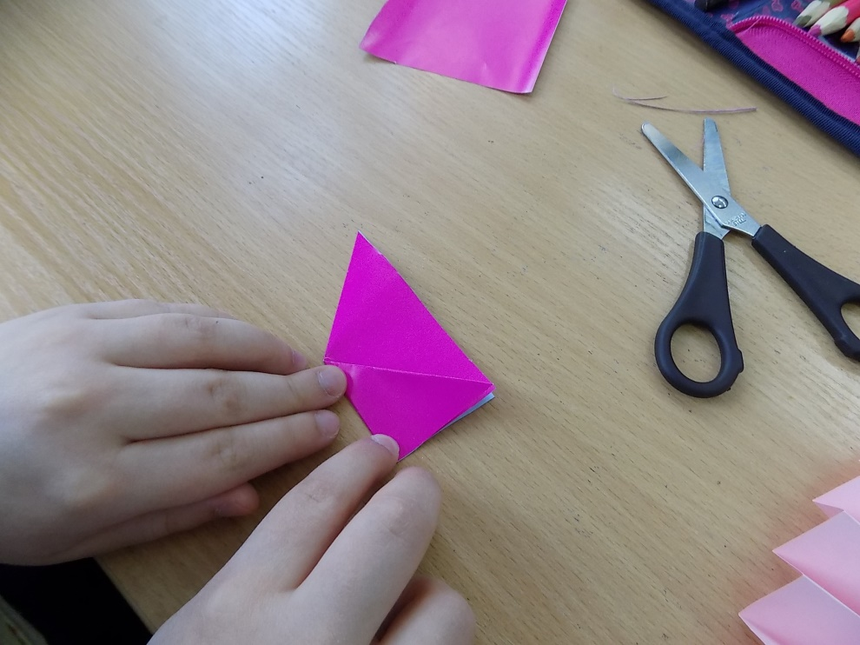
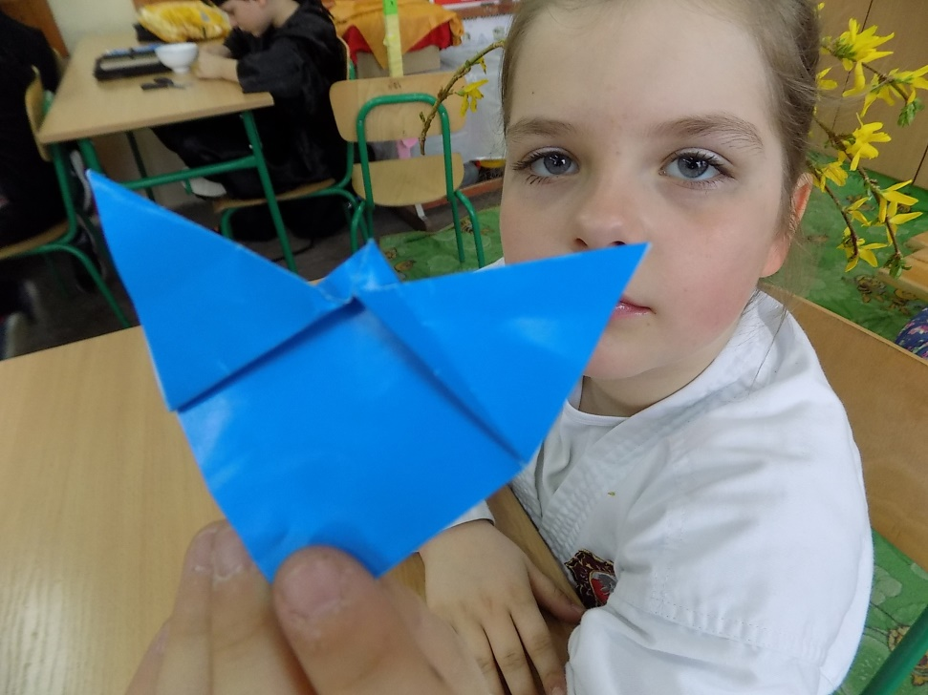
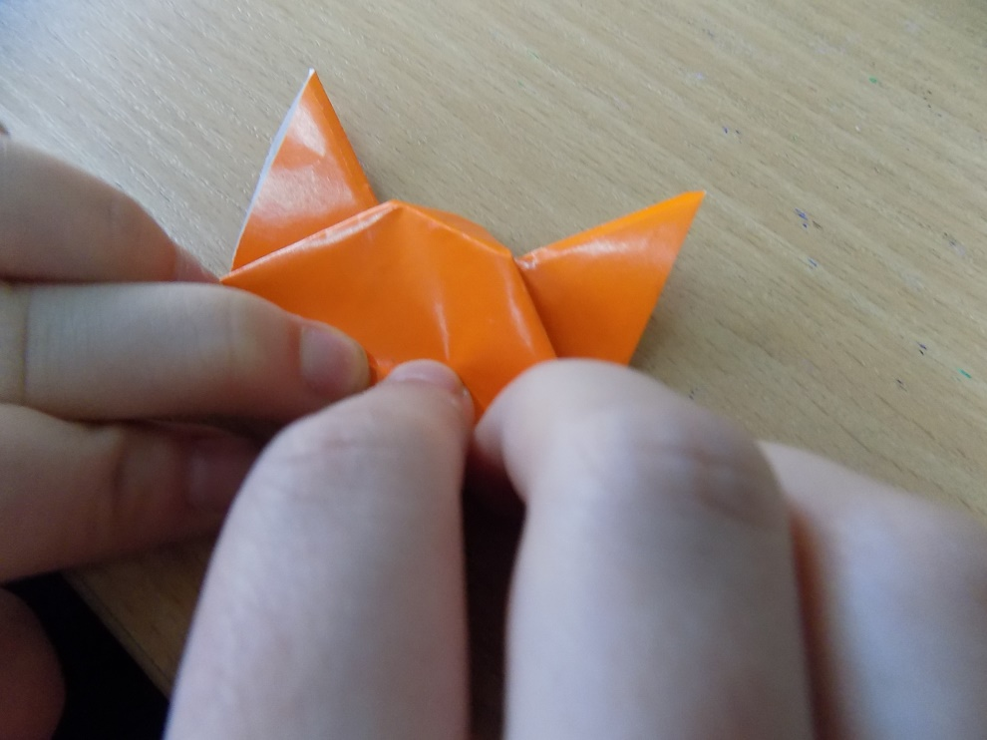
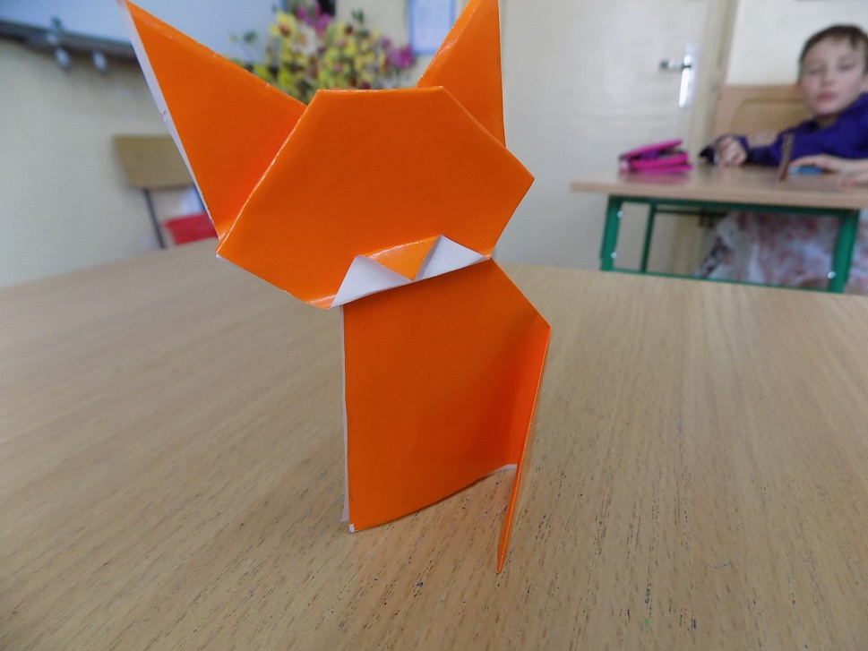
We have made cats using origamii, the Japanese art of folding paper

Slide 10
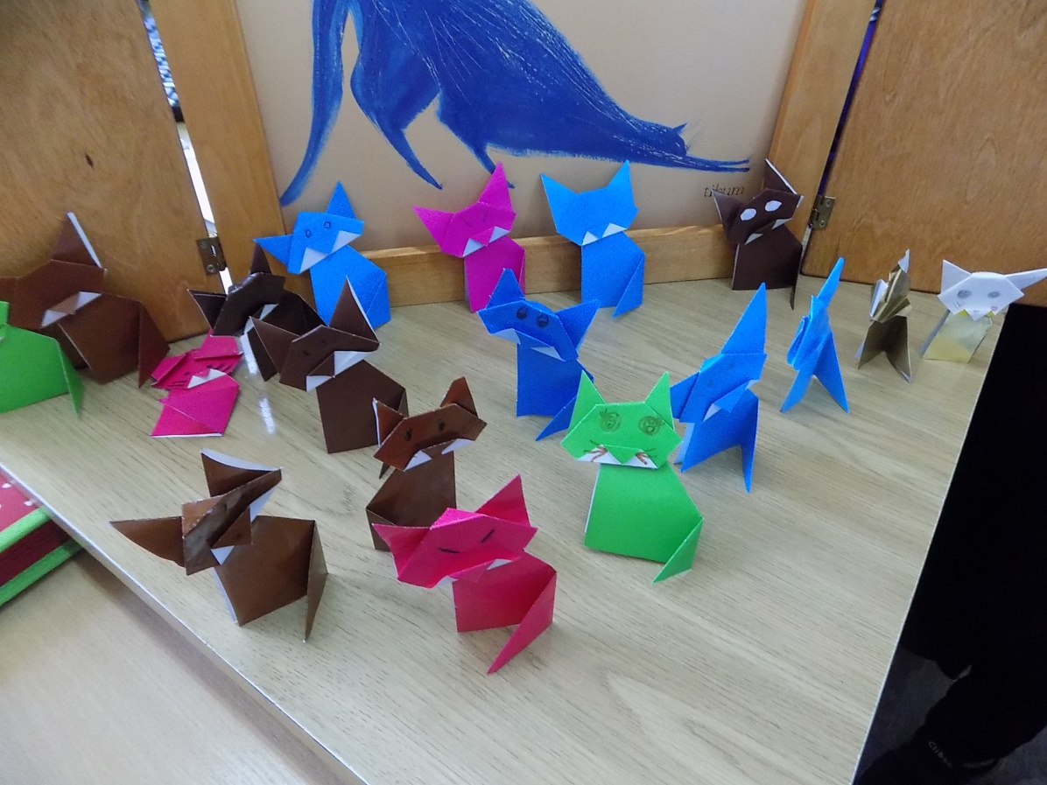
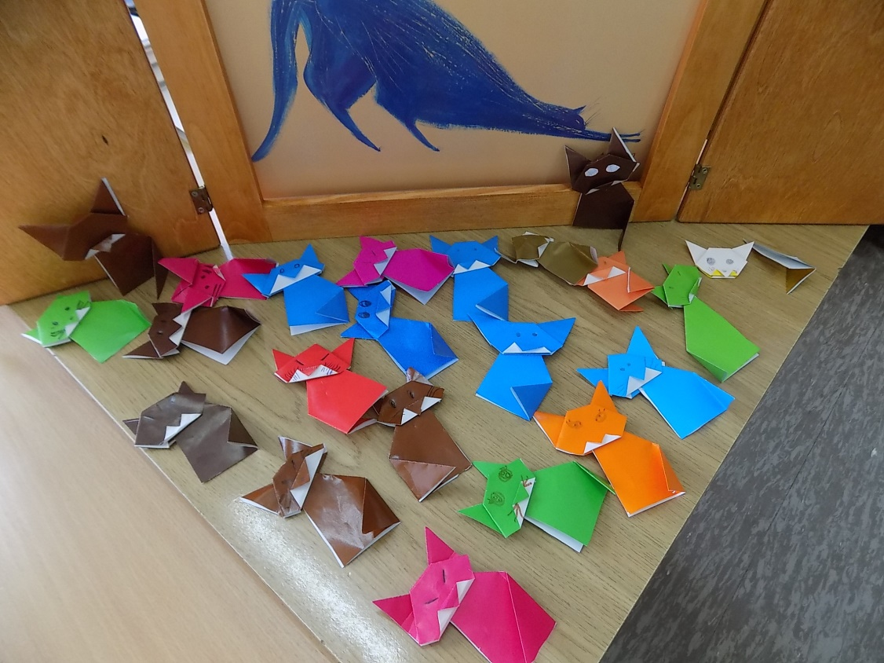

Slide 11
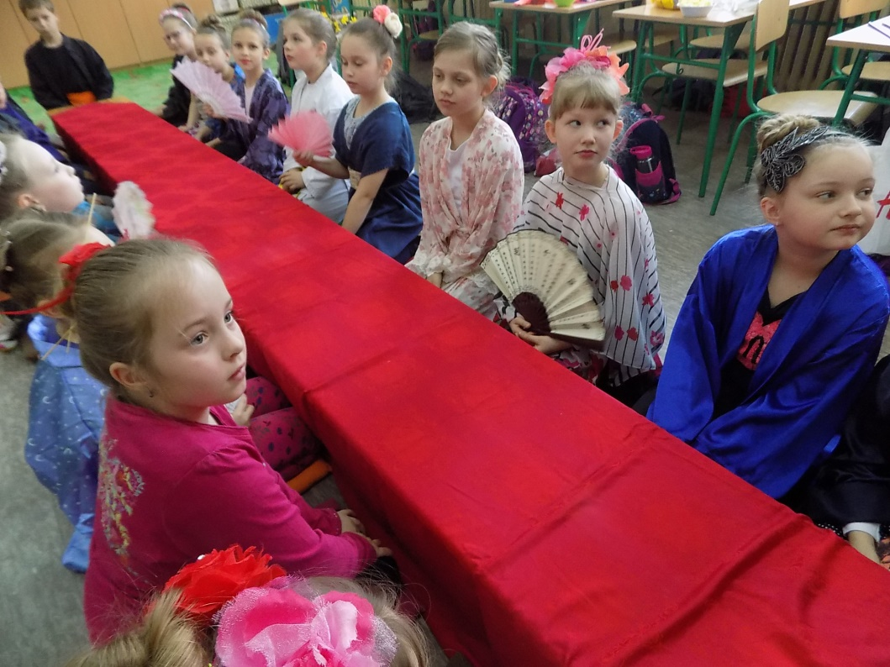
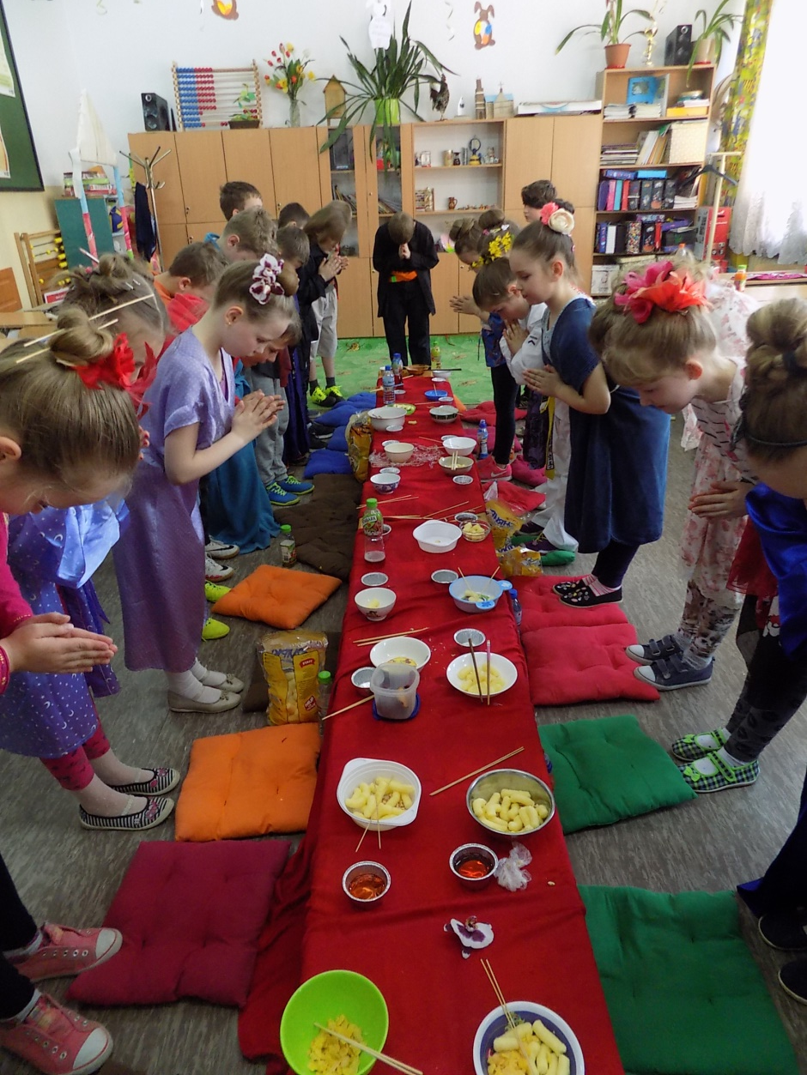
And finally there was a Japanese feast! We sat at the table, ate with chopsticks and drank cherry juice.

Slide 12
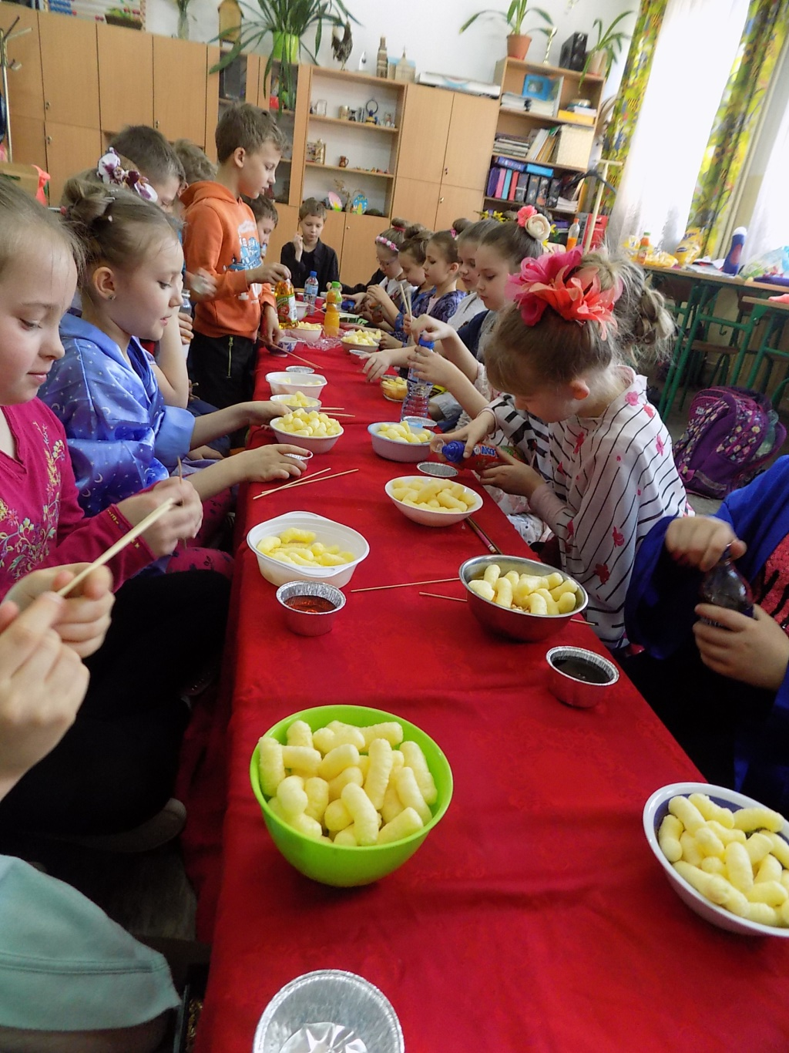
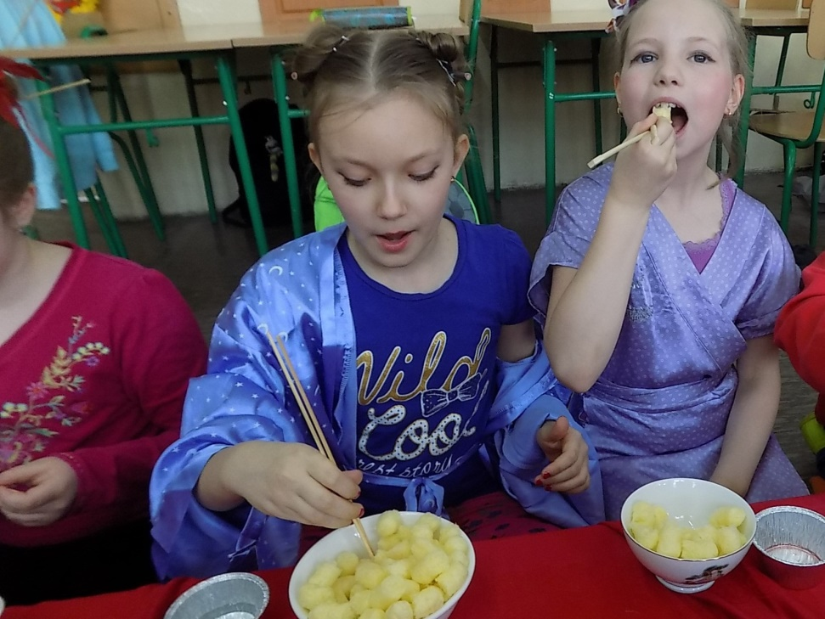

Slide 13
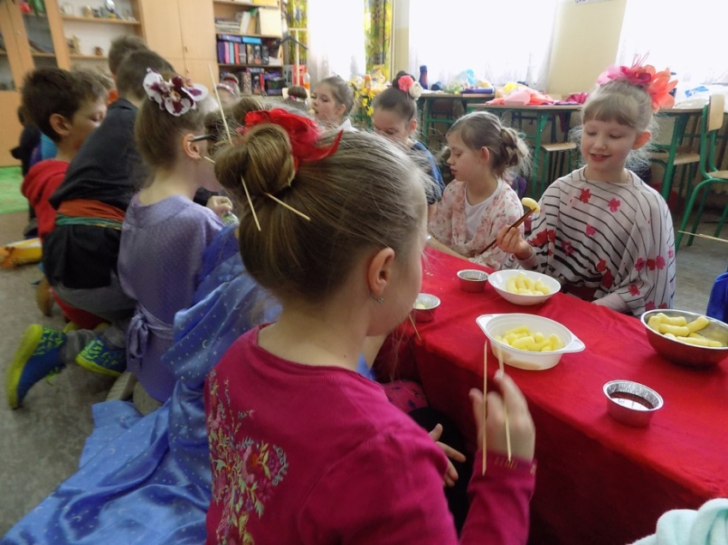
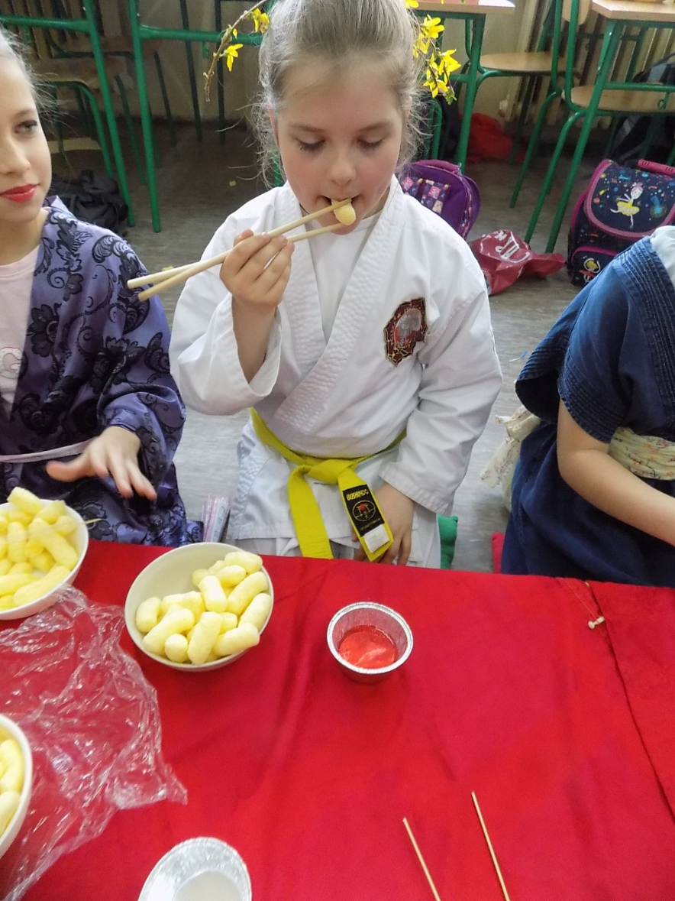
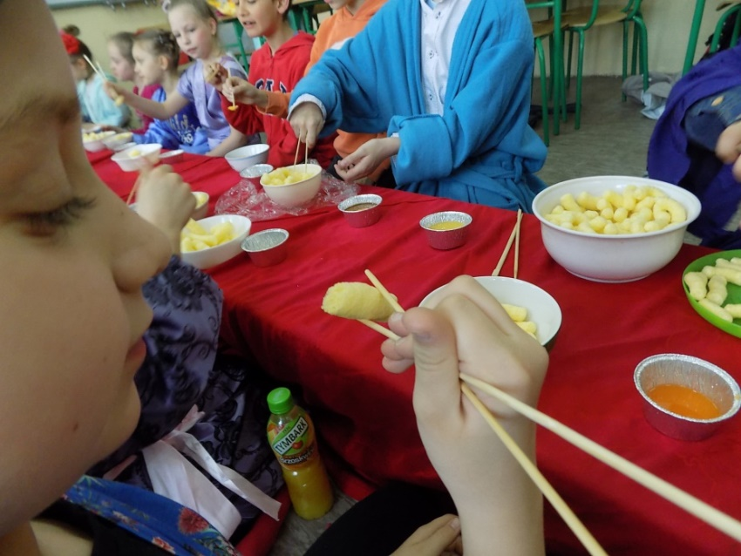
It was an unforgettable day for us!

Slide 14
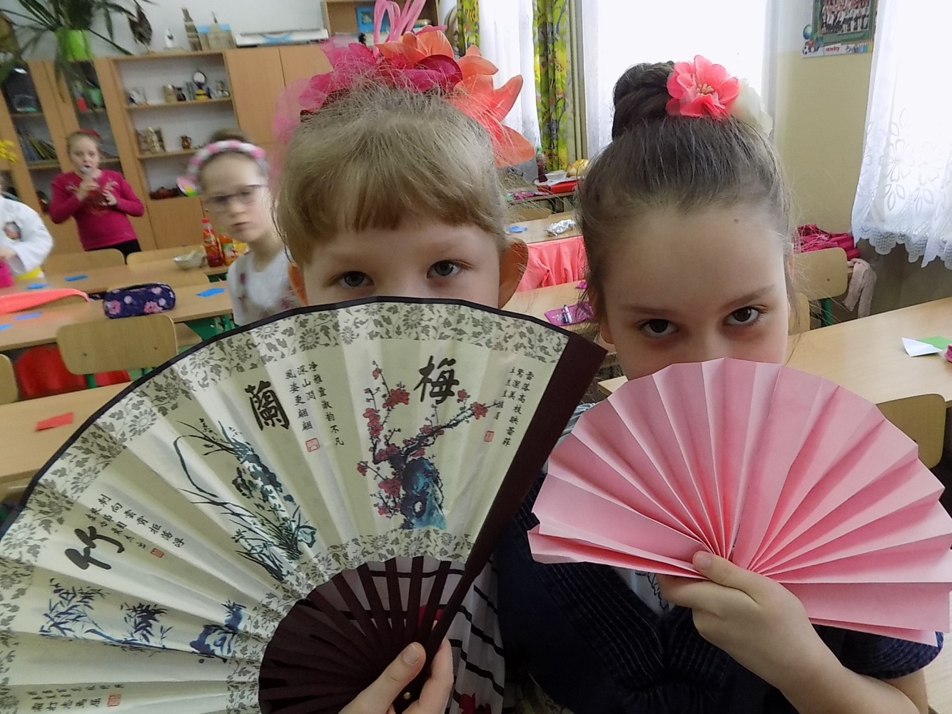
Thank you for your watching

