Slide 1
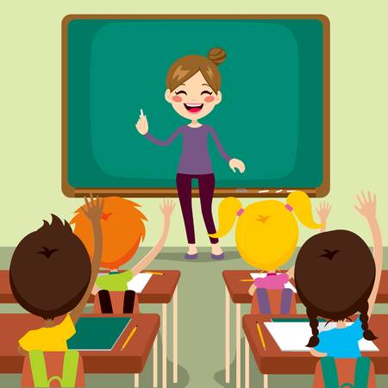
Our School
In this presentation I’ll show you, what
our school looks like and how do we learn :D

Slide 2
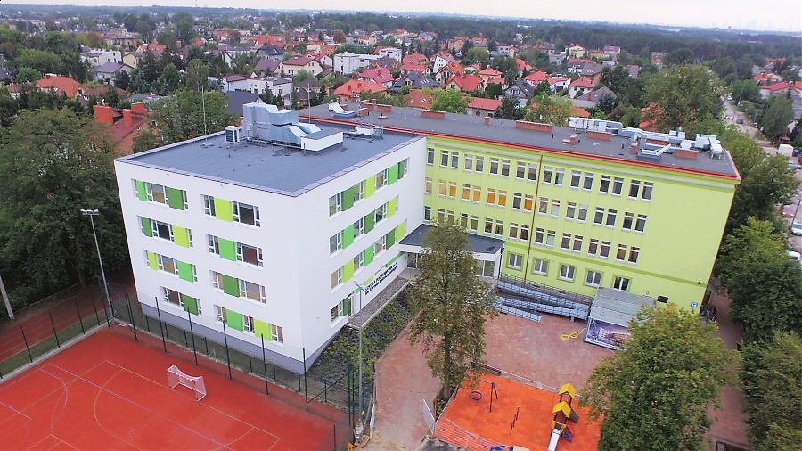
Our school’s full name is: Primary School number 1 in Marki of Kornel Makuszyński. Over 850 students go here. Over 60 teachers work here.
That means we are the biggest school in our town now – there are five public schools and two private schools. We have playgrounds for younger students, two pitches and even a track for running! But don’t forget that we have lots of great classrooms ;)

Slide 3
When we go to school?
We go to school from Monday to Friday (five days) and on Saturday and on Sunday we’ve got free days.
But we also have two months of summer holidays (July and August), two weeks of winterbreak in January or February (depends on the region of Poland)
We have also some free days around holidays like Christmas, New Year’s Eve or Easter.

Slide 4
Grades and Marks
We have eight grades of primary school and then four grades of highschool (or five grades of technical school). Children usually start primary school at the age of 7 and go to highschool at the age of 15.
About the marks – we have marking system from 1 (the worst mark) to 6 (the best mark).

Slide 5
School Register
In our school we don’t use typical paper register for grades. Our teachers use an electronic register called „Librus”.
The teachers check presence here, they make an assessment here
We can check our marks, lessons plan, our absence and much more „school stuff” on our mobile phones, computers, tablets.

Slide 6
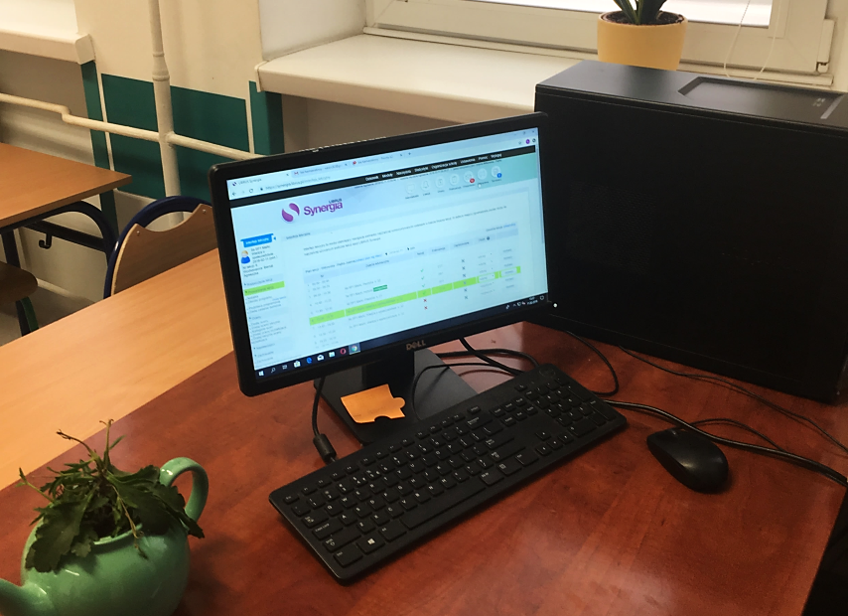
Computers
Students can’t use any technological devices at school wihout teacher’s permission, but in every classrom there is a computer or laptop for teacher to use „Librus”.

