Slide 1
ASSESSMENT

Slide 2
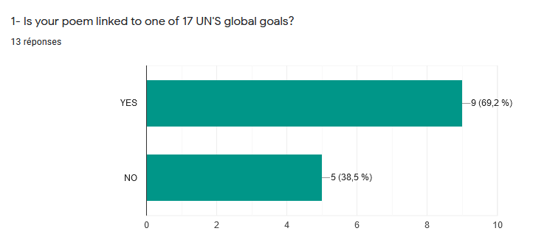
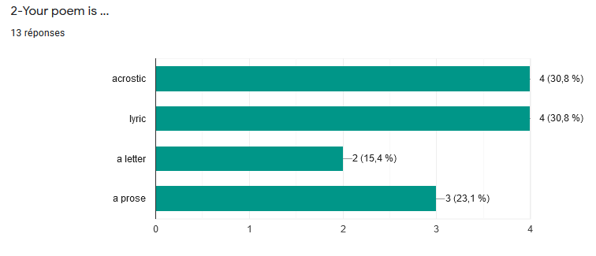
Most of you have respected the theme. You preferred acrostic and lyric poems. The prose was also mostly chosen.

Slide 3
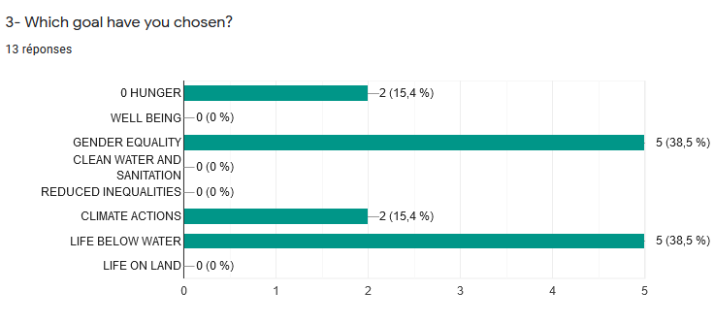
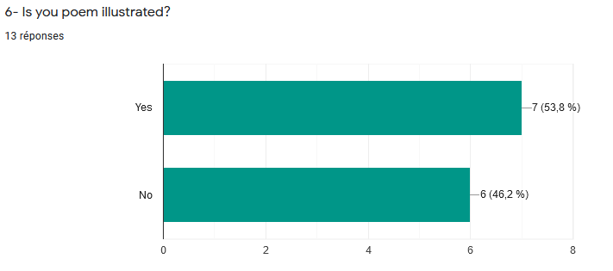
Gender equality and life below water were the main goals that you preferred.

