Slide 1
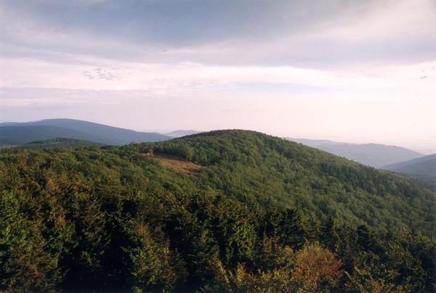
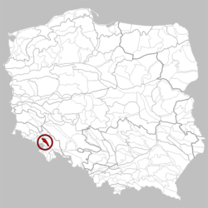
The Owl Mountains
Ecosystem quiz
Start

Slide 2

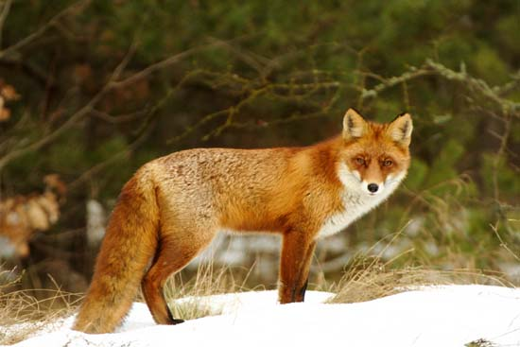
What is it?
a fox
a wolf
a hare

Slide 3
Well done!!!
Congratulations!!!
Next question

Slide 4
No!!!
Try again!!!

Slide 5
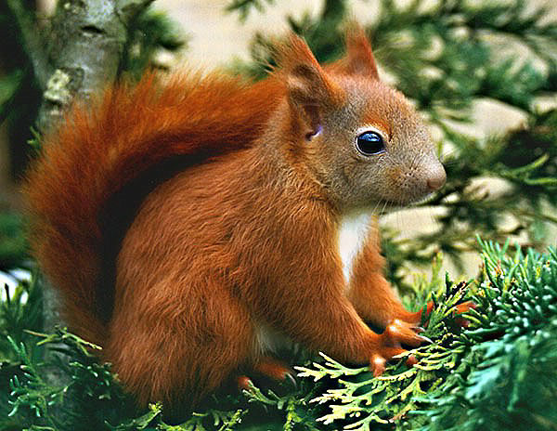
What animal is it?
a fox
a squirrel
a deer

Slide 6
Well done!!!
Congratulations!!!
Next question

Slide 7
No!!!
Try again!!!

Slide 8
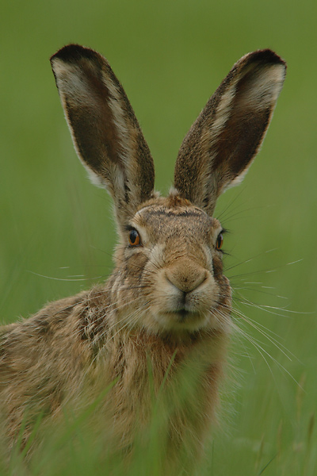
What animal is it ?
a fox
a rabbit
a hare

Slide 9
Well done!!!
Congratulations!!!
Next question

Slide 10
No!!!
Try again!!!

Slide 11
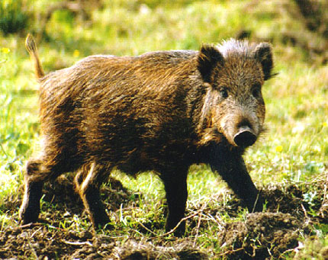
What animal is it?
a roe
a squirrel
a boar

Slide 12
Well done!!!
Congratulations!!!
Next question

Slide 13
No!!!
Try again!!!

Slide 14
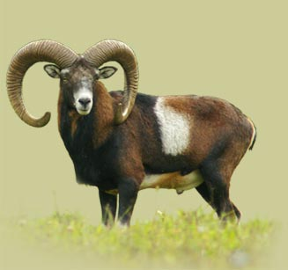
What animal is it?
a goat
a mouflon
a deer

Slide 15
Well done!!!
Congratulations!!!
Next question

Slide 16
No!!!
Try again!!!

Slide 17
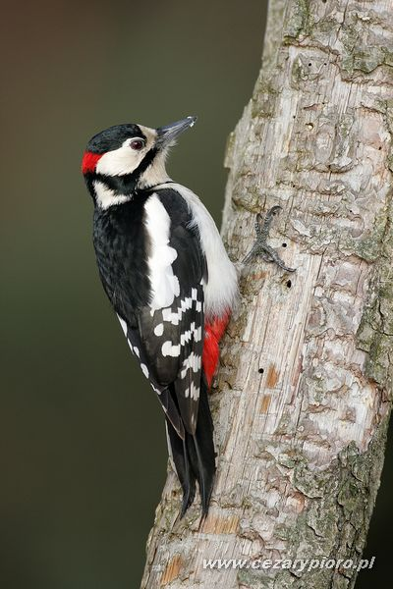
What bird is it?
a hawk
a jay
a woodpecker

Slide 18
Well done!!!
Congratulations!!!
Next question

Slide 19
No!!!
Try again!!!

Slide 20
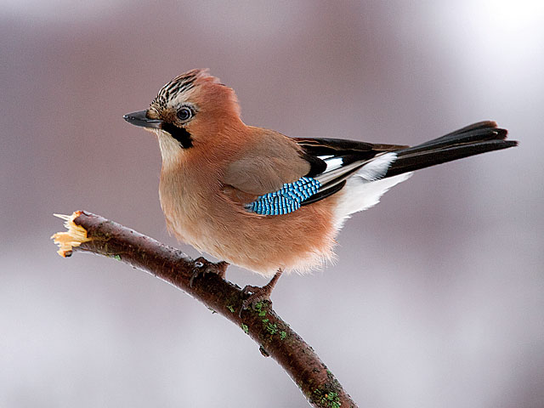
What bird is it?
a cuckoo
a jay
a woodpecker

Slide 21
Well done!!!
Congratulations!!!
Next question

Slide 22
No!!!
Try again!!!

Slide 23
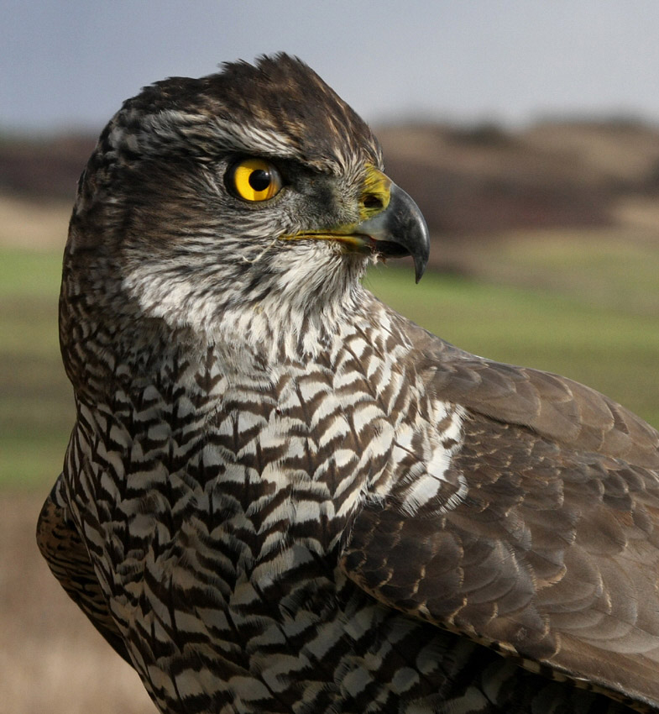
What bird is it?
a hawk
a jay
a woodpecker

Slide 24
Well done!!!
Congratulations!!!
Next question

Slide 25
No!!!
Try again!!!

Slide 26
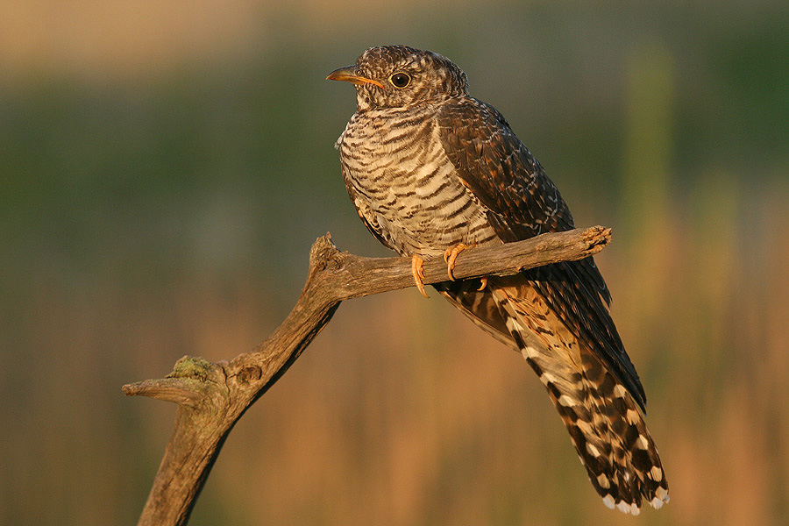
What bird is it?
a cuckoo
a hawk
a woodpecker

Slide 27
Well done!!!
Congratulations!!!
Next question

Slide 28
No!!!
Try again!!!

Slide 29
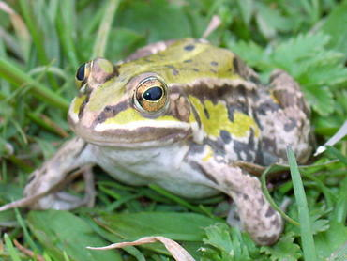
What animal is it?
a frog
a lizard
a snake

Slide 30
Well done!!!
Congratulations!!!
The end

Slide 31
No!!!
Try again!!!

Slide 32
The end
Thank you for joining our quiz
Ecosystems around us…
Berlin, 28-30 March 2012

