Slide 1
Project Nr: 2019-1-CZ01-KA229-061106 It´s our world - take care of it

Slide 2
Impact of climate change on agriculture
in Spain in the last 40 years.

Slide 3
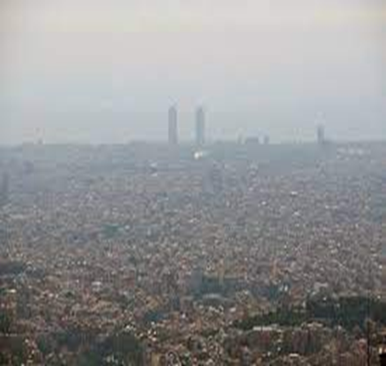
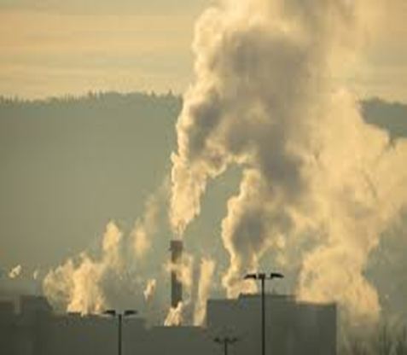
Causes:
From the 18th century to the present day, human behaviour have changed the composition of our atmosphere due to GHG. Our biological needs as living beings are adapted after an evolution of thousands of years with stable climatic conditions.

Slide 4
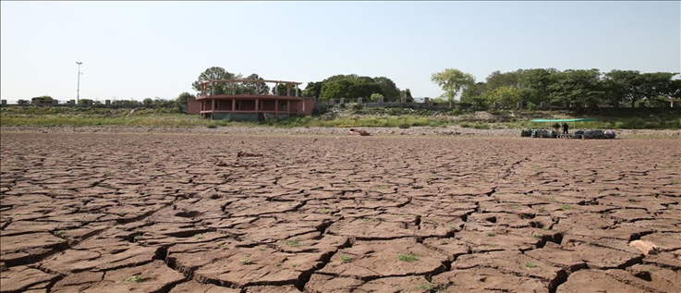
Consequences:
-Earth’s average temperature has increased exponentially.
-Torrential rains.
-Destruction of soil structure.
-Increase in pests and tropical diseases.
-Prolonged droughts.
-20% decrease in food production.
-Desertification.

Slide 5
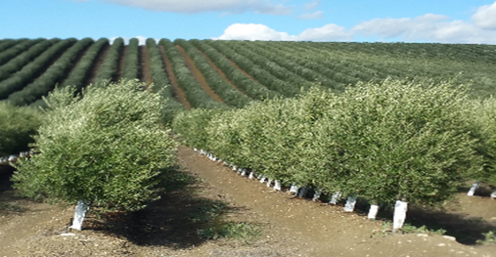
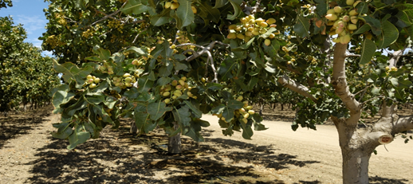
Possible solutions:
1) Use non-polluting energy sources.
2) Establish irrigation systems adapted to rainfall.
3) Reduce the irrigated area.
4) Avoid groundwater overexploitation.
5) Use of adapted crops and varieties for risk reduction, soil and water conservation: almond tree or pistachio tree instead of traditional crops (olive groove), because they do not need much water and can resist high temperature.

Slide 6
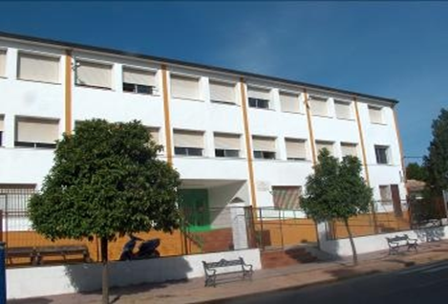
At our school...
1) We have reduced reduce energy consumption replacing our fluorescent tubes with LED (so we reduce our carbon footprint)
2) We have installed taps with timing device (so we reduce our water footprint)
3) We have moved from paper-based to digital document.
4) We separate our recyclable materials into different bins in order to reduce carbon and water footprint).
5) We grow and produce plants in our agricultural facilities, the greenhouse, shade house and orchard
6) We have changed enclosures to save energy

Slide 7
Bibliography
Greenpeace Spain.
Our school’s pollution specialist.

Slide 8
"The European Commission support for the production of this publication does not constitute an endorsement of the contents which reflects the views only of the authors, and the Commission cannot be held responsible for any use which may be made of the information contained therein."
C. San Sebastián s/n
14520 Fernán-Núñez, Córdoba
Tel. +34 957 38 20 53
info@greguerias.com
www.greguerias.com

