Slide 1
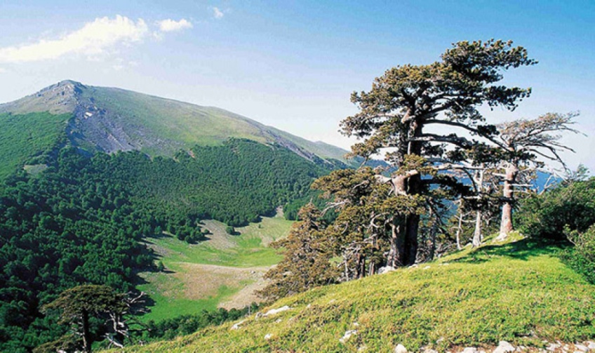
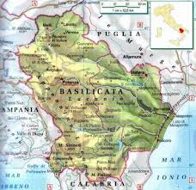
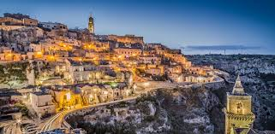
ENERGY IN OUR REGION:
BASILICATA
Basilicata is in the South of Italy, between Campania, Puglia and Calabria. here is a predominant hilly landscape, with lots of small rivers, like Agri and Sinni

Slide 2
Erasmus+ Project „It´s our world - take care of it“
Project Nr: 2019-1-CZ01-KA229-061106

Slide 3
In Basilicata, the whole production of electric energy is 2805 GWh/year;
2450 GWh come from renewable sources. That’s 87%.

Slide 4
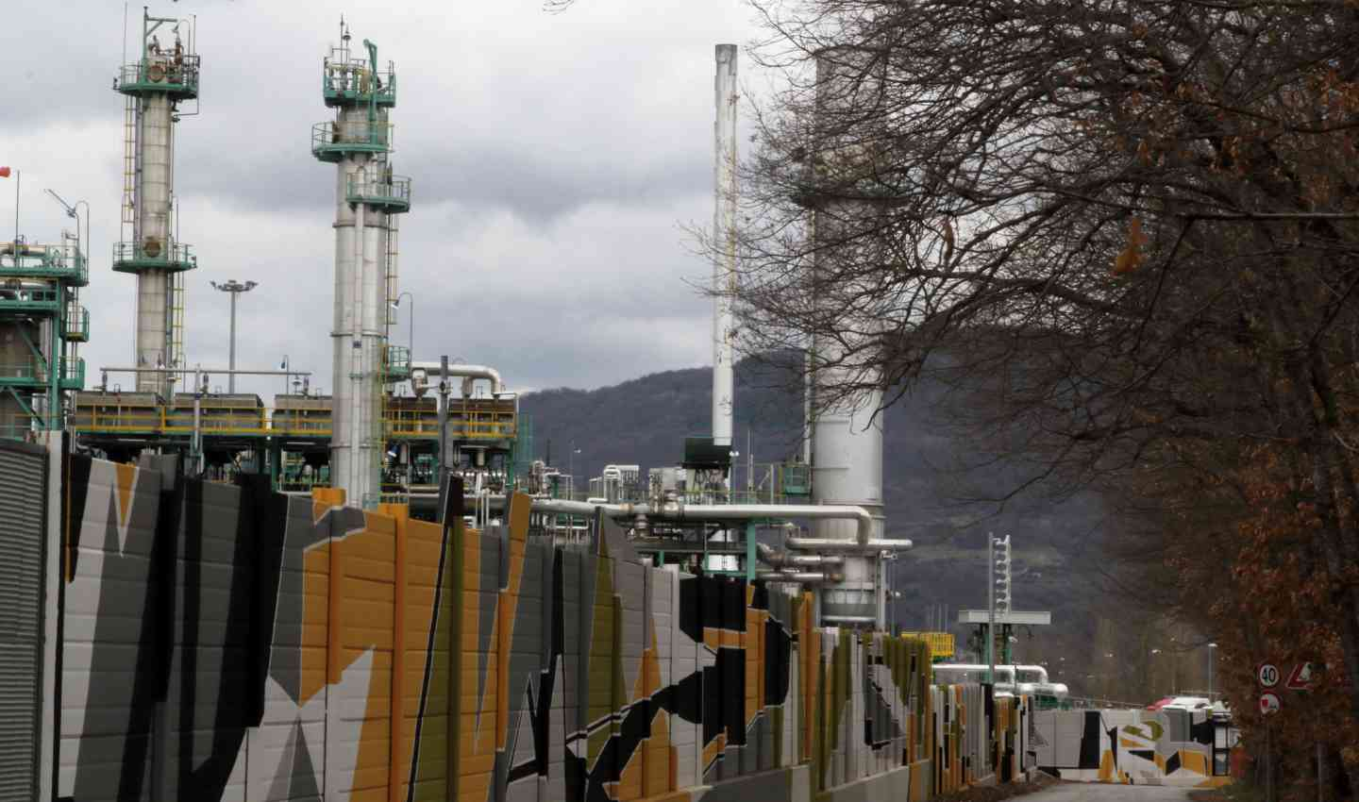
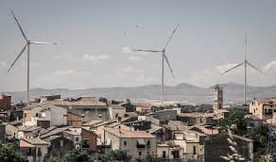
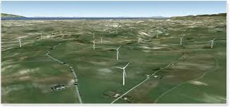
Aeolian is mostly the widest technology used with 1560 GWh/ year.
However, sometimes these wind turbins change the landscape.

Slide 5
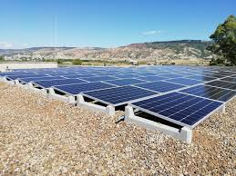
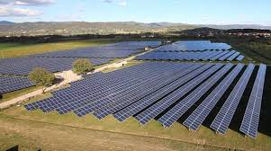
Solar energy plants produce 440 GWh/year. Together with Aeolic system, they make 82% of the renewable whole energy production.

Slide 6
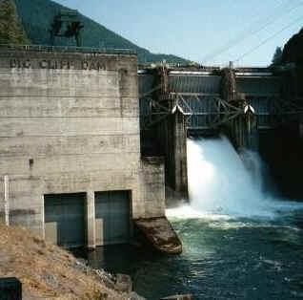
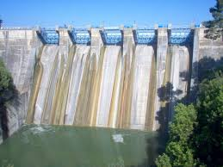
As for Hydroelectric plants, the estimated annual energy production amounts to 267 GWh/year. Only 3.5%.

Slide 7
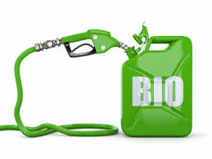
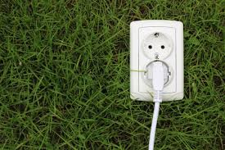
Eventually, bioenergy with its 1,5% make only 184 GWh/year.

Slide 8
Despite all this «green» production, Basilicata is also the most exploited region in Italy by Oil companies

Slide 9
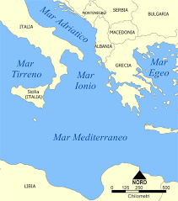
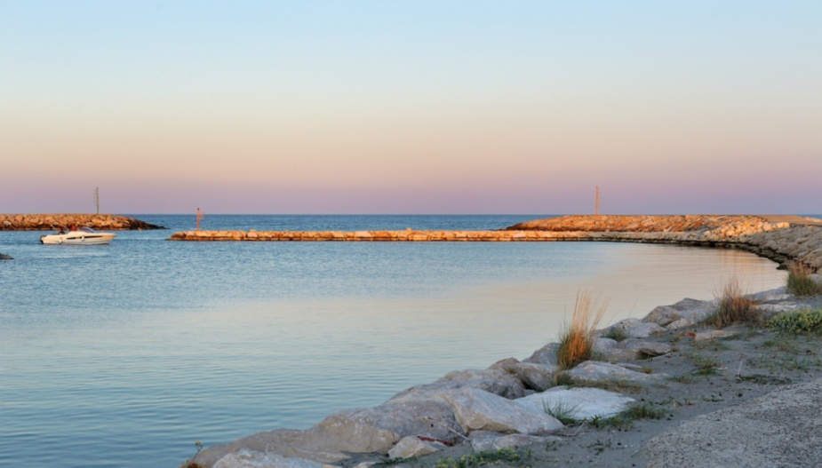
In fact, it contributes with 71% to the whole national production of crude oil.
2 oil concessions have been working since 2010
7 oil research agreements have been already signed
17 oil research requests have been asked (in the Ionian sea too)

Slide 10
We hope for our region
a green and blue future.
FOR OUR REGION AND FOR OUR PLANET!!

Slide 11
MADE BY:
Samuele Buccolo
Second year, Commerce and management student
@samubuck_ on instagram

Slide 12
"The European Commission support for the production of this publication does not constitute an endorsement of the contents which reflects the views only of the authors, and the Commission cannot be held responsi­ble for any use which may be made of the information contained therein."

