Slide 1
Water resource and climate changes

Slide 2
Climate changes affect the freshwater ecosystem
Climate changes can modify your ecosystem in various ways,for example it can :
1 Change the water holding capacity of the atmosphere;
2 Shift weather patterns;
3 Change evaporation rates;
4 Melting frozen water storages (glaciers and permafrost lands)
5 Changing hydrological regimes
6 Changes in the frequency of extreme events

Slide 3
Intensification of the hydrological cycle
Let’s start with the definition of hydrological cycle.
We define hydrological the existance and the movement of water in the entire planet earth.
After various research we’ve noticed that In a warmer climate, evaporation rates increase, and therefore soil moisture decreases. When soils dry out,the severity of droughts increases.
Conversely, the atmosphere has a greater water holding capacity when it becomes warmer. This means that, when a precipitation events occurs, rainfall is likely to be more intense.

Slide 4
Other problems with the climate changes and the future security of water
The expansion of the tropics
The reduction of snowfields and glaciers
Since the late 1970s, atmospheric observations indicate that the region of the tropical belt has expanded. Whilst the exact mechanisms are not fully understood, the expansion is most likely driven by increasing greenhouse gases and pollutants.
In a warmer world,precipitation as snow are decreasing and this os very impactfull on the coldest region,with the reduction in ice cover, hence a diminishing snowpack, glacier depth and extent.

Slide 5
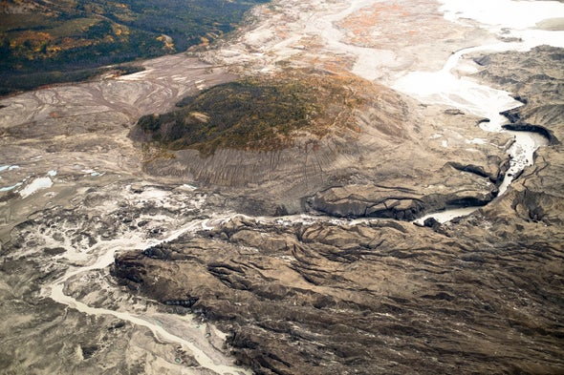
The impact on aquatic ecosystems
Growing evidence shows that streams, rivers and lakes are among the most sensitive ecosystems to climate change.The evidence from long-term data and experiments, shows, for example, that:
1 Organisms in freshwater ecosystems are linked closely to their hydrology, hydraulics, and the hydrological cycle affect them.
2 Warmer water hold less oxygen than cooler waters , so warming directly affects lots of aquatic species.
3 Climate changes interacts with other pressures on freshwater ecosystems, for example from intensified catchment land-use, pollution, water abstraction and invasive species.

Slide 6
How about the future climate
In order to understand how the earth will respond to this changes we need to have some information about the greenhouse gas concentrations in a span of time that goes from month to decades or also centuries for knowing all the information about our future.

Slide 7
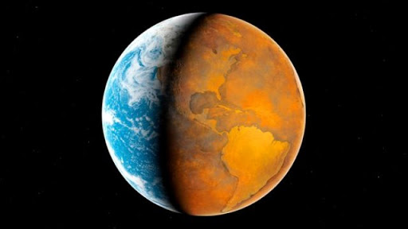

Slide 8
The downscaling process
Many scientists don’t work on a complete model of the climate changes in the years,but a reducted one, is that many assumptions and simplifications need to be done because of the uncertainty over predictions is usually much higher.

Slide 9
WRCP( World Climate Research Programme)
Models are simplifications of the real world and can be more or less skilful in simulating climate change. To support the development of climate models, WRCP organize regular model inter-comparison projects.
WCRP experiments help scientist understand model capabilities in simulating natural climate variability and predictability on decadal and centennial time scales.
Researchers want to avoid to depend only for the result of a model,for that they use some criteria,like:
1 Natural climate variability;
2 Model uncertainty;
3 Emissions.

Slide 10
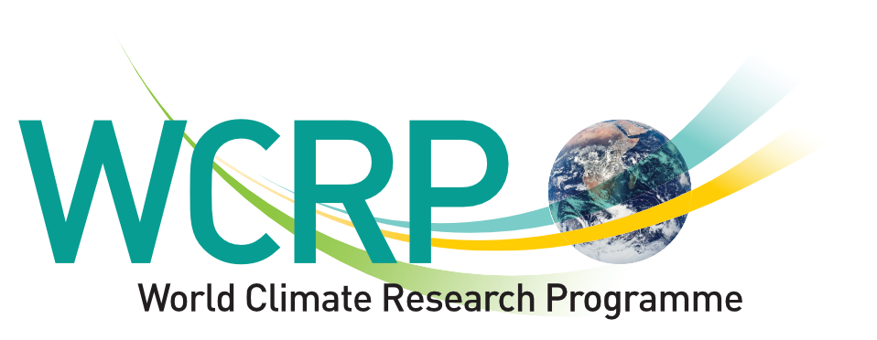

Slide 11
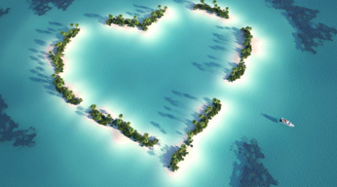
Thank you for watching this presentation
All the information comes from: https://www.futurelearn.com/courses
Now be careful and protect the water resources with all your strength

