Slide 1
Project Nr: 2019-1-CZ01-KA229-061106
It´s our world - take care of it

Slide 2
Endangered animals
Lucia Osuna Luna
Dario Acosta Sánchez

Slide 3
INTRODUCTION
There are more than 7,7 million of endangered animals in the world.
In our school, Greguerias, we think we must all do our bit to save these endangered species from extinction.

Slide 4
IN SPAIN
Spain is one of the 25 biodiversity hotspots in the world-
In the European Union, Spain is one of the most diverse countries in terms of biodiversity.
However, it is the most fragile in Europe, too. There are more than 1000 animals in danger.
If we talk about forest, Spain is the third country in Europe on forested area. The UE takes care about the importance of European forests if we want to save the biological diversity.

Slide 5
CAUSES
Species become endangered for several reasons, but the main one is GLOBAL WARMING
If the planet's temperature continues to rise unchecked, ALL ecosystems will have problems and 20-30% of species will be at increased risk of extinction..

Slide 6
Iberian lynx
In the last ten years there has been a reduction in the Iberian lynx population of 50-65%.
In 1960, the Iberian lynx occupied 31 areas in the Iberian Peninsula, but today its habitat is restricted to very limited 8 areas in southern Spain
Its main threats are human activity (road accidents and illegal hunting), diseases, fragmentation of its habitat and loss of habitat due to fires or inadequate reforestation.

Slide 7
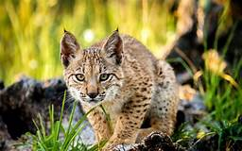

Slide 8
Spanish Imperial Eagle
It was on the edge the extinction, but thanks to the conservation programs, the Iberian Imperial Eagles is slightly increasing.
Some of the reasons are:
Poisoning.
Habitat loss.
Electrocution.
Human activity (pollution).

Slide 9
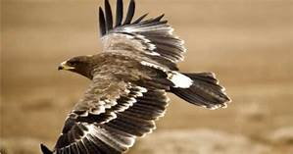

Slide 10
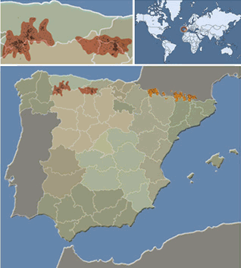
Cantabrian Brown Bear
It is estimated that the population of these animals that live in freedom in Spain is 332 bears.
Main threats (human factors):
habitat destruction (due to agriculture and construction).
illegal hunting (for its meat, as trophy, etc.)

Slide 11
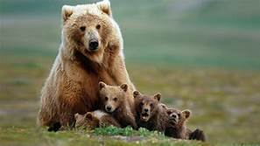

Slide 12
The Bearded Vulture
Its name in Spanish refers to the habit of this bird of throwing bones from a considerable height against carefully chosen flat rocks in order to break them and be able to eat the marrow inside. It is the largest bird of prey in Europe, reaching up to 2.85 meters with outstretched wings.
The main cause of mortality in the bearded vulture include:
illegal use of poisoned baits.
habitat degradation,
seriously compromising the growth of the population and its colonization process in new areas.

Slide 13
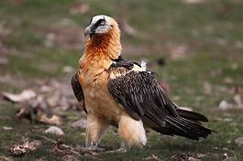

Slide 14
PODARCYS PITYUSENSIS
Better know as “lagartija ibicenca” they live in Ibiza and Formentera (Balears Islands) It is an endangered animal because one snake enter to the island there are more than 30 subspecies from this lizard. It is the logo from the island, there are a lot of campains behind the live of this lizards, the most important is called Ibiza Unida

Slide 15
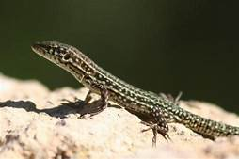

Slide 16
AGUILA ADALVERTI
Better know as Aguila Imperial Ibérica, was near to the extincion too. They live in the suroest peninsular, they eat other animal
it is a big rapacious. In 1960 was considerated a critical endangered animal ,with only 60 ,having luck in 2015 they was more than 500.

Slide 17
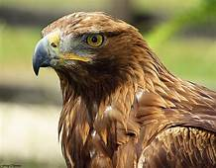

Slide 18
The solution is in our hands

Slide 19
The European Commission support for the production of this publication does not constitute an endorsement of the contents which reflects the views only of the authors, and the Commission cannot be held responsible for any use which may be made of the information contained there in."
C. San Sebastián s/n
14520 Fernán-Núñez, Córdoba
Tel. +34 957 38 20 53
info@greguerias.com
www.greguerias.com

