Slide 1
Electricity production and consumption in the Czech Republic in 2018
We achieved the highest production, but also
the consumption of electricity.

Slide 2
Erasmus+ Project Project Nr: 2019-1-CZ01-KA229-061106 „It´s our world - take care of it“

Slide 3
Net electricity production reached 81.9 TWh per year 2018
nuclear power plants produced 34%
various forms of steam power plants (biomass, coal / lignite, ...) accounted for 51.2%
combined gas, gas and combustion plants together have 8.4%
photovoltaics with 2.65%
water is only 1.85%
pumped make up 1.2%
wind only 0.7%

Slide 5
Net consumption reached 61.0 TWh
Our power plants produce much more energy than we are able to consume. The result was 13.9 TWh. Interestingly, this amount of energy would manage to charge about 4-5 million passenger electric vehicles

Slide 6
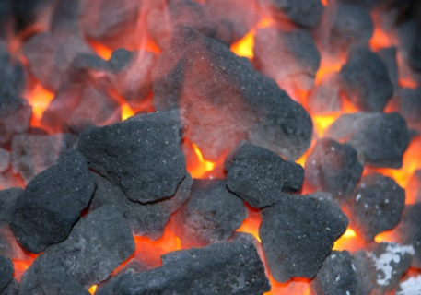
Coal-fired power plant in the Czech Republic
worldwide – 44 % generated electric energy is produced by coal-fired power plant
in Europe – 33 %
in the Czech Republic – 50 %
location: mostly in north-western and north Moravia
fuel: most of power plant burns north-Bohemian brown coal
average price of coal: 3100 CZK/tons (brown coal), 5300 CZK/tons (black coal)

Slide 7
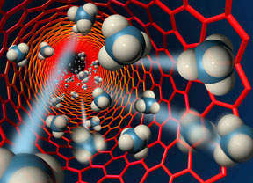
Nuclear power plant in the Czech Republic
worldwide – 437 nuclear reactors in 30 states (situation of as 01.04.2015), total installed capacity 380 GW
in Europe – 30 %
in the Czech Republic – 20 %
location: in south part of the Czech Republic
fuel: UO₂ (oxide uranium)

Slide 8
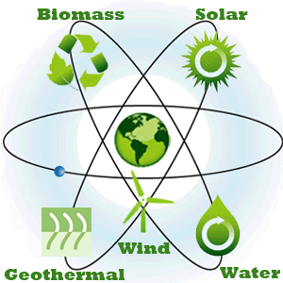
Renewable energy sources – generally
consumption and price of fossil fuels increase along with the growth of population all over the planet – additional pressure on the fossil resources and significant impact on the environment – renewable energy sources play important role in today electrical power engineering in the world and provide a significant potential for the future
water energy: rivers, dams, seas (e.g. tidal energy)
wind energy
solar energy: active utilization (photovoltaic power plant, solar power plant, solar collectors), passive utilization (greenhouses, Trombe wall)
biomass energy: burning of dry biomass in fluid boilers in coal-fired power plant, degradation of wet and dry biomass to produce biogas in biogas station
geothermal energy: heat pumps and power plant (basic types: Hot Dry Rock HDR and Hot Fractured Rock HFR)

Slide 9
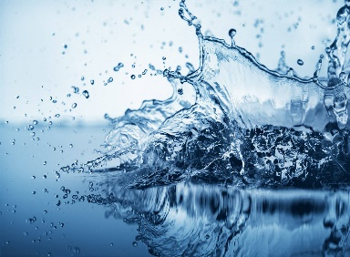
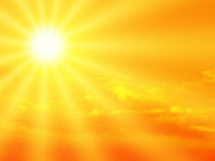
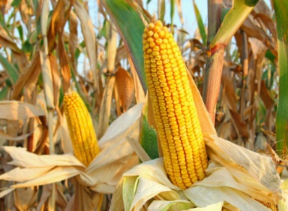
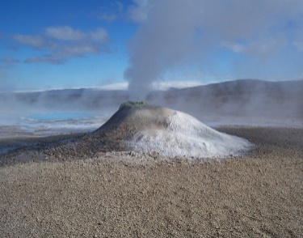
Renewable energy sources in the Czech Republic
worldwide – 16 % generated electric energy is produced by renewable energy sources
in European Union – 30 %
in the Czech Republic – 13 %

Slide 10
"The European Commission support for the production of this publication does not constitute an endorsement of the contents which reflects the views only of the authors, and the Commission cannot be held responsi­ble for any use which may be made of the information contained therein."

