Slide 1
Project Nr: 2019-1-CZ01-KA229-061106 It´s our world - take care of it

Slide 2
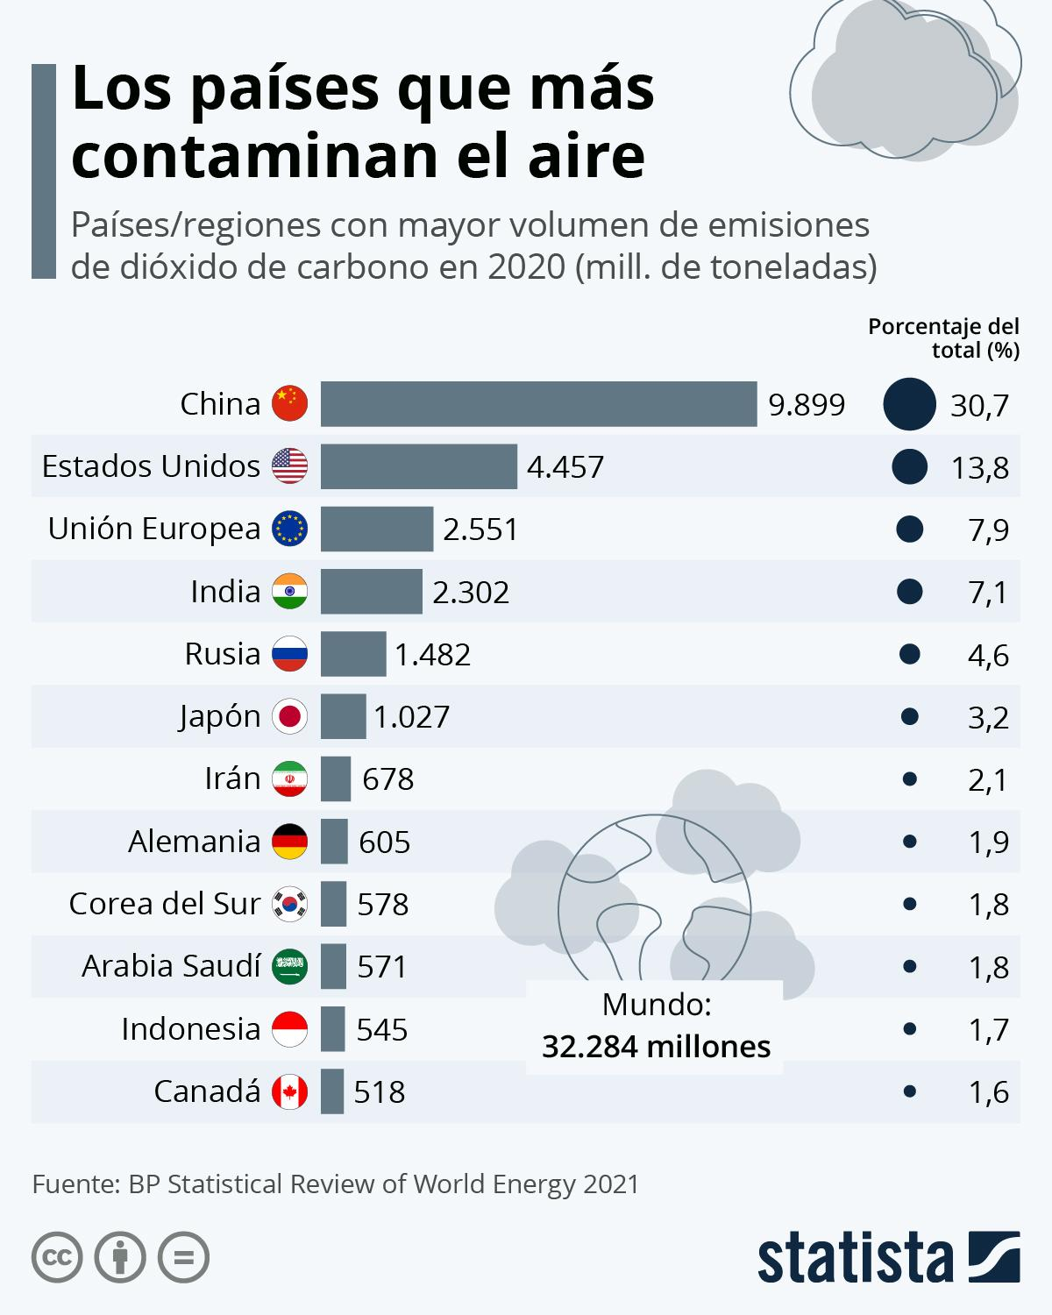
THE AIR POLLUTION IN THE LAST 30 YEARS
Pollution is the biggest threat to human health, because air pollutants have an effect on climate change.
The World Health Organization (WHO) data estimates that air pollution kills an estimated seven million people worldwide every year
(THE MOST CONTAMINATING COUNTRIES)

Slide 3
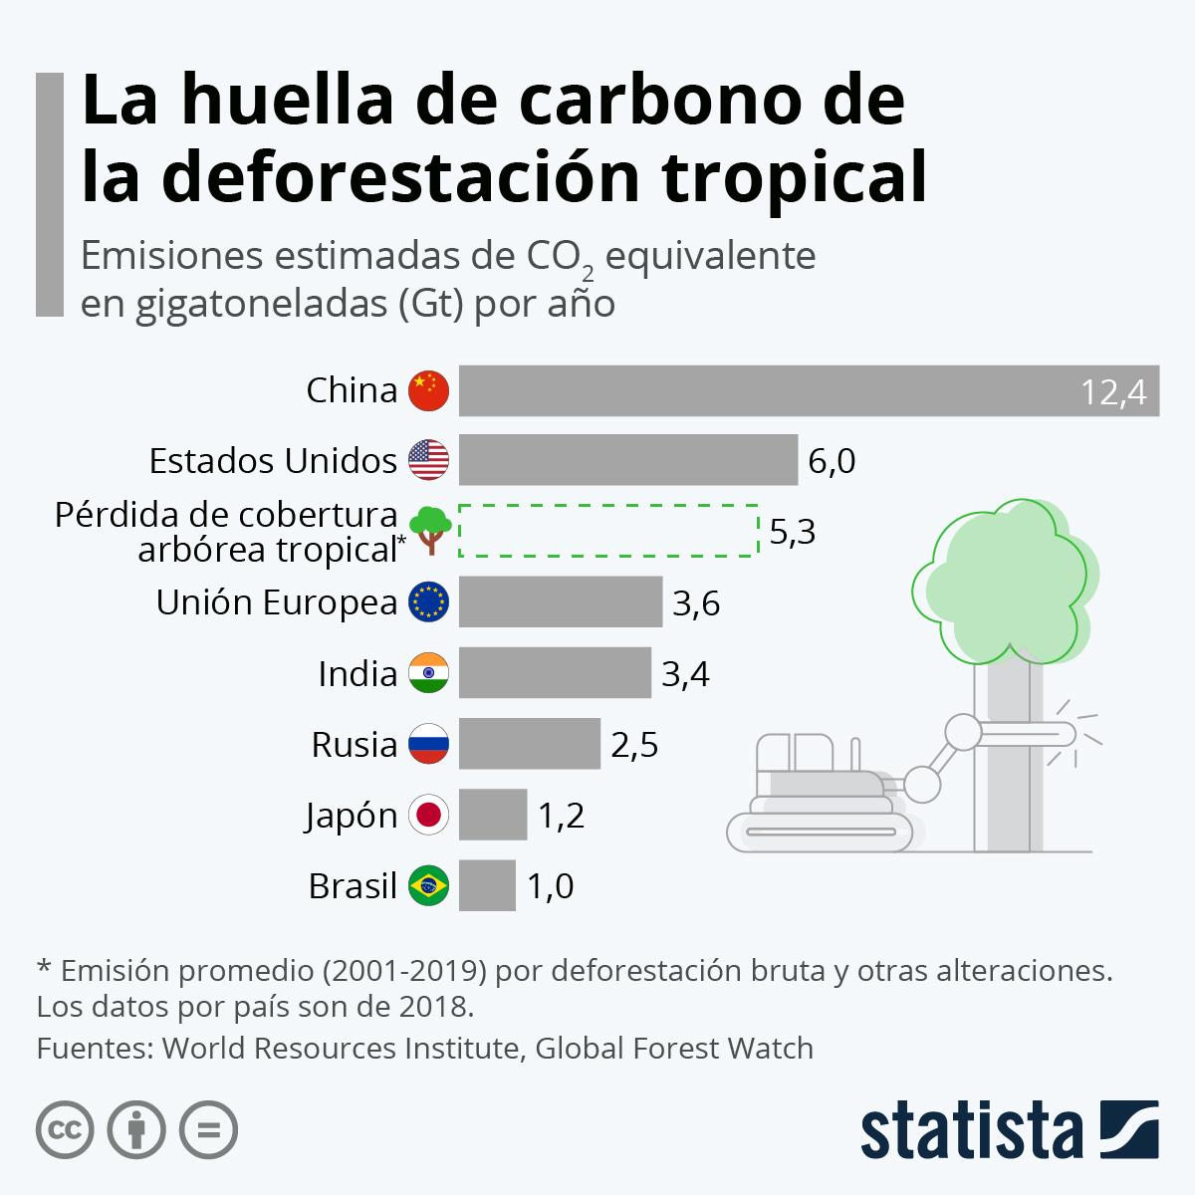
CAUSES OF AIR POLLUTION
Human activity is the main cause of air pollution.
We are polluting all ecosystems and increasing the greenhouse effect.
For example, in our hometown, Córdoba, temperatures are rising, so we reached nearly 50 degrees last summer.

Slide 4
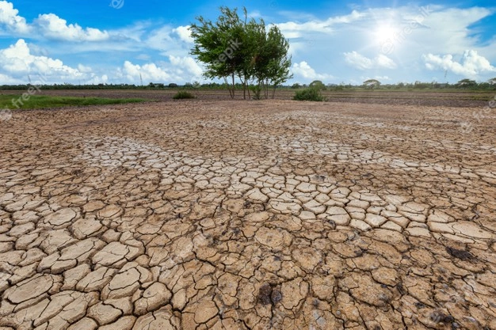
CONSEQUENCES:
Changes in intensity of rainfall (some areas experience more rain than usual, while others experience less).
Extreme weather events (cold, flood, heat wave, wildfire, droughts...)
Spread of invasive species and pathogens in Andalusia (West Nile Virus)
Economic loss and depopulation of rural areas.
Rising air pollution-related death.

Slide 5
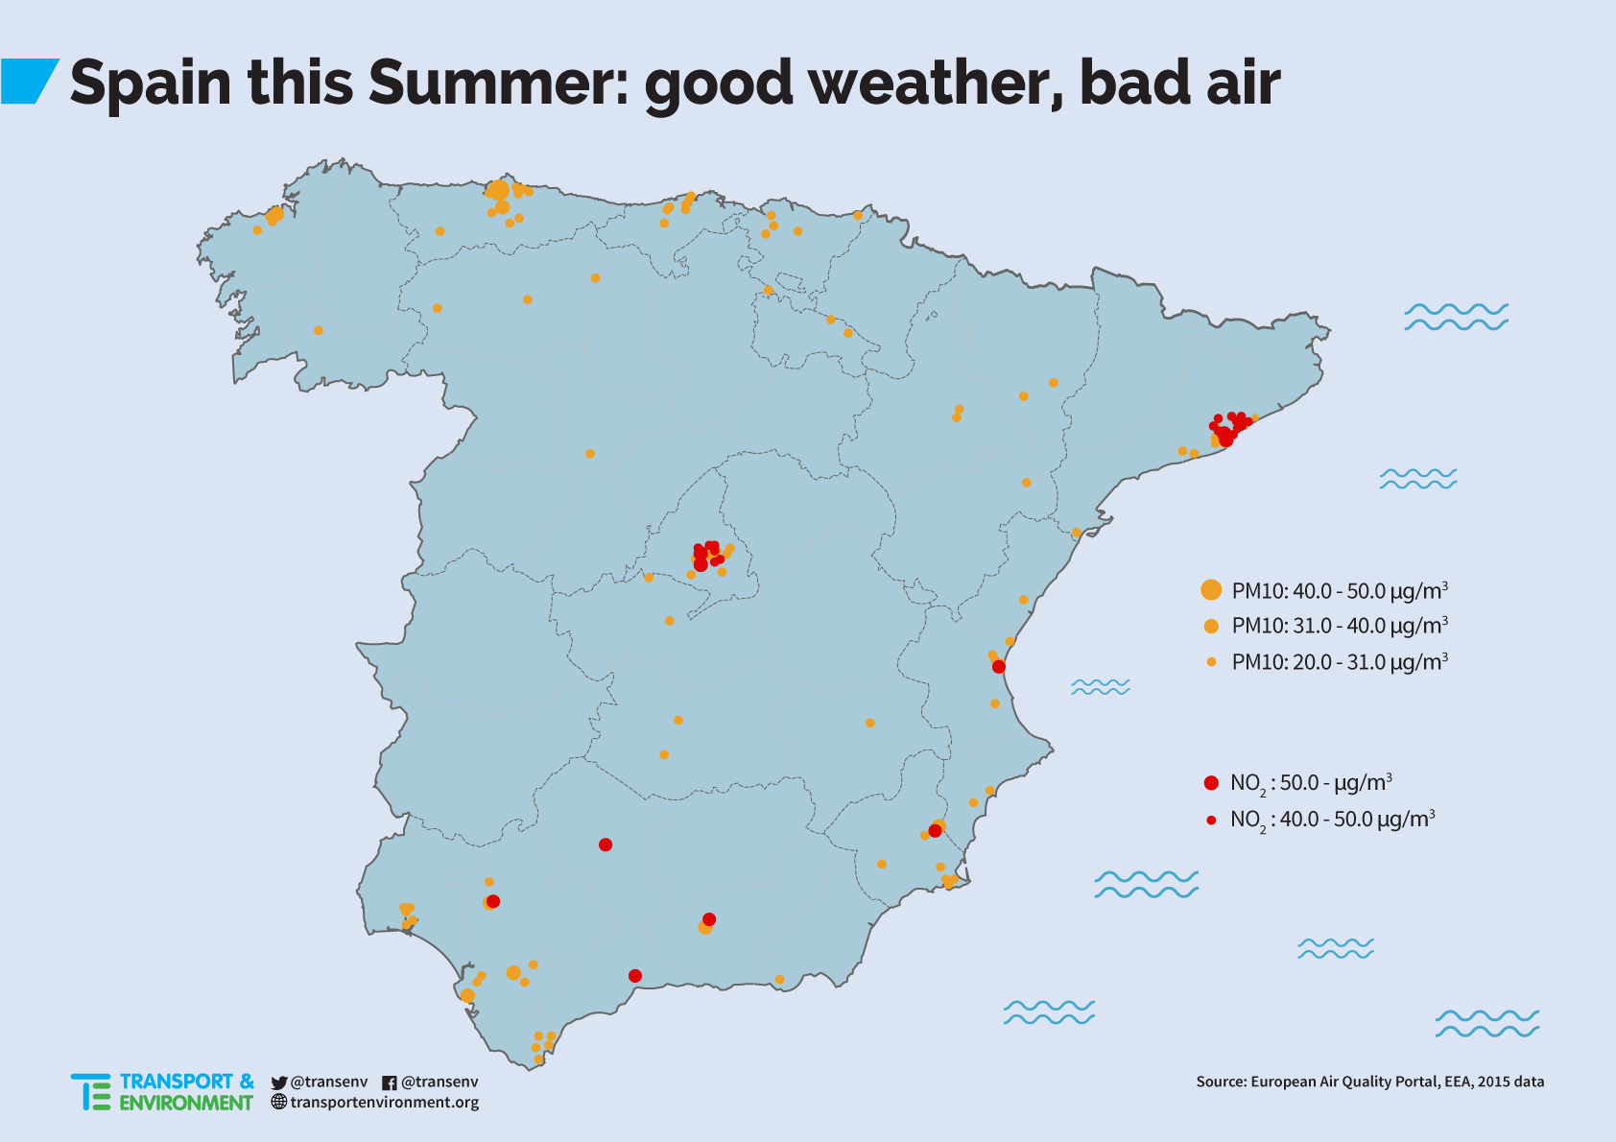
AIR POLLUTION IN SPAIN
In 2020, nearly 30.000 people died as a consequence of contamination of air in Spain.
In our country the main causes of pollution are man-made pollution: CO2 emissions, vehicle emissions , industrial emissions, etc.

Slide 6
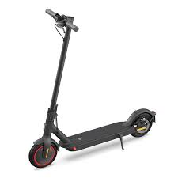
HOW WE CAN FIX IT
Reducing CO2 emissions, for example using public transport (bus), or using electrical means of transports such as electric cars, bikes or scooters.
Rationalization of food and water consumption.

Slide 7
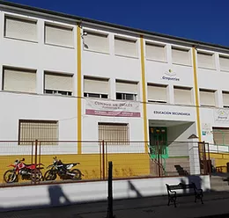
WHAT DOES OUR SCHOOL DO
TO REDUCE AIR POLLUTION?
Switching energy efficient school lighting leds.
Installing taps with timing device.
Reducing single-use plastic (reusable water bottles, sandwich wraps…)
Installing water filters to reduce bottled water consumption.

Slide 8
BIBLIOGRAPHY:
https://es.statista.com/grafico/15726/emisiones-de-co2-mundiales-y-la-reduccion-propuesta-por-la-onu/ Grafica emisiones CO2 recomendacion onu.
https://es.statista.com/grafico/26113/huella-de-carbono-de-la-deforestacion-tropical/ GRAFICA HUELLA DE CO2 DEFORESTACION INTERNATIONAL
https://www.who.int/es/news-room/fact-sheets/detail/climate-change-and-health INFO EFECTOS DE LA CAUSA Y EL EFECTO DE LA CONTAMINACION QUE CAUSA EFECTO
https://www.sport.es/es/noticias/salud/virus-nilo-deja-primera-muerte-12006334 VIRUS NILO
VIDEOS DEL TRABAJO:
https://www.youtube.com/watch?v=WfGMYdalClU VIDEO DEL HUMANO
VIDEOS DE LLUVIAS TORRENCIALES EN EL NORTE
VIDEOS DE MADRID CONGELADA

Slide 9
The European Commission support for the production of this publication does not constitute an endorsement of the contents which reflects the views only of the authors, and the Commission cannot be held responsible for any use which may be made of the information contained there in."
C. San Sebastián s/n
14520 Fernán-Núñez, Córdoba
Tel. +34 957 38 20 53
info@greguerias.com
www.greguerias.com

