Slide 1


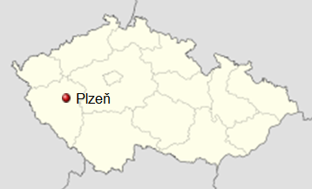
Electrical Power Engineering in the Czech Republic

Slide 2
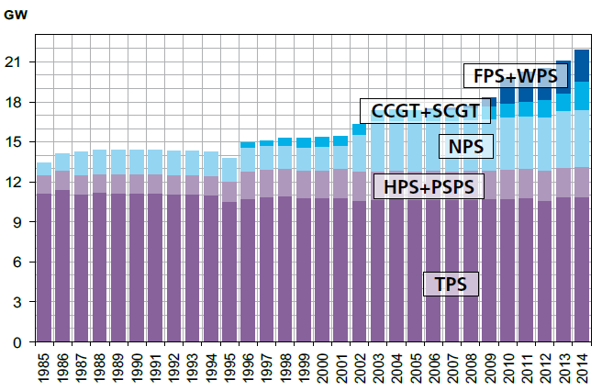
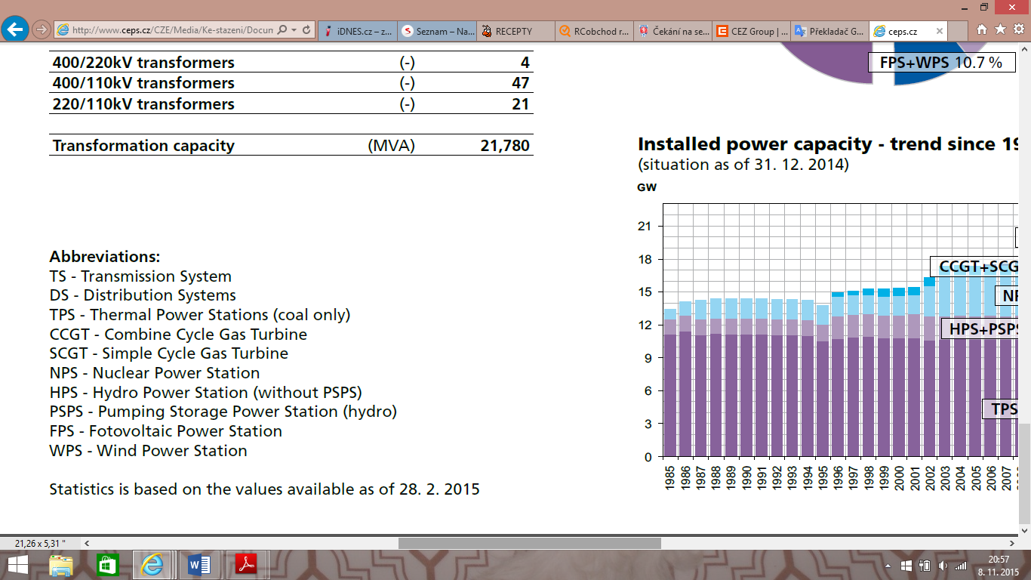
Basic type of the power plant
Installed power capacity – trend since 1985
coal-fired power plant
nuclear power plant
hydroelectric power plant
wind power plant
photovoltaic power plant
biogas station
geothermal power plant

Slide 3
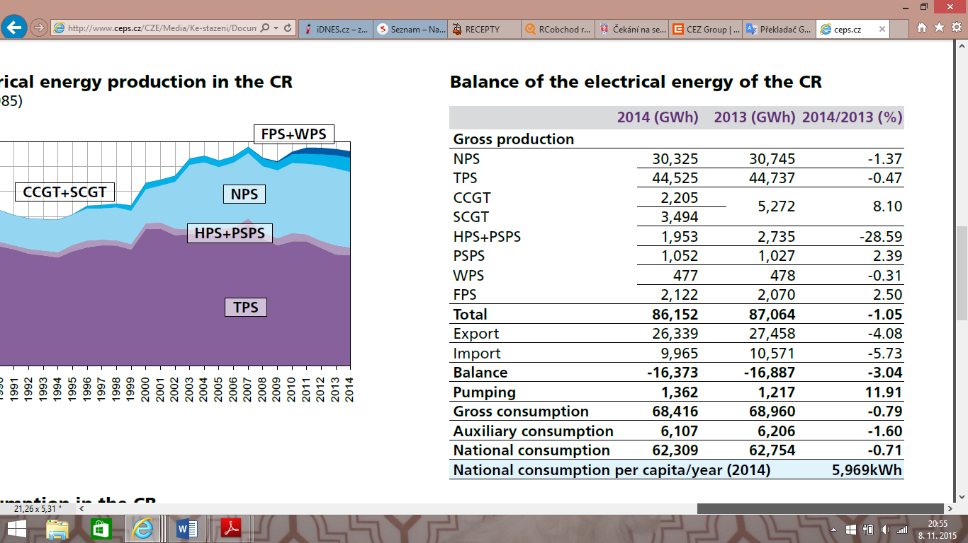
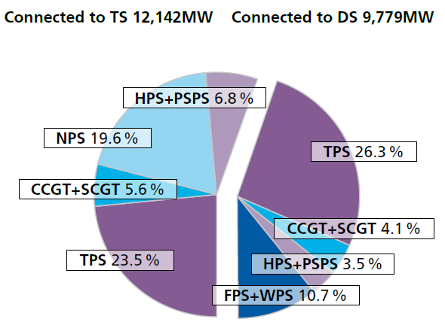
Structure of the power plant
(situation of as 31.12.2014)
Balance of electrical energy in 2013 and 2014

Slide 4
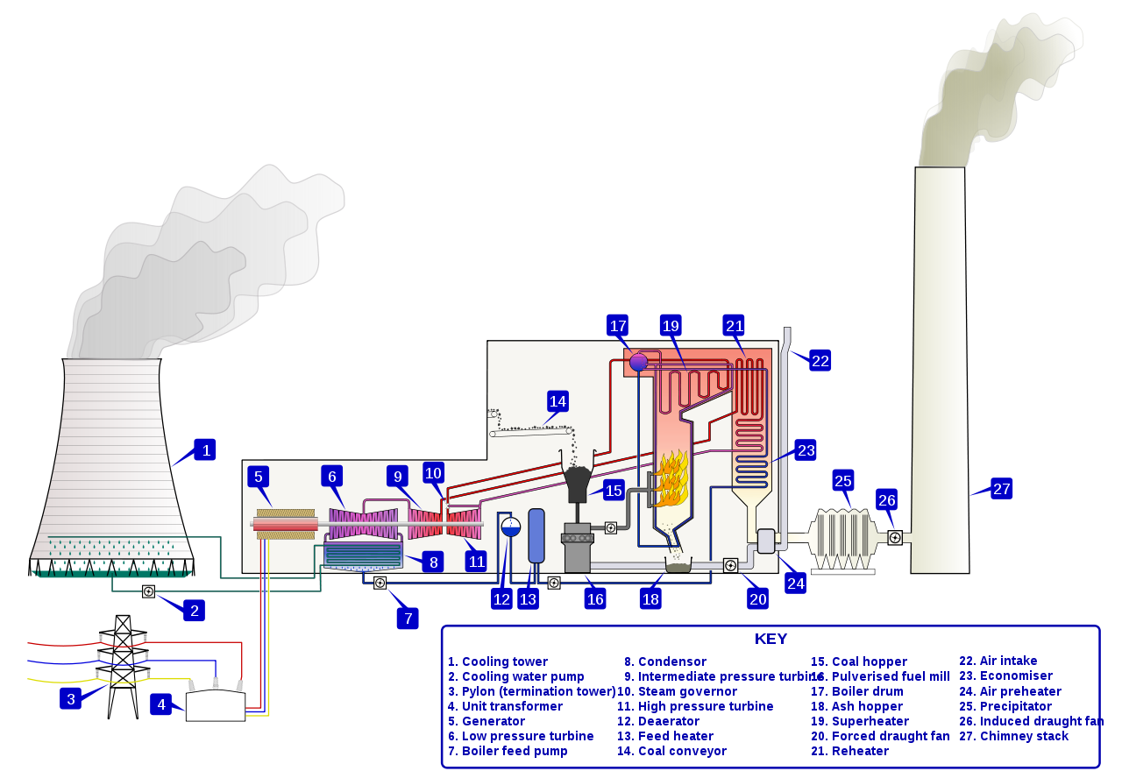
Coal-fired power plant – principle

Slide 5
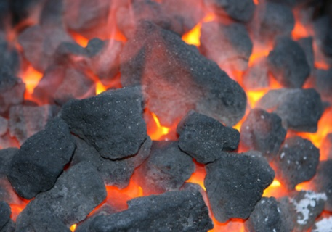
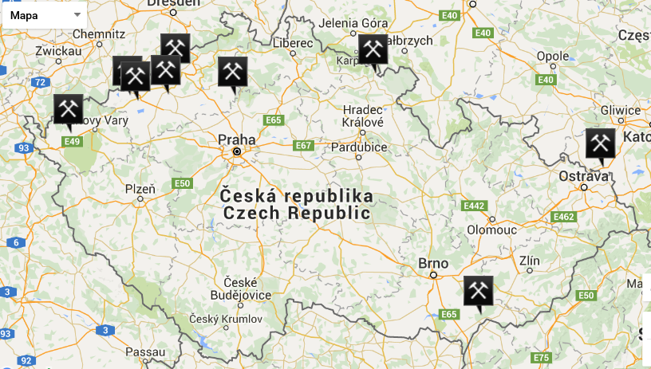
Coal-fired power plant in the Czech Republic
worldwide – 44 % generated electric energy is produced by coal-fired power plant
in Europe – 33 %
in the Czech Republic – 50 %
location: mostly in north-western and north Moravia
fuel: most of power plant burns north-Bohemian brown coal
average price of coal: 3100 CZK/tons (brown coal), 5300 CZK/tons (black coal)

Slide 6
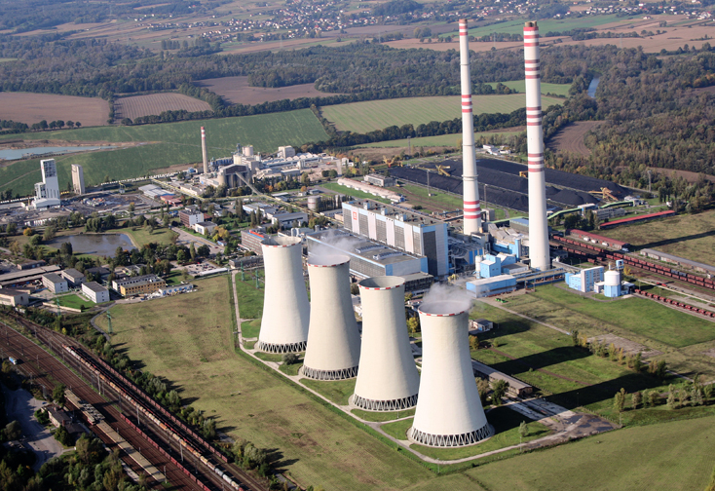
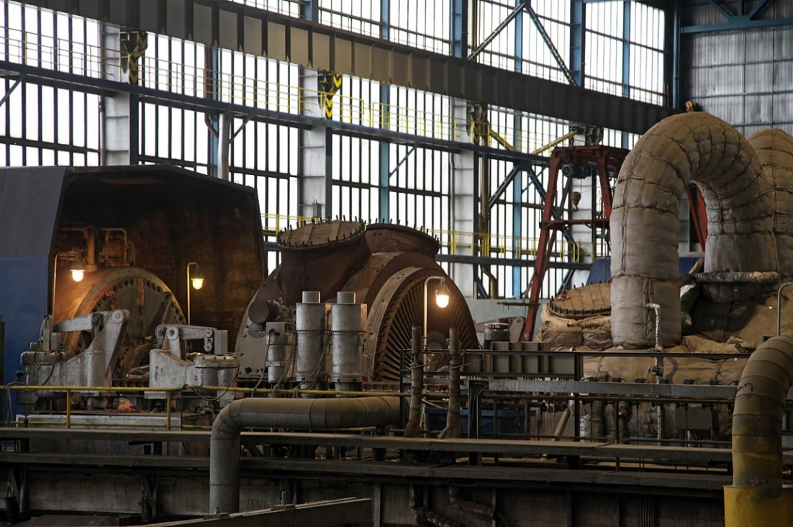
Dětmarovice
year of operation commenced: 1976
location: near Ostrava – the largest coal power plant in Moravia
number of production units: 4
fuel: black coal from Ostrava-Karviná Mines is burned in 4 boilers – average daily consumptions is about 1600 ton of coal for one production unit
steam: temperature 540ºC, pressure 17 MPa
total installed capacity: 800 MW (electric), 120 MW (heat)
generator: 15.75 kV – electrical energy is transformed to 110 kV for transmission system
annually production: 2.5 TWh of electric energy and over 800 TJ of heat
emission reduction equipment: nitrogen oxides, sulphur oxides and ash

Slide 7
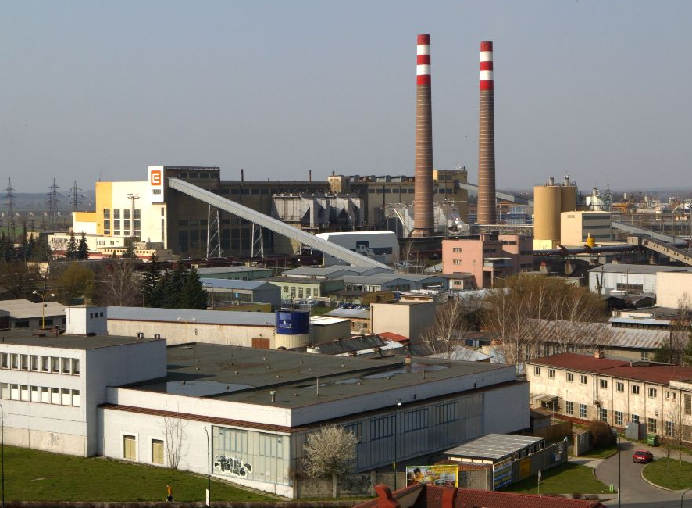
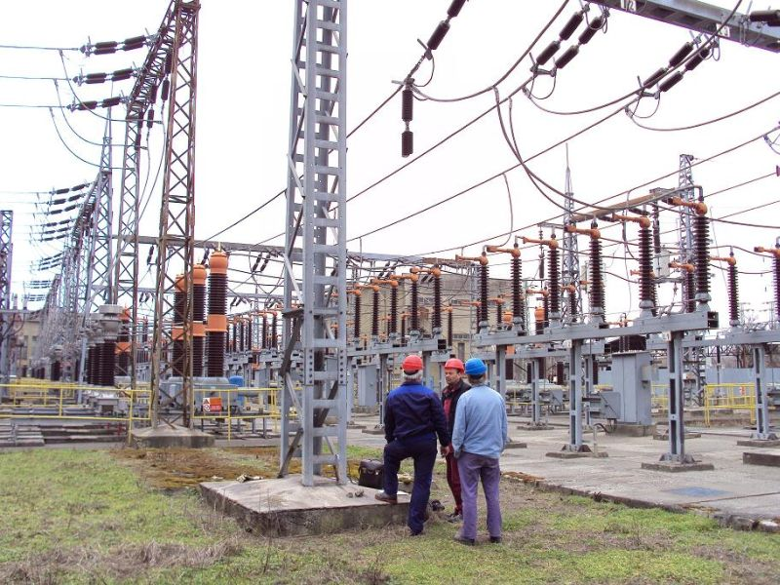
Hodonín
year of operation commenced: 1957 – one of the oldest coal power station in the Czech Republic, the largest electricity resource in the Czechoslovakia
location: south Moravia
fuel: lignite, brown coal and biomass
heat plant operation: power plant was modified in 1963, supply steam with condition of 1.8 MPa/270ºC to Hodonín and hot water with conditions of 150/70ºC to the Slovak town of Holíč – European unique in cross-border supply of heat
biomass burning: change of one of the units entirely to clear biomass in 2009
total installed capacity: 105 MW (electric), 250 MW (heat)
annually production: 750 TJ of heat

Slide 8
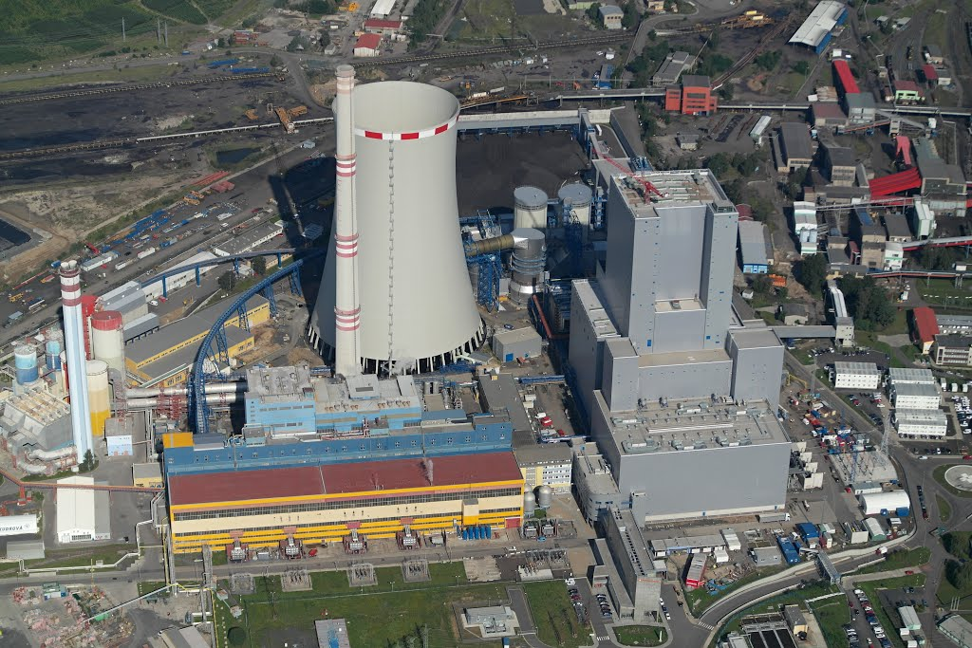
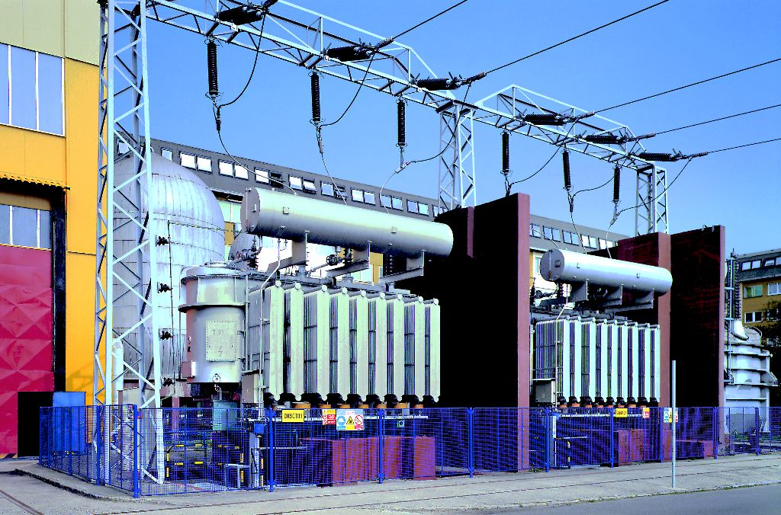
Ledvice II, Ledvice III
year of operation commenced: 1968, 1998
location: at the foothill of the Krušné Mountains eastern part, between the towns of Teplice and Bílina
number of production units: 3 (originally 5)
fuel: brown coal from Bílina Mines
total installed capacity: 105 MW (electric), 380 MW (heat)
annually production: 1000 TJ of heat
emission reduction equipment: nitrogen oxides, sulphur oxides and ash

Slide 9
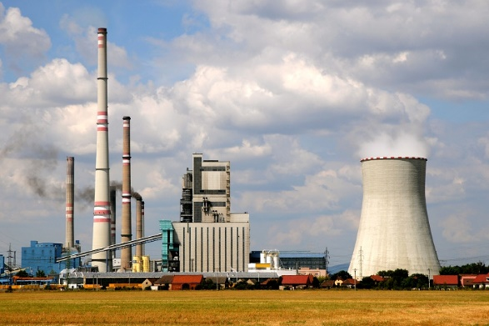
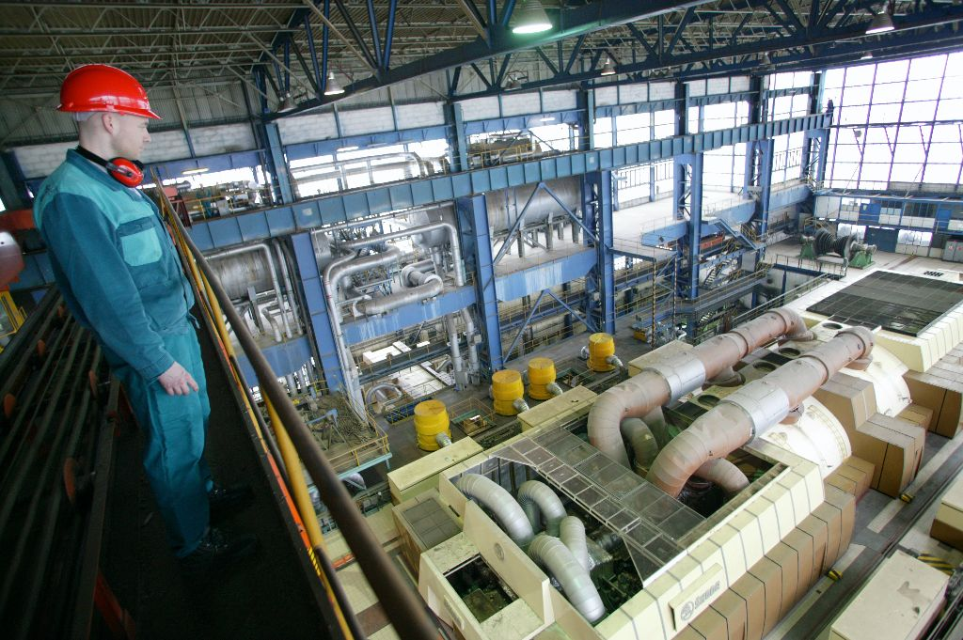
Mělník I, Mělník II, Mělník III
year of operation commenced: 1960, 1971, 1981
location: 13 km below the Elbe and Vltava River confluent – the nearest coal power plant to the capital of Prague
fuel: brown coal
total installed capacity: 1050 MW (electric), 340 MW (heat) – Mělník III is the largest coal burning in the Czech Republic (500 MW)
hot water: supply hot water to the towns of Mělník, Horní Počaply and Dolní Beřkovice
power generation by-product: industrial gypsum – it is used for gypsum plasterboard producing in nearby Saint-Gobain Construction Products CZ, division Rigips
emission reduction equipment: nitrogen oxides, sulphur oxides and ash

Slide 10
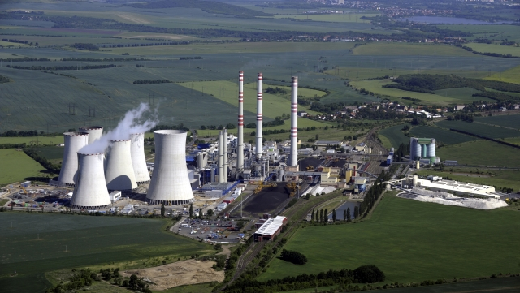
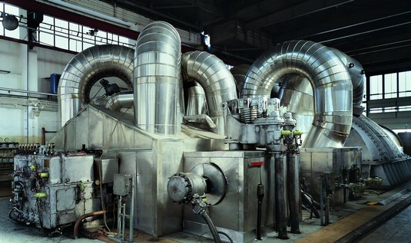
Počerady I, Počerady II
year of operation commenced: 1971, 1977
location: in the north-west part of the Czech Republic, nearly in the middle among the towns of Louny, Žatec and Most
number of production units: 5
fuel: brown coal from Most Mines (area Hrabák)
total installed capacity: 1000 MW
generator: 15 kV, 235 MVA
power generation by-product: industrial gypsum – it is used for gypsum plasterboard producing in nearby Knauf-Počerady s.r.o. and or it is performed into briquettes and supplied to cement factories as a substitute for natural gypsum

Slide 11
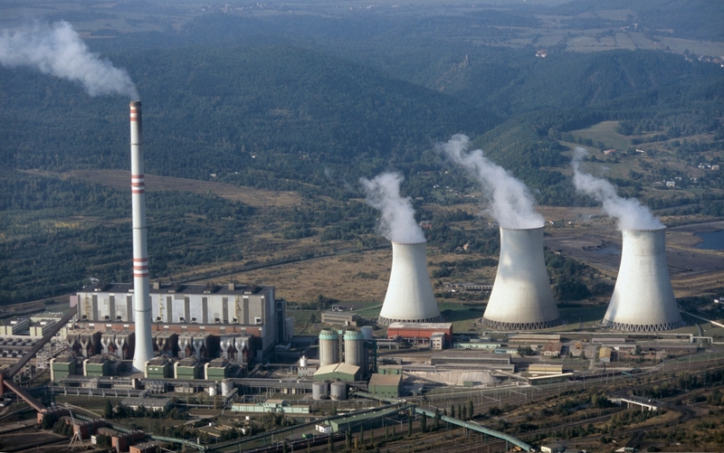
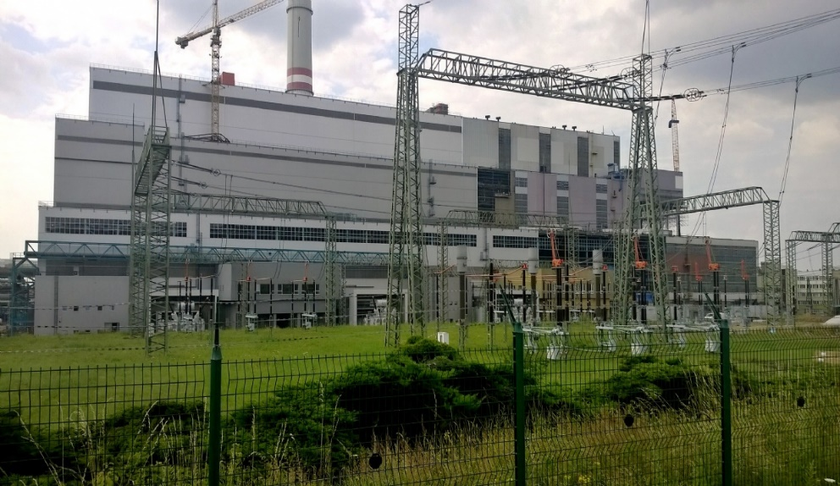
Prunéřov I, Prunéřov II
year of operation commenced: 1968, 1982
location: on the western edge of the North-Bohemian brown coal basin near the town of Chomutov
number of production units: 6
fuel: brown coal from Nástup Tušimice Mine
steam: 660 tons of stream per hour (Prunéřov II), temperature 540ºC/530ºC, pressure 13,53 MPa,
total installed capacity: 1490 MW (electric), 500 MW (heat) – the largest fossil power plant complex in the Czech Republic
hot water: supply hot water to the towns of Chomutov, Jirkov and Klášterec nad Ohří
power generation by-product: industrial gypsum – annually produce about 750 tons, it is used to make construction material called Alpha-binders,
emission reduction equipment: nitrogen oxides, sulphur oxides and ash

Slide 12
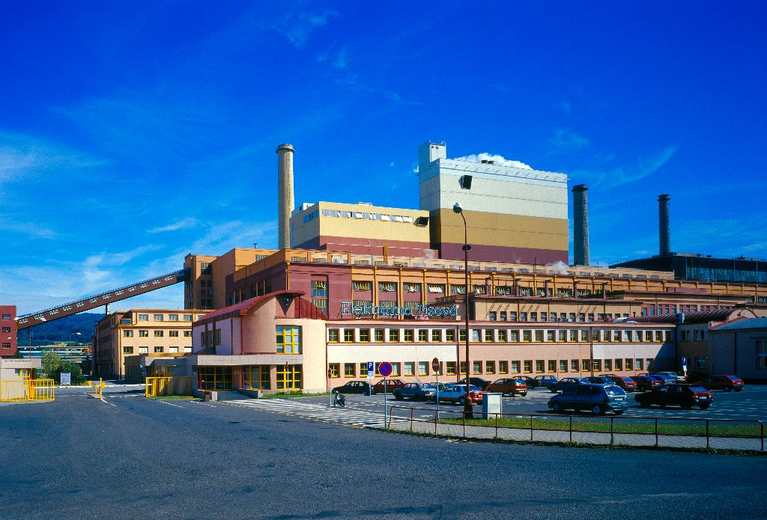
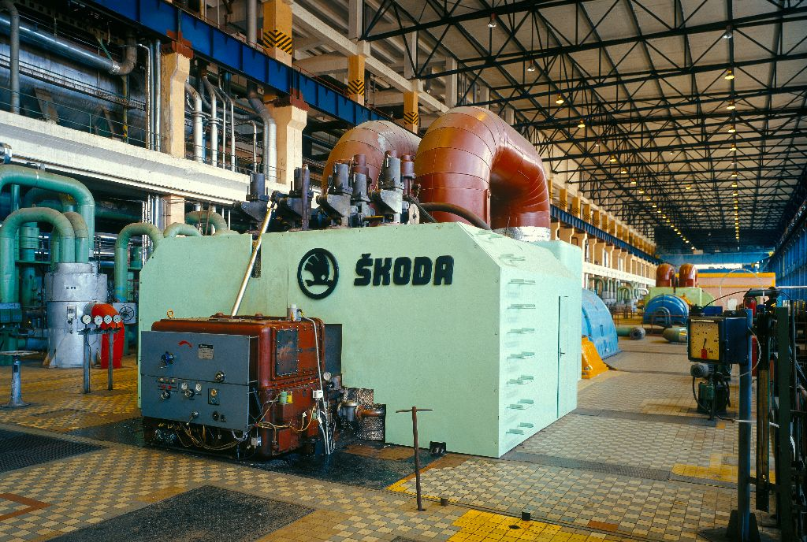
Tisová I, Tisová II
year of operation commenced: in the western part of the Sokolov basin, between of the Krušné Mountains and the Slavkov Forest
location: 1959, 1962 – one of the oldest brown coal power plant
fuel: brown coal, biomass
total installed capacity: 295.8 MW
annually production: 1.6 TWh of electric energy, 1500 TJ of heat
hot steam: supply hot steam with condition of 1.2 MPa/240ºC to Sokolov, Březová, Habartov, Bukovany, Svatava and Královské Poříčí
power generation by-product: stabilized from fluidized ash for earth structures and underlying beds of the ground road constructions, slag for backfilling the worked out-surface mine areas, etc.

Slide 13
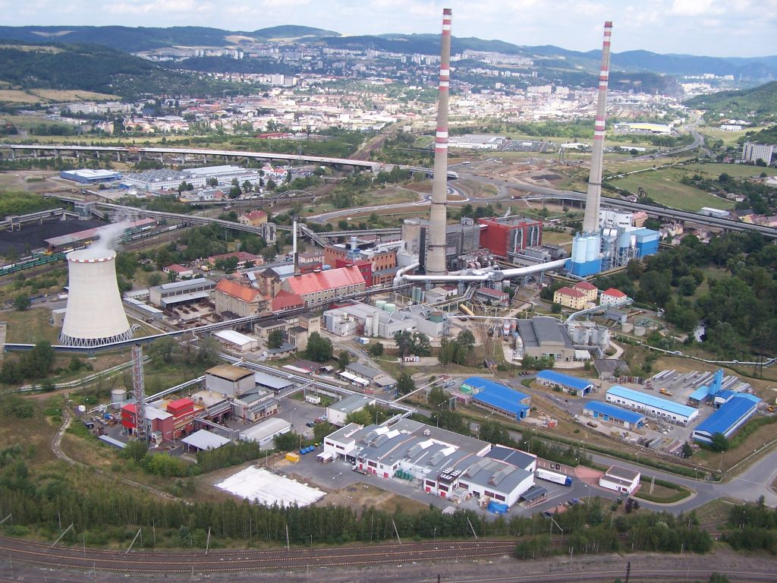
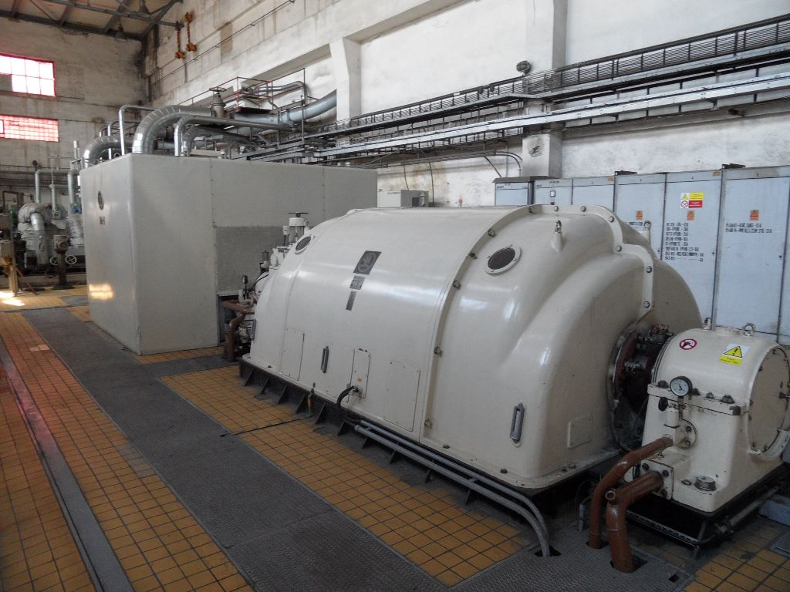
Trmice
year of operation commenced: 1916 (the first power plant in Trmice, installed capacity 6 MW), big reconstruction in 1939, 1974 and 1976
location: on the outskirts of Ústí nad Labem, at foothills of the Krušné Mountains
number of production units:
fuel: brown coal
heat plant operation: power plant was modified in 1976
total installed capacity: 89 MW (electric), 469 MW (heat)
annually production: 3700 TJ of heat

Slide 14
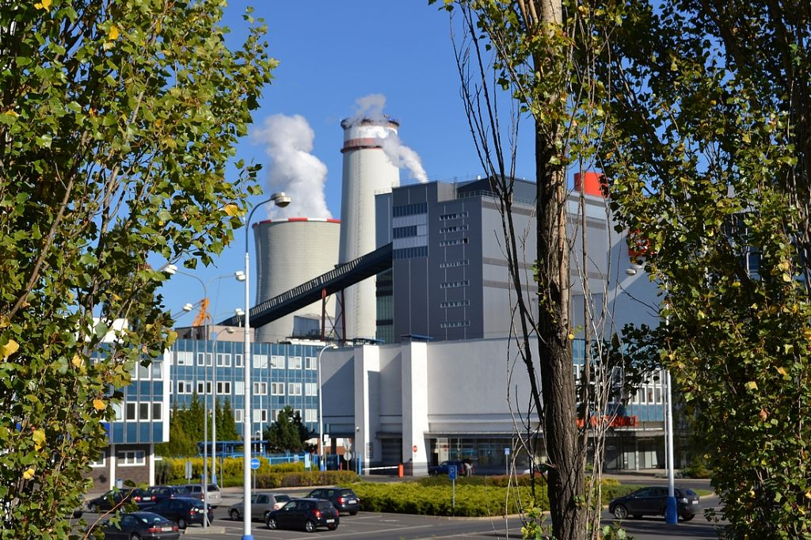
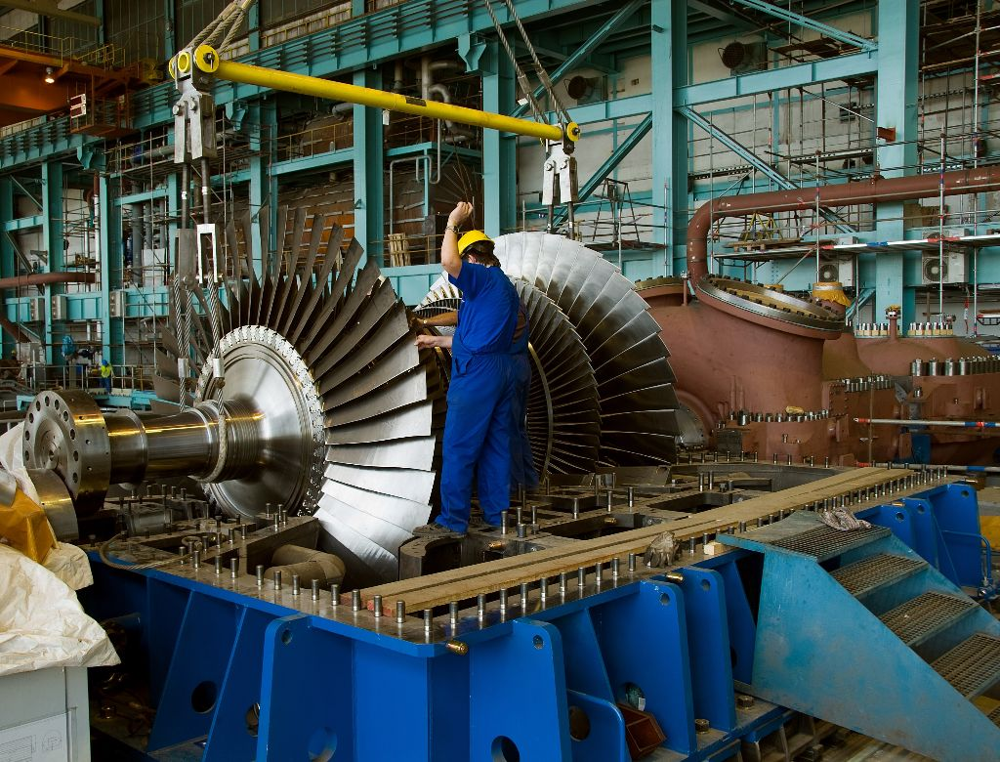
Tušimice I, Tušimice II
year of operation commenced: 1964, 1974
location: near the town of Chomutov
end of Tušimice I: 6 units were shut down under attenuation program at the beginning of the 1990’s – the power plant stack (the tallest reinforced-concrete stack in the Czech Republic, 196 m) was blasted in 2005
complex restauration of Tušimice II: from 2007 to 2012 – efficiency increased by 6 %, new desulfurization equipment, new boilers and steam turbines
number of production units: 4 (Tušimice II)
fuel: brown coal from Nástup Tušimice Mine
total installed capacity: 1000 MW (electric), 120 MW (heat)
hot water: supply hot water to the town Kadaň
annually production: 750 TJ of heat

Slide 15
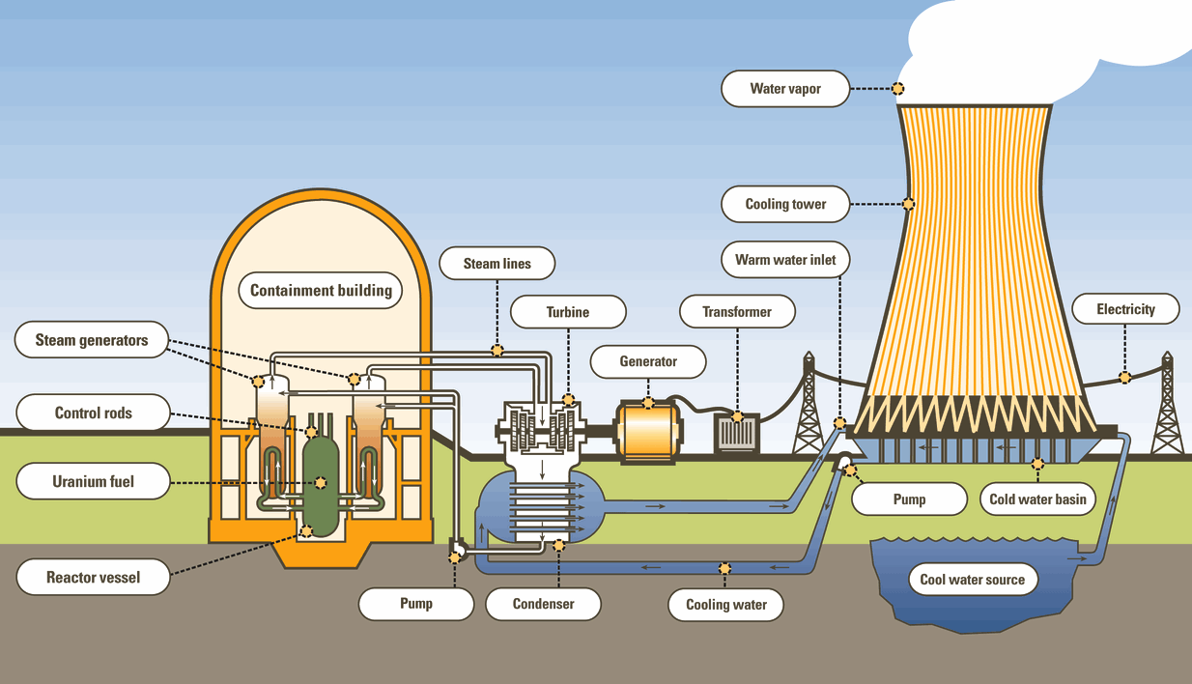
Nuclear power plant – principle

Slide 16
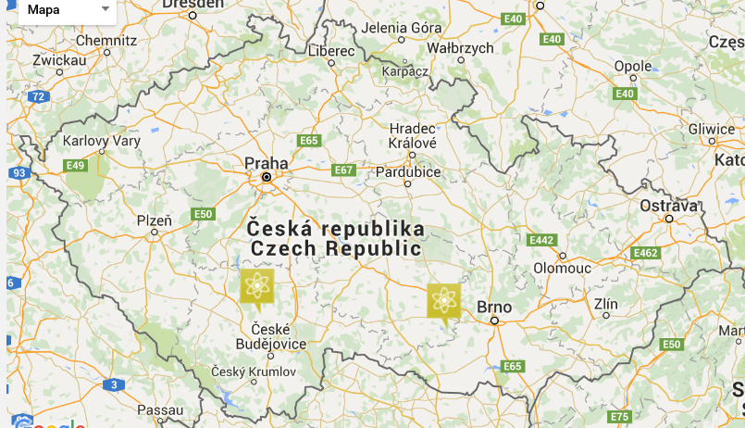
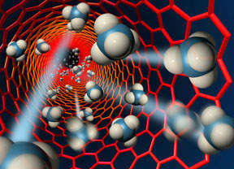
Nuclear power plant in the Czech Republic
worldwide – 437 nuclear reactors in 30 states (situation of as 01.04.2015), total installed capacity 380 GW
in Europe – 30 %
in the Czech Republic – 20 %
location: in south part of the Czech Republic
fuel: UO₂ (oxide uranium)

Slide 17
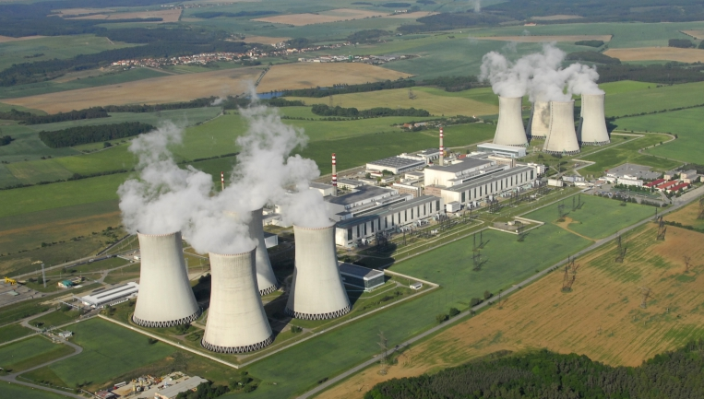
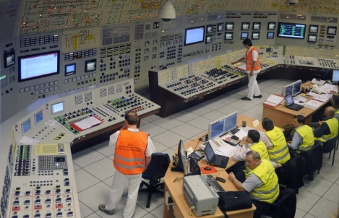
Dukovany
year of operation commenced: 1985
location: 30 km south-east of Třebíč
number of production units: 4
reactor: VVER 1000 Type V 213, pressurized-water reactors – reactor core contains 312 fuel assemblies, each with 126 fuel rods and 37 regulating rods
fuel: UO₂ – average of 3.5% of the fission isotope ²³⁵U
total installed capacity: 2040 MW (electric), 5500 MW (heat)
annually production: 14 TWh – 20 % of total consumption of electricity in the Czech Republic, produced electricity has the lowest specific costs in the Czech Republic
safety: the 5th of the best operated nuclear power plant in the world

Slide 18
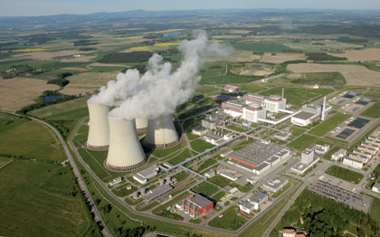
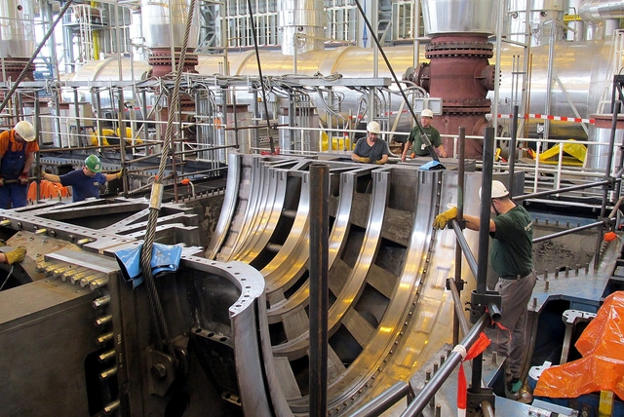
Temelín
year of operation commenced: 2002 (investment design of the construction was issued in 1979)
location: 24 km from České Budějovice and 5 km from Týn nad Vltavou
number of production units: 2
reactor: VVER 1000 Type V 320, pressurized-water reactors – reactor core contains 163 fuel assemblies, each with 312 fuel rods and 61 regulating rods
fuel: UO₂ (Westinghouse Company) – average of 3.5% of the fission isotope ²³⁵U
total installed capacity: 2133 MW (electric) – the most powerful resource in the Czech Republic
steam-generator: 1.47 tons of steam per hour – pressure 6.3 MPa and temperature 278.5°C
process water reservoir: Hněvkovice reservoir on the Vltava River – built as a part of the power plant project

Slide 19
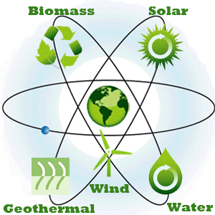
Renewable energy sources – generally
consumption and price of fossil fuels increase along with the growth of population all over the planet – additional pressure on the fossil resources and significant impact on the environment – renewable energy sources play important role in today electrical power engineering in the world and provide a significant potential for the future
water energy: rivers, dams, seas (e.g. tidal energy)
wind energy
solar energy: active utilization (photovoltaic power plant, solar power plant, solar collectors), passive utilization (greenhouses, Trombe wall)
biomass energy: burning of dry biomass in fluid boilers in coal-fired power plant, degradation of wet and dry biomass to produce biogas in biogas station
geothermal energy: heat pumps and power plant (basic types: Hot Dry Rock HDR and Hot Fractured Rock HFR)

Slide 20
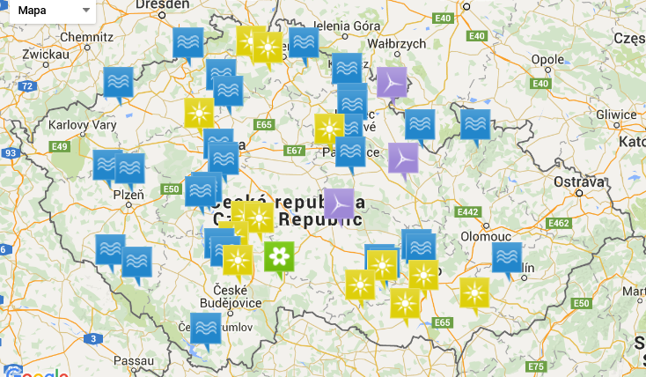




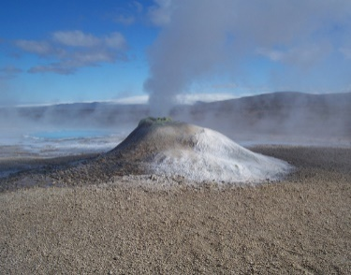
Renewable energy sources in the Czech Republic
worldwide – 16 % generated electric energy is produced by renewable energy sources
in European Union – 30 %
in the Czech Republic – 13 %

Slide 21
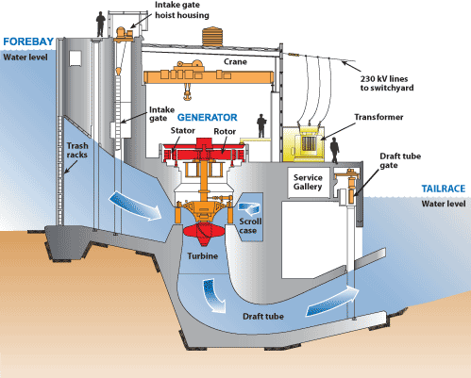
Hydropower energy in the Czech Republic
location: all over the Czech Republic
total installed capacity: 1491 MW (situation of as 31.12.2014)
annually production: 1953 GWh (year 2014)
number of hydroelectric power plants: ca 1650
3.5 % produced electric energy is produced by hydroelectric power plant (year 2014)

Slide 22
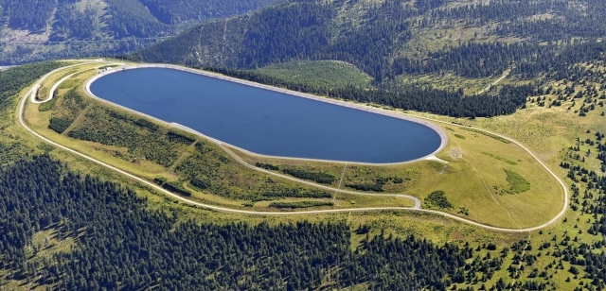
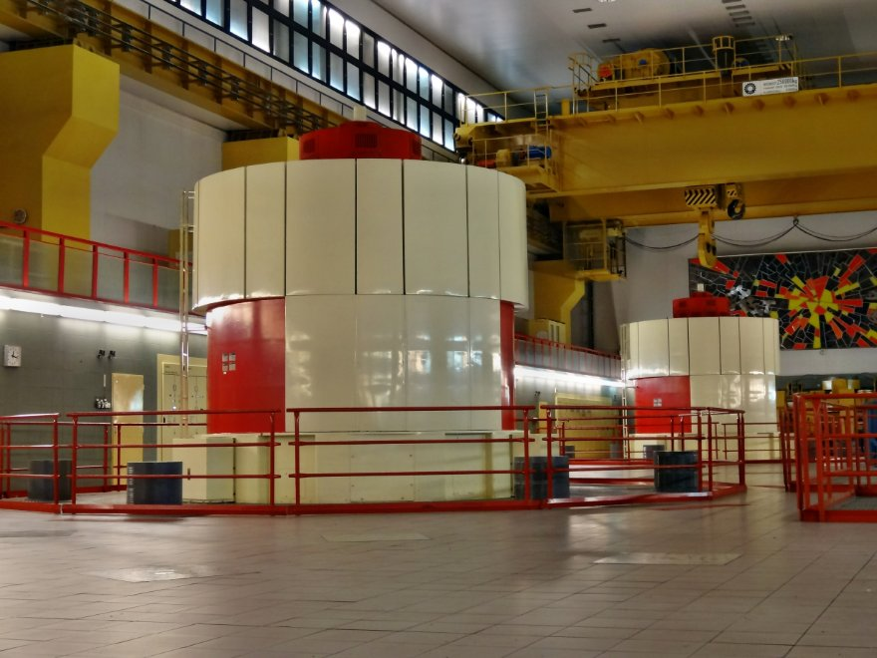
Dlouhé Stráně
year of operation commenced: 1996
location: in Jeseníky Mountains near Loučná nad Desnou in the district of Šumperk
total installed capacity: 650 MW – the most powerful hydroelectric power plant in the Czech Republic
turbine: 2 reversing Francis turbines – the largest reversing Francis turbine in the Europe
type: pumped storage plant
reservoirs: upper reservoir is situated on top of the Dlouhé Stráně Mountain 1350 m above sea level, lower reservoir is on the Divoká Desná River
turbine gradient: 543 m
annually production: 550 GWh (year 2014)

Slide 23
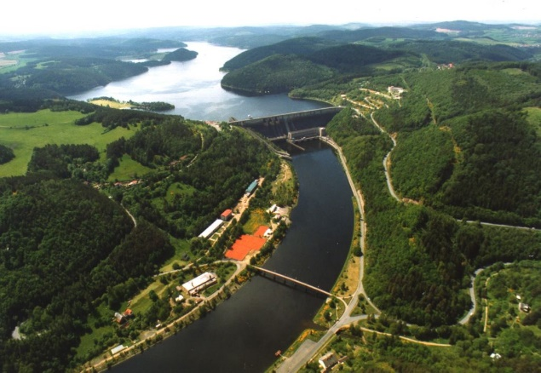
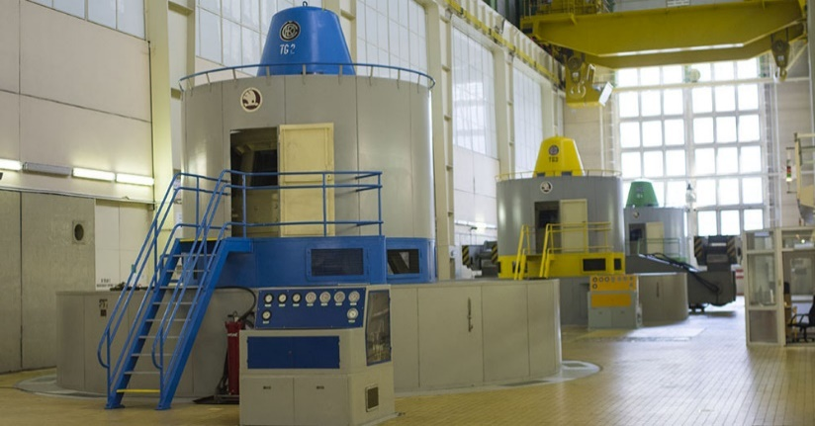
Orlík
year of operation commenced: 1961
location: on the longest Czech River Vltava – the 1st part of the Vltava River Cascade
total installed capacity: 364 MW – the 3rd most powerful hydroelectric power plant in the Czech Republic
turbine: 4 Kaplan turbines
type: accumulative plant
reservoirs: surface covers an area of 27.3 km², total volume 717 000 000 m³ water – the most voluminous reservoir in the Czech Republic
flow: 150 – 600 m³ per second
achieving full load: 128 seconds
annually production: 264 GWh (year 2014) – supply electricity to 100 000 households

Slide 24
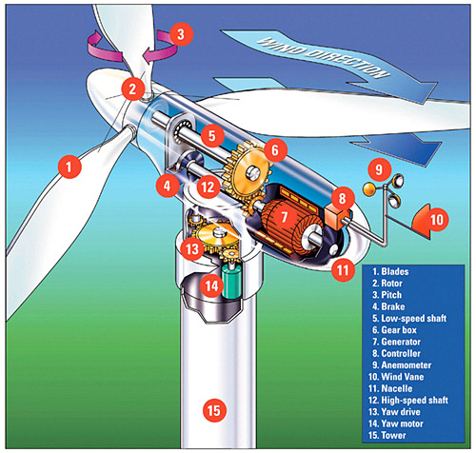
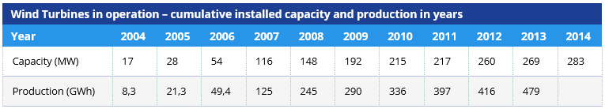
Wind energy in the Czech Republic
location: especially mountains area
total installed capacity: 283 MW (situation of as 31.12.2014) – potential for the future is 5800 MW
annually production: 477 GWh (year 2014)
number of wind energy power plants: 75 (with the exception of small installation for own consumption, situation of as 31.12.2014)
0.8 % produced electric energy is produced by wind power plant

Slide 25
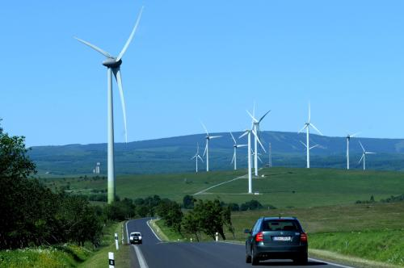
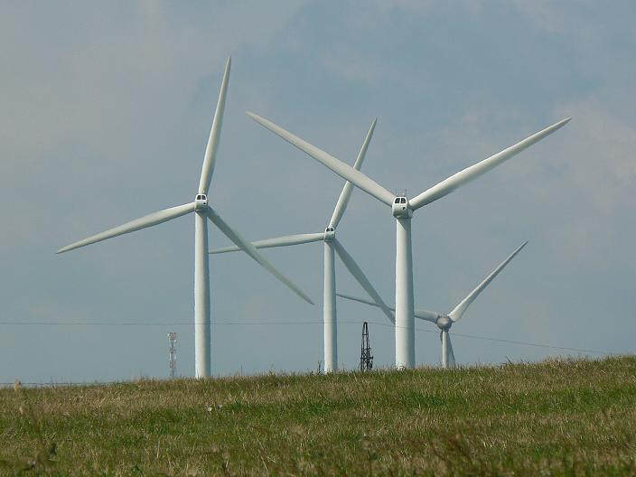
Kryštofovy Hamry – Přísečnice
year of operation commenced: 2007
location: in Krušné Mountains, from 800 to 850 m above sea level
number of power plant: 21 (total height 119 m, diameter of rotor 82 m)
total installed capacity: 42 MW – the most powerful wind power plant in the Czech Republic
producer, type: Enercon, E-82
owner: German company Ecoenerg Windcraft
annually production: 97.5 GWh (year 2014) – supply electricity to 30 000 households

Slide 26
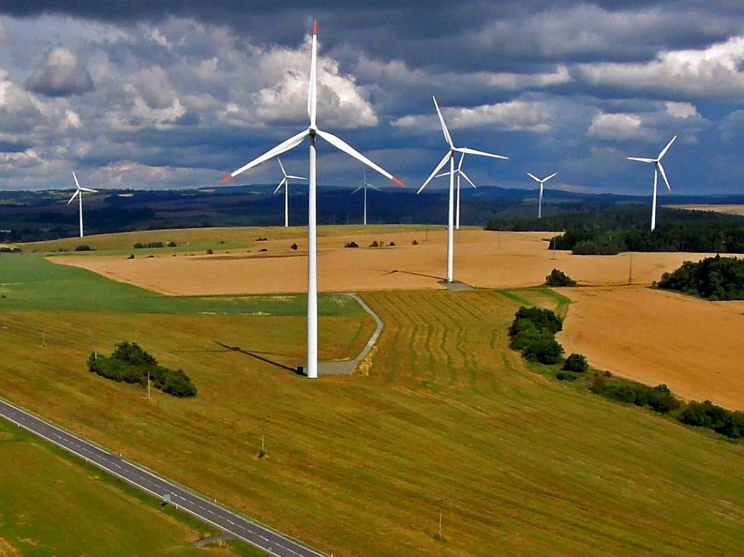
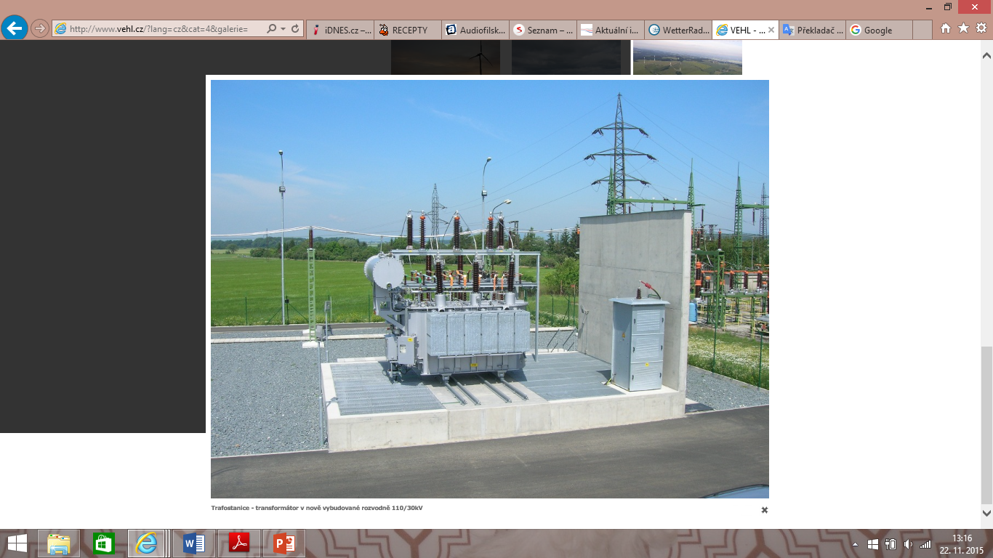
Horní Loděnice – Lipina
year of operation commenced: 2009
location: in Jeseníky Mountains
number of power plant: 9 (total height 105 m, diameter of rotor 90 m)
total installed capacity: 18 MW – the 2nd most powerful wind power plant in the Czech Republic
producer, type: Vestas, V-90
minimum/maximum wind speed: 4 m.s⁻¹/25 m.s⁻¹
annually production: 43 GWh (year 2014) – supply electricity to 12 500 households

Slide 27
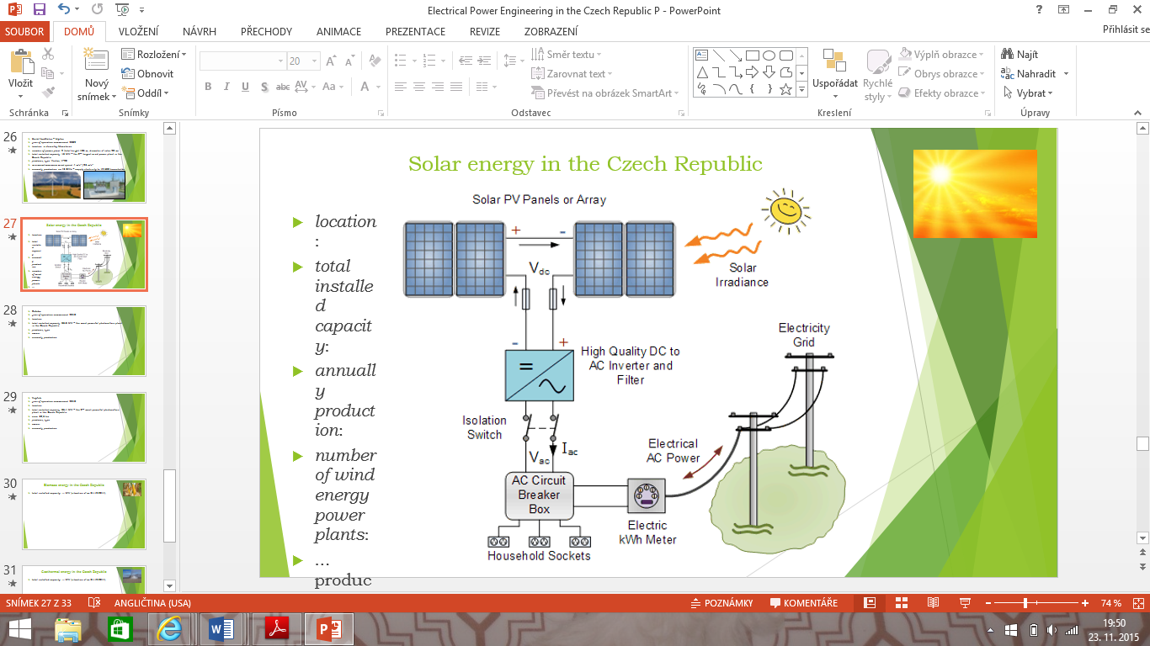
Solar energy in the Czech Republic – photovoltaic
location: all over the Czech Republic
total installed capacity: 2.1 MW (situation of as 30. Juny 2014)
annually production: 2.1 GWh (year 2014)
number of photovoltaic power plants: ca 28 000 (with the exception of installation with capacity less than 100 kW, situation of as 31.12.2014)
2.4 % produced electric energy is produced by photovoltaic power plant (year 2014)

Slide 28
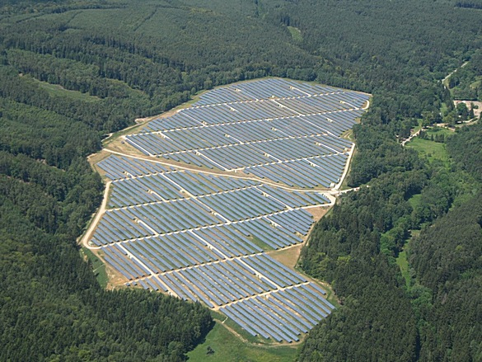
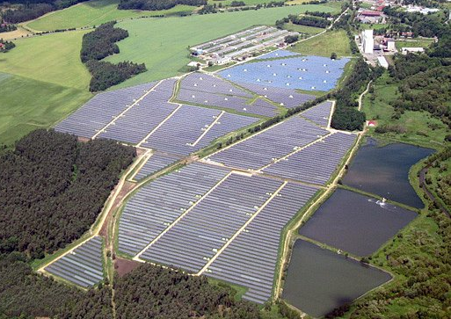
Ralsko Ra 1
year of operation commenced: 2010
location: in the district of Česká Lípa, near the town of Liberec
parts: Ralsko – Jabloneček Ra1a, Ralsko – Jabloneček Ra1b, Ralsko – Jabloneček Ra1c and Ralsko Ra2 Jih
number of photovoltaic cells: 167 000
total installed capacity: 55.7 MW – the most powerful photovoltaic plant in the Czech Republic
owner: ČEZ, a.s.

Slide 29


Vepřek
year of operation commenced: 2010
location: in the district of Mělník, near the capital of Prague
total installed capacity: 34.96 MW – the 2nd most powerful photovoltaic plant in the Czech Republic
number of photovoltaic cells: 186 960 – monocrystalline silicon cells
area: 82,5 ha

Slide 30

Biomass energy in the Czech Republic – biogas station
location: all over the Czech Republic
total installed capacity: 358 MW (situation of as 31.12.2014)
annually production: 2566 GWh (year 2014)
number of biogas power plants: 507 (situation of as 31.12.2014)
2.8 % produced electric energy is produced by photovoltaic power plant (year 2014)

Slide 31


Třeboň
year of operation commenced: 1974 – the oldest biogas station in the Czech Republic
location: in the south Bohemian
total installed capacity: 175 kW (electric), 226 kW (heat)
enlargement: new cogeneration unit was built in area of Aurora Spa in 2009 – 844 kW (electric) and 840 kW (heat) – the 1st biogas pipeline in the Czech Republic (4.3 km, from original biogas station to area of Aurora Spa)
input feedstock: corn silage (14500 tons per year), grass silage (4300 tons per year) and manure (3500 tons per year)
annually production: 8 GWh of electric energy (25 % total consumption in the town of Třeboň), 17 TJ of heat and 3760000 m³ biogas per year

Slide 32


Velký Karlov
year of operation commenced: 2006
location: in south Moravia – near the town of Znojmo
total installed capacity: 1.96 MW (electric), 2.07 MW (heat) – one of the most powerful biogas station in middle Europe
input feedstock: silage, manure, fruit and vegetables
annually production: 15 GWh of electric energy, 16 TJ of heat

Slide 33


Geothermal energy in the Czech Republic
currently, geothermal energy uses for heating purposes – heat pumps
upcoming project – construction of the 1st geothermal power plant in the Czech Republic will start in Litoměřice in 2016
Litoměřice
year of operation commenced: after 2016
location: Litoměřice – district of Ústí nad Labem
technology: HDR (Hot Dry Rock) – 2 or 3 drill hole to the depth of 5 km
preparation: perform of test drill hole to the depth of 2.1 km
annually production: theoretical 40 MW of heat and a few kW to MW electrical energy

Slide 34

"The European Commission support for the production of this publication does not constitute an endorsement of the contents which reflects the views only of the authors, and the Commission cannot be held responsi­ble for any use which may be made of the information contained therein."

