Slide 1
Endangered species in Poland
Project Nr: 2019-1-CZ01-KA229-061106 „It´s our world - take care of it”
Created by : Zuzanna Wanecka

Slide 2
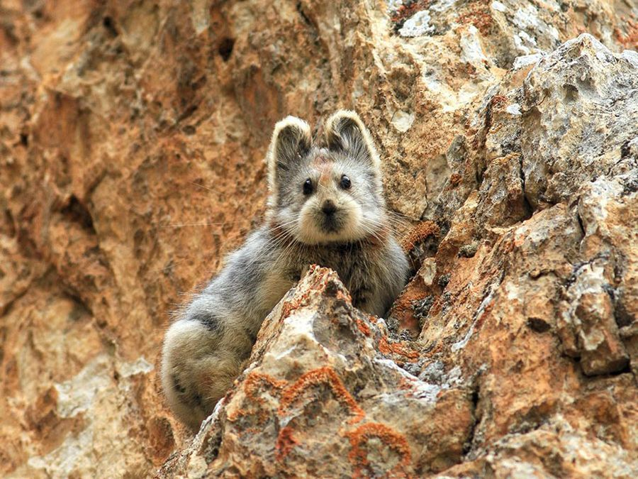
What does that mean?
Endangered species means that some species all around the world are threatend with total or partial extinction. It’s caused by climate changes or disappearance of their natural environments.

Slide 3
Endangered species in Poland acording to the Red Book.
The European Lynx
Brown Bear
Wolf
The European wildcat
Wisent

Slide 4
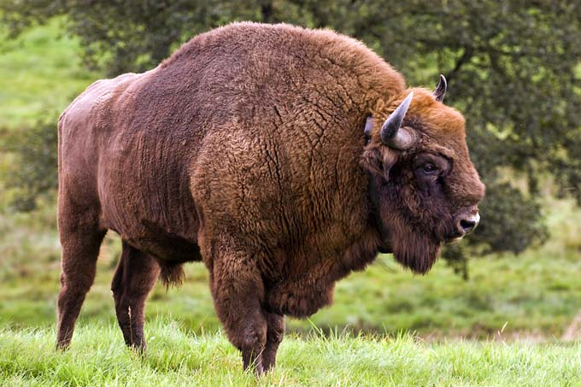
Wisent
In Poland, the area in zoos and in the Bialowieza Forest lives only approx. 1,800 of this species.
Before the World War 1st in the Poland are were alive approx. 737, but after the War none of them has been left.

Slide 5
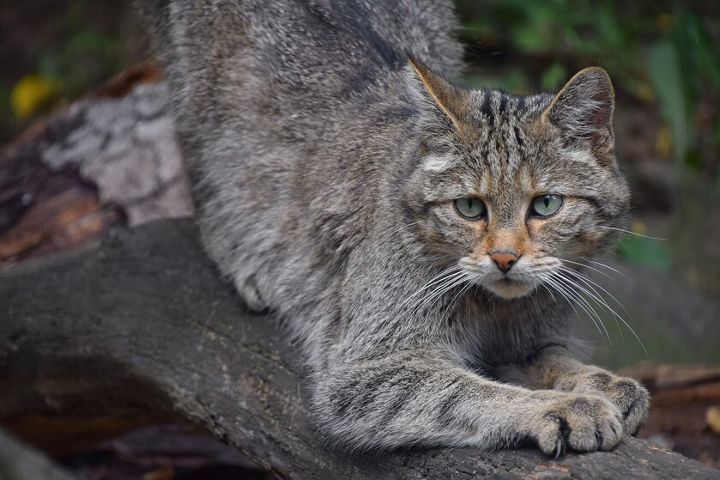
The European wildcat
In Poland, in the east part of the Carpathians are no more than 200 wildcats. Despite the species protection, the wildcat population doesn’t recover. A small number of wildcats in the wildlife and close neighborhood to domestic cats cause them to cross and lose the purity of the species.

Slide 6
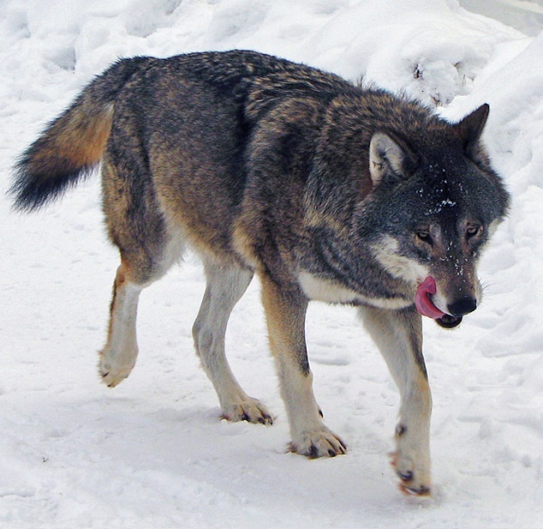
Wolf
The wolf was on the list of animals threatened with extinction because of the shrinking of its natural habitats and human activities. In Poland survived below 2000 wolves.

Slide 7
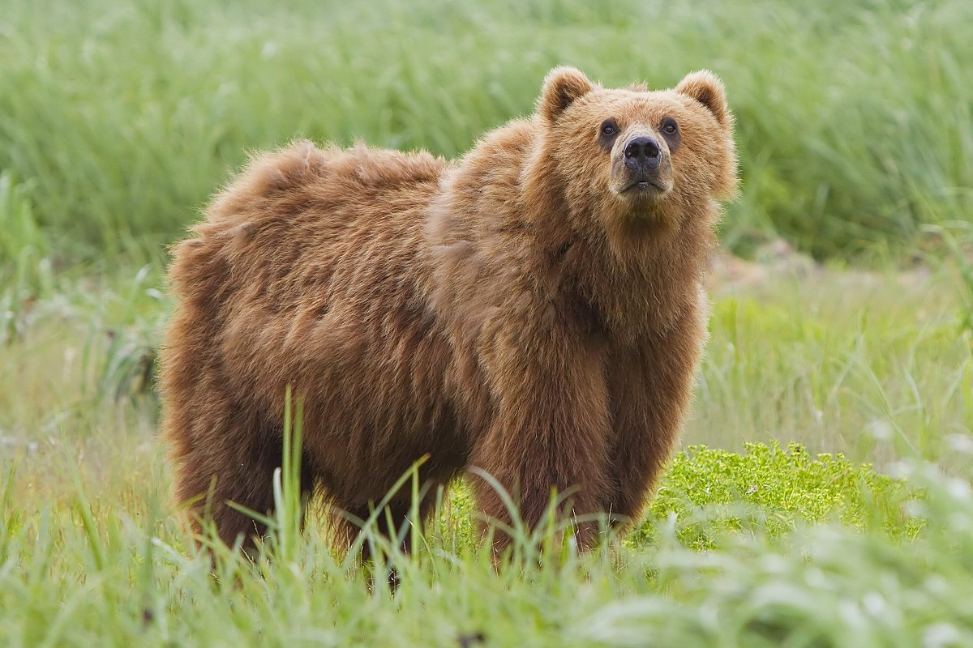
Brown Bear
Such a huge decrease in the population is mainly the result of limitation of the natural living environment. Bears used to be found all over Poland but nowadays there are only approx. 100 of them.

Slide 8
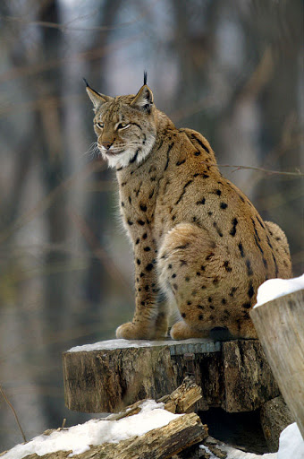
European Lynx
In Poland, they’ve been under a strict protection since 1995, and during 25 years they haven’t significantly expanded their range of occurrence. In our country because of the people activity stayed only about 200.

Slide 9
How can we help?
To protect an animal environment we should care about the nature, because that’s where they live. We have to prevent fires and do not throw up anything on the ground. We can also donate money for WWF organisation to help doctors, zoo’s owners and people who care about those animals to keep them safe and ensure them home in the best conditions.

Slide 10
Thanks for attention!
Zuzanna
Wanecka

