Slide 1
Endangered animals in the Czech republic
Erasmus+ KA229 - School Exchange Partnerships
Project Nr:
2019-1-CZ01-KA229-061106
It´s our world - take care of it
Denis Demeter, Jakub Vícha, Daniel Vogeltanz & Jan Němec

Slide 2
ACQUAINTANCE
- Thanks to its geographical location and diversity of natural conditions, the Czech Republic is characterized by a great diversity of animal species.
In the Czech Republic there are more than 50 % of protected species living in our country
Three categories of protection of specially protected species are determined according to the degree of threat:
Critically endangered species
Highly endangered species
Endangered species

Slide 3
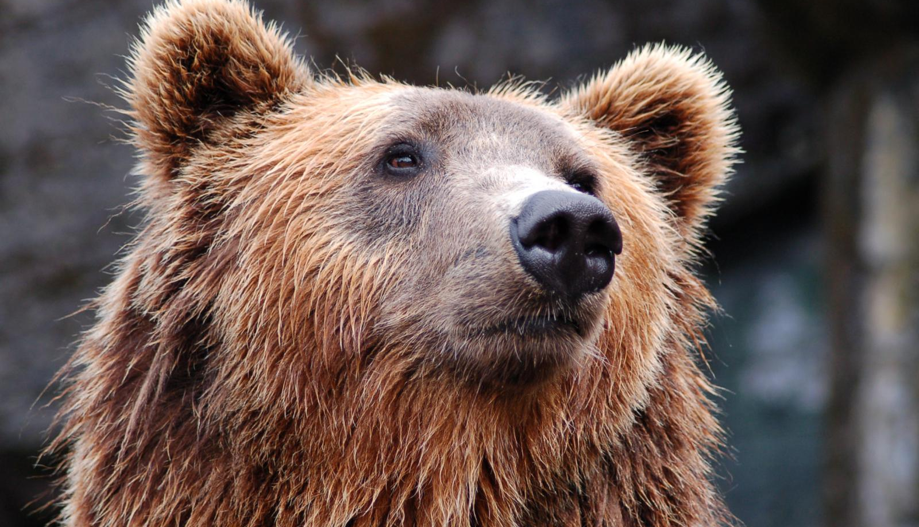
1. Vertebrates

Slide 4
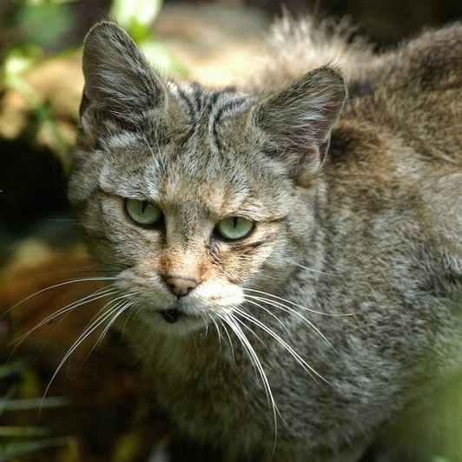
Mammals
- In the Czech republic is 86 endangered species.
- A total of 30 species specially protected.
- The most endangered species include: Brown bear, Wolf, Wildcat and Stepee polecat …

Slide 5
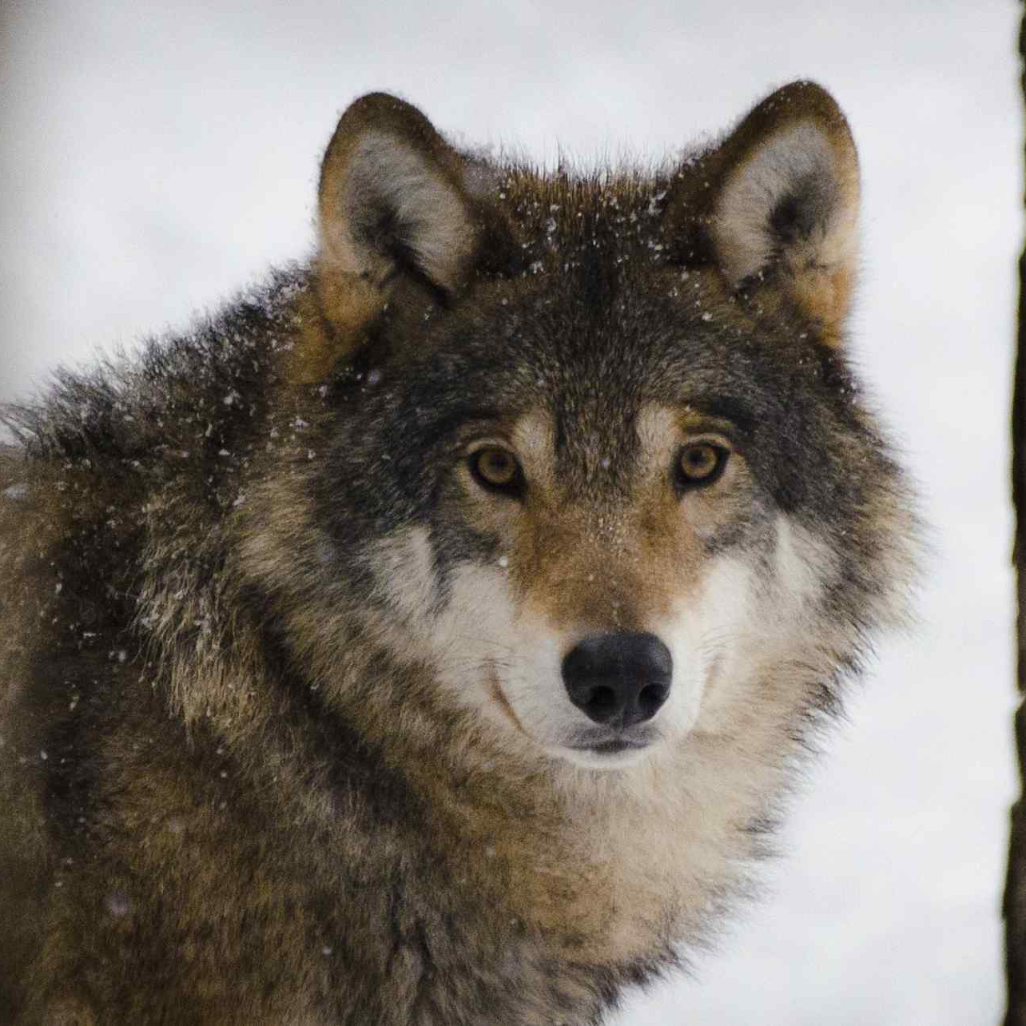
In Pilsen region Wolf
- The common wolf is a large canine beast.
- Occurrence: Šumava / Pilsen Region.
- Class: mammals.
- Order: Beasts.
- Family: canine.

Slide 6
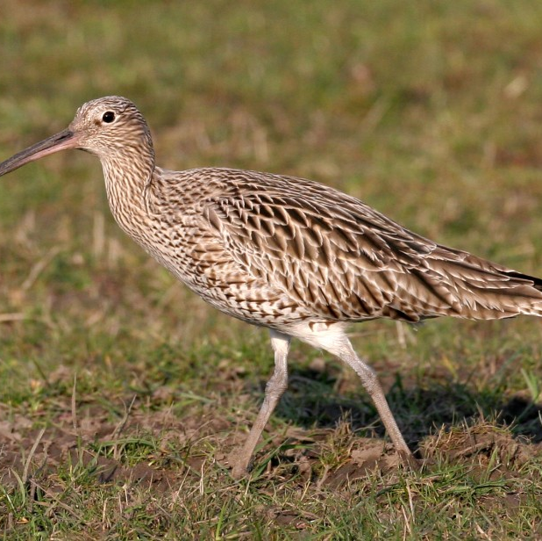
Birds
- We have a total of 209 nesting bird species.
- A total of 77 species are endangered (37 %).
- The most endangered include: Great Crested Grebe, Barn Owl…

Slide 7
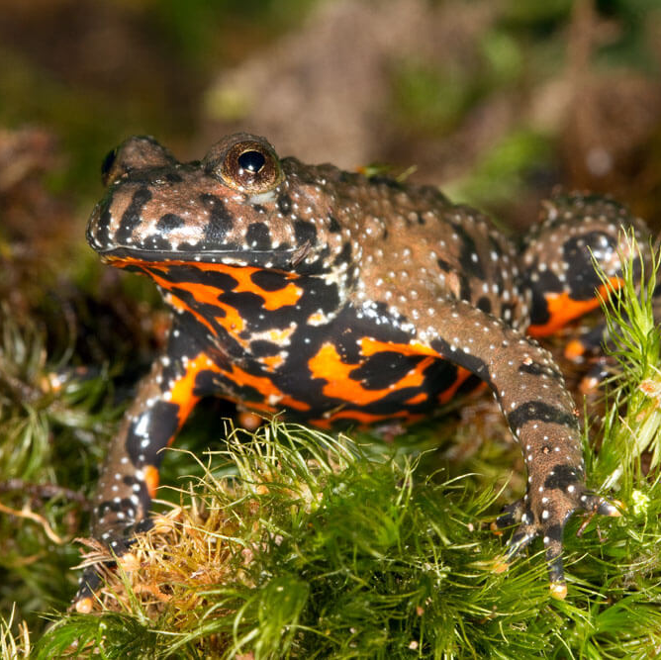
Amphibians
- A total of 20 species are endangered in the Czech Republic.
among the most endangered are:
Newt Newt: large, mountain, common;
Frogs: Common Toad, Common Toad, Green Tree;
Frog Jumps: Brown Jumper, Sharp-nosed Jumper, Slender Jumper.

Slide 8
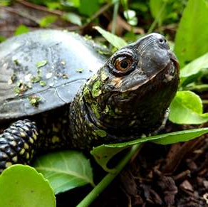
Reptiles
- endangered species include: Lizards: common, green…
Common: eastern, fragile;
Snake: arboreal, submerged;
Turtles: beautiful, muddy;
Viper: general.

Slide 9
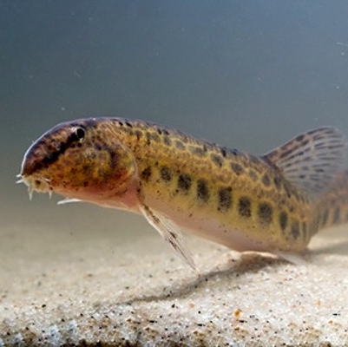
Fish
- there are a total of 57 species in our country;
- 2 species of fish are endangered;
- 7 species of fish are assessed as vulnerable and another 8 species of fish are included in the almost endangered category;
- Critically endangered include:
Drsek major,
Drsek smaller.

Slide 10
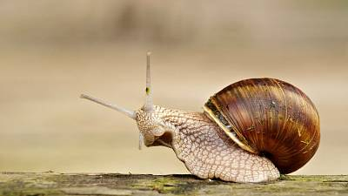
2. invertebrate

Slide 11
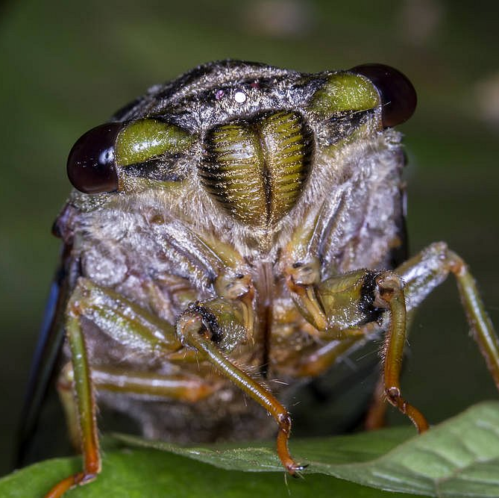
insect
- we divide it into 3 species, namely useful, harmful, difficult insects;
- the most endangered insects include: Eastern White, Cicada, Aspen, Beetle, Mantis…

Slide 12
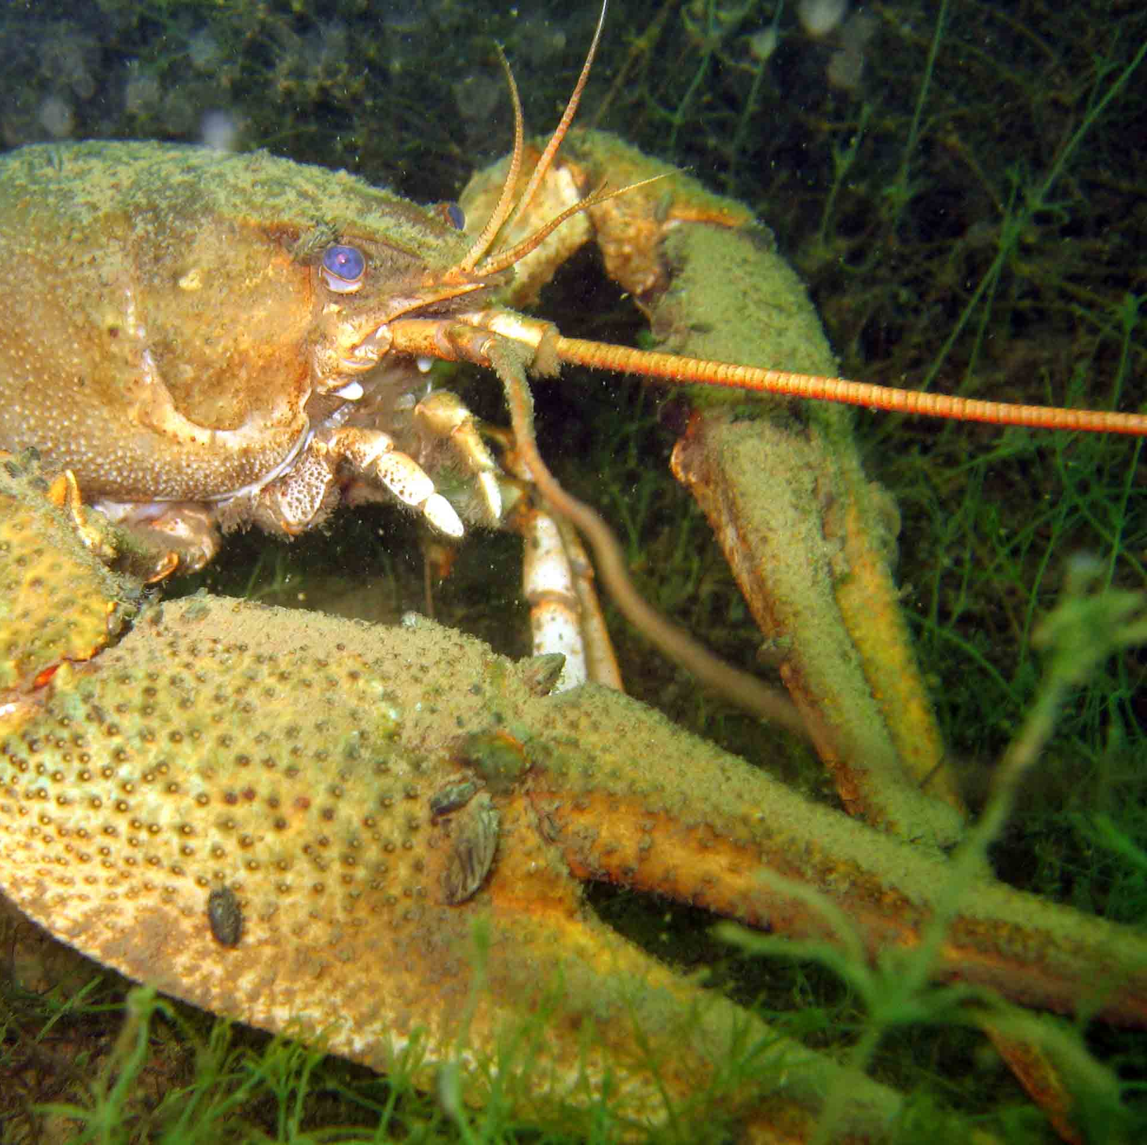
crayfish and arachnids
- There are a total of 5 species of cancers, of which 3 species are endangered:
Rak říční;
Rak kamenáč;
Rak bahenní.

Slide 13
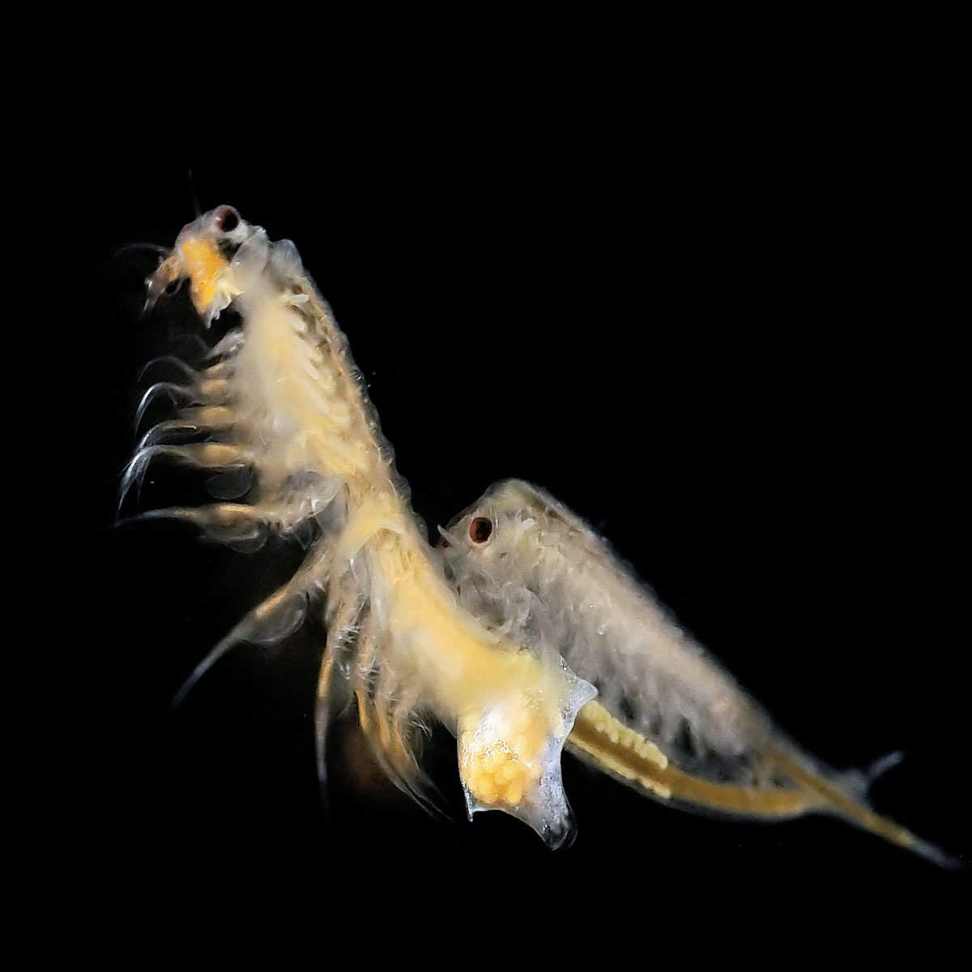
leafhoppers
- There are a total of 12 species in the Czech Republic.
- 2 species extinct, 2 endangered, 5 critically endangered and 3 vulnerable.
- we include among them: Gills, Postcards, Clams and Pears.

Slide 14
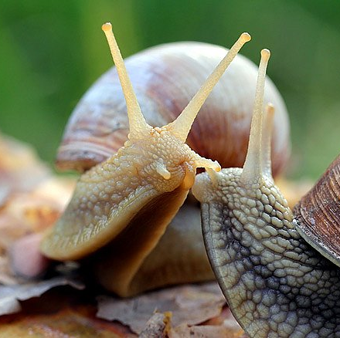
molluscs
- a total of 247 species in the wild
snails - 219 species,
bivalves - 28 species.

Slide 15
thank you for your attention

Slide 16
"The European Commission support for the production of this publication does not constitute an endorsement of the contents which reflects the views only of the authors, and the Commission cannot be held responsible for any use which may be made of the information contained therein."

