Slide 1
Electricity production - consumption: CZECH REPUBLIC ITALY POLAND SPAIN

Slide 2
Czech Republic
Production
Renewables: 11.9% in eletricity production
_{Steam – 51,2%}
_{Nuclear – 34%}
_{Wind – 9,3%}
_{Gas – 8,4%}
_{Solar – 6,7%}
_{Photovoltaics – 2,65%}
_{Water – 1,85%}
_{Pumped – 1,2%}

Slide 3
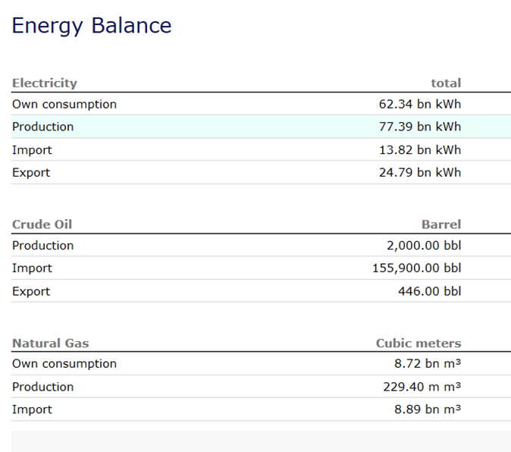
Compsumption – Production Import - Export
Power plants in the Czech Republic produce much more energy than we are able to consume. This amount of energy would manage to charge about 4-5 million passenger electric vehicles.

Slide 4
Italy
Production
Renewables: 40% in eletricity production
_{Gas – 33.5%}
_{Water – 21.5%}
_{Coal – 15,5%}
_{Solar – 8%}
_{Biomass – 6,7%}
_{Wind – 5,4%}
_{Geothermal – 2,1%}

Slide 5
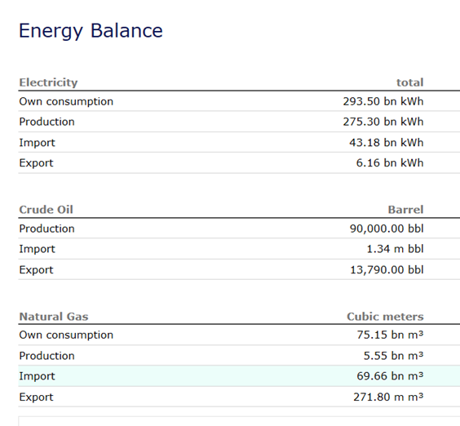
Compsumption – Production Import - Export
Italy has few energy resources, and most of supplies are imported.
The government responded by closing existing nuclear power plants and stopping work on projects underway, continuing to work to the nuclear energy program abroad.
The national power company Enel operates seven nuclear reactors in Spain and four in Slovakia, and in 2005 made an agreement with Électricité de France for a nuclear reactor in France. With these agreements, Italy has managed to access nuclear power and direct involvement in design, construction, and operation of the plants without placing reactors on Italian territory.

Slide 6
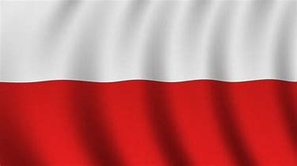
Poland
Production
Renewables: 13% in eletricity production
Coal: 79,6%
Gas: 5,8%
Water: 1,3%
Wind, biomass, biogass: 10%

Slide 7
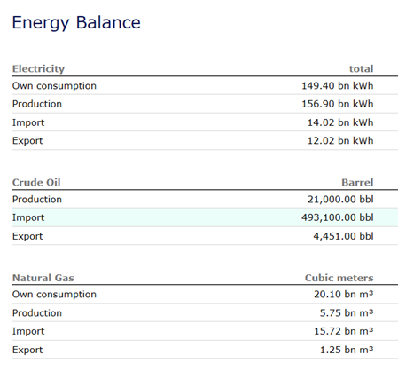
Consumption – Production Import - Export
Poland has no nuclear power plants. Most of the nation's electricity is currently produced by burning coal.
As Poland has limited hydropower and geothermal potential, wind power, biogas and biomass are expected to be the primary sources of new renewable energy. Limited solar applications for water and space heating are also expected to grow. Hydropower Polish hydropower resources are limited.

Slide 8
Spain
Production
Renewables: 39% in eletricity production
Nuclear: 44,8%
Solar, wind, geothermal: 22,4%
Biomass, waste: 21,1%
Water: 7,2%
Fosil: 4,5%

Slide 9
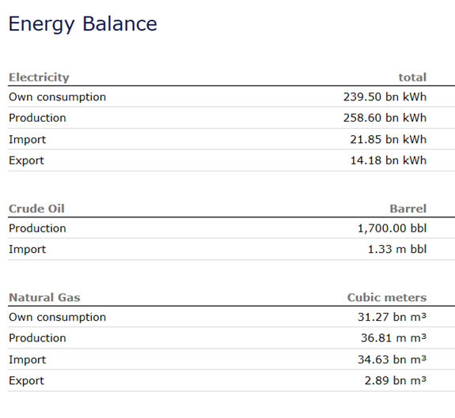
Consumption – Production Export - Import
Most of the renewable electricity being generated in Spain comes from wind, which alone provided 22.5 percent of the country’s electricity in April 2015. Wind often competes with nuclear for the title of Spain’s top electricity generation source overall — in fact, though nuclear pulled through in March 2015 as the top source of electricity, wind has overall provided more electricity to Spain in the entirety of 2015. From January to March 2015, according to REE, wind provided 23.7 percent of electricity generation while nuclear made up 22.7 percent

Slide 10
"The European Commission support for the production of this publication does not constitute an endorsement of the contents which reflects the views only of the authors, and the Commission cannot be held responsi­ble for any use which may be made of the information contained therein."

