Slide 1
(DROUGHTS)
Project Nr: 2019-1-CZ01-KA229-061106 It´s our world - take care of it

Slide 2
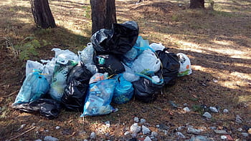
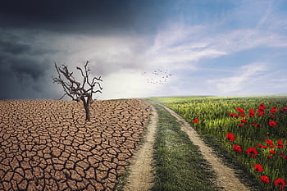
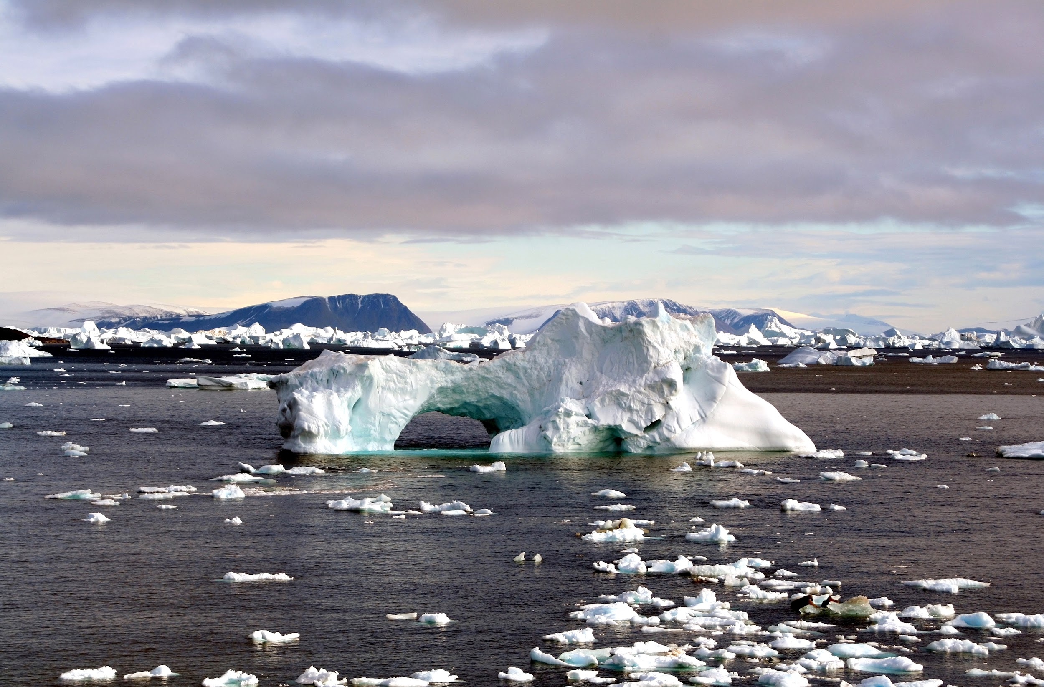
CLIMATE CHANGE
The climate change refers to long-term changes in temperatures and weather patterns. These changes can be natural or by human activities.

Slide 3
CONSEQUENCES OF CLIMATE CHANGE
The climate changes provokes the appearance of many meteorological problems such as: droughts, fires, the death of animal and plant species, the overflowing of rivers and lakes among others.

Slide 4
CAUSES THAT CAUSE GLOBAL WARMING
The greenhouse effect is a natural process that allows The Earth the necessaries conditions to harbor life, the problem is when the human activities increases the greenhouse gas emissions into the atmosphere and it keeps more heat than necessary, producing that the medium temperature of The Earth increases and produces what we popularly call global warming.

Slide 5
HOW TO AVOID CLIMATE CHANGE
MITIGATE THE EFFECTS
Mitigation consists of implementing actions to reduce and limit greenhouse gas emissions with the aim of preventing the planet's global temperature from continuing to rise.
ADAPT TO THE ENVIRONMENT
Adaptation is focused on actions to reduce vulnerability to the effects of climate change, such as improving safer and more resilient infrastructure and facilities, reforestation and landscape restoration

Slide 6
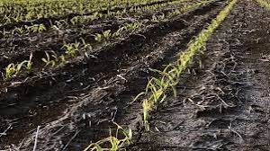
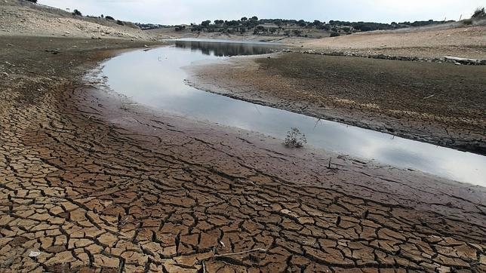
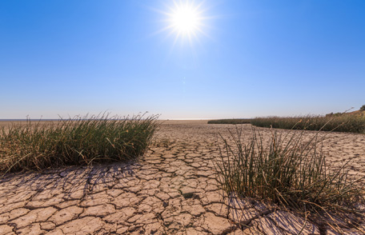
2. DROUGHT
The drought it’s the extreme lack of water in specific areas like rivers, lakes and swamps.
One reason of drought its the lack of rainfall or rain.
The periods of the drought may cause desertification.

Slide 7
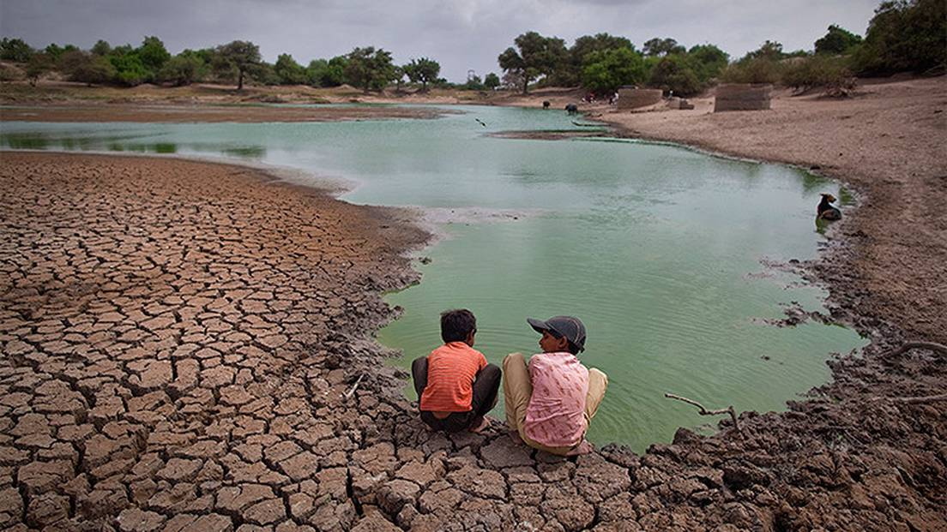
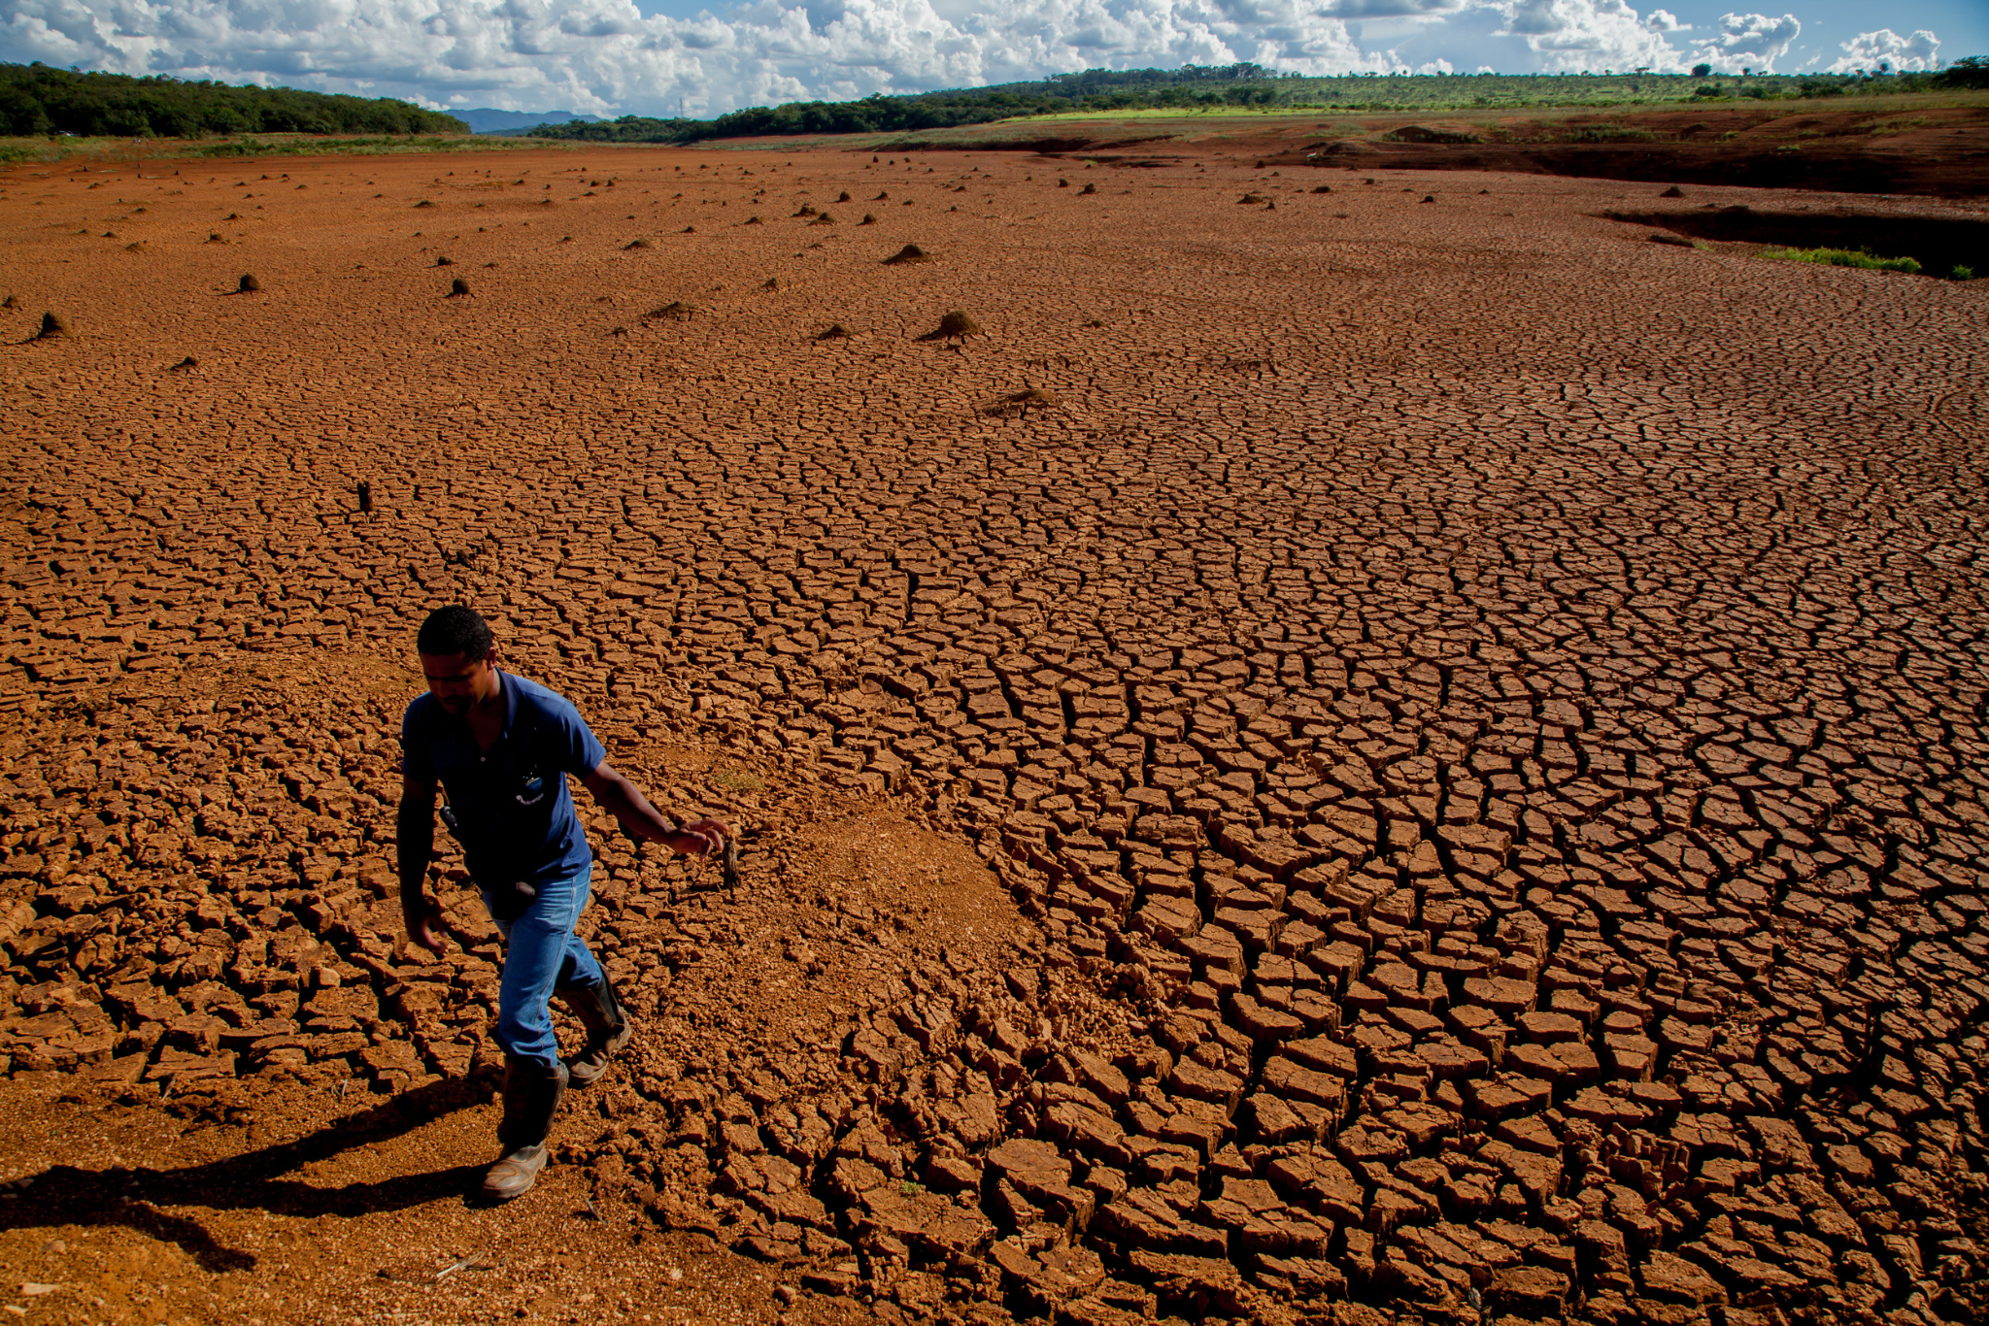
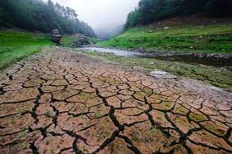
What are the most affected countries in the world?
Armenia
East Timor
Morocco
Algeria
Namibia
Ethiopia

Slide 8
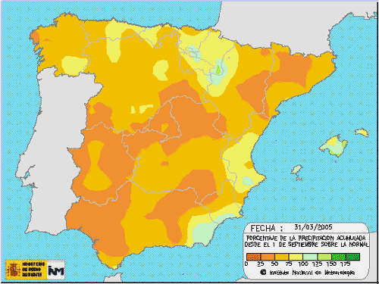
According to the latest United Nations report on the environment, they have warned that drought is the "most visible" threat of climate change in Spain and that 75 percent of the Iberian Peninsula is in "danger of desertification."

Slide 9
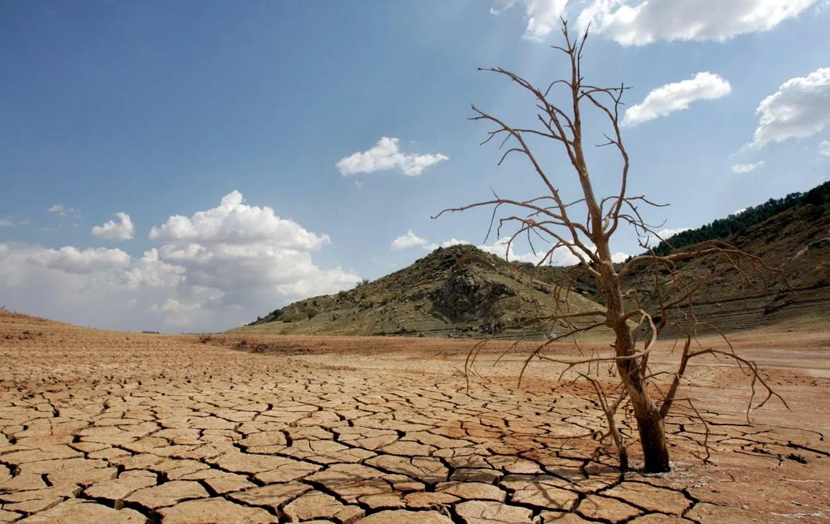
3. CAUSES
Droughts are mainly caused by:
Lack of rain.
Irregulars period of precipitation.
Human activities as overexploitation of land affects negatively in order to store and to retain water.
Activities that encourage the climate change and global overheating.

Slide 10
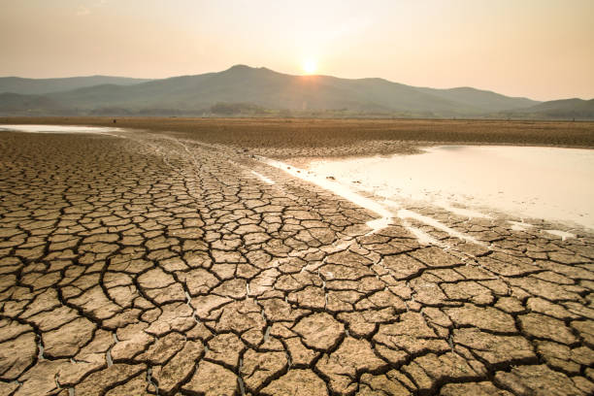
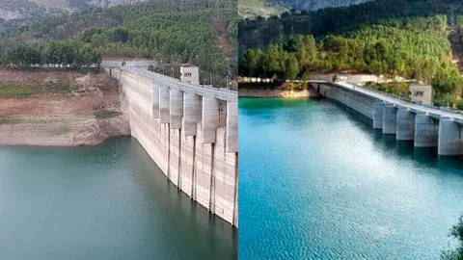
CAUSES OF DROUGHT IN ANDALUSIA
The drought in Andalusia is produced as consequence of the climate crisis due to global warming.
For this reason, periods of drought increase and summers lengthen, while autumns and springs are shortened.

Slide 11
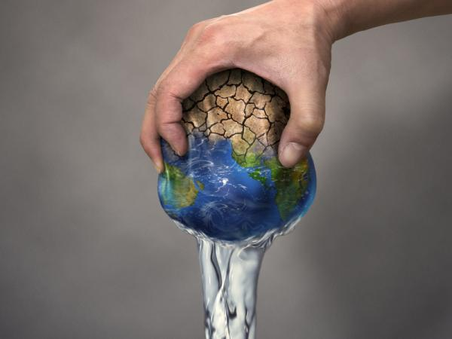
The Water on our Planet
The planet is made up of 70% water.
Only of 3,5% of water is sweet water and only the 0’025 % is drinking water.
2.200 millions people in the world have no access to drinking water services. 4.200 millions don`t have sanitation services.
3.300 millions don’t have the basic to wash their hands.

Slide 12
4. CONSEQUENCES
The drought makes impossible the grow up from the grasses to feed different animals
Usually, the lack of water makes impossible to plant many species.
Most of the crops lost performance
If there is no water, animals can’t drink so it makes difficult to live.

Slide 13
The drought in the humans
The humans need drink water diary and also make as:
Quantity and quality committed from potable water.
Increase the danger in recreational activities.
Worst quality from air.
Less quality from food and nutrition.
Increase in the incidence from diseases.

Slide 14
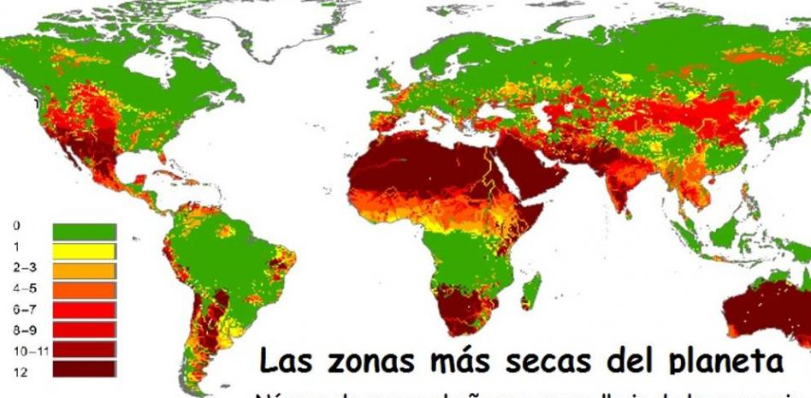
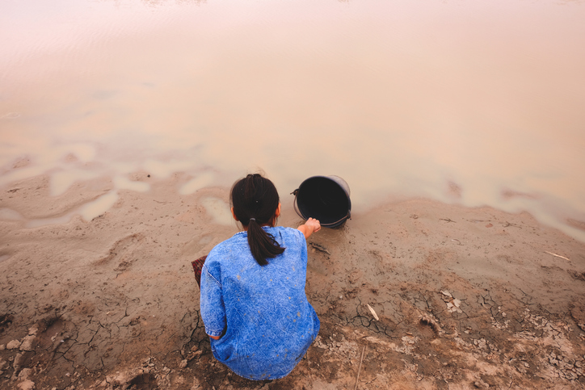
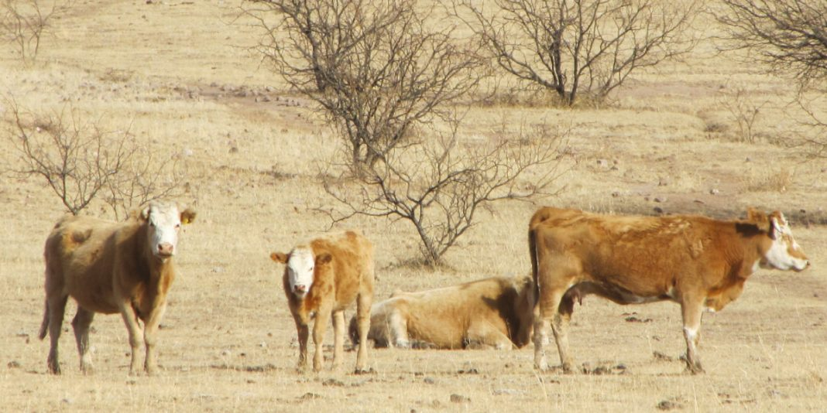
Images
XDDDDDDDDDDDDDDDDDDDDD

Slide 15
Definition:
It is an indicator of the use of water that refers to both its direct and indirect use by the consumer or producer.
5. WATER FOOTPRINT

Slide 16
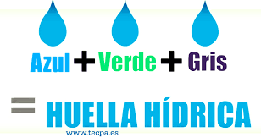
How is it measured?
The water footprint is measured in cubic meters. It consists of three elements that have been named according to the colors usually assigned to water:
Green: is the one obtained directly from rain or snow.
Blue: they are facilities managed by humanity
Grey: amount of contaminated water

Slide 17
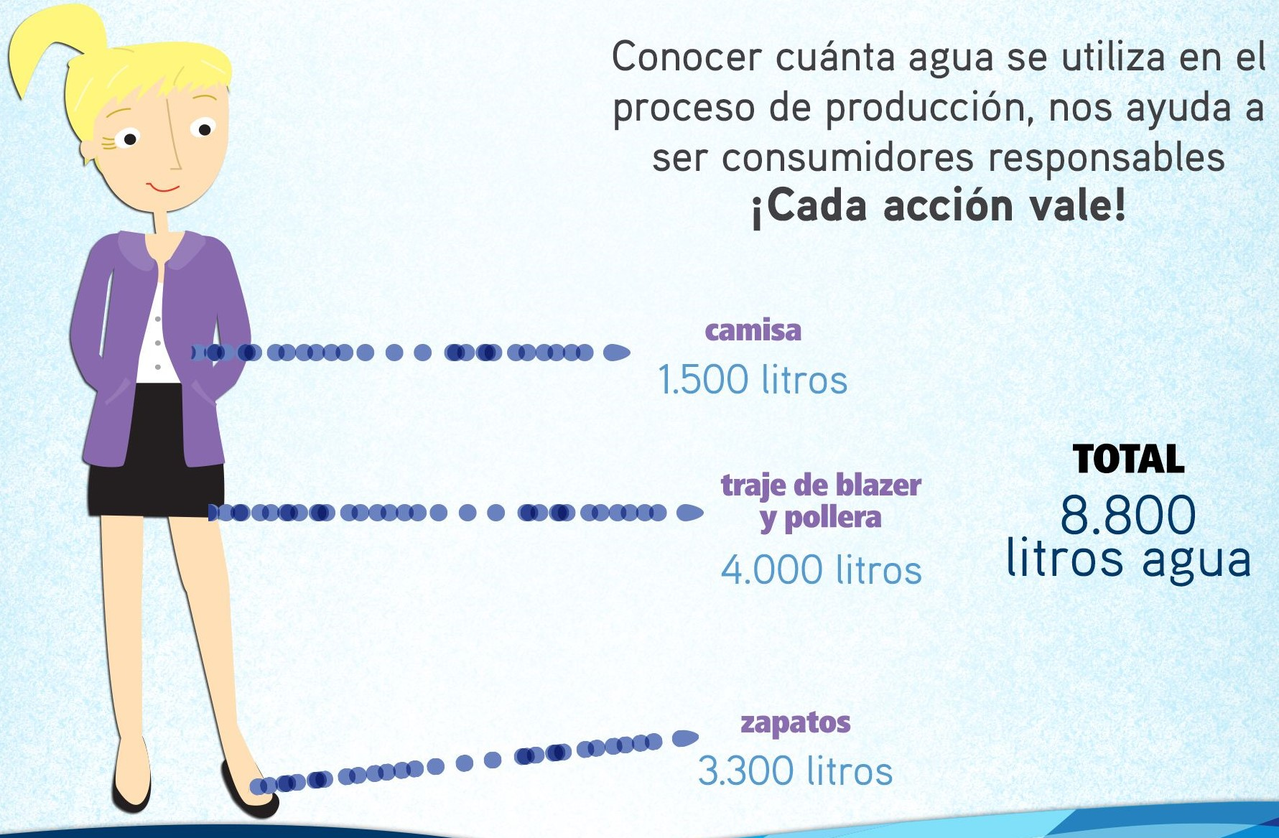
How many litres of water do we consume in our
day to day?
Every action we do involves water consumption
Some examples could be:
3000 liters of water is necessary to
produce a kilogram of rice
2700 liters to manufacture a cotton
T-shirt
1130 liters per family every day

Slide 18
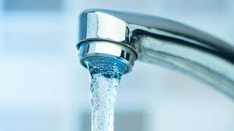
6. MEASURES IN OUR SCHOOL
Toilets:
Change from manual opening and closing to automatic closing tap with timer.
Double button tank

Slide 19
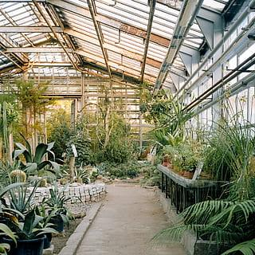
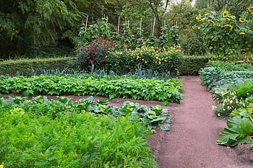
Other facilities:
Green house with a localized irrigation system
Umbraculum with a localized irrigation system and shading nets to prevent liquid losses
Vegetable patch with a localized irrigation system and mulch technique
Osmosis filter. This filter allows us to consume quality water practically free of microplastics

Slide 20
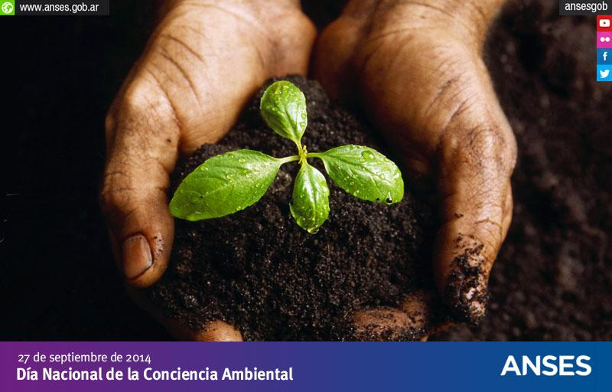
Environmental Education and Awareness
In this way we value and care for the environment to reduce our water footprint through knowledge.
Through:
Development of codes of behaviour
Creation of the environmental committee and the educational community
EDUCATION IS THE BEST PREVENTION

Slide 21
Thanks for your attention!

