Slide 1
ERASMUS
ENDANGERED ANIMALS IN THE CZECH REPUBLIC
Erasmus+ KA229 - School Exchange Partnerships | Project Nr: 2019-1-CZ01-KA229-061106 It´s our world - take care of it

Slide 2
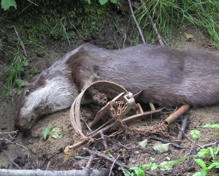
Why are some animals endangered or even extinct?
destruction of the natural environment;
hunting and trapping of animals;
pollution;
climate change;

Slide 3
Degree of threat
EW | extinct in the wild
CR | criticaly endangered
EN | endangered
VU | vulnerable
LR/cd | lower risk / conservation depended
LR/nt | lower risk / near threatened
DD | data deficient

Slide 4
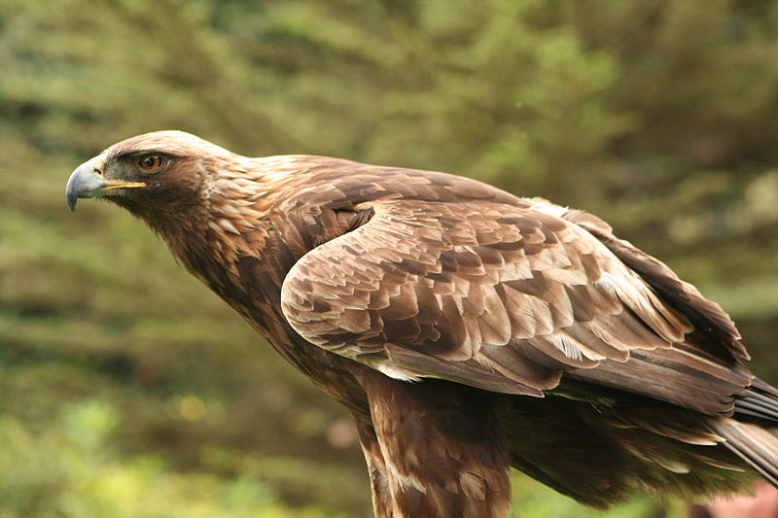
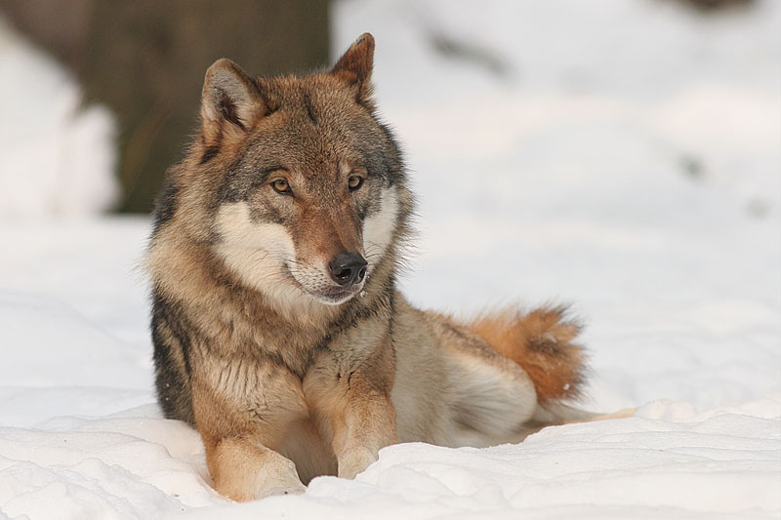
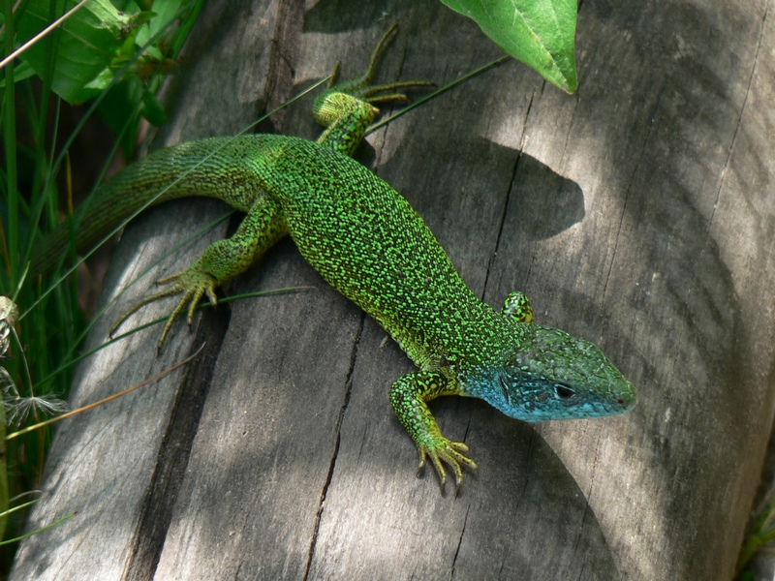
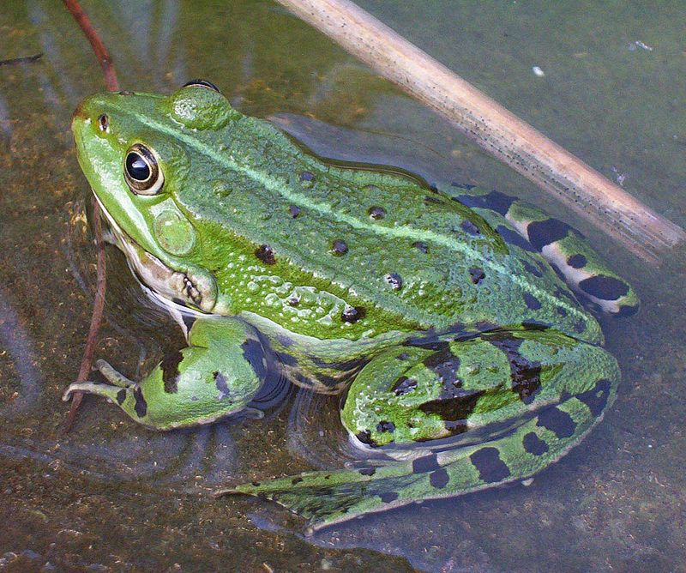
Vertebrates
① mammals
② birds
③ reptiles
④ amphibians
⑤ fish and grouse

Slide 5
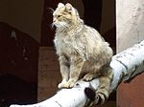
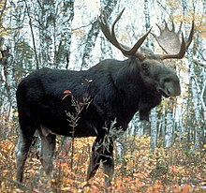
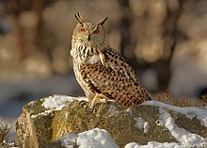
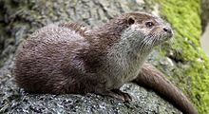
Vertebrates
brown bear
wildcat
eurasian beaver
moose
eurasian otter
eurasian eagle-owl

Slide 6
Eurasian Lynx
Problem #1 – poaching.
Problem #2 – migration barriers.
According to scientific estimates, poachers have destroyed at least 500 lynxes in our country in the last 20 years.
60-80 Lynx live in southwestern Bohemia (Šumava).

Slide 7
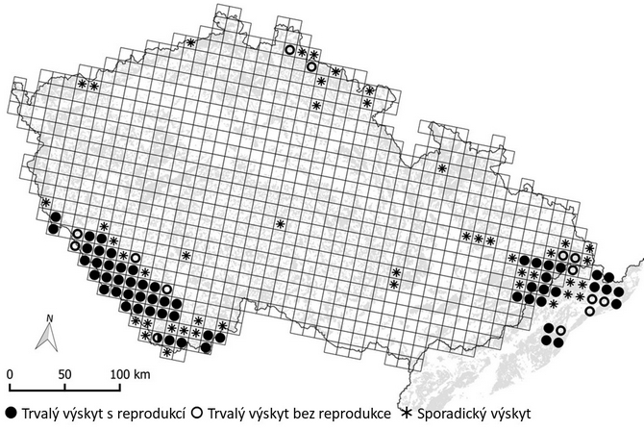
Occurrence of lynx in the Czech Republic
Permanent occurrence with reproduction.
Permanent occurrence without reproduction.
Occasional occurrence.

Slide 8
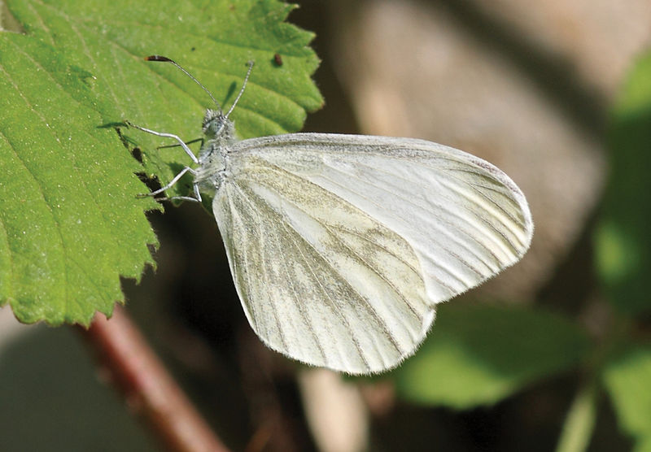
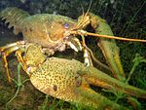
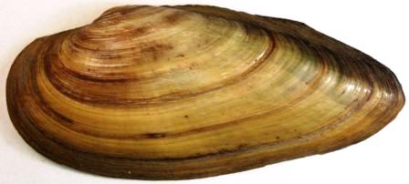
Invertebrates
① insect
② crayfish and arachnids
③ leafhoppers
④ molluscs

Slide 9
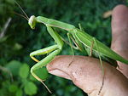
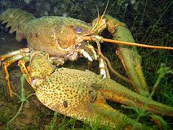
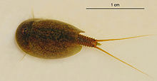
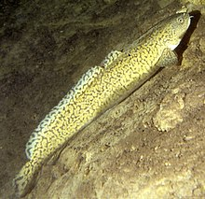
Invertebrates
European mantis
Lepidurus apus
Astacus leptodactylus
Burbot
Smooth newt

Slide 10
LILIANA KUNCLOVÁ RICHARD DVOROŽŇÁK MIKULÁŠ KUBÍK VIKTOR NEYMETI THANK´S FOR YOUR ATTENTION
Prepared by:
"The European Commission support for the production of this publication does not constitute an endorsement of the contents which reflects the views only of the authors, and the Commission cannot be held responsible for any use which may be made of the information contained therein."

