Slide 1
Air pollution in the Czech Republic and our region
Erasmus+ KA229 - School Exchange Partnerships
Project Nr: 2019-1-CZ01-KA229-061106 It´s our world - take care of it
Dominik Buranský, Petr Flajšman, Patrik Hranáč, Matěj Linhart

Slide 2
Air pollution in the Czech Republic
Air pollution → long-term problem in the Czech Republic.
Cause of several deaths and diseases (airways, incidence of cancer and heart disease).
The largest sources of impurities → thermal power plants and industry, car transport, local heating with coal and burning waste.
Ostrava area and surroundings → the most polluted area not only in the Czech Republic!
Around 11 000 people die every year due to air pollution!
Over the last 20 years, the air has improved significiantly, but even so, 60 % of the population lives in areas where the legal limits for air pollution are exceeded .

Slide 3
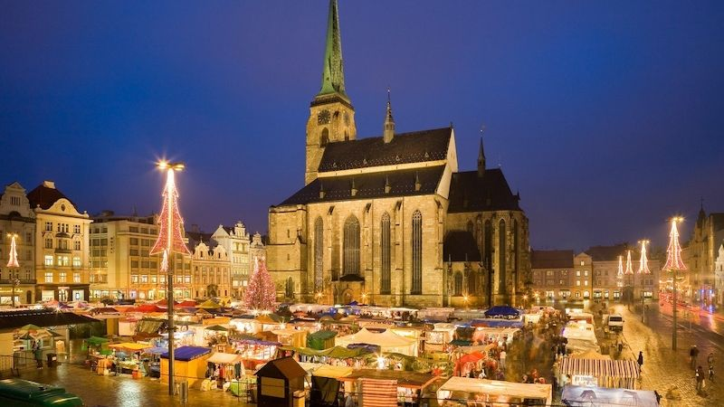
Air pollution in the Pilsen region
The main pollutant in Pilsen is nitrogen dioxide→ within the Czech Republic, Pilsen is one of the areas most at risk from higher concentrations.
Main sources of this substance → car transport and coal combustion in heating plants and local heating plants.
At 27 places in Pilsen, which is most burdened by traffic, experts examined air quality → in six cases the nitrogen dioxide values were exceeded.

Slide 4
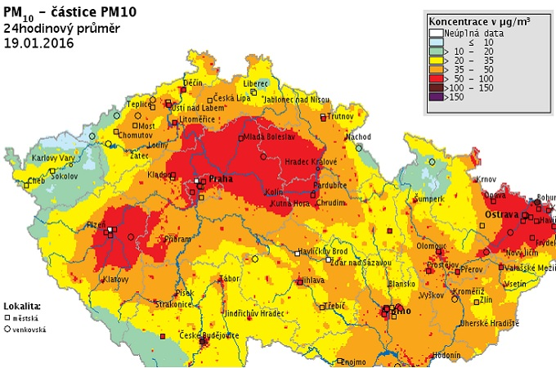
What to do against air pollution?
Reducing traffic emissions by using more modern, less harmful vehicles.
Reducing traffic intensity.
Traffic also causes noise pollution → noise walls along roads allow, among other things, to bring traffic emissions to slightly higher heights and this help to improve the air.

Slide 5
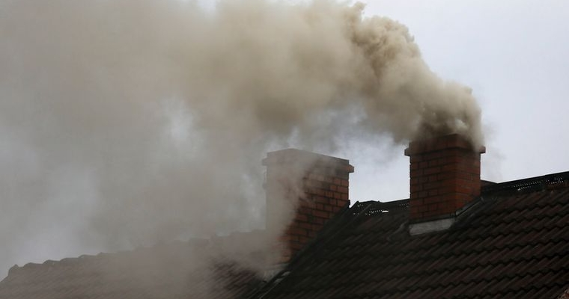
THANK YOU FOR YOUR ATTENTION!

Slide 6
RESOURCES:
https://www.hnutiduha.cz/sites/default/files/publikace/2018/11/znecisteni_ovzdusi_cr_podklad_cad_2018.pdf;
https://cs.wikipedia.org/wiki/Zne%C4%8Di%C5%A1t%C4%9Bn%C3%AD_ovzdu%C5%A1%C3%AD_v_%C4%8Cesku#:~:text=Zne%C4%8Di%C5%A1t%C4%9Bn%C3%AD%20ovzdu%C5%A1%C3%AD%20p%C5%99edstavuje%20v%20%C4%8Cesk%C3%A9,vyt%C3%A1p%C4%9Bn%C3%AD%20uhl%C3%ADm%20nebo%20spalov%C3%A1n%C3%AD%20odpadu;
https://www.airqualitynow.eu/cz/pollution_acting.php;
https://www.idnes.cz/plzen/zpravy/oxid-uhlicity-silnice-komunikace-kvalita-ovzdusi-odbornik-koncentrace-alzheimerova-choroba-karlovars.A190720_490372_plzen-zpravy_vb;
https://www.sitmp.cz/wp-content/uploads/2019/08/Satelitn%C3%AD-anal%C3%BDza-Plze%C5%88sk%C3%A9ho-ovzdu%C5%A1%C3%AD.pdf;

Slide 7
"The European Commission support for the production of this publication does not constitute an endorsement of the contents which reflects the views only of the authors, and the Commission cannot be held responsible for any use which may be made of the information contained therein."

