Slide 1
Climate change in the Czech Republic
Created by : Alex Kiričenko and Richard Goldschmid
Erasmus+ KA229 - School Exchange Partnerships
Project Nr: 2019-1-CZ01-KA229-061106 It´s our world - take care of it

Slide 2
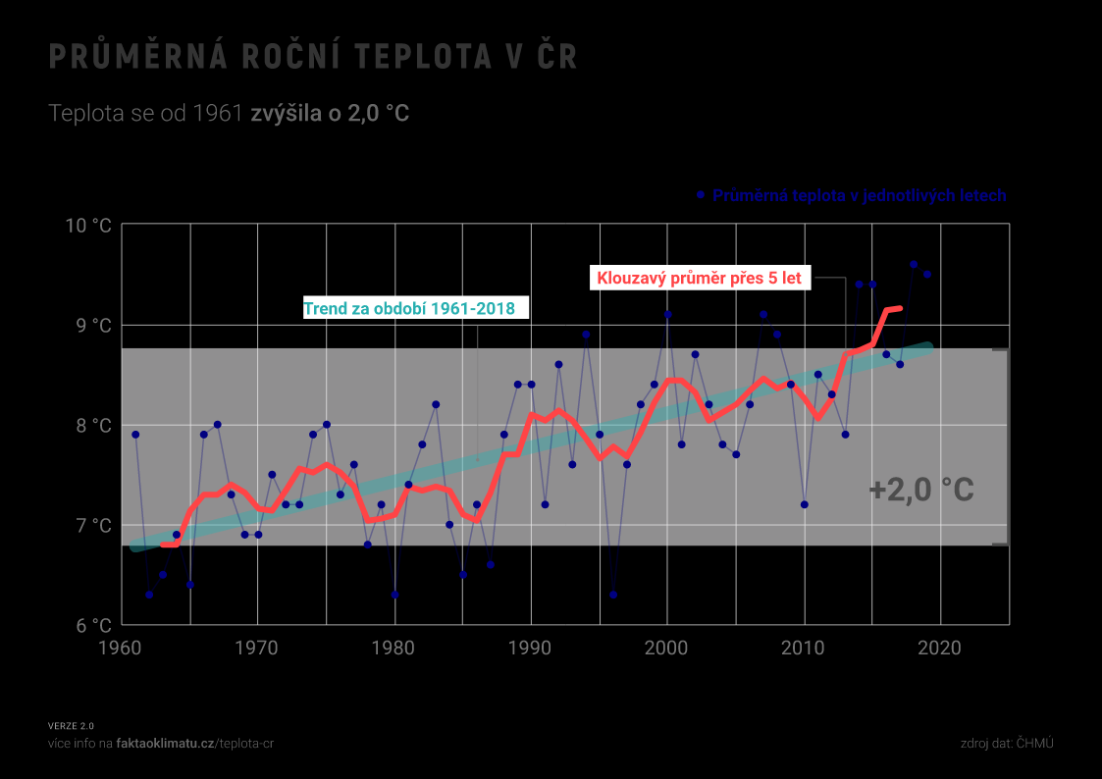
In the last two decades, the average number of days with high temperatures in the Czech Republic has increased (summer and tropical days, tropical nights) and logically to reduce the average number of days with low temperature (frosty, icy and arctic days). The trend will continue and to the end of the century, the number of summer and tropical days will increase, it will appear very exceptional tropical nights, the number of frosty and icy days will strong decrease and the arctic days practically cease to occur. The occurrence of these days with limit values will, of course, occur differently in the Czech Republic depending on the locality.

Slide 3
Causes of climate change
Greenhouse gases: there are gases , which occurring in the Earth's atmosphere or another space bodies, which most of them contribute to the so-called greenhouse effect. The most of important greenhouse gases of natural origin are water steam, carbon dioxide, methane and nitrous oxide.
The most of common greenhouse gas which produces by human activity is CO². It is responsible for 63 % of global warming caused by man. Its concentration in the air is currently 40 % higher than it was at the beginning of industrialization.
The increase in emissions is mainly due to the following human activities.
Burning fossil fuels, because the combustion of hard coal, oil and natural gas produces carbon dioxide and nitrous oxide.

Slide 4
Felling forests, because trees absorb CO² from the atmosphere, helping to regulate the climate. By deforestation, this effect disappears and much more carbon dioxide enters to the atmosphere, thereby squares the greenhouse effect.
Traffic which is a major producer of greenhouse gases CO² and NO².
More intensive cattle breeding, because cows, as ruminants, produce large amounts of methane during digestion.
Using of fertilizers containing nitrogen, which emit nitrous oxide.
Using of fluorinated gases, for example in the manufacture of refrigeration equipment, air conditioning equipment and heat pumps, etc. which cause a strong greenhouse effect.

Slide 5
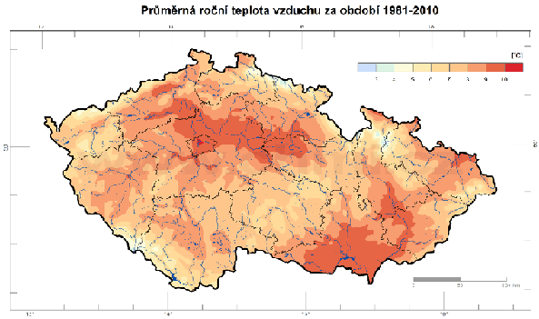
Climate change in the Czech Republic has so far manifested itself mainly in a severe drought. Water evaporation increases with increasing temperature and in the Czech Republic there is also a rapid decrease winter precipitation in the lowlands, which are crucial for replenishing groundwater supplies. Groundwater accumulates for a long time and short-term precipitation in summer does not replenish it, because water is drained by vegetation during rains. There are dies not only spruces and larch, but also trees like pines, which have deeper roots.

Slide 6
Other manifestations of global warming in the Czech Republic
In the last ten years the values of all snow – related characteristics decreased. The number of days with snow cover is decreasing, as well as monthly and seasonal maximum snow height. Snow is declining in the lowlands and the mountains. The occurrence of snow is an important supposition for the creation of a sufficient amount of surface and groundwater. Climate change is also evident in the living nature. Observations in the Moravian floodplain forests show that in the period 1961-2000 has moved here to an earlier period of leaf sprouting in selected tree species and flowering by selected bushes and herbs. By the selected birds species was recorded a shift in the beginning of nesting. For some flowers in floodplain forests was observed an increase the number of florets.
Impact of climate change
According to the forecasts in the context of climate change could decrease during 21st century to average flows in many Czech river basins by about 15-20%, eventually by up to 25-30% to deepen water disturbances, it could occur especially in the summer and autumn months.
Climate change will be result in the earlier onset of the spring seasons and an increase in average temperatures in the winter months, as a result will be growth could accelerate and the development of vegetation in the spring and a consequent increased risk of damage from late frosts and increased incidence of both existing and newly migrating pathogens and weeds.

Slide 7
Climate change mitigation
Climate change mitigation is a measure to reduce the magnitude and speed of long-term climate change. Clime change mitigation generally involves reducing human (anthropogenic) greenhouse gas (GHG) emissions. Mitigation can also be achieved by increasing carbo storage capacity, for example though reforestation. Examples of mitigation include the transition to low- carbon energy sources, such as renewables and nuclear energy, and the expansion of forests and other sinks to remove more carbon dioxide from the atmosphere. Energy efficiency can also play an important role, for example by improving the insulation of buildings.
Paris Agreement
On October 5, 2017 the Czech Republic ratified the Paris Agreement. The aim of the agreement is to keep the increase in global average temperature well below 2 °C compared to pre-industrial levels, ideally so that the increase in temperature does not exceed 1.5 °C. The Czech Republic is not doing enough to meet the objectives of the Paris Agreement. According to the ICC report, we have until 2030 to reverse the current trend and be able to achieve the goals of the Paris Agreement at all .
What must the Czech Republic do ?
Half of our energy production comes from coal. We are also one of the largest exporters of energy. We must get it of our dependence on coal for energy production, not continue mining, not expand mines in the Czech Republic, We need to start investing thoughtfully in renewables and the distribution network. We need to change our management of the landscape and the water in the landscape.

Slide 8
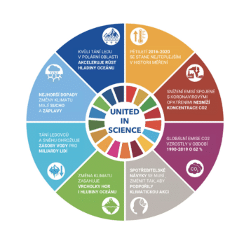
What can you do ?
Reduce your own carbon footprint by changing your energy supplier reduce your meat consumption , don't travel by air unnecessarily . Shop for local foods that are grown sustainably . Educate yourself , discuss , get involved.

Slide 9
Resources
https://cs.wikipedia.org/wiki/Glob%C3%A1ln%C3%AD_oteplov%C3%A1n%C3%AD
https://www.ceska-krajina.cz/projekty/zmena-klimatu/
https://clanky.rvp.cz/clanek/c/Z/140/globalni-oteplovani-a-klimaticke-zmeny-v-minulosti.html/

Slide 10
"The European Commission support for the production of this publication does not constitute an endorsement of the contents which reflects the views only of the authors, and the Commission cannot be held responsible for any use which may be made of the information contained therein."

