Slide 1
Znečištění vzduchu v ČR a našem kraji Air pollution in Czech Republic and our region
Erasmus+ KA229 - School Exchange Partnerships
Project Nr: 2019-1-CZ01-KA229-061106 It´s our world - take care of it
Created by: J. Šimana, J. Václav, J. Mašát, D. Kurfürst

Slide 2
The level of Air pollution is getting better, but only slowly, biggest problems is causing airborne dust, Benzo(a)pyren and tropospheric ozone
Air pollution is a big and well known problem in Czech Republic.
Polluted air is the cause of lot of deaths and diseases, for example – Airways diseases, occurrences of cancer and heart diseases.
Among the largest sources of pollution include- thermal power plants, industries, car transport, local coal heating or trash burning.

Slide 3
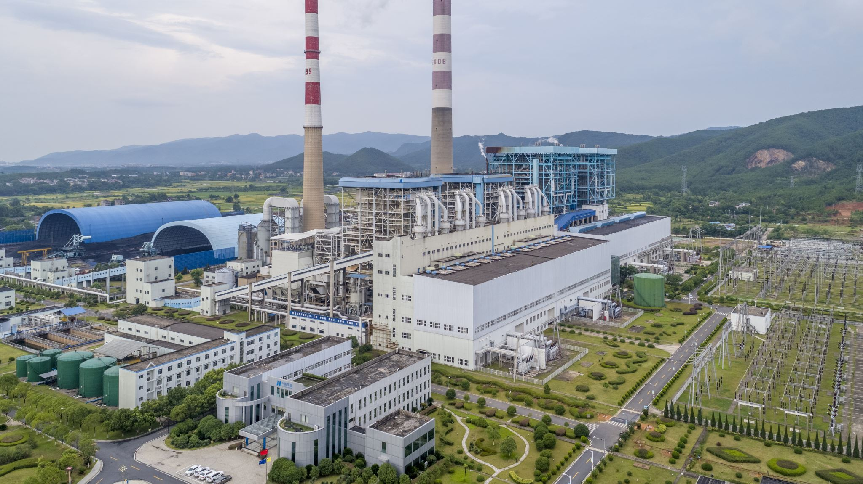
areas
In the Czech republic, there are a lot of areas and big agglomerations that are often hit by air pollution.
Ostravsko » Oblast Ostravy and areas (50 km) is the most polluted area not only in Czech Republic. Regularly the limit for airborne dust is exceeded (PM 10) and more polluting substances.
Ústecko » The source of pollution is the surface mining of brown coal and its burning in coal power plants.
Praha » The main source of Pollution here is mainly the transport, also there are high values of airborne dust pollution.

Slide 4
Historic development in 70s And 80s of 20th century in some industrial areas was among the worst in Europe
In the current situation the main problems of air quality in the Czech Republic are similar like in other countries of European Union especially the airborne dust and ozone. Most of country´s population is exposed to high concentrations of these pollutants, that are exceeding the limits. The areas within intensive car transport and concentration of industry are highly hit by benzo(a)pyrem pollution. The highly transport loaded areas have a problem with exceeding the limits for nitrogen dioxide

Slide 5
Air pollution 30 years ago
In the long run Czech Republic has very high emission of carbon dioxide in greenhouse gasses, which is among the highest among the Member states of the European Union.
The values for Aggregated emissions in Czech Republic between the years 2005 and 2007 have gone up, the main cause of this is the exponential growth of the transport emissions, these emissions in the year 2007 accounted for over 13 % of total emissions, meanwhile in the year 1990 didn´t even reach 5 %.
Thus, the goal of the State Enviromental Policy of the Czech Republic to reduce greenhouse gas emissions is not being met.

Slide 6
Thank you for your attention

Slide 7
"The European Commission support for the production of this publication does not constitute an endorsement of the contents which reflects the views only of the authors, and the Commission cannot be held responsible for any use which may be made of the information contained therein."

