Slide 1
Global warming over the last 50 years in the Czech Republic
Erasmus+ KA229 - School Exchange Partnerships
Project Nr: 2019-1-CZ01-KA229-061106
It´s our world - take care of it
Martin Tichý, Adam Hlinka , Thanh Dat Nguyen, Lukáš Blanda

Slide 2
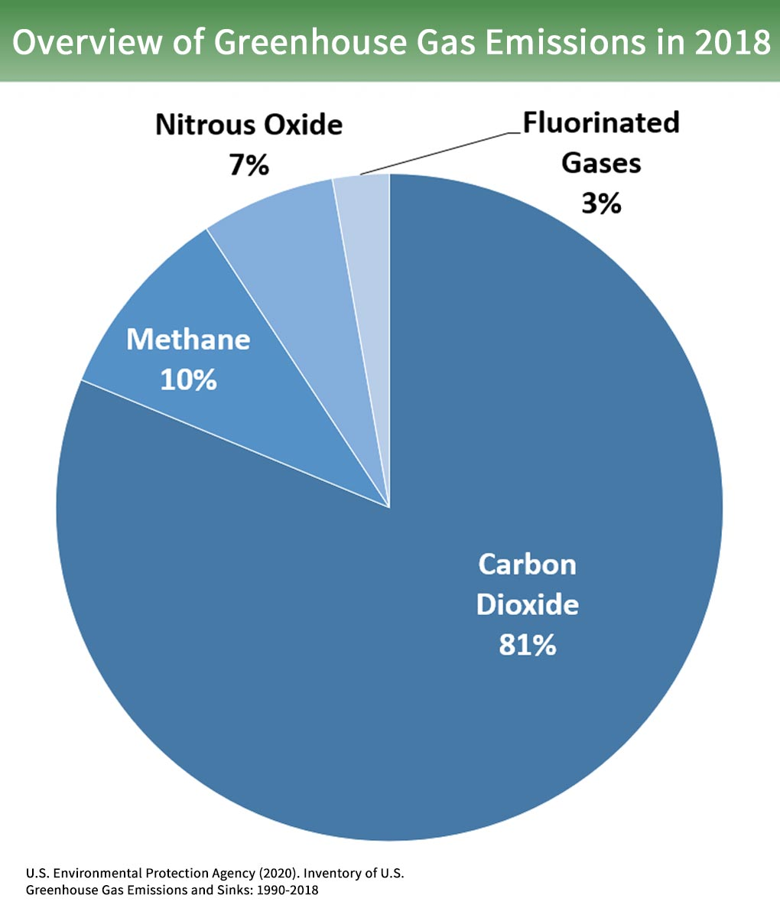
Causes of climate change
The impact of human activity on climatic conditions on our planet, including average temperatures, is constantly escalating, whether it is the consumption of fossil fuels.
This creates a huge amount of greenhouse gases, which increase the volume of naturally occurring gases of this type in the atmosphere and intensify the greenhouse effect, and, as a result, global warming.

Slide 3
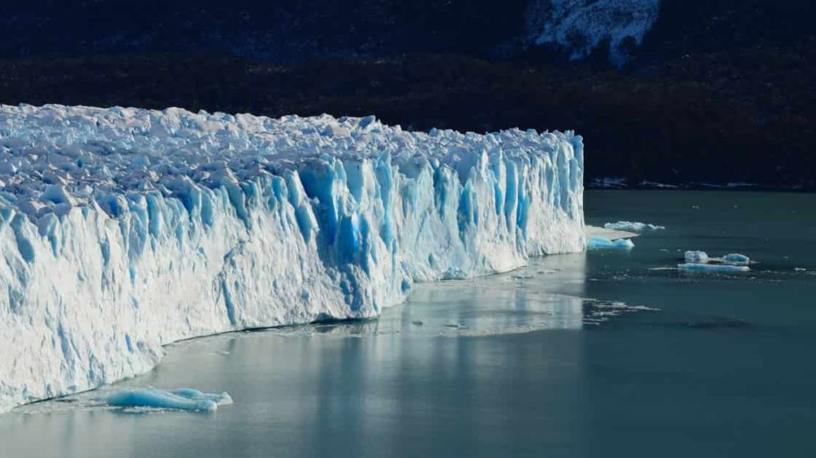
Global warming and its problems
Global warming is a long-term increase in the average temperature of the Earth's climate system.
Combustion of fossil fuels is the most important continuous source of carbon dioxide, which has its origin in human activity.
Due to the continuing dependence of the world's energy on fossil fuels (approximately 81 %), whose consumption will continue to grow, it is important to pay attention to the possibilities of reducing CO2 emissions in this sector.

Slide 4
Manifestations of Global Warming in the Czech Republic

Slide 5
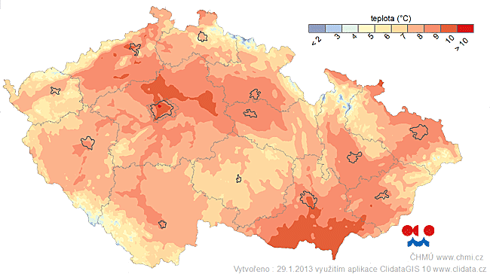
1.Temperature changes
In ten years, the temperature in the Czech Republic has risen by about 0.28 °C.
The warmest year was 2018 with an average temperaure of 9.6 ° C (extremely above normal with a deviation of +1.7 °C from normal).
Even in the warmest last decade of this period, one of the three coldest years of the entire forty occurred, namely 1996 with an average of 6.3 °C.
In 2018, the Czech Republic recorded the largest warming in Europe and the second largest in the world.

Slide 6
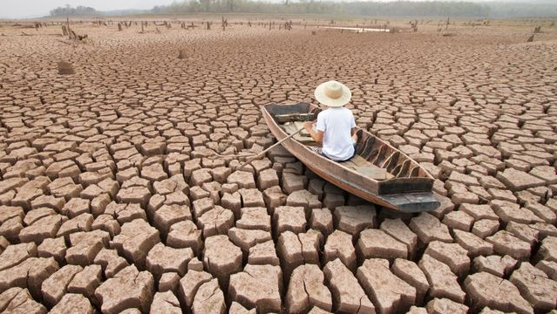
2. Drought
With increasing temperature, water evaporation increases and in the Czech Republic also a rapid decrease in winter precipitation in the lowlands, which are crucial for replenishing groundwater reserves.
Groundwater accumulates for a long time and short-term precipitation in summer does not replenish it, because the water is drained by vegetation during rains.
Not only spruces and larch dies die, but also trees like pines, which have deeper roots.

Slide 7
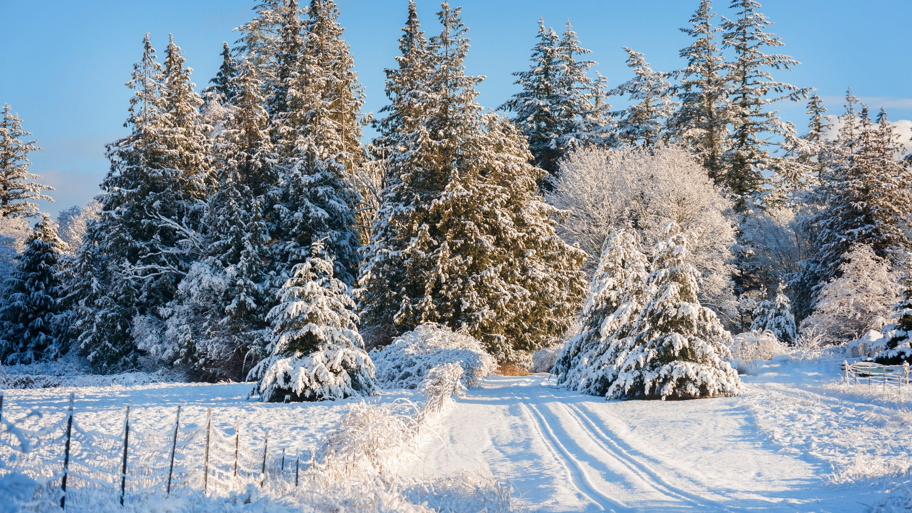
3. Other manifestations of warming in the Czech Republic
In the last ten years, the values ​​of all snow-related characteristics have decreased.
The number of days with snow cover and the monthly and seasonal maximums of snow cover are decreasing.
The occurrence of snow is an important prerequisite for the creation of a sufficient amount of surface and groundwater.

Slide 8
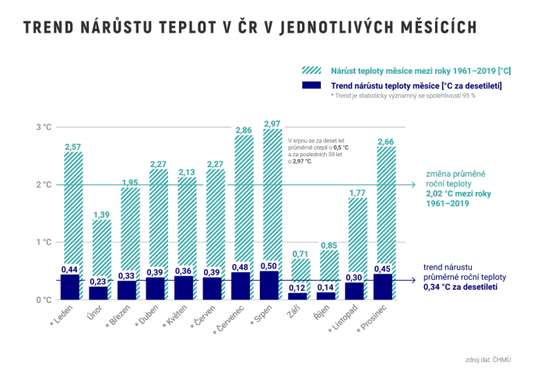
Impact on agriculture in the Czech Republic
the biggest problem is the frequency and intensity of extreme events (heavy rainfall, floods, agricultural drought)
which will exacerbate existing problems in agriculture, such as water scarcity, excessive erosion and soil degradation.
. Current forecasts predict increase in five-day precipitation totals in the winter months in the second half of the 21st century (in the period 2070-2099).
An increase in the incidence of precipitation extremes in the summer months is also predicted.

Slide 9
What we can do to improve situation of global warming?

Slide 10
You don't have to be an eco activist to save planet earth

Slide 11
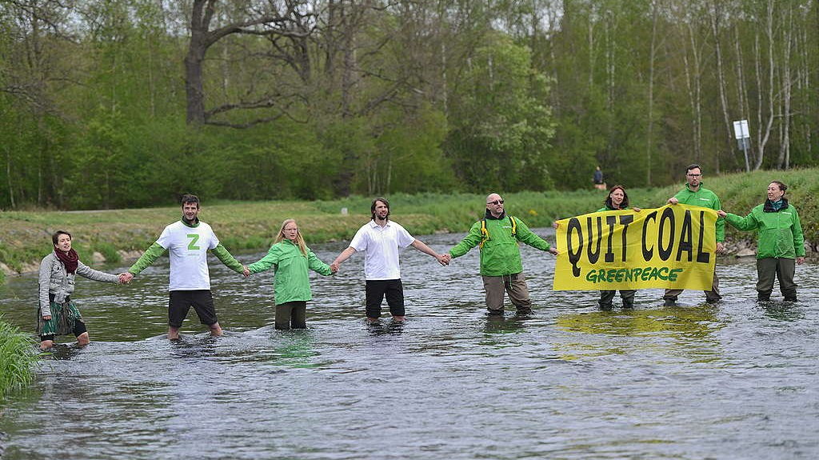
What the Czech Republic can do?
We must get rid of our dependence on coal for energy production, not continue mining, not expand mines in the Czech Republic.
We need to start investing thoughtfully in renewables and the distribution network.
We need to change our management of the landscape and the water in the landscape.

Slide 12
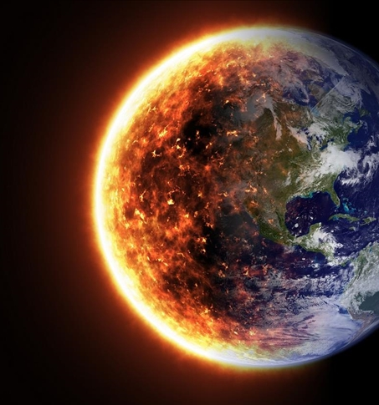
questions and videos at the end
What is global warming?
= long-term increase in average temperature.
List at least 3 consequences of global warming:
Temperature changes, Drought, There is less snow.
By how many degrees did the average temperature in the Czech Republic rise in 10 years?
= 0.28 °C
Interesting videos on the topic:
https://www.youtube.com/watch?v=wbR-5mHI6bo
https://www.youtube.com/watch?v=Y3gqoDUtmt4

Slide 13
Thank you for your attention
Resources:
https://oceanservice.noaa.gov/ocean/earthday.html,
https://www.sazimebudoucnost.cz/cs/prinosy-stromu, https://cs.wikipedia.org/wiki/Glob%C3%A1ln%C3%AD_oteplov%C3%A1n%C3%AD_v_%C4%8Cesku, https://www.ceska-krajina.cz/projekty/zmena-klimatu/

Slide 14
"The European Commission support for the production of this publication does not constitute an endorsement of the contents which reflects the views only of the authors, and the Commission cannot be held responsible for any use which may be made of the information contained therein."

