Slide 1
My planet,
a drop in the Universe

Slide 2
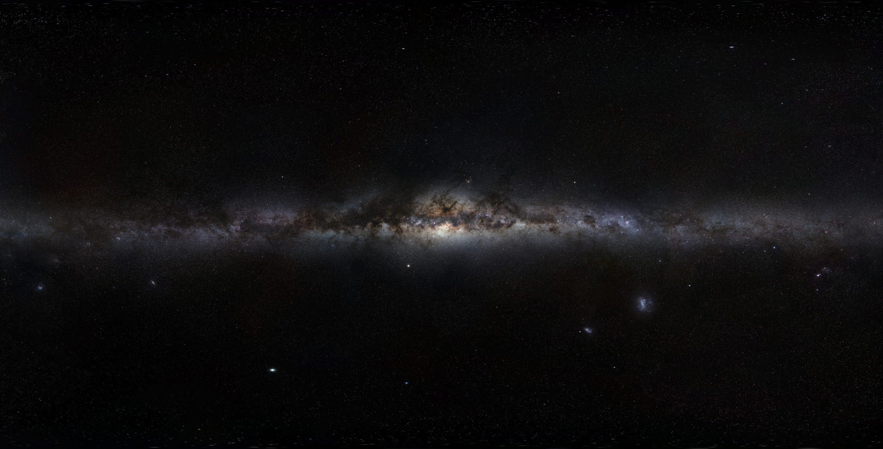
Milky Way
source: https://pl.wikipedia.org/wiki/Droga_Mleczna

Slide 3
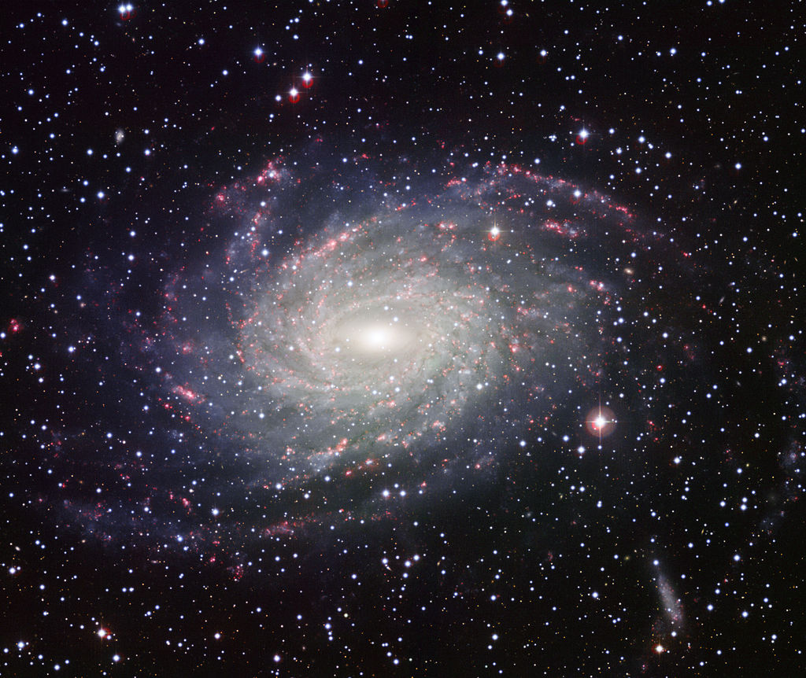
Milky Way
source: https://pl.wikipedia.org/wiki/Droga_Mleczna

Slide 4
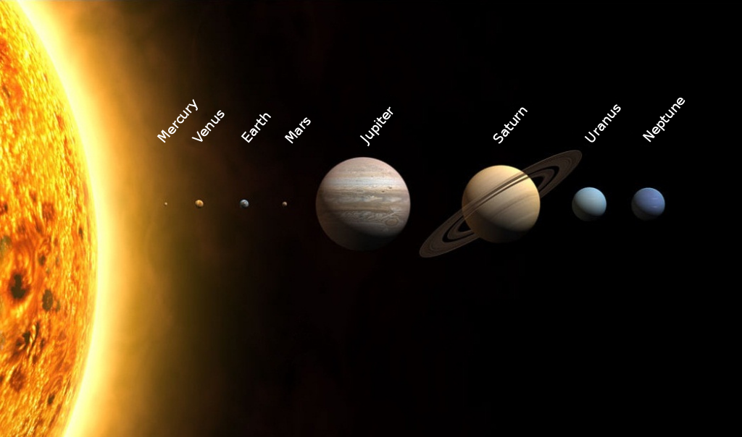
Solar System
source: https://pl.wikipedia.org/wiki/Uk%C5%82ad_S%C5%82oneczny

Slide 5
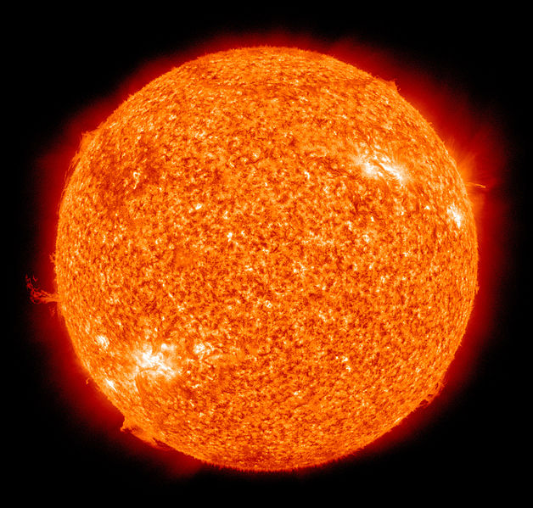
Sun
Sun is the star at the center of the Solar System. It is a nearly perfect sphere of hot plasma, with internal convective motion that generates a magnetic field via a dynamo process. It is by far the most important source of energy for life on Earth.
Source: https://pl.wikipedia.org/wiki/S%C5%82o%C5%84ce

Slide 6
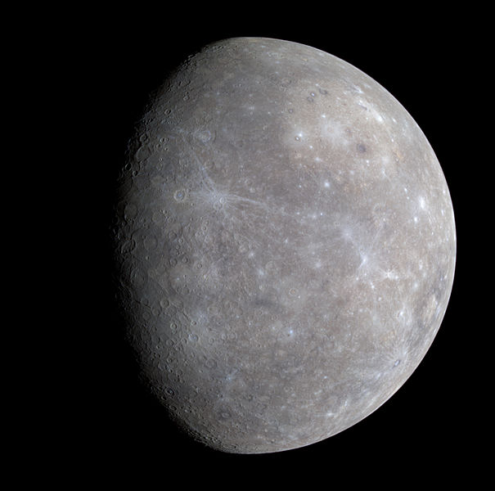
Mercury is the smallest and innermost planet in the Solar System. Its orbital period around the Sun of 88 days is the shortest of all the planets in the Solar System. It is named after the Roman deity Mercury, the messenger to the gods.
Source: https://pl.wikipedia.org/wiki/Merkury

Slide 7
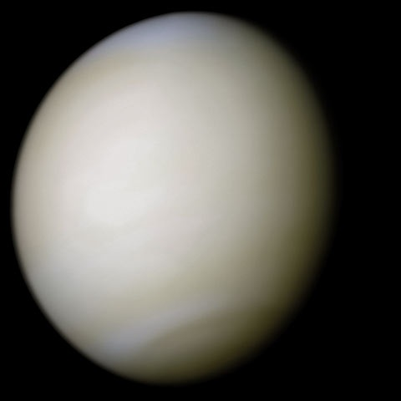
Venus
Venus is the second planet from the Sun, orbiting it every 224.7 Earth days. It has the longest rotation period (243 days) of any planet in the Solar System and rotates in the opposite direction to most other planets. It has no natural satellites. It is named after the Roman goddess of love and beauty.
Source: https://pl.wikipedia.org/wiki/Wenus

Slide 8
Our Earth
Earth is the third planet from the Sun and the only object in the Universe known to harbor life. According to radiometric dating and other sources of evidence, Earth formed over 4 billion years ago. Earth's gravity interacts with other objects in space, especially the Sun and the Moon, Earth's only natural satellite. Earth revolves around the Sun in 365.26 days, a period known as an Earth year.

Slide 9
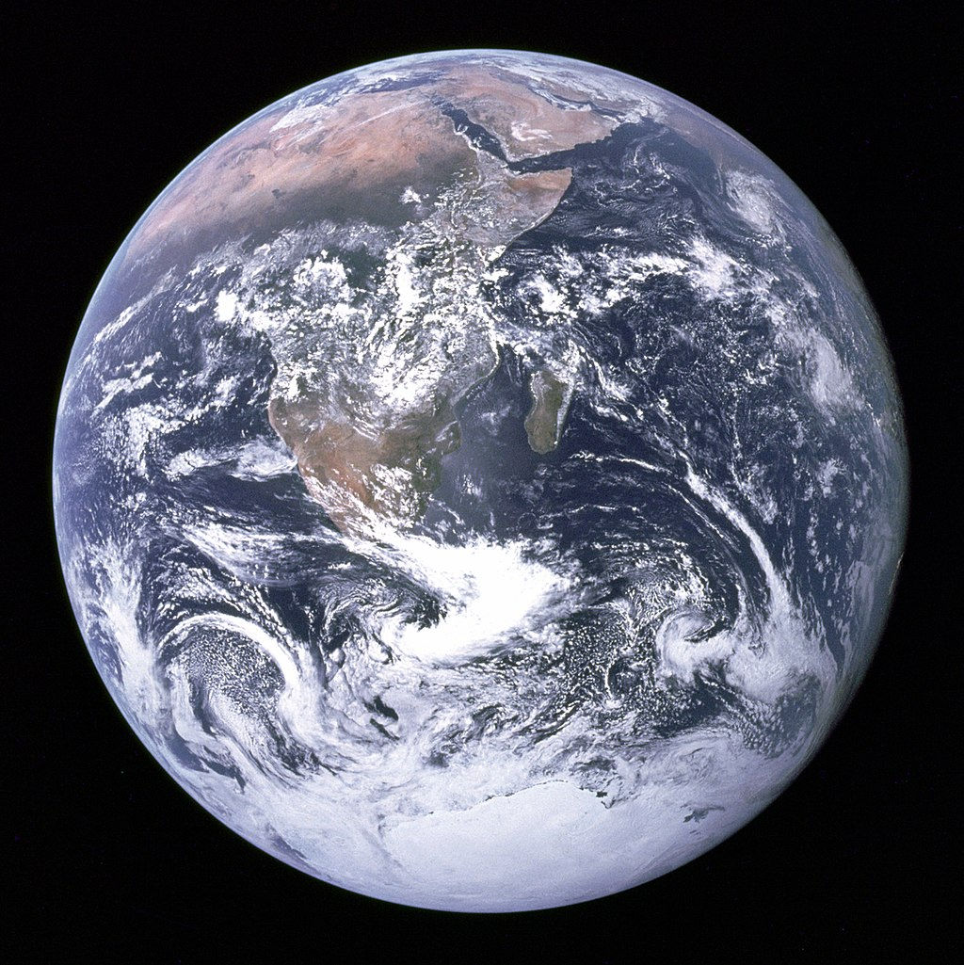
Nasza Planeta Ziemia
Source: https://pl.wikipedia.org/wiki/Ziemia#/media/File:The_Earth_seen_from_Apollo_17.jpg

Slide 10
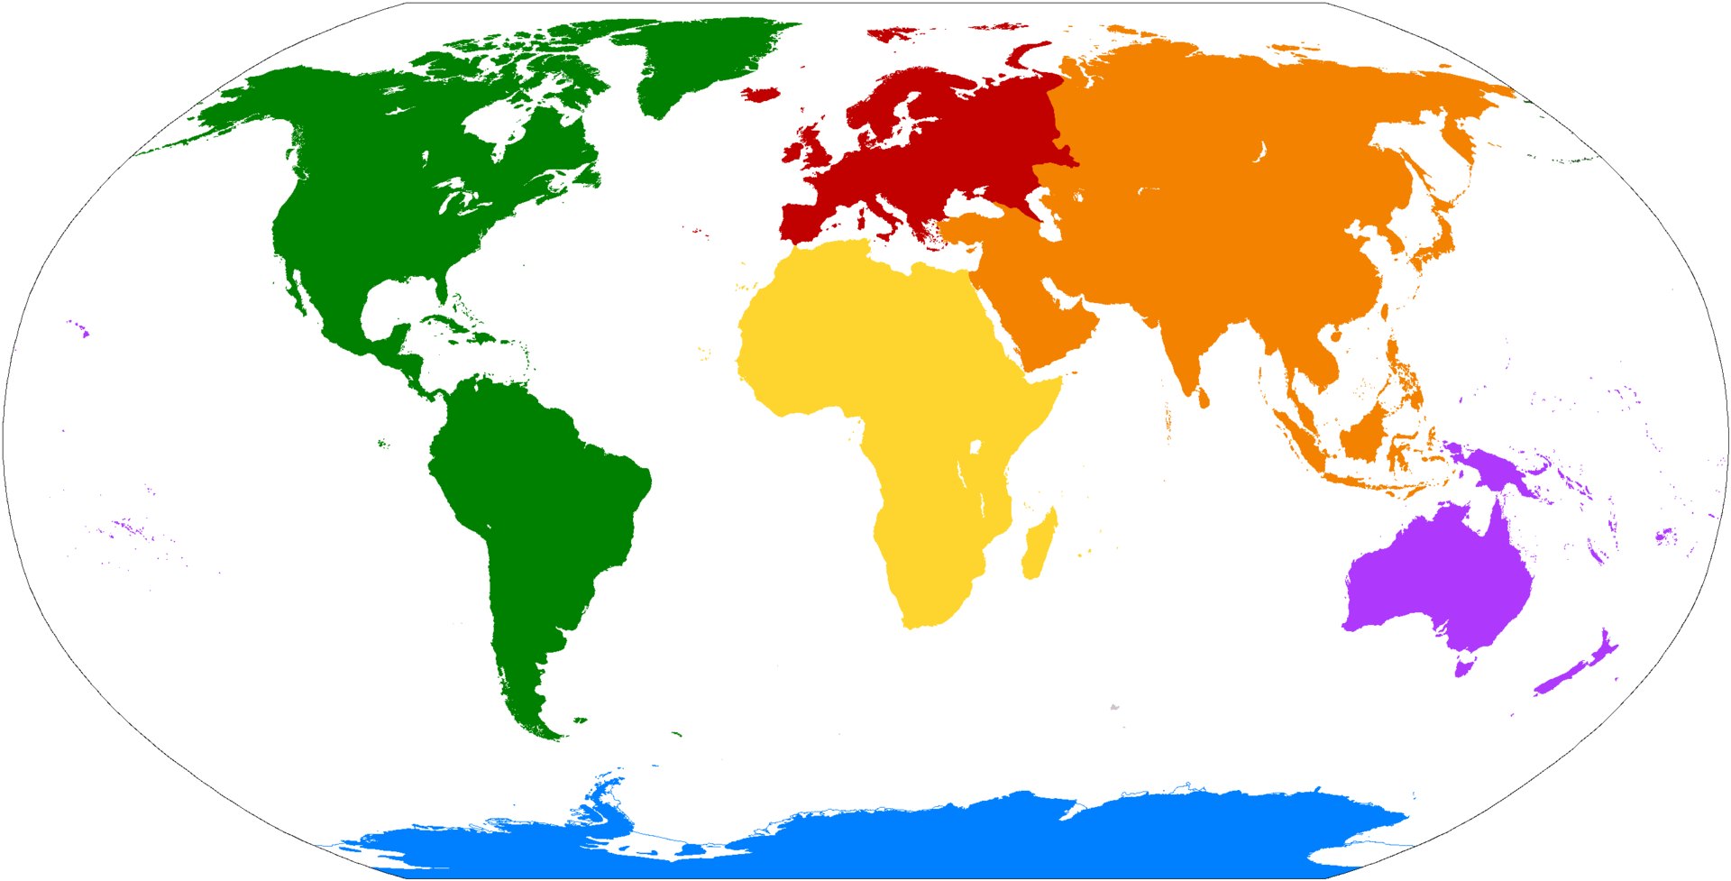
Earth and the continents
https://pl.wikipedia.org/wiki/Cz%C4%99%C5%9Bci_%C5%9Bwiata#/media/File:Maailmajaod_pd.png

Slide 11
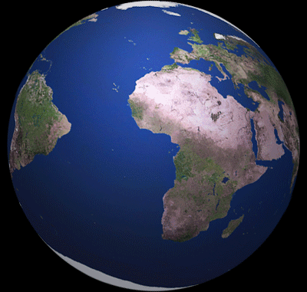
Ziemia- season
Spring, Summer, Autumn, Winter
Spring: 21 march
Summer: 22 june
Autumn: 23 september
Winter: 22 december

Slide 12
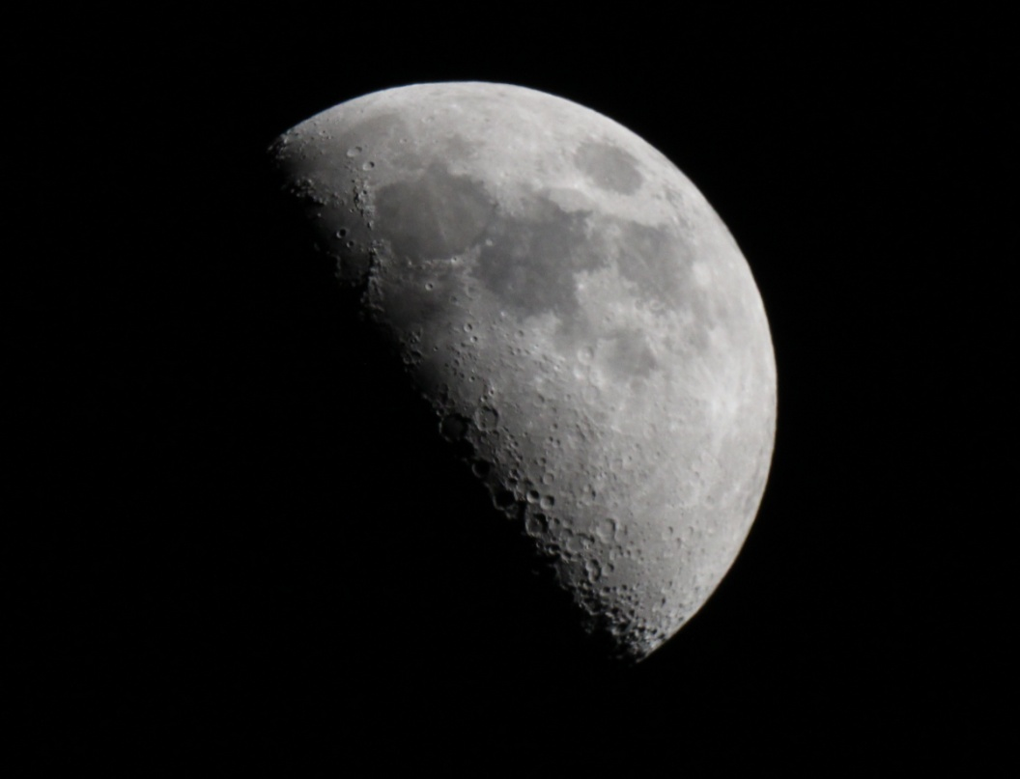
And in the evening sky is?
The Moon is an astronomical body that orbits planet
Earth, being Earth's only permanent natural satellite.
Source: https://en.wikipedia.org/wiki/Moon

Slide 13
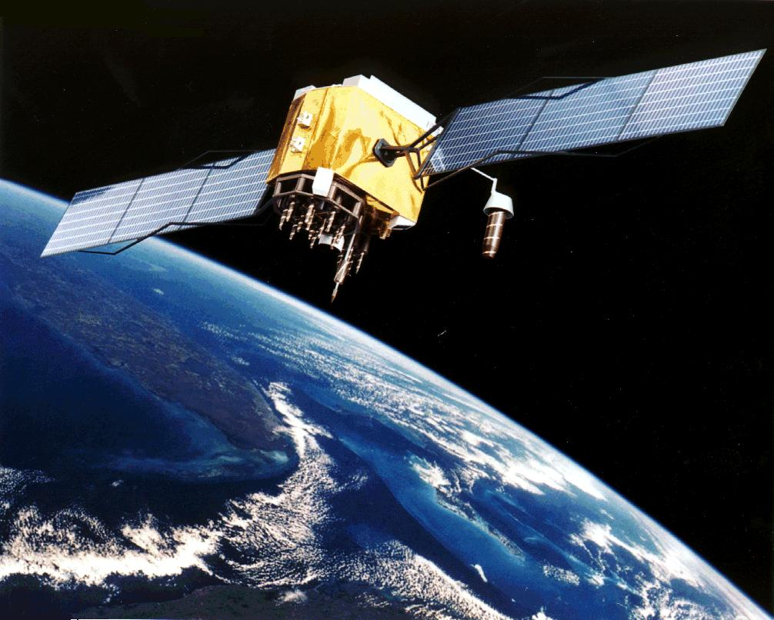
Sky is full- but not just with the stars
Satellites
https://pl.wikipedia.org/wiki/Satelita_nawigacyjny#/media/File:GPS_Satellite_NASA_art-iif.jpg

Slide 14
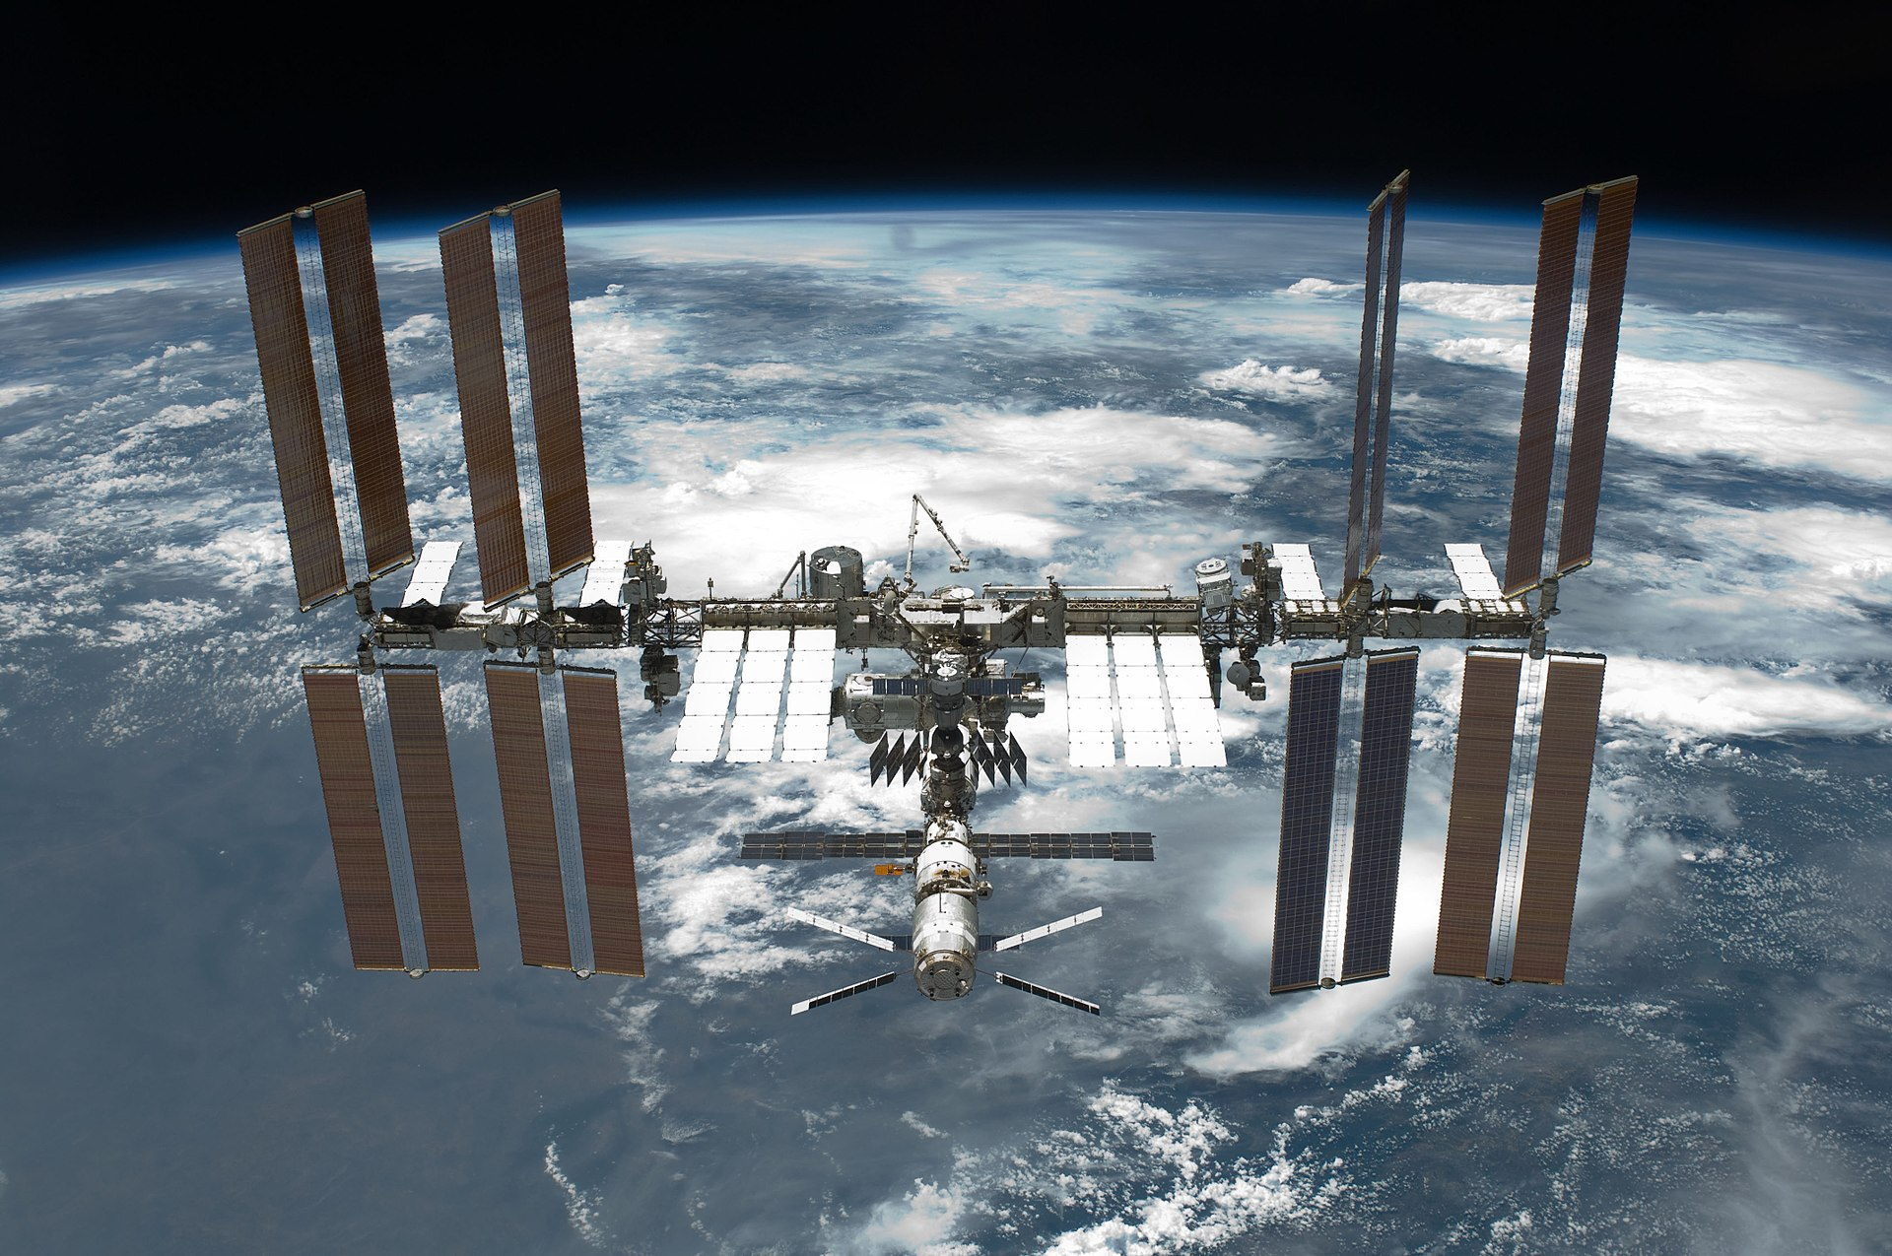
Sky is full- but not just with the stars
ISS
https://pl.wikipedia.org/wiki/Mi%C4%99dzynarodowa_Stacja_Kosmiczna#/media/File:STS-134_International_Space_Station_after_undocking.jpg

Slide 15
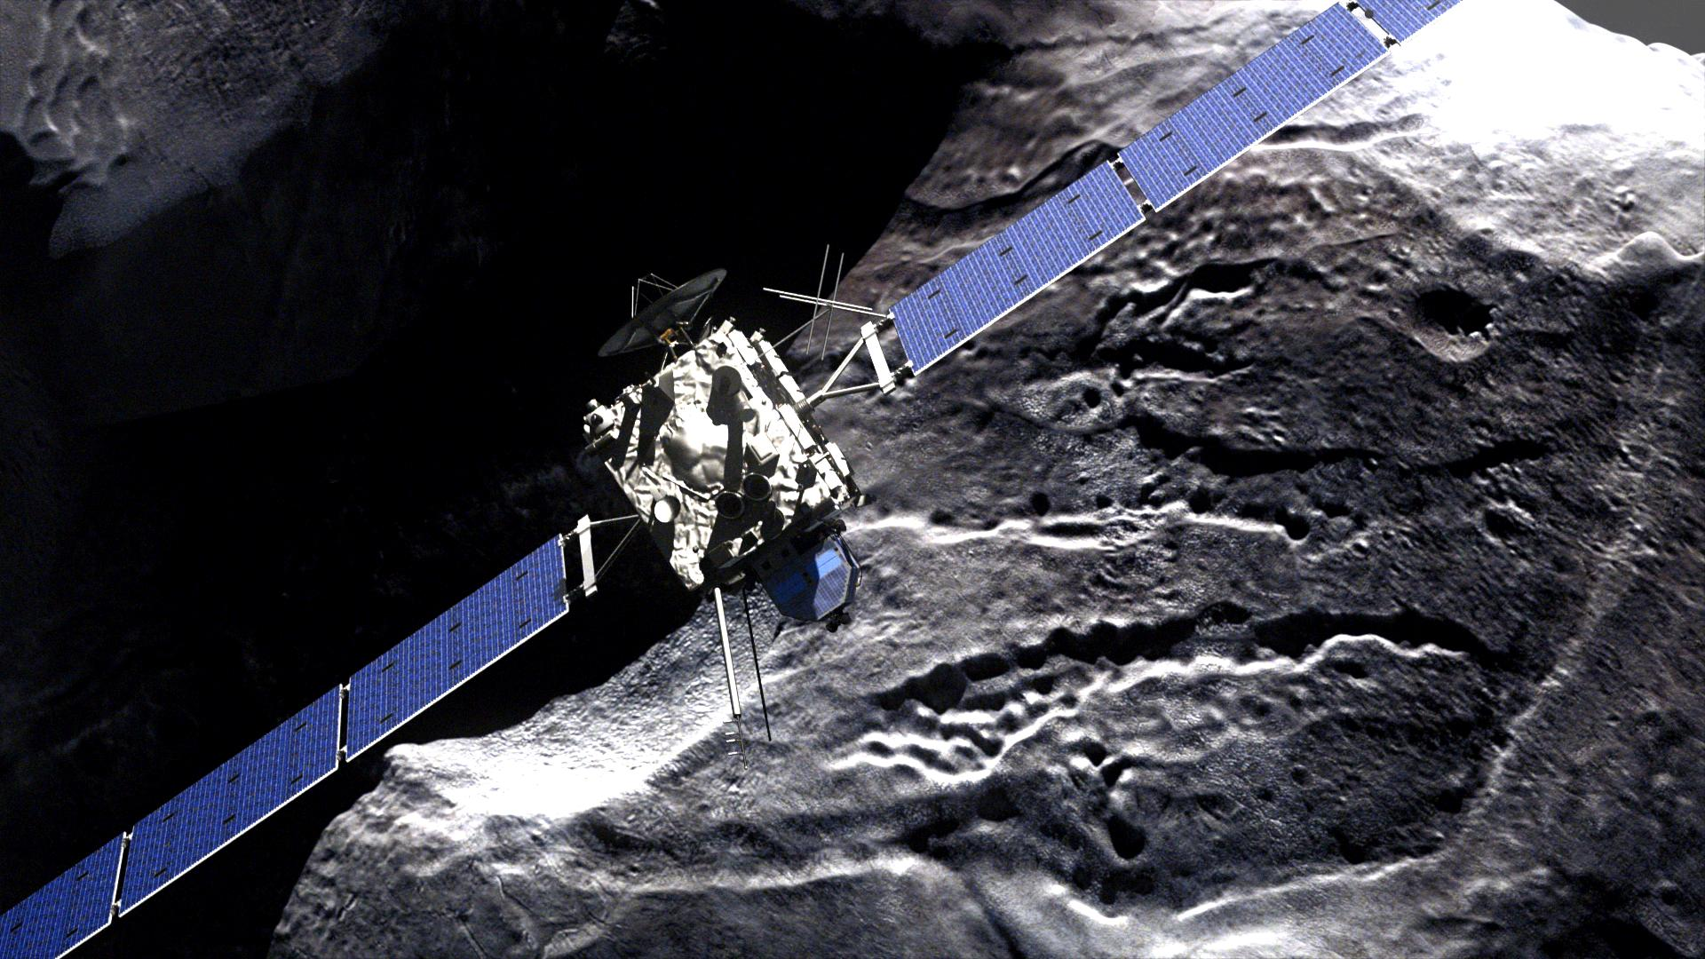
Sky is full- but not just with the stars
Rosetta
https://pl.wikipedia.org/wiki/Rosetta_(sonda_kosmiczna)#/media/File:Rosetta_-_comet_fly-by.jpg

Slide 16
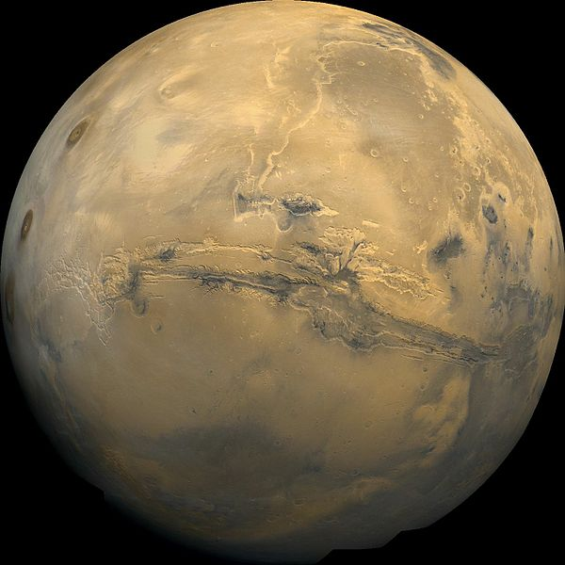
Mars
Mars is the fourth planet from the Sun and the second-smallest planet in the Solar System after Mercury. In English, Mars carries a name of the Roman god of war, and is often referred to as the "Red Planet„.
https://pl.wikipedia.org/wiki/Mars

Slide 17
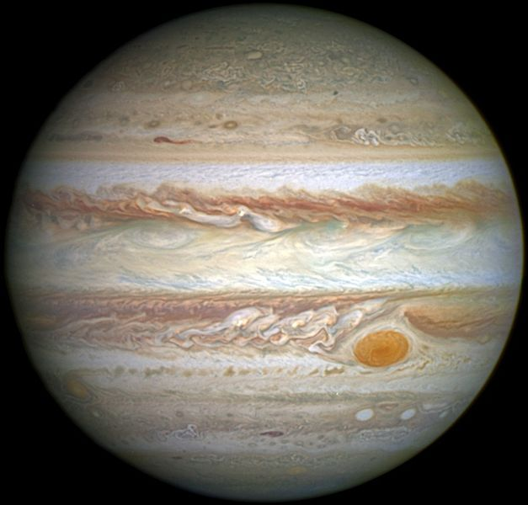
Jupiter
Jupiter is the fifth planet from the Sun and the largest in the Solar System. It is a giant planet with a mass one-thousandth that of the Sun.
https://pl.wikipedia.org/wiki/Jowisz

Slide 18
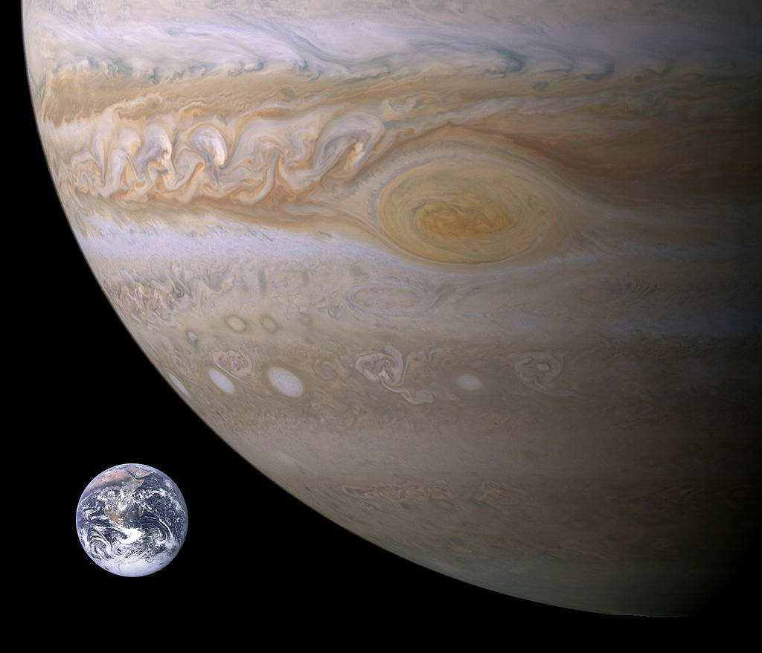
Jupiter- how small we are?
https://pl.wikipedia.org/wiki/Jowisz#/media/File:Jupiter,_Earth_size_comparison.jpg

Slide 19
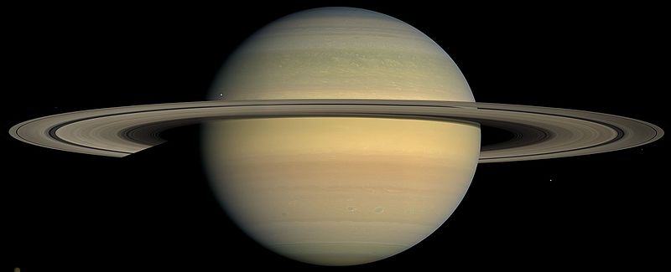
Saturn
is the sixth planet from the Sun and the second-largest in the Solar System, after Jupiter. It is a gas giant with an average radius about nine times that of Earth.
https://pl.wikipedia.org/wiki/Saturn

Slide 20
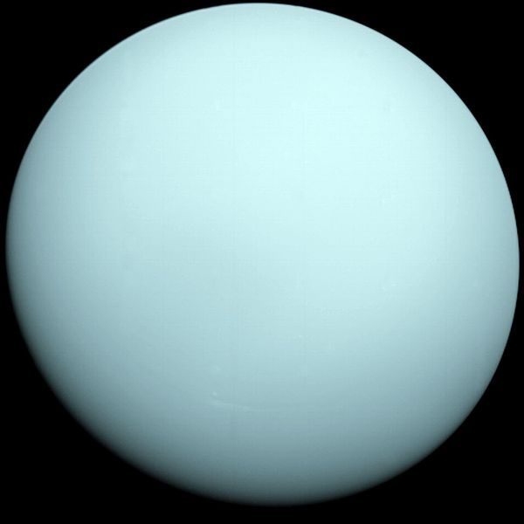
Uranus
is the seventh planet from the Sun. It has the third-largest planetary radius and fourth-largest planetary mass in the Solar System.
https://pl.wikipedia.org/wiki/Uran

Slide 21
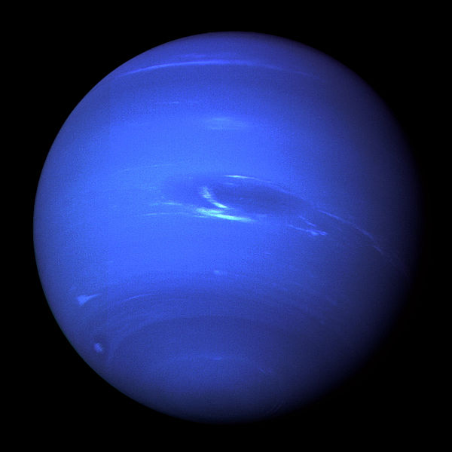
Neptune
is the eighth and farthest known planet from the Sun in the Solar System. It is named after the Roman god of the sea and has the astronomical symbol ♆, a stylised version of the god Neptune's trident.
https://pl.wikipedia.org/wiki/Neptun

Slide 22
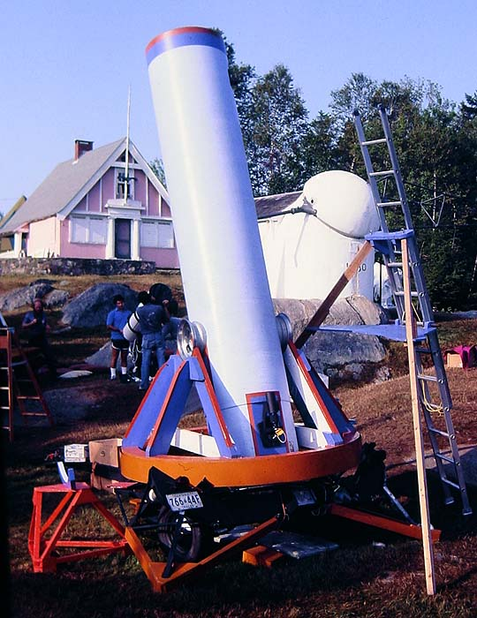
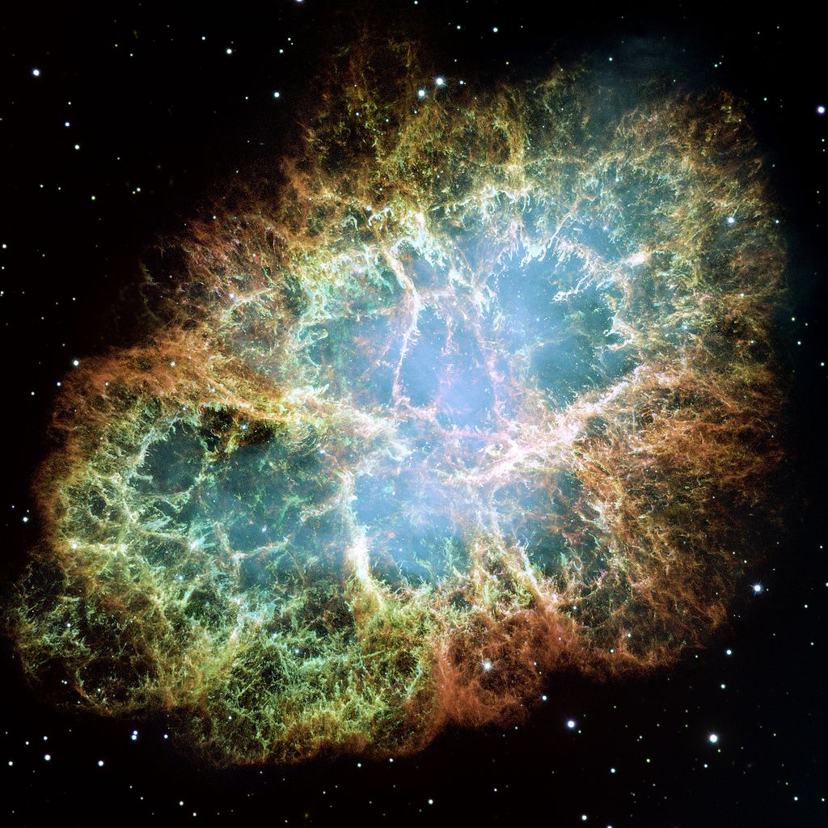
How to become an astronomer?
An astronomer is a scientist in the field of astronomy who concentrates their studies on a specific question or field outside the scope of Earth. They look at stars, planets, moons, comets and
galaxies, as well as many other celestial objects.
https://pl.wikipedia.org/wiki/Astronomia

Slide 23
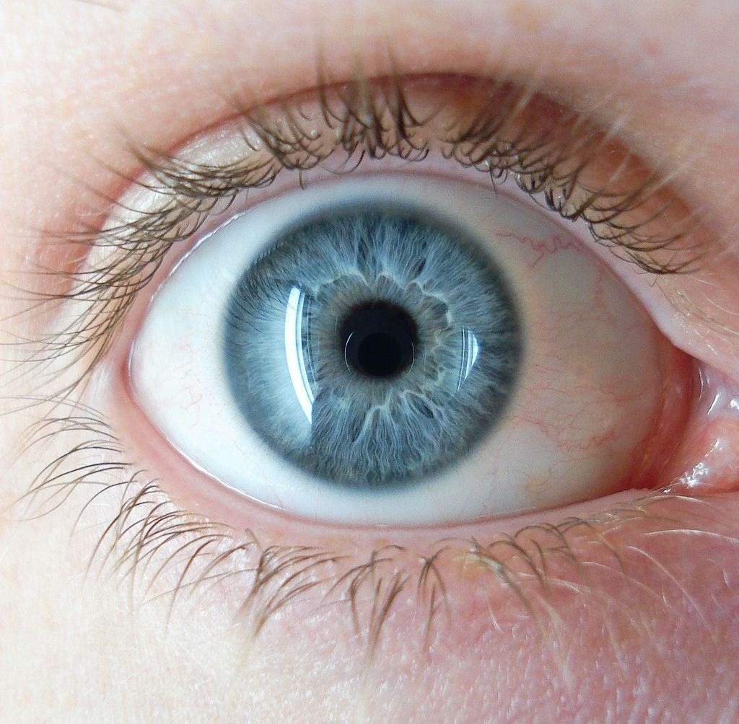
How to start observation of the sky?
https://pl.wikipedia.org/wiki/Oko

Slide 24
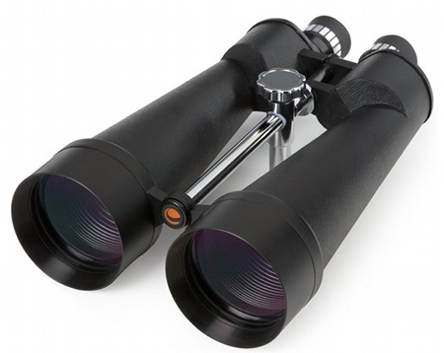
What will we use?

Slide 25
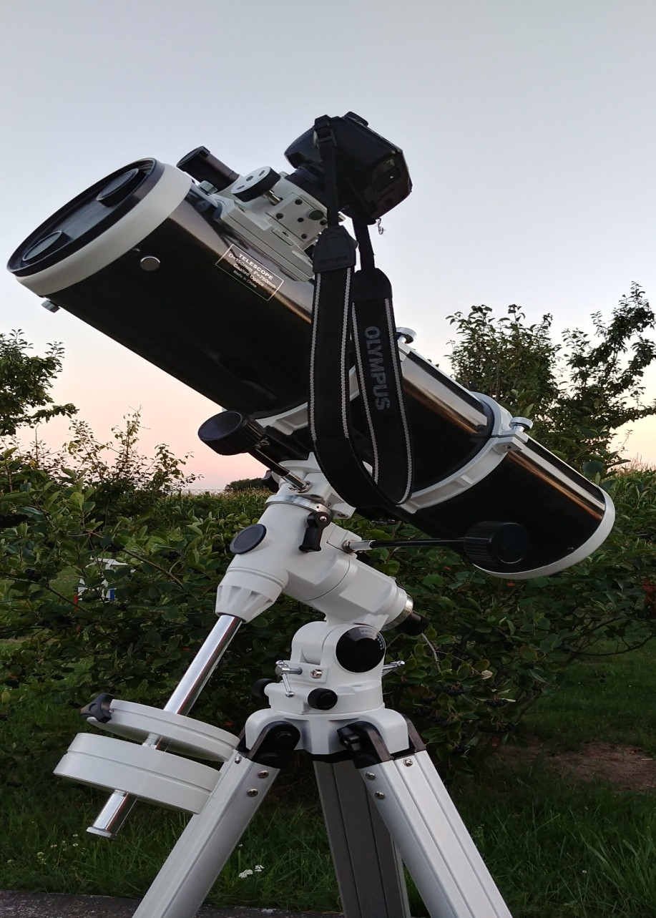
What will we use?

Slide 26
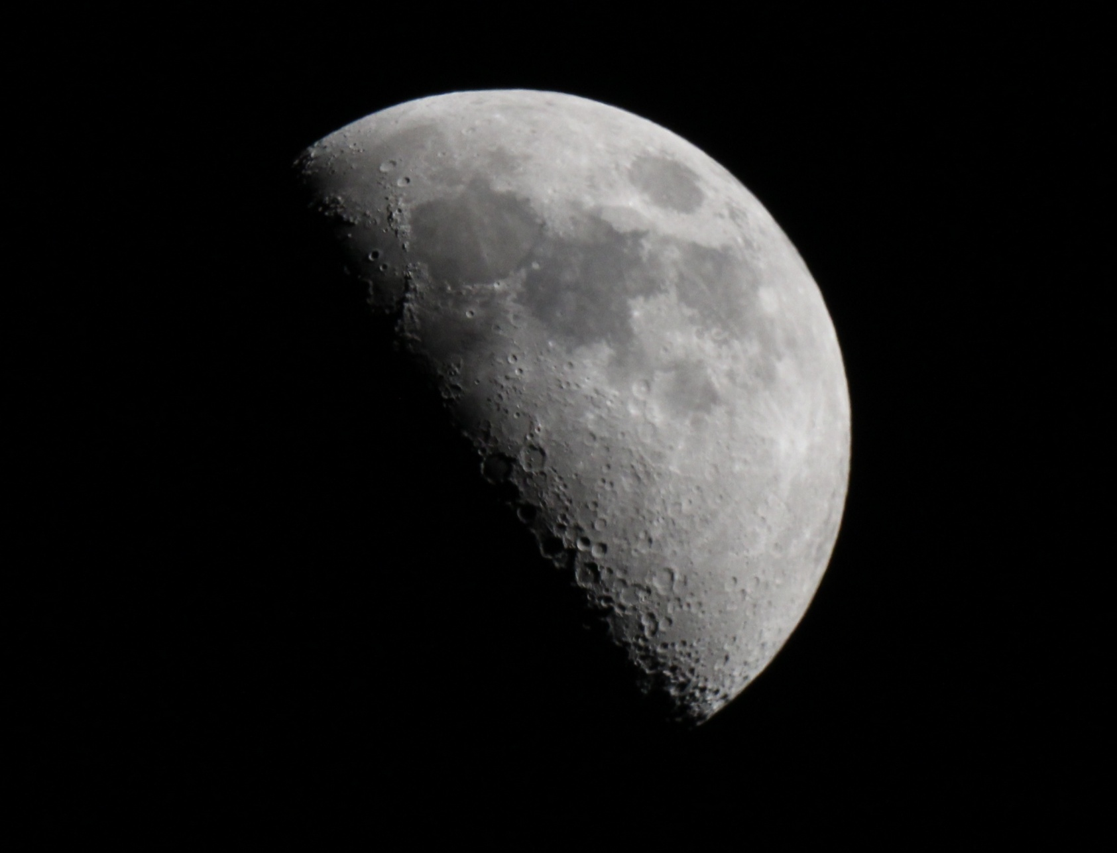
What can we watch?
Łukasz Sobeczko photography

Slide 27
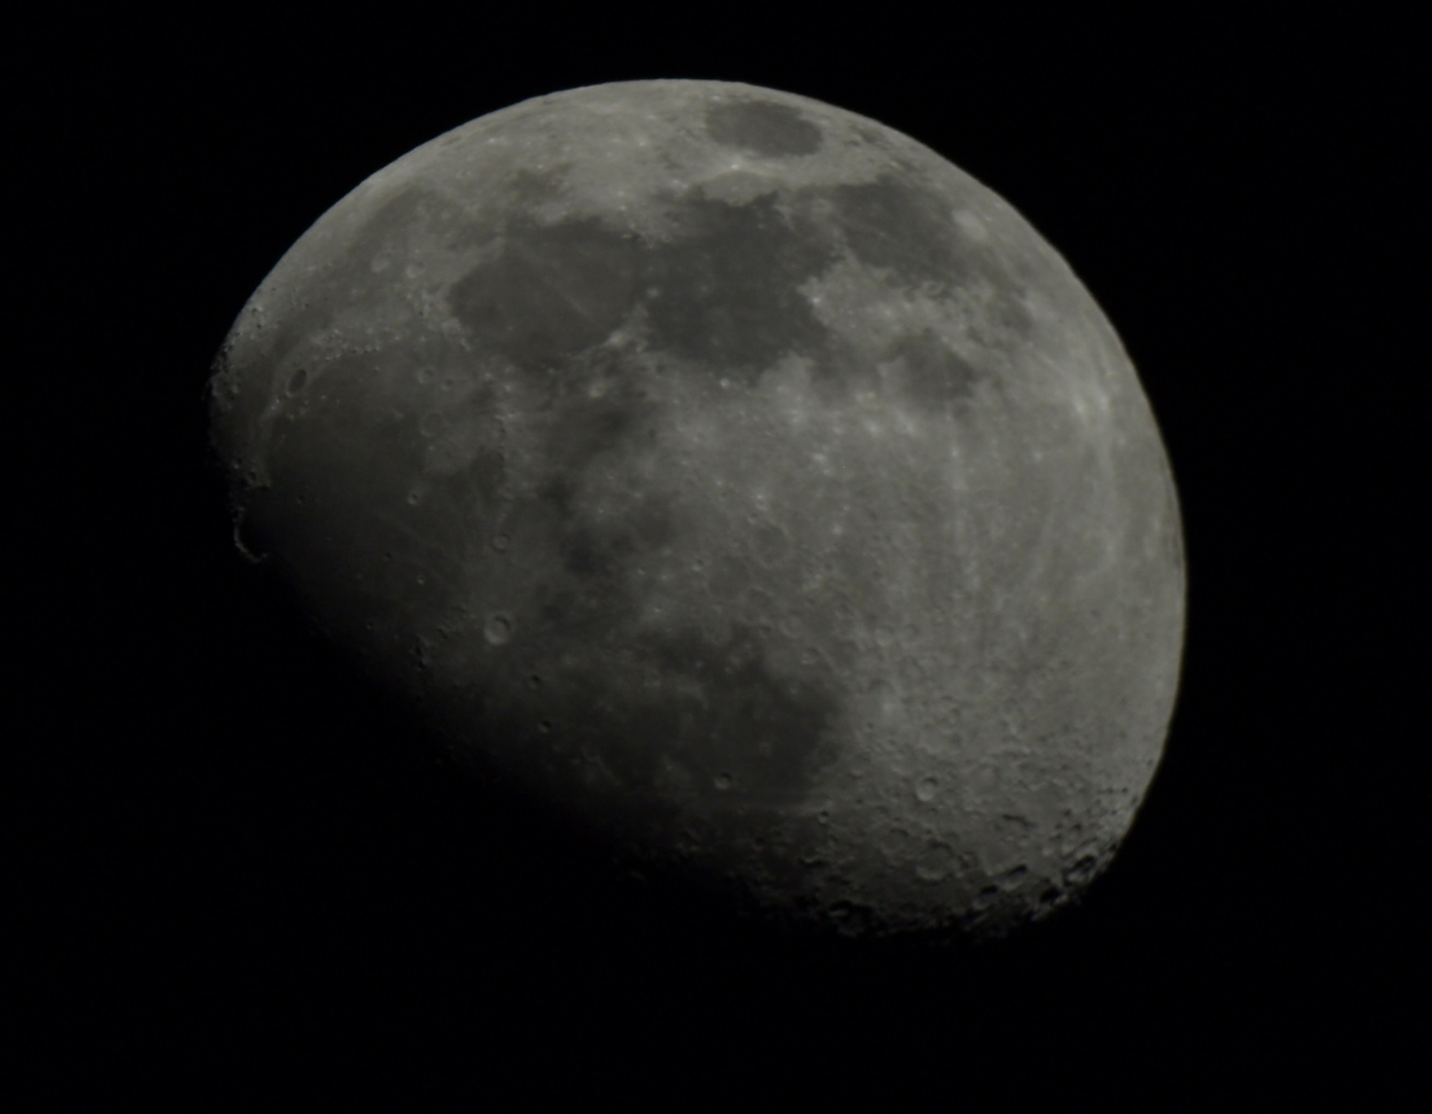
What can we watch?
Łukasz Sobeczko photography

Slide 28
The planet- Saturns
Łukasz Sobeczko photography

Slide 29
Thank you for your attention ☺

