Slide 1
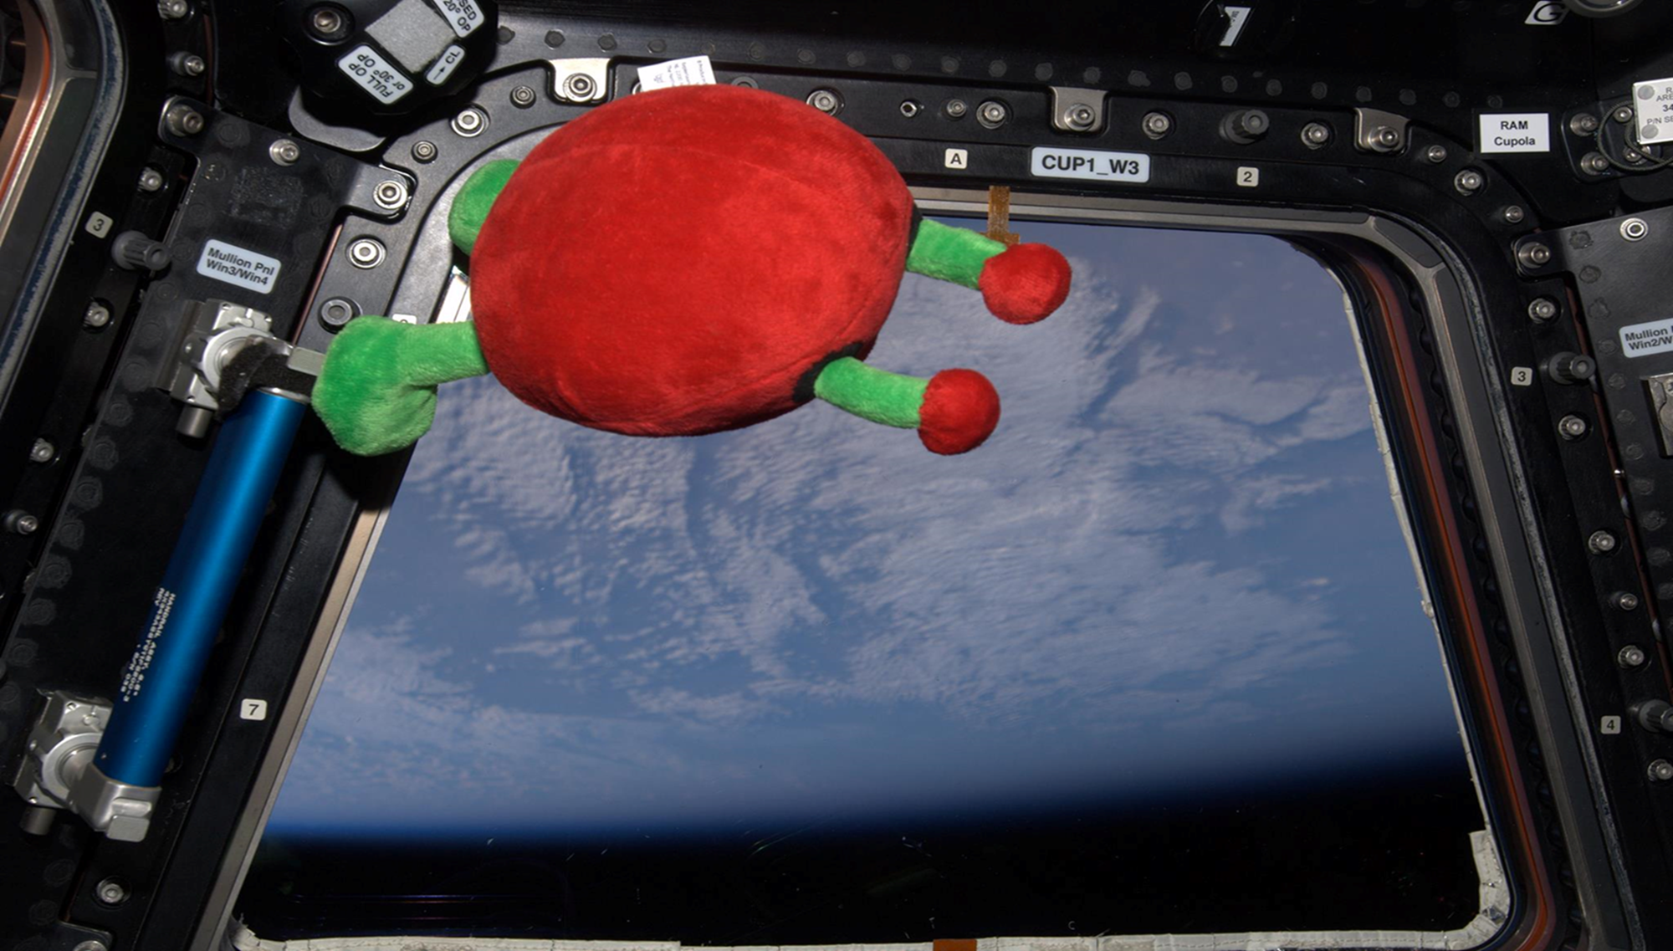
Diseminare si linkuri utile
Cristina Stancu – ESERO Ro Deputy Manager
www.esero.ro

Slide 2
Diseminare
formarea cadrelor didactice
educație informală
Conferinte si ateliere
Puncte de interes
Activități extrascolare
Canale bazate pe Web
Jurnale & publicații

Slide 3
Impact
La catedra proprie/elevii proprii
Scoala
La alte catedre/departamente
Profesori locali ( toate subiectele )
Local/Regional
grupurile de interese
Impact
Profesorii de științe
National
Organizatii stiintifice
International
Organizatii profesorale
Jurnale/publicatii

Slide 4
Date de contact:
www.esero.ro
https://www.facebook.com/esero.romania

Slide 5
Agentia Spatiala Romana
www.rosa.ro

Slide 6
Agentia Spatiala Europeana
www.esa.int

Slide 8
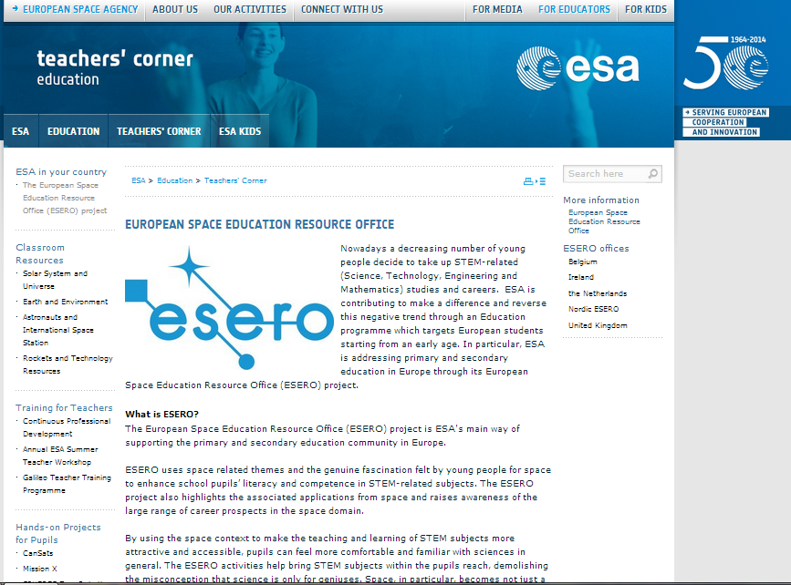

Slide 9
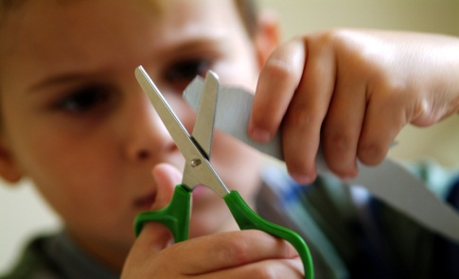
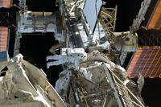
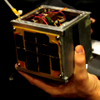
ESA Education
Email address: teachers@esa.int
ESA Education Facebook page :
https://www.facebook.com/ESAEducation
Get to know Paxi our ESA Kids mascot:
https://www.facebook.com/PaxiESAKids

Slide 10
Rosetta: Join the adventure
Web site: www.esa.int/rosetta/
Blog: http://blogs.esa.int/rosetta/
Facebook: www.facebook.com/RosettaMission
Twitter: @ESA_Rosetta

Slide 11
ATV: Automated Transfer Vehicle
Website : http://www.esa.int/Our_Activities/Human_Spaceflight/ATV
Blog : http://blogs.esa.int/atv/
Twitter: https://twitter.com/esaoperations
Twitter: https://twitter.com/ESAHSOeducation

Slide 12
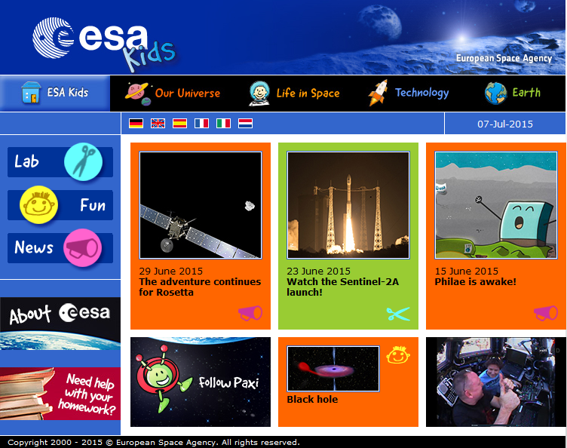
http://www.esa.int/esaKIDSen/index.html

Slide 13
http://www.esa.int/esaKIDSen/index.html

Slide 15
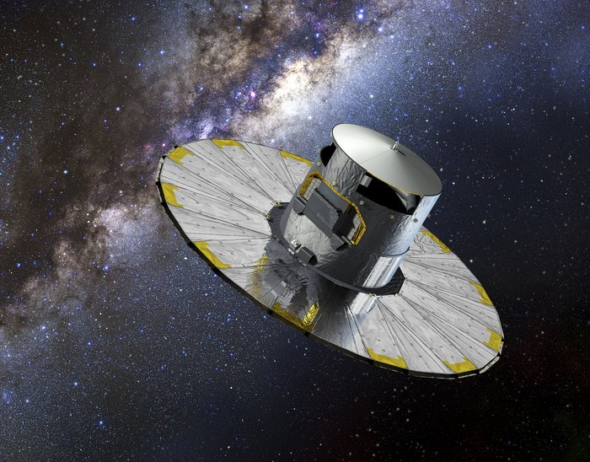
http://www.esa.int/Education/Little_Books_of_Gaia
Set of mini-books in child-friendly language
Information about the Gaia telescope and its science goals
Several languages available

Slide 16
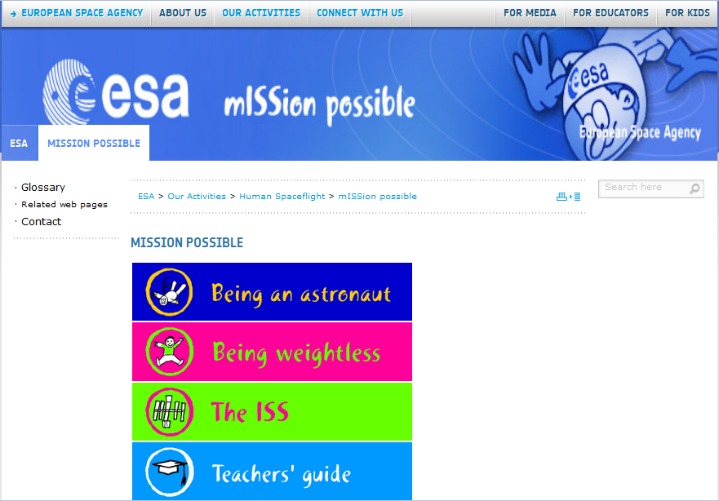
http://www.esa.int/Our_Activities/Human_Spaceflight/mISSion_possible/mISSion_possible
18 lectii
6 teme majore:
Ce face un astronaut
Calatoria in spatiu
In spatiu
ISS
Cum comunici cu satelitii and

Slide 17
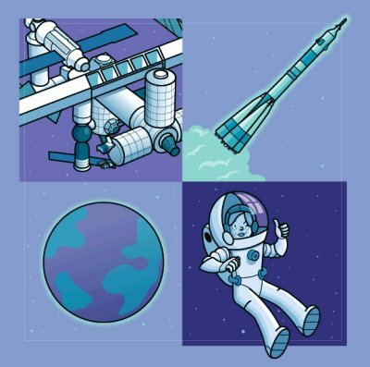
http://www.esa.int/Our_Activities/Human_Spaceflight/Education/Primary_level_ISS_Education_Kit_-_download
Viata in spatiu, lectii pe instelesul tutuor

Slide 19
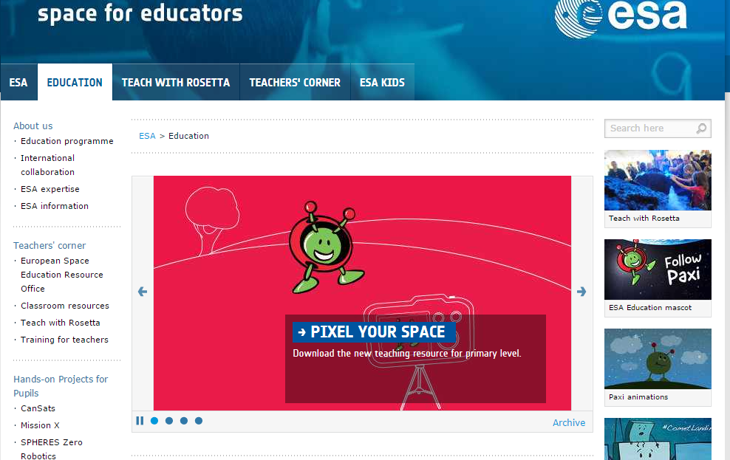
http://www.esa.int/Education

Slide 20
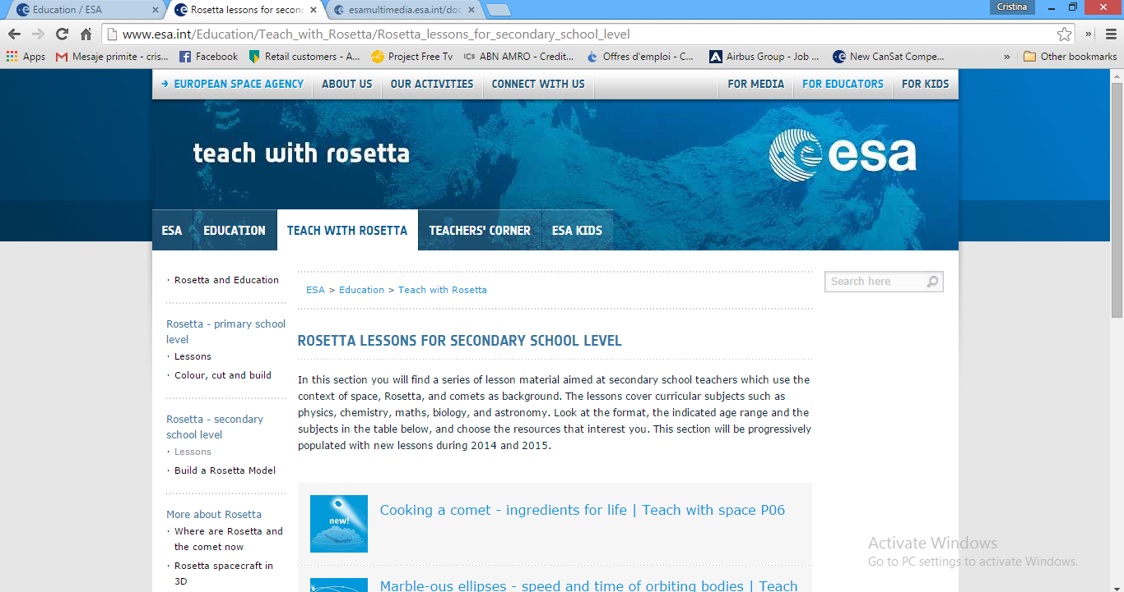
Teach with Rosetta

Slide 21
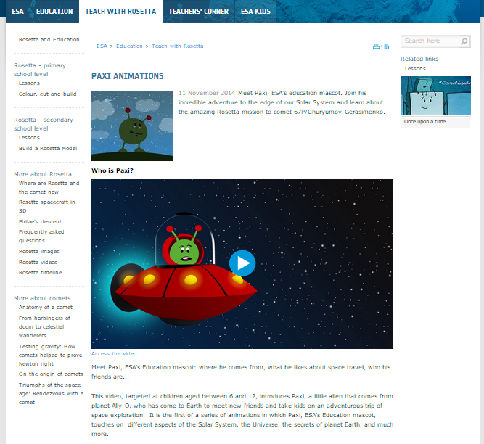
http://www.esa.int/Education/Teach_with_Rosetta/Paxi_animations

Slide 22
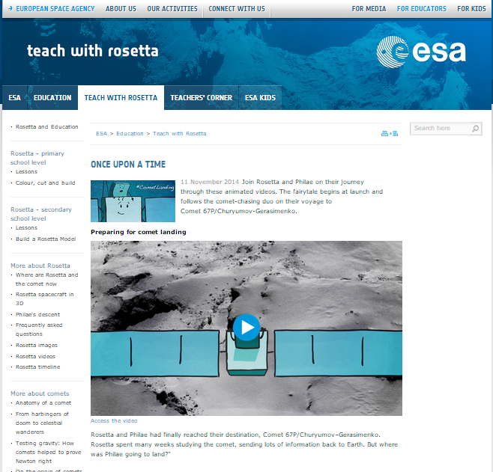
http://www.esa.int/Education/Teach_with_Rosetta/Once_upon_a_time

Slide 23
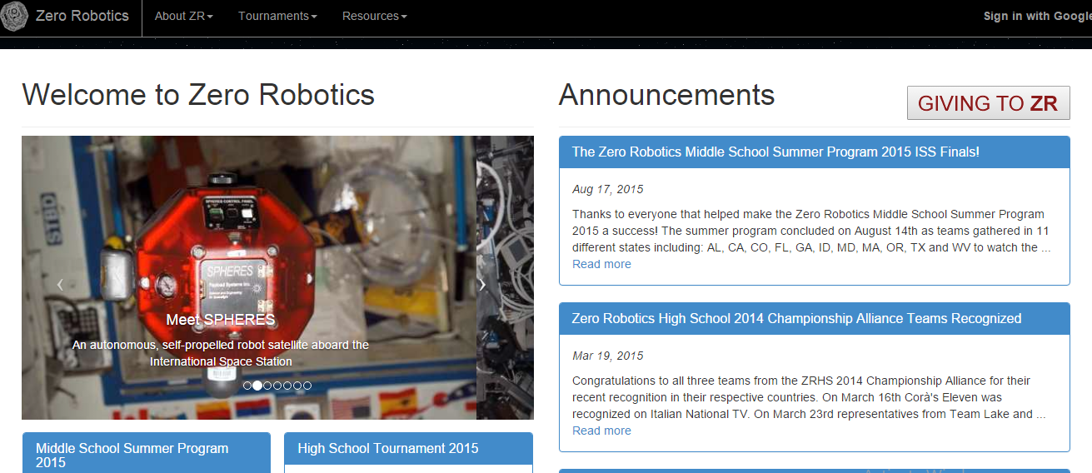
Competitii ESA Edu
http://zerorobotics.mit.edu/

Slide 24
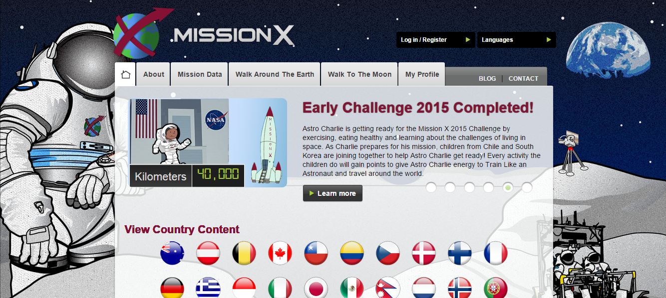
Train like an astronaut
http://trainlikeanastronaut.org/

Slide 25
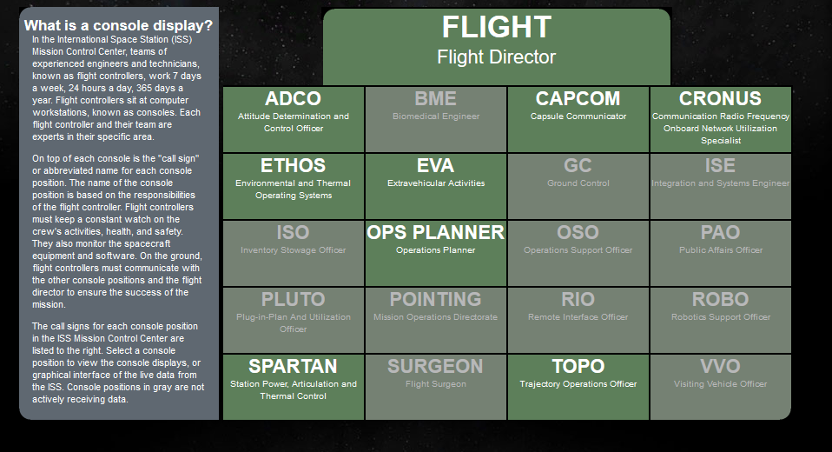
Linkuri ISS, space debris
http://isslive.com/displays/index.html
http://apps.agi.com/SatelliteViewer/

Slide 26
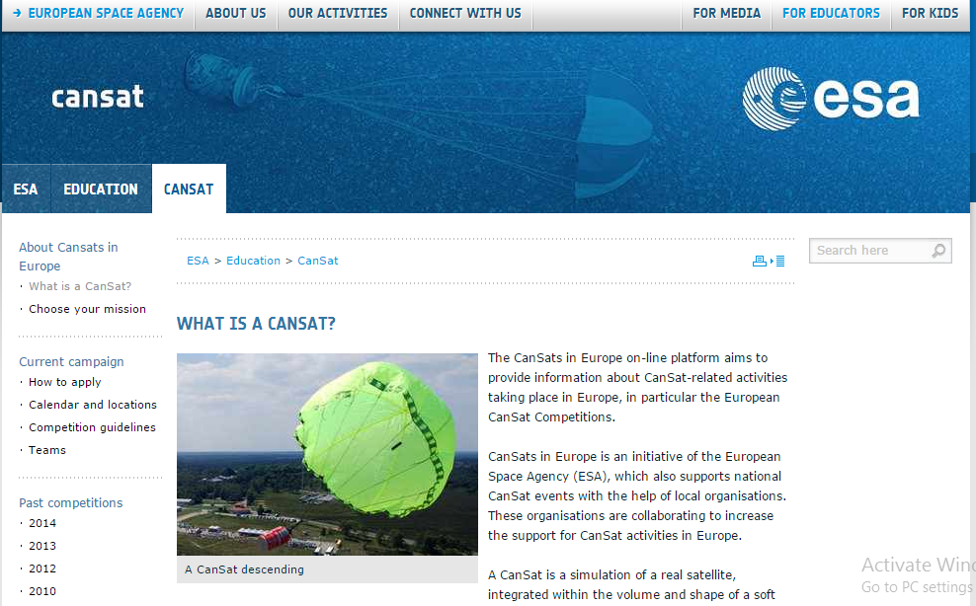
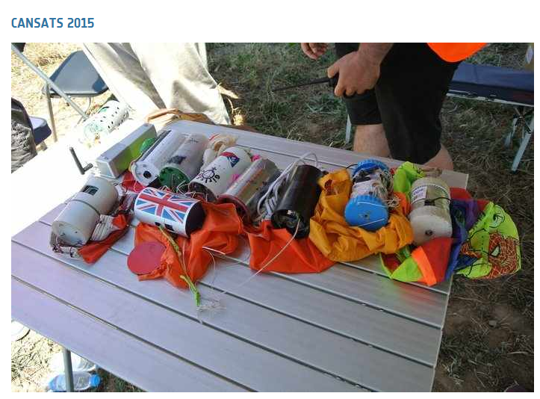
CanSats in Europe
http://www.esa.int/Education/CanSat

Slide 27
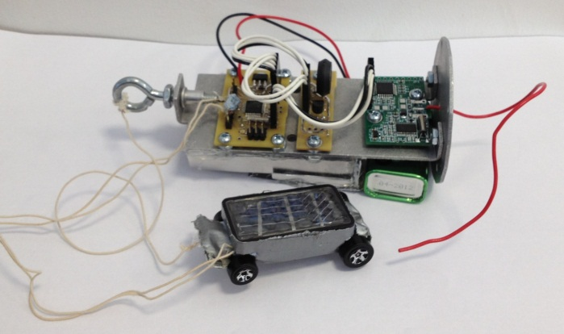
European CanSat Competition
Primary mission is predefined
Measure temperature
Measure pressure
Transmit data to ground station every second
All teams receive a basic CanSat kit with these capabilities
Secondary mission is defined by student teams. Examples include:
Advanced telemetry
UV Radiation, GPS, acceleration, live video, stereo camera
Targeted landing
Autonomous
Ground-controlled
Planetary probe
Rover deployment, light intensity measurement,
atmospheric dust measurement
Stereo Camera, Team Icaromenippus 3D (Greece)
Rover, Team Alpha (Scotland)

Slide 28
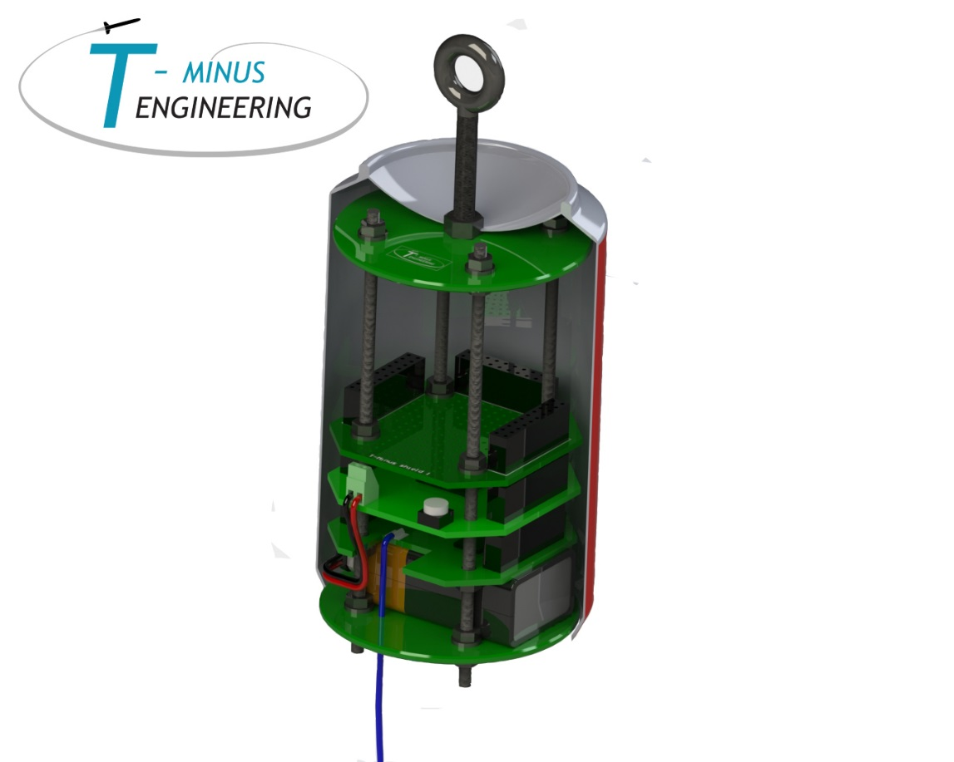
Educational Goals
Experimenting with Space technology
Experience with electronics and programming
Project management
Team work
Innovation and creativity
Documentation
English
Dealing with set-backs
Problem solving
Etc. etc.

Slide 29
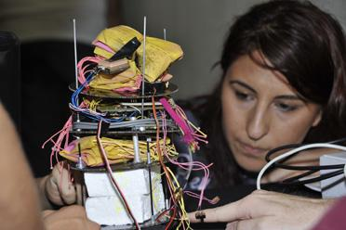
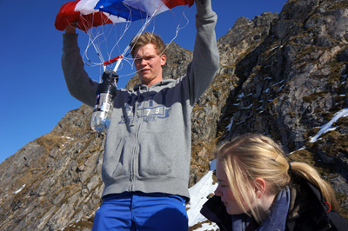
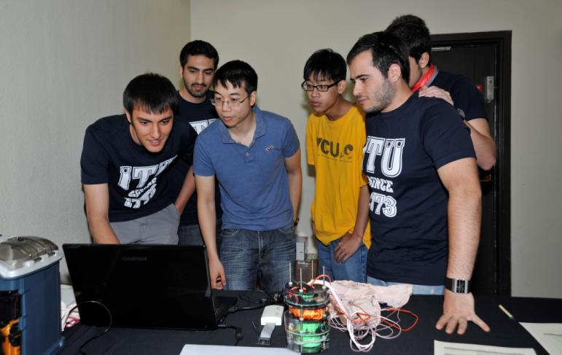
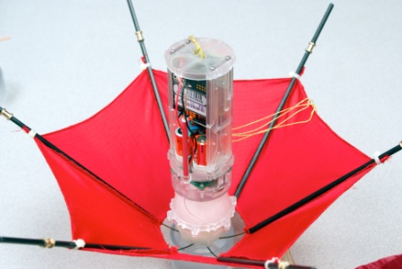
Xperience of the project

Slide 30
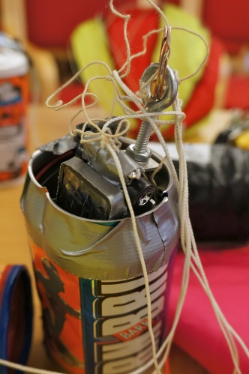
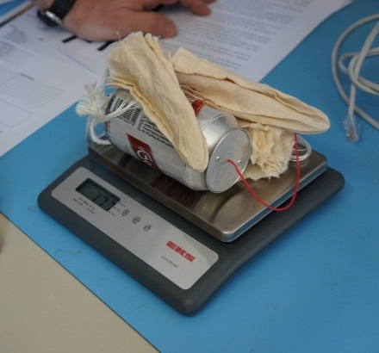
Competition Guidelines
Team Eligibility
4-6 students assisted by teacher or tutor
Enrolled in high school in an ESA member state
Majority must hold nationality of ESA member state
CanSat requirements → similar to real space system
Volume: must fit inside a standard soda can
Weight: must not exceed 350 grams
Cost: must not exceed 500 EUR
Other requirements relating to flight time and descent rate, experiment deployment, etc…
Competition guidelines / info
€

Slide 31
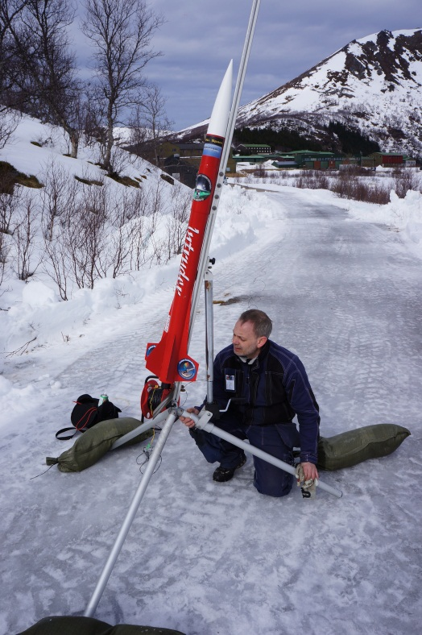
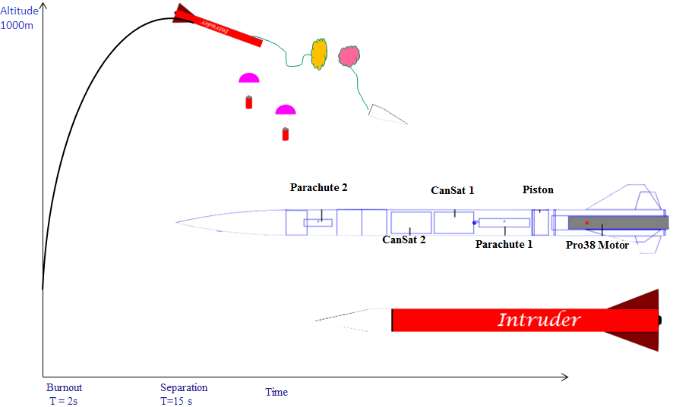
Competition Guidelines
7 rockets launched, 2 CanSats each
Deployment at ~ 1 km altitude
CanSats descend on parachute
Launch accelerations can reach 11g
Launch velocity up to 550 km/h

Slide 32
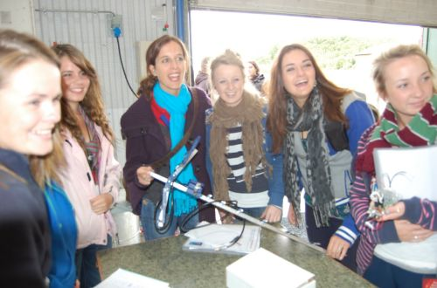
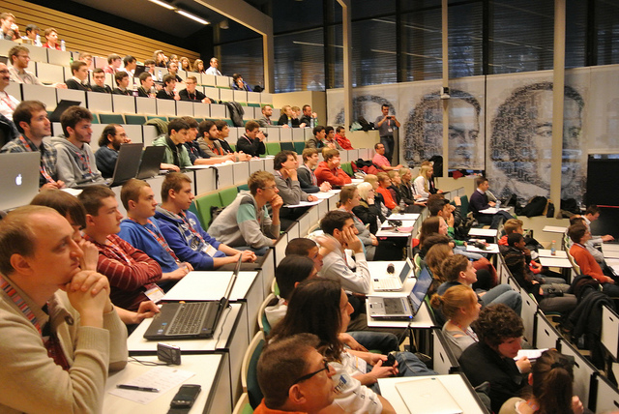
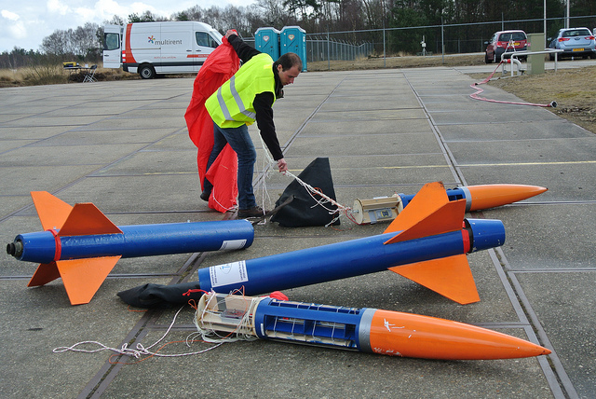

Slide 33
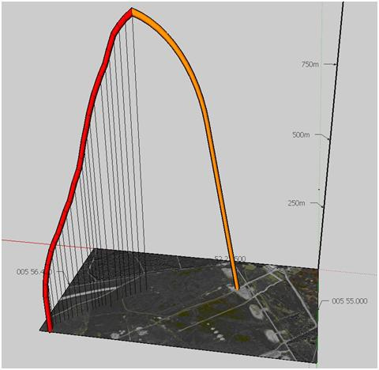
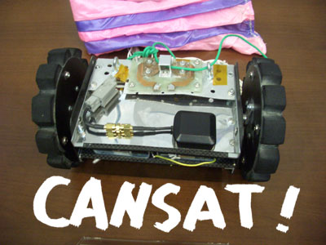
Experienta proiectului
Distractie la pachetel!

Slide 34
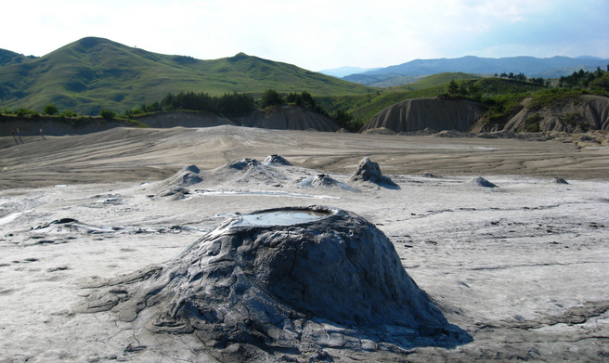
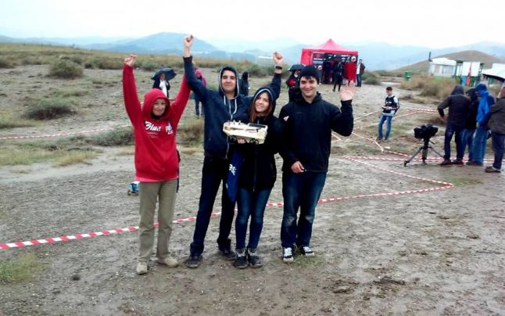
Exo RO – Competitia Nationala de Rovere
Competitia Nationala de Rovere “Exo-Ro”
Vulcanii Noroiosi, 15-17 Septembrie 2016

Slide 35
Continuarea in episodul urmator
Va multumim!

