Slide 1
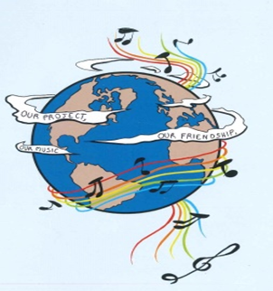
MUSIC: A MELODIC METHODOLOGY INTO TEACHING AND LEARNING 2018-1-ES01-KA229-050761 SCHOOL EXCHANGE PARTNERSHIP
THE ROMANIAN TEAM PRESENTS:
'Music Unites People’
based on an online survey applied to 101 Romanian students

Slide 2
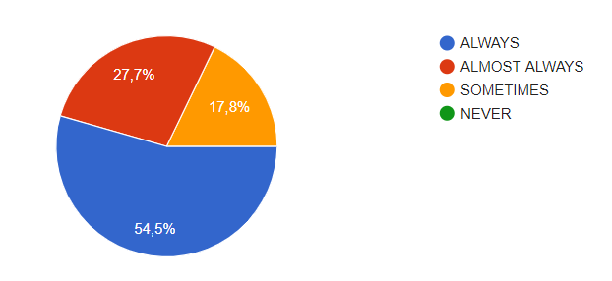
1. Do you think the music you listen to is connected with your personal emotions/feelings?
More than half of the Romanian respondents (54,5 %)believe that the music they listen to is always connected with their personal emotions and feelings, 27,7 % consider that this happens almost always while 17,8 % of them think that there is sometimes a connection between the two aspects.

Slide 3
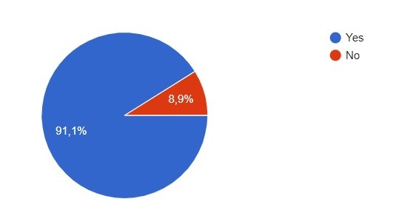
2. Do you feel different emotions when different instruments are being played?
The vast majority of the students (91,1% ) say that when they listen to different musical instruments certain emotions are triggered whereas only 8,9% from them can’t see a connection between emotions and musical instruments.
Guitars trigger joy and energy, violins and pianos are linked to sadness, pianos and harps are connected with relaxation and drums show the feeling of energy.

Slide 4
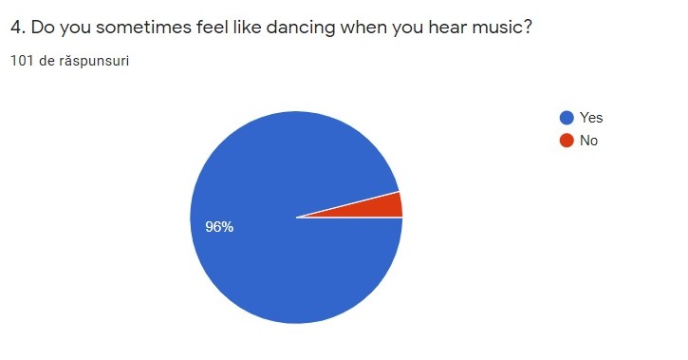
3. Do you hum to yourself or whistle when you're feeling cheerful?
For 89,1 % from the Romanian students, being cheerful makes them hum a song or whistle while 10,9% do not do this.
4. Do you sometimes feel like dancing when you hear music?
Most Romanian respondents (96%) feel like dancing when they listen to music.

Slide 5
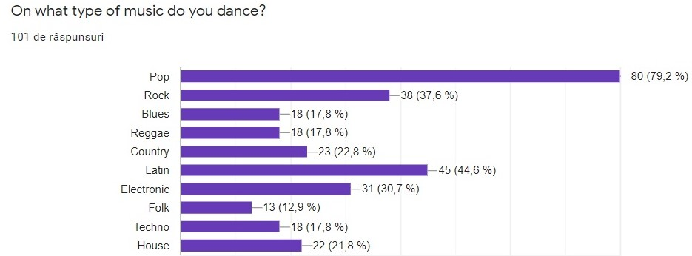
A large percentage of the respondents (79,2 %) dance on pop music, followed by Latin music (44,6%), rock (37,6 %) and electronic music (30,7%).

Slide 6
5. The English songs that make the Romanian students feel happy.
There were many different answers, but the songs that had been mentioned more than once were:
1. More than you know- Axwell & Ingrosso-22 votes
2. Happy- Pharell Williams-11 votes
3. Billionare- Bruno Mars-5 votes
4. Don`t worry, be happy-2 votes
6. What kind of music do you usually listen to if you are sad?
The Romanian respondents have stated that when they are sad, they usually listen to the following kinds of music: Pop-18 votes, Sad song-15 votes, Blues-12 votes, .Rock-12 votes, Rap-7 votes, .R&B-4 votes, .Classical-3 votes, Electronic-3 votes, .Lo-Fi-3 votes, K-pop-3 votes, Jazz-3 votes, Orchestral-2 votes, Heavy Metal-2 votes, Alternative Rock-2 votes, Reggae-2 votes, Opera- 2 votes, Latin-2 votes , Trap-2 votes, Instrumental-1 votes, Dubster-1 vote, Slow song-1 vote and Old song-1 vote
7. Songs in English that comfort you if you feel blue
The Romanian respondents have mentioned the following songs more than once.
Only you -23 votes
November rain-15 votes
Believer-2 votes
Among the songs that the Romanian students have mentioned there are: Yellow flicker beat; Be Somebody; Mood Swings; Through glass, All Eyes On Me; Foreigner; Memories; Hard act to follow; Peace of mind; Dancing In The Dark; The search; Fallen angel; Sad; More than words; Lovely; Thinking Out Loud; Lose Youself ; Nothing Else Matters; Snuff; I don't wanna miss a thing; Listen before I go; Shallow, Wish that you were here; Falling; Kiss the rain; Wait; Coming home; The lonely shepherd

Slide 7
8. Songs in English that make you think about tolerance
The top three song about tolerance are:
1. They don’t care about us-36 votes
2. Black or white-6 votes
3. Take me to church-2 votes
9. Songs in English that make you think about love
According to the Romanian respondents, the songs that hold the 3 first places are: Perfect by Ed Sheeran (33 times), Still loving you by Scorpions (4 times) and. All of me by John Legend (2 times). Among the other songs that have been mentioned only once, there are:If the world was ending; All I ever need; Love had no limits; Anchor; Teen romance; I love you; You're not alone; A thousand years; Put your head on my shoulder; You don’t own me; Insatiable ; I’ll be there for you; Just the way you are; Time; Thinking out loud; All I need to know; If I let you go; Us; Time of my life; Love me like you do

Slide 8
10. Songs in English that make you think about peace
The top three answers given by the respondents were:
1. Heal the world-46 votes
2. Imagine-4 votes
3. We are the world-3 votes
Among other answers, there are : I want to break free, What a wonderful world, Don’t worry be happy,
I miss the days, Earth song, Bohemian rhapsody, Someone-Somewhere, One Day; Sanctuary

Slide 9
Yeah, more than you know Yeah, more than you know You should know that baby you're the best Yeah, more than you know Yeah, more than you know.
Yeah, more than you know yeah, more than you know. Yeah, more than you know yeah, more than you know. Yeah, more than you know yeah, more than you know. Yeah, more than you know yeah, more than you know. Yeah, more than you know yeah, more than you know.
I just
I just need to get it off my chest. Yeah, more than you know yeah, more than you know. You should know that baby you're the best. Yeah, more than you know yeah, more than you know.
Songs in English that make you feel happy
More Than You Know, sung by Axwell & Ingrosso
I just need to get it off my chest Yeah, more than you know, Yeah, more than you know. You should know that baby you're the best Yeah, more than you know, Yeah, more than you know.
I saw it coming, from miles away. I better speak up if I got something to say 'Cause it ain't over, until she sings You had your reasons, you had a few But you knew that I would go anywhere for you 'Cause it ain't over, until she sings.
I just need to get it off my chest Yeah, more than you know, Yeah, more than you know. You should know that baby you're the best Yeah, more than you know, Yeah, more than you know
I just….
Your good intentions are sweet and pure But they can never tame a fire like yours, No it ain't over, until she sings. Right where you wanted, down on my knees. You got me begging, pretty baby set me free 'Cause it ain't over, until she sings.
Come a little closer, let me taste your smile Until the morning lights Ain't no going back the way you look tonight I see it in your eyes
I just need to get it off my chest
The interpretation of the song.
``More than you know`` is a song by Axwell and Ingrosso that refers to the felling of happiness.
In this song the singers associate the felling of happiness with making others feel good and appreciated. So, the artist confesses to a person and tells her what he thinks about her.
Also, the singer feels relieved when he tells her everything, he thinks about her and what a good person she is. As a result of the confession, both are very happy and they sing. The song is a motivational one as it invites people to have a friendly chat and speak their minds.

Slide 10
Because I'm happy Clap along if you feel like a room without a roof Because I'm happy Clap along if you feel like happiness is the truth Because I'm happy Clap along if you know what happiness is to you Because I'm happy Clap along if you feel like that's what you wanna do
Hey, come on, uh Bring me down, can't nuthin' (happy) Bring me down My level is too high to bring me down (happy) Can't nuthin', bring me down (happy) I said, let me tell you now, unh (happy) Bring me down, can't nuthin', bring me down (happy, happy, happy) My level is too high to bring me down (happy, happy, happy) Can't nuthin' bring me down (happy, happy, happy) I said Because I'm happy Clap along if you feel like a room without a roof Because I'm happy Clap along if you feel like happiness is the truth Because I'm happy Clap along if you know what happiness is to you Because I'm happy Clap along if you feel like that's what you wanna do.
Happy by Pharrell Williams
It might seem crazy what I'm 'bout to say Sunshine she's here, you can take a break I'm a hot air balloon that could go to space With the air, like I don't care baby by the way
Huh, because I'm happy Clap along if you feel like a room without a roof Because I'm happy Clap along if you feel like happiness is the truth Because I'm happy Clap along if you know what happiness is to you Because I'm happy Clap along if you feel like that's what you wanna do Here come bad news, talking this and that (Yeah) Well, give me all you got, and don't hold it back (Yeah) Well, I should probably warn you I'll be just fine (Yeah) No offense to you, don't waste your time Here's why

Slide 11
Because I'm happy Clap along if you feel like a room without a roof Because I'm happy Clap along if you feel like happiness is the truth Because I'm happy Clap along if you know what happiness is to you Because I'm happy Clap along if you feel like that's what you wanna do Come on, unh bring me down can't nuthin' (happy, happy, happy) Bring me down my level is too high (happy, happy, happy) Bring me down can't nuthin' (happy, happy, happy) Bring me down, I said Because I'm happy Clap along if you feel like a room without a roof Because I'm happy Clap along if you feel like happiness is the truth Because I'm happy Clap along if you know what happiness is to you, eh eh eh Because I'm happy Clap along if you feel like that's what you wanna do Because I'm happy Clap along if you feel like a room without a roof Because I'm happy Clap along if you feel like happiness is the truth Because I'm happy Clap along if you know what happiness is to you, eh hey Because I'm happy Clap along if you feel like that's what you wanna do, heh come on.
The interpretation of the song
This beautiful song speaks about happiness and about its importance in everybody’s life. It emphasises how simple and easy it can be if we look at the bright side of the things and events that happen to us every day. Our well-being, our comfort is in our hands: it’s up to us how we want to see things in life.
People really like this song as it helps them change their mood as it makes them feel happy. It is both a motivational and an inspiring way of starting your day.

Slide 12
Songs in English that comfort you if you feel blue
Only you, sung by Mishelle featuring Randi
[Mishelle]
What's that feeling that I get?
My heart is drowning in regret
Hands are shaking, eyes are full of shame
Lost myself, but I don't care,
I'm going but I don't know where
My feet are taking me away from you
[Chorus]
Only you, only you,
My beautiful dream, I loved you
Only you, only you
You gave me your heart (x2)
[Randi]
I have no reason now to stay,
But I will think of you and pray
That you will find someone to love again
I'm leaving and I won't come back
You'll find your way, you'll be alright,
But promise me you won't forget my name
[Mishelle]
Only you, only you,
My beautiful dream, I loved you
Only you, only you
You gave me your heart.
[Randi]
Only you, only you,
My beautiful dream, I loved you
Only you, only you
You gave me your heart.
[Chorus] Only you, only you, My beautiful dream, I loved you Only you, only you You gave me your heart (x4)
The interpretation of the song
In this song entitled “Only you”, we have the aftermath of a love story gone bad with the two lovers who are slowly falling apart.
First, we hear a sad woman singing about her regrets over the love she lost. She struggles to understand what she’s feeling and her heart is full of regrets. She has trouble coping with her loss: her hands are shaking, she’s feeling ashamed and she doesn’t know what her life would be like from now on, away from him.
A few seconds later, the chorus tells us that this story was as beautiful as a dream and they loved each other.
After the chorus, we hear him sing about how he is still thinking of her and praying for her to be loved again. However, he states he won’t be coming back to her, but would like her to keep him in her mind.
In the end, the chorus repeats the same verse, but this time the two ex-lovers sing it together as a sign that they both moved on after the sad story ended.

Slide 13
November Rain
When I look into your eyes I can see a love restrained But darlin' when I hold you Don't you know I feel the same
Nothin' lasts forever And we both know hearts can change And it's hard to hold a candle In the cold November rain
We've been through this such a long long time Just tryin' to kill the pain, oo yeah But love is always coming and love is always going And no one's really sure who's lettin' go today Walking away
If we could take the time To lay it on the line I could rest my head Just knowin' that you were mine All mine So if you want to love me Then darlin' don't refrain Or I'll just end up walkin' In the cold November rain
Do you need some time on your own Do you need some time all alone Everybody needs some time On their own
Don't you know you need some time all alone
I know it's hard to keep an open heart When even friends seem out to harm you
But if you could heal a broken heart Wouldn't time be out to charm you
Sometimes I need some time On my own Sometimes I need some time all alone Everybody needs some time On their own Don't you know you need some time all alone
And when your fears subside And shadows still remain, oh yeah I know that you can love me When there's no one left to blame
So never mind the darkness We still can find a way 'Cause nothin' lasts forever Even cold November rain
Don't ya think that you need somebody Don't ya think that you need someone Everybody needs somebody You're not the only one You're not the only one
The interpretation of the song
“November rain” is the typical love song, involving all sorts of feelings: hope, sadness, joy, regret.
We can understand right from the beginning that there’s a love story arrived at a turning point. There are always obstacles in a relationship, but the singer thinks that they should take their love into account and not be afraid of what the future holds for them.
He reminds his lover that they have a history together and he explains her that one has to fight for love so that it should last.
Everyone needs some time alone to clear their head or to get back on their feet before resuming a relationship. Love is compared to a candle’s light that might not resist in the rain.
The song ends in an optimistic way, with an invitation to try getting involved in a love story, even if there’s only a chance to be happy.

Slide 14
Songs in English that make you think about tolerance
Black or white by Michael Jackson
I took my baby on a Saturday bang Boy is that girl with you? Yes, we're one and the same
Now I believe in miracles And a miracle has happened tonight
But, if you're thinkin' about my baby It don't matter if you're black or white
They print my message in the Saturday Sun I had to tell them I ain't second to none
And I told about equality and it's true Either you're wrong or you're right
But, if you're thinkin' about my baby It don't matter if you're black or white
I am tired of this devil I am tired of this stuff I am tired of this business Sew when the going gets rough I ain't scared of your brother I ain't scared of no sheets I ain't scared of nobody Girl, when the going gets mean
Protection For gangs, clubs, and nations Causing grief in human relations
It's a turf war on a global scale I'd rather hear both sides of the tale See, it's not about races Just places, faces Where your blood comes from Is were your space is I've seen the bright get duller
I'm not going to spend my life being a color
Don't tell me you agree with me When I saw you kicking dirt in my eye
But, if you're thinkin' about my baby It don't matter if you're black or white
I said if you're thinkin' of being my baby It don't matter if you're black or white
I said if you're thinkin' of being my brother It don't matter if you're black or white
Ooh, ooh Yea, yea, yea now Ooh, ooh Yea, yea, yea now
It's black, it's white It's tough for you to get by (yeah, yeah, yeah) It's black, it's white
It's black, it's white It's tough for you to get by (yeah, yeah, yeah) It's black, it's white
The interpretation of the song
As the title suggests, it’s a song about tolerance. Judging people by the colour of the skin doesn’t mean equality. Everybody talks about fighting against discrimination, about having the same rights, but in the end, what we see is someone’s colour.
It’s not about being right or wrong, it’s about what should be the most important: taking into consideration what we can see with our hearts, what makes us human. We are all the same: we all do bad things, we all are afraid of the unknown, we all want to be happy.
The singer is tired of fighting discrimination and he advises everybody to stop hurting each other, to be kind and to see the beauty of the world.
The colour of the skin doesn’t matter, he considers everyone his brother and he hopes the others would do the same.

Slide 15
They don't really care about us, by Michael Jackson
Skin head, dead head Everybody gone bad Situation, aggravation Everybody allegation In the suite, on the news Everybody dog food Bang bang, shot dead Everybody's gone mad.
All I want to say is that They don't really care about us All I want to say is that They don't really care about us.
Beat me, hate me You can never break me Will me, thrill me You can never kill me Sue me, Sue me Everybody do me Kick me, kick me Don't you black or white me
All I want to say is that They don't really care about us All I want to say is that They don't really care about us.
Tell me what has become of my life I have a wife and two children who love me I am the victim of police brutality, now I'm tired of bein' the victim of hate You're rapin' me of my pride oh, for God's sake.
The interpretation of the song
The message in this song tells the reality about people, they are incapable of thinking about others because they are too busy with their own lives.
Michael Jackson is singing about the Afro- American people’s live in the USA and he talks about situations where police forces used brutality against black people, asking God to set them free.
Then he reminds us about two great men from the American history. He thinks Roosevelt and Martin Luther King wouldn’t allow black people to suffer after the proclamation that promised them freedom and liberty.
People are different and everyone is beautiful in their own way, but sometimes we are judged on our appearance. We have to accept the fact that no one is perfect, but we have to be kind to others because the only thing that really matters is our personality.
We got used to judging others without really knowing them or their situation and the song is an attempt to combat racial inequality through nonviolent resistance.

Slide 16
Songs in English that make you think about love
Perfect by Ed Sheeran
I found a love for me Darling just dive right in And follow my lead Well I found a girl beautiful and sweet I never knew you were the someone waiting for me 'Cause we were just kids when we fell in love
Not knowing what it was I will not give you up this time But darling, just kiss me slow, your heart is all I own And in your eyes you're holding mine
Baby, I'm dancing in the dark with you between my arms Barefoot on the grass, listening to our favorite song When you said you looked a mess, I whispered underneath my breath But you heard it, darling, you look perfect tonight
Well I found a woman, stronger than anyone I know She shares my dreams, I hope that someday I'll share her home I found a love, to carry more than just my secrets To carry love, to carry children of our own We are still kids, but we're so in love Fighting against all odds I know we'll be alright this time Darling, just hold my hand Be my girl, I'll be your man I see my future in your eyes.
The interpretation of the song
This song is the top choice for a song about love. The lyrics describe a romantic love. The stage in which the relationship is at the moment of the song is a stable one. “Perfect” is a song that makes every person who listens to it feel safe and worm, quite like the feeling you get when drinking a hot chocolate on a beautiful winter’s day. Overall, the core message of the song is that in the eyes of that one person all your little quirks will become endearing or we should say, perfect.

Slide 17
Still Loving You by Scorpions
Time, it needs time To win back your love again I will be there I will be there Love, only love Can bring back your love someday I will be there I will be there
Fight, babe, I'll fight To win back your love again I will be there I will be there Love Only love Can break down the wall someday I will be there I will be there
If we'd go again All the way from the start I would try to change Things that killed our love Your pride has built a wall, so strong That I can't get through Is there really no chance To start once again I'm loving you
Try Baby try To trust in my love again I will be there I will be there
Love, our love Just shouldn't be thrown away I will be there I will be there
If we'd go again All the way from the start I would try to change Things that killed our love Your pride has built a wall, so strong That I can't get through Is there really no chance To start once again
If we'd go again All the way from the start I would try to change Things that killed our love Yes, I've hurt your pride, and I know What you've been through You should give me a chance This can't be the end.
I'm still loving you I'm still loving you I'm still loving you I need your love I'm still loving you Still loving you baby
I'm still loving you I need your love I'm still loving you I need your love I'm still loving you I need your love
I need your love.
The interpretation of the song
The second choice is about romantic love as well, but unlike “Perfect” where love was stable and safe, in “Still Loving You” the couple has broken up, the lyrics being written from the perspective of the person who caused a sad break- up, trying to win back the other and reassure her that they’ve learnt their lesson and they understand they’ve hurt the other but, if they get one more chance, things will be different, they will be better. It is also of note that the verb “love” is used in the continuous form even though that is grammatically incorrect, but for the singer, love is in progress. To symbolise that, despite the couple splitting up, the partner continues to be in love with her.

Slide 18
Songs in English that make you think about peace
In my heart I feel you are all my brothers
Create a world with no fear
Together we cry happy tears
See the nations turn their swords into plowshares
We could really get there
If you cared enough for the living
Make a little space
To make a better place
Make it a better place
For you and for me
And the entire human race
There are people dying
If you care enough for the living
Make a better place for you and for me
Heal the world
Make it a better place
For you and for me
And the entire human race.
Heal the world by Michael Jackson
There's a place in your heart
And I know that it is love
And this place could be much
Brighter than tomorrow
And if you really try
You'll find there's no need to cry
In this place you'll feel
There's no hurt or sorrow
There are ways to get there
If you care enough for the living
Make a little space
Make a better place
Heal the world
Make it a better place
For you and for me
And the entire human race
There are people dying
If you care enough for the living
Make it a better place
For you and for me
If you want to know why
There's love that cannot lie
Love is strong
It only cares of joyful giving
If we try we shall see
In this bliss we cannot feel
Fear of dread
We stop existing and start living
The it feels that always
Love's enough for us growing
So make a better world
Make a better place
Heal the world
Make it a better place
For you and for me
And the entire human race
There are people dying
If you care enough for the living
Make a better place for you and for me
And the dream we were conceived in
Will reveal a joyful face
And the world we once believed in
Will shine again in grace
Then why do we keep strangling life
Wound this earth, crucify its soul
Though it's plain to see
This world is heavenly
Be god's glow
We could fly so high
Let our spirits never die

Slide 19
There are people dying
If you care enough for the living
Make a better place for you and for me
Heal the world
Make it a better place
For you and for me
And the entire human race
There are people dying
If you care enough for the living
Make a better place for you and for me
There are people dying
If you care enough for the living
The interpretation of the song
The title of this lovely song is a personification as the world is seen as a human being that can be healed. The message of the song is a very simple and powerful one at the same time: we all have to contribute to make the world we live in a better place. We have to offer a helping hand whenever it is needed, to love and protect the environment for us and for the next generations. The key word that binds all these elements together is: peace.

Slide 20
Imagine - John Lennon & The Plastic Ono Band
Imagine there's no heaven
It's easy if you try
No hell below us
Above us only sky
Imagine all the people
Living for today (ah ah ah)
Imagine there's no countries
It isn't hard to do
Nothing to kill or die for
And no religion, too
Imagine all the people
Living life in peace
You may say that I'm a dreamer
But I'm not the only one
I hope someday you'll join us
And the world will be as one
Imagine no possessions
I wonder if you can
No need for greed or hunger
A brotherhood of man
Imagine all the people
Sharing all the world
You may say that I'm a dreamer
But I'm not the only one
I hope someday you'll join us
And the world will live as one
The interpretation of the song
“Imagine” is loved and praised as one of the most influential songs in the history of music. The plain lyrics may hide the powerful message behind it: to see what might happen if we don’t cherish our world. He imagines an ideal world without boundaries, religions, possessions in which the people will live happily. The song is an invitation itself to meditate, to raise awareness of the facts that unite us and make us happy. He presents the problems that all the societies are confronted with and offers solutions: together we will find the best way of getting rid of any problem that may appear or may prevent us from being happy.

Slide 21
"This project has been funded with support from the European Commission. This publication reflects the views only of the author, and the Commission cannot be held responsible for any use which may be made of the information contained therein."

