Slide 1
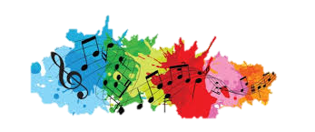
‘Music: a melodic methodology into teaching and learning’
'Music unites people'
This survey conducted in our school, IES Pablo Ruiz Picasso, shows the results about the musical preferences of 100 of our students.

Slide 2
1. Do you think the music you listen to is connected with your personal emotions/feelings? →Results:
ALWAYS
NEVER
ANALYSIS OF THESES RESULTS:
Most students, the 42% of them, say music is ALWAYS connected to their feelings and emotions.
A total of 41.9% of students say that music is ALMOST ALWAYS or QUITE OFTEN connected to their feelings and emotions.
Finally, only 16% of them say that music is HARDLY EVER or NEVER connected to their feelings.

Slide 3
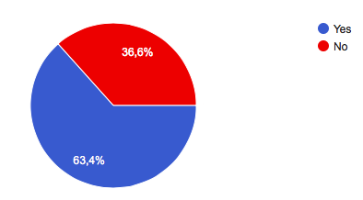
2. Do you feel different emotions when different instruments are being played?
3.
2.
ONLY 63.4% agree on feeling different emotions depending on the instrument that is playing music.
Maybe some teenagers are not able to differenciate among all the different feelings they experience at the same time while listening to music.

Slide 4
Relate INSTRUMENTS with FEELINGS:



More than 50 students relate sadness with mellow instruments like a piano or the harp.
Joy and hapiness are mostly related to electronic instruments like synthesizers, percussion instruments like the Spanish guitar and brass instruments like the trumpet.
More than 40 of students relate fury or rage with electronic synthesizers and percussion instruments like drums.

Slide 5
More than 50 students relate excitement or energy with electronic instruments.



More than 30 of students relate solitude or melancholy with mellow instruments like a piano or the harp.
More than 50 students also relate romance with mellow instruments like a piano or the harp.

The feelings of anxiety or anguish are related to different instruments like electronic instruments, brass instruments like the trumpet and percussion instrument like drums.

More than 60 students relate relaxation withmellow instruments like a piano or the harp.

Slide 6
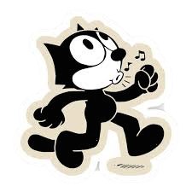
3. Do you hum to yourself or whistle when you're feeling cheerful?

Big majority
RESEARCH ABOUT HUMMING: People hum for several reasons, such as to calm nerves, feel happier and reduce stress. People hum unconsciously and consciously. Many use humming as a simple and effective way to ease tension and reduce stress and often derive health benefits in the form of improved sinus health in the process.
Then, most people probably hum and whistle listening to music because you feel happy and relaxed.

Slide 7
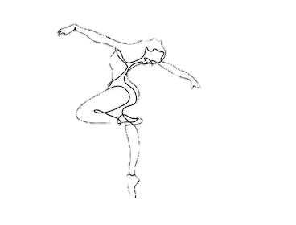
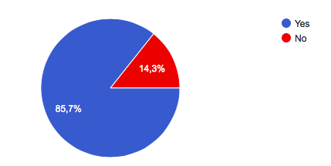
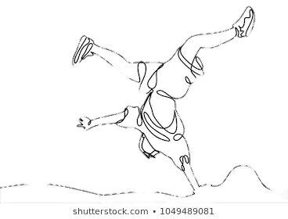
4. Do you sometimes feel like dancing when you hear music?

Big majority
RESEARCH ABOUT DANCING: Music and dance, together seem to create an emotional duo, always complementing each other. Music stimulates the orbitofrontal cortex of the brain, which is the major reward and pleasure region of the brain. Also, there’s an activation in the supplementary motor area in the brain—the area involved moving.
Then, most people probably dance while listening to music to express what they feel in a physical way.

Slide 8
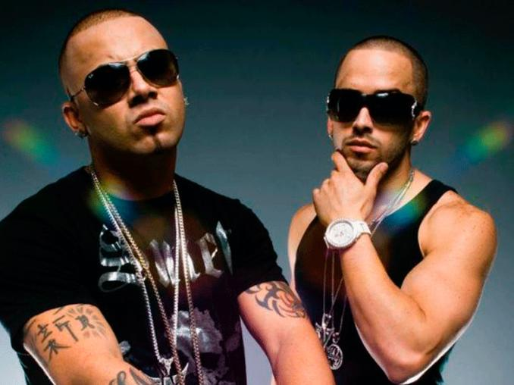
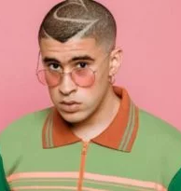
5. What type of music do you dance with?
The music genre students have mentioned the most related to making them dance is REGGAETON:
Reggaeton also known as reguetón is a music style which originated in Puerto Rico during the late 1990s. It has evolved from dancehall and influenced by American hip hop, Latin American, and Caribbean music.
The word reggaeton (formed from the word reggae plus the augmentative suffix -tón) was first used in 1994, when Daddy Yankee and DJ Playero used the name on the album Playero 36 to describe the new underground genre emerging from Puerto Rico that synthesized hip-hop and reggae rhythms with vocals which include rapping and singing, typically in Spanish.
In 2004, reggaeton starting becaming very popular in the United States and Europe. The first famous artists in Europe were: Daddy Yankee, Don Omar, or Wisin & Yandel.
Nowadays, some of them continue singing, but the are a lot of new singers as J.Balvin, Becky G,
Bad Bunny or Maluma.

Slide 9
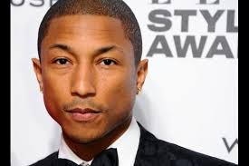
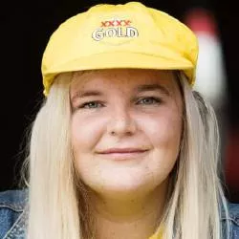
6. Songs that makes you feel HAPPY. → RESULTS:
The songs that make us feel happy in Spain are:
“HAPPY” by PHARRELL WILLIAMS
Pharrell Lanscilo Williams is an American singer, rapper, and songwriter, Williams has received numerous accolades and nominations; He is also a two-time Academy Award nominee, receiving a 2014 Best Original Song nomination for "Happy".
“DANCE MONKEY” by TONES AND I
Toni Watson, known professionally as Tones and I, is an Australian indie pop singer-songwriter and musician. Her second single, "Dance Monkey", was released in May 2019 and reached number one in over 30 countries. In November of that year, she broke the record for the most weeks at number one.
Notes:
🡪 (AQUÍ HAY QUE PONER CUALES SON LAS 2 CANCIONES EN INGLÉS DE LA FELICIDAD Y HABLAR DE LOS AUTORES, + LA CANCIÓN EN ESPAÑOL– EL ENCARGADO DE ESTO - , COMO MUCHO QUE OCUPE DOS DIAPOSITIVAS)

Slide 10
LYRICS OF THE SONGS
“HAPPY”
It might seem crazy what I'm 'bout to say Sunshine she's here, you can take a break I'm a hot air balloon that could go to space With the air, like I don't care baby by the way CHORUS: Huh, because I'm happy Clap along if you feel like a room without a roof Because I'm happy Clap along if you feel like happiness is the truth Because I'm happy Clap along if you know what happiness is to you Because I'm happy Clap along if you feel like that's what you wanna do Here come bad news, talking this and that (Yeah) Well, give me all you got, and don't hold it back (Yeah) Well, I should probably warn you I'll be just fine (Yeah) No offense to you, don't waste your time Here's why CHORUS
Hey, come on, uh Bring me down, can't nuthin' (happy) Bring me down My level is too high to bring me down (happy) Can't nuthin', bring me down (happy) I said, let me tell you now, unh (happy) Bring me down, can't nuthin', bring me down (happy, happy, happy) My level is too high to bring me down (happy, happy, happy) Can't nuthin' bring me down (happy, happy, happy) I said CHORUS X2 Come on, unh bring me down can't nuthin' (happy, happy, happy) Bring me down my level is too high (happy, happy, happy) Bring me down can't nuthin' (happy, happy, happy) Bring me down, I said CHORUS X2 heh come on
In the chorus Pharrell asks you to clap along to celebrate freedom: “room without a roof” and happiness with no limits.
He is repeating that he never surrenders, he is too positive to let things affect him.
Here he shows a very positive attitude when he faces bad news. He´s brave, he is not scared of problems.

Slide 11
“DANCE MONKEY”
They say oh my god I see the way you shine
Take your hand, my dear, and place them both in mine
You know you stopped me dead when I was passing by
And now I beg to see you dance just one more time
CHORUS
Ooh I see you, see you, see you every time
And oh my I, I like your style
You, you make me, make me, make me wanna cry
And now I beg to see you dance just one more time
So I say: Dance for me, dance for me, dance for me, oh, oh, oh
I've never seen anybody do the things you do before
They say move for me, move for me, move for me, ay, ay, ay
And when you're done I'll make you do it all again
I said oh my god I see you walking by
Take my hands, my dear, and look me in my eyes
Just like a monkey I've been dancing my whole life
And you just beg to see me dance just one more time
CHORUS
They say: Dance for me, dance for me, dance for me, oh, oh, oh, oh, oh, oh, oh
I've never seen anybody do the things you do before
They say move for me, move for me, move for me, ay, ay, ay
And when you're done I'll make you do it all again
Ooh (all again, all again)
Woah-oh, woah-oh, oh
Ooh (all again, all again)
Ah ah, ah ah, ay
They say: Dance for me, dance for me, dance for me, oh, oh, oh
I've never seen anybody do the things you do before
They say move for me, move for me, move for me, ay, ay, ay
And when you're done I'll make you do it all again
They say Dance for me, dance for me, dance for me, oh, oh, oh, oh, oh, oh, oh
I've never seen anybody do the things you do before
They say move for me, move for me, move for me, ay, ay, ay
And when you're done I'll make you do it all again
All again
The speaker is very excited about seeing someone dancing
In the phrase ``Dance for me, dance for me, dance for me, oh, oh, oh´´ he is requesting people to dance and have fun.
She is comparing herself to a trained monkey because they entertain and make people laugh.

Slide 12
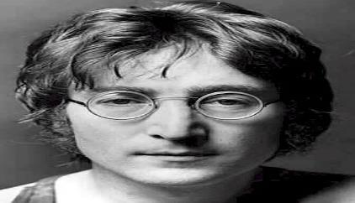
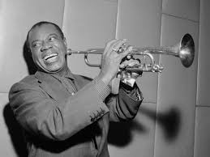
7. Songs that make you think about PEACE: → RESULTS:
The chosen songs are:
ENGLISH SONGS:
1. “Imagine” by: John Lenon
2. “What a Wonderful World” by: Louis Armstrong
SONG 1 “Imagine” by
John Lennon: He was an artist, musician, multinstrumentist, singer-songwriter, poet, cartoonist, writer, pacifist, activist and English actor, known for being one of the founding members of the rock band The Beatles.
He was born and raised in Liverpool, where as a teenager he was immersed in the British skiffle boom; He formed the band The Quarrymen in 1956, which later in 1960 would become The Beatles. When the group disintegrated at the end of that decade, Lennon began a solo career in which he published several albums such as John Lennon / Plastic Ono Band and Imagine, and songs like "Give Peace a Chance" and "Imagine"; most of them express their liberal and pacifist ideas.
SONG 2 “What a wonderful world” by
Louis Armstrong:Also known as Satchmo or Pops, he was an American jazz trumpeter and singer.He is one of the most charismatic and innovative figures in the history of jazz and probably its most popular musician. Thanks to his musical skills and his brilliant personality, he transforms jazz from his initial dance music condition into a popular art form. Although at the start of his career he cemented his fame especially as a cornetist and trumpeter, later on he would be his vocalist condition that would consecrate him as an internationally recognized figure and of enormous influence for jazz singing.

Slide 13
“Imagine” “What a wonderful love”
LYRICS OF THE SONGS
Imagine there's no heaven
It's easy if you try
No hell below us
Above us only sky
Imagine all the people
Living for today (ah ah ah)
Imagine there's no countries
It isn't hard to do
Nothing to kill or die for
And no religion, too
Imagine all the people
Living life in peace
You may say that I'm a dreamer
But I'm not the only one
I hope someday you'll join us
And the world will be as one
Imagine no possessions
I wonder if you can
No need for greed or hunger
A brotherhood of man
Imagine all the people
Sharing all the world
You may say that I'm a dreamer
But I'm not the only one
I hope someday you'll join us
And the world will live as one
I see trees of green, red roses too
I see them bloom for me and you
And I think to myself what a wonderful world
I see skies of blue and clouds of white
The bright blessed day, the dark sacred night
And I think to myself what a wonderful world
The colors of the rainbow so pretty in the sky
Are also on the faces of people going by
I see friends shaking hands saying how do you do
They're really saying I love you
I hear babies crying, I watch them grow
They'll learn much
more than I'll never
know
And I think to myself what a wonderful world
Yes I think to myself what a wonderful world.
He´s saying despite the racism going on at the time, Louis was largely accepted into white society
There are no bad things (“hell”), only good things (“heaven”)
Here he asks us to imagine a world without anything that separates people (“countries and religion”).
He gives a message of hope. Despite all the starvation, poverty, genocide and the bad things that are happening, the world is a wonderful place full of beauty and we all need to take time to realize that and appreciate it.
He calls for a sacrifice of one’s possession as a step on the path of Enlightenment.
When you destroy a need for material goods, you also destroy any need for greed, and in turn war and suffering.
He observes life around him, he sees people bond and develop relationships which, to him, make up for the dark sacred times that he witnesses in the world.

