Slide 1
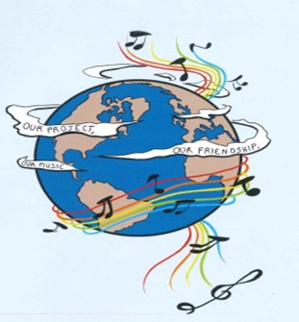
MUSIC: A MELODIC METHODOLOGY INTO TEACHING AND LEARNING 2018-1-ES01-KA229-050761 SCHOOL EXCHANGE PARTNERSHIP The Romanian team presents Landscape in traditional clothing

Slide 2
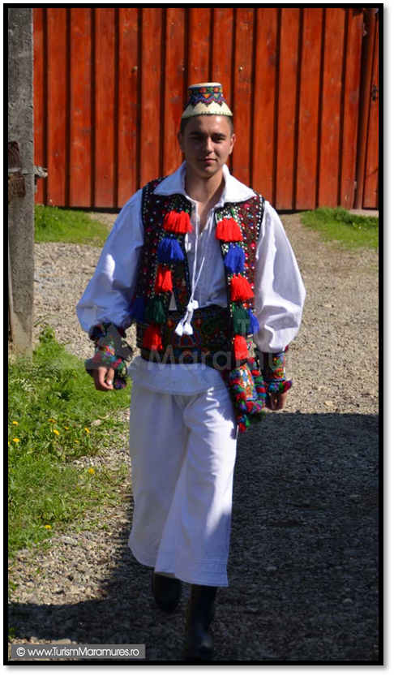
Costumes from Maramureș
Folk costumes are an important element when it comes to a country’ s culture. They actually represent a symbol, similar to the national flag. Of course, there exists a wide variety of costumes , with different colours , patterns and details, depending on the area they came from. The relief also influences the materials the costumes are made of. For instance, in mountainous areas they mostly use materials that are meant to keep people warmer, like wool, while in field areas, where the weather is less unpredictable and the rainy and snowy days are considerably fewer the costumes are made of light materials like linen.
Maramureș is a wide area which means it has both mountains as well as field or hill and, in doing so, more types of climate. That is why the folk costumes from Maramureș vary from region to region.
Regardless of that, the men costumes from Maramureș are, basically quite simple, containing a plain white shirt which is a little bit longer than usual, up to hip, and a pair of white trousers.
The lack of originality and authenticity of the first two pieces is offset though, by the other important piece, the sheepskin. It is decorated with all sorts of details made of leather and, sometimes made of multi coloured wool. These two materials can easily illustrate the relief because they are specific to mountains. Also, wool is practically the sheep’ s fur, while leather can be of synthetic origin or of animal origin. Regardless of that, the association of the costume with animals such as sheep helps us imagine a mountainous landscape, where the animals can walk around freely, “enjoying” the pure air from the green, large and beautiful, flower-covered pastures.

Slide 3
On the other hand, the women’ s costume is more complex, as usual. It is represented by a shirt, traditionally called “ie” and a knee length white skirt. The skirt itself is pretty basic, but what makes it special is the apron, worn around the hips. The apron is really colourful and it has a lot of horizontal stripes. The colours of the apron vary –depending on each and every village- from yellow and green to blue and orange, even though the most common are red and black .The costumes for women are completed by the sheepskin coat, which is worn during winter, along with the kerchief which is very popular- the women usually wear it all the time, not just during cold weather.The kerchief is decorated with colourful, small flowers which bring us back to the landscape I mentioned before, highlighting our relief. Another important element when it comes to the women’ s costume is the belt, made of a variety of materials.
The white colour of the basic pieces which underpin not only the female costume, but also the male costume suggests the purity of the outer frame, while the multicloured details that decorate the costumes represent the imperfections of the landscape. Nevertheless, as we all know very few things in this world are truly perfect and that is why it is extremely important to understand the fact that even the so called flaws or irregularities are important when it comes to defining beauty. This idea applies to the landscape as well considering that its beauty is rendered by its imperfections as well.

Slide 4
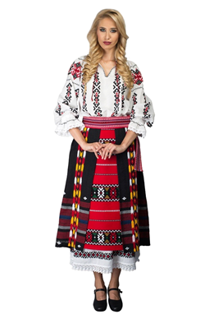
THE MUNTENIAN COSTUME
The specific costume of Muntenia is a well-known costume in Roumania. It has vivid colours for women and men, too.
The costume for women has a large shirt and a skirt. The shirt is white and it has a lot of colourful flowers, inspired by the plants from the fields. These always respect the model, but it can introduce some particularities. For instance, the usual model includes the material made with white hemp canvas, linen and cotton which is decorated with a lot of floral motifs. The special models include cloth with orange parts, long sleeves and flowers with gold thread. The skirt is a long piece of material which surrounds the body. It is made of wool and it has a lot of colourful lines. The motifs are inspired by the objects from nature, represented by geometric figures. The costume for woman is very colourful and it shows happiness, femininity and love for nature. Being a costume from the hill, it has summer dresses and warm clothes for winter.

Slide 5
The costume for men is noticeable by its stitch pattern, its simplicity and its sobriety. The differences between the regions are small, so there are discreet variations. The costume has a tunic shirt, trousers, a specific hat and a pair of boots. The shirt was made by women from natural materials and it is long. Its sleeves, collar and chest are embroidered. The trousers are large, long, without any colourful models. Sometimes, they present some wristbands. Around the wristbands, there are some beads made by the seam. In summer, men wear hats, while in winter, men wear a fur cap. The footwear is represented by a black pair of boots. This costume shows the seriousness and determination of the men from the hill. It is adapted to the climate of the hill and to the men’s activity.
People wear these clothes in the most important moments of their lives: at weddings, at Christmas and at Easter.

Slide 6
The costumes from Transylvania
Just like architecture, ceramics, fabrics, customs and folklore, the folk clothes reflect the Romanian people’s traditional way of life. With the creation of the ethnographic areas of the country, the folk costumes specific to them also appeared. The Romanian clothes, as a general feature, have a general resemblance throughout the country, with of course, differences of detail, with changes of form, cut, ornamentation and chromaticity, depending on the area of ​​origin.
Each symbol has its own meaning. For example:
The tree and its branches are symbols of reinvention and wisdom.
Blue and silver represent the water, gold and green symbolize the plains, red and brown indicate the mountains.

Slide 7
The main feature of the Transylvanian women's folk clothes is represented by two narrow, black, or black-red combinations. Catrința (which is also found in other regions of the country) is a rectangular piece (40-50 cm) that is worn vertically in front and back, from the shoulder down that serves either as a skirt or as an apron.
As for the men's folk costume in Transylvania (Sibiu, Făgăraș, Târnave) there is a long shirt, and in the west and the north of Transylvania (Oaș, Sălaj, Bihor, Maramureș), the men wear short shirt and "gaci"- (white canvas trousers).
In order to create the clothes that make up the traditional outfit of Transylvania’s inhabitants, nature played a decisive role as a supplier of raw materials and also of sources of inspiration. For example, the red color of the fabric was obtained from the leaves and the apple blossoms that were oiled and then boiled. The colours that predominate in the folk costumes are red (inspired by the hills with the wheat fields), blue (the colour of lakes and rivers), yellow (the colour of the sun and wheat). We find in the stitches on the blouses worn by both men and women multicolored flowers that embellish both the plains of our country and also the Romanian folk costumes.

Slide 8
The costume from Dobrogea
The area of Dobrogea is characterized by the co-existence of people belonging to different nationalities, such as: Romanian, Bulgarian, Greek, Turkish. The predominant colours are red, white and blue.
The women wear a silk veil (maramă) which is embroidered. The traditional footwear are the leather peasant sandals (opinci). They also wear a long, white shirt fully decorated with small geometrical and floral ornaments which give beauty and elegance. Over this shirt, they wear two halves of skirt which are adorned with small diamond shapes, squares and rectangles. For their waist, they have a woolen belt called “bârneață”.
Unlike the women’s folk costume, the men’s is not so rich in ornaments.They wear a shirt decorated with floral and geometrical ornaments which has embroideries on the sleeves, collar and chest. They also wear large trousers made of gossamer. Their waistcoat called „bundiță” is made of wool and it has geometrical shape. Everything is connected to nature. Their embroideries are in the same direction in which the rivers flow and the ones from their shirts look like the top of the mountains.
The complexity and the originality of these traditional folk costumes from Dobrogea make them unique.

Slide 9
The costume from Moldova
Moldovia is a geographical area where rivers flow rapidly, descending from mountains to sunny valleys, hay fields and fruit orchards. Men's traditional clothing has kept the beauty and diversity of reliefs from the old days to the present day, but also the men's basic occupation, sheep and cattle breeding.
Shepherds from father to son, Moldovian men wore clothes made of wool: white trousers tight on the leg, woolen socks over which laces from their shoes made of thick beef leather were fastened.
The shirt was simple, white, long up to the knees, with wide sleeves, tightened on the wrist, gathering the summer coolness of the wind breeze over the sunny hills of this breathtaking region.
The most beautiful pieces, specific to the hills and mountains landscape of Moldovia, are wide woolen belts decorated with coloured folk motifs and the vest made of sheep fur and also woven with colorued decorative motifs.
The flowers of hills are stylized and stitched with red and green threads in vertical rows on the sleeves of the shirts, on the chest of the vests and on the girdles around their waists.
Moldovian men cover their heads, and in the summer they protect themselves from the low mountain sun with a black hat made of woolen cloth.
In the winter, men face the cold and the blizzard of the mountain ridges with thick Astrakhan hats and long coats of sheepskin, harmonizing the hardship of the mountains with their fierce, powerful character and their busy and most beloved occupation: being shepherds.

Slide 10
The Moldavian women are hardworking, powerful, energetic, cheerful and good housewives, doing all the chores of the house, from spring when men ascend to the top of the mountains with their sheep flocks to the pasture, up to late autumn when their shepherds return home with their flocks sheep for wintering. Their items of clothing reflect their character and harmoniously blend with the richness of shapes and colours of the hills at the foot of the mountains, crossed by fast and cold rivers. The traditional blouse is made of white cloth, with wide sleeves, tight on the wrist, over which women wear wool vest during summer, or sheepskin in winter. These two items of clothing are stitched with patterns and colours that stand for the rich vegetation of the hills that provide shelter and food to the families of the Moldovian people .The sleeves of the blouse, the chest and the hem of the vest together with the thick white sheepskin coats are hand-sewn in the shape of flowers with 7 petals, adorned with rows of twigs, along with buds or even clusters of grapes, all these give the impression that the Moldovian women do not wear clothes, but a cloth of hay flowers and branches loaded with fruit, gathered by them right from the hills. In the same way, the vail that covers their heads, the waist around the middle and the long and straight skirt, woven even by them, are also decorated with field flowers represented in bright colours: yellow, green and predominantly red. She wears white woolen stockings and brown fur coats of thick cow ‘skin. The clothes of the Moldavians preserve the white of the serene sky.

Slide 11
"This project has been funded with support from the European Commission. This publication reflects the views only of The author, and the Commission cannot be held responsible for any use which may be made of the information contained therein."

