Slide 1
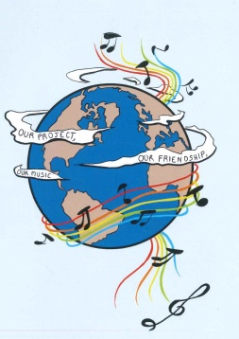
MUSIC: A MELODIC METHODOLOGY INTO TEACHING AND LEARNING 2018-1-ES01-KA229-050761 SCHOOL EXCHANGE PARTNERSHIP
THE ROMANIAN TEAM PRESENTS
'FRIENDSHIP THROUGH MUSIC’
TEACHING ENGLISH THROUGH SONGS

Slide 2
A FRIEND LIKE YOU
The proposed activities for teaching English through songs are based on a the song “A Friend Like You” , which was composed by Andy Grammer, and appears on the Captain Underpants: The First Epic Movie (Original Motion Picture Soundtrack). The official soundtrack of this film was released on June 2nd, 2017.
The 1st sequence of teaching techniques.
Minecraft
1.1 The teacher divides the class into groups and she/he gives them a sheet of paper with a table in which some words are written and she/he tells them that they have to identify 5 pairs of synonyms/antonyms.
1.2 The students will identify the topics that these words are characteristic of and they have to write 3 words for each topic
a)jobs
b)friendship
c) enmity
1.3 The teacher tells the students to find the expressions and words representative of the friendship message and to colour them in red. They have to colour in blue the fields containing expressions and words that are opposites of friendship. They will tell what the image in red represents.
challenges |  | get in a fight |  | Difficult life | low self-esteem |  | failing
anger |  | sadness |  |  | nobody to help you |  | heated argument
breakup |  | teamwork |  |  | friends |  | hate
bitterness | helping each other |  |  | trust | trying to progress |  |  | enemies
dislike | happy times |  | communication |  | happiness | agreement |  | conflicts
lack of politeness |  | a big happy family |  | gifts | harmony |  | disappointment
cruelty | quarrel |  | parties | learning together |  | deceit/ lie |  | abandon
to give up |  | tears |  | smiles | distrust |  | envy

Slide 3
challenges |  | get in a fight |  | Difficult life | low self-esteem |  | failing
anger |  | sadness |  |  | nobody to help you |  | heated argument
breakup |  | teamwork |  |  | friendship |  | hate
bitterness | Helping each other |  |  | trust | trying to progress |  |  | enemies
dislike | happy times |  | communication |  | happiness | agreement |  | conflicts
lack of politeness |  | A big happy family |  | gifts | harmony |  | disappointment
cruelty | quarrel |  | parties | Learning together |  | Deceit/ lie |  | abandon
to give up |  | tears |  | smile | distrust |  | envy

Slide 4
2. Debate. The students are asked: a)Why is the heart the symbol of love? b)Can the heart be the symbol of friendship? The students bring arguments for their answers.
3. Brainstorming. Group Work. The teacher tells the students that in groups they will name 3 songs about friendship and each group will choose one to talk about its message.
4. Identifying. The teacher informs the students that they are going to listen to a song about friendship and they will identify the elements through which friendship is defined. The teacher gets feedback.
5. Vocabulary. American cultural background. The teacher gives the students the first verse of the song and tells them to find items that are specific to the American cultural background and to explain the ones they know something about. Then the teacher gives extra information or explain the meaning of the words that the students do not know about.
‘Right from the start, couldn't pull us apart, it just works
Nobody else ever gets me as well on this earth
Like rock and roll, Marshall’s and Telly’s
Mac and cheese, PBs and jellies
Some things are better together, and that’s you and me’
a) Mac and cheese- ‘macaroni and cheese’ is one of the most popular American dishes;
b) Marshall's and Telly's expression from the song refers to the Telly Awards that honor “excellence in video and television across all screens and to the fact that USC Marshall’s Online MBA program was twice honored at the 39th annual Telly Awards;
c)Mac and cheese- ‘macaroni and cheese’ is one of the most popular American dishes
Marshall's and Telly's expression from the song refers to the Telly Awards that honor “excellence in video and television across all screens and to the fact that USC Marshall’s Online MBA program was twice honored at the 39th annual Telly Awards;

Slide 5
c) Rock and roll - a genre of popular music that originated and evolved in the United States during the late 1940s and early 1950s from musical styles such as gospel, jump blues, jazz, boogie woogie, rhythm and blues, and country music.;
d) The students are asked: ‘Why are these elements presented in twos, as a pair?’ They are to find other examples of pairs in the text and explain what they think they have been used.
7. Matching items of vocabulary. The teacher gives the students a worksheet in which they have to match items of vocabulary from the song with their explanation. They will try to understand the meaning from the context.
1.Pull somebody apart | a)a homeboy, a boy or man from your own town, or someone who is a close friend
2.Dude /d(j)uːd/ | b) a person who treats diseases by pressing a person's joints (= places where two bones are connected), especially those in the back
3.Chiropractor /ˈkʌɪrə(ʊ)ˌpraktə/ | c)to be willing and prepared to help or defend someone; to look out for someone in case they need assistance.
4. Homie/homey | d)To thoroughly understood one's personality
5.To get somebody | e)a man; a guy (often as a form of address, mainly US slang)/any man, or one who comes from a city and dresses in a stylish way
6. To get (someone's) back | f)to separate/ to make the relationships between people in a group bad or difficult
Answers.
1-f; 2-e; 3-b; 4-a; 5-d; 6-c

Slide 6
8. Group Work. The students will make up sentences using the new items of vocabulary
9. Homework. The students will write an argumentative essay with the title ‘What would I do without a friend like you?’ (140-160 words)
2nd sequence of teaching techniques
1. Unjumble the lines of the lyrics. The teacher divides the class into five groups and tells them to choose a spokesperson for each group. The teacher announces the students that each group will receive a set of sentences with the verses and the choruses of the selected song. For this, the teacher prepares five sets of sentences that contain the lines for the two verses of the song and for the three choruses. These are written on separate sheets of paper, they are jumbled, and the students’ task is to put them in order. The students solve the task and the spokesperson from each group reads what the respective group has solved.
2. Making predictions. The teacher asks the students which ones they consider that there are the versus and the choruses and they should give arguments for their choice.
3. Making suggestions. The teacher sets the class in groups and asks the students to make suggestions of a possible title for the song. The students read their answers.
3. Listening and checking. The teacher plays the song and the students check their findings.
4. Atmosphere and feelings. The students are set in groups and they are to describe the feelings the song transmits and how the general atmosphere is. The teacher gets feedback.

Slide 7
3rd sequence of teaching techniques
1.Brainstorming Activity. The teacher divides the class into groups and writes down on the whiteboard the title of the song. The students’ task is to come up with ideas that the song might refer to. The teacher gets the students’ feedback.
2. Right or Wrong. The teacher plays the song and the students see if their predictions have been right or not. They report this to the class.
3. Discussion. The students discuss the main ideas of the song.
4. Sharing experience. In groups, the students share their own experience about friendship.
Homework. As homework they will write an essay with the title ‘A Friend like You’
The 4th sequence of teaching techniques
1. Brainstorming. The teacher divides the class into groups and asks them to name words related to friendship. The students might give the following answers: relations, relationship, ties, admiration, harmony, affection, love, unity, cooperation, fellowship, friends, friendly, pal, company, companionship, partnership, understanding, happiness, dialogue, trust, empathy, compassion, solidarity, gratitude. The teacher gets feedback.
2. Explaining. The teacher tells the students to explain why the words they have mentioned have only a positive meaning.
3. Characteristics. In groups the students will choose five characteristics of friendship they consider the most important. The teacher writes the answers on the whiteboard/blackboard and the characteristics that will be mentioned the most times will be considered the defining ones for the respective class. In the case these will not be mentioned many times, the students will vote for the top five. The teacher tells the students to explain why they have chosen these attributes as the most important ones for friendship.

Slide 8
4. The teacher tells the students that they are going to listen to a song about friendship and as a task they have to:
a) identify how the singer defines friendship
b) tell if some characteristics of friendship that they have mentioned are present in the song
5. The teacher plays the song again and the students will be given two tasks
Read the following sentences and tell if the following lines are in the song. Answer with TRUE(T) or FALSE(T).
a) Sis, I love you
b) Like the sun and the moon, all the best things come when they have to
c) You’re my brother, from another ‘nother mother
d) What would I do without a friend like my brother ?
e) Nobody else ever gets me as well on this earth
II ) Choose the correct word:
a) Right from the start/end, couldn’t pull us apart, it just works
b) Dude, I like/love you
c) Some things are better together/on their own, and that is you and me
d) Like rock and roll/ball, Marshall’s and telly’s
Mac and cheese, PB’s and jellies/candies
e) Like the sun and the moon all the best things come/comes in twos
The teacher gets feedback.
6. As homework the students will write a composition/ an opinion essay with the following title ’Friendship – the key to happiness’ ( 120-140 words)

Slide 9
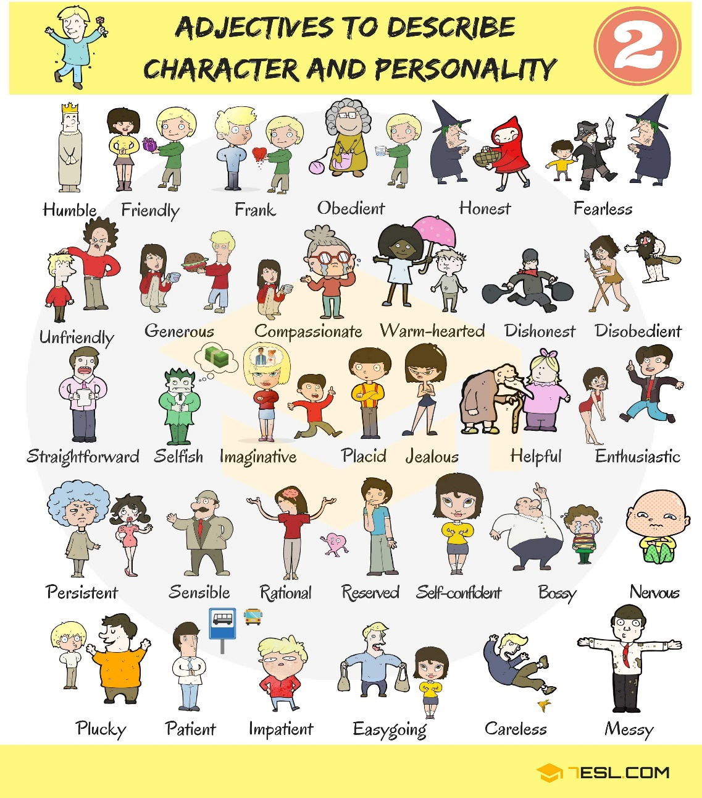
The 5th sequence of teaching techniques
1.Warm up. This is an activity to help students explore the qualities of healthy relationships. Have the students stand up behind their desks or in a circle at the front of the room. Toss the ball to someone in the group, and ask them to call out a word that represents qualities of a healthy relationship (for example; trust, supportive, kind, fun…). Ask that person to then toss the ball to someone else. Each time a new student catches the ball, ask them to share a new quality… and so on. Here is a list to help you at lower levels.

Slide 10
2. Pre-speaking task 1 - Write the word FRIEND on the board. Tell the students that you are going to leave the room for 5 minutes. While you are gone they have to fill up the whole board with words connected to this theme. They can use their dictionaries if they like. Nominate a student as the secretary; give them the board marker or chalk and leave. Come back after 5 minutes (or before if you think it’s too long!) and go over what they have written.
3.Pre-speaking task 2 – Group formation Tell the students that they are going to do a listening activity related to friends. They must change places with another student if the sentence you read out to them are true for them . Read out the following sentences and stop when you think people have moved around enough. They then form groups of three with the new people they are sitting next to. Change places if…
• You have few friends.
• Your best friend is your pet.
•You have many friends .
• You have a pen friend.
• Your best friend is a boy.
• Your best friend is a girl.
• You would like a different job.
4.Speaking task – Rank the cards. Now tell the students to imagine that their partner/friend could have one of these jobs. Which one would be the best? Why? Give an example for yourself and write it on the board. Then tell the students the rules for the speaking activity
1. Put the cards in order from best to worst job for your partner/friend.

Slide 11
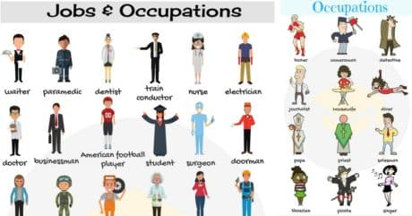
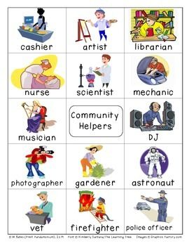
2. Decide in your group what is the best order and why.
3. Talk only in English. When they are finished, ask a couple of groups to explain their order.
5. Extra activity. Learners can try this fun quiz worksheet on the topic of friends:
1. Choose the answer! Are you a good friend? Choose the answer that’s true for you.
1. Your friend hasn’t done their homework. What do you do?

Slide 12
a. promise not to tell b. help your friend do it quickly c. tell the teacher
2. It’s your friend’s birthday. Do you …
a. give them a present? b. say ‘Happy Birthday’? c. forget?
3. Your friend has forgotten their lunch. What do you do?
a. share yours b. eat yours in front of them c. lend them money
4. Your friend calls you while you are watching your favourite TV programme. Do you …
a. ignore them? b. chat to them? c. ask them to call later?
5. You get a very good mark in a school test and your friend gets a bad mark. Do you …
a. help them next time? b. call your friend ‘stupid’? c. say ‘oh dear’?
6. You are playing football and your friend falls over. What do you do?
a. run on and score a goal b. stop and help c. kick the ball out
7. You borrow money from a friend. Do you …
a. forget to pay it back? b. wait for them to ask? c. give it back soon?

Slide 13
8. Your best friend is on holiday for three weeks. Do you …
a. text/email every day? b. text/email once? c. find another friend?
9. Your friend looks sad. What do you do?
a. ignore them b. ask them what’s wrong c. make a joke
10. Your friend tells you a really interesting secret. Do you …
a. tell your mum? b. tell no one? c. tell everyone?
2. Find your score! Now calculate your score and find out how good a friend you are!
1. a. 1 b. 2 c. 0
2. a. 2 b. 1 c. 0
3. a. 2 b. 0 c. 1
4. a. 0 b. 2 c. 1
5. a. 2 b. 0 c. 1
6. a. 0 b. 2 c. 1
7. a. 0 b. 1 c. 2
8. a. 2 b. 1 c. 0
9. a. 0 b. 2 c. 1
10. a. 1 b. 2 c. 0
0- 7 points or less: Oh dear! You don’t think about your friends much at all! Next time your friend is in need, try to help them whatever the situation!
8–15 points: You’re a pretty good friend most of the time, but sometimes you need to think more about others and less about yourself!
16 points or more: Wow! What a great friend you are! You always help a friend in need! Are your friends this good to you too?

Slide 14
“A Friend Like You”
[Verse 1]
Right from the start, couldn't pull us apart, it just works
Nobody else ever gets me as well on this earth
Like rock and roll, Marshall's and Telly's
Mac and cheese, PBs and jellies
Some things are better together, and that’s you and me
[Chorus]
Dude, I love you, bro, I love you
Man, I love you
You're my brother from another, 'nother mother
You are my favorite, I'm not ashamed to admit
Cause I do, dude, I do
Dude, I love you, bro, I love you
Man, I love you
You're my homie, no one knows me like you know me
Like the sun and the moon, all the best things come in twos
What would I do without a friend like you?

Slide 15
[Post-Chorus]
W-w-w-w-what would I do?
Without a friend like you
W-w-w-w-what would I do?
Without a friend like you?
[Verse 2]
Laughed and we cried when we're passing the time away
Even our fights always end with a smile on our face
Like black and white, keys on a whirley
Sounds just right when we're in harmony
Some things are better together and that's you and me.
[Chorus]
Dude, I love you, bro, I love you
Man, I love you
You're my brother from another, 'nother mother
You are my favorite, I'm not ashamed to admit
Cause I do, dude, I do
Dude, I love you, bro, I love you
Man, I love you
You're my homie, no one knows me like you know me
Like the sun and the moon, all the best things come in twos
What would I do without a friend like you?

Slide 16
[Post-Chorus]
W-w-w-w-what would I do?
Without a friend like you
W-w-w-w-what would I do?
Without a friend like you
[Bridge]
Without a friend like you
Without a friend like you
W-w-w-w-what would I do? (I wouldn't be the same, man)
Without a friend like you? (I wouldn't be the same, man)
Without a friend like you
[Chorus]
Dude, I love you, bro, I love you
Man, I love you (bro, love you)
You're my homie, no one knows me like you know me
You are my favorite, I'm not ashamed to admit

Slide 17
Cause I do, dude, I do
Dude, I love you, bro, I love you
Man, I love you
Got my back, I got your back, like chiropractors
Like the sun and the moon, all the best things come in twos
What would I do without a friend like you?
[Outro]
W-w-w-w-what would I do?
Without a friend like you
W-w-w-w-what would I do?
Without a friend like you

Slide 18
Gift of a Friend
The teaching techniques are based on the song about friendship ‘Gift of a Friend’ sung by Demi Levato. The song belongs to the album ‘Here we Go Again”. This song was released as a soundtrack single for the Disney movie ‘Tinker Bell and the Lost Treasure’ on December 16, 2009. The song was written by Adam Watts, Andy Dodd, and Demi Lovato.
Warm-up
Pre- reading activity
1. Look at the quotes bellow and express your opinion on it .Do you agree? Why? /Why not?
Friends are the most important ingredients in the recipe of life.
Good friends are like stars. You don’t always see them but you know they are always there.
A true friend is the greatest of all blessings.
Walking with a friend in the dark is better than walking alone in the light.
Friends make good times better and hard times easier.
A friend is one of the nicest things you can have and one of the best things you can be.
A journey is best measured in friends rather than miles.
Friends make life a lot more interesting.
A friend is someone to share your last bar of chocolate with.
Spending some quality time with friends is the best therapy.
True friendship never dies.
.

Slide 19
As iron sharpens iron, so a friend sharpens a friend
Friendship is a sheltering tree.
While -reading activity
2. You are going to listen to a song. Please pay attention to the lyrics and try to get the message the singer is trying to convey. Does the message have any connection to the GIVEN/DEBATED quotes ?
After-reading activity
3.Unjumble the given sentences so as to create the original text.
Sometimes you think you'll be fine by yourself
'Cause a dream is a wish that you make all alone
It's easy to feel like you don't need help
But it's harder to walk on your own
When you realize
You'll change inside
The world comes to life
And everything's bright
From beginning to end
When you have a friend
By your side

Slide 20
The beauty you are
That helps you to find
When you open your heart
And believe in
The gift of a friend
The gift of a friend
Someone who knows when you're lost and you're scared
Beside you wherever you go
There through the highs and the lows
You'll change inside
When you realize
And everything's bright
The world comes to life
From beginning to end
When you have a friend
By your side
That helps you to find
The beauty you are
And believe in
When you open your heart
The gift of a friend
When your hope crashes down
Shattering to the ground
You, you feel all alone
When you don't know which way to go

Slide 21
There's no sign leading you home
You're not alone
The world comes to life
And everything's bright
When you have a friend
From beginning to end
By your side
That helps you to find
The beauty you are
When you open your heart
And believe in
When you believe in
You can believe in
When you believe in
The gift of a friend
Pre -listening activity
4.Look at the sentences. Which verb forms are incorrect?
Sometimes you thinks you be fine by yourself
'Cause a dream is a wish that you make all alone
It's easy to feeling like you don't need help
But it's harder to walk on your own

Slide 22
You changed inside
When you’ll realize
The world come to life
While-listening activity
5.Listen to the song carefully identify and underline all the affirmative present forms.
After-listening activity
6.Make up sentences with the following words and idioms related to friendship:
a best friend: to describe the person they are closest to. A 'best friend' is usually your best friend for life
a close friend: a good friend
a pal:(informal): a friend
a mate:(informal): a friend
a girlfriend: a girl or woman who is your friend or a girl or woman you have a relationship with
a boyfriend: a boy or man who is your friend or you have a relationship with a shoulder to cry on: someone who listens to your problems It's always good to talk to Hilary, she's so sympathetic. She's a real shoulder to cry on
see eye to eye: to agree with someone (usually used in the negative) They don't always see eye to eye on politics but they're still great friends
clear the air: two people talk about a problem they have been avoiding discussing I hated the way he kept borrowing things without asking me but we had a chat about it and cleared the air so now he knows to check with me first through thick and thin: people who have had some good times and difficult times together They've been friends for 20 years. They've had a lot of fun over the years but he was unemployed after university and she was very ill for a long time recently. They've really been through thick and thin together.

Slide 23
Pre-writing activity
7. You are supposed to write an essay about friendship. Invent an essay title related to the given topic. Brainstorm for ideas and make a note of them.
While-writing activity
8.Write a paragraph plan for your essay. You need to take into account the following steps:
Use topic sentences to begin each paragraph.
Write a clear introduction, but do not go into detail. You will discuss your ideas in the main paragraphs.
Finish with a brief conclusion that summarises your ideas.
Post-writing activity
9.Present your plan
Homework
Write your reply to your friend’s email who asked you to listen to Demi Lovato’s song “A Gift from a Friend”. Explaining him/her why you liked it or not.
Puzzle
The method proposes un exercise – a game of logic and attention, that consists in putting in order the words from the chorus of the song Gift of a friend.
Students must work in pairs or groups and they have to rearrange the words in order to obtain the song’s chorus. An advantage of the method is that it prompts the students to develop their teamwork spirit with a touch of the competitive aspect.
The task is:
Rearrange the words in order to create the song’s chorus (The students can number the words in the order they should be in each line of the chorus). The winner will be the team who completes the task in the shortest time.

Slide 25
The chorus is:
You'll change inside when you realize The world comes to life and everything's bright From beginning to end when you have a friend by your side That helps you to find the beauty you are When you open your heart and believe in the gift of a friend
"This project has been funded with support from the European Commission. This publication reflects the views only of the author, and the Commission cannot be held responsible for any use which may be made of the information contained therein."

