Slide 1
‘Music: a melodic methodology into teaching and learning’
'Music- what and why I listen to.'
This survey conducted in our school, IES Pablo Ruiz Picasso, shows the results about the musical preferences of 100 of our students.

Slide 2
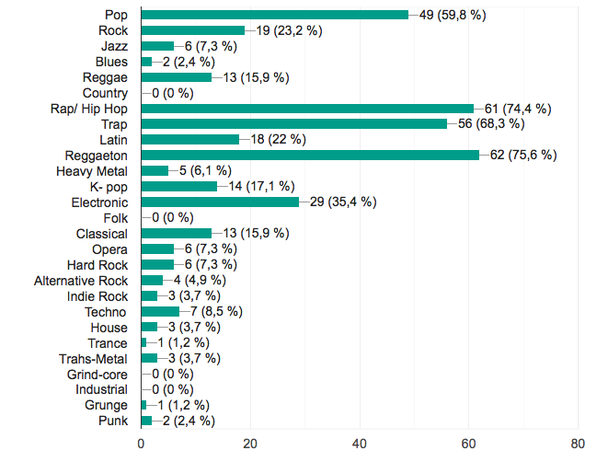
1. What music genres do you listen the most? →Results:THE TOP 5 are:
1.
REGGAETON 75.6%
2.
RAP/ HIP – HOP 74.4%
3.
TRAP 68.3%
4.
POP 59.8%
5.
ELECTRONIC 35.4%

Slide 3
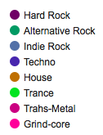
2. What is your favourite one?
REGGAETON

4.
3.

2.

TRAP
POP
1.

RAP/ HIP – HOP
THE FAVOURITE MUSIC STYLE AMONG OUR STUDENTS IS REGGAETON

Slide 4
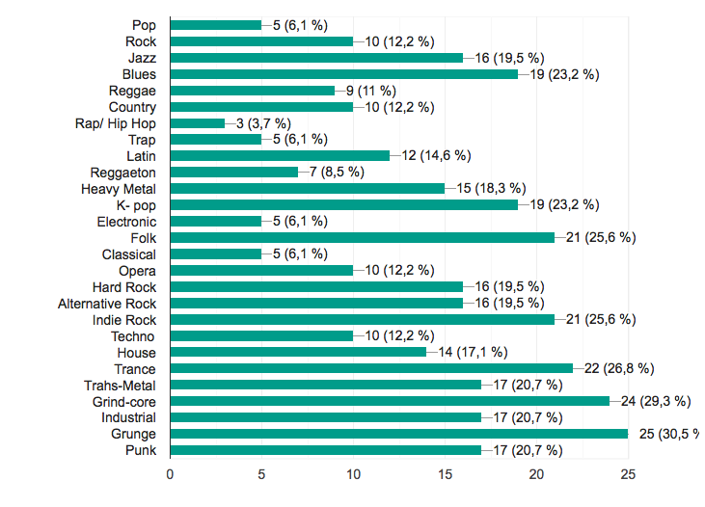
3. Which ones have you never listened to? →Results:THE TOP 5 are:
1.
GRUNGE 30.5%
2.
GRIND-CORE 29.3%
3.
TRANCE 26.8%
4.
INDI ROCK 25.6%
5.
FOLK 25.6%

Slide 5
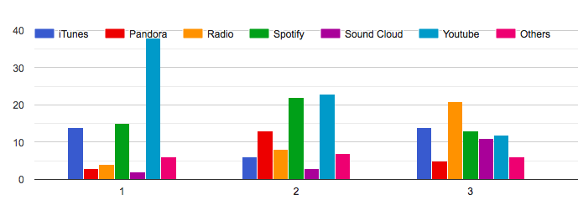
4. How do you listen to music? These are the tools students use the most:
ITUNES
RADIO
SPOTIFY
YOUTUBE
SOUNDCLOUD
PANDORA
→ As you can see in these examples the use of these tools varies a lot, but Youtube and Spotify are some of the most frequently used.

Slide 6
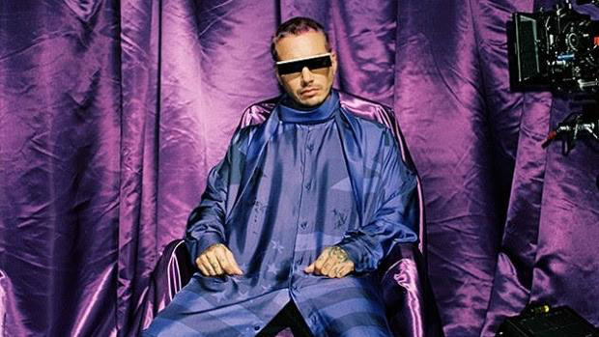
5. What is your favourite song right now?
The songs vary a lot but the 3 ones many students have mentioned are:
“Tusa” by Nicki Minaj, Karol G: It´s a songby Colombian singer Karol G and Nicki Minaj released on November 7, 2019. This song mixes Spanish and English lyrics and the title “Tusa” is Colombian slang to express the feeling of heartache when someones breaks up with you.
“Yo x ti, tu x mi” by Rosalía, Ozuna: This is a song by Spanish singer and songwriter Rosalía and Puerto Rican singer Ozuna. It was released as a single from her upcoming third studio album, on 15 August 2019 through Sony Music. It reached number one in Spain in September 2019, becoming her fifth number-one single and her fourth consecutive number-one single.
“Morado” by J Balvin: This is a song by the Colombian reggaeton singer J Balvin, released on Jan. 9, 2020. This new single “Morado” (Spanish for purple) describes a person who is powerful or likes to be in charge of any situation.

Slide 7
6. What is your favourite group or singer right now?
The students like many different singers but the one with more choosing coincidences are: Morad, Black pink and the BTS
Morad: He is a teenager of Moroccan descent. He sings rap’s songs, the songs are usually ”street song’’
BlackPink: It's a k-pop group formed by four South Korean’s girls.
Their first hit on Billboard World Digital Songs, was the debut music video most watched by a Korean band. They debuted on 8th of August, 2016 with the EP entitled Square One, in which appears "Whistle“.
BTS: It’s a group formed by seven South Korean’s boys.The group debuted on June 13, 2013 with the song «No More Dream».
In their beginnings, BTS had a moderate success, first, with the publication of its simple debut album 2 Cool 4 Skool and later with the discs O! RUL8,2? and Skool Luv Affair, as well as with their first studio album, Dark & ​​Wild in 2014.

Slide 8
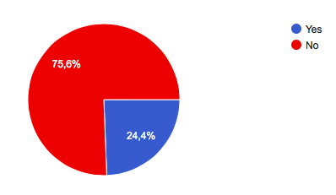
7. Have you been to any of his/her/their concerts?
WE THINK THAT THIS RESULT IS EASY TO UNDERSTAND AS WE ARE VERY YOUNG AND WE DON´T HAVE THE ECONOMY OR FREEDOM TO ATTEND CONCERTS, SPECIALLY IF THEY ARE ABROAD.

Slide 9
8. How do you prefer to listen to music?
WITH FRIENDS


OTHERS: BOTH – IT DEPENDS – WITH MY FAMILY…

ALONE
THIS IS ALMOST A 50%/50% SITUATION, ALMOST HALF OF OUR STUDENTS 48.1% PREFER TO LISTEN TO MUSIC WHEN THEY ARE ALONE BUT THE OTHER HALF ARE SPLIT BETWEEN DOING IT WITH FRIENDS, 40.5% AND DOING IT HAPPILY IN EVERY SITUATION, THE 11.9%.

Slide 10
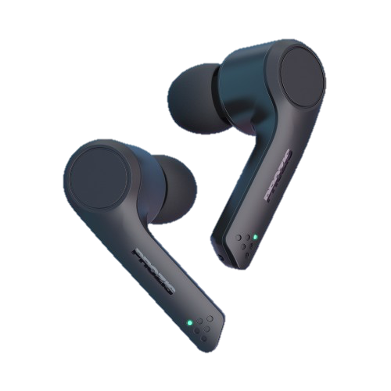
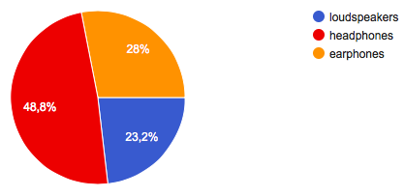
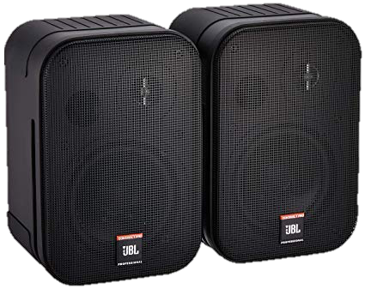
9. Do you prefer to listen to music coming from: ?
IT SEEMS CLEAR THAT OUR STUDENTS PREFER THE LIFELIKE LISTENING EXPERIENCE AND THE COMFORT PROVIDED BY HEADPHONES WHILE LISTENING TO MUSIC.

Slide 11
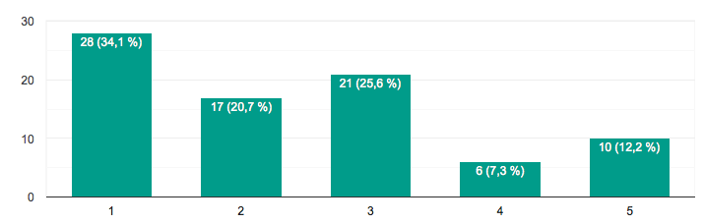
10. Do you know the lyrics to all the songs you like?
ALWAYS
NEVER
ANALYSIS OF THESE RESULTS:
Most students, the 34.1% of them, say they ALWAYS know the lyrics of the songs they listen to.
A total of 46.3% of students ALMOST ALWAYS or QUITE OFTEN know the lyrics of the songs.
Finally, only 19.5% of them HARDLY EVER or NEVER know the lyrics of the songs they listen to.

Slide 12
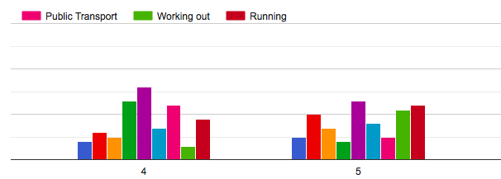
11. Where do you usually listen to music?
SOME STUDENTS SEEM TO HAVE A CLEAR PREFERENCE, CHOOSING PRIVATE SPACES TO LISTEN TO MUSIC LIKE THEIR HOME, THEIR BEDROOM OR THE SHOWER
SOME OTHER STUDENTS SEEM TO DIVIDE UP THE PLACES THEY CHOOSE TO LISTEN TO MUSIC ALMOST EQUALLY

Slide 13
12. What do you prefer: songs in your mother tongue, songs in English or others?

OTHERS: BOTH – ANY LANGUAGE – FRENCH – ARAB – KOREAN – RUMANIAN…
SONGS IN YOUR MOTHER TONGUE: SPANISH


SONGS IN ENGLISH
ANALYSIS OF THESE RESULTS:
In this case, our students are divided almost equally into the 3 different options:
32.9% of students prefer listening to songs in their mother tongue, Spanish.
31.7% of students prefer listening to songs in English.
The 35.7% of students remaining prefer listening to songs in other languages like French, Arab, Korean, Rumania… or listening to songs in any language, without preferences.

Slide 14
13. Why do you listen to music?
Spanish answers vary a lot but all the answers express POSITIVE feelings. As this was an open question, these are some examples of our students´answers:
“Because music relaxes me”
“Because it helps me to concentrate better”
“It makes me happy when I feel sad”
“When I listen to music I find comfort”
“Because I feel identified with some lyrics an that makes me feel good”
“I love music because it helps me in every aspect of my life”
“Because music motivates me to study and work out”
“It makes me forget about my problems”
“Because listening to music is the best way to have fun with my friends”
In conclusion, when students listen to music they feel better in general, they feel happy, relaxed, comforted and motivated.

Slide 15
MARÍA
RAÚL
MANU
ÓSCAR
JOSE MARÍA

