Slide 1
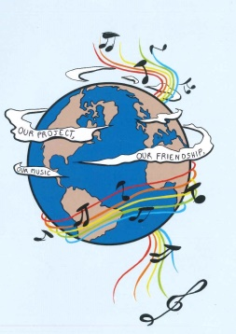
MUSIC: A MELODIC METHODOLOGY INTO TEACHING AND LEARNING 2018-1-ES01-KA229-050761 SCHOOL EXCHANGE PARTNERSHIP
SONGS ABOUT LOVE - GREECE

Slide 2
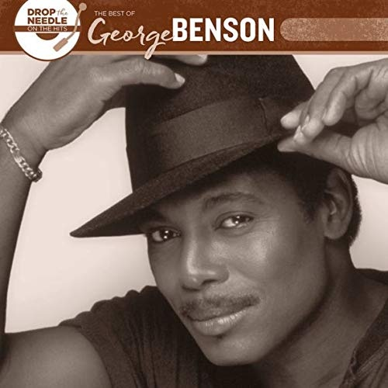
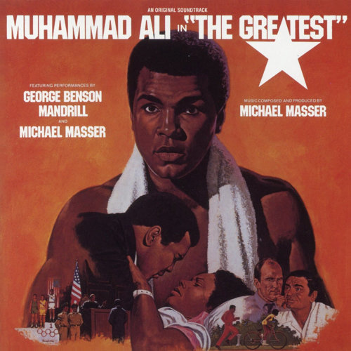
1.THE GREATEST LOVE OF ALL-GEORGE BENSON
https://www.youtube.com/watch?v=X2iLpkN7KC8

Slide 3
1.THE GREATEST LOVE OF ALL-GEORGE BENSON
I believe that children are our future
Teach them well and let them lead the way
Show them all the beauty they possess inside
Give them a sense of pride, to make it easier
Let the children's laughter remind us how we use to be
Everybody's searching for a hero
People need someone to look up to
I never found anyone who fulfilled my needs
A lonely place to be, and so I learned to depend on me
I decided long ago never to walk in anyone's shadow
If I fail, if I succeed
At least I lived as I believe
No matter what they take from me
They can't take away my dignity

Slide 4
1.THE GREATEST LOVE OF ALL-GEORGE BENSON
Because the greatest love of all was happening to me
I found the greatest love of all inside of me
The greatest love of all is easy to achieve
Learning to love yourself, it is the greatest love of all
And if by chance that special place
That you've been dreaming of
Leads you to a lonely place
Find your strength in love

Slide 5
ANALYSIS:
"The Greatest Love of All" is a song written by Michael Masser, who composed the music, and Linda Creed, who wrote the lyrics. It was originally recorded in 1977 by George Benson. The song was written and recorded to be the main theme of the 1977 film The Greatest, a biopic of the boxer Muhammad Ali.Benson also recorded three live versions, the last time in a duet with Luciano Pavarotti in 2001.The Greatest is a film based on the life of former heavyweight boxing champion Muhammad Ali. According to the Los Angeles Times, after he had been asked to write the song for the movie, Masser felt drawn to Jerusalem, even though he was not a religious man, "to get the feelings - not just my own." Masser also told the Los Angeles Times his special feelings about Ali:
Here was a man who wanted to change his name and religion. That's all. Ali hadn't believed in the war in Vietnam and had refused to fight in it. He won that battle through the legal system. Still, he lost everything including his title. But Ali retained the most important thing of all his dignity. Masser said that "He (Ali) represented to me a tremendous athlete who suffered prejudice from the white man's world. He didn't give up what he believed even though he lost his title." Masser also told the Los Angeles Times that the song had another personal meaning for him to give up a legal career to pursue his interest in music, adding, "People thought I was crazy. I had to starve. Had no money. Marriage broke up. But I had to do what I'd wanted to do since I was 6... write music." Upon his return from Jerusalem, he contracted with lyricist Creed to work on the song and wrote it right from the heart. Then Masser had George Benson perform the song for the soundtrack. He said, "The record came out and the song became an underground theme for black people." And in order for someone to love, s/he has to love oneself , to be able to give love to others.

