Slide 1
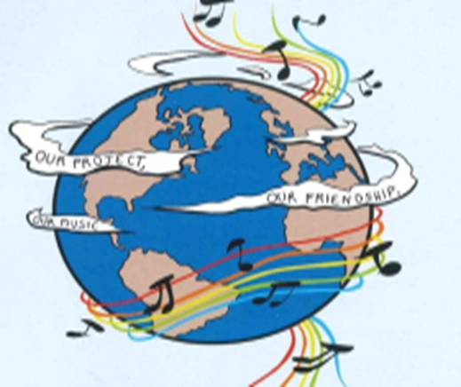
MUSIC: A MELODIC METHODOLOGY INTO TEACHING AND LEARNING 2018-1-ES01-KA229-050761_2 SCHOOL EXCHANGE PARTNERSHIP
The Italian team presents
Co-funded by The Erasmus Plus Programme
Of the European Union
TRADITIONAL INSTRUMENTS

Slide 2
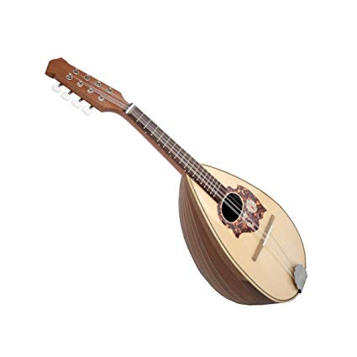
THE MANDOLIN:THE ORIGINS
The mandolin is a small, lute-like instrument with eight strings. Originally appearing in 18th-century Italy, this bright-toned instrument has become a staple in styles of music all over the world, ranging from classical to bluegrass and even to jazz. But that’s only a small part of the story of the mandolin.
History
The instrument we now call the mandolin first truly appeared in the workshops of Naples, Italy, in the middle of the 1700s. But similar instruments going by the names mandora, mandola, and mandore preceded the Neapolitan mandolin by centuries.
The mandora first appeared as early as the 15th century in Italy. Starting out with only four or five strings, its name probably came from the word mandorla, or almond.
With gut strings, a pear shaped body carved from a single piece of wood, and no frets, this instrument had a deeper, sweeter tone than today’s mandolins. The term mandora has since come to refer more broadly to mid-sized mandolins.
By the Baroque period (roughly 1600–1750), a new instrument had developed that was known as the mandolino, or little mandola.
It was primarily a melodic instrument, which differentiated it from the lute, which played both harmonic and melodic roles in the music of that time.

Slide 3
The modern mandolin developed from the mandolino between 1750 and 1850.
The Vinaccia family in Naples played a crucial role in this development throughout that period, and Pasquale Vinaccia (1806–82) is the man who was most responsible for establishing the standard design of the instrument.
Among the developments that differentiate the mandolin from the Baroque mandolin were a bent soundboard, a raised fret board, more frets (and therefore more notes), and 8 metal strings.
The strings are paired in sets, known as courses, of two, in which each pair of strings is tuned to the exact same pitch.
This means there are actually only four pitches represented by the eight strings. The strings are tuned to the same pitches as are the strings of a violin – G, D, A, and E, from low to high.
In the second half of the 1800s, the mandolin began to become a worldwide phenomenon. Virtuoso performers such as Carlos Munier, grandon of Pasquale Vinaccia, toured Europe and persuaded audiences that the mandolin was more than just an Italian folk instrument. And, from the 1870s onward, masses of immigrants to the United States from Italy brought their mandolins along with them
Styles of music
The earliest music for the mandolin is found in Italian classical music and folk music. In the classical world, composers like Antonio Vivaldi (1678–1741) incorporated the mandolin into the orchestra.
Vivaldi himself wrote two concertos for the instrument; one for mandolin solo and one for two mandolins.
Another composer, Wolfgang Amadeus Mozart (1756–1791), wrote music for the mandolin in his opera Don Giovanni.

Slide 4
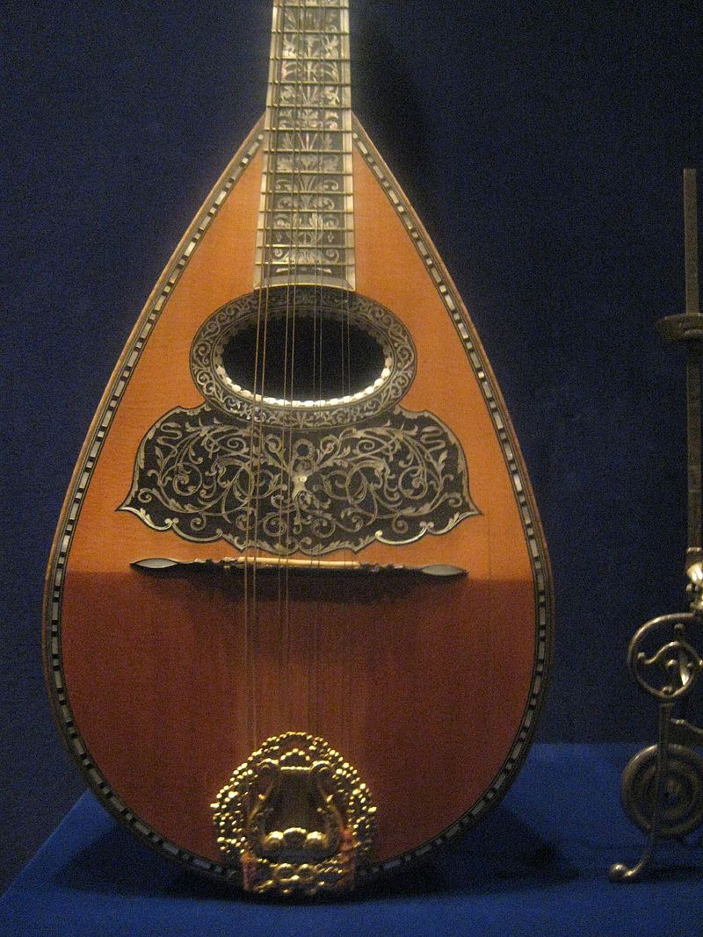
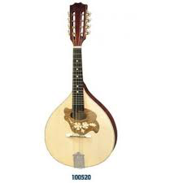
TYPES OF MANDOLIN
The classic mandolin, also known as neapolitan,is characterized by a paunchy drop-shaped body made of staves that join at the top at the handle; while the back of the case is strengthened by the shield :a wooden band that sorrounds the soundboard of the perimeter. The classic mandolinhas a delicate and very expressive tone and the sound is sweet and argentine.
The Italian nordic mandolin is very similar to the previous one with the only characteristic that the shield is langer. The bottom is flat; the instrument has better projection capability and is used for more aggressive use.
The Portuguese mandolin, also called bandolim has the table very wide and has parallel chains arranged perpendicularly to the centerline . The handle joins the case in a more backward position than the classic one and has a thin dorsal profile favoring the emission of more acute sounds.

Slide 5
THE MANDOLIN: characteristics and materials
The mandolin has a relatively short neck comprised of two main parts: a fingerboard and frets. The fingerboard is a flat piece of wood attached to the neck, while the frets are thin pieces of metal that are hammered into channels on the fretboard.
The frets stop the vibration of the strings at a specific point along the neck of the instrument, creating a different pitch depending on the length of the string.
The strings end at the final major part of the mandolin, its head. The head is a solid piece of wood that hosts the tuners, a set of eight pegs attached to gears that are turned to tighten or loosen the strings, which in turn raises or lowers the pitch of that string.
The rope is a plate equipped with hooks to which the strings are normally fixed in harmonic steel.

Slide 6
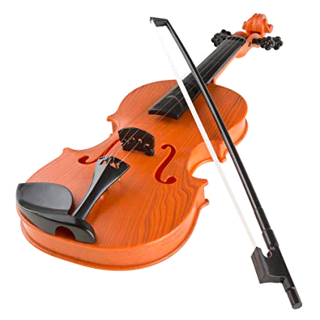
The violin is a string instrument which has four strings and is played with a bow.It is held between the left collar bone (near the shoulder) and the chin.. Most historians agree that today’s violin emerged in the early 16th century in northern Italy, an area which would maintain the violin-making tradition over the coming centuries. Maple and spruce, the two types of wood most favored by violin makers then and since, were readily available in the Lombardy region. The city of Brescia, located at the foot of the Alps, was the earliest to excel in the crafting of violins, but Cremona, home to the world’s most famous luthiers, Giuseppe Guarneri, Antonio Stradivari, and the Amati family, became synonymous with the art of violin making The violin’s sound continued to expand through the centuries, embraced by fiddlers and virtuosos alike. During the 17th century, the violin became an important instrument in the orchestra as composers like Claudio Monteverdi incorporated it into their compositions. Composers and musicians, such as Antonio Vivaldi (1678-1741), Franz Joseph Haydn (1731-1809), and Niccolò Paganini (1782-1840), continued to focus on the sounds of the strings, bringing the violin to greater prominence in the orchestra.
THE VIOLIN: THE ORIGINS

Slide 7
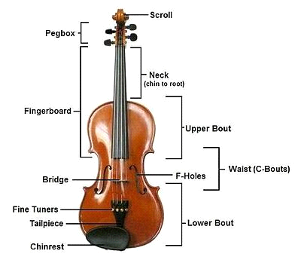
The biggest part of the violin is the wooden body. This acts as a resonating box. It makes the vibrating strings sound louder. Many of the parts of the violin are named after parts of the body. The front is called the “belly”. The back is called the “back”. The sides are the “ribs”. The strings go from near the top of the “neck” down the “fingerboard” and on to the “tail piece”. The strings go across the bridge halfway between the end of the fingerboard and the tailpiece. The bridge is not fixed onto the violin. It is held in place by the strings. The strings keep it in place because they are so tight. If the strings are completely loosened, the bridge will not stay on. The bridge helps to send the vibrations of the strings down to the body of the instrument. Inside the body there is a “soundpost”. This is a small piece of wood. It looks like a small finger. It goes from the belly to the back. The soundpost is also held in place by the strings. In the middle of the belly there are two long, curved holes. They are called “f holes”. This is because of their shape. The top of the strings are wound around pegs. The violin can be tuned by turning the pegs. The very top of the neck is called the scroll. Violins today also have a chinrest. This helps to hold the violin against the player's shoulder.
THE VIOLIN: characteristics and materials

Slide 8
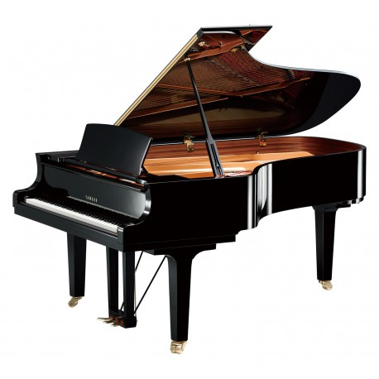
The piano is an italian musical instrument invented by Bartolomeo Cristofori around the year 1700 in which the strings are struck by hammer. It is played using a keybord with 88 keys; 52 white for the notes of the c major scale (C,D,E,F,G,A,B) and 36 black. The black keysareaccidental. There are different types of piano: The Grand Piano; The Upright Piano; The electric, electronic and digital piano. This instrument it's very diffucult and expensive but it's very great and to play
THE PIANO: THE ORIGINS
The story of the piano begins in Padua, Italy in 1709, in the shop of a harpsichord maker named Bartolomeo di Francesco Cristofori (1655-1731). Many other stringed and keyboard instruments preceded the piano and led to the development of the instrument as we know it today. First exhibited in Florence in 1709, Cristofori’s new instrument was named gravicembalo col piano e forte (roughly “soft and loud keyboard instrument”). Eventually, it was shortened to fortepiano or pianoforte, and finally just piano.
The piano as a musical instrument suffered various transformations since its invention in 1700, according to the needs and exigencies of the musicians. Bartolomeo Cristofori fabricated 20 pianos before his death, and the first piano recital open to the public in history occurred in 1768, performed by Johann Christian Bach, son of Johan Sebastian Bach.
What’s the piano made of?
Pianos are made of the optimum materials, not only for looks but for excellent sound creation. The long fibers of maple wood are strong and flexible for construction of the border, but long fibers of spruce are needed for the strength of the brackets. Wood is also needed for making patterns of other parts. Metal is used for a variety of parts, counting the cast iron plate; and sand is needed for casting molds. The character of the sand is altered by using additives and folders such as bentonite (a type of clay) and firewood powder. Molten iron for the casting is made of pig iron with some steel and scrap iron to add strength. Strings are made of high tensile steel cable that is manufactured at specialized piano string mills.
.

Slide 9
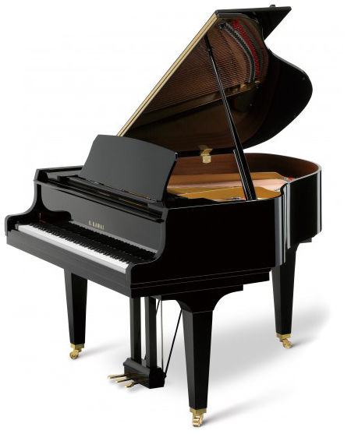
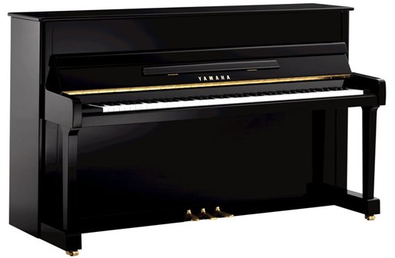
UPRIGHT PIANO Upright pianos, also called vertical pianos, are more compact due to the vertical structure of the frame and strings. In an upright piano, the strings are strung vertically to make the instrument more compact, which allows the piano to be played in a limited space. In contrast, the grand piano retains the shape of the original pianoforte in which the strings are strung horizontally, and has a greater potential for expression.
GRAN PIANO
In grand pianos the frame and strings are horizontal, with the strings spreading away from the keyboard. F
Features of the grand piano include:
More rich and varying sonority with wide dynamics-from pianissimo to fortissimo.
Smoother sustain.
More substantial tone.
Higher ability to add subtle expression to notes.
Sound is uniform and well balanced.
Higher ability of note repetitions

Slide 10
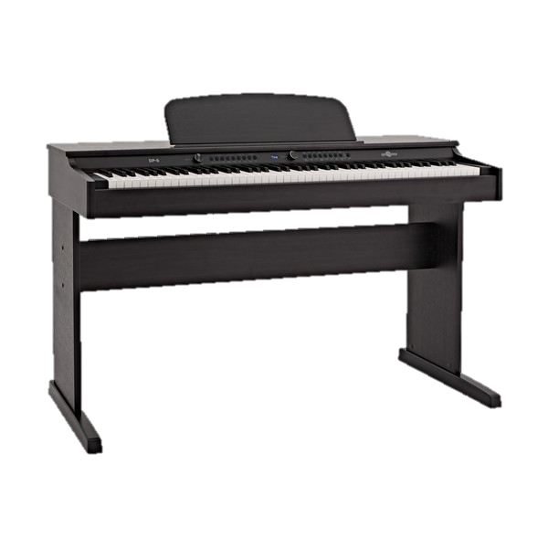
Digital piano - Electronic keyboards designed to sound and feel like an ordinary acoustic piano. They typically contain a amplifier and loudspeakers built into the instrument. In most cases they can fully replace acoustic pianos and provide several features, such as recording and saving files to a computer. Digital pianos are a mix between an acoustic piano and an electronic keyboard. ... Electronic keyboards are typically smaller than a full acoustic piano in that they tend to have approximately 61 keys (4 or 5 octaves) whereas a full acoustic has 88 keys (6 octaves Digital piano features: Keyboard action and touch response. One of the main differences between pianos and electronic keyboards is the feel of the keys. ... Digital piano sound quality. ... Polyphony. ... Number of sounds/tones. ... Learning tools. ... Amplification and speakers. ... Amps and Cables. ... Piano benches.
Electric Digital Piano

Slide 11
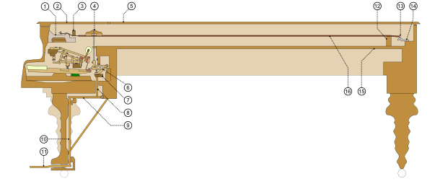
Pianos can have over 12,000 individual parts,supporting six functional features: keyboard, hammers, dampers, bridge, soundboard, and strings. Many parts of a piano are made of materials selected for strength and longevity. T It is most commonly made of hardwood, typically hard maple or beech." Hardwood rims are commonly made by laminating thin, hence flexible, strips of hardwood, bending them to the desired shape immediately after the application of glue. Previously, the rim was constructed from several pieces of solid wood, joined and veneered, and European makers used this method well into the 20th century. A modern exception, Bösendorfer the Austrian manufacturer of high-quality pianos, constructs their inner rims from solid spruce. the same wood that the soundboard is made from, which is notched to allow it to bend; rather than isolating the rim from vibration, their "resonance case principle" allows the framework to resonate more freely with the soundboard, creating additional coloration and complexity of the overall sound.
Piano : characteristics and materials

Slide 12
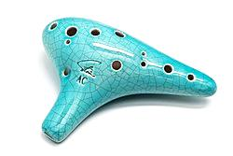
The modern ocarina was created by Giuseppe Donati in 19th century Budrio, northern Italy. At the time, the only available vessel flutes were crude toys capable of playing just a few notes. Donati developed an instrument and fingering system capable of playing chromatically over an octave and a fourth. The word 'ocarina' comes from a historic dialect of Italian, and means 'little goose'. It originally referred to sculptural ceramic whistles shaped like a goose, and Donati adopted the name for his instrument. Donati's instrument was shaped like a cone, with a protruding mouthpiece and 10 finger holes. Modern instruments generally retain this same design, but have evolved in a number of ways. Most notably, 'subholes’ were added by Asian makers, which extend the sounding range of the instrument downwards. Ocarinas often have one or two subholes; the one shown below has one. .Various sizes were made which enabled ocarina players to form ensembles. One such ocarina ensemble is the famed Gruppo Ocarinistico Budriese which is still actively performing today. .
THE OCARINA:THE ORIGINS

Slide 13
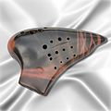
There are many different styles of ocarinas varying in shape and the number of holes: Transverse – This is the best known style of ocarina. It has a rounded shape and is held with two hands horizontally. Depending on the number of holes, the player opens one more hole than the previous note to ascend in pitch. The two most common transverse ocarinas are 10-hole (invented by Giuseppe Donati in Italy) and 12-hole. English Pendant – These are usually very small and portable, and use an English fingering system (4–6 holes). Peruvian Pendant – Dating from the time of the Incas, used as instruments for festivals, rituals and ceremonies. They are often seen with designs of animals. They usually have 8–9 holes. Inline – These are often called a "fusion" of the pendant and transverse ocarinas. This style is known for being very small and compact, with more holes than the pendant. This allows one to ascend in pitch with the linear finger pattern rather than finger combinations. Multi-chambered ocarinas – exist within the three broad categories of ocarina. These ocarinas overcome the ocarina's usual limited range of notes. A transverse double ocarina typically plays two octaves plus a major second, and a transverse triple ocarina plays with a range about two octaves plus a fifth. Double ocarinas for pendant and inline ocarinas also exist. Double inline ocarinas are specially designed to play chords, for harmonic playing. Several makers have produced ocarinas with keys, mostly experimentally, beginning in the late 19th century. Keys and slides either expand the instrument's range, help fingers reach holes that are widely spaced, or play notes not in the native key of the instrument.
TYPES OF OCARINA

Slide 14
Characteristics and materials
CLAY OCARINAS
Clay ocarinas are the most abundant type of ocarina. Various types of clay are used to make ocarinas.
Clay ocarinas may be glazed, painted, lacquered, or left unglazed.
WOOD OCARINAS
Many different types of wood can be used to make a wooden ocarina. Common woods include, walnut, bloodwood, coccobolo.
PLASTIC OCARINAS
Plastic ocarinas are known for their relative indestructibility making them a popular choice for younger children or for those worried about breaking their ocarina while traveling.
Several types of plastic are commonly used such as polycarbonate, corian.
METAL OCARINAS
Ocarinas made of metal are typically made of aluminum

Slide 15
Musical performance
To understand the ocarina's capability, it is important to take the right point of view: the ocarina is a limited instrument which works brilliantly in some situations. Limited does not mean useless, and no instrument is inherently 'better' than any other. Music is a collage of sound, and which instruments are best depends on the desired effect. Interest in music comes from the interplay of multiple instruments, rarely any single instrument in isolation. Ocarinas can be used to play quite a wide range of music from lyrical vocal melodies to more upbeat music like Scottish dance tunes. They are functionally similar to the tin whistle, Uilleann pipe, and cornemuse du Centre. Single chambered ocarinas have a range of about an octave and a fourth, with multichambers breaking two octaves. They respond very quickly to both pressure changes and finger movements
Ocarinas work best when paired with limited and simple accompaniment like acoustic guitar, ukulele, harp, and piano. The instrument's tone is close to but not exactly a pure sine wave: they have other tonal components including some quiet overtones and a portion of wind noise. These things are required to make the instrument listenable. However, it's very easy to drown them out with overpowering accompaniment, leaving you with an unpleasant sound as a result.

Slide 16
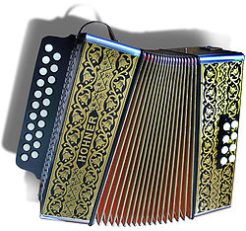
THE ACCORDION :THE ORIGIN
The Accordion is a bellows-driven, free reed, aerophone musical instrument. For many years it was tied to traditional folk dancing, but it has undergone an evolution that actually began at the time of its inception and which has continued to this day, gaining widespread popularity. It is believed that the forefather of the accordion is the ”sheng”, a Chinese wind instrument dating back 4,500 years which uses the principle of an oscillating reed, a metal tongue placed in a pipe which vibrates and produces a sound, thanks to the passage of air.
In the year 1500 Leonardo da Vinci designed a musical instrument that was very similar to an accordion; it had a double-action bellows with a vertical keyboard for the right hand and the sound was produced by flattened pipes made of paper or very thin wood.
Castelfidardo a little city on the Hill of Marche in Italy is recognized internationally as the home of the accordion. Paolo Soprani, a local craftsman, created the prototype of the instrument in the nineteenth century and founded one of the first Italian manufacturers. The International Museum of the Accordion of Castelfidardo hosts a collection consisting of about 150 specimens that also includes tools such as a rare forerunners accordions cheng Chinese and Harmoniflute of 1836. It ‘also revived a faithful reconstruction of a workshop of the early twentieth century.

Slide 17
Types of Accordions There are three main styles of accordion: diatonic, chromatic and keyboard. Diatonic and chromatic accordions have buttons for keys and keyboard accordions have a piano keyboard for keys. In a standard instrument, the keys are on the player's right-hand side of the instrument. The left-hand side has chord or bass notes, used to play rhythm. Diatonic accordions have either one, two or three rows of buttons, and each row is tuned to a specific key, having only the notes of that scale. Each button plays a different note depending on whether the bellows are being compressed ("pushed") or expanded ("pulled"). Diatonic accordions generally have two or four left-hand buttons, providing bass notes and/or chords tuned to the same key of the melody buttons. Chromatic accordions have three to five rows of buttons on the melody side of the instrument. Unlike the diatonic accordion, these buttons are tuned to a specific note, regardless of whether the bellows are being pushed or pulled. Chromatic accordions can generally play in any key, having at least one button for every standard note, whether natural, sharp, or flat. The left-hand side of the instrument contains a variety of chords. Piano accordions are generally the most recognizable to the general public, having been popularized by people like Lawrence Welk and "Weird Al" Yankovic. The right-hand side is simply a piano keyboard and works just the same. The left-hand has anywhere from eight to 120 chord buttons.

Slide 18
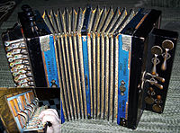
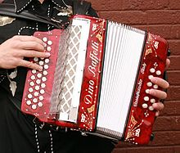
Accordions make noise when the bellows fill with air and this air is forced out of holes which have a small reed over them. Accordion makers tune these reeds by hand, and each note may trigger anywhere from one to four reeds—the more reeds, the more volume you have. Characteristics and Materials Literally hundreds of different parts are used to make an accordion. These can be made of a variety of materials, including wood, metal, plastic, and others. The larger parts of the instrument, such as the frame, pallets, and reed block are typically made of poplar wood. This wood is useful because it is sturdy and lightweight. The bellows are made of strong manilla cardboard which is folded and pleated. Leather gussets are put on each inner corner, and metal protectors are fashioned on the outer corners to strengthen and protect the bellows. The treble grill is a fretted metal cover. It is often decorated with the manufacturer's logo and is vented to allow greater sound production. Metal is also used to make many of the smaller pieces. For example, the reeds are made of highly tempered, watch-spring steel. They are riveted to an aluminum alloy reed plate. To minimize the amount of air that goes through a slot, leather or plastic flaps are used to cover the side opposite the reed. The rods which connect the bass buttons to the pallets and register slides that control the reed blocks on the inside of the accordion are also made of metal. The straps which allow the player to wear the accordion are made of strong leather and are usually padded. Leather or plastic washers are used throughout the instrument to keep it airtight. Additionally, wax is also used in some areas to prevent air leaks. Finally, the keys on the treble keyboard and the many buttons and switches are primarily made of plastic.

Slide 19
Accordion Today
Today there is a renewed enthusiasm for the accordion, with increased attention to higher quality instruments rather than the emphasis being on mass production. The study of the instrument has been included in musical conservatories, while several workshops have started . Furthermore there has been an emphasis on the attention to musical literature, while the idea that the accordion is exclusively a solo instrument is gradually changing, thanks to influential artists such as Richard Galliano and Marc Perrone in France, Gianni Coscia in Italy, and Frank Marocco in the USA
Further innovations followed and continue to the present. Various buttonboard and keyboard systems have been developed, as well as voicings (the combination of multiple tones at different octaves), with mechanisms to switch between different voices during performance, and different methods of internal construction to improve tone, stability and durability. These companies will only have a future if they can correctly interpret market demands, as Paolo Soprani did in 1863.

Slide 20
THANKS FOR YOUR ATTENTION

