Slide 1
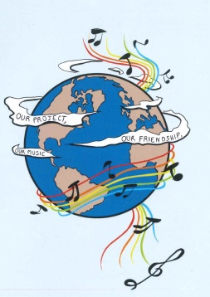
MUSIC: A MELODIC METHODOLOGY INTO TEACHING AND LEARNING 2018-1-ES01-KA229-050761 SCHOOL EXCHANGE PARTNERSHIP
THE ROMANIAN TEAM PRESENTS
TRADITIONAL INSTRUMENTS

Slide 2
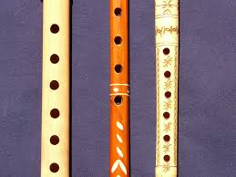
Folk music is the oldest form of Romanian musical creation, characterized by great vitality; it is the defining source of the cultured musical creation, both religious and lay. The earliest music was played on various pipes with rhythmical accompaniment. The religious musical creation, born under the influence of Byzantine music adjusted to the intonations of the local folk music, saw a period of glory between the 15th-17th centuries, when reputed schools of liturgical music developed within Romanian Monasteries. Let’s discover now some important musical instruments that played a key role in our mentality and our cultural dimension as a nation.
The Whistle
The whistle is a musical blowing instrument, made of wood, bone, and occasional made of metal. All types of whistles have the shape of a cylindrical tube, with or without holes.The traditional Romanian whistle was made by shepherds from different types of wood. Sometimes they used soft wood such as: walnut, elder tree or willow. Other times they took the wood from the orchard, which is harder to process and produce low sounds, such as: apricot, cherry or plum, the latter having the most beautiful sound.
First the shepherds harvested and brought the wood home, kept it dry for about two weeks, then carved it and polished it in a round shape, along the fiber, all the holes being made manually by carving.
The whistle has at one end the hole half-blocked, this being the hole through which the interpreter blows air inside. The side holes are closed in a row with the fingers to produce the scales.
The whistle was a traditional musical instrument, used especially by the shepherds in ancient times when they went with the sheep up in the mountains or down the hills according to season. It is melodious, it produces slightly melancholic sound, it is small and very easy to carry.

Slide 3
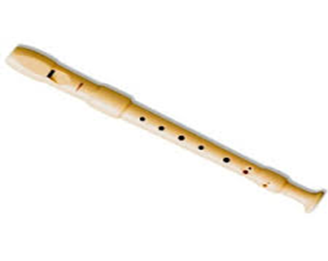
In the old Romanian fairy tales, the whistle was used by heroes for its magical powers to act on the forces of evil, to tame wild animals and as a weapon to fight against the supernatural powers of evil characters.
An example of an ancient song, in which the hero loses his flock of sheep and then uses this instrument in order to find it, is the ballad When The Shepherd Lost His Sheep, a song that shows the close connection between the shepherds and their favourite instrument which accompanied them all the time witnessing daily problems, but also their moments of joy. The ballad is an old folk legend, according to which a shepherd, with his great flock of sheep on a plain far from the village, on the hill, on the mountain or near a frightening forest at a certain moment, sleeps in the middle of nature. When he wakes up after a certain time, he no longer finds his flock. Overwhelmed with fear, pain and worry, he sets off in search of the lost flock, playing whistle songs well known by his animals, but also songs of sorrow that express his sadness. He hopes that this way the flock will hear him and that the sheep, attracted by the magical sound of his instrument, will come to him. In his journey, the shepherd goes through many trials, but his whistle seems to have magical powers, helping him to defeat the forces of nature, evil spirits, and wild animals. After many searches, the shepherd finds his flock. At this moment, the feeling of sadness is changed into a state of joy and optimism. Finally, the songs performed by the shepherd's whistle are cheerful.

Slide 4
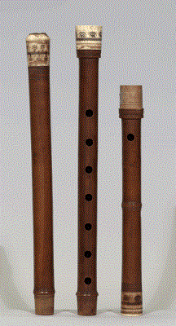
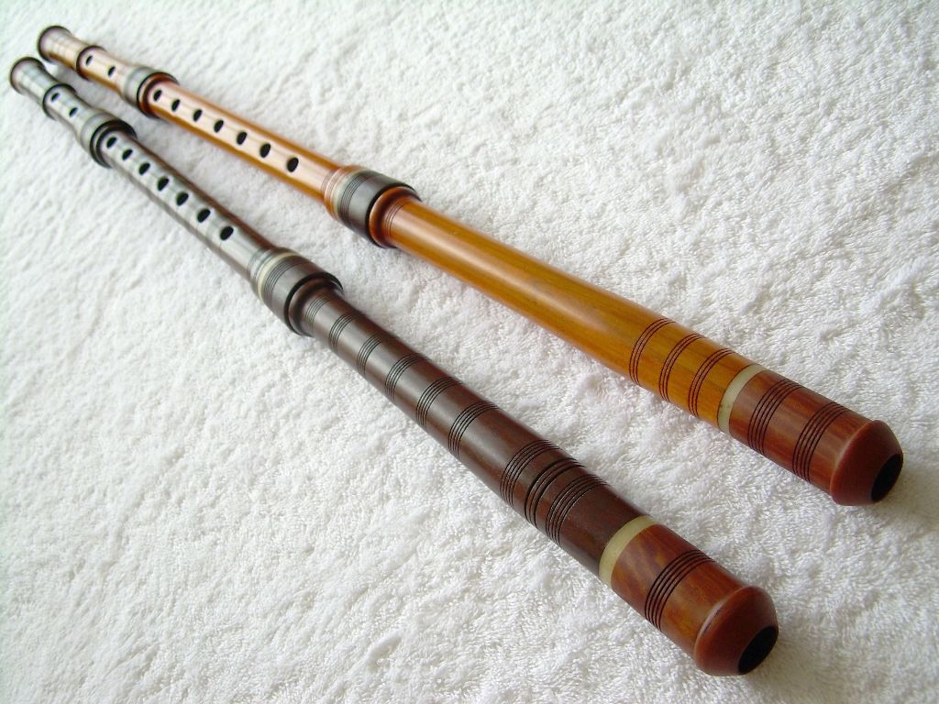
The Kaval (Cavalul)
The Romanian Kaval is a blowing instrument, a similar whistle with 8 holes, but bigger than this, made in general of hazelnut wood or sycamore wood. It is fully open at both ends, and is played by blowing on the sharpened edge of one end. There are seven holes in front, one in the back for the thumb and usually other four near the bottom of the kaval. These holes improve the tone and the intonation. The Kaval is an aerophore instrument of big sizes which belongs to the family of whistle without stopper.
Usually this instrument is made of wood (hazelnut, sycamore, plum, apricot etc.); the Kaval is also made of water buffalo horn, metal or plastic. It can be in one piece, in two pieces or three pieces. The ones of two and three pieces are made to be easy to carry. Shepherds played an important role, because they spread the instrument by practising transhumance.
The legend of the instrument said that one day, after the God created the world, the Devil stole the fire from people. As God did not like and accept this, He went with Saint Peter to take it back. While the Devil wasn’t there Saint Peter hid some pieces of coal into this musical instrument. And from that moment on, the world has had fire.
This instrument is usually used in songs in which the feeling is of sorrow.

Slide 5
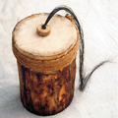
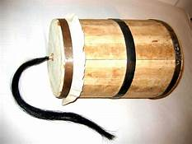
The buhai ( Buhaiul)
The buhai is a Romanian traditional instrument. It is made of a wood coffer and on the bottom is covered by goat or sheep skin which form a resonance box. The skin is well stretched, fixed with a rope. In the middle of the skin, there is some horse hair. To make sounds, you must pull the horse hair, but your fingers must be wet. When the horse hair slides between your fingers it makes a sound that reminds us of an angry bull.
The origin of buhai is Romanian, but it was popular in the whole Europe. The Czech call it “bukal” or “bukaci”. In Europe, the buhai disappeared but not in Romania. We have a tradition on Christmas Eve: the carolers sing and play the buhai in order to announce Christ’s Birth. This musical instrument is used so as to raise awareness of the outmost importance of this event.
The composer Orlando Gibbons (1583–1625) wrote a keyboard fantasia in which he quotes the Dutch melody De Rommelpot. In modern times, the buhai has been used by several Western composers. Edgard Varèse used it in Hyperprism (1924) and Ionisation (1933). Alexander Goehr specifies a Lion’s roar in his Romanza for cello and orchestra (1968). Carl Orff used a whirled friction drum in A Midsummer Night’s Dream (1934–52) and Benjamin Britten, in his Children’s Crusade (1969), calls for a string drum to be struck with drumsticks and bowed by means of the stretched string.

Slide 6
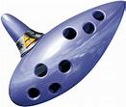
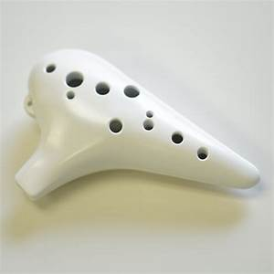
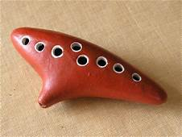
Ocarina
Ocarina, is a folk musical instrument made of ceramic (burnt clay), metal or wood (especially plum tree), having the shape of a larger and slightly elongated egg. Each manufacturer can change the shape of this instrument depending on the sound effects that are pursued. A typical ocarina has an enclosed space in which there are from four to twelve finger holes and there is the mouthpiece which is the place where the performer blows the instrument. The holes are arranged in such a way that the performer can cover them with the fingers, as at the whistle, changing the height of the sounds. Air pulses in and out of the ocarina, as the vessel resonates at a specific pitch. When the performer covers the holes, the pitch lowers. When this uncovers the holes, the pitch raises. When he/she blows more softly, the pitch lowers while if he/she blows more strongly, the pitch raises. The pitch can be changed by three semitones using the breath force. This blowing instrument produces sounds similar to those of the flute.

Slide 7
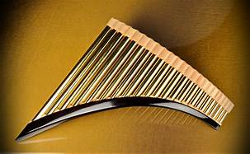
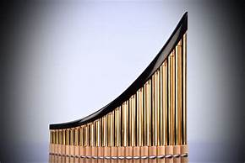
The Pan Flute
The pan flute is a musical instrument whose function is based on the principle of the closed tubes. There are multiple pipes that gradually increase their length. Multiple varieties of pan flutes have been popular as folk instruments in Romania. These pipes are typically made from bamboo, giant reeds or local reeds. Other materials that are used include wood, plastic, metal and ivory.
The pan flute is named after Pan, the Greek God of Nature and shepherds are often depicted with such an instrument.
In Greek mythology, Syrink was a forest Nymph. In her attempt to escape the affection of god Pan (a creature half he-goat and half he-man), she was transformed into a water-reed. Then, Pan cut several reeds, placed them in parallel one next to the other, and bound them together to make a melodic musical instrument. Ancient Greeks called this instrument Syrinx, in honour of the Muse, and Pandean, or Pan-pipes and Pan-flute, after Pan.
Conservation of Romanian folk music has been aided by a large and enduring audience, and by numerous performers who helped propagate and further develop the folk sound. One of them, Gheorghe Zamfir is famous throughout the world today, and helped popularization of a traditional Romanian folk instrument, the pan flute.

Slide 8
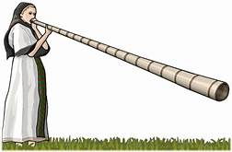
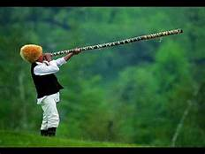
The Bucium ( Buciumul)
This is usually 1.5m to 3m in length and made of well-seasoned deal, maple, ash, lime or hazel wood which is conical or cylindrical bored, slit lengthways, hollowed out and then glued together. In the north it can be made of galvanised iron and folded like a trombone. As it does not have valves or finger holes, it can only play the pitches in the natural harmonic series. The generic term ‘bucium’, is used in the Muntenian Carpathians of Argeş and Prahova, and in the Moldavian Carpathians of Vrancea and Neamţ. The name ‘bucium’ is derived from the Latin bucinum = trumpet blast. In the Apuseni mountains it is known as ‘tulnic’, and is often played by women.
The bucium has several different functions: Integrated into pastoral life, it is used to call the sheep into the sheep-folds in the afternoons and evenings. In the Apuseni mountains it is also used in the morning when taking the sheep out. In Oaş there are two types of melodies, at the sheepfold and at the end of the milking the sheep, when the instrument plays a high tune. In Bucovina, Oaş, Maramureş, and some villages in the north of Neamţ it is used to lead the funeral processions. In the Apuseni it is also used for communication for people in the highlands who are situated at great distances from one another.

Slide 9
"This project has been funded with support from the European Commission. This publication reflects the views only of the author, and the Commission cannot be held responsible for any use which may be made of the information contained therein."

