Slide 1
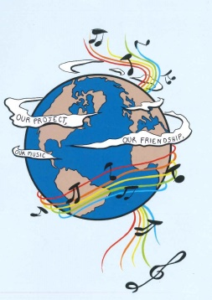
ERASMUS + PROJECT SCHOOL EXCHANGE PARTNERSHIP MUSIC: A MELODIC METHODOLOGY INTO TEACHING AND LEARNING 2018-1-ES01-KA229-050761 PRESENTATION OF THE DISSEMINATION WORKSHOP WHICH WAS HELD AT COLEGIUL NAȚIONAL ‘ION LUCA CARAGIALE’ FROM MORENI, ROMANIA DATE: The 3rd of June 2019

Slide 2
AIM: TO PRESENT THE RESULTS OBTAINED DURING THE SECOND LEARNING,TEACHING AND TRAINING ACTIVITIES ORGANISED AT GYMNASIO VALTINOU FROM TRIKALA,GREECE ,THE 19TH -25TH OF MAY 2019
TARGET GROUP:
THE STUDENTS OF THE LOWER SECONDARY SCHOOL FROM COLEGIUL NAȚIONAL ‘ION LUCA CARAGIALE’ MORENI, ROMANIA

Slide 3
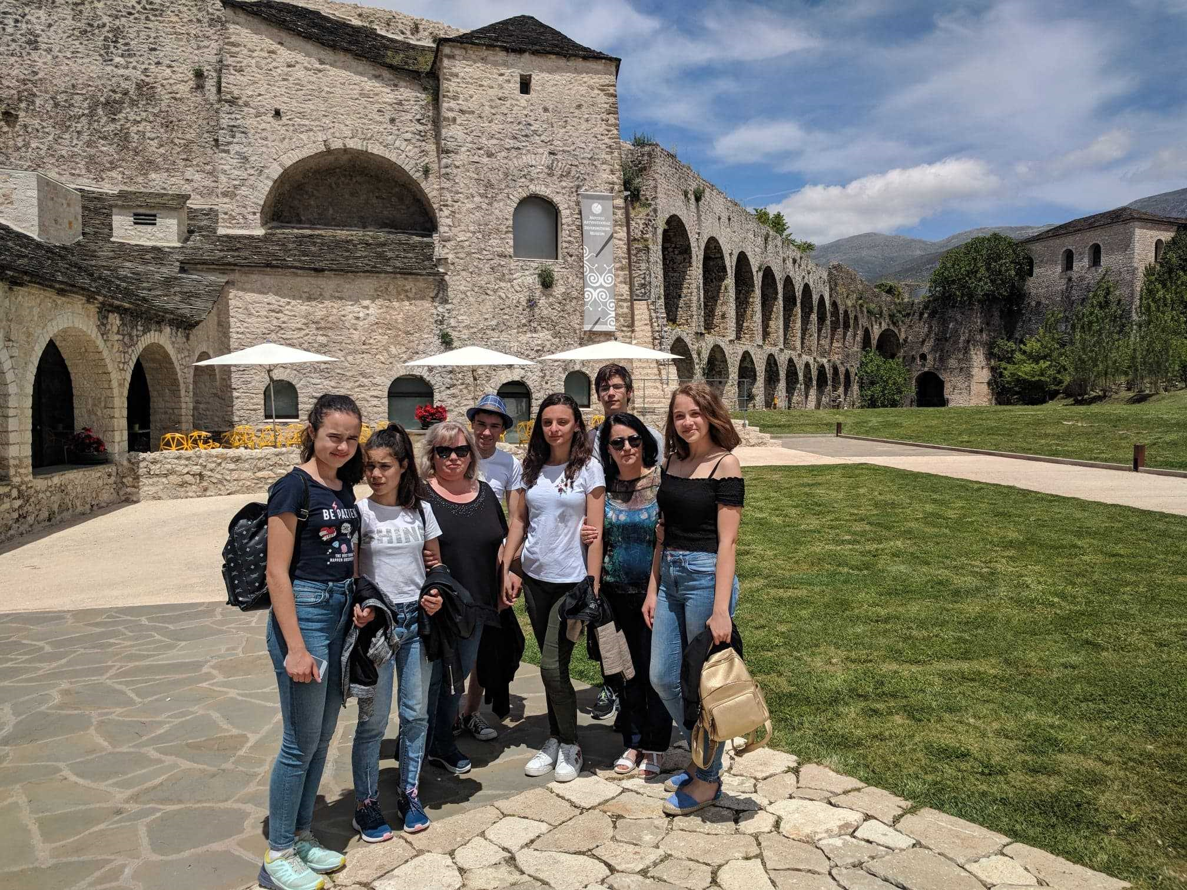
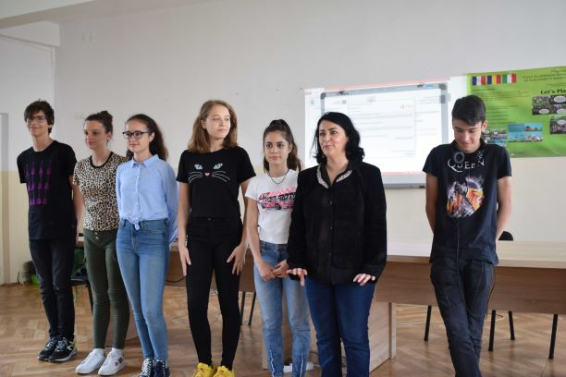
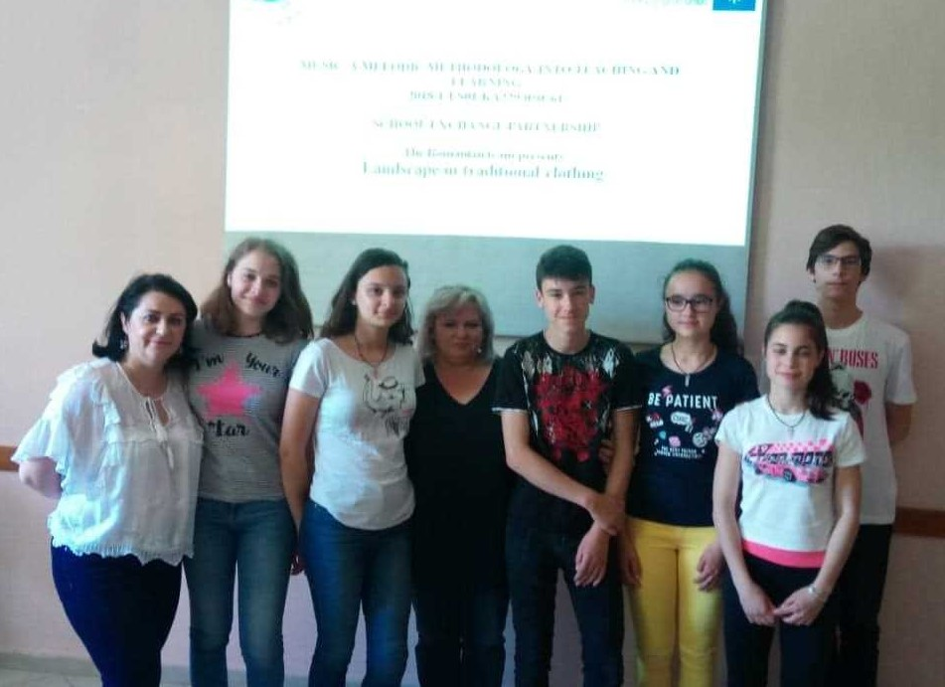
Introducing ourselves. Sharing our experience in Greece. Presenting the project’s objectives.
On the 3rd of June 2019 a group of eight people : two teachers and six students proudly shared their beautiful experience in Greece to ninety students, gymnasium graders from Colegiul National “ Ion Luca Caragiale” Moreni.

Slide 4
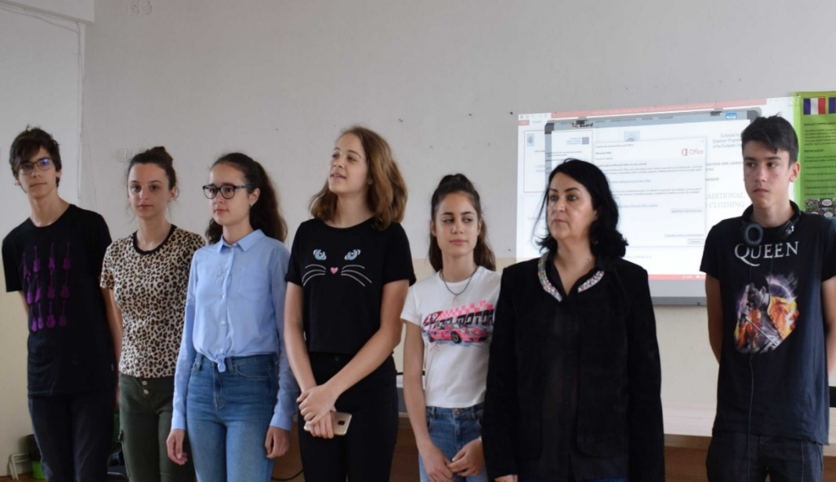
Introducing ourselves. Sharing our experience in Greece. Presenting the project’s objectives.

Slide 5
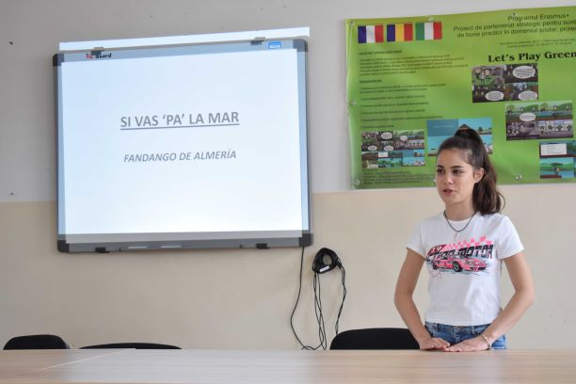
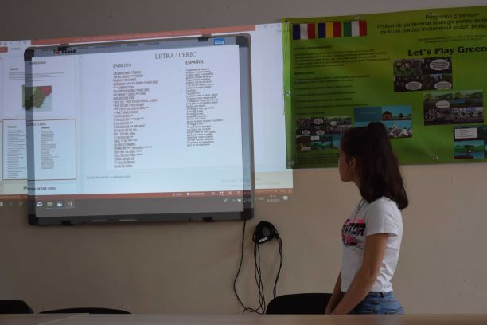
Sharing our experience in Greece. Presenting the project’s objectives. Final products’ presentation.
The students introduced themselves and started presenting ,in turns, the final products that they worked on together with their friends from Spain, Portugal, Italy and Greece. They also emphasized the project’s main objective: to develop high-quality skills and competences: intercultural, social, civic,digital,language skills , literacy and cultural awareness.

Slide 6
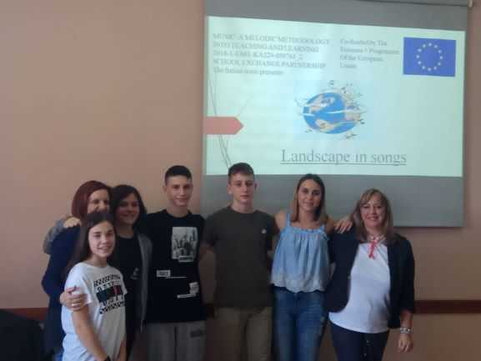
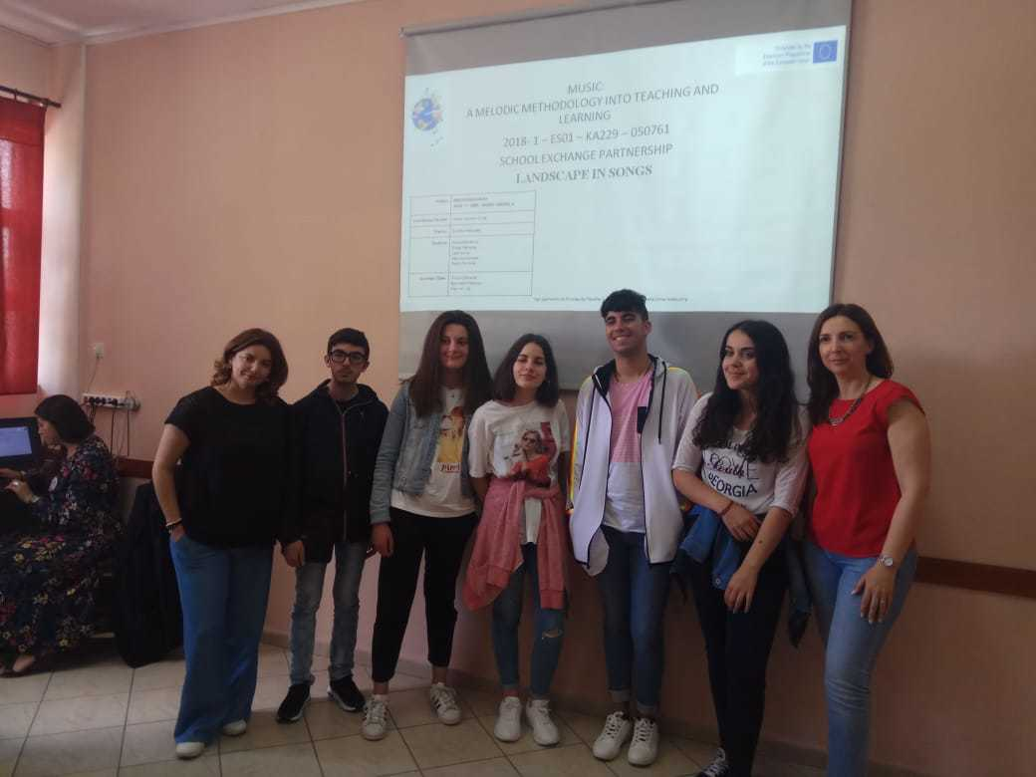
FINAL PRODUCTS. POWERPOINT PRESENTATION ON ‘LANDSCAPE IN SONGS’
‘Landscape in songs’ is first final product’s presentation made by the Romanian students to their mates. They explained all the steps that were made in order to create it before the meeting in Greece. Students had to seek for eight songs related to landscape and nature. Students needed to analyze how :their country’s landscape and nature (mountains, lakes, rivers etc) are revealed in songs and how these forms of relief influenced native people’s lives. The lyrics were both in the mother tongue and English and for each song they tried to say what each song expressed (the explanation was given in English).

Slide 7
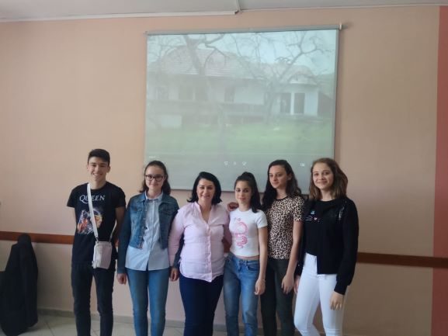
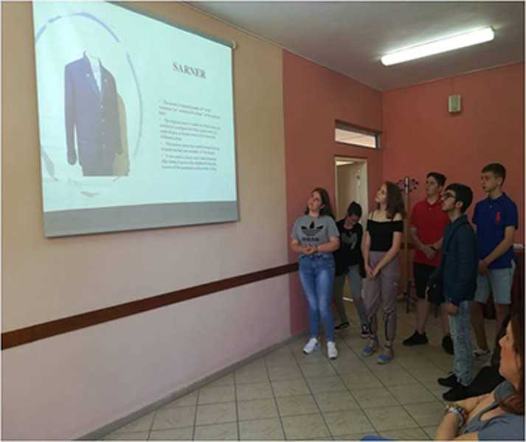
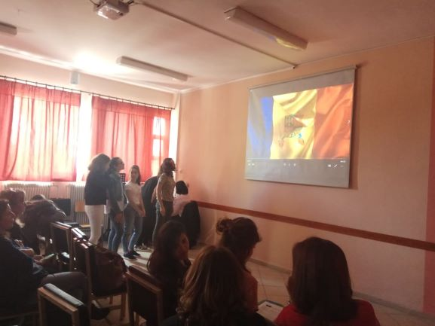
THE SECOND FINAL PRODUCT ’’LANDSCAPE AND TRADITIONAL SONGS, DANCES AND CLOTHING “
This final product was structured into 4 different parts. That is why, we needed to create each at a time, not to combine them on the same presentation from the very beginning. In Greece, we joined the first part for the 5 countries, then the second part for the five countries and, in the end, we joined all of them in the final product.
1. A Power Point presentation of how landscape is presented in traditional songs (6-8 songs)-the same procedure, lyrics both in your native tongue and English and the analysis in English. The songs were recorded on a MP4 format.
2. A Power Point presentation of how the landscape determines the steps in traditional dances. We selected 8 dances for our country, we analysed (in English) the rhythm, the steps, we mentioned when the respective dance was performed, by whom .We also had a MP4 format that contained those songs.
3. A PPT of how the landscape determined/determines the clothes people used and use to wear.
4. A photo collection/album that contained photos of the traditional dances and the clothes.

Slide 8
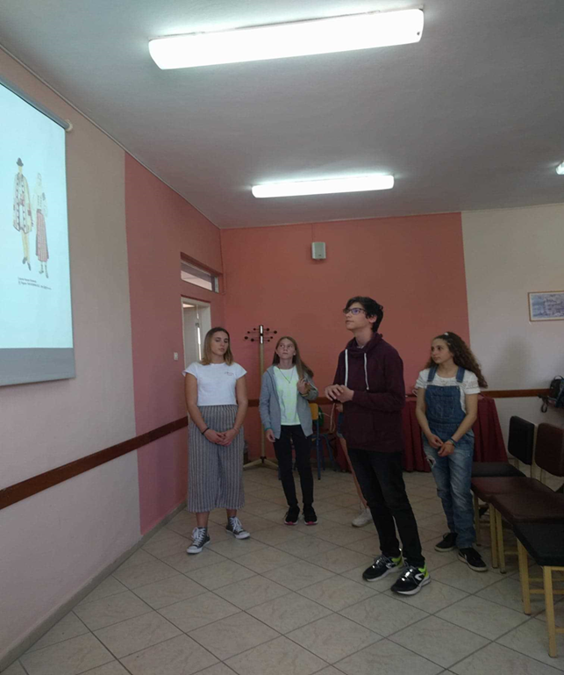
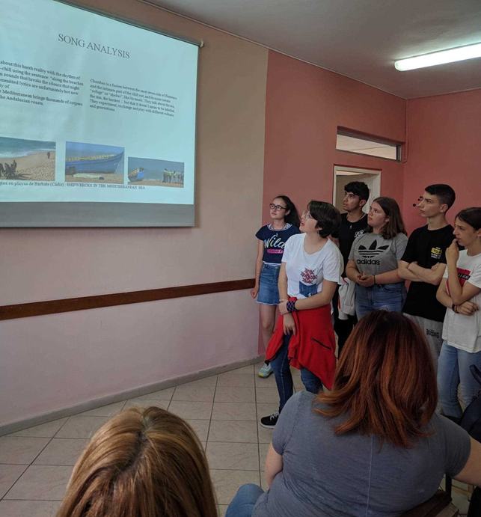
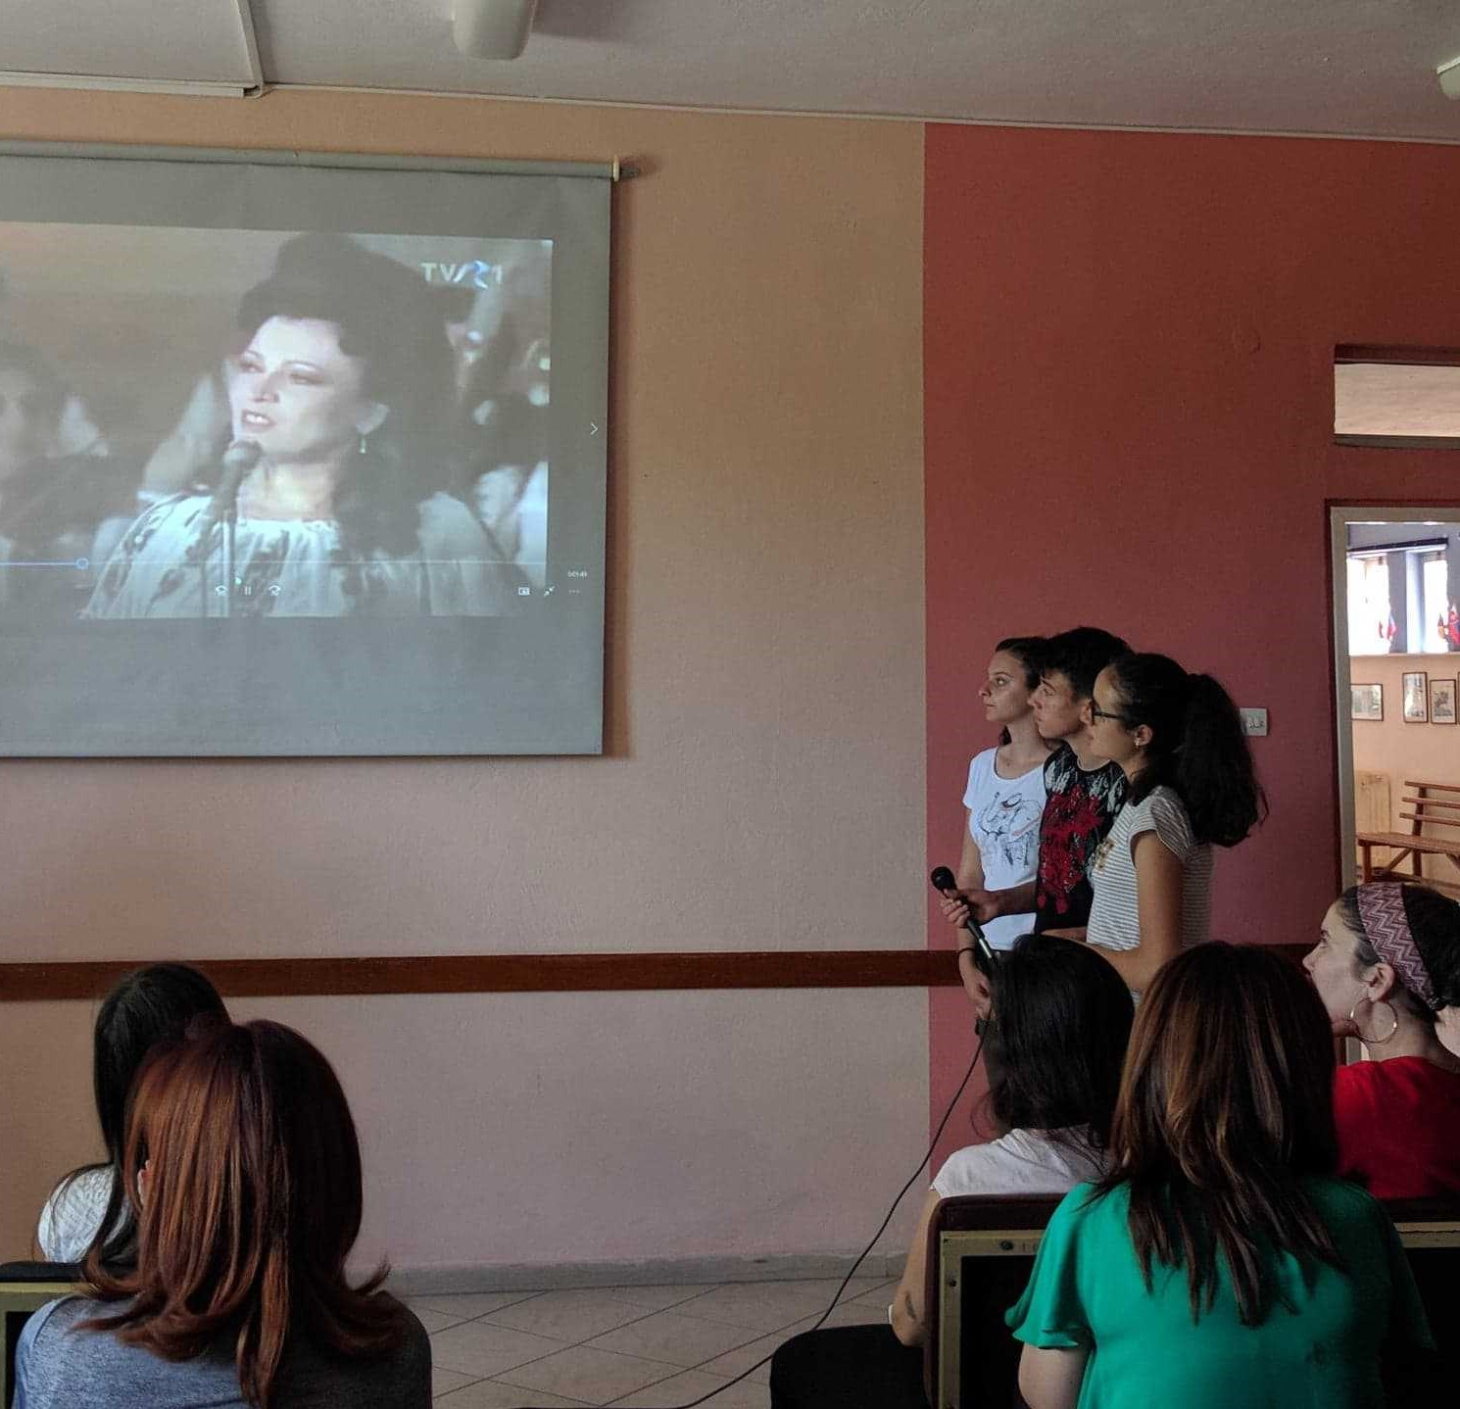
FINAL PRODUCTS
During the meeting, each school team presented their work that had been done in preparation for the joint products, they provided explanations, they answered questions and then, they formed mixed teams with the other partners in order to exchange information, ideas, make comparisons and do the final products.

Slide 9
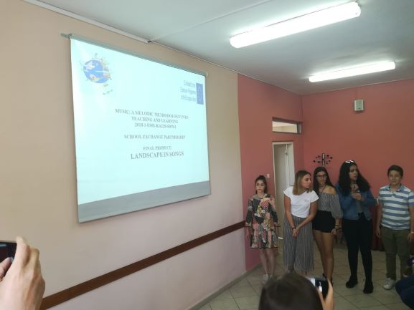
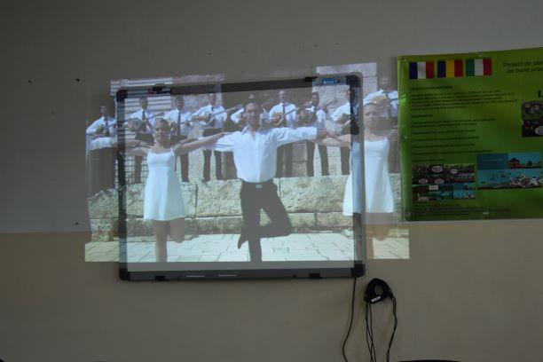
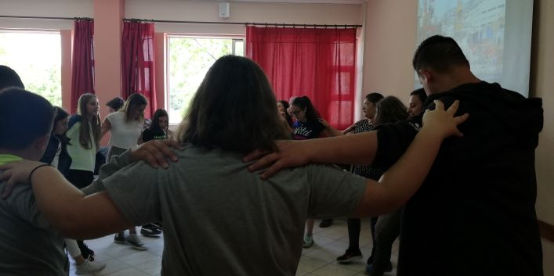
Medeea’s personal experience shared with the audience.
I must admit that,at first, I was a bit nervous and even scared regarding my departure to Greece, but as soon as I got there I realised that I had nothing to be afraid of. The other kids were sociable, talkative and willing to make friends, just as I was. We had a lot of fun together untill the very last day when our laughter turned into tears of sadness beacuse we knew that we would probably never see each other again. The tears that we shed represented the deep connections that we had established in only one week . Most of all, I loved the family that hosted me. I have never seen such enjoyable people to be around . They were simply amazing and due to their personalities and their kind hearts I felt like home in their house and I considered them my own family for those magical five days. Putting aside my own personal experince and all the moments and memories I have created there , I must say that I learned a lot through this project. I found out a lot of information about the other countries’ culture and habits within the projects that were carefully accomplished . In the last day, we actually tried to learn how to dance Sirtaki, the greek traditional dance.

Slide 10
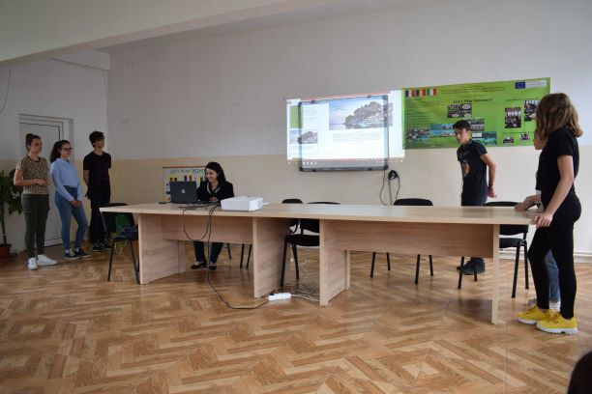
Final products’ presentation.Sharing experience .The project seen through Ștefan’s eyes.

Slide 11
For me, the Erasmus+ project was a life lesson, actually an another life’s lesson. I had the big opportunity to learn about different styles of living.When I arrived in Greece I was a bit scarred, because I started to doubt my English knowledge, but when I continued to talk with other children I figured out that the only thing you had to do was to make ourselves understood, nothing more.It lasted about two days to get along with each other, we got past the introductions and we started to build conversations learning about each culture, and in the 3rd day you couldn’t figure out which is from which team, all of us we were spread talking about stories, history lessons of our countries or how a normal day was for each of us.
I needed to adapt to my host’s timetable, this was a big part of the project, to feel how a normal week in Greece was. I took part in classes and I put my Greek mask on. I lived with them ,I ate with them I stayed with them, I also wanted to learn a bit of Greek.At the end of the project I felt this project was magic. After I burst into tears, because this project was about to finish and we were supposed to leave Greece, I started to feel confused, still now I don’t understand how we got so attached to each other in only a week.This is what this project does, it builds strong friendships regardless nationality, race, colour ,mentality.

Slide 12
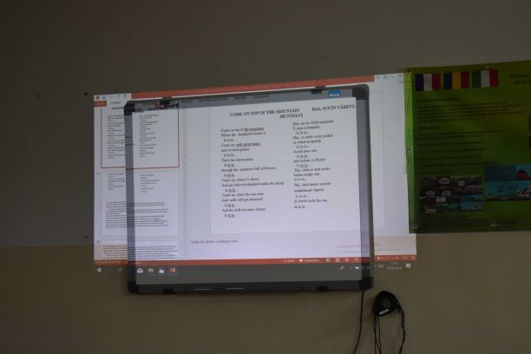
Paty’s presentation of final products and testimony.

Slide 13
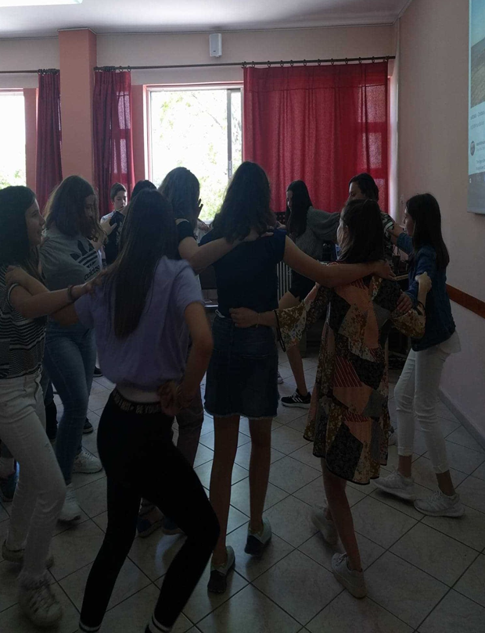
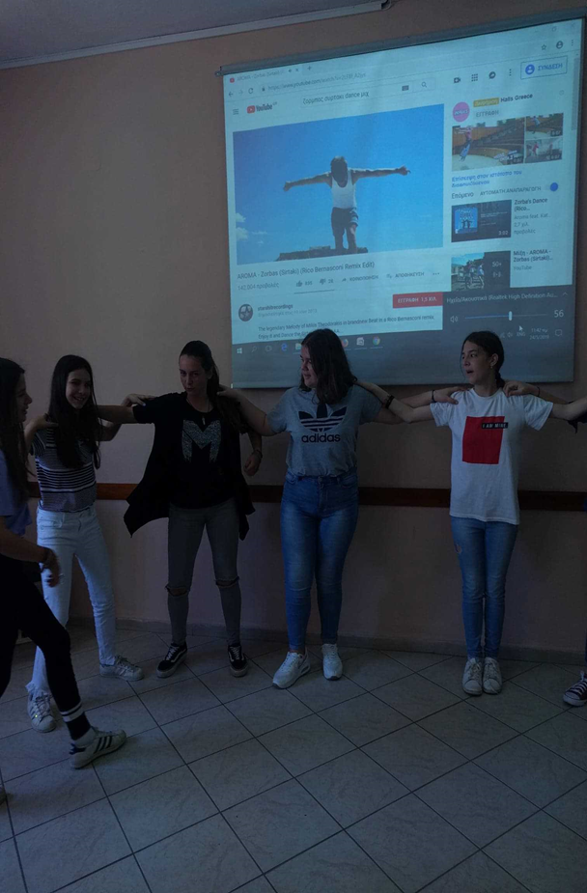
My experience in Greece was great because I had a wonderful time with my hosts there. I managed to meet beautiful people and discover the traditions of other countries. Greece was the place where a lot of students and teachers from different countries have met and shared their own cultures. That was an interesting method to learn about other nationalities and furthermore, to present my specific traditions. Also, I have learnt a lot of things which prepare me for the future. I have learnt how important is to understand the others, to communicate and to express yourself. And the adaptation to other lifestyle is not a problem, while you are surrounded by people who care about you and always give you the best advice. That week was very beautiful as we learnt things about communication, socialization and adaptation to new lives. I was happy to see that a lot of people from Portugal, Spain, Italy, Greece and Romania succeeded in communicating, using only English.I advise all the children to be a part of these projects and to be happy for all the knowledge they gain.Before leaving Greece we had together one last dance. I would repet, for sure, this experience .

Slide 14
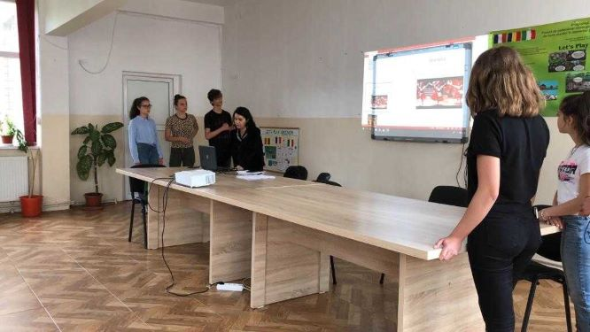
Andrei’s speech and opinion on the project.

Slide 15
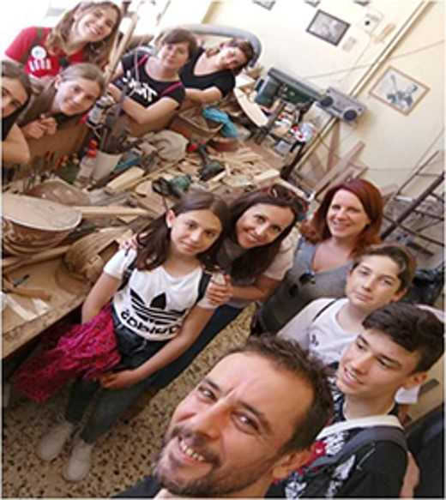
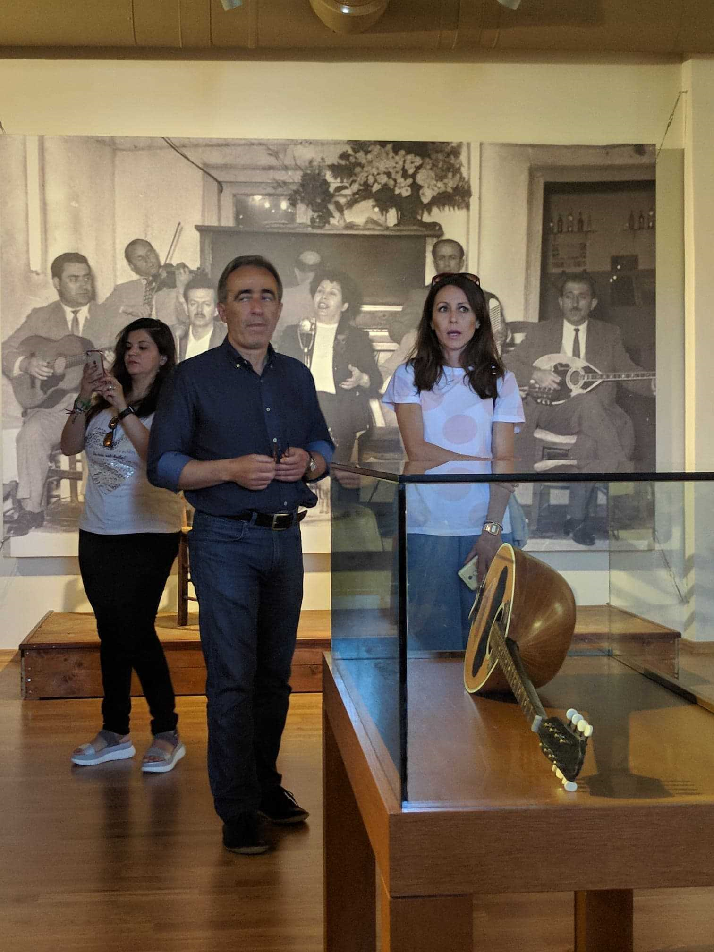
I would like to present you , my experience with the Erasmus + project in Greece. In this project everything was super fun, educational but also a little tiring. I have many beautiful activities such as: Traditional dances and songs from Romania but also from other countries. The thing I liked the most was when we went to the music school from Trikala. I liked that the atmosphere was full of harmony, sounds and pozitive energy, you could hear instruments every you step we took on the school’s hallway. We even had the chance to listen to the traditional instruments that at first they seemed strange to us. We even attended a concert having its main actors the students from that music school. Then we went to the workshop where bouzouki is created ( their traditional instrument). Here we saw how to create this tool. At first the idea of going to another country without your parents, only 2 teachers and a few students can be a little scary but it is not the way you imagine. The same with the documents we had to do, they are not as hard as you imagine. To cut the long story short, the Erasmus + experience was amazing, I would like to go back in time and experience it again.

Slide 16
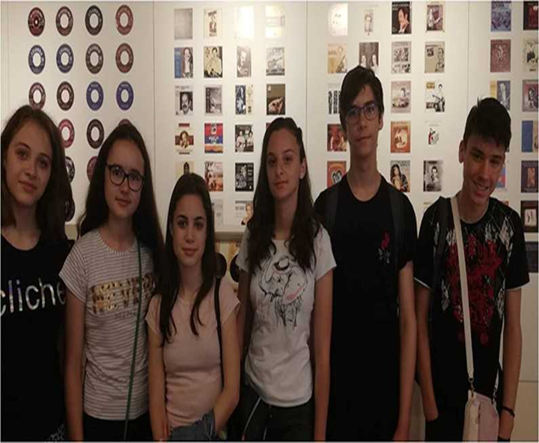
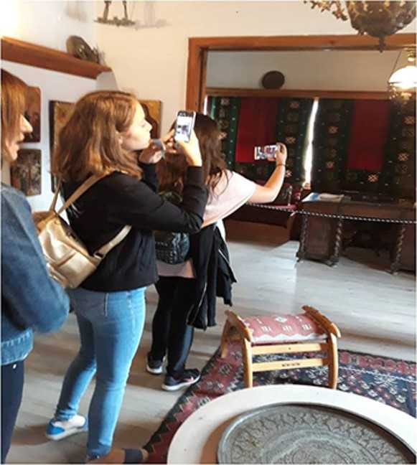
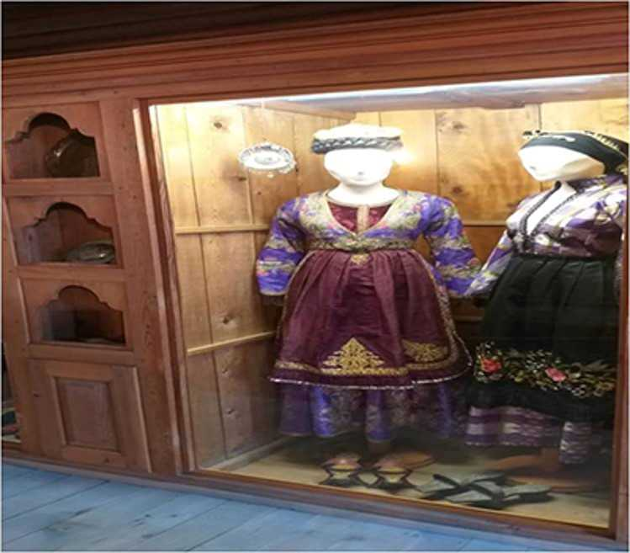
Mara’s experience during the project’s activities.
I wanted so much to take part in this project, as I wished to achieve a new experience. I was surprised by everything I saw there. Our colleagues, I mean those from the other countries, were friendly, always smiling and pleased to communicate with us. Communication was the key of this project and English played an important role in our conversations. The presentations of the other countries impressed me a lot, as I wanted to find some information about each one. So, we managed to learn some Greek-specific dances, being taught and guided by the Greek students, who were proud and willing to teach us. Every trip I went on had one benefit, the history of Greece fascinated me, and the information we received proved to be exactly what we needed. The hosts were very hospitable with us, being eager to feel good all the time and this was greatly appreciated! We left them with tears on our cheeks, because all that time we became friends and I am sure they felt the same. Erasmus really changes lives and gives birth to life long friendship

Slide 17
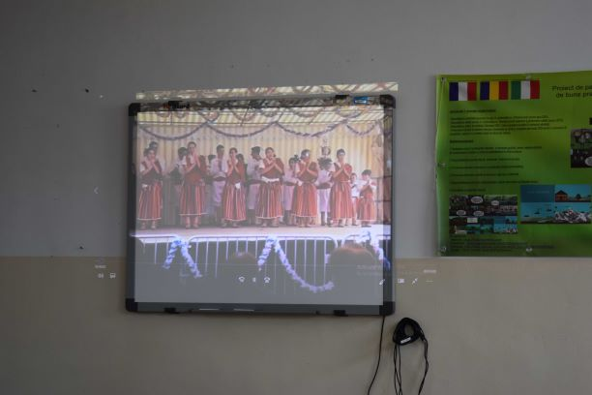

Slide 18
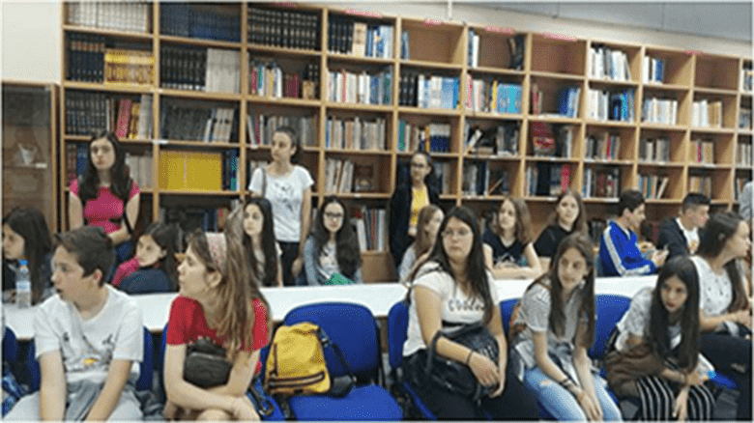
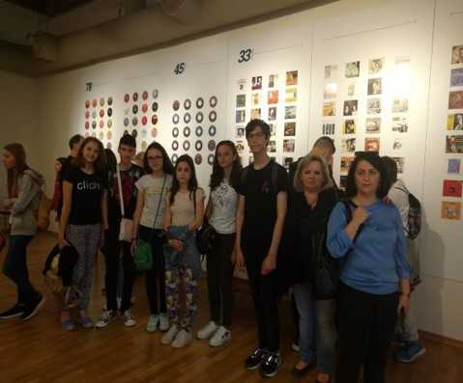
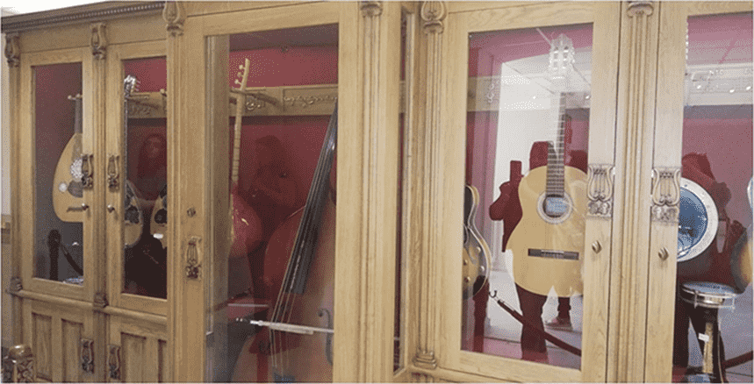
Viviana’s experience.
In this project I learned a lot of useful things: how to interact better with the foreign students and how to express myself without having any problems.Firstly, I have improved my ability to speak English because of the permanent communication with the other students from 4 different countryes. They were very friendly but at the same time so kind trying to make us feel that we are just a big family.Secondly, I developed my team-work ability by working together many hours for the final products.Also, by presenting the projrcts I learned how to express myself without feeling weird.Lastly, I found out many thinghs about every country. So now I know how to dance some traditional dances or to talk about the traditions and the habits of the participating countries.

Slide 19
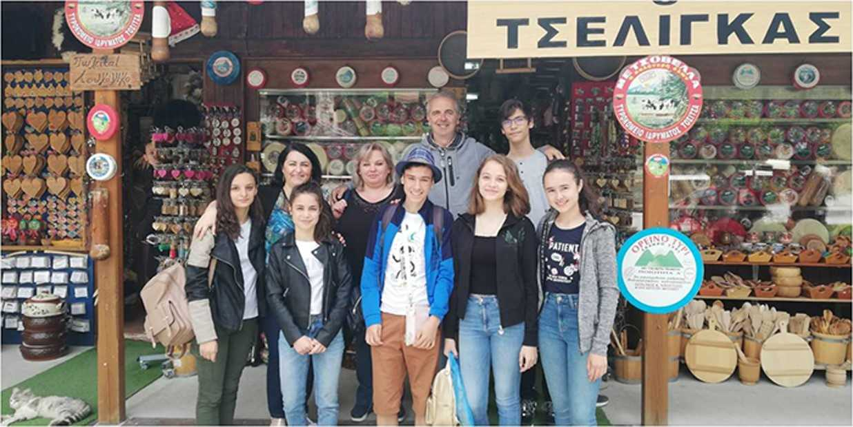
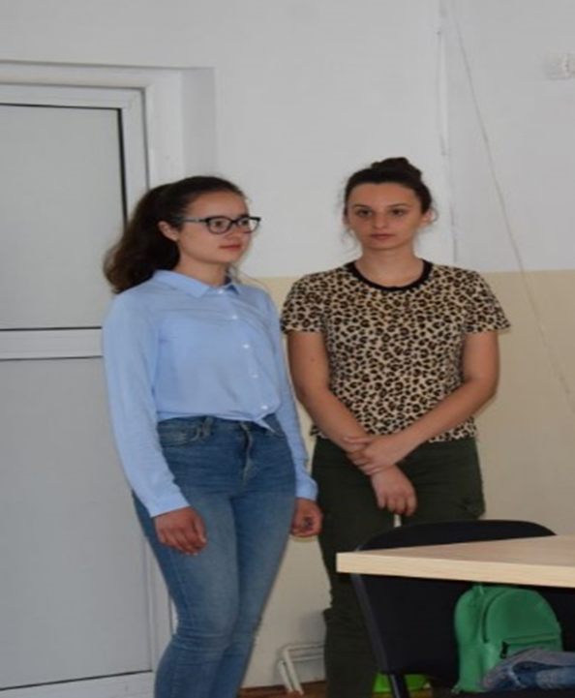
Viviana’s most memorable picture while visiting a museum in Greece whose exhibits depicted a region in Romania, Dobrogea, and whose inhabitants spoke Aromanian, a language derived from our native one.

Slide 20
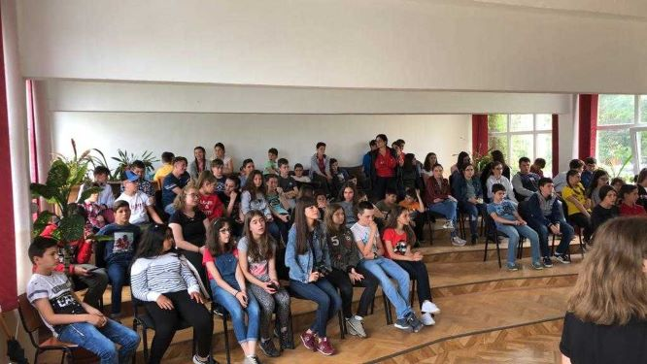
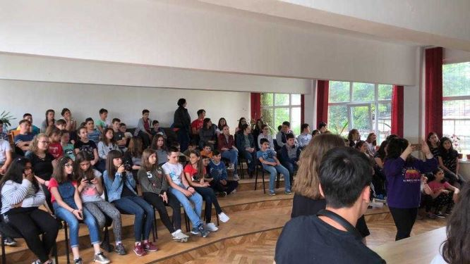
The target group
The audience was made of almost ninety students ,5th ,6th,7th,and 8th graders. They were very interested in listening to their colleagues’ presentations and experience. During this dissemination they felt so good that they started singing .After each student’s speech they asked relevant questions showing a lot of interest in what they heard and learnt.

Slide 21
The audience

Slide 22
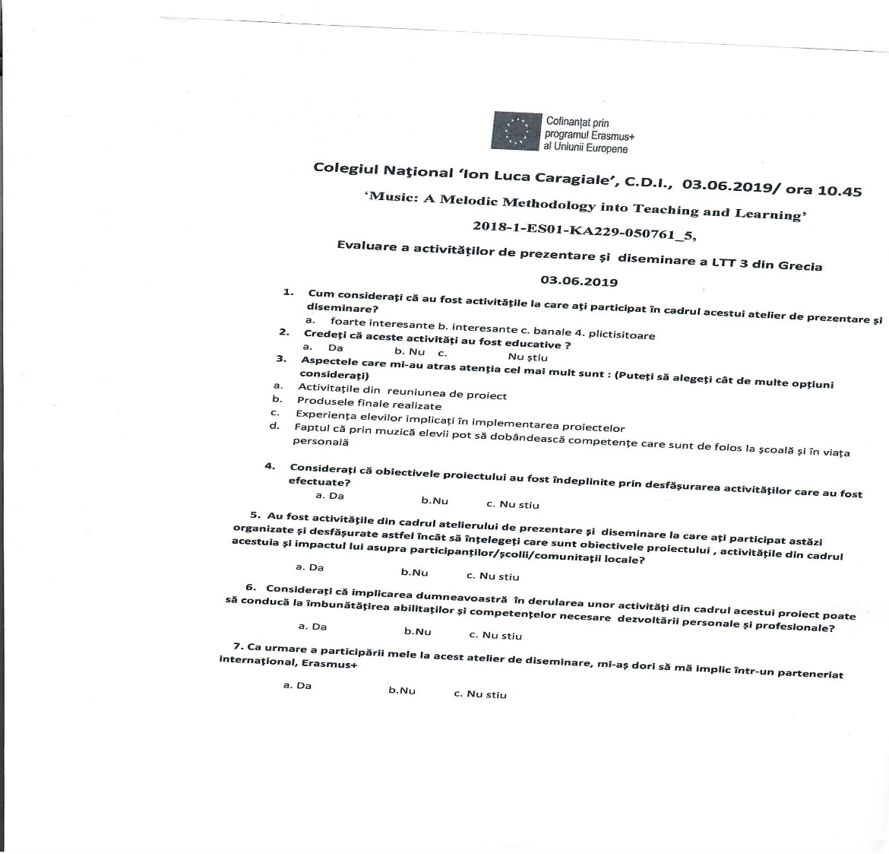
At the end of this activity we needed the audience’s feedback. Thus ,the students received a questionnaire regarding this project’s activity of dissemination.

Slide 23
What did we learn from the questionnaire?
The students were asked seven questions which may reflect their interest in Erasmus+ projects and in learning new and interesting facts about European culture, showing that they deeply understood this projects objectives.
80% found this activity very interesting
83% considered this activity an educational one
76% liked the most: the final products made in Greece , the experience their colleagues had and that through music they can develop useful skills that may help them both at school and in personal life
87% consider that the project’s objectives were achieved
81% liked this type of activity as they clearly understood the project’s objectives and their impact on students/school/local community
90% admitted the fact that such activities may help them improve the necessary skills and abilities in their personal and professional development
78% expressed their willingness to take part in an Erasmus+ project

Slide 24
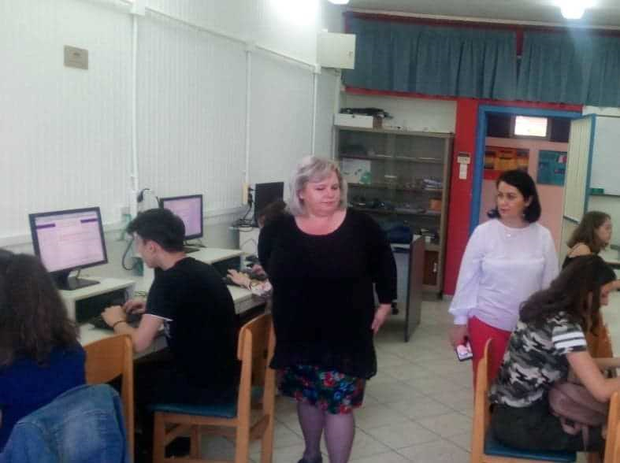
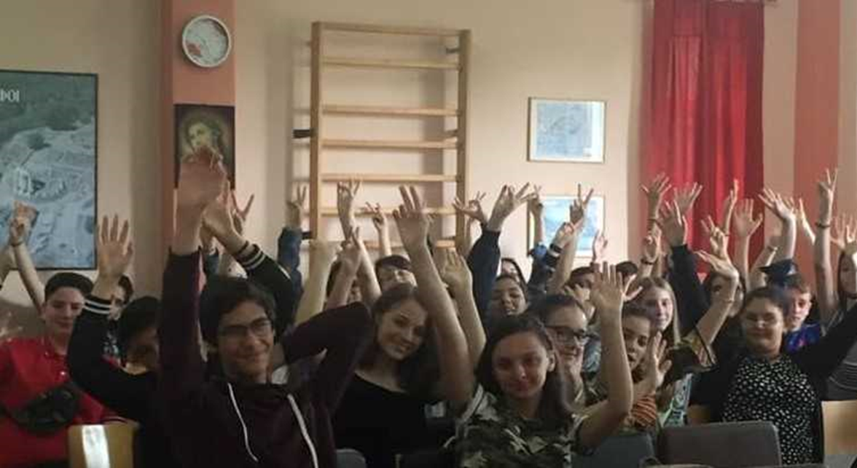
Conclusion:
Through the project interactions, the students and staff developed the following relevant and high-quality skills and competences:intercultural, soci.al,civic,digital,language skills ,literacy and cultural awareness.
Through innovative integrated approaches students learnt in a more interesting way to gain new experience in a practical way. The project used inter-disciplinary approaches and its aim was to show students that the knowledge of different subjects was used in every aspect of their everyday lives.The results were the tangible ones seen in the final products and the intangible ones given by the attitudes, skills and competences that the participants acquired and that will be useful in their lives and careers, in this globalised world.
These were the most important aspects and objectives of this project that were successfully achieved during the second project’s meeting in Greece.
Presentation made by Daniela Florentina Cismaru, member of the Romanian project team

Slide 25
"This project has been funded with support from the European Commission. This publication reflects the views only of the author, and the Commission cannot be held responsible for any use which may be made of the information contained therein."

