Slide 1
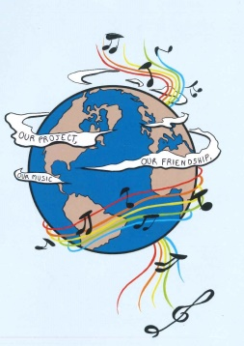
MUSIC: A MELODIC METHODOLOGY INTO TEACHING AND LEARNING 2018-1-ES01-KA229-050761 SCHOOL EXCHANGE PARTNERSHIP
A HAPPINESS SONG - GREECE

Slide 2
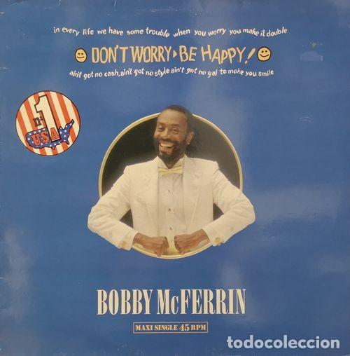
DON’T WORRY, BE HAPPY - BOBBY McFERRIN
https://www.youtube.com/watch?v=d-diB65scQU

Slide 3
DON’T WORRY, BE HAPPY - BOBBY McFERRIN
Here is a little song I wrote You might want to sing it note for note Don't worry be happy In every life we have some trouble When you worry you make it double Don't worry, be happy......
Ain't got no place to lay your head Somebody came and took your bed Don't worry, be happy The landlord say your rent is late He may have to litigate Don't worry, be happy Look at me I am happy Don't worry, be happy Here I give you my phone number When you worry call me I make you happy Don't worry, be happy Ain't got no cash, ain't got no style Ain't got no girl to make you smile But don't worry be happy Cause when you worry

Slide 4
DON’T WORRY, BE HAPPY - BOBBY McFERRIN
Your face will frown And that will bring everybody down So don't worry, be happy (now).....
Now there this song i wrote I hope you you learned it note for note like good little children Don’t worry be happy Listen to what I say In your life expect some trouble When you worry you make it double
Don’t worry be happy Be happy now Don’t worry, be happy Don’t worry, be happy Don’t worry, be happy Don’t worry, be happy Don’t worry Don’t worry be happy Don’t worry, don't worry, don't do it, Be happy,put a smile on your face, Don’t bring everybody down like this Don't worry, it will soon pass whatever it is, Don't worry, be happy, I'm not worried

Slide 5
ANALYSIS:
The phrase "Don't Worry Be Happy" came from the Indian guru Meher Baba. In an interview with USA Weekend magazine, McFerrin explained that he saw a poster of Meher Baba with the phrase and thought it was "a pretty neat philosophy in four words." McFerrin is very optimistic in this song, but some of the problems listed in the verses will require more than a cheerful demeanor to overcome. The person he's singing to has lost his bed, has no cash or girlfriend, and his rent is late. "Don't worry" might not be the best advice for him. No matter what, this song has become the ultimate song of happiness and optimism that eventually everything will turn out to be just fine!

